Slide 1
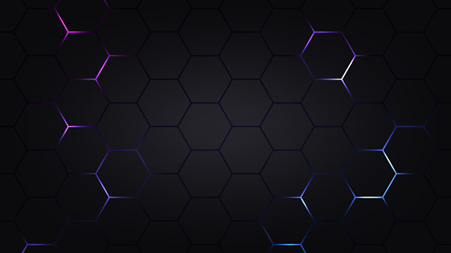
Game Developer AI
Designed and Developed by
Piyush Chall
Under the Guidance of
ASS. PROF. GANESHKUMAR R. NARAYANKAR
B.Sc. Computer Science
Shree Shankar Narayan College of Arts And Commerce

Slide 2
Game Developer AI
Designed and Developed by
Piyush Chall
Under the Guidance of
ASS. PROF. GANESHKUMAR R. NARAYANKAR
B.Sc. Computer Science
Shree Shankar Narayan College of Arts And Commerce

Slide 3




Problem Statement
Rapidity
In the competitive gaming landscape, rapid game development is paramount.

Slide 4


Problem Statement
Rapidity
In the competitive gaming landscape, rapid game development is paramount.

Slide 5


Problem Statement
AI Integrity
By deploying a team of specialized AI agents, we can streamline the entire game development process.

Slide 6

Problem Statement
Efficiency
In the fast-paced world of competitive gaming, developers must race to create efficient and effective games.

Slide 7



Propose System
Agent Implementation
The system is implemented with a multimodal AI Agent system via the CrewAI Framework in Python.
The Agents are:
1. Designer
2. Programmer
3. QA Analyst
4. Manager

Slide 8

Propose System
Agent Implementation
The system is implemented with a multimodal AI Agent system via the CrewAI Framework in Python.
The Agents are:
1. Designer
2. Programmer
3. QA Analyst
4. Manager

Slide 9



Propose System
Task Implementation
The multimodal AI Agent System necessitates the implementation of diverse tasks and goals that the agents must fulfill to achieve the outcome.
The task are:
1.Brainstorming
2.Programming
3.Evaluating

Slide 10


Propose System
Crew Collaboration
Here, the system leverages CrewAI's built-in capability to integrate all agents and their tasks into a single Python code module.

Slide 11



Advantages and Disadvantages
Efficiency
Accelerates game development processes, reducing time-to-market.

Slide 12

Advantages
Efficiency
Accelerates game development processes, reducing time-to-market.

Slide 13



Advantages
Cost-Effectiveness
Lowers development costs through automation and streamlined processes.

Slide 14

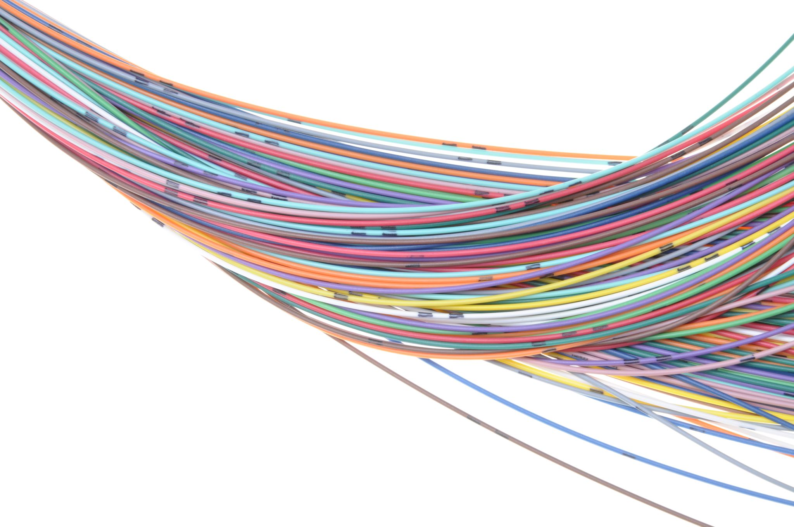
Advantages
Flexibility
Adapts to changing requirements and integrates new technologies seamlessly.

Slide 15




Disadvantages
Limited Creativity
May need help with generating truly innovative or out-of-the-box game ideas compared to human creativity.

Slide 16

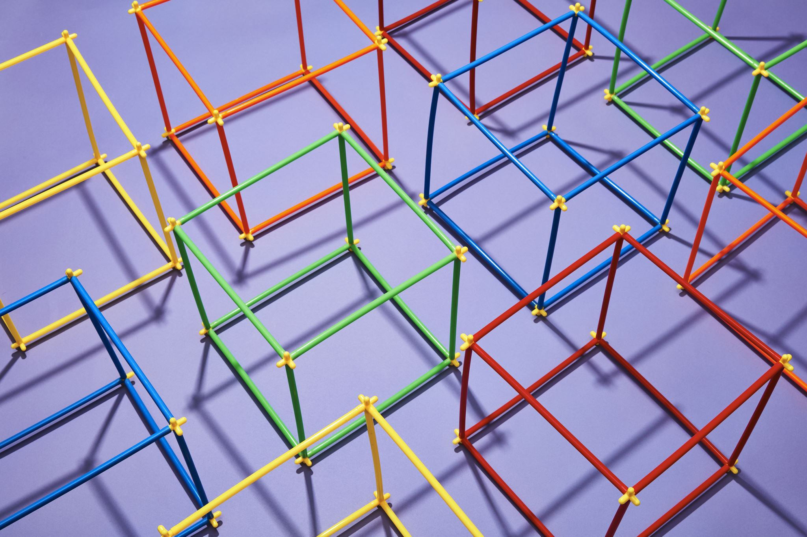

Disadvantages
Performance Limitations
Depending on the AI's capabilities, there may be limitations in handling complex game mechanics or real-time interactions effectively.

Slide 17


Disadvantages
Risk of Over-Automation
This could lead to a reduction in human involvement and creativity in game development processes.

Slide 18
Process Flow
Game
Name
Start
Brainstorm
Research
Mechanics
Game
Document
Find Bugs
Raw Code
Generate
Code
Fix Bugs
Evaluate
Code
Final Game
Document

Slide 19
Process Flow
Game
Name
Start
Brainstorm
Research
Mechanics
Game
Document
Find Bugs
Raw Code
Generate
Code
Fix Bugs
Evaluate
Code
Final Game
Document

Slide 20
Conclusion
The implementation of AI agent system in game development brings significance benefits to both game developers and players across the globe. This comprehensive system streamlines various aspects of AI agent system using crewai like rapid ideations, debugging and code generation. Thus by developing this AI system we have learned various aspects of the crewai framework.

Slide 21
Conclusion
The implementation of AI agent system in game development brings significance benefits to both game developers and players across the globe. This comprehensive system streamlines various aspects of AI agent system using crewai like rapid ideations, debugging and code generation. Thus by developing this AI system we have learned various aspects of the crewai framework.

Slide 22
Future Enhancement
The future of the Game Developer AI holds exciting possibilities with the integrations of emerging technologies like GPT O1 model. As O1 model is exclusively designed for multimodal AI agent system.
Plans for the Future of Game Developer AI:
Integrating more power full AI models
Integrating variety of programming language
Reenforcing with more advance tools
Adapting to upcoming advance libraries

Slide 23
Future Enhancement
The future of the Game Developer AI holds exciting possibilities with the integrations of emerging technologies like GPT O1 model. As O1 model is exclusively designed for multimodal AI agent system.
Plans for the Future of Game Developer AI:
Integrating more power full AI models
Integrating variety of programming language
Reenforcing with more advance tools
Adapting to upcoming advance libraries
The implementation of AI agent system in game development brings significance benefits to both game developers and players across the globe. This comprehensive system streamlines various aspects of AI agent system using crewai like rapid ideations, debugging and code generation. Thus by developing this AI system we have learned various aspects of the crewai framework.

