Slide 1
Solving Problems by Searching
Chapter 3 from Russell and Norvig
Uninformed Search

Slide 2
Example Problems for Search
The problems are usually characterized into two types
  Toy Problems
    may require little or no ingenuity, good for homework
    games
  Real World Problems
    complex to solve
  Medium Problems
    Solved in projects

Slide 3
Building Goal-Based Agents
We have a goal to reach
  Driving from point A to point B
  Put 8 queens on a chess board such that no one attacks another
  Prove that John is an ancestor of Mary
We have information about where we are now at the beginning
We have a set of actions we can take to move around (change from where we are)
Objective: find a sequence of legal actions which will bring us from the start point to a goal

Slide 4
Building Goal-Based Agents
To build a goal-based agent we need to answer the following questions:
  What is the goal to be achieved?
  What are the actions?
  What relevant information is necessary to encode about the world to describe the state of the world, describe the available transitions, and solve the problem?
Initial
state
Goal
state
Actions

Slide 5
Problem-Solving Agents

Slide 6
Problem-Solving Agents
Problem-solving agents decide what to do by finding sequences of actions that lead to desirable states.
Goal formulation is the first step in problem solving.
In addition to formulating a goal, the agent may need to decide on other factors that affect the achieveability of the goal.

Slide 7
Problem-solving agents (cont.)
A goal is a set of world states.
Actions can be viewed as causing transitions between world states.
What sorts of actions and states does the agent need to consider to get it to its goal state?
Problem formulation is the process of deciding what actions and states to consider
  it follows the goal formulation.

Slide 8
3.1 Problem-solving agents (cont.)
What if there is no additional information available?
In some cases, the agent will not know which of its possible actions is best because it does not know enough about the state that results from taking each action.
The best it can do is choose one of the actions at random.

Slide 9
3.1 Problem-solving agents (cont.)
An agent with several immediate options of unknown value can:
  decide what to do by examining different possible sequences of actions that lead to states of known value
  then choosing the best one.
This process is called a search.
Search can be done in real or simulated environment.

Slide 10
3.1 Problem-solving agents (cont.)
The search algorithm takes a problem as input and returns a solution in the form of an action sequence.
Once a solution is found, the actions it recommends can be carried out.
This is called the execution phase.

Slide 11
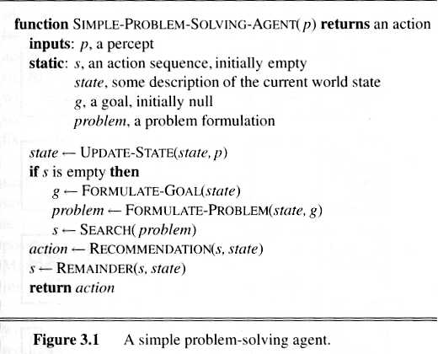
3.1 Problem-solving agents (cont.)
A simple formulate, search, execute design is as follows:
after formulating a goal and a problem to solve, the agent calls a search procedure to solve it.
Formulate a goal for a state
Finds sequence of actions
it then uses the solution to guide its actions, doing whatever the solution recommends.
Updates sequence of actions
Returns action for precept p in state state
Once the solution has been executed, the agent will find a new goal.
Fig. 3.1. A Simple problem-solving agent

Slide 12
What is the goal to be achieved?
A goal could describe a situation we want to achieve, a set of properties that we want to hold, etc.
Requires defining a “goal test” so that we know what it means to have achieved/satisfied our goal.
This is a hard question that is rarely tackled in AI, usually assuming that the system designer or user will specify the goal to be achieved.
Certainly psychologists and motivational speakers always stress the importance of people establishing clear goals for themselves as the first step towards solving a problem.

Slide 13
What are the actions?
Characterize the primitive actions or events that are available for making changes in the world in order to achieve a goal.
Deterministic world:
  no uncertainty in an action’s effects.
  Given an action (a.k.a. operator or move) and a description of the current world state, the action completely specifies
    whether that action can be applied to the current world (i.e., is it applicable and legal), and
    what the exact state of the world will be after the action is performed in the current world
      (i.e., no need for "history" information to compute what the new world looks like).

Slide 14
What are the actions?
Quantify all of the primitive actions or events that are sufficient to describe all necessary changes in solving a task/goal.
Deterministic:
  No uncertainty in an action’s effect.
  Given an action (aka operator or move) and a description of the current state of the world, the action completely specifies
    Precondition: if that action CAN be applied to the current world (i.e., is it applicable and legal), and
    Effect: what the exact state of the world will be after the action is performed in the current world
      (i.e., no need for "history" information to be able to compute what the new world looks like).

Slide 15
Representing actions
Note also that actions in this frameworks can all be considered as discrete events that occur at an instant of time.
  For example, if "Mary is in class" and then performs the action "go home," then in the next situation she is "at home."
  There is no representation of a point in time where she is neither in class nor at home (i.e., in the state of "going home").
The number of actions / operators depends on the representation used in describing a state.
  In the 8-puzzle, we could specify 4 possible moves for each of the 8 tiles, resulting in a total of 4*8=32 operators.
  On the other hand, we could specify four moves for the "blank" square and we would only need 4 operators.
Representational shift can greatly simplify a problem!

Slide 16
Representing states
At any moment, the relevant world is represented as a state
  Initial (start) state: S
  An action (or an operation) changes the current state to another state (if it is applied): state transition
  An action can be taken (applicable) only if the its precondition is met by the current state
  For a given state, there might be more than one applicable actions
  Goal state: a state satisfies the goal description or passes the goal test
  Dead-end state: a non-goal state to which no action is applicable

Slide 17
Representing states
State space:
  Includes the initial state S and all other states that are reachable from S by a sequence of actions
  A state space can be organized as a graph:
  nodes: states in the space
  arcs: actions/operations
The size of a problem is usually described in terms of the number of states (or the size of the state space) that are possible.
  Tic-Tac-Toe has about 3^9 states.
  Checkers has about 10^40 states.
  Chess has about 10^120 states in a typical game.
The state space is not the same as the search space (known also as solution space).

Slide 18
Closed World Assumption
We will generally use the Closed World Assumption.
All necessary information about a problem domain is available in each percept so that each state is a complete description of the world.
There is no incomplete information at any point in time.

Slide 19
Problem: Remove 5 Sticks
Given the following configuration of sticks, remove exactly 5 sticks in such a way that the remaining configuration forms exactly 3 squares.

Slide 20
Knowledge representation issues
What's in a state ?
  Is the color of the boat relevant to solving the Missionaries and Cannibals problem?
  Is sunspot activity relevant to predicting the stock market?
  What to represent is a very hard problem that is usually left to the system designer to specify.
??? What level of abstraction or detail to describe the world.????
The number of states depends on the representation and level of abstraction chosen.
  In the Remove-5-Sticks problem, if we represent the individual sticks, then there are 17-choose-5 possible ways of removing 5 sticks.
  On the other hand, if we represent the "squares" defined by 4 sticks, then there are 6 squares initially and we must remove 3 squares, so only 6-choose-3 ways of removing 3 squares.

Slide 21
Example Problems

Slide 22
Some example problems
Toy problems and micro-worlds
  8-Puzzle
  Missionaries and Cannibals
  Cryptarithmetic
  Remove 5 Sticks
  Water Jug Problem
Real-world-problems
Other River-Crossing Puzzles

Slide 23
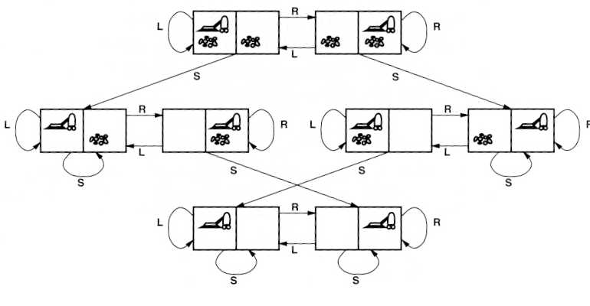
Example of a Problem: The Vacuum World
Assume, the agent knows where located and the dirt places
  Goal test: no dirt left in any square
  Path cost: each action costs one
  States: one of the eight states
  Operators:
    move left L
    move right R
    suck S
Initial state: any
Goal states

Slide 24
Single-state problem
Actions: Left, Right, Suck
Goal state: 7, 8
Initial state: 5
Solution: [Right, Suck]
1
2
5
6
3
4
7
8

Slide 25
Multiple-state problem
Actions: Left, Right, Suck
Goal state: 7, 8
Initial state: one of {1,2,3,4,5,6,7,8}
Right: one of {2,4,6,8}
Solution: [Right, Suck, Left, Suck]
1
2
5
6
3
4
7
8

Slide 26
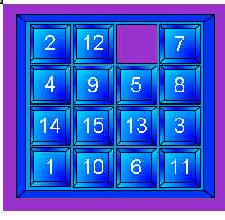
Examples: The 8-puzzle and the 15-puzzle
The 8-puzzle is a small single board player game:
Tiles are numbered 1 through 8 and one blank space on a 3 x 3 board.
A 15-puzzle, using a 4 x 4 board, is commonly sold as a child's puzzle.
Possible moves of the puzzle are made by sliding an adjacent tile into the position occupied by the blank space, this will exchanging the positions of the tile and blank space.
Only tiles that are horizontally or vertically adjacent (not diagonally adjacent) may be moved into the blank space.

Slide 27
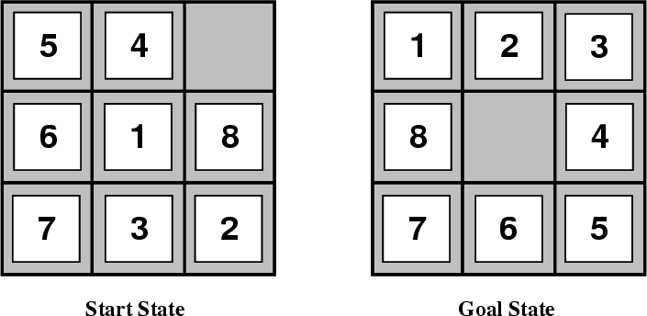
8-Puzzle
Given an initial configuration of 8 numbered tiles on a 3 x 3 board, move the tiles in such a way so as to produce a desired goal configuration of the tiles.

Slide 28
Example: The 8-puzzle
Goal test: have the tiles in ascending order.
Path cost: each move is a cost of one.
States: the location of the tiles + blank in the n x n matrix.
Operators: blank moves left, right, up or down.

Slide 29
8 Puzzle
State: 3 x 3 array configuration of the tiles on the board.
Operators: Move Blank square Left, Right, Up or Down.
  This is a more efficient encoding of the operators than one in which each of four possible moves for each of the 8 distinct tiles is used.
Initial State: A particular configuration of the board.
Goal: A particular configuration of the board.
The state space is partitioned into two subspaces
NP-complete problem, requiring O(2^k) steps where k is the length of the solution path.
15-puzzle problems (4 x 4 grid with 15 numbered tiles), and N-puzzles (N = n^2 - 1)

Slide 30
The 8-puzzle
←
→
↓
↑
5
4
1
2
3
Goal:
8
4
6
1
8
7
6
5
7
3
2
←
↓
5
4
5
4
8
6
1
8
6
1
7
3
2
7
3
2
←
→
↓
←
↓
↑
5
4
5
4
5
1
4
5
4
8
5
4
8
5
4
6
1
8
6
1
8
6
8
6
1
6
1
2
6
1
8
7
3
2
7
3
2
7
3
2
7
3
2
7
3
7
3
2

Slide 31
Review of search terms: Goal node D
D:
Parent: {C}
Depth: 2
Total cost: 2
A
B
C
D

Slide 32
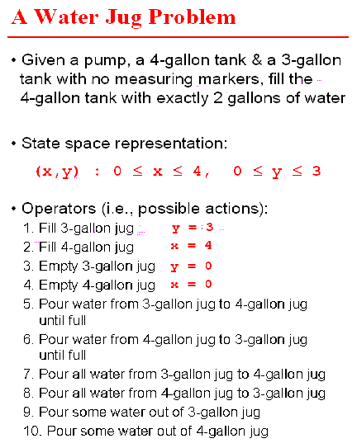
A Water Jug Problem
x = 4 gallon tank
y = 3 gallon tank

Slide 33
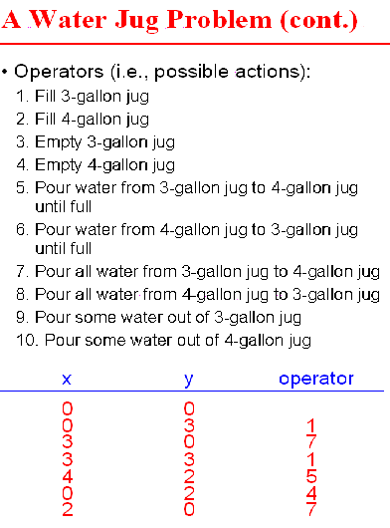
Example: A Water Jug Problem
Initial state
1
00
03
7
1
30
33
5
42
4
02
7
20
Goal state

Slide 34
Example: A Water Jug Problem
General observations:
Optimality
  There are many sequences of operators that will lead from the start to the goal state–how do we choose the best one?
To describe the operators completely, we made explicit assumptions not mentioned in the problem statement:
  Can fill a jug from pump
  Can pour water from jug onto ground
  Can pour water from one jug to other
  No measuring devices available
Useless rules
  Rules 9 and 10 are not part of any solution
Problems to think:
  How to define a Genetic Algorithm for this problem?
  How to improve this approach based on problem knowledge?
  Is GA good for this kind of problems?

Slide 35
3.3.1.3 Cryptarithmetic
      CROSS + ROADS = DANGER
      SEND + MORE = MONEY
      DONALD + GERALD = ROBERT
In 1924 Henry Dudeney published a popular number puzzle of the type known as a cryptarithm, in which letters are replaced with numbers.
Dudeney's puzzle reads: SEND + MORE = MONEY.
Cryptarithms are solved by deducing numerical values from the mathematical relationships indicated by the letter arrangements (i.e.) . S=9, E=5, N=6, M=1, O=0,….
The only solution to Dudeney's problem: 9567 + 1085 = 10,652.
  "Puzzle," Microsoft® Encarta® 97 Encyclopedia. © 1993-1996 Microsoft Corporation.

Slide 36
Cryptarithmetic
Find an assignment of digits (0, ..., 9) to letters so that a given arithmetic expression is true. examples: SEND + MORE = MONEY and
    FORTY Solution: 29786
    + TEN 850
    + TEN 850
    ----- -----
    SIXTY 31486
    F=2, O=9, R=7, etc.
Note: In this problem, the solution is NOT a sequence of actions that transforms the initial state into the goal state, but rather the solution is simply finding a goal node that includes an assignment of digits to each of the distinct letters in the given problem.

Slide 37
3.3.1.3 Cryptarithmetic(cont.)
Goal test: puzzle contains only digits and represents a correct sum.
Path cost: zero. All solutions equally valid
States: a cryptarithmetic puzzle with some letters replaced by digits.
Operators: replace all occurrences of a letter with a digit not already appearing in the puzzle.

Slide 38
3.3.1.5 River-Crossing Puzzles
A sequential-movement puzzle, first described by Alcuin in one of his 9th-century texts.
The puzzle presents a farmer who has to transport a goat, a wolf, and some cabbages across a river in a boat that will only hold the farmer and one of the cargo items.
  In this scenario, the cabbages will be eaten by the goat, and the goat will be eaten by the wolf, if left together unattended.
Solutions to river-crossing puzzles usually involve multiple trips with certain items brought back and forth between the riverbanks.
Contributed by: Jerry Slocum B.S., M.S.
  "Puzzle," Microsoft® Encarta® 97 Encyclopedia. © 1993-1996 Microsoft Corporation. All rights reserved.

Slide 39
3.3.1.5 River-Crossing Puzzles(cont.)
0 = on left bank
wolf
goat
cabbage
farmer
Goal test: reached state (0,0,0,0).
Path cost: number of crossings made.
States: a state is composed of four numbers representing the number of goats, wolfs, cabbages, boat trips. At the start state there is (1,1,1,1)
Operators: from each state the possible operators are: move wolf, move cabbages, move goat. In total, there are 4 operators. (also, farmer himself).
We showed already several approches to solve this problem in Lisp.
Think about others, with your current knowledge
Think how to generalize these problems (two wolfs, missionairies eat cannibales, etc).,

Slide 40
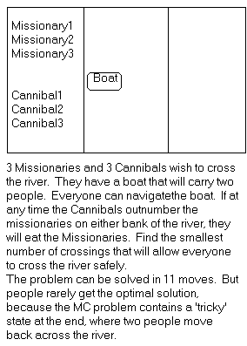
Missionaries and Cannibals
There are 3 missionaries, 3 cannibals, and 1 boat that can carry up to two people on one side of a river.
Goal: Move all the missionaries and cannibals across the river.
Constraint: Missionaries can never be outnumbered by cannibals on either side of river, or else the missionaries are killed.
State: configuration of missionaries and cannibals and boat on each side of river.
Operators: Move boat containing some set of occupants across the river (in either direction) to the other side.

Slide 41
Missionaries and Cannibals Solution
Near side Far side
0 Initial setup: MMMCCC B -
1 Two cannibals cross over: MMMC B CC
2 One comes back: MMMCC B C
3 Two cannibals go over again: MMM B CCC
4 One comes back: MMMC B CC
5 Two missionaries cross: MC B MMCC
6 A missionary & cannibal return: MMCC B MC
7 Two missionaries cross again: CC B MMMC
8 A cannibal returns: CCC B MMM
9 Two cannibals cross: C B MMMCC
10 One returns: CC B MMMC
11 And brings over the third: - B MMMCCC

Slide 42
Search-Related Topics Covered in the Course
Search and Problem-Solving strategies
AI programming
  LISP (this quarter), Prolog (next quarter)
Problem solving
  State-space search
  Game playing
Knowledge representation & reasoning
  Mathematical logic
  Planning
  Reasoning about uncertainty
Advanced topics
  Learning Robots
  Computer vision
  Robot Planning
  Robot Manipulation
These are useful only to understand the problems
These are useful in projects to solve parts of real-life problems
These are useful in projects to solve real-life problems

Slide 43
Topic II: Problem Solving
Example problems:
    The 8-queens problem
    Place 8 queens on a chessboard so that no queen directly attacks another
    Route-finding
    Find the best route between two cities given the type & condition of existing roads & the driver’s preferences
What is a problem?
  We have a problem when we want something but don’t immediately know how to get it
Easy problems may take just a moment’s thought, or recollection of familiar techniques, to solve;
  hard ones may take a lifetime, or more!

Slide 44
Some Distinctions (cont.)
Specialized problem solving: Given a problem solving agent (e.g., a Mars rover, vacuum cleaner) :
  Consider what the agent will need to do
  Build it using traditional engineering & programming techniques
General problem solving :
  Abstract away from particular agents & particular domains and use symbolic representations of them
  Design general problem solving techniques that work for any such abstract agents & domains
Bottom-up versus top-down problem solving

Slide 45
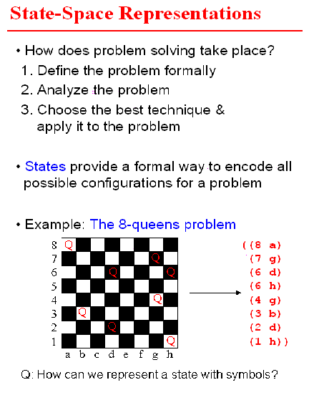
The 8-queens problem
State-space representation in Problem Solving
This is not a correct placement
Representation of a state

Slide 46
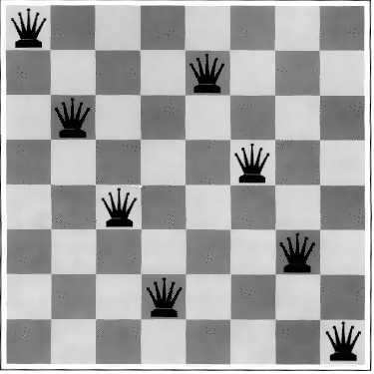
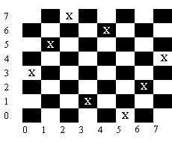
The 8-queens problem
In this problem,we need to place eight queens on the chess board so that they do not check each other.
This problem is probably as old as the chess game itself, and thus its origin is not known,
  but it is known that Gauss studied this problem.
Good solution
Bad solution

Slide 47
The 8-Queens Problem
Place eight queens on a chessboard such that no queen attacks any other!
Total # of states: 4.4x10^9
Total # of solutions:
12 (or 96)
Goal test: eight queens on board, none attacked
Path cost: zero.
States: any arrangement of zero to eight queens on board.
Operators: add a queen to any square

Slide 48
The 8-queens Solution
If we want to find a single solution, it is not hard.
If we want to find all possible solutions, the problem becomes increasingly difficult
  and the backtrack method is the only known method.
For 8-queen, we have 96 solutions.
If we exclude symmetry, there are 12 solutions.

Slide 49
Traveling Salesman Problem (TSP)
Given a road map of n cities, find the shortest tour which visits every city on the map exactly once and then return to the original city (Hamiltonian circuit)
(Geometric version):
  A complete graph of n vertices (on an unit square)
  Distance between any two vertices: Euclidean distance
  n!/2n legal tours
  Find one legal tour that is shortest

Slide 50
Formalizing Search in a State Space
A state space is a directed graph, (V, E) where V is a set of nodes and E is a set of arcs, where each arc is directed from a node to another node
node: a state
  state description
  plus optionally other information related to the parent of the node, operation used to generate the node from that parent, and other bookkeeping data
arc: an instance of an (applicable) action/operation.
  the source and destination nodes are called as parent (immediate predecessor) and child (immediate successor) nodes with respect to each other
  ancestors (predecessors) and descendents (successors)
  each arc has a fixed, non-negative cost associated with it, corresponding to the cost of the action
Remember, state space is not a solution space

Slide 51
Formalizing Search in a State Space
node generation: making explicit a node by applying an action to another node which has been made explicit
node expansion: generate all children of an explicit node by applying all applicable operations to that node
One or more nodes are designated as start nodes
A goal test predicate is applied to a node to determine if its associated state is a goal state
A solution is a sequence of operations that is associated with a path in a state space from a start node to a goal node
The cost of a solution is the sum of the arc costs on the solution path

Slide 52
Formalizing Search in a State Space
State-space search is the process of searching through a state space for a solution
This is done by making explicit a sufficient portion of an implicit state-space graph to include a goal node.
  Initially V={S}, where S is the start node; when S is expanded, its successors are generated and those nodes are added to V and the associated arcs are added to E.
  This process continues until a goal node is generated (included in V) and identified (by goal test)
During search, a node can be in one of the three categories:
  Not generated yet (has not been made explicit yet)
  OPEN: generated but not expanded
  CLOSED: expanded
Search strategies differ mainly on how to select an OPEN node for expansion at each step of search

Slide 53
A General State-Space Search Algorithm
Node n
  state description
  parent (may use a backpointer) (if needed)
  Operator used to generate n (optional)
  Depth of n (optional)
  Path cost from S to n (if available)
OPEN list
  initialization: {S}
  node insertion/removal depends on specific search strategy
CLOSED list
  initialization: {}
  organized by backpointers to construct a solution path
There are also other approaches

Slide 54
A General State-Space Search Algorithm
open := {S}; closed :={};
repeat
n := select(open); /* select one node from open for expansion */
if n is a goal
then exit with success; /* delayed goal testing */
expand(n)
/* generate all children of n
put these newly generated nodes in open (check duplicates)
put n in closed (check duplicates) */
until open = {};
exit with failure
Duplicates are checked in open, closed or both

Slide 55
State-Space Search Algorithm
function general-search (problem, QUEUEING-FUNCTION)
;; problem describes the start state, operators, goal test, and operator costs
;; queueing-function is a comparator function that ranks two states
;; general-search returns either a goal node or "failure"
nodes = MAKE-QUEUE(MAKE-NODE(problem.INITIAL-STATE))
loop
if EMPTY(nodes) then return "failure"
node = REMOVE-FRONT(nodes)
if problem.GOAL-TEST(node.STATE) succeeds
then return node
nodes = QUEUEING-FUNCTION(nodes, EXPAND(node,
problem.OPERATORS))
end
;; Note: The goal test is NOT done when nodes are generated
;; Note: This algorithm does not detect loops

Slide 56
Key Procedures to be Defined
EXPAND
  Generate all successor nodes of a given node
GOAL-TEST
  Test if state satisfies all goal conditions
QUEUEING-FUNCTION
  Used to maintain a ranked list of nodes that are candidates for expansion

Slide 57
Bookkeeping
Typical node data structure includes:
  State at this node
  Parent node
  Operator applied to get to this node
  Depth of this node (number of operator applications since initial state)
  Cost of the path (sum of each operator application so far)

Slide 58
Some Issues
Search process constructs a search tree, where
  root is the initial state S, and
  leaf nodes are nodes
    not yet been expanded (i.e., they are in OPEN list) or
    having no successors (i.e., they're "deadends")
Search tree may be infinite because of loops, even if state space is small
Search strategies mainly differ on select (open)
Each node represents a partial solution path (and cost of the partial solution path) from the start node to the given node.
  in general, from this node there are many possible paths (and therefore solutions) that have this partial path as a prefix.

Slide 59
Some Issues
Return a path or a node depending on problem.
  E.g., in cryptarithmetic return a node; in 8-puzzle return a path
Changing definition of the QUEUEING-FUNCTION leads to different search strategies

Slide 60
Evaluating Search Strategies
Completeness
  Guarantees finding a solution whenever one exists
Time Complexity
  How long (worst or average case) does it take to find a solution? Usually measured in terms of the number of nodes expanded
Space Complexity
  How much space is used by the algorithm?
  Usually measured in terms of the maximum size that the “OPEN" list becomes during the search
Optimality/Admissibility
  If a solution is found, is it guaranteed to be an optimal one? For example, is it the one with minimum cost?

Slide 61
Uninformed vs. Informed Search
Uninformed Search Strategies
  Breadth-First search
  Depth-First search
  Uniform-Cost search
  Depth-First Iterative Deepening search
Informed Search Strategies
  Hill climbing
  Best-first search
  Greedy Search
  Beam search
  Algorithm A
  Algorithm A*
Do not use evaluation of partial solutions
Sorting partial solutions based on cost (not heuristics)
Use evaluation of partial solutions

Slide 62
Example Illustrating Uninformed Search Strategies
S
1
8
5
A
B
C
3
9
7
4
5
D
E
G

Slide 63
Breadth-First
Algorithm outline:
  Always select from the OPEN the node with the smallest depth for expansion, and put all newly generated nodes into OPEN
  OPEN is organized as FIFO (first-in, first-out) list, i.e., a queue.
  Terminate if a node selected for expansion is a goal
Properties
  Complete
  Optimal (i.e., admissible) if all operators have the same cost. Otherwise, not optimal but finds solution with shortest path length (shallowest solution).
  Exponential time and space complexity,
  O(b^d) nodes will be generated, where
  d is the depth of the shallowest solution and
  b is the branching factor (i.e., number of children per node)
  at each node

Slide 64
Breadth-First
s
  A complete search tree of depth d where each non-leaf node has b children, has a total of
  1 + b + b^2 + ... + b^d = (b^(d+1) - 1)/(b-1) nodes
  Time complexity (# of nodes generated): O(b^d)
  Space complexity (maximum length of OPEN): O(b^d)
1
1
b
2
b^2
d
b^d
  For a complete search tree of depth 12, where every node at depths 0, ..., 11 has 10 children and every node at depth 12 has 0 children, there are 1 + 10 + 100 + 1000 + ... + 10^12 = (10^13 - 1)/9 = O(10^12) nodes in the complete search tree.
BFS is suitable for problems with shallow solutions

Slide 65
Breadth-First Search
S
1
5
8
A
B
C
3
9
7
4
5
D
E
G
exp. node OPEN list CLOSED list
{ S } {}
S { A B C } {S}
A { B C D E G } {S A}
B { C D E G G' } {S A B}
C { D E G G' G" } {S A B C}
D { E G G' G" } {S A B C D}
E { G G' G" } {S A B C D E}
G { G' G" } {S A B C D E}
Solution path found is S A G <-- this G also has cost 10
Number of nodes expanded (including goal node) = 7

Slide 66
CLOSED List: the search tree connected by backpointers
Another solution would be to keep track of path to every node in the node description
S
1
8
5
A
B
C
3
9
7
4
5
D
E
G
G’
G”

Slide 67
Depth-First (DFS)
Enqueue nodes on nodes in LIFO (last-in, first-out) order.
  That is, nodes used as a stack data structure to order nodes.
May not terminate without a "depth bound," i.e., cutting off search below a fixed depth D
Not complete (with or without cycle detection, and with or without a cutoff depth)
Exponential time, O(b^d), but only linear space, O(bd) is required
Can find long solutions quickly if lucky (and short solutions slowly if unlucky!)
When search hits a deadend, can only back up one level at a time even if the "problem" occurs because of a bad operator choice near the top of the tree.
  Hence, only does "chronological backtracking"

Slide 68
Depth-First (DFS)
Algorithm outline:
  Always select from the OPEN the node with the greatest depth for expansion, and put all newly generated nodes into OPEN
  OPEN is organized as LIFO (last-in, first-out) list.
  Terminate if a node selected for expansion is a goal
goal
May not terminate without a "depth bound," i.e., cutting off search below a fixed depth D
(How to determine the depth bound?)

Slide 69
Depth-First Search
return GENERAL-SEARCH(problem, ENQUEUE-AT-FRONT)
exp. node OPEN list CLOSED list
{ S }
S { A B C }
A { D E G B C}
D { E G B C }
E { G B C }
G { B C }
Solution path found is S A G <-- this G has cost 10
Number of nodes expanded (including goal node) = 5
S
1
8
5
A
B
C
3
9
7
D
E
G
In this example closed list represented by pointers

Slide 70
Uniform-Cost (UCS)
Let g(n) = cost of the path from the start node to an open node n
Algorithm outline:
  Always select from the OPEN the node with the least g(.) value for expansion, and put all newly generated nodes into OPEN
  Nodes in OPEN are sorted by their g(.) values (in ascending order)
  Terminate if a node selected for expansion is a goal
Called “Dijkstra's Algorithm” in the algorithms literature and similar to “Branch and Bound Algorithm” in operations research literature

Slide 71
Uniform-Cost Search
GENERAL-SEARCH(problem, ENQUEUE-BY-PATH-COST)
exp. node nodes list CLOSED list
{S(0)}
S {A(1) B(5) C(8)}
A {D(4) B(5) C(8) E(8) G(10)}
D {B(5) C(8) E(8) G(10)}
B {C(8) E(8) G’(9) G(10)}
C {E(8) G’(9) G(10) G”(13)}
E {G’(9) G(10) G”(13) }
G’ {G(10) G”(13) }
Solution path found is S B G <-- this G has cost 9, not 10
Number of nodes expanded (including goal node) = 7
S
1
8
5
A
B
C
3
9
4
5
7
D
E
G
G’
G”

Slide 72
Uniform-Cost (UCS)
It is complete (if cost of each action is not infinitesimal)
  The total # of nodes n with g(n) <= g(goal) in the state space is finite
  If n’ is a child of n, then g(n’) = g(n) + c(n, n’) > g(n)
  Goal node will eventually be generated (put in OPEN) and selected for expansion (and passes the goal test)
Optimal/Admissible
  It is admissible if the goal test is done when a node is removed from the OPEN list (delayed goal testing), not when it's parent node is expanded and the node is first generated
  Multiple solution paths (following different backpointers)
  Each solution path that can be generated from an open node n will have its path cost >= g(n)
  When the first goal node is selected for expansion (and passes the goal test), its path cost is less than or equal to g(n) of every OPEN node n (and solutions entailed by n)
Exponential time and space complexity, O(b^d) where d is the depth of the solution path of the least cost solution

Slide 73
Uniform-Cost (UCS)
REMEMBER:
  Admissibility depends on the goal test being applied when a node is removed from the nodes list, not when its parent node is expanded and the node is first generated
S
1
8
5
A
B
C
3
9
4
5
7
D
E
G
G’
G”

Slide 74
Depth-First Iterative Deepening (DFID)
BF and DF both have exponential time complexity O(b^d)
  BF is complete but has exponential space complexity
  DF has linear space complexity but is incomplete
Space is often a harder resource constraint than time
Can we have an algorithm that
  Is complete
  Has linear space complexity, and
  Has time complexity of O(b^d)
DFID by Korf in 1985 (17 years after A*)
  First do DFS to depth 0 (i.e., treat start node as
  having no successors), then, if no solution found,
  do DFS to depth 1, etc.
    until solution found do
    DFS with depth bound c
    c = c+1

Slide 75
Depth-First Iterative Deepening (DFID)
Complete
  (iteratively generate all nodes up to depth d)
Optimal/Admissible if all operators have the same cost.
  Otherwise, not optimal but guarantees finding solution of shortest length (like BFS).
Time complexity is a little worse than BFS or DFS because nodes near the top of the search tree are generated multiple times.

Slide 76
Depth-First Iterative Deepening
Linear space complexity, O(bd), like DFS
Has advantage of BFS (i.e., completeness) and also advantages of DFS (i.e., limited space and finds longer paths more quickly)
Generally preferred for large state spaces where solution depth is unknown

Slide 77
Depth-First Iterative Deepening
If branching factor is b and solution is at depth d, then nodes at depth d are generated once, nodes at depth d-1 are generated twice, etc., and node at depth 1 is generated d times.
  Hence
  total(d) = b^d + 2b^(d-1) + ... + db
  <= b^d / (1 - 1/b)^2 = O(b^d).
  If b=4, then worst case is 1.78 * 4^d, i.e., 78% more nodes searched than exist at depth d (in the worst case).

Slide 78
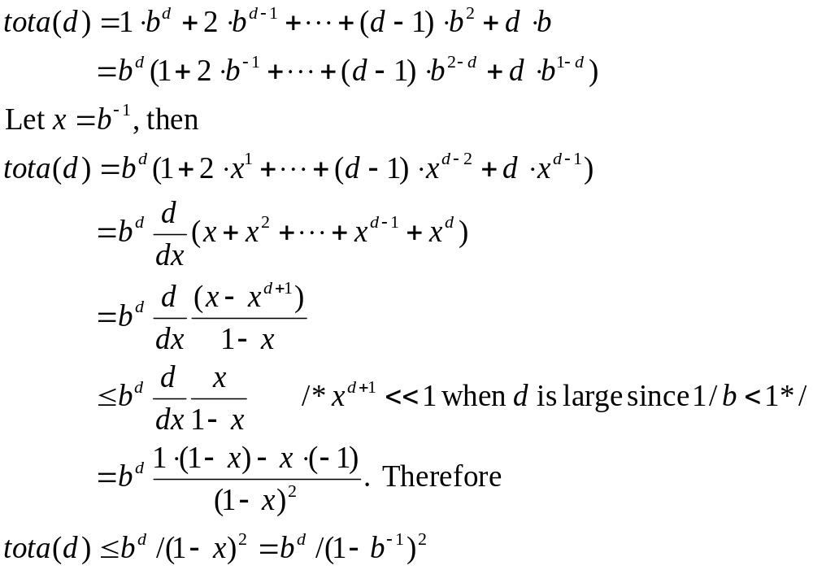

Slide 79
Depth-First Iterative Deepening (DFID)
Time complexity is a little worse than BFS or DFS because nodes near the top of the search tree are generated multiple times, but because almost all of the nodes are near the bottom of a tree, the worst case time complexity is still exponential, O(b^d)

Slide 80
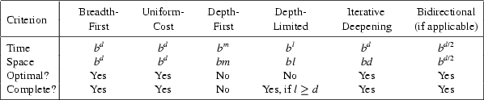
Comparing Search Strategies
And how on our small example?

Slide 81
How they perform
Depth-First Search:
  Expanded nodes: S A D E G
  Solution found: S A G (cost 10)
Breadth-First Search:
  Expanded nodes: S A B C D E G
  Solution found: S A G (cost 10)
Uniform-Cost Search:
  Expanded nodes: S A D B C E G
  Solution found: S B G (cost 9)
  This is the only uninformed search that worries about costs.
Depth First Iterative-Deepening Search:
  nodes expanded: S S A B C S A D E G
  Solution found: S A G (cost 10)
S
1
8
5
A
B
C
3
9
7
4
5
D
E
G

Slide 82
When to use what?
Depth-First Search:
  Many solutions exist
  Know (or have a good estimate of) the depth of solution
Breadth-First Search:
  Some solutions are known to be shallow
Uniform-Cost Search:
  Actions have varying costs
  Least cost solution is the required
  This is the only uninformed search that worries about costs.
Iterative-Deepening Search:
  Space is limited and the shortest solution path is required

Slide 83
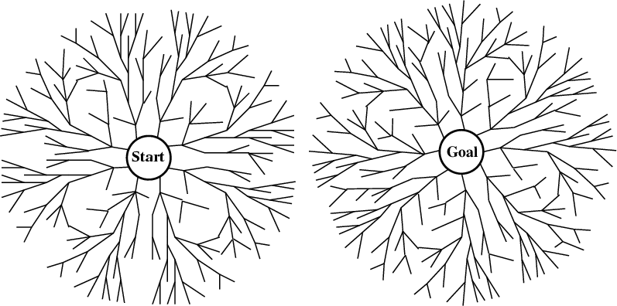
Bi-directional search
Alternate searching from the start state toward the goal and from the goal state toward the start.
Stop when the frontiers intersect.
Works well only when there are unique start and goal states and when actions are reversible
Can lead to finding a solution more quickly (but watch out for pathological situations).

Slide 84
Avoiding Repeated States
In increasing order of effectiveness in reducing size of state space (and with increasing computational costs.)
  1. Do not return to the state you just came from.
  2. Do not create paths with cycles in them.
  3. Do not generate any state that was ever created before.
Net effect depends on ``loops'' in state-space.

Slide 85
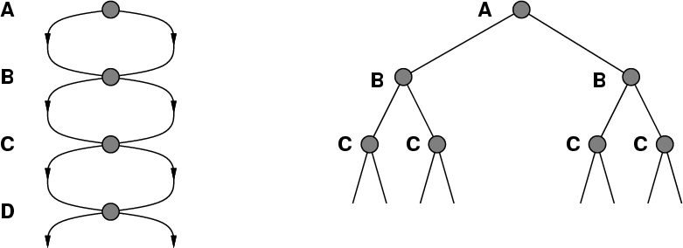
A State Space that Generates an
Exponentially Growing Search Space

Slide 86
The most useful topic of this class is search!!

Slide 87
Formulating Problems

Slide 88
Formulating Problems
There are four different types of problems:
1. single-state problems
    Suppose the agent’s sensors give it enough information to tell exactly which state it is in and it knows exactly what each of its actions does.
    Then it can calculate exactly which state it will be in after any sequence of actions.
Example: games
  . multiple-state problems
    This is the case when the world is not fully accessible.
    The agent must reason about the sets of states that it might get to rather than single states.
Example: mobile robot in known environment with moving obstacles

Slide 89
Formulating Problems (cont.)
  . contingency problems
    This occurs when the agent must calculate a whole tree of actions rather than a single action sequence.
    Each branch of the tree deals with a possible contingency that might arise.
Example: mobile robot in partially known environment creates conditional plans
    Many problems in the real, physical world are contingency problems because exact prediction is impossible.
    These types of problems require very complex algorithms.
    They also follow a different agent design in which the agent can act before it has found a guaranteed plan.

Slide 90
Formulating Problems (cont.)
  exploration problems
    In this type of problem, the agent learns a ‘map’ of the environment by:
      experimenting,
      gradually discovering what its actions do
      and what sorts of states exist.
    This occurs when the agent has no information about the effects of its actions.
  If it survives, this ‘map’ can be used to solve subsequent problems.
Example mobile robot learning plan of a building

Slide 91
Well-defined problems & solutions
A problem is a collection of information that the agent will use to decide what to do.
The basic elements of a problem definition are the states and actions.
  These are more formally stated as follows:
the initial state that the agent knows itself to be in
the set of possible actions available to the agent. The term operator will be used to denote the description of an action in terms of which state will be reached by carrying out the action
Together, these define the state space of the problem: the set of all states reachable from the initial state by any sequence of actions.

Slide 92
Choosing states and actions
What should go into the description of states and operators?
Irrelevant details should be removed.
This is called abstraction.
You must ensure that you retain the validity of the problem when using abstraction.

Slide 93
Formalizing a Problem
Basic steps:
  1. Define a state space
  2. Specify one or more initial states
  3. Specify one or more goal states
  4. Specify a set of operators that describe the actions available:
    What are the unstated assumptions?
    How general should the operators be made?
    How much of the work required to solve the problem should be represented in the rules?

Slide 94
Problem Characteristics
Before attempting to solve a specific problem, we need to analyze the problem along several key dimensions:
1. Is the problem decomposable?
  Problem might be solvable with a divide-and-conquer strategy that breaks the problem into smaller sub-problems and solves each one of them separately Example: Towers of Hanoi
2. Can solution steps be ignored or undone?
  Three cases of problems:
    ignorable (water jug problem)
    recoverable (towers of Hanoi)
    irrecoverable (water jug problem with limited water supply)

Slide 95
Problem Characteristics (cont.)
3. Is the universe predictable?
  Water jug problem: every time we apply an operator we always know the precise outcome
  Playing cards: every time we draw a card from a deck there is an element of uncertainty since we do not know which card will be drawn
4. Does the task require interaction with a person?
  Solitary problems: the computer produces an answer when given the problem description
  Conversational problems: solution requires intermediate communication between the computer & a user

Slide 96

Real World Problems
Route finding
Travelling salesman problems
VLSI layout
Robot navigation
Assembly sequencing

Slide 97
Some more real-world problems
Logistics
Robot assembly
Learning

Slide 98
Route finding
Used in
  computer networks
  automated travel advisory systems
  airline travel planning systems
    path cost
    money
    seat quality
    time of day
    type of airplane

Slide 99
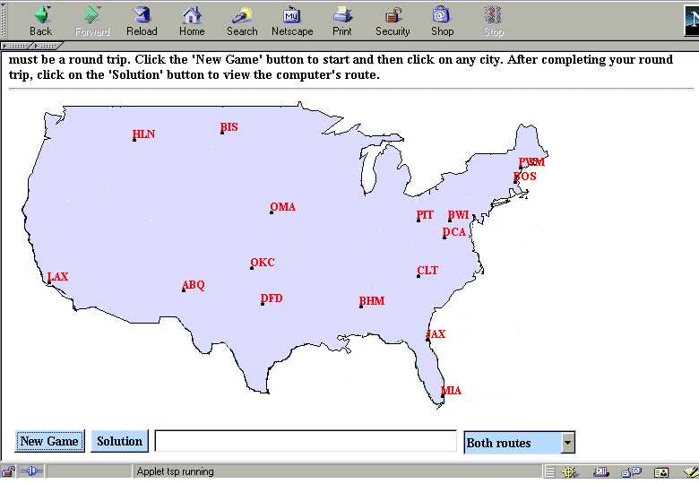
Travelling Salesman Problem(TSP)
A salesman must visit N cities.
Each city is visited exactly once and finishing the city started from.
There is usually an integer cost c(a,b) to travel from city a to city b.
However, the total tour cost must be minimum, where the total cost is the sum of the individual cost of each city visited in the tour.
It’s an NP Complete problem
  no one has found any really efficient way of solving them for large n.
Closely related to the hamiltonian-cycle problem.

Slide 100
Travelling Salesman interactive1

Slide 101
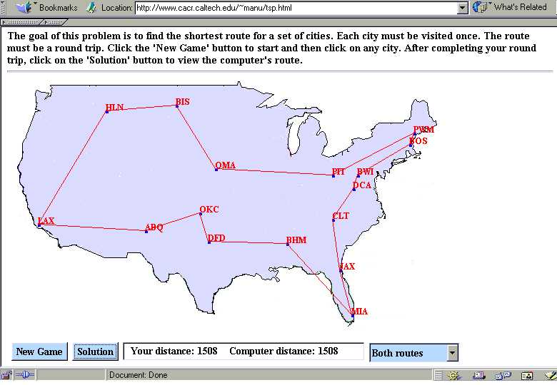
Travelling Salesman interactive1

Slide 102
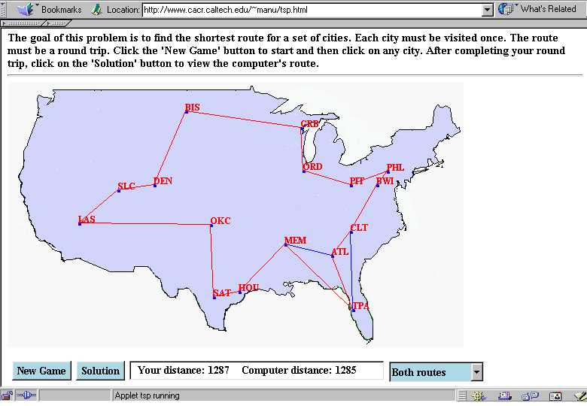
computer wins

Slide 103
VLSI layout
The decision of placement of silicon chips on breadboards is very complex. (or standard gates on a chip).
This includes
  cell layout
  channel routing
The goal is to place the chips without overlap.
Finding the best way to route the wires between the chips becomes a search problem.

Slide 104
Searching for Solutions to VLSI Layout
Generating action sequences
Data structures for search trees

Slide 105
Generating action sequences
What do we know?
  define a problem and recognize a solution
Finding a solution is done by a search in the state space
Maintain and extend a partial solution sequence

Slide 106
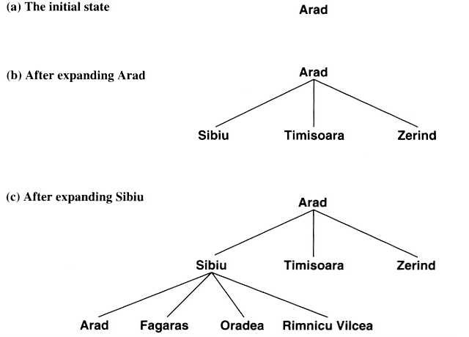
Generating action sequences
A search tree is built over the state space
A node corresponds to a state
The initial state corresponds to the root of the tree
Leaf nodes are expended
There is a difference between state space and search tree

