Slide 1
Adversarial Search
Dr. Rana Majumdar

Slide 2
Outline
Optimal decisions
α-β pruning
Imperfect, real-time decisions

Slide 3
Games vs. search problems
"Unpredictable" opponent → specifying a move for every possible opponent reply
Time limits → unlikely to find goal, must approximate

Slide 4
Adversarial search is a game-playing technique where the agents are surrounded by a competitive environment. A conflicting goal is given to the agents (multi agent). These agents compete with one another and try to defeat one another in order to win the game. Such conflicting goals give rise to the adversarial search.
Here, game-playing means discussing those games where human intelligence and logic factor is used, excluding other factors such as luck factor. Tic-tac-toe, chess, checkers, etc., are such type of games where no luck factor works, only mind works.

Slide 5
Techniques required to get the best optimal solution
There is always a need to choose those algorithms which provide the best optimal solution in a limited time. So, we use the following techniques which could fulfill our requirements:
Pruning: A technique which allows ignoring the unwanted portions of a search tree which make no difference in its final result.
Heuristic Evaluation Function: It allows to approximate the cost value at each level of the search tree, before reaching the goal node.

Slide 6
S₀: It is the initial state from where a game begins.
PLAYER (s): It defines which player is having the current turn to make a move in the state.
ACTIONS (s): It defines the set of legal moves to be used in a state.
RESULT (s, a): It is a transition model which defines the result of a move.
TERMINAL-TEST (s): It defines that the game has ended and returns true.
UTILITY (s,p): It defines the final value with which the game has ended. This function is also known as Objective function or Payoff function. The price which the winner will get i.e.
(-1): If the PLAYER loses.
(+1): If the PLAYER wins.
(0): If there is a draw between the PLAYERS.
For example, in chess, tic-tac-toe, we have two or three possible outcomes. Either to win, to lose, or to draw the match with values +1,-1 or 0.

Slide 7

Game tree (2-player, deterministic, turns)

Slide 8
Types of algorithms in Adversarial search
In a normal search, we follow a sequence of actions to reach the goal or to finish the game optimally.
But in an adversarial search, the result depends on the players which will decide the result of the game. It is also obvious that the solution for the goal state will be an optimal solution because the player will try to win the game with the shortest path and under limited time.
There are following types of adversarial search:
Minmax Algorithm
Alpha-beta Pruning.

Slide 9
In artificial intelligence, minimax is a decision-making strategy under game theory, which is used to minimize the losing chances in a game and to maximize the winning chances. This strategy is also known as ‘Minmax,’ ’MM,’ or ‘Saddle point.’
Basically, it is a two-player game strategy where if one wins, the other loose the game. Like, if two persons are playing chess, the result will be in favor of one player and will unfavor the other one. The person who will make his best try,efforts as well as cleverness, will surely win.

Slide 10

Minimax
Perfect play for deterministic games
Idea: choose move to position with highest minimax value
= best achievable payoff against best play

Slide 11
MINIMAX algorithm is a backtracking algorithm where it backtracks to pick the best move out of several choices. MINIMAX strategy follows the DFS (Depth-first search) concept. Here, we have two players MIN and MAX, and the game is played alternatively between them, i.e., when MAX made a move, then the next turn is of MIN. It means the move made by MAX is fixed and, he cannot change it. The same concept is followed in DFS strategy, i.e., we follow the same path and cannot change in the middle. That’s why in MINIMAX algorithm, instead of BFS, we follow DFS.
Keep on generating the game tree/ search tree till a limit d.
Compute the move using a heuristic function.
Propagate the values from the leaf node till the current position following the minimax strategy.
Make the best move from the choices.

Slide 12
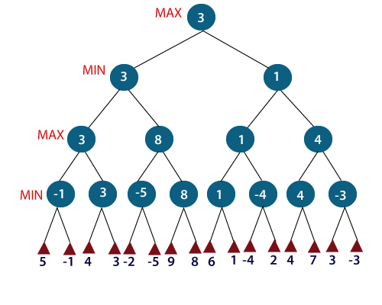

Slide 13
So, if the level is minimizing, the node will accept the minimum value from the successor nodes. If the level is maximizing, the node will accept the maximum value from the successor.
Note: The time complexity of MINIMAX algorithm is O(bd) where b is the branching factor and d is the depth of the search tree.

Slide 14

Minimax algorithm

Slide 15
Properties of minimax
Complete? Yes (if tree is finite)
Time complexity? O(bd)
Space complexity? O(bd) (depth-first exploration)
For chess, b ≈ 35, d ≈100 for "reasonable" games
→ exact solution completely infeasible
Optimal? Yes (against an optimal opponent)

Slide 16
Alpha-beta Pruning
Alpha-beta pruning is an advance version of MINIMAX algorithm. The drawback of minimax strategy is that it explores each node in the tree deeply to provide the best path among all the paths. This increases its time complexity. But as we know, the performance measure is the first consideration for any optimal algorithm. Therefore, alpha-beta pruning reduces this drawback of minimax strategy by less exploring the nodes of the search tree.

Slide 17
The method used in alpha-beta pruning is that it cutoff the search by exploring less number of nodes. It makes the same moves as a minimax algorithm does, but it prunes the unwanted branches using the pruning technique . Alpha-beta pruning works on two threshold values, i.e., α (alpha) and β (beta).
α: It is the best highest value, a MAX player can have. It is the lower bound, which represents negative infinity value.
β: It is the best lowest value, a MIN player can have. It is the upper bound which represents positive infinity.

Slide 18

α-β pruning example

Slide 19

α-β pruning example

Slide 20

α-β pruning example

Slide 21

α-β pruning example

Slide 22

α-β pruning example

Slide 23
Properties of α-β
Pruning does not affect final result
Good move ordering improves effectiveness of pruning
With "perfect ordering," time complexity = O(b^{m/2})
  → doubles depth of search
A simple example of the value of reasoning about which computations are relevant (a form of meta reasoning)

Slide 24

Why is it called α-β?
α is the value of the best (i.e., highest-value) choice found so far at any choice point along the path for max
If v is worse than α, max will avoid it
→ prune that branch
Define β similarly for min

Slide 25

The α-β algorithm

Slide 26

The α-β algorithm

Slide 27
Resource limits
Suppose we have 100 secs, explore 10⁴ nodes/sec
→ 10⁶ nodes per move
Standard approach:
  e.g., depth limit
evaluation function
  = estimated desirability of position
cutoff test:

Slide 28
Evaluation functions
For chess, typically linear weighted sum of features
Eval(s) = w₁ f₁(s) + w₂ f₂(s) + … + w_{n} f_{n}(s)
e.g., w₁ = 9 with
f₁(s) = (number of white queens) – (number of black queens), etc.

Slide 29
Cutting off search
MinimaxCutoff is identical to MinimaxValue except
  Terminal? is replaced by Cutoff?
  Utility is replaced by Eval
Does it work in practice?
b^{m} = 10⁶, b=35 → m=4
  4-ply ≈ human novice
  8-ply ≈ typical PC, human master
  12-ply ≈ Deep Blue, Kasparov
4-ply lookahead is a hopeless chess player!

Slide 30
Working of Alpha-Beta Pruning

Slide 31
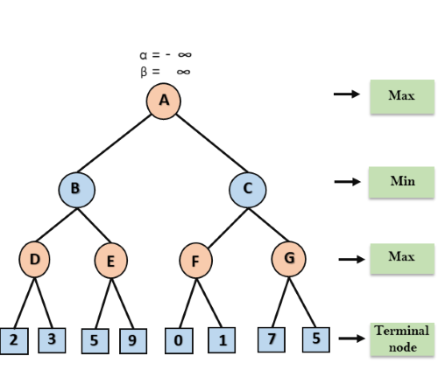
Step 1: At the first step the, Max player will start first move from node A where α= -∞ and β= +∞, these value of alpha and beta passed down to node B where again α= -∞ and β= +∞, and Node B passes the same value to its child D.

Slide 32
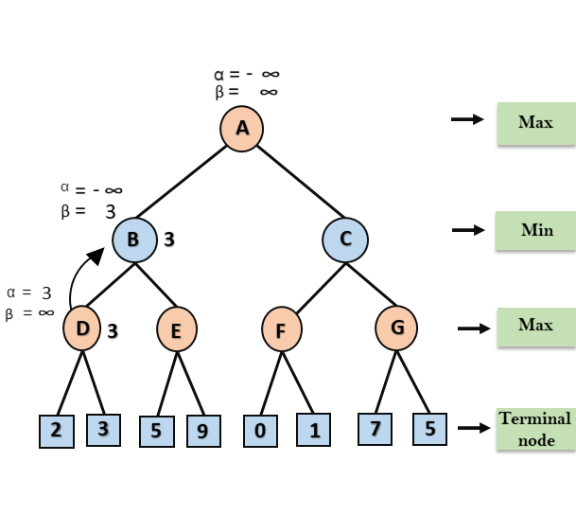
Step 2: At Node D, the value of α will be calculated as its turn for Max. The value of α is compared with firstly 2 and then 3, and the max (2, 3) = 3 will be the value of α at node D and node value will also 3.
Step 3: Now algorithm backtrack to node B, where the value of β will change as this is a turn of Min, Now β= +∞, will compare with the available subsequent nodes value, i.e. min (∞, 3) = 3, hence at node B now α= -∞, and β= 3.

Slide 33
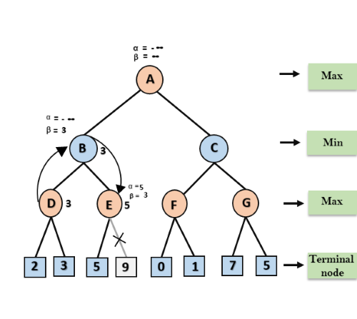
In the next step, algorithm traverse the next successor of Node B which is node E, and the values of α= -∞, and β= 3 will also be passed.
Step 4: At node E, Max will take its turn, and the value of alpha will change. The current value of alpha will be compared with 5, so max (-∞, 5) = 5, hence at node E α= 5 and β= 3, where α>=β, so the right successor of E will be pruned, and algorithm will not traverse it, and the value at node E will be 5.

Slide 34
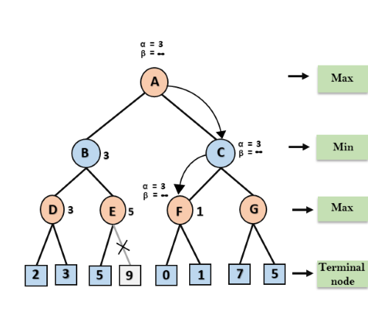
Step 5: At next step, algorithm again backtrack the tree, from node B to node A. At node A, the value of alpha will be changed the maximum available value is 3 as max (-∞, 3)= 3, and β= +∞, these two values now passes to right successor of A which is Node C.
At node C, α=3 and β= +∞, and the same values will be passed on to node F.

Slide 35
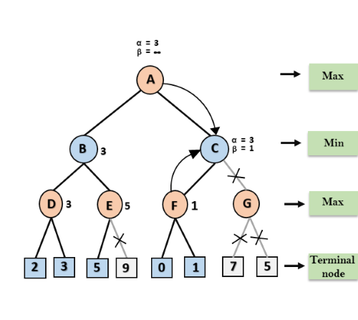
Step 7: Node F returns the node value 1 to node C, at C α= 3 and β= +∞, here the value of beta will be changed, it will compare with 1 so min (∞, 1) = 1. Now at C, α=3 and β= 1, and again it satisfies the condition α>=β, so the next child of C which is G will be pruned, and the algorithm will not compute the entire sub-tree G.

Slide 36
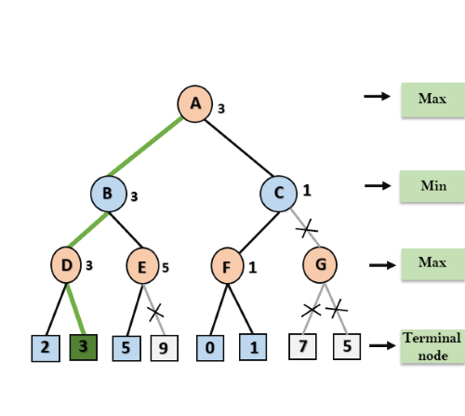
Step 8: C now returns the value of 1 to A here the best value for A is max (3, 1) = 3. Following is the final game tree which is the showing the nodes which are computed and nodes which has never computed. Hence the optimal value for the maximizer is 3 for this example.

Slide 37
Summary
Games are fun to work on!
perfection is unattainable → must approximate
good idea to think about what to think about
They illustrate several important points about AI

