Slide 1
What is knowledge representation
Dr. Rana Majumdar

Slide 2
Humans are best at understanding, reasoning, and interpreting knowledge. Human knows things, which is knowledge and as per their knowledge they perform various actions in the real world. But how machines do all these things comes under knowledge representation and reasoning. Hence we can describe Knowledge representation
Knowledge representation and reasoning (KR, KRR) is the part of Artificial intelligence which concerned with AI agents thinking and how thinking contributes to intelligent behavior of agents.
It is responsible for representing information about the real world so that a computer can understand and can utilize this knowledge to solve the complex real world problems such as diagnosis a medical condition or communicating with humans in natural language.
It is also a way which describes how we can represent knowledge in artificial intelligence. Knowledge representation is not just storing data into some database, but it also enables an intelligent machine to learn from that knowledge and experiences so that it can behave intelligently like a human.

Slide 3
What to Represent
Following are the kind of knowledge which needs to be represented in AI systems:
Object: All the facts about objects in our world domain.
Events: Events are the actions which occur in our world.
Performance: It describe behavior which involves knowledge about how to do things.
Meta-knowledge: It is knowledge about what we know.
Facts: Facts are the truths about the real world and what we represent.
Knowledge-Base: The central component of the knowledge-based agents is the knowledge base. It is represented as KB. The Knowledgebase is a group of the Sentences.

Slide 4
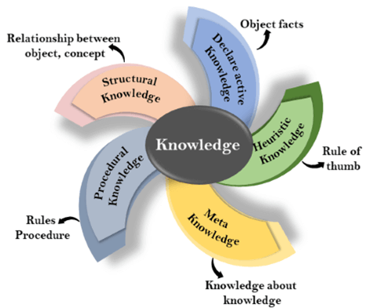
Knowledge

Slide 5
Declarative Knowledge:
Declarative knowledge is to know about something.
It includes concepts, facts, and objects.
It is also called descriptive knowledge and expressed in declarative sentences.
It is simpler than procedural language.
Procedural Knowledge
It is also known as imperative knowledge.
Procedural knowledge is a type of knowledge which is responsible for knowing how to do something.
It can be directly applied to any task.
It includes rules, strategies, procedures, agendas, etc.
Procedural knowledge depends on the task on which it can be applied.

Slide 6
Meta-knowledge:
Knowledge about the other types of knowledge is called Meta-knowledge.
Heuristic knowledge:
Heuristic knowledge is representing knowledge of some experts in a filed or subject.
Heuristic knowledge is rules of thumb based on previous experiences, awareness of approaches, and which are good to work but not guaranteed.
Structural knowledge:
Structural knowledge is basic knowledge to problem-solving.
It describes relationships between various concepts such as kind of, part of, and grouping of something.
It describes the relationship that exists between concepts or objects.

Slide 7
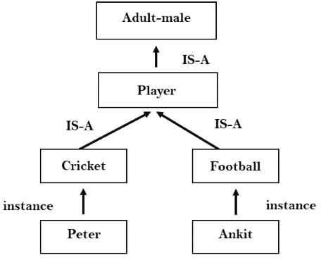
Inheritable knowledge
In the inheritable knowledge approach, all data must be stored into a hierarchy of classes.
All classes should be arranged in a generalized form or a hierarchal manner.
In this approach, we apply inheritance property.
Elements inherit values from other members of a class.
This approach contains inheritable knowledge which shows a relation between instance and class, and it is called instance relation.
Every individual frame can represent the collection of attributes and its value.
In this approach, objects and values are represented in Boxed nodes.
We use Arrows which point from objects to their values.

Slide 8
Inferential knowledge
Inferential knowledge approach represents knowledge in the form of formal logics.
This approach can be used to derive more facts.
It guaranteed correctness.
Example: Let's suppose there are two statements:
  Marcus is a man
  All men are mortal
  Then it can represent as;
man(Marcus)
∀x = man (x) ----------> mortal (x)

Slide 9
Procedural knowledge
Procedural knowledge approach uses small programs and codes which describes how to do specific things, and how to proceed.
In this approach, one important rule is used which is If-Then rule.
In this knowledge, we can use various coding languages such as LISP language and Prolog language.
We can easily represent heuristic or domain-specific knowledge using this approach.
But it is not necessary that we can represent all cases in this approach.

Slide 10
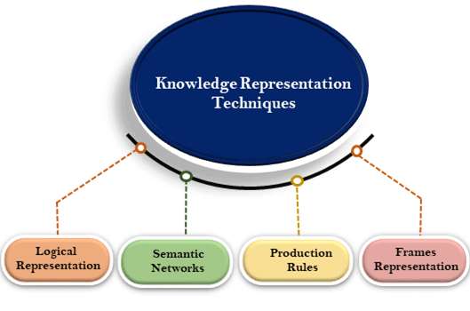
knowledge representation
Techniques
Logical Representation
Semantic Network
Frame Representation
Production Rule

Slide 11
Logical Representation
Logical representation is a language with some concrete rules which deals with propositions and has no ambiguity in representation. Logical representation means drawing a conclusion based on various conditions. This representation lays down some important communication rules. It consists of precisely defined syntax and semantics which supports the sound inference. Each sentence can be translated into logics using syntax and semantics.
Syntax:
Syntaxes are the rules which decide how we can construct legal sentences in the logic.
It determines which symbol we can use in knowledge representation.
How to write those symbols.
Semantics:
Semantics are the rules by which we can interpret the sentence in the logic.
Semantic also involves assigning a meaning to each sentence.

Slide 12
Logical representation can be categorized into mainly two logics:
Propositional Logics
Predicate logics

Slide 13
Advantages of logical representation:
Logical representation enables us to do logical reasoning.
Logical representation is the basis for the programming languages.
Disadvantages of logical Representation:
Logical representations have some restrictions and are challenging to work with.
Logical representation technique may not be very natural, and inference may not be so efficient.

Slide 14
Semantic Network Representation
Semantic networks are alternative of predicate logic for knowledge representation. In Semantic networks, we can represent our knowledge in the form of graphical networks. This network consists of nodes representing objects and arcs which describe the relationship between those objects. Semantic networks can categorize the object in different forms and can also link those objects. Semantic networks are easy to understand and can be easily extended.
This representation consist of mainly two types of relations:
IS-A relation (Inheritance)
Kind-of-relation

Slide 15
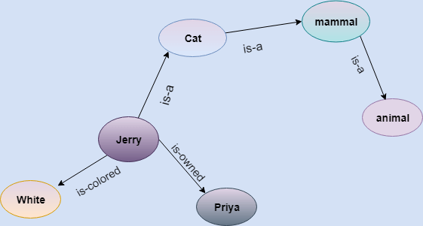
Statements:
Jerry is a cat.
Jerry is a mammal
Jerry is owned by Priya.
Jerry is brown colored.
All Mammals are animal.

Slide 16
Frame Representation
A frame is a record like structure which consists of a collection of attributes and its values to describe an entity in the world. Frames are the AI data structure which divides knowledge into substructures by representing stereotypes situations. It consists of a collection of slots and slot values. These slots may be of any type and sizes. Slots have names and values which are called facets.
Facets: The various aspects of a slot is known as Facets. Facets are features of frames which enable us to put constraints on the frames. Example: IF-NEEDED facts are called when data of any particular slot is needed. A frame may consist of any number of slots, and a slot may include any number of facets and facets may have any number of values. A frame is also known as slot-filter knowledge representation in artificial intelligence.

Slide 17
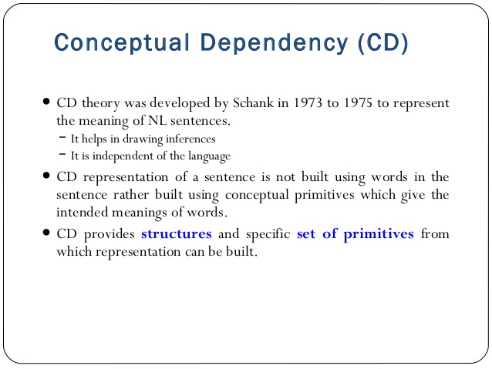

Slide 18
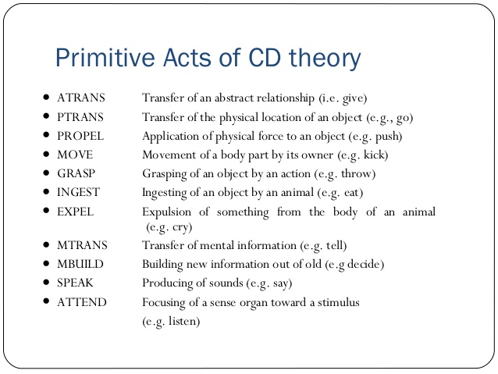

Slide 19
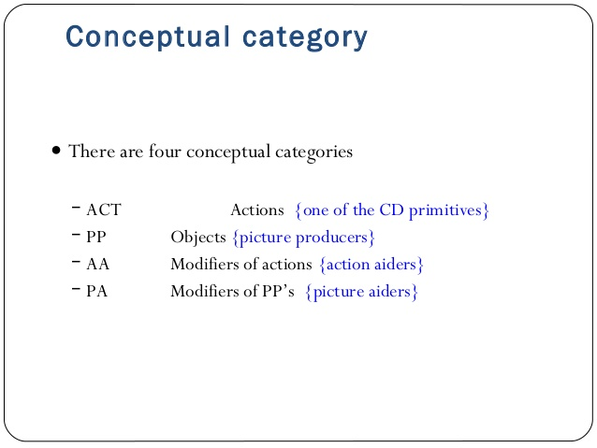

Slide 20
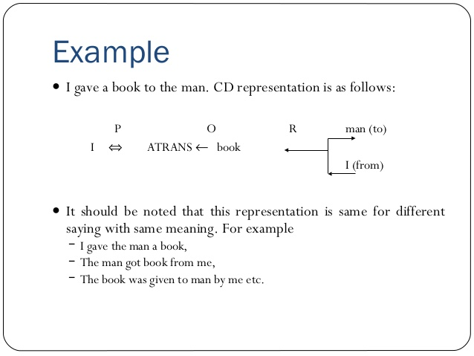

Slide 21
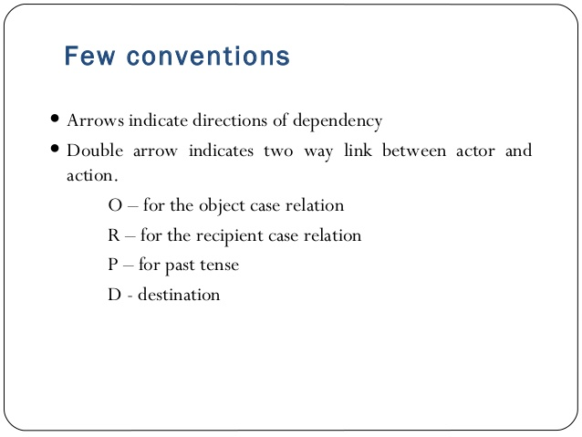

Slide 22
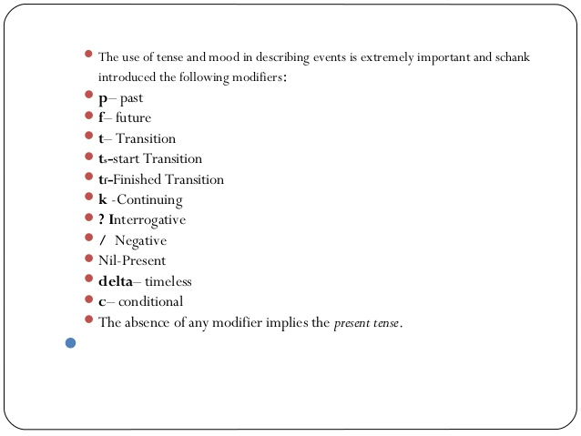

Slide 23
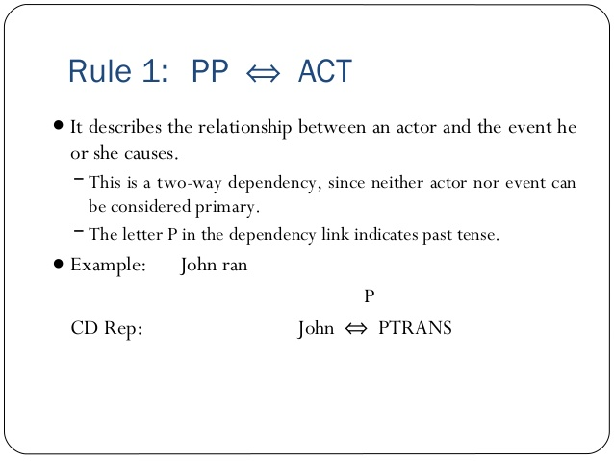
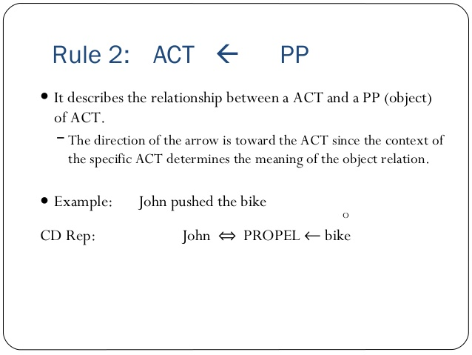

Slide 24
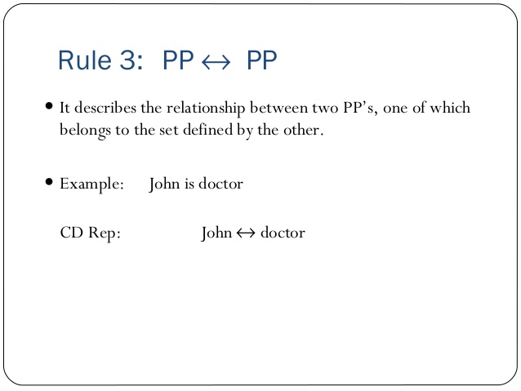
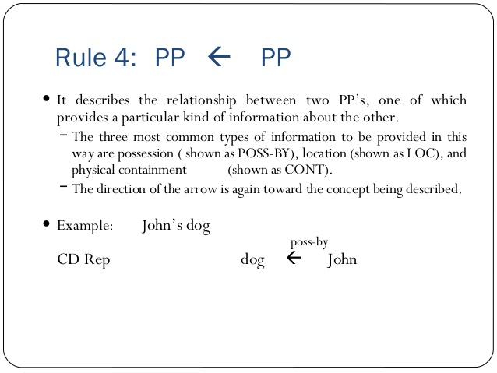

Slide 25
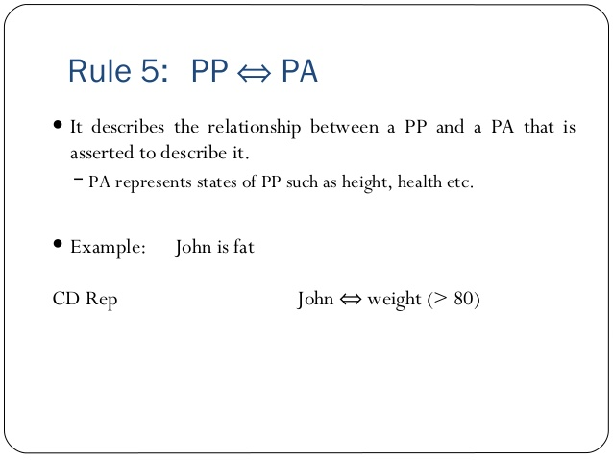
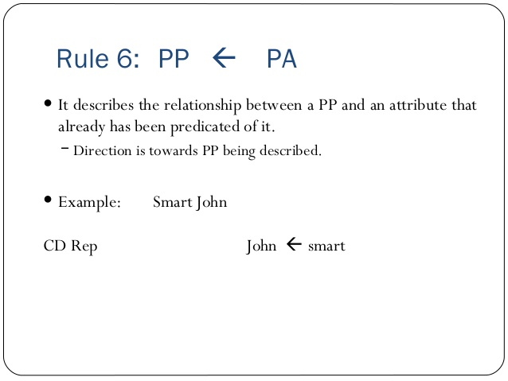

Slide 26
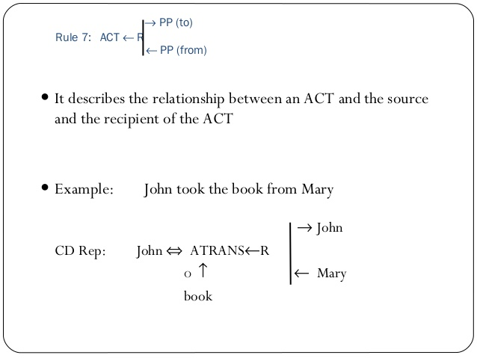
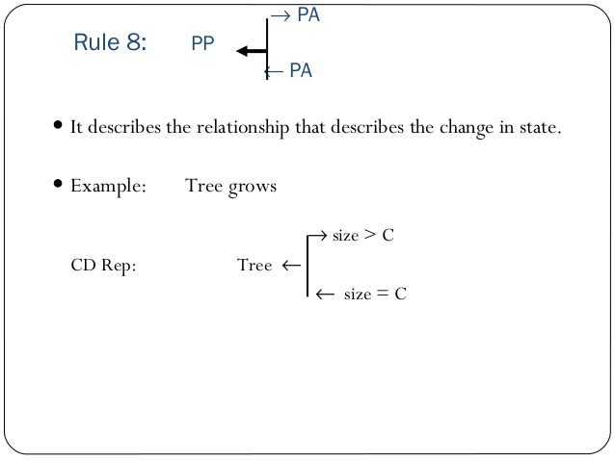

Slide 27
THANKS

