Slide 1
Duality
Find the dual of the following
Max z= 2x₁+ 3x₂ +4x₃
Sub to,
x₁-5x₂+3x₃=7
2x₁-5x₂≤ 3
3x₂-x₃≥5
x₁, x₂≥0 and x₃ is unrestricted in sign.

Slide 2
Solution
Max z= 2x₁+ 3x₂ +4(x₃’- x₃’’)
Sub to,
x₁-5x₂+3(x₃’- x₃’’) =7
2x₁-5x₂≤ 3
3x₂-(x₃’- x₃’’) ≥5
x₁, x₂,x₃’, x₃’’ ≥0

Slide 3
Solution
Max z= 2x₁+ 3x₂ +4(x₃’- x₃’’)
Sub to,
x₁-5x₂+3(x₃’- x₃’’) ≤ 7
x₁-5x₂+3(x₃’- x₃’’) ≥ 7
2x₁-5x₂≤ 3
3x₂-(x₃’- x₃’’) ≥5
x₁, x₂,x₃’, x₃’’ ≥0

Slide 4
Solution
Max z= 2x₁+ 3x₂ +4(x₃’- x₃’’)
Sub to,
x₁-5x₂+3(x₃’- x₃’’) ≤ 7
-x₁+5x₂-3(x₃’- x₃’’) ≤ -7
2x₁-5x₂≤ 3
-3x₂+(x₃’- x₃’’) ≤ -5
x₁, x₂,x₃’, x₃’’ ≥0

Slide 5
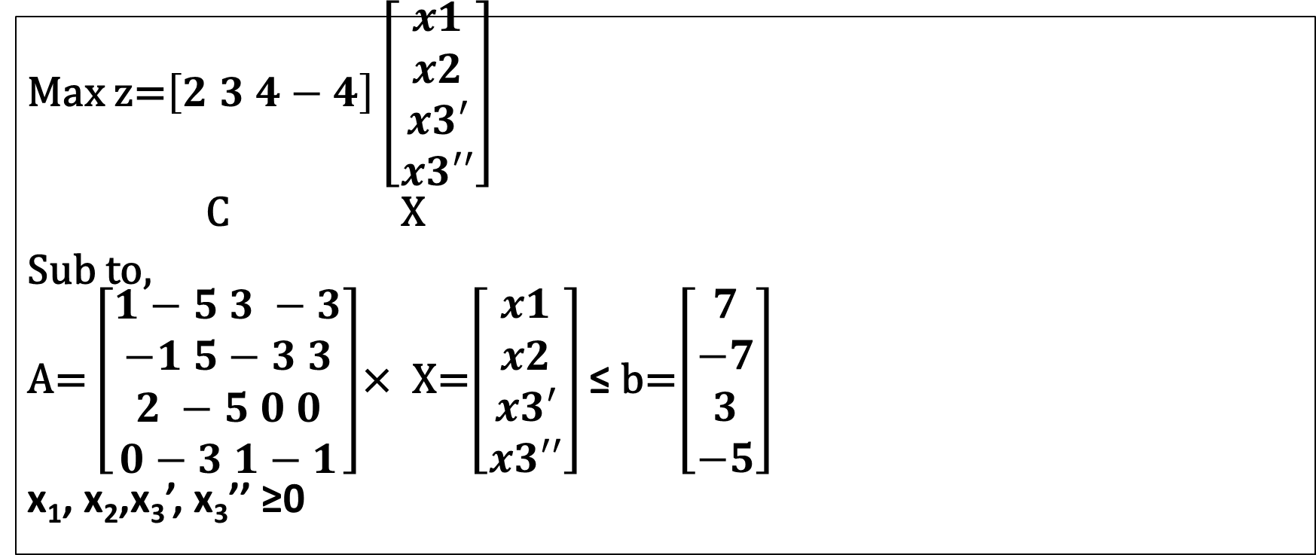
Solution
Max z=$\left[2 3 4−4\right]\left[\begin{aligned}x1 \\ x2 \\ x3′ \\ x3′′\end{aligned}\right]$
C X
Sub to,
A= $\left[\begin{aligned}1−5 3 −3 \\ −1 5−3 3 \\ 2 −5 0 0 \\ 0−3 1−1\end{aligned}\right]$× X=$\left[\begin{aligned}x1 \\ x2 \\ x3′ \\ x3′′\end{aligned}\right]$ ≤ b=$\left[\begin{aligned}7 \\ −7 \\ 3 \\ −5\end{aligned}\right]$
x₁, x₂,x₃’, x₃’’ ≥0

Slide 6
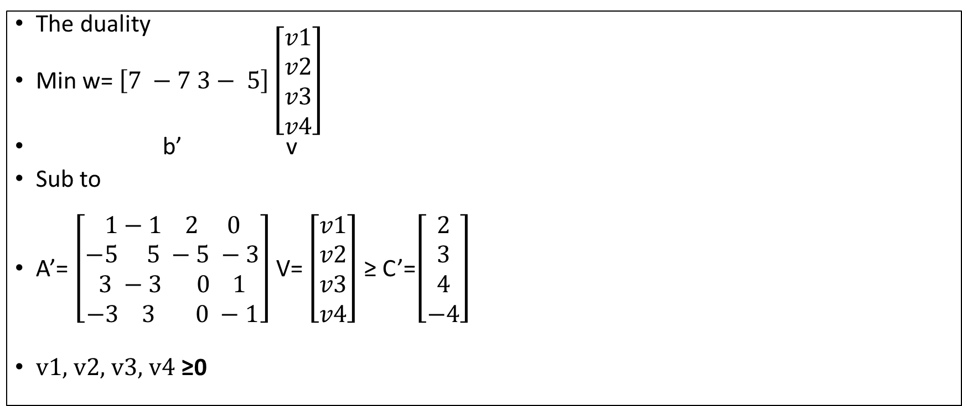
Solution
The duality
Min w= $\left[7 −7 3− 5\right]\left[\begin{aligned}v1 \\ v2 \\ v3 \\ v4\end{aligned}\right]$
b’ v
Sub to
A’= $\left[\begin{aligned}1−1 2 0 \\ −5 5 −5 −3 \\ 3 −3 0 1 \\ −3 3 0 −1\end{aligned}\right]$ V= $\left[\begin{aligned}v1 \\ v2 \\ v3 \\ v4\end{aligned}\right]$ ≥ C’=$\left[\begin{aligned}2 \\ 3 \\ 4 \\ −4\end{aligned}\right]$
v1, v2, v3, v4 ≥0

Slide 7
Solution
Min w=7v1-7v2 +3v3-5v4
Sub to,
v1-v2+2v3 ≥2
-5v1+5v2-5v3 -3v4 ≥3
3v1-3v2+v4 ≥4
-3v1+3v2-v4 ≥-4
v1, v2, v3, v4 ≥0

Slide 8
Solution
Min w=7v1-7v2 +3v3-5v4
Sub to,
v1-v2+2v3 ≥2
-5v1+5v2-5v3 -3v4 ≥3
3v1-3v2+v4 ≥4
3v1-3v2+v4 ≤ 4
v1, v2, v3, v4 ≥0

Slide 9
Solution
Min w=7v1-7v2 +3v3-5v4
Sub to,
v1-v2+2v3 ≥2
-5v1+5v2-5v3 +3v4 ≥3
3v1-3v2+v4=4
v1, v2, v3, v4 ≥0

Slide 10
Solution
Min w=7(v1-v2) +3v3-5v4
Sub to,
(v1-v2)+2v3 ≥2
-5(v1-v2)-5v3 -3v4 ≥3
3(v1-v2)+v4=4
v1, v2, v3, v4 ≥0

Slide 11
Solution
Min w=7v’+3v3-5v4
Sub to,
v’+2v3 ≥2
-5v’-5v3 -3v4 ≥3
3v’+v4=4
v3, v4 ≥0 and v’ is unrestricted in sign

