Slide 1
Context API vs REDUX

Slide 2
Accessibility
Flow of Data

Slide 3
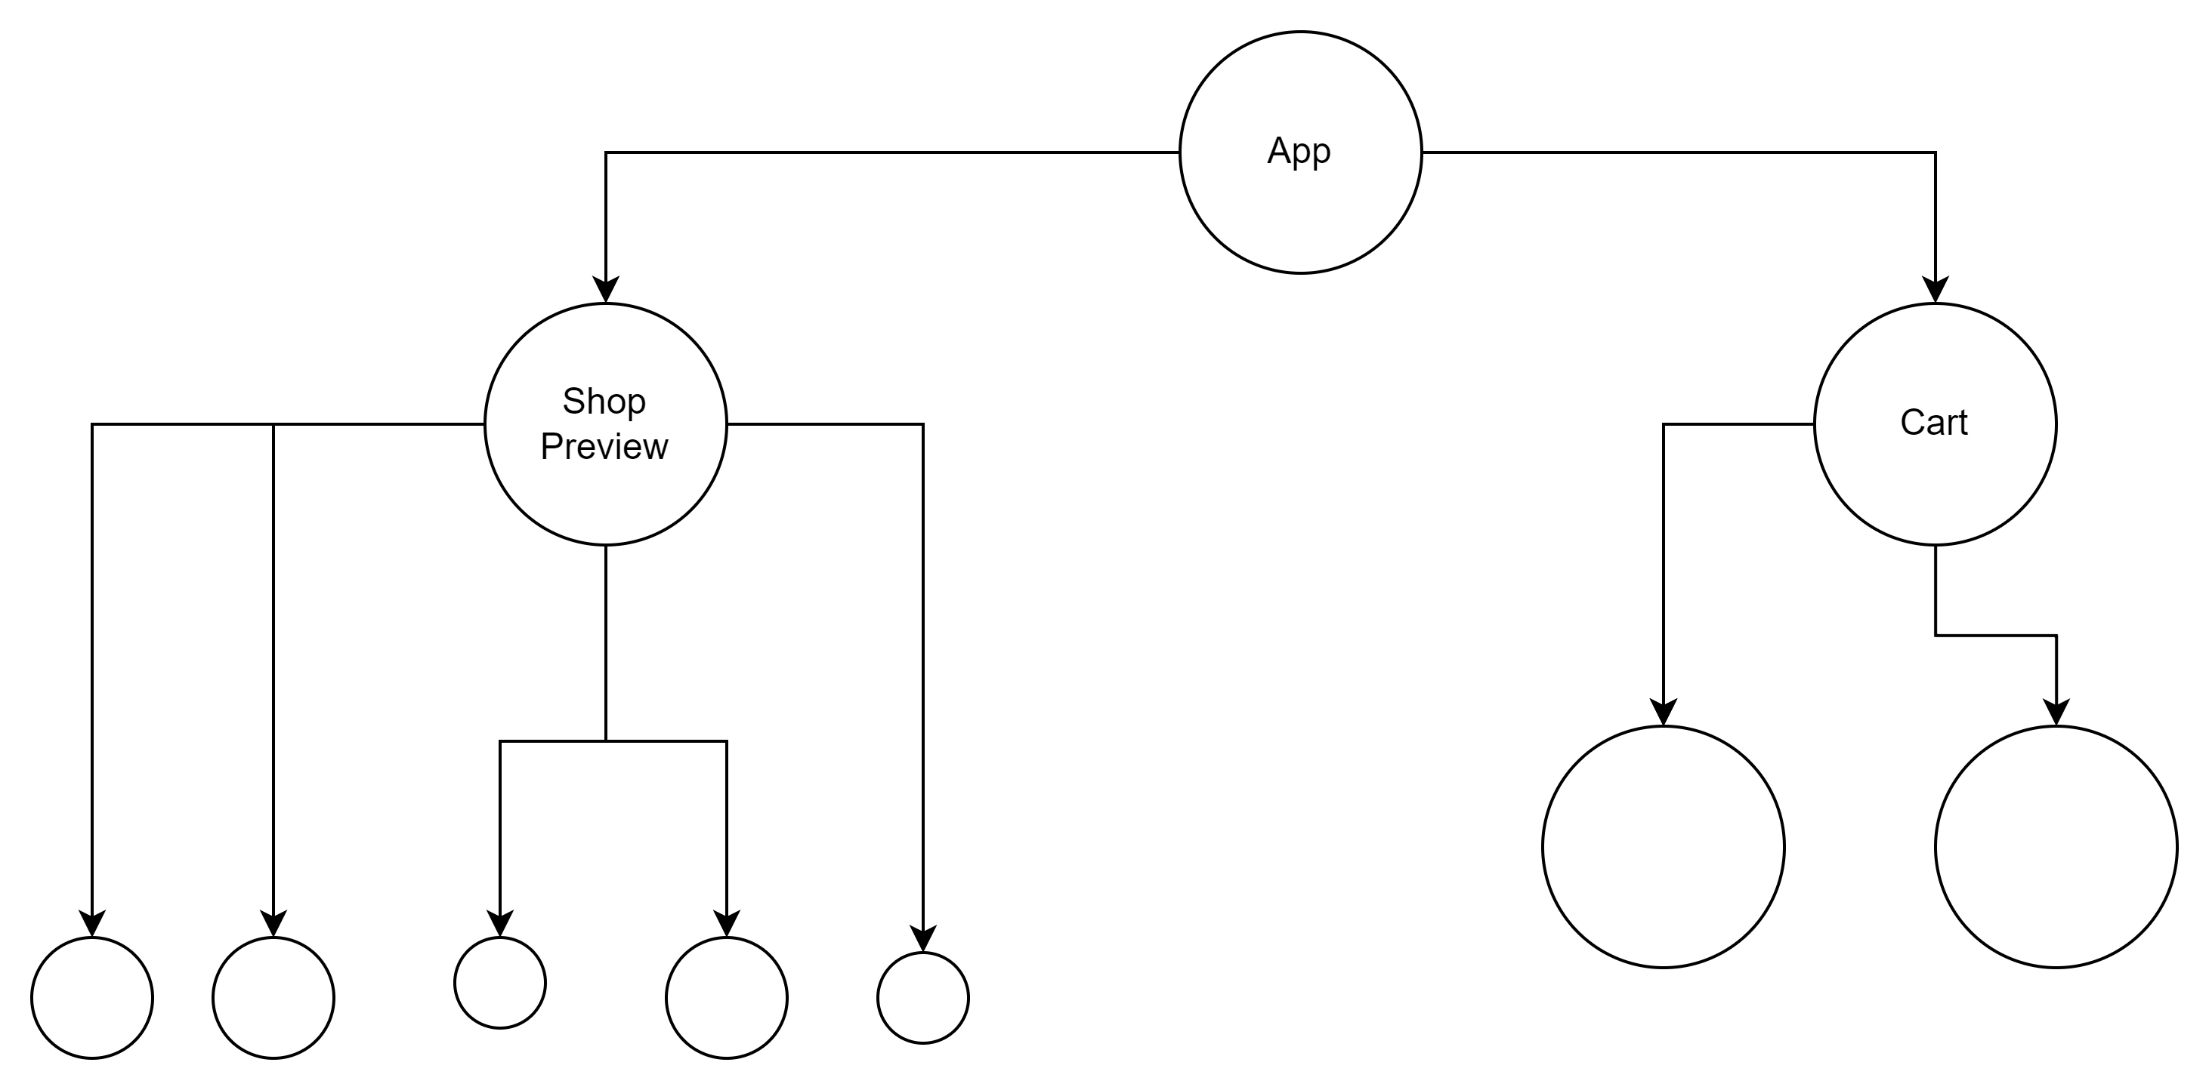

Slide 4
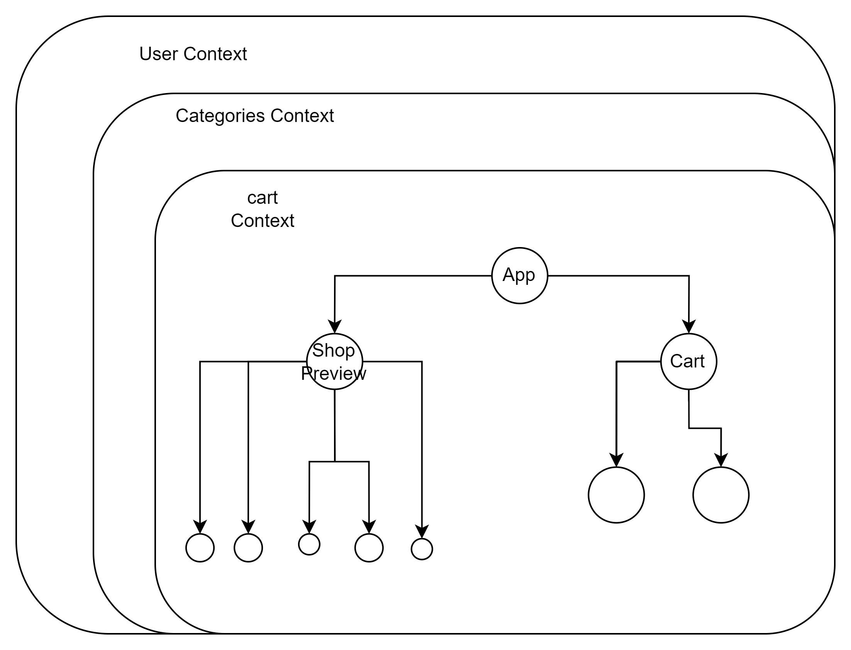

Slide 5
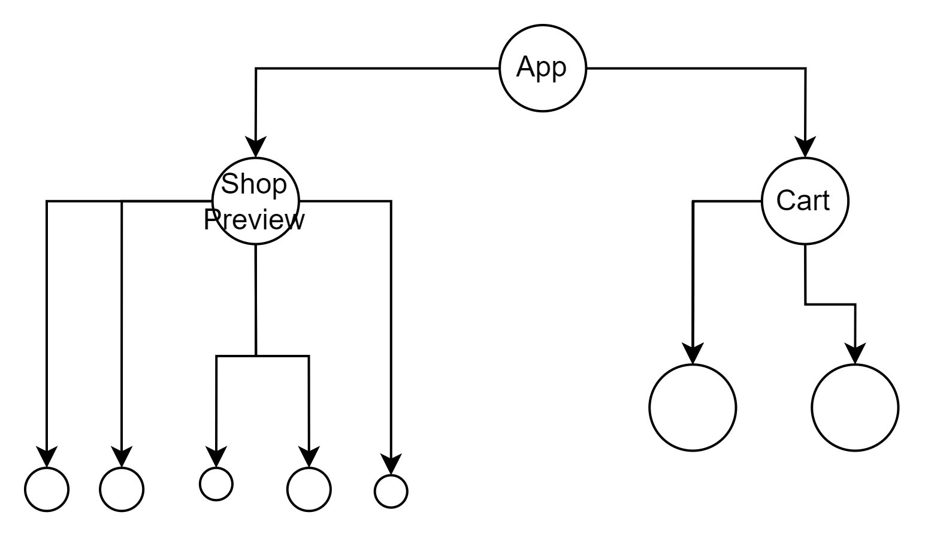





Slide 6
Redux Store

Slide 7
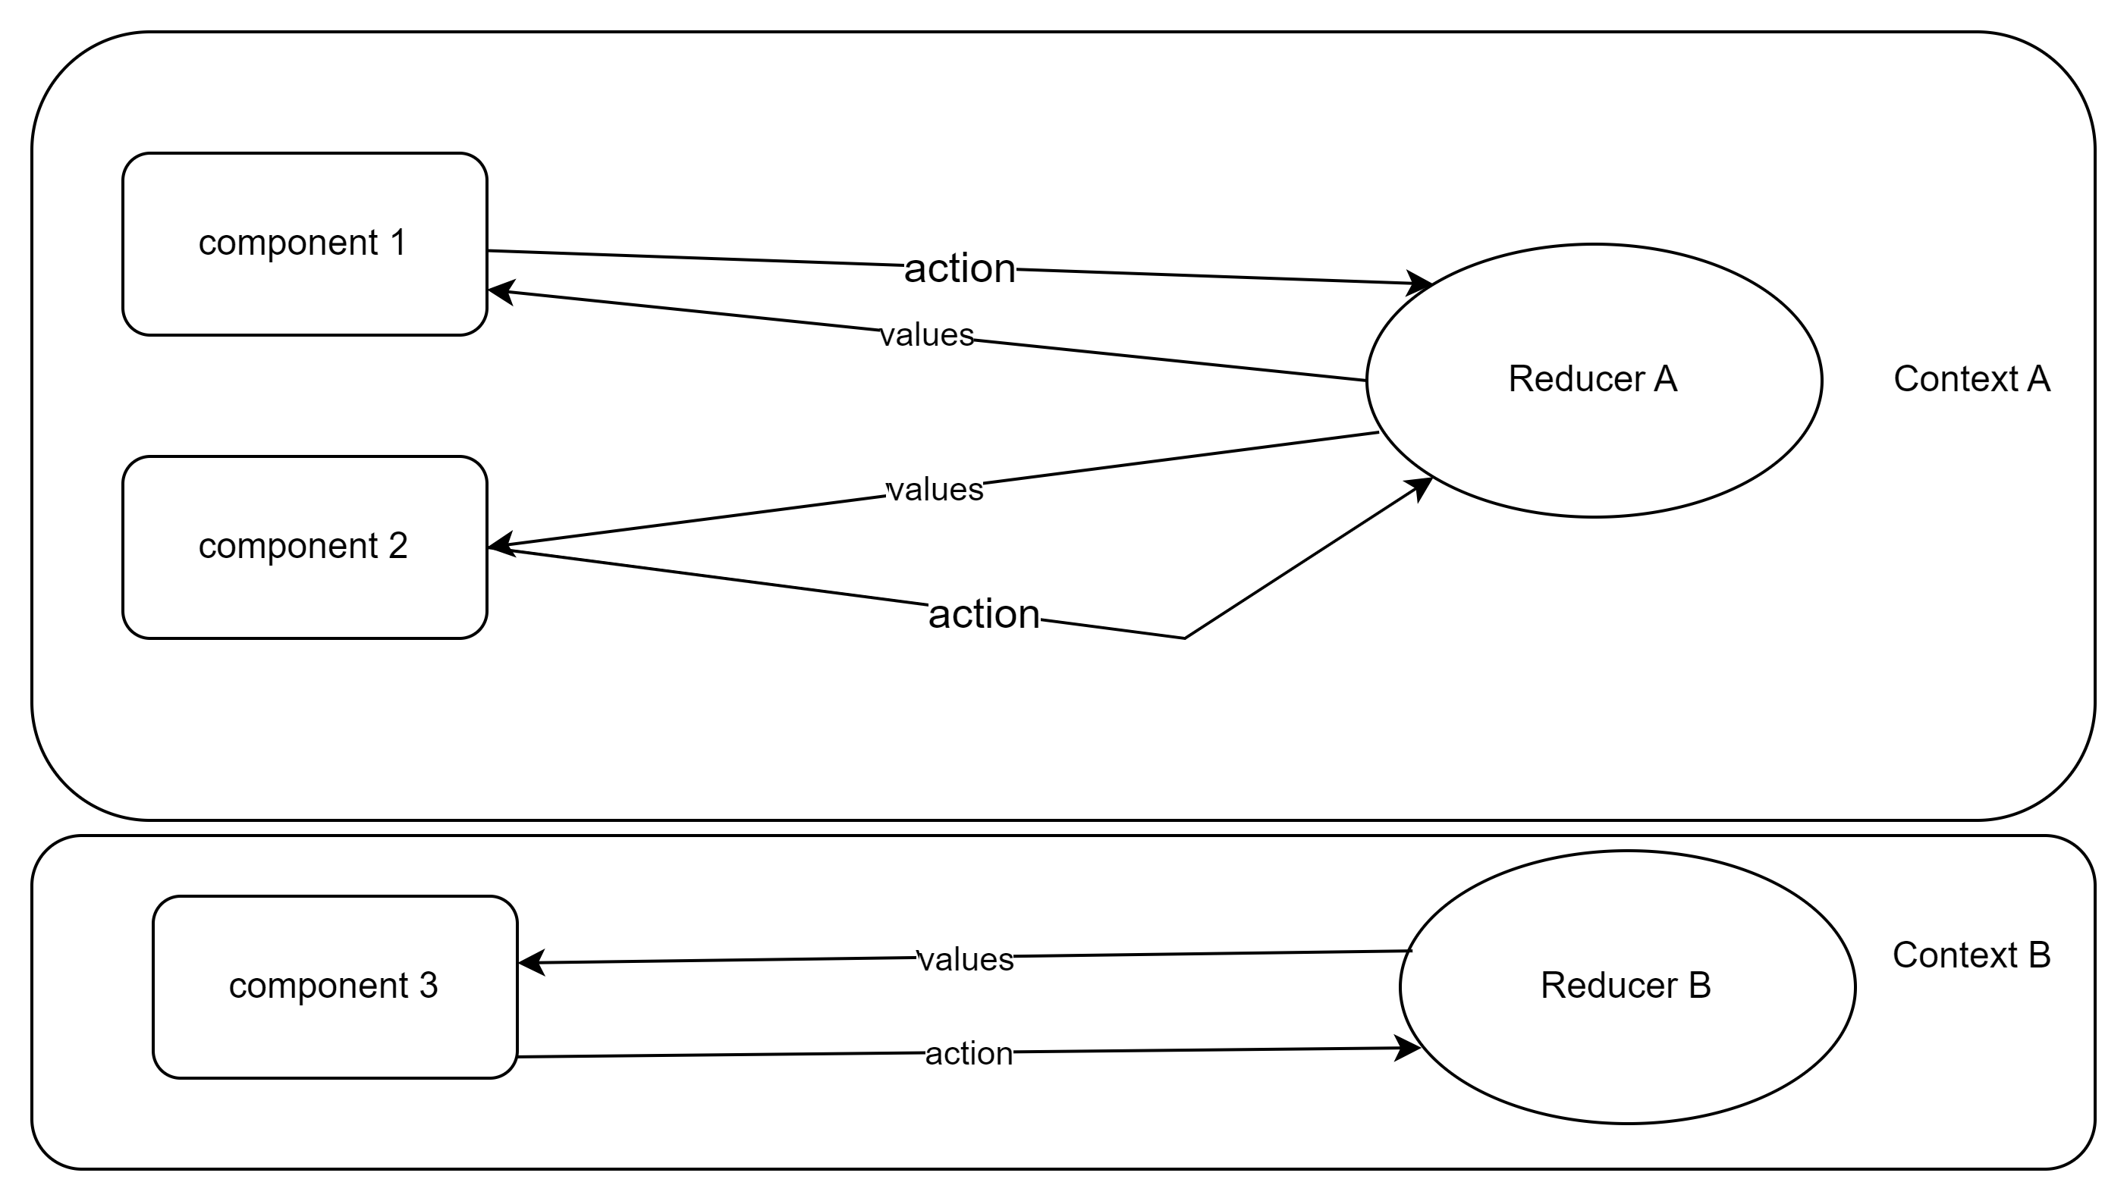
Redux vs Context Data Flow
UI Components
Contexts with Reducers

Slide 8
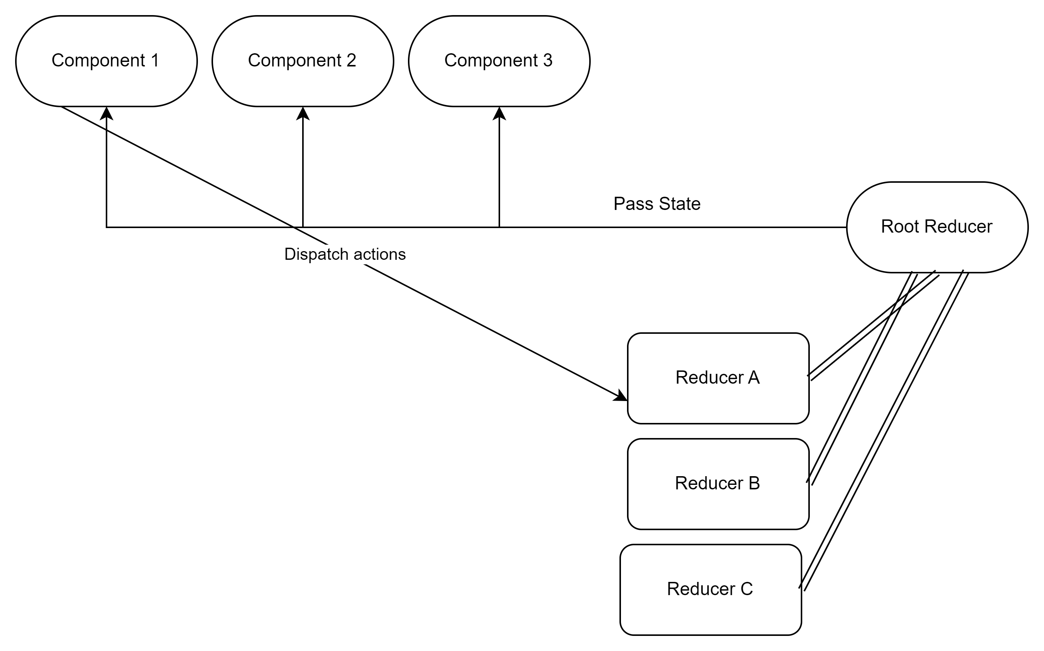
UI Components
Redux Store

Slide 9
React Redux Installation
ReactRedux Setting Up Our Store
ReactRedux Creating User reducer
Creating Selectors
Categories Reducer
Categories selectors
Business Logic in Our Selectors

