Slide 1
Context API vs REDUX

Slide 2
Accessibility
Flow of Data

Slide 3
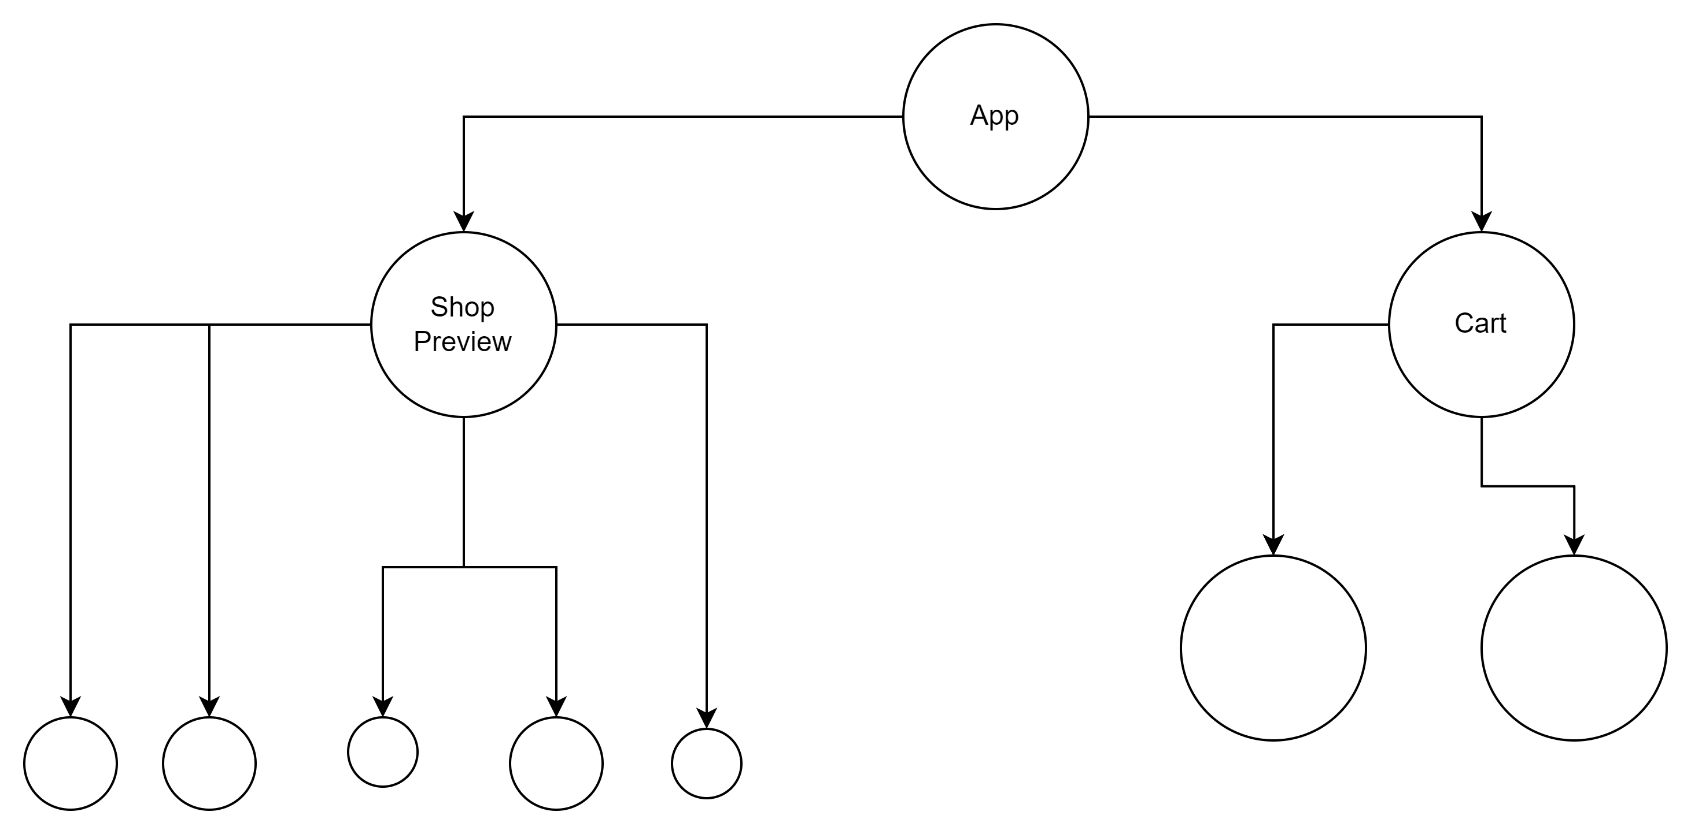

Slide 4
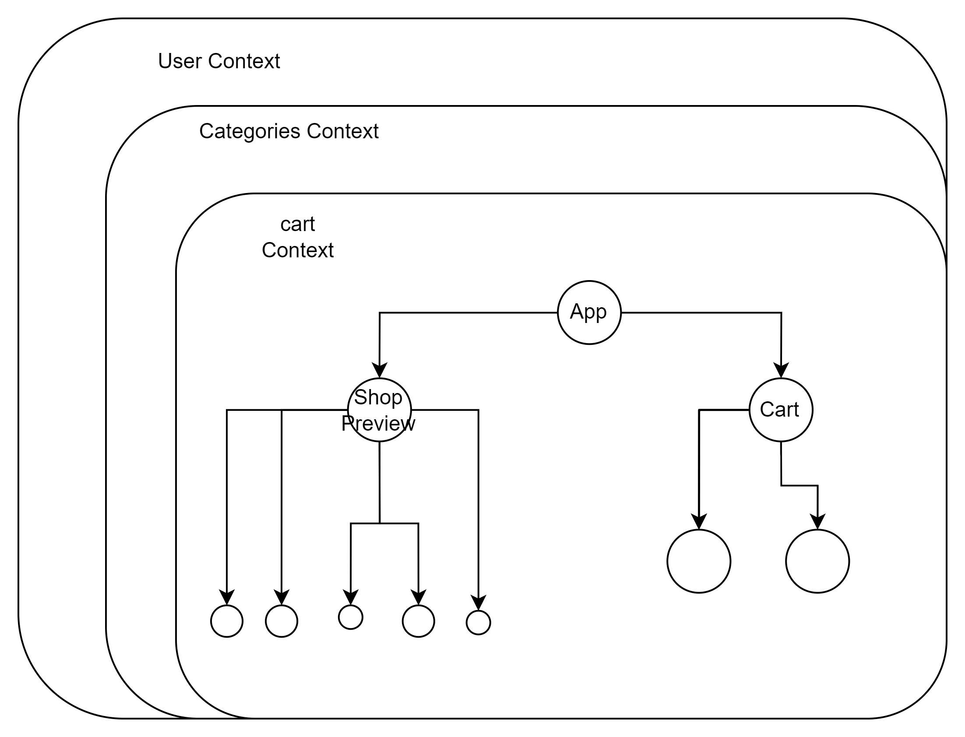

Slide 5
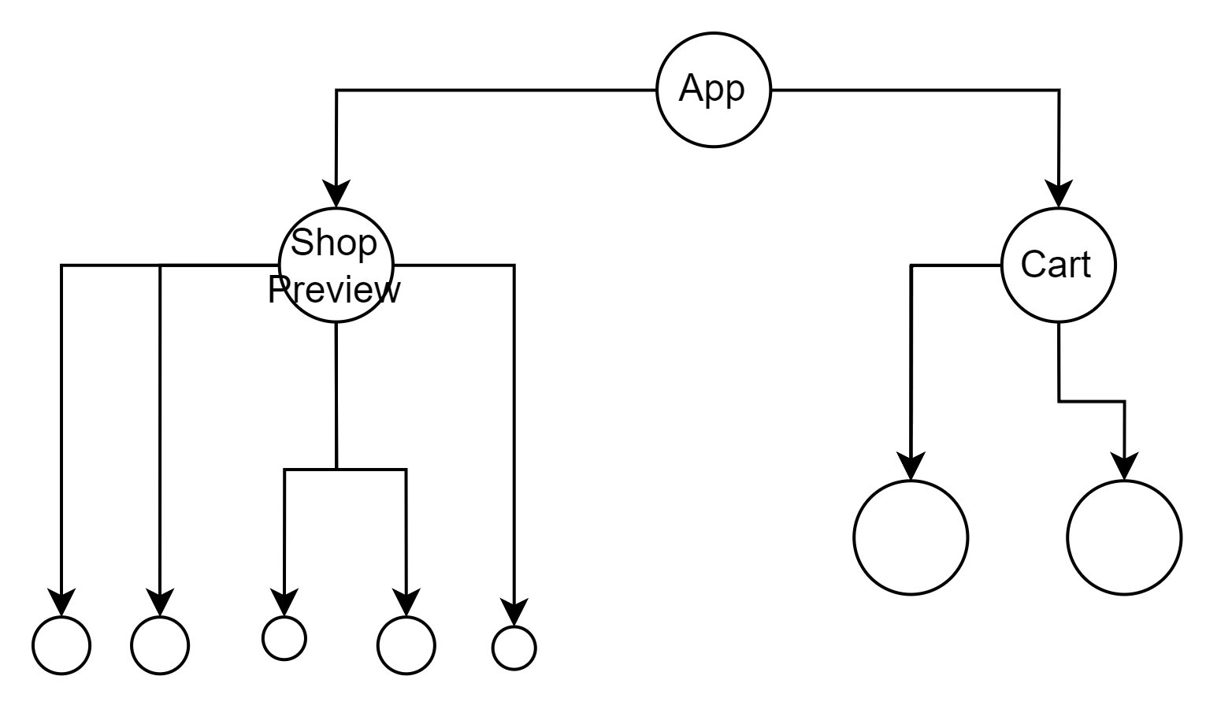





Slide 6
Redux Store

Slide 7
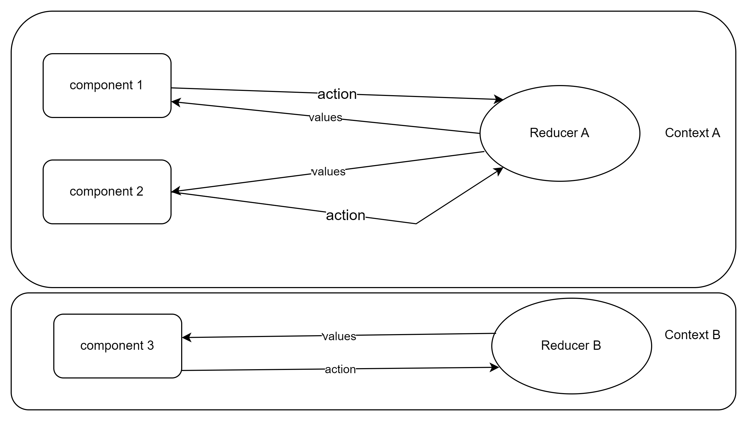
Redux vs Context Data Flow
UI Components
Contexts with Reducers

Slide 8
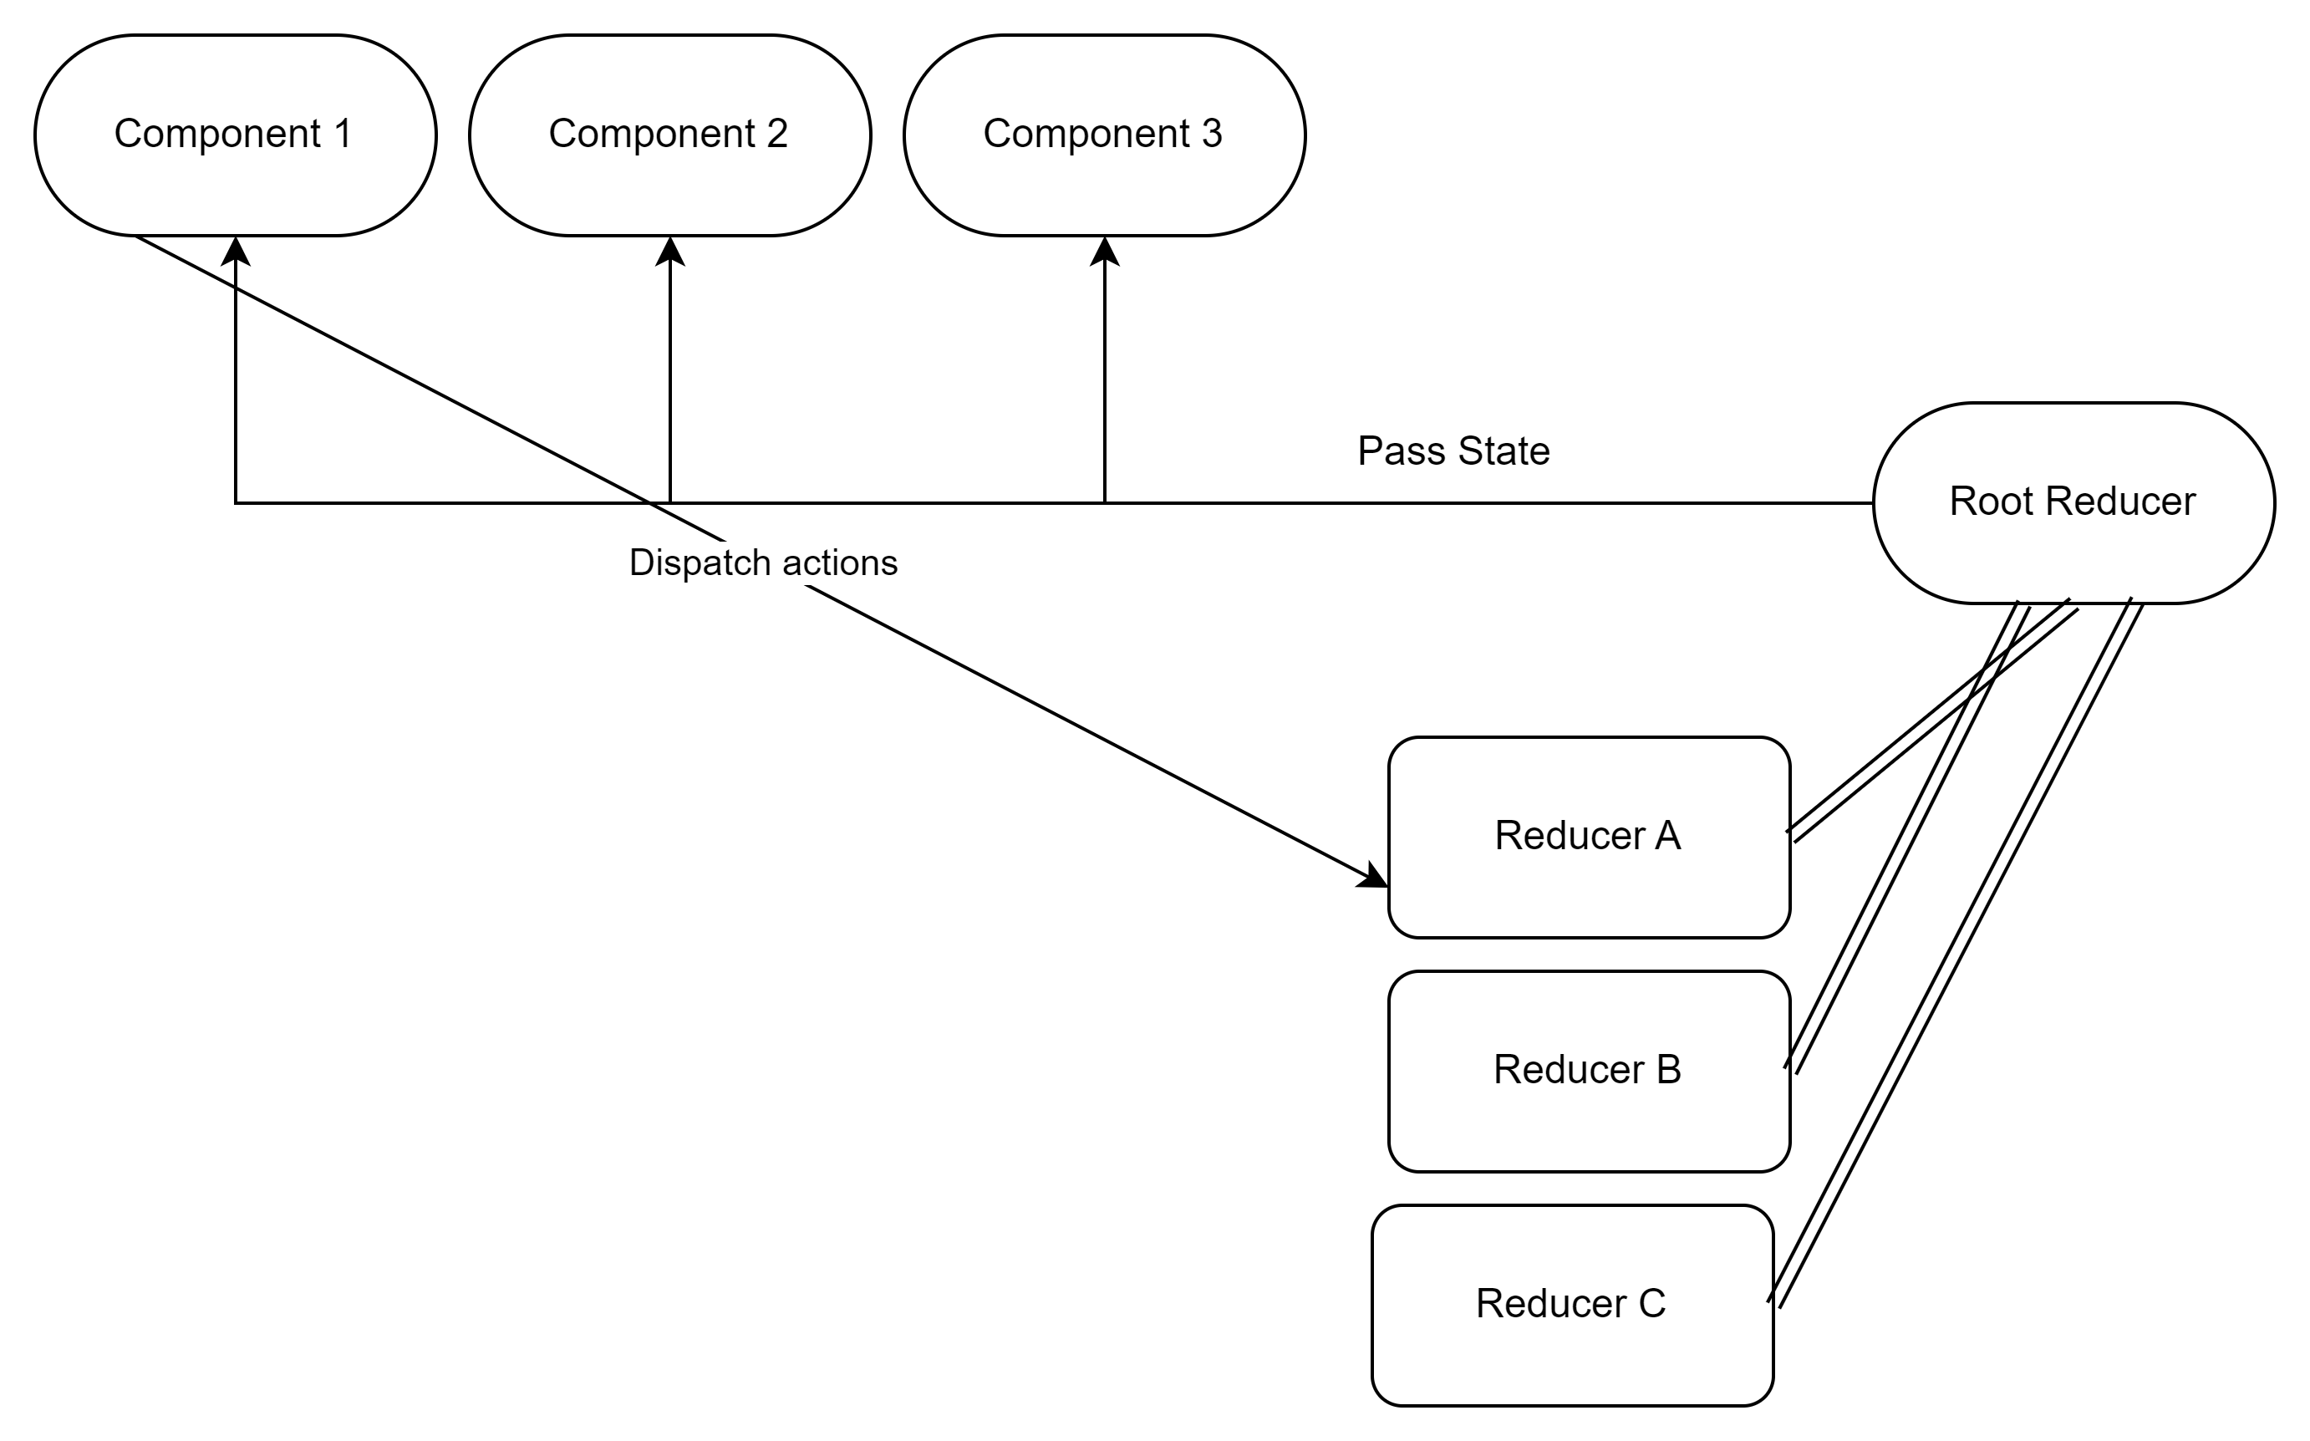
UI Components
Redux Store

Slide 9
React Redux Installation
ReactRedux Setting Up Our Store
ReactRedux Creating User reducer
Creating Selectors
Categories Reducer
Categories selectors
Business Logic in Our Selectors
What Triggers useSelector
Middleware

Slide 10
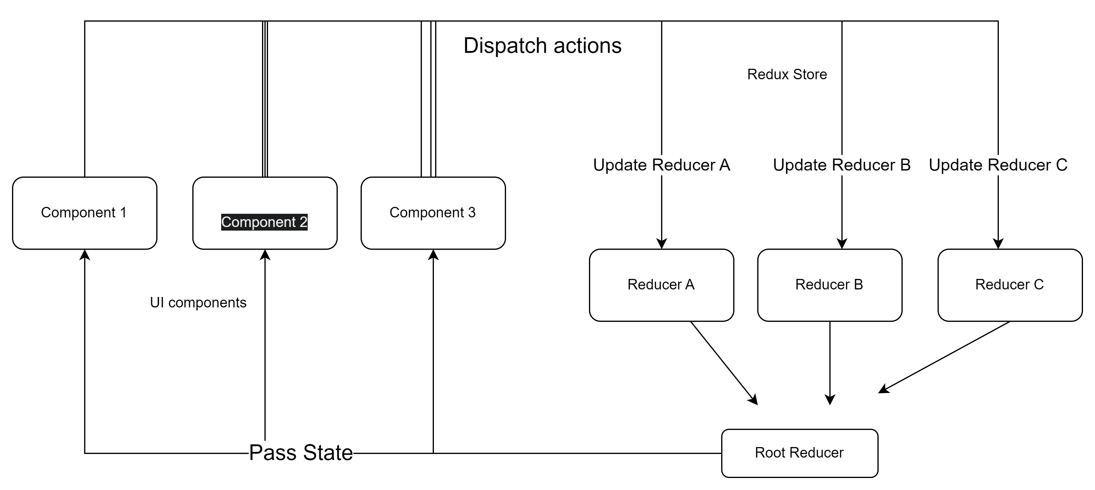

Slide 11
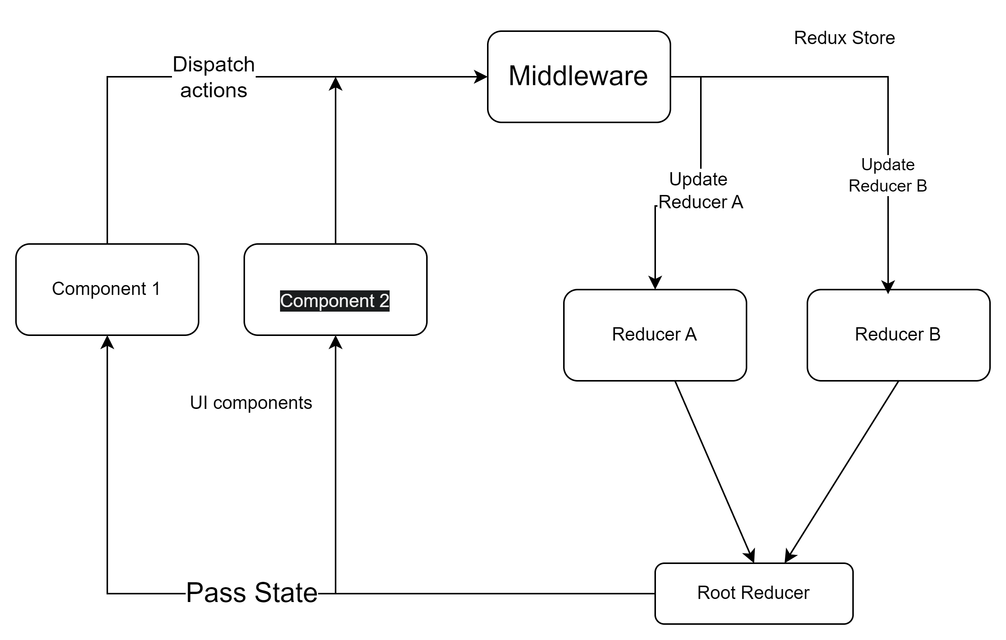

Slide 12
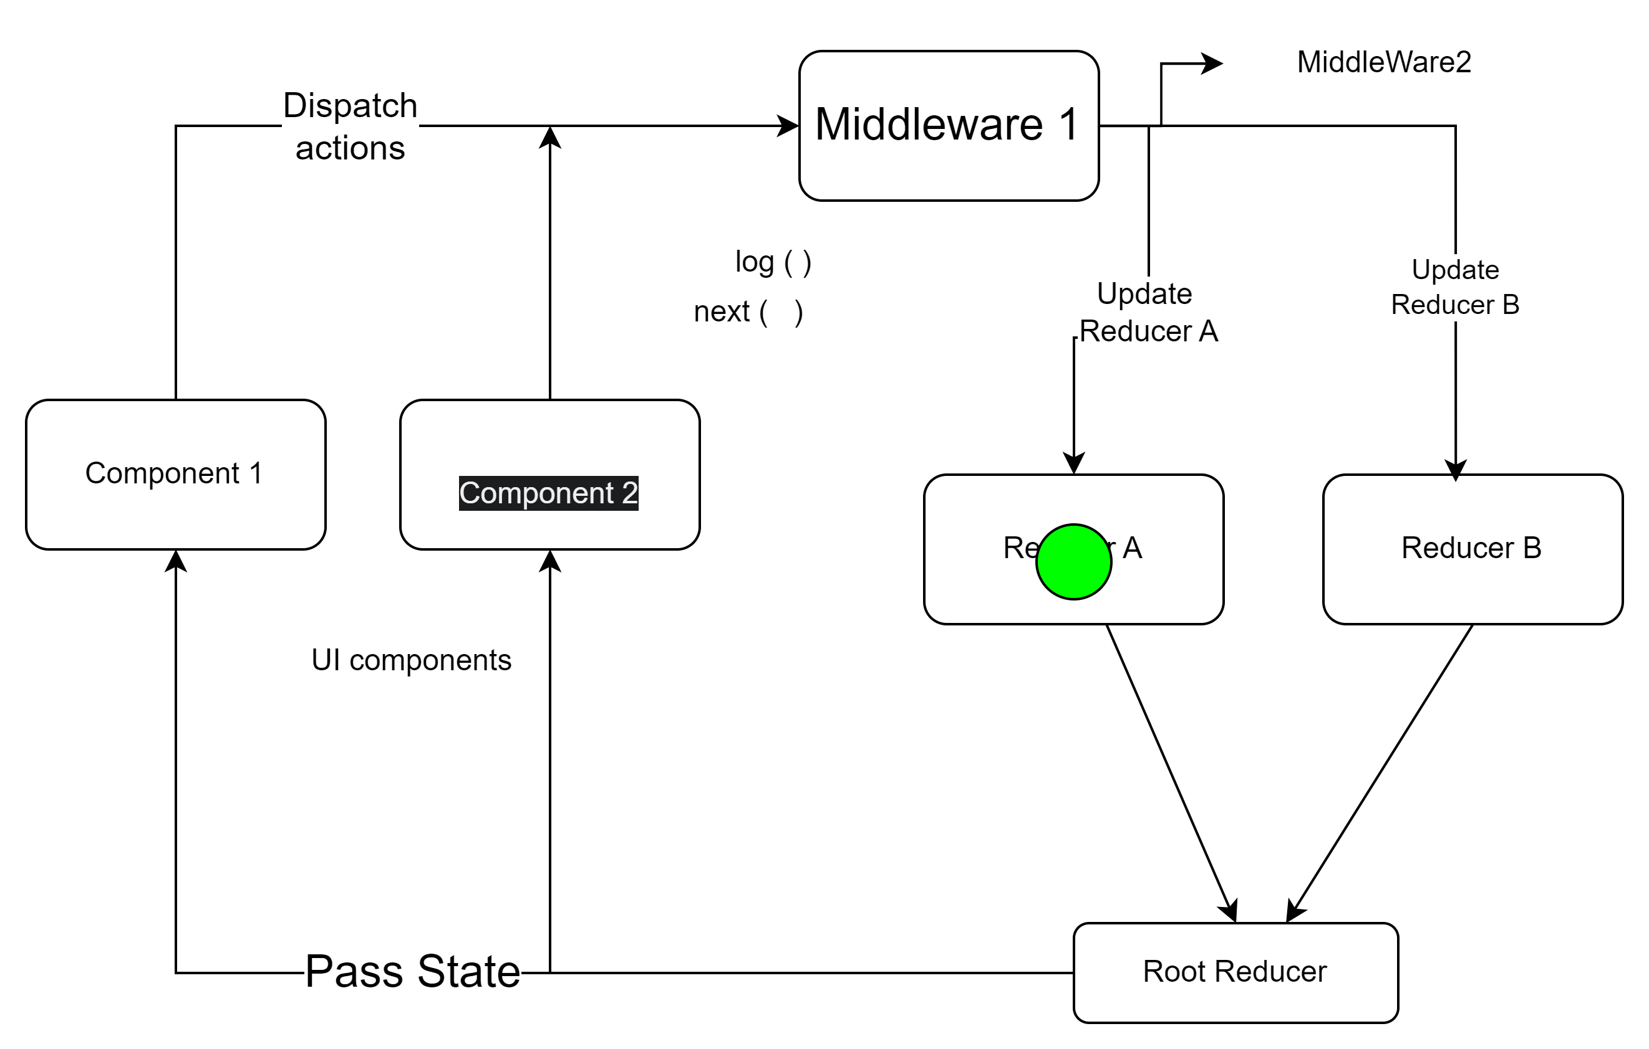

Slide 13
Middleware

