Slide 1
What is React?
React is a JavaScript library for building user interface
Developed & maintained by Facebook (Meta)

Slide 2
What is Component?
A component is a small, reusable piece of code that defines a part of a user interface.
They can be reused throughout an application, making it easier to build and maintain large, modular applications.
Components can be nested inside other components to create complex user interfaces.

Slide 3
Install node js
Vs code
Auto import
Es7

Slide 4
Components Class & Function Based
JSX In-depth Intro
Return a single root element
Close all the tags
camelCase all most of the things!
Basic Template Structure
States
Why we need States
State introduction hook ‘useState’
useState Multiple
useState Array State Value
Conditional Templates
Multiple Components & Fragments
Props In-depth Intro
Props Children
Props Drilling

Slide 5
App
Header
Task list
Footer
props
Task Card

Slide 6
Styline
Global Level Styling
Component Level Styling
Inline Level Styling
Module level Styling

Slide 7
Forms
Forms & Input
onChange Event
Controlled Inputs
onSubmit Event
addNew Task
useRef

Slide 8
JSON Server
useEffect Hook
React StrictMode
List Output
onClick Event
useCallback hook
custom hook
Loading State
Error Handling
Aborting Fetch Request
Infinite loops

Slide 9
Project1
Project Structure
Components
State tasklist & setTasklist
Function Edit & Delete
Warning Undefine Value
Update Button
Local Storage Store All Tasks
Theme Change Background

Slide 10
Github
Netlify

Slide 11
React Router
Introduction
React Router Setup
Navigation
Route Parameters
No route parameter
Nested routes
Project Restructuring

Slide 12
Tailwindcss
Responsive Design

Slide 13
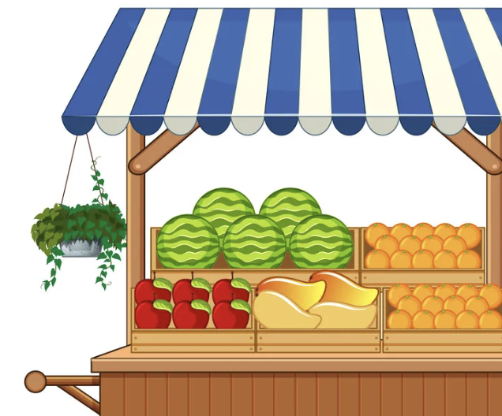

Slide 14
Project2
Cinema introduction-based application
Project Setup
Tailwind npm setup
TMDB API Documentation
UI Design (Tailwind & Flowbite)
Navigation Structure
Dark Mode Integration
Movie List Structure
API Fetch Movie List
Custom Hook useFetch
API Fetch Movie Search
Tailwind CSS Customization
PageNotFound
Individual movie information
Scroll Restoration
Dynamic Page Title

Slide 15
Shopmall
Global State Management
Context
Reducer
methods

Slide 16
Props
App.js
Props
Header.js
AllRoutes.js
Props
Home.js
Cart.js
ProductCard.js
CartCart.js

Slide 17
Context and Reducers
useContext: Global State Management
Used to save state globally so state is available globally in our application.
useReducers: Perfom Actions On Global State
Allow us to manage complex state logic
Context – an API given to us by React, allowing for the passing of information to child components without the use of props
Reducer – a pure function, accepting a state & action, and returning a new state
Action – an object literal, which describes a change to state
useContext – a react hook, allowing functional components to take advantage of the context
useReducer – a react hook, used in place of useState, generally for more complex state
Dispatch – a function returned to us by useReducer, which sends action objects to the reducer function

Slide 18
Redux
npm install react-redux@8
npm install @reduxjs/toolkit
https://redux-toolkit.js.org
Project structure
Slice & Action
Reducers Add & Remove
Redux store state

Slide 19
Code book
Project structure
Header Component
Product List
Rating Component
Filter
Individual Product Component
Dark Mode
https://github.com/typicode/json-server/issues/1550
Json-server-auth
API LoginRegister End Point
Session Storage
Toggle Dropdown(Hide)
Cart Interface
Cart context & reducers
Condition check already incart
Out of stock products
Protected routes
Checkout Modal -
npx json-server-auth db.json -r routes.json –p 8000
Order Submit Function
orderPage
dashboard
Auth service API End Points
Product service API End Points
Page Not Found
Dynamic page title
Error handling
Env file
Frontend Deployment

Slide 20
Portfolio
Project
Html+css+bootstrap
Javascript – 10+

