Slide 1
JavaScript

Slide 2
Module
Intro
Fundamentals – part 1
Fundamentals – part 2
Developer skills
Dom manipulation
How JavaScript works
Modern operators (ES6+)
Functions
Arrays
Numbers, dates, timers
Advanced dom
Object-oriented js
Mapty Project
Asynchronous js
Modern js applications
Forkify project
Deployment and GIT

Slide 3
Setting UP
VS Code

Slide 4





Fundamentals – part 1
We don’t have to worry about computer lang like memory management
JAVASCVRIPT IS A HIGH-LEVEL, OBJECT-ORIENTED,
MULTI-PARADIGM
PROGRAMMING LANGUAGE
Based on objects, for storing most kinds of data
We can use different styles of programming
Instruct computer to do things

Slide 5
The Role of JavaScript in web devewlopment
NOUNS
<p></p>
Means ‘paragraph’
CONTENT
HTML
ADJECTIVES
p{color: red}
Means ‘the paragraph text is red’
CSS
JS
Programming language budling web applications
VERBS
p.hide();
Means ‘hide’ the praragraph
PRESNTATION

Slide 6
There is nothing you can’t do with javascript
Dynamic effects and web applications in the browser
JS: Reactjs
Angluar
Vuejs
Front-end
Web application on web servers
JS: nodejs
Back-end
Native mobile applications
JS: React Native
Native desktop applications
JS: atom

Slide 7

JavaScript releases
Biggest update to the language EVER
New updates to JS every single year
ECMA Script
ES5
ES6 /
ES2015
ES7 /
ES2016
ES8 /
ES2017
ES9 /
ES2018
ES10/ES2019
ES11/ES2020
MODERN JAVASCRIPT
Learn modern JavaScript from the beginning but without forgetting the older parts!

Slide 8
Data Types

Slide 9
OBJECTS AND PRIMITIVES
VALUE
OBJECT
PRIMITIVE
let me = {
Name: ‘Ram’
}
let firstName = ‘ram’;
Let age = 30;

Slide 10
THE 7 PRIMITIVE DATA TYPES
Number: Floating point numbers → used for decimals and integers. Let age = 23;
String: Sequence of characters → used for text. let firstName = ‘Ram’;
Boolean: Logical type that can only be true or false → used for taking decisions
let fullAge = true;
Undefined: Value taken by a variable that is not yet defined (‘empty value’)
Null: Also means ‘empty value’
Symbol (ES2015): Value that is unique and cannot be changed (not useful for now)
BigInt (ES2020): Larger integers than the Number type can hold
JavaScript has dynamic typing: We do not have to manually define the data type of the value stored in a variable. Instead, data types are determined automatically.
Value has type, NOT variable!

Slide 11
LET, CONST AND VAR

Slide 12
BASIC OPERATORS

Slide 13
OPERATOR PRECEDENCE

Slide 14
Strings and Template Literals

Slide 15
Taking Decisions: if/else Statements

Slide 16
Type Conversion and Coercion

Slide 17
Truthy and Falsy Value

Slide 18
Equality Operators: = = vs = = =

Slide 19


Boolean Logic: AND, OR & NOT Operators
A AND B
A OR B
NOT A, NOT B
“Ram has a driver’s license
AND good vision
“Ram has a driver’s license
OR good vision
Inverts true/false Value
AND | TRUE | FALSE
TRUE | True | False
FALSE | False | False
OR | TRUE | FALSE
TRUE | True | True
FALSE | True | False
Example:
A: Ram has a driver’s license.
B: Ram has good vision.
True when ALL are true
Example:
A: Ram has a driver’s license.
B: Ram has good vision.
True when ONE is true.

Slide 20
Age=16
Boolean Variables
A: Age is greater or equal 20 false
B: Age is less than 30. true
Let’s use operators!
!A (false) true
A (false) AND B (true) false
A (false) OR B (true) true
!A (true) AND B(true) true
A (false) OR !B (false) false

Slide 21
Switch

Slide 22
Statements and Expressions

Slide 23
The Conditional (Ternary) Operator

Slide 24
Brief History of JavaScript
1995 – Brendan Eich – first version of JavaScript in just 10 days. It was called Mocha
1996 – Mocha changes to LiveScript and then to JavaScript, nothing to do with Java.
Microsoft launches IE, copying JavaScript from Netscape and calling it Jscript.
1997 – ECMA releases ECMAScript 1 (ES1) the first official standard for JavaScript.
2009 – ES5 (ECMAScript5) is released with lots of great new features;
2015 – ES6 /ES2015 (ECMAScript 2015) was released: the biggest update to the language ever!
Annual release cycle
2016 – cont… - ES2016/ES2017/…ES/3017

Slide 25
Don’t Break the WEB!
Old features are never removed.
Incremental updates(releases)
Website keep working forever!
1997 – 2024

Slide 26
Modern JavaScript
ES5 : Fully supported in all browsers (IE )
Ready to be used today.
ES6/ES2015 : ES6+ Well supported in all modern browsers;
No support in older browsers;
Transpiling and polyfilling
During development
Google Chrome
During production
Use of Babel to transiple and polyfil in code ( converting back to ES5 to ensure browser compatibility for all users.)

Slide 27
Learn modern JavaScript from the beginning!
But , also learn how some things used to be done before moder JavaScript. Ex: const & let , var)
3 reasons why we should not forget the Good JavaScript:
Better understand how JS actually works.
Tutorial and project code are still in ES5;
Old codebases, written in ES5;

Slide 28
Activating Strict Mode

Slide 29
Function
Function declaration, expression.
Arrow Functions

Slide 30
Functions calling other functions

Slide 31
Function declaration : Function that can be used before it’s declared.
Function expression : Essentially a function value stored in a variable.
Arrow function: Great for a quick one-line functions. Has no this keyword.
Three different ways of writing functions, but they all work in a similar way; receive input data, transform data, and then output data.

Slide 32
Function name
Parameters: placeholders to receive input values. Like local variables of a function.
Function body : block of code that we want to reuse. Processes the function’s input data
Calling, running or invoking the function, using ().
Variable to save returned.
Arguments: actual values;
Return statement to output a value from the function.

Slide 33
Array Basic Operations(Methods)

Slide 34
Objects
Dot vs. Bracket Notation
Object Methods
this

Slide 35
For Loop Looping arrays, breaking and continuing looping backwards loops in loops

Slide 36
The While Loop
Do-while loop

Slide 37
Developer skills & Editor Setup
Prettier and VSCode
File => Preferences => settings => default format
Prettier configure
Snippets
Installing Node.js and setting up a DEV Environment

Slide 38

Learning How to code
He didn’t have a clear goal at the beginning of his journey.
He started by watching courses and reading tutorials, but he would just copy and paste code without caring how it works!
He didn’t reinforce what he was learning by doing small challenges or taking notes.
He didn’t practice coding, and didn’t come up with his own project ideas.
He quickly became frustrated when his code was not perfectly clean or efficient
He lost motivation because he thought he could never know everything
He was learning in isolation.
After finishing a couple of courses, he thought he now was a web developer and could start applying to jobs. But he couldn’t even build an app on his own!

Slide 39
He didn’t have a clear goal at the beginning of his journey
He quickly became frustrated when his code was not perfectly clean or efficient
He didn’t reinforce what he was learning by doing small challenges or taking notes.
Don’t get stuck! Trying to write the perfect code!
just write tons of code, no matter the quality!
Clean and efficient code will come with time
You can always refactor code later
After we learn a new feature or concept, use it immediately.
Take notes.
Challenge yourself and practice with small coding exercises and challenges
Don’t be in a hurry to complete the course fast!
Set a specific, measurable, realistic and time-based goal
Know exactly why you are learning to code: Switching careers? Finding a better job?
Imagine a big project we want to be able to build!
Research technologies we need and then learn them.

Slide 40
He didn’t practice coding, and didn’t come up with his own project ideas.
He started by watching courses and reading tutorials, but he would just copy and paste code without caring how it works!
He lost motivation because he thought he could never know everything
Understand the code that you’re studying and typing
Always type the code. Don’t copy-paste
Embrace the fact that you will never you know everything.
Just focus on what you need to achieve your goal!
Practicing on your own is the most important thing to do..
This is NOT optional!
Come up with your own project ideas or sites or application, or just parts of them in the beginning

Slide 41
Study courses: understand code, take challenges and notes
Stay motivated: Keep writing lots of code on your own, no matter how bad
Learn with other people, devs and beginners, and share progress
Keep challenging yourself, run into lots of problems and fix them
Round up your skillset with best practices and tools
Job ready(but the learning never stops)

Slide 42
How to think like a developer: Become a problem solver!

Slide 43
How to Fail at solving problems
Whenever encounters a problem:
He Jump at the problem without much thinking
Implements solution in an unstructured way.
He get stressed out when things don’t work.
He is too proud to research solutions.
FIX
Stay clam and slow down, don’t just jump at a problem without a plan.
Take a very logical and rational approach(programming is just logic, in the end…)
4-step framework to solve any problem

Slide 44
4 steps to solve any problem
1. Make sure you 100% understand the problem. Ask the right questions to get a clear picture of the problem.
Example
Project Manger: “We need a function that reverses whatever we pass into it”
What does “whatever” even mean in this context? What should be reversed? Ans: Only strings, numbers, and arrays make sense to reverses…
What to do if something else is passed in?
What should be returned? Should it always ;be a string, or should the type be the same as passed in?
How to recognize whether the argument is a number, a string or an array?
How to reverse a number, a string and an array?

Slide 45

4 steps to solve any problem
Make sure you 100% understand the problem. Ask the right questions to get a clear picture of the problem.
Divide and conquer: break a big problem into smaller sub-problems.
Example
Project Manger: “We need a function that reverses whatever we pass into it”
2 SUB-PROBLEMS:
Check if argument is a number, a string or an array?
Implement reversing a number
Implement reversing a string
Implement reversing an array
Return reversed value
Looks like a task list that we need to implement

Slide 46
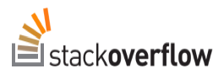

4 steps to solve any problem
Make sure you 100% understand the problem. Ask the right questions to get a clear picture of the problem.
Divide and conquer: break a big problem into smaller sub-problems.
Don’t be afraid to do as much research as you have to.
Example
Project Manger: “We need a function that reverses whatever we pass into it”
3
How to check if a value is a number in JS?
How to check if a value is a string in JS?
How to check if a value is an array in JS?
How to reverse a number in JS?
How to reverse a string in JS?
How to reverse an array in JS?

Slide 47
4 steps to solve any problem
Make sure you 100% understand the problem. Ask the right questions to get a clear picture of the problem.
Divide and conquer: break a big problem into smaller sub-problems.
Don’t be afraid to do as much research as you have to.
For bigger problem, write pseudo-code before writing the actual code
Example
Project Manger: “We need a function that reverses whatever we pass into it”
4
function reverse(value)
If value type !sting && !number && !array
Return value
If value type == string
Reverse string
If value type == number
Reverse number
If value type == array
Reverse array
Return reversed value

Slide 48
Using Google, stack overflow and MDN
Debugging(Fixing Errors)

Slide 49
What is a Software BUG?
Software bug: Defect or problem in a computer program. Basically, any unexpected or unintended behavior of a computer program is a software bug.
Bugs are completely normal in software development!
Debugging: Process of finding, fixing and preventing bugs.

Slide 50

The DEBUGGING PROCESS
IDENTIFY
FIX
PREVENT
FIND
Isolating where exactly the bug is happening in code
Correct the bug
Becoming aware that there is a bug
Preventing it from happening again
Developer console (simple code)
Debugger (complex code)
Replace wrong solution with new correct solution
Searching for the same bug in similar code.
Writing tests using testing software.
During development
Testing software
User reports during production
Context: browsers, users, etc.

Slide 51
Debugging with the console and breakpoints

Slide 52






PROJECT 1
Guess Number

Slide 53
What is DOM?
DOCUMENT OBJECT MODEL: structured representation of HTML documents, allows JavaScript to access HTML elements and styles to manipulate them.
-change text, html attribute, and even CSS styles

Slide 54
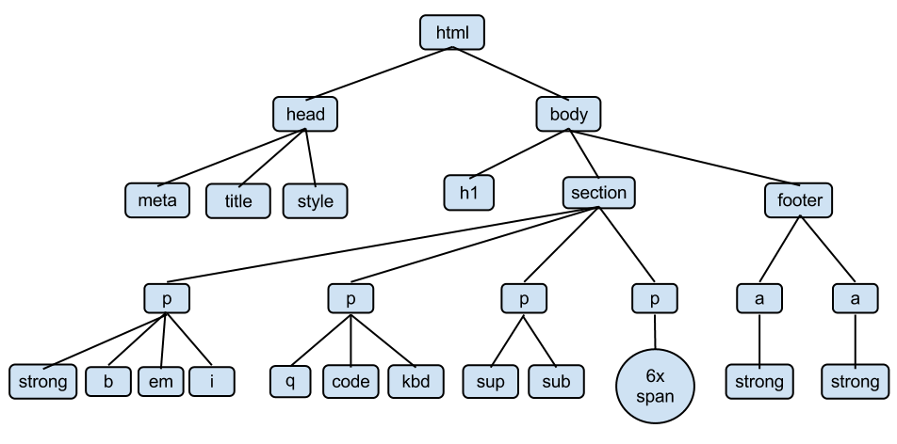

Special object that is the entry point to the DOM. Example:
Document.querySelector()
<html>
<head>
<title>A simple Page</title>
</head>
<body>
<section>
<p> A paragraph with <a> <link> </a> </p>
<p>A second paragraph</p>
</section>
<section>
<img src=“don.png”alt=”The DOM/>
</section>
</body>
</html>

Slide 55
Selecting and Manipulating Elements
Handling Click Events
Manipulating CSS styles
High scores implementing
Refactoring our code: the DRY principle

Slide 56
Modal Window
Working with classes
Handling an ‘esc’ keypress event

Slide 57
DOM and Events Fundamentals
PIG Game

Slide 58
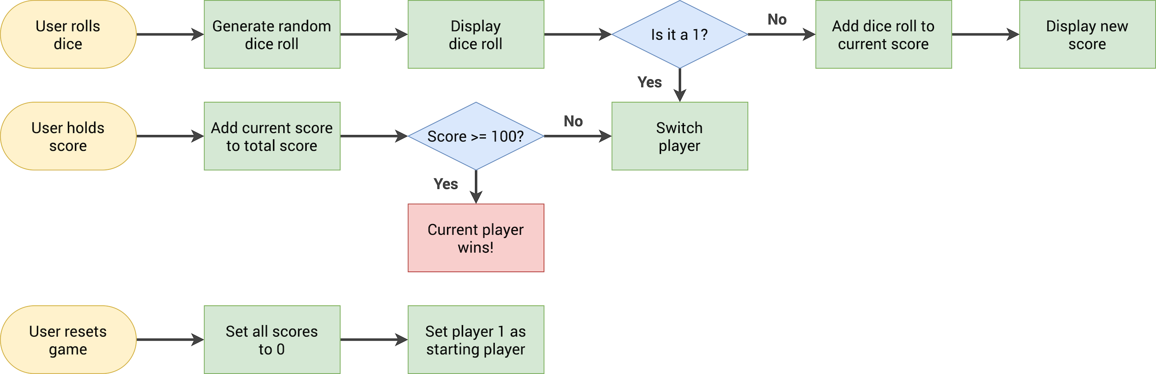

Slide 59
Rolling the dice
Switching the active player

Slide 60
JS works behind the scenes.

Slide 61
An High-level overview of JS
JS: Js is a high-level, object-oriented, multi-paradigm programming language.

Slide 62
An High-level overview of JS
JS: Js is a high-level, object-oriented, multi-paradigm programming language.
JS is a
HIGH-LEVEL
PROTOTYPE-BASED
OBJECT-ORIENTED
MULTI-PARADIGM
INTERPRETED OR JUST-IN-TIME COMPILED
DYNAMIC
SINGLE-THREDED
GARBAGE-COLLECTED
PROGRAMMING LANGUAGE WITH
FIRST-CLASS FUNTIONS
AND NON-BLOCKING EVENT LOOP CONCRRENCY MODEL.

Slide 63
High-level – Garbage-collected – Interpreted or just-in-time compiled – Multi-paradigm – Prototype-based object-oriented First-class functions Dynamic Single-threaded Non-blocking
C (Low Level Language: developer has to manage resources manually)
Python, JS (Developer does NOT have to worry, everything happens automatically)
cleaning the memory so we don’t have to use.
covert to machine code.
Paradigm. An approach and mindset of structuring code, which will direct your coding style and technique.
Procedural programming
Object-oriented programming (OOP)
Function programming (FP)
Inherits methods from prototype.
Array.protype.push
Arr.push()
In a language with first-class functions, functions are simply treated as variables. We can pass them into other functions, and return them from functions.
const modal = () =>{console.log(‘hello’)}
Button.addEventListner(‘click’,modal);
*Passing a function into another function as an argument: First class functions!
No data type definitions. Types becomes known at runtime.
Data type of variable is automatically changed.
Concurrency Model: JS engine handles multiple tasks happing at the same time.
JS runs in one single thread, so it can only do one thing at a time.
*it would block the single thread but we want non-blocking behavior!
By using an event loop takes long running tasks, executes them in the “background” and puts them back in the main thread once they are finished.

Slide 64


Object in memory
Where objects are stored
Scoping in Practice
Execution context
Where our code is executed
Call Stack
Heap

Slide 65
Compilation : Entire code is converted in machine code at once, and written to a binary file that can be executed by a computer.
Interpretation: Interpreter runs through the source code and executes it line by line.
Just-in-time compilation: Entire code is converted into machine code at once, then executed immediately.
Source code
Portable file:
Machine code
Program running

Slide 66
Hoisting and TDZ

Slide 67
The THIS keyword
This keyworde: Special variable that is created for every execution context. Takes the value of the “owner” of the function in which the this keyword is used.
This is not static. It depends on how the function is called, and its value is only assigned when the function is actually called
Method ==> this ➔<Object that is calling the method)
Simple function call ➔ this = undefined
Arrow functions ➔ this = <this of surrounding function (lexical this)>
Event listerner ➔ this = <DOM element that the handler is attached to>

Slide 68
Regular Functions vs Arrow Function
Primitive's vs objects (Primitives vs reference type)

Slide 69


Objects
Object literal
Arrays
Functions
Many more…
Primitives
Numbers
Strings
Boolean
Undefined
Null
Symbol
bigInt
Reference types
Primitive types
CallStack
HEAP

Slide 70
Data Structures, Modern Operators and Strings
Destructing Arrays
Destructing Objects
Short circuiting (&& and ||)
Nullish operator
Logical assignment operators
Looping Arrays: The For-of loop
Enhanced object Literals
Optional chaining (.?)
Looping objects: object keys, values and entries
SETS
Maps: Fundamentals
Maps: Iteration

Slide 71
Sources of Data
From the program itself: Data written directly in source code (e.g. status message)
From the UI: Data input from the user or data written in DOM (e.g. tasks in todo app)
From external Sources: Data fetched from example from web API(Application Programming Interface)e.g. recipe objects (JSON data format example)
OTHER BUILT-IN:
WeakMap
WeakSet
Non-Built IN:
Stacks
Queues
Linked Lists
Trees
Hash tables
Collection of Data
DATA structure
Simple List
Key/Value List (Keys allow us to describe values)
Arrays or Sets
Objects or Maps

Slide 72
Arrays vs Sets
Use when you need ordered list of values (might contain duplicates)
Use when you need to work with unique values.
Use when you need to manipulate data.
Use when high-performance is really important
Use to remove duplicates from arrays.

Slide 73
Objects vs Maps
More ”traditional” key/value store.
Easier to write and access values with . And [].
Use when you need to include functions (methods)
Use when working with JSON(can convert to map)
Better performance.
Keys can have any data type.
Easy to iterate.
Easy to compute size.
Use when you simply need to map key to values.
Use when you need keys that are not strings.

Slide 74
Working with Strings Part – 1 Part – 2 Part – 3

Slide 75
A closer look at function How Passing Arguments works: Value vs Reference First-class and Higher-order functions

Slide 76
First-class and Higher-order functions
First-Class Functions
JavaScript treats functions as first-class citizens
This means that functions are simply values
Functions are just another ‘type” of object
Store functions in variables or properties:
const add = (a,b) ➔ a + b;
const counter ={
value:23,
Inc: function() {this.value++;}
Pass functions as arguments to OTHER functions:
const greet = () ➔ console.log(‘Hello Ram’);
btnClose.addEventListener(‘click’,greet);
Return functions FROM functions
Call methods on functions:
Counter.inc.bind(someOtherObject);
Higher-Order Functions
A function that receives another function as an argument, that returns a new function, or both.
This is only possible because of first-class functions
Function that receives another function
const greet = () ➔ console.log(‘Hello ram’);
btnClose.addEventListerner(‘click’,greet)
2. Function that returns new function
Function count(){
Let counter = 0;
return function (){
counter++;
};
}
Higher-order function
Callback function
Higher-order function
Returned function

Slide 77
Functions accepting callback functions Functions returning functions The Call and Apply Methods The BIND Method – return a new function Challenge 1 IIFE(Immediately Invoked Function Expressions Closures

Slide 78

const secureBooking = function(){ let passengerCount = 0; return function () { passengerCount++; console.log(`${passengerCount} passengers`); } } const booker = secureBooking(); booker(); booker(); booker();
passengerCount = 0
Secure booking = <f>
Booker = <f>
Closure
passengerCount = 0
Booker() - empty
Call Stack

Slide 79
A function has access to the variable environment (VE) of the execution context in which it was created. Closure: VE attached to the function, exactly as it was at the time and place the function was created.

Slide 80





A closure is the closed-over variable environment of the execution context in which a function was created, even after that execution context is gone;
A closure makes sure that a function doesn’t loose connection to variables that existed at the function’s birth place;
A closure is like a backpack that a function carries around wherever it goes. This backpack has all the variables that were present in the environment where the function was created.
Function Connection Parent scope. variables
Function closure. variablee

Slide 81
Intro what is Nodejs? JS Arrow function Arrays & method Object property method primitive vs refer destructing async & Promises template Literals

