Slide 1

OPERATION ANALYTICS AND INVESTIGATING METRIC SPIKE
PROJECT:-

Slide 2
ABOUT PROJECT
This project focuses on analyzing the data given to us in the dashboard. I have provided 2 different Case Studies with some datasets attached and I have to answer all those questions by running SQL Queries which are required by the operation team, marketing team, etc to predict the overall growth and decline of the company’s wealth. And give insights to improve on weak areas by improving productivity, better automation, effective workflow, etc.
In Case Study-1 job_data table is given while in Case Study-2 users, events, and email_events table is given.
In Case Study 1 the insights are found based on:
1. Number of jobs reviewed: Amount of jobs reviewed over time.
2. Throughput: Calculate 7-day rolling average of throughput? For throughput, do you prefer daily metric or 7-day rolling and why?
3. Percentage share of each language: Share of each language for different contents.
4. Duplicate rows: Rows that have the same value present in them.
In Case Study 2 the insights are found based on:
1. User Engagement: To measure the activeness of a user. Measuring if the user finds quality in a product/service.
2. User Growth: Amount of users growing over time for a product.
3. Weekly Retention: Users getting retained weekly after signing
4. Weekly Engagement: To measure the activeness of a user. Measuring if the user finds quality in a product/service weekly.
5. Email Engagement: Users engage with the email service.

Slide 3
Project Approach
This project is developed using MYSQL Workbench. First, I need to create database by using the dataset-1 table which was
Given in the dashboard. Next, I will analyze and find the information that will help operation, marketing team, etc to comprehend questions like - Why is there a dip in daily engagement? Why sales is down? etc
Questions like these must be answered and for that, it’s necessary to investigate metric spike.
Tech-Stack Used- MYSQL WORKBENCH 8.0
MY SQL is a visual editor software that unifies data modeling, SQL development, and database administration in one interface. It allows us to visualize, generate and manage data.
It is used to handle structured data. It is an open-source RDBMS that used SQL to interact with databases.
In MYSQL workbench we can easily move data to and from the SQL server also.

Slide 4
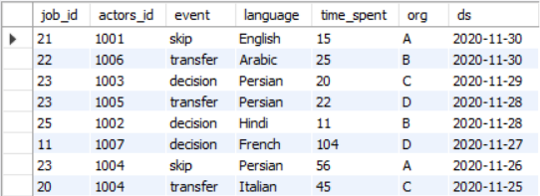
Case Study 1 (Job Data)

Slide 5
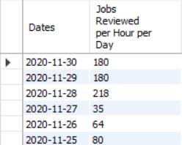
A. Number of jobs reviewed: Amount of jobs reviewed over time. Task: Calculate the number of jobs reviewed per hour per day for November 2020?
Query :-
SELECT ds AS Dates, ROUND((Count(job_id)/SUM(time_spent))*3600)AS "Jobs Reviewed
per Hour per Day“
FROM job_data
WHERE ds BETWEEN '2020-11-01' and '2020-11-30’
GROUP BY ds;
Output:-

Slide 6

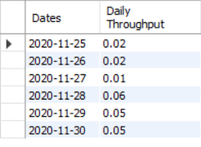
B. Throughput: It is the no. of events happening per second. Task: Let’s say the above metric is called throughput. Calculate 7-day rolling average of throughput? For throughput, do you prefer daily metric or 7-day rolling and why?
Query:-
SELECT ROUND(COUNT(event)/SUM(time_spent), 2) AS "Weekly Throughput“
FROM job_data;
Output:-
The weekly throughput is 0.03
Query:-
SELECT ds AS Dates, ROUND(COUNT(event)/SUM(time_spent), 2) AS "Daily Throughput“
FROM job_data
group by ds
order by ds;
Output:-
Metrics will always go up and down on a weekly and daily basis.
As a result rolling metrics are superb at showing if your metrics are trending up or down on a daily level.

Slide 7
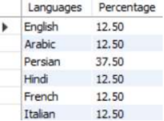
C. Percentage share of each language: Share of each language for different contents.
Task: Calculate the percentage share of each language in the last 30 days?
Query:-
SELECT language As Languages, ROUND(100*COUNT(*)/total,2) As Percentage
from job_data
CROSS JOIN (SELECT COUNT(*) AS total FROM job_data) sub
GROUP BY language;
Output:-
Persian language is the highest with 37.5% total.

Slide 8

Query:-
SELECT actors_id, Count(*) As Duplicates
FROM job_data
GROUP BY actors_id
HAVING COUNT(*) > 1;
D. Duplicate rows: Rows that have the same value present in them. Task: Let’s say you see some duplicate rows in the data. How will you display duplicates from the table?
Output:-

Slide 9
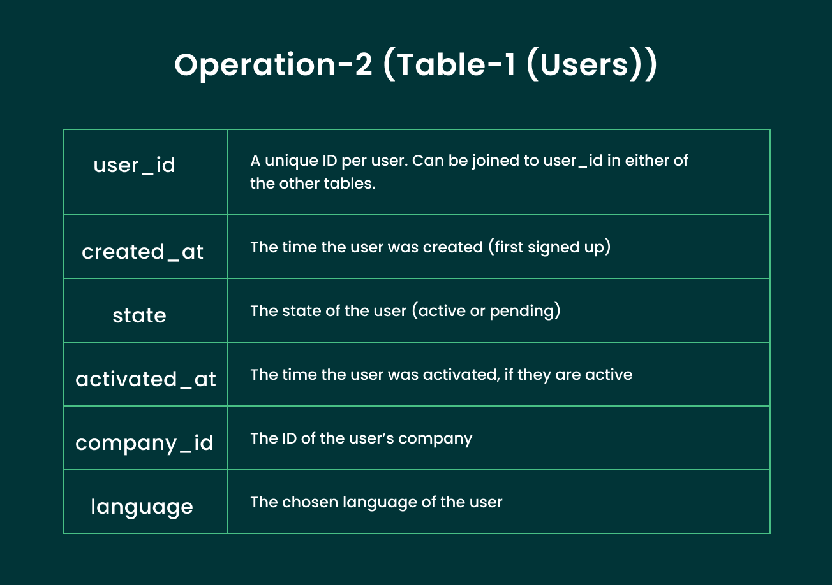
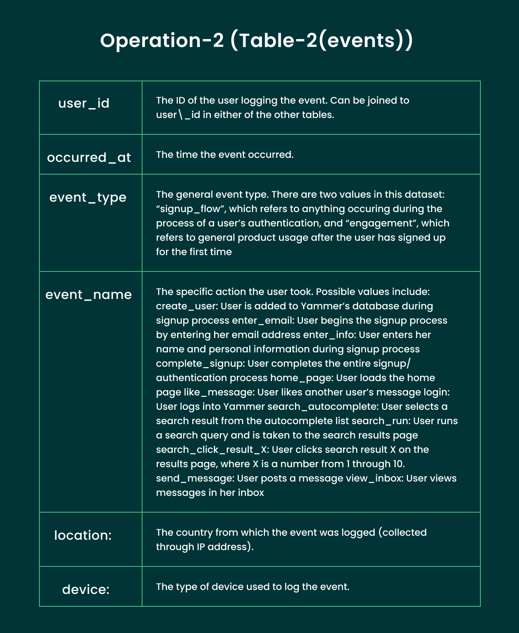
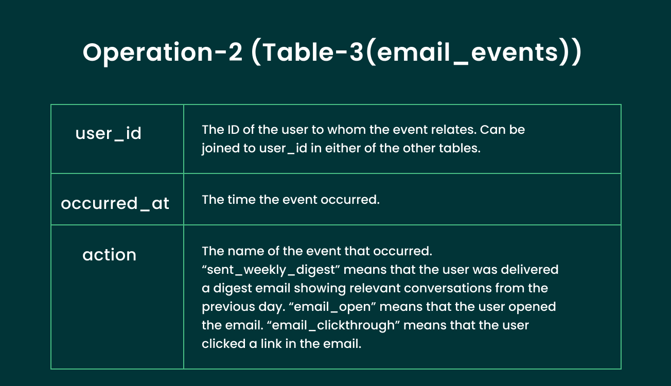
Case Study 2 (Investigating metric spike)

Slide 10
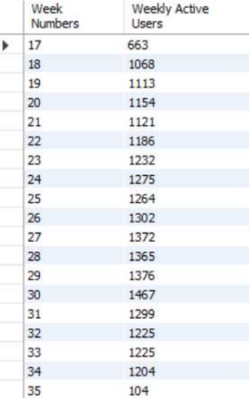
User Engagement: To measure the activeness of a user. Measuring if the user finds quality in a product/service. Task: Calculate the weekly user engagement?
Query:-
Select Extract(Week from occurred_at) AS “Week Numbers”, Count(Distinct
user_id) AS "Weekly Active Users"
FROM events
WHERE event_type = 'engagement'
GROUP BY 1;
Output:-

Slide 11
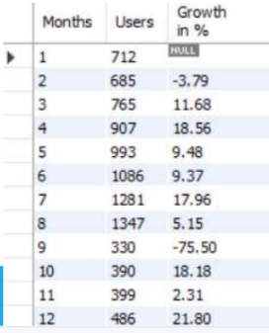
B. User Growth: Amount of users growing over time for a product. Task: Calculate the user growth for product?
Query:-
Select Months, Users, ROUND(((Users/LAG(Users, 1) OVER (ORDER BY Months) - 1)*100),2) AS"GROWTH in %“
From(Select EXTRACT( Month From created_at) AS Months, COUNT(activated_at) AS Users
From Users
WHERE activated_at NOT IN ("")
GROUP BY 1
ORDER BY 1 ) sub;
Output:-

Slide 12
C. Weekly Retention: Users getting retained weekly after signing-up for a product. Task: Calculate the weekly retention of users-sign up cohort?
Query:-
Select first AS “WEEK NUMBERS”,
SUM(CASE WHEN week_number = 0 THEN 1 Else 0 END) AS “WEEK 0”
SUM(CASE WHEN week_number = 1 THEN 1 Else 0 END) AS “WEEK 1”
SUM(CASE WHEN week_number = 2 THEN 1 Else 0 END) AS “WEEK 2”
SUM(CASE WHEN week_number = 3 THEN 1 Else 0 END) AS “WEEK 3”
SUM(CASE WHEN week_number = 4 THEN 1 Else 0 END) AS “WEEK 4”
SUM(CASE WHEN week_number = 5 THEN 1 Else 0 END) AS “WEEK 5”
SUM(CASE WHEN week_number = 6 THEN 1 Else 0 END) AS “WEEK 6”
SUM(CASE WHEN week_number = 7 THEN 1 Else 0 END) AS “WEEK 7”
SUM(CASE WHEN week_number = 8 THEN 1 Else 0 END) AS “WEEK 8”
SUM(CASE WHEN week_number = 9 THEN 1 Else 0 END) AS “WEEK 9”
SUM(CASE WHEN week_number = 10 THEN 1 Else 0 END) AS “WEEK 10”
SUM(CASE WHEN week_number = 11 THEN 1 Else 0 END) AS “WEEK 11”
SUM(CASE WHEN week_number = 12 THEN 1 Else 0 END) AS “WEEK 12”
SUM(CASE WHEN week_number = 13 THEN 1 Else 0 END) AS “WEEK 13”
SUM(CASE WHEN week_number = 14 THEN 1 Else 0 END) AS “WEEK 14”
SUM(CASE WHEN week_number = 15 THEN 1 Else 0 END) AS “WEEK 15”
SUM(CASE WHEN week_number = 16 THEN 1 Else 0 END) AS “WEEK 16”
SUM(CASE WHEN week_number = 17 THEN 1 Else 0 END) AS “WEEK 17”
SUM(CASE WHEN week_number = 18 THEN 1 Else 0 END) AS “WEEK 18”
FROM
(
SELECT m.user_id, m.login_week, n.first, m.login_week, n.first, m.login_week- first AS week number
FROM
(SELECT user_id, EXTRACT(WEEK FROM occurred_at) AS login_week from events
GROUP BY 1, 2) m,
(SELECT user_id, MIN(EXTRACT (WEEK FROM occurred_at) AS first from events
GROUP BY 1) n
WHERE m.user_id = n.user_id
) sub
GROUP BY first
ORDER BY first;

Slide 13
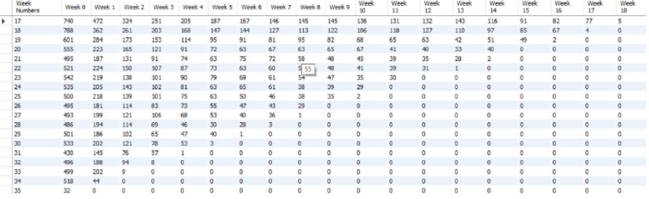
Output:-

Slide 14
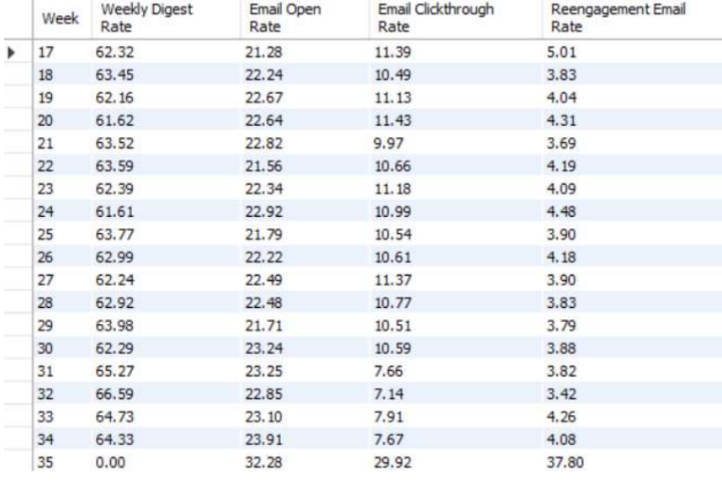
E. Email Engagement: Users engaging with the email service. Task: Calculate the email engagement metrics?
Query:-
SELECT Week,
ROUND((weekly_digest/total*100),2) AS "Weekly Digest Rate",
ROUND((email_opens/total*100),2) AS "Email Open Rate",
ROUND((email_clickthroughs/total*100),2) AS "Email Clickthrough Rate",
ROUND((reengagement_emails/total*100),2) AS "Reengagement Email Rate"
FROM
(
SELECT EXTRACT(WEEK FROM occurred_at) AS WEEK,
COUNT(CASE WHEN action = 'sent_weekly_digest’ THEN user_id ELSE NULL END ) AS
weekly_digest,
COUNT(CASE WHEN action = 'email_open’ THEN user_id ELSE NULL END ) AS
email_opens,
COUNT(CASE WHEN action = 'email_clickthrough’ THEN user_id ELSE NULL END ) AS
email_clickthroughs,
COUNT(CASE WHEN action = 'sent_reengagement_email’ THEN user_id ELSE NULL END )
AS reengagement_emails,
COUNT(user_id) AS total
FROM email_events
GROUP BY 1
) sub
GROUP BY 1
ORDER BY 1;

Slide 15

Result
How this project helped me:-
-This project helped me understand the importance of performance analytics. -From this work, I can understand how companies use metric spike as a secret weapon. -With knowledge and experience, they can use these leverage insights to identify returns that optimize their strategies
and increase ROI.
Challenges that I faced in this project:-
The big problem was using Case Study 2 dataset because its data is huge and importing it into MY SQL Workbench is time-consuming.
So, I used the LOAD DATA statement to solve this problem.
Conclusion:-
Operational analytics solves the problem by synchronizing data in real-time. It has the ability to aggregate data from multiple sources into a unified, streamlined, and actionable solution that delivers real-time analytical models to create quality insights into customer profiles and company performance. This ensures that your routines and systems are efficient. When used correctly, performance appraisals can benefit our citizens and the world at large, and improve performance everywhere.

