Slide 1

Forest Conservation Using Chainsaw Detection And Forest Fire Prediction
By IoT Embed Group
Abhinav Dudeja
21111001
Arpan Kapoor
21111016
Manish Kumar
21111037
Piyush Gangle
21111046

Slide 2
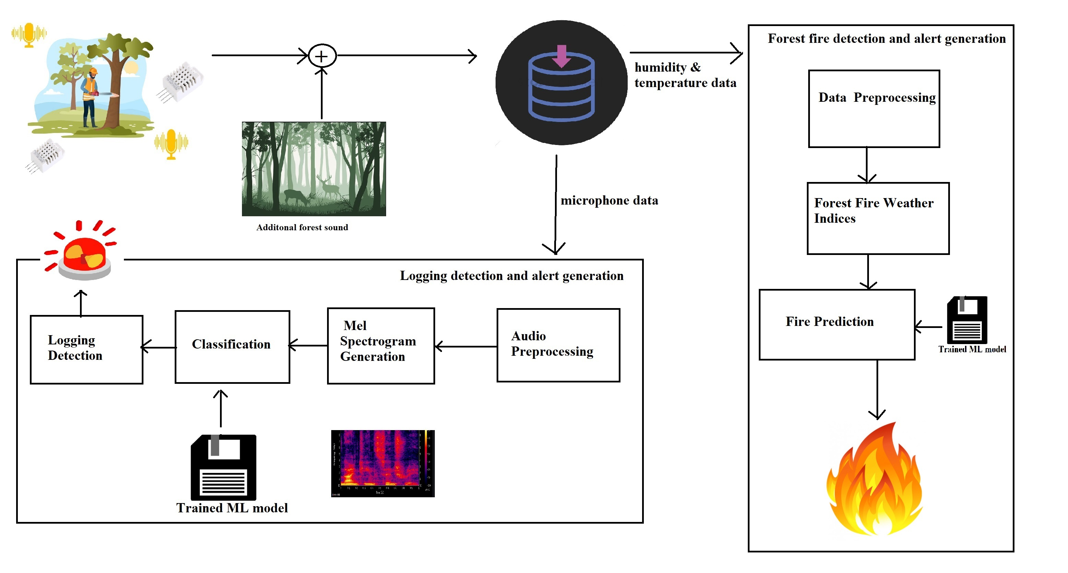

Slide 3
Literature Survey

Slide 4
Forest Fire Prediction
Literature Survey
GIS based modelling of forest fire prone areas – This system uses satellite imaging to gather geographical data(slope, curvature, distance to settlement, distance to road, etc) to find the areas that are most susceptible to fires.
Forest fire prediction model using atmospheric data – This system uses SVM model to predict forest fires using weather data(temperature, humidity, rainfall, etc).
Our Approach
Use of Weather data – Temperature, humidity, wind-speed, rainfall.
Use of FWI system – This system uses 6 forest fire weather indices to calculate the risk of forest fire. These indices are calculated using past day's data.

Slide 5
Comparison
Forest fire prediction – We have used an approach where we give importance to past days' data and cost effectiveness.
Attributes | Weather Data | Forest Fire Indices | Satellite Imaging
Paper 1 | ✓ | ✕ | ✓
Paper 2 | ✓ | ✕ | ✕
Our approach | ✓ | ✓ | ✕
1. GIS-based forest fire susceptibility modeling in Pauri Garhwal, India
2. Artificial intelligence for forest fire prediction

Slide 6
Deforestation Detection
Literature Survey
Use of 10 meters spatial resolution Sentinal-1 and Sentinal-2 images, detect deforestation with the help of ML models MLP, LSTM
Chainsaw detection using temporal and frequency domain features like MFCC with traditional ML models like GMM, K means clustering.
Threshold value based detection using gyro sensor and microphone.
Our Approach
Chainsaw detection using mel spectrogram based audio classification using CNN
Use of cheap sound sensor, i.e. cost effective approach

Slide 7
Comparison
 | Machine Learning/Deep Learning | Sensor used | Temporal features | Spectral features
Paper 1 | None | Gyro sensor
Paper 2 | ML | Microphone |  | MFCC
Paper 3 | GMM, K-means | Microphone | Min peak, ZCR, RMSE, Std Dev | Spectral centroid, rolloff, flux
Paper 4 | SGBC | Microphone |  | Modified MFCC
Our Approach | CNN | Microphone |  | Mel spectrogram
1. Multiple Sensor on Clustering Wireless Sensor Network to Tackle Illegal Cutting​
2. Illegal Logging Detection Based on Acoustic Surveillance of Forest​
3. Automatic detection of tree cutting in forests using acoustic properties
4. Acoustic Signal Classification for Deforestation Monitoring: Tree Cutting Problem

Slide 8
Methodology

Slide 9
Forest Fire Prediction
Used forest fire data from UCI datasets.
Atmospheric data (Temperature, Humidity, Wind Speed)
These data points give the current atmospheric conditions.
Forest fire weather indices (FFMC, DMC, DC, ISI, BUI, FWI)
These indices are calculated using previous days data thus providing for a better prediction.
ML model used is Non-Linear SVM(kernel = poly, degree = 2)
Validation set accuracy of +90%

Slide 10
Forest Fire Weather Indices
The startup of the Forest fire weather system takes place when the temperature goes above 12°C for consecutively three days. Initially FFMC = 85, DMC = 6, DC = 15
FFMC (Fine Fuel Moisture Code) - rating of the moisture content of litter and fine fuels.
DMC (Duff Moisture Code) - rating of the moisture content of medium sized fuel (branches and small sticks).
DC (Drought Code) - rating of the moisture content of large sized fuel (logs).
ISI (Initial Spread Index) - rating of the expected rate of fire spread.
BUI (Build Up Index) - rating of the total amount of fuel available for combustion.
FWI (Fire Weather Index) - rating of fire intensity.

Slide 11
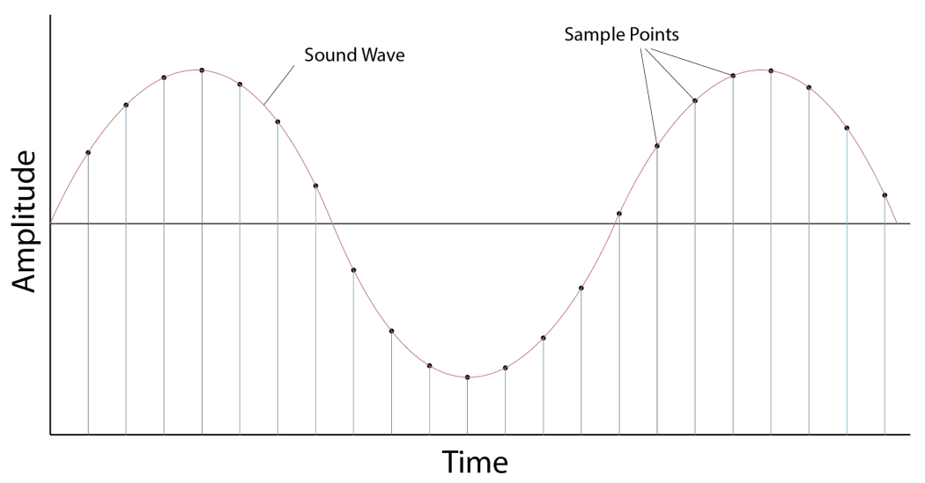
Chainsaw detection
Dataset: Google Research AudioSet
431 audio samples of chainsaw
1486 audio samples of rain, thunderstorm, wind and wild animals
10 second strongly labelled samples of YouTube videos
Downloaded using youtube-dl, python and ffmpeg
Audio samples loaded into python using librosa at a sample rate of 22050Hz
Image Source

Slide 12
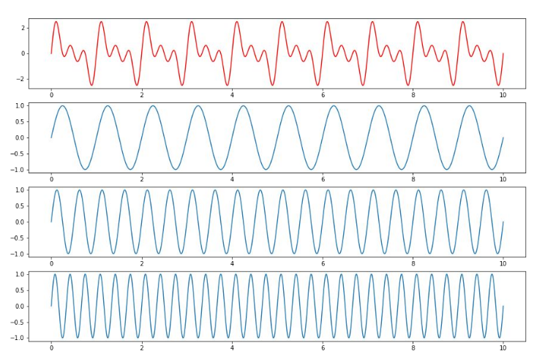
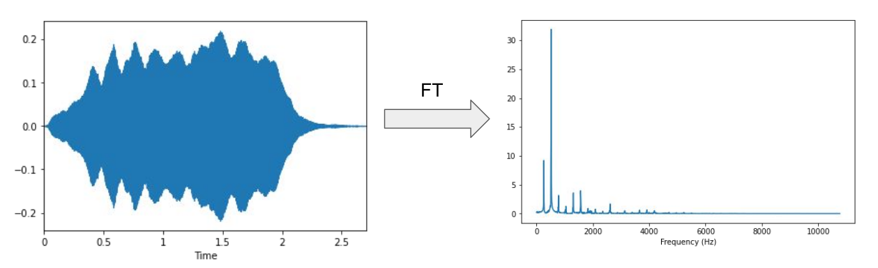
Fourier Transform
Find the frequency components of a signal
Image Source

Slide 13
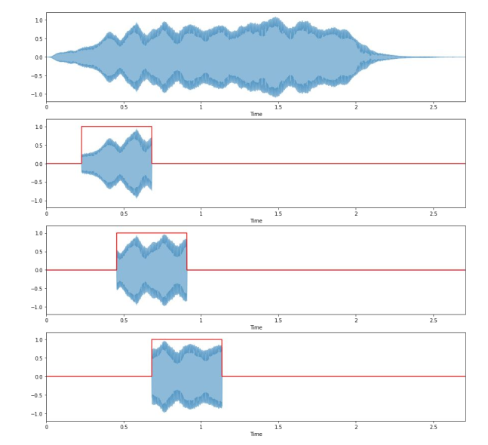
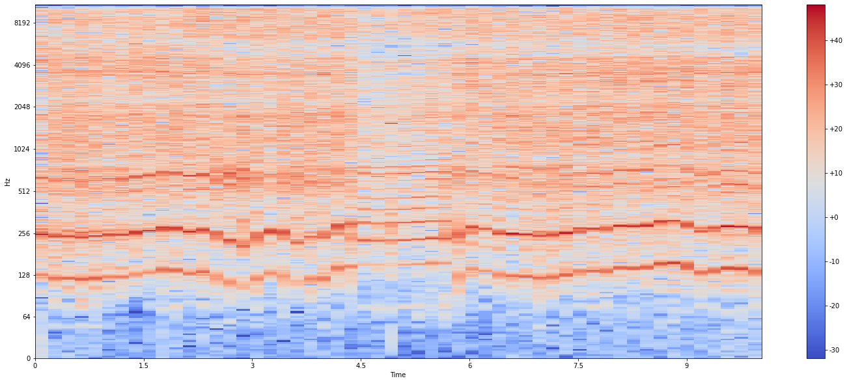
Short-time FT
Divide signal into short frames and apply FT on the frames to get the spectrogram
Visually represent a signal’s frequency components as it varies over time
Image Source

Slide 14
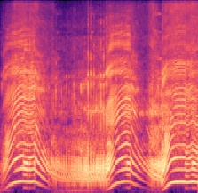
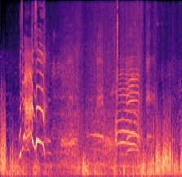
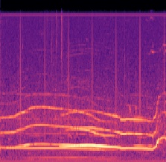
Mel spectrogram
Mel scale: perceptually informed frequency scale
Humans perceive frequency logarithmically
Convert frequency to mel scale in a spectrogram to get a mel spectrogram
Melspectrogram of a 6 second chainsaw audio signal
Melspectrogram of a 10 second wind audio signal
Melspectrogram of a 10 second howl of a wolf

Slide 15
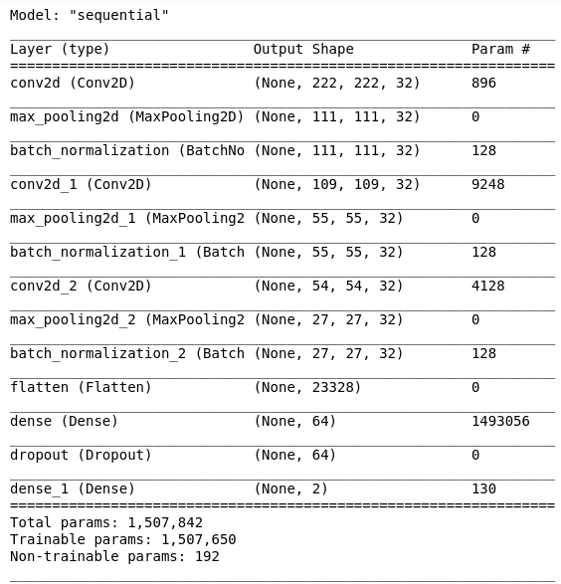
Model
Audio data converted to mel spectrogram images using librosa+matplotlib
Dataset divided into 80% training and 20% validation set
Binary image classification using CNN into 2 classes: Chainsaw and Others
3 Convolution+Pooling layers
Library used: tensorflow+keras
91% accuracy with 88% validation set accuracy

Slide 16

Forest Fire Prediction DEMO

Slide 17

Chainsaw Detection Demo

Slide 18
Contributions
 | Forest Fire Prediction | Chainsaw Sound Detection | Presentation | Report | Literature Survey | Percentage Contribution
Abhinav Dudeja | ✓ | ✕ | ✓ | ✓ | ✓ | 25%
Arpan Kapoor | ✕ | ✓ | ✓ | ✓ | ✓ | 25%
Manish Kumar | ✓ | ✓ | ✓ | ✓ | ✓ | 25%
Piyush Gangle | ✕ | ✓ | ✓ | ✓ | ✓ | 25%

Slide 19
References
Automatic detection of tree cutting in forests using acoustic properties
https://cwfis.cfs.nrcan.gc.ca/background/summary/fwi
GIS-based forest fire susceptibility modeling in Pauri Garhwal, India
Acoustic Signal Classification for Deforestation Monitoring: Tree Cutting Problem
3Blue1Brown – But what is the Fourier Transform?
Remote Sensing Approaches for Deforestation Identification in Ukraine
Illegal Logging Detection Based on Acoustic Surveillance of Forest
Multiple Sensor on Clustering Wireless Sensor Network to Tackle Illegal Cutting
9. Artificial intelligence for forest fire prediction

Slide 20
Thank You!

