Slide 1


End-to-End Business Analysis: Sales, Profitability & Trends 2023

Slide 2

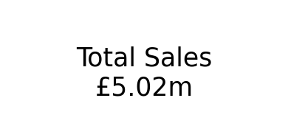

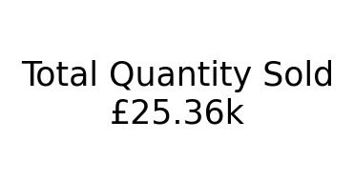

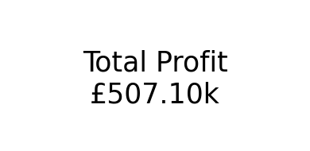
KPI → Sales, Quantity, And Profit

Slide 3
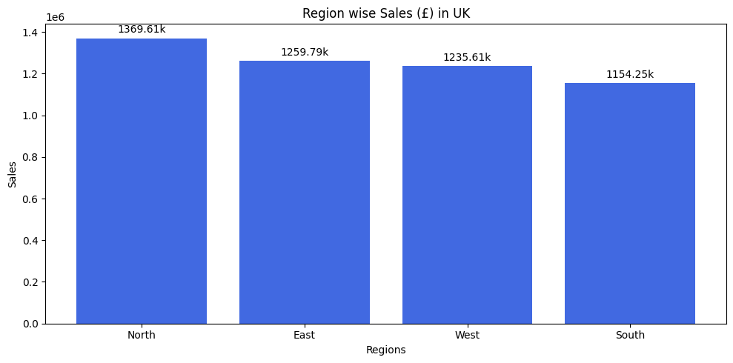
Region-wise Sales (£) in UK
Regional Sales Distribution The analysis reveals the North UK as the leading sales region (£1.37M), showing strong market demand and effective sales strategies.
East (£1.26M) and West (£1.23M) closely follow, indicating balanced performance across these regions.
South (£1.15M) records the lowest sales, highlighting a potential area for growth through targeted campaigns or localised promotions.
This regional breakdown helps identify high-performing markets and where focused efforts can boost sales penetration.

Slide 4
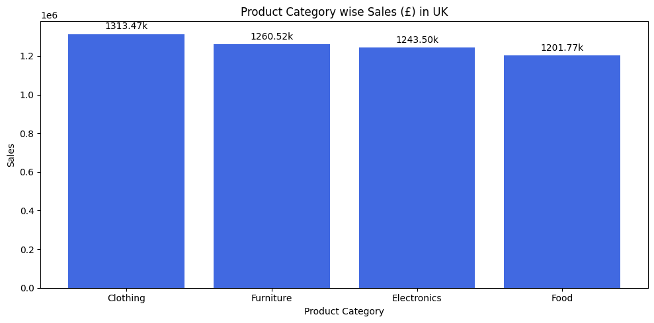
Sales BY Product Category (£) in UK
Sales Distribution by Product Category The sales analysis highlights that Clothing leads all categories (£1.31M), suggesting strong consumer demand and seasonal trends driving purchases.
Furniture (£1.26M) and Electronics (£1.24M) show closely competitive performance, reflecting steady household and tech-related spending.
Food (£1.20M), while slightly lower, remains a core contributor, emphasising its consistent role in everyday essentials.

Slide 5
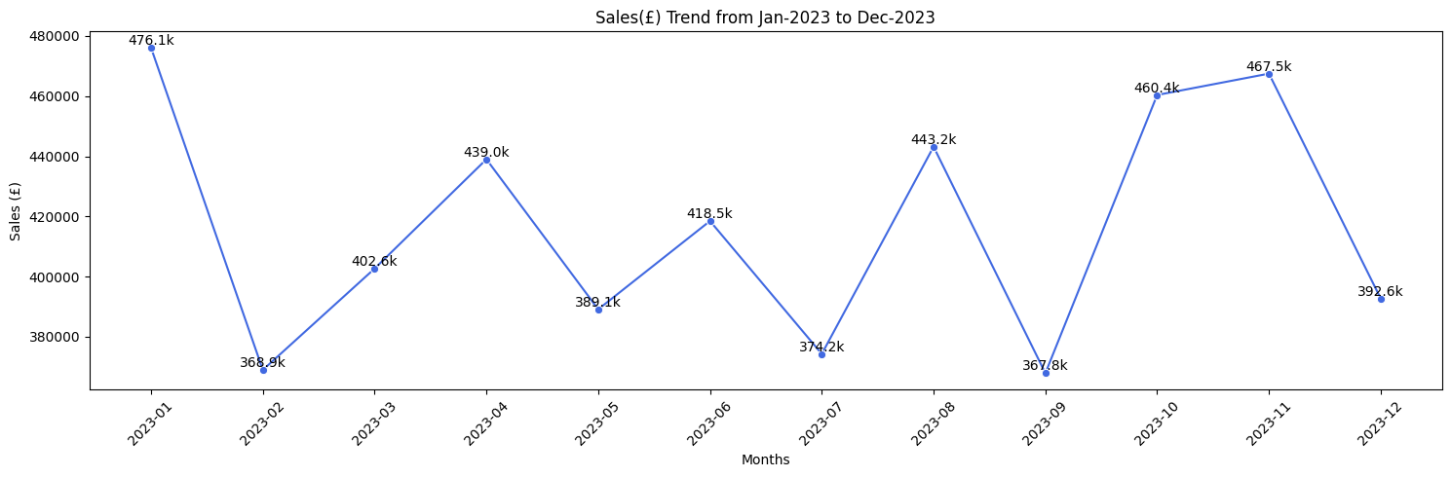
Sales Trend Summary (Jan–Dec 2023):
The sales trend from January to December 2023 shows notable fluctuations throughout the year. Sales began strongly in January at £476.1k, likely benefiting from post-holiday momentum, but dropped sharply in February to £368.9k. The following months saw steady recovery, with March reaching £402.6k and April peaking at £439k. Mid-year sales (May to July) displayed moderate volatility, while September recorded the lowest point of the year at £367.8k. However, performance improved significantly in the final quarter, driven by seasonal shopping events, with October and November achieving £460.4k and £467.5k, respectively. December experienced a slight decline to £392.6k, reflecting a typical post-holiday slowdown. Overall, strong Q4 performance helped stabilise annual sales, underscoring the impact of holiday-driven consumer spending.

Slide 6
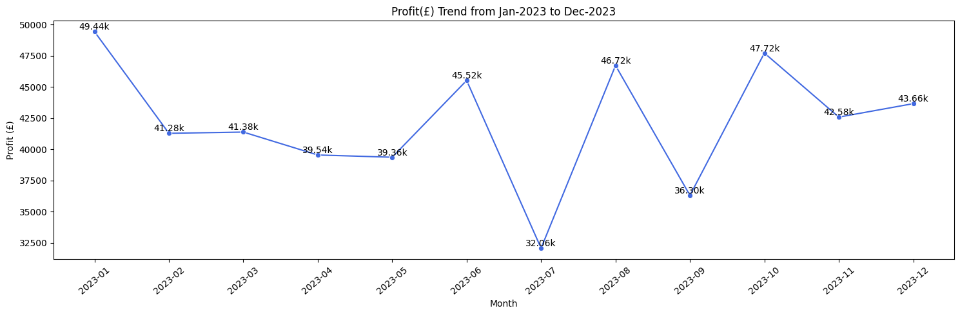
Profit Trend Summary (Jan–Dec 2023):
The profit trend from January to December 2023 demonstrates moderate fluctuations throughout the year. January recorded the highest profit of £49.44k, followed by a steady decline in February (£41.28k) and stabilising levels through March to May, averaging around £40k. June showed a strong rebound, reaching £45.52k, but July saw the lowest profit of the year at £32.06k, likely indicating seasonal or operational factors affecting margins. Profits recovered in August (£46.72k) and peaked again in October (£47.72k) during the holiday sales period. The year closed with stable profits in November (£42.58k) and December (£43.66k), reflecting consistent performance in Q4. Overall, while profit remained steady across most months, spikes during peak sales periods indicate strong profitability during high-demand seasons.

Slide 7
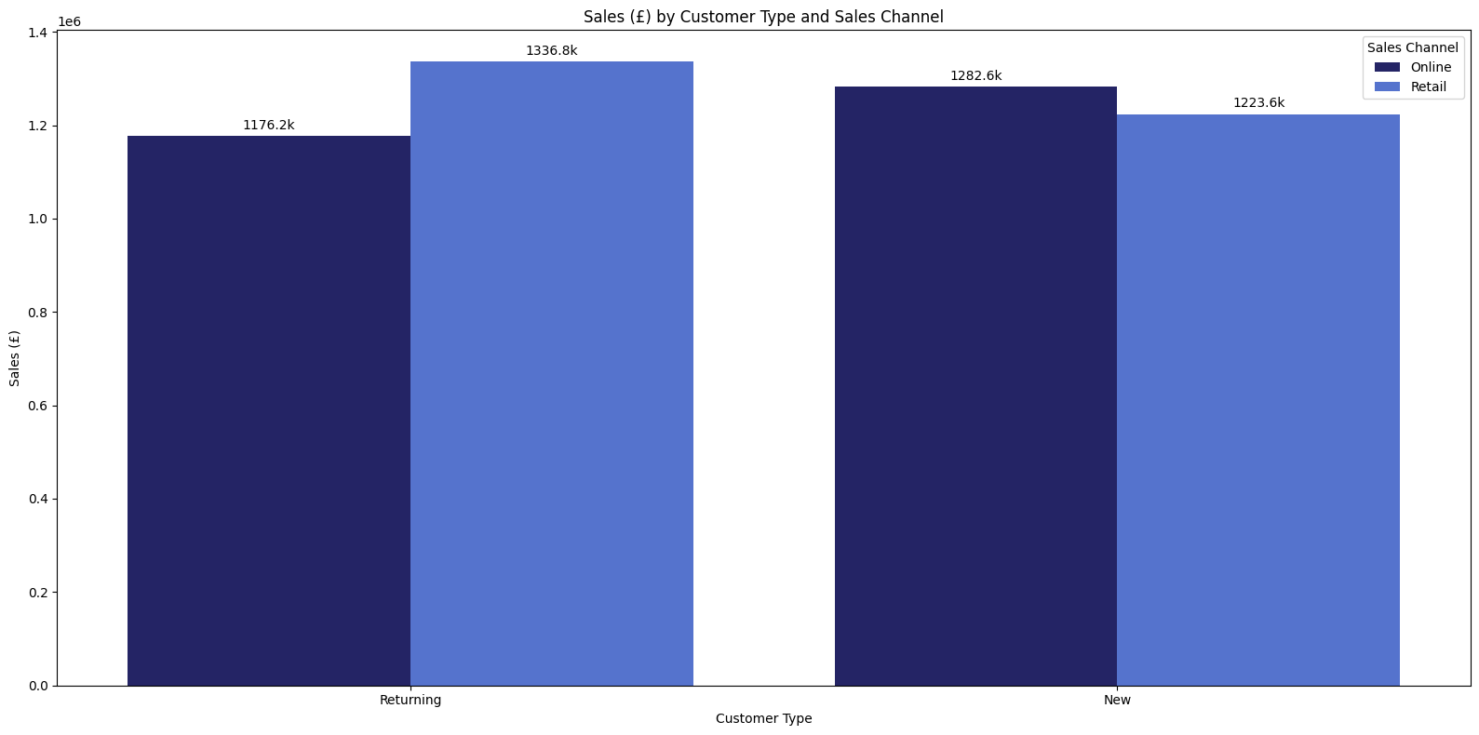
Customer Type and Sales Channel Performance Analysis (£)
This chart illustrates sales (£) distribution by customer type and sales channel for John Lewis. It highlights that retail sales among returning customers (£1.34M) are the highest, showcasing the strong loyalty of repeat shoppers in physical stores. However, new customers are contributing significantly through online channels (£1.28M), reflecting a growing trend in digital adoption. Although retail remains dominant for returning customers, online sales show competitive performance for both new and existing customers, underscoring the importance of an omnichannel strategy. This insight suggests focusing on enhancing the online experience for new customers while sustaining in-store engagement for loyal shoppers.

Slide 8
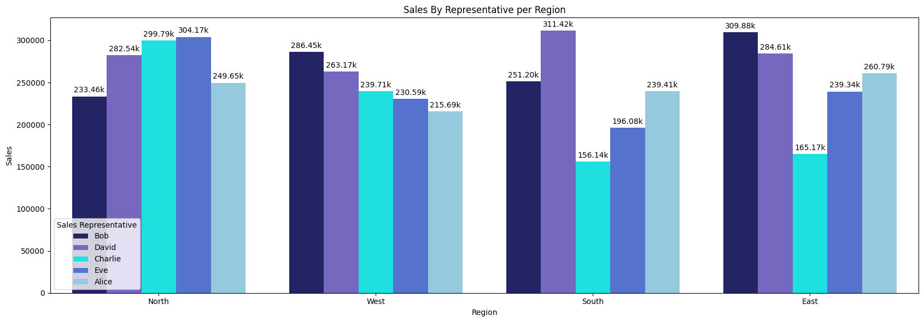
This chart highlights regional sales performance by representative, showing that Charlie leads in the North region, while David excels in the South. Other regions display more evenly distributed performance among reps. The insight suggests focusing on replicating high-performing strategies from top reps in specific regions to drive balanced growth across all areas.

Slide 9
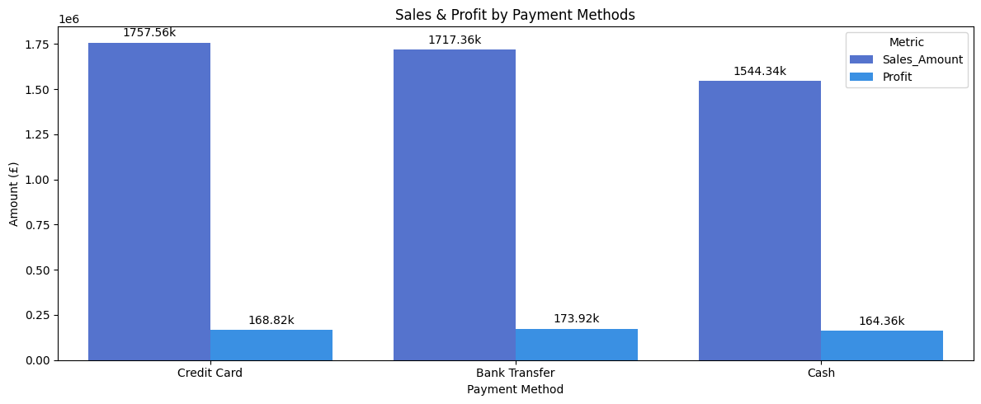
This chart shows that Credit Card payments lead with the highest sales (£1.76M) and profit (£168.82K), followed closely by Bank Transfers with sales of £1.72M and profit of £173.92K. Cash transactions recorded the lowest sales (£1.54M) and profit (£164.36K). This indicates that encouraging digital payment methods like credit cards and bank transfers can significantly boost both revenue and profitability.

Slide 10
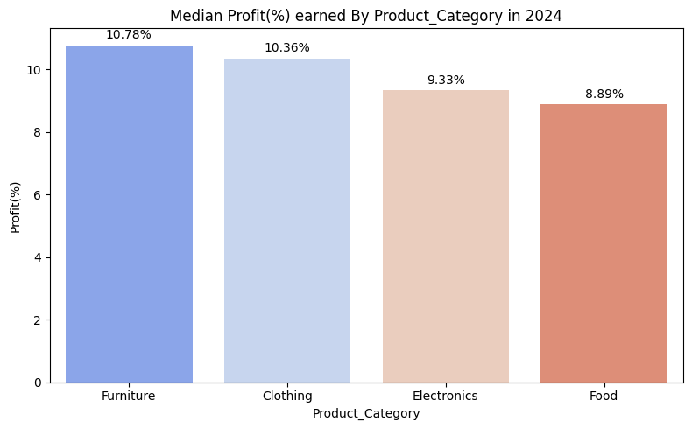
Median profit percentage by product category for 2023.
The chart illustrates the median profit percentage earned by each product category in 2024. Furniture achieved the highest profit margin at 10.78%, followed closely by Clothing at 10.36%, indicating strong performance and effective pricing strategies in these categories. Meanwhile, Electronics (9.33%) and Food (8.89%) recorded relatively lower profit margins, suggesting higher competition or tighter pricing pressures in these segments. This analysis highlights the need to focus on maintaining profitability in high-performing categories like Furniture and Clothing, while implementing cost optimisation measures to improve margins in Electronics and Food.

Slide 11
Recommendations
Seasonal Campaign Planning: Launch targeted promotions during peak shopping months to maximise revenue.
Regional Growth Strategies: Strengthen sales in underperforming regions (South) through localised marketing and offers.
Product Mix Optimisation: Focus on upselling high-margin categories like Furniture and Clothing to boost profitability.
Omnichannel Enhancement: Improve the online shopping experience for new customers while maintaining in-store loyalty for returning ones.
Predictive Analytics: Implement forecasting models to anticipate demand and optimise inventory planning.
Customer Personalisation: Leverage segmentation to offer personalised recommendations, increasing retention and lifetime value.

Slide 12
Conclusion
This analysis of John Lewis UK provided valuable insights into sales, profit trends, customer behavior, and regional performance.
Sales peaked during festive months (Jan, Aug, Nov), driven by seasonal demand.
Clothing led in sales, while Furniture yielded the highest profit margin (10.78%), highlighting profitable product focus areas.
North region outperformed others, while the South region requires targeted strategies.
The shift towards online shopping for new customers emphasizes the growing importance of digital engagement.
Credit card payments dominated, reflecting evolving consumer payment preferences.

Slide 13
THANK YOU For collaborations or feedback, feel free to connect!

