Slide 1




SMART INDIA HACKATHON 2026
  Problem Statement ID- 26117
  Problem Statement Title- Sovereign On-Premise Agentic AI Workbench using Open-Weight Multimodal LLMs for Confidential Industrial Work
  Theme- Smart Automation
  PS Category- Software
  Team ID-
  Team Name- Orchestra

Slide 2





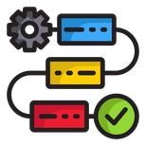


On-Premise Agentic AI for Refineries & PSUs
Orchestra
IDEA/SOLUTION:
PROBLEM RESOLUTION:
A self-hosted, air-gapped AI workbench for confidential industrial work.
  Confidentiality maintained in regulated industries (at scale).
  On-premise deployment letting teams use AI despite a cloud AI ban in sensitive sectors.
  Saves engineer time by auto-generating structured data from scans.
Document Generation
Excel files, PPTs, Word reports all in predefined templates.
Multimodal Analysis
OCR+VLM for scanned PDFs, engineering drawings, handwriting.
Coding Agents
Write code, executes, iterates inside network isolated Sandbox.
Agentic Core
Multi-step planning, automatic tool calling for complex workflows.
UNIQUE VALUE PROPOSITIONS (UVP):
  Extensible model: New models plug in via YAML, no rewrite needed.
  Breaks the task into steps with 4 models on standby; automatically picks the right model at each step.
  Parallel document processing across many documents at once.
Audit Logs
Prints every step of calculations and logs every model, tool call.
Locally Hosted
Local knowledge base grounds answers in organisation’s SOPs.
@SIH Idea submission- Template
2
Notes:
2

Slide 3
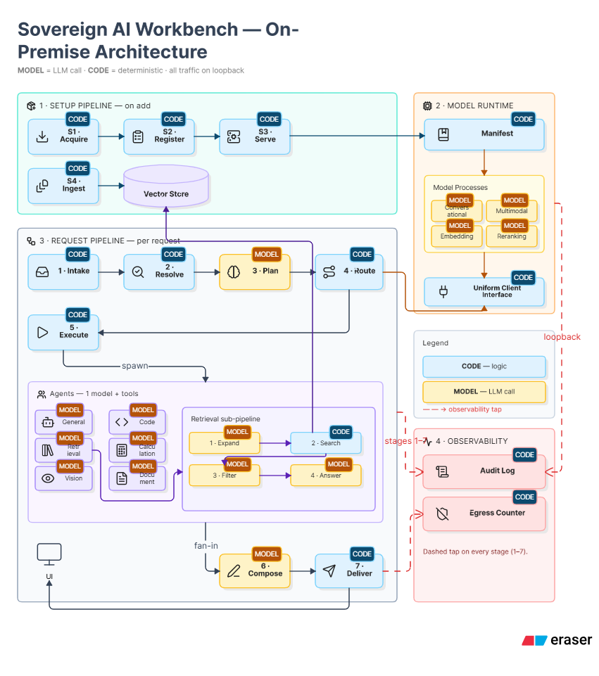
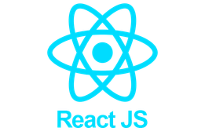


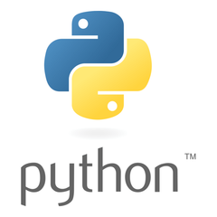

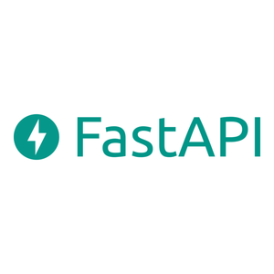
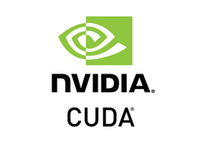
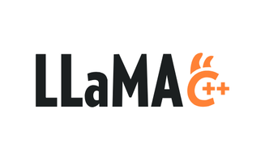

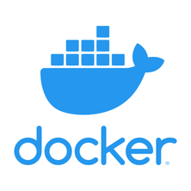

TECHNOLOGIES USED
ARCHITECTURE
Orchestra
Interface:
Backend Serving:
Model Runtime:
Retrieval & Persistence:
Execution & Distribution:
@SIH Idea submission- Template
3
Notes:
3

Slide 4


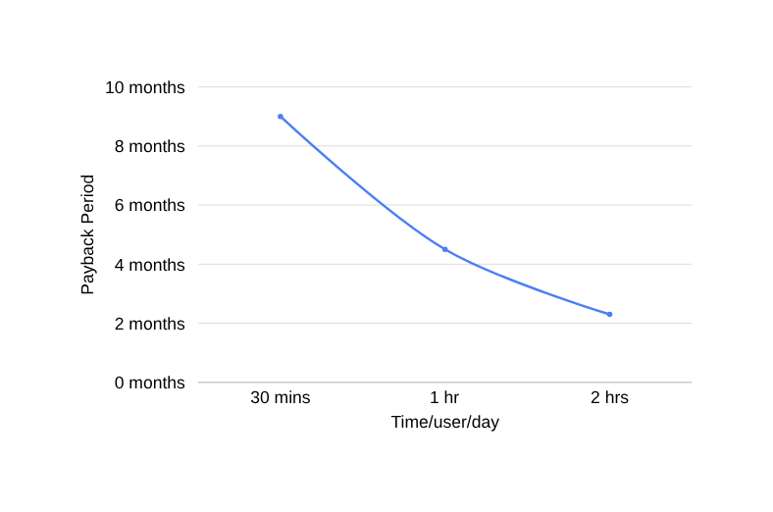

Risks | Strategy | Status
Small on-premise open weight models less reliable at open ended planning | Fixed roster of 7 agents with the planner emitting one validated plan
Even "offline" tools can leak data via hidden telemetry or license check calls | Sovereignty demonstrated live where logs show zero external calls
Sovereign on-premise hosting is commoditizing fast, with risk of no lasting competitive moat | Shift the moat entirely to the orchestration layer above the model
Needs sustained usage to justify GPU hardware cost | Pilot in one department first, then scale hardware tier once proven
“The unit is not a token.
It is an hour of engineer time.”
Risks
Strategy
Orchestra
Feasibility & Viability
On-premise LLMs are proven in banking & defence, while our edge is intelligent multi-model orchestration.
4.5 mo
Payback period
₹1.25 cr
Value returned/ yr
757%
Four-year ROI
₹110
Cost / hour returned
When built on a single H100 80 GB server holding four models resident, serving fifty named users across process engineering, inspection, projects and materials.
No per-seat licence.
No per-token billing.
The cost is flat regardless of how heavily it is used.
All ingested content is treated as untrusted data, and requires human approval before file writes.
@SIH Idea submission- Template
4
Notes:
4

Slide 5







Secure automation, real impact
on-premise, at scale.
Orchestra
BENEFITS
SOCIAL IMPACT:
Removes incentive for shadow IT by keeping confidential data off public AI tools.
Logs in every model and tool action for built-in audit and compliance.
ECONOMIC IMPACT:
Frees up significant engineer time from routine paperwork for higher-value work, thus improving throughput without adding headcount.
Engineers reclaim about 1 hour per day from manual drafting, data extraction, and summarizing correspondence.
Institutional knowledge in SOPs and correspondence becomes searchable with citations, not lost when senior staff retire.
Faster turnaround on approval notes, inspection summaries, and board decks means quicker decision cycles across departments.
ENVIRONMENTAL IMPACT:
One on-prem server reduces redundant cloud compute and repeated manual effort.
Digitizing records cuts reliance on printed documentation, helps lower digital & physical waste.
@SIH Idea submission- Template
5
Notes:
5

Slide 6
RESEARCH AND REFERENCES
Orchestra
Technical References
  Local LLM + RAG deployments — proven in banking, defense, healthcare
  Models: Qwen3-Coder, DeepSeek-OCR (open-weight, benchmarked)
  Infra: Qdrant (vector DB), Docker (sandboxed execution)
LLM Research Areas
  Confidence via multi-agent agreement — active LLM research area;
  arXiv 2602.11619, "Behavioral Consistency as an Uncertainty Signal for LLM Agents"
Confidentiality and Compliance Agreements
  Data residency & compliance regulations for refineries
  NCIIPC critical infrastructure & CERT-In mandatory reporting norms (energy sector)
@SIH Idea submission- Template
6
Notes:
6

