Slide 1
Gold as an Investment
Over a Period of 5, 6, 7 and 8 Years
Created By : Piyush Jain
Created On : 12/28/2021

Slide 2
Pre-Requisites
Data Source is collected from National Stock Exchange Website.
Data Source includes Gold Closing Price between 5-Jun-2005 to 21-Nov-2021.
Returns are calculated as Compounded Annual Growth Return (CAGR).

Slide 3
What Questions will be answered?
What form of Gold Investment is best over various time periods?
Probability of Gold returns beating Inflation over various time periods.
Is Gold Really an investment ?

Slide 4
Ways to Invest in Gold
Sovereign Gold Bond
Index Fund
Physical Gold

Slide 5
Sovereign Gold Bond
RBI Backed Gold Bonds with maximum 8 year tenure.
Issued almost every month.
Annual Interest of 2.5% credited every year on a half yearly basis.
Buy and Sell Price Decided as per gold price.

Slide 6
Index Fund
Gold Index Fund tracking the Physical Value of Gold.
Expenses Include –
Total Expense Ratio - 0.4 %
Impact Cost - 0.04 %
Tracking error - 0.16 %

Slide 7
Physical Gold
Bought in the form of jewelry , coins or bricks.
Assumed Making Charges - 8%

Slide 8
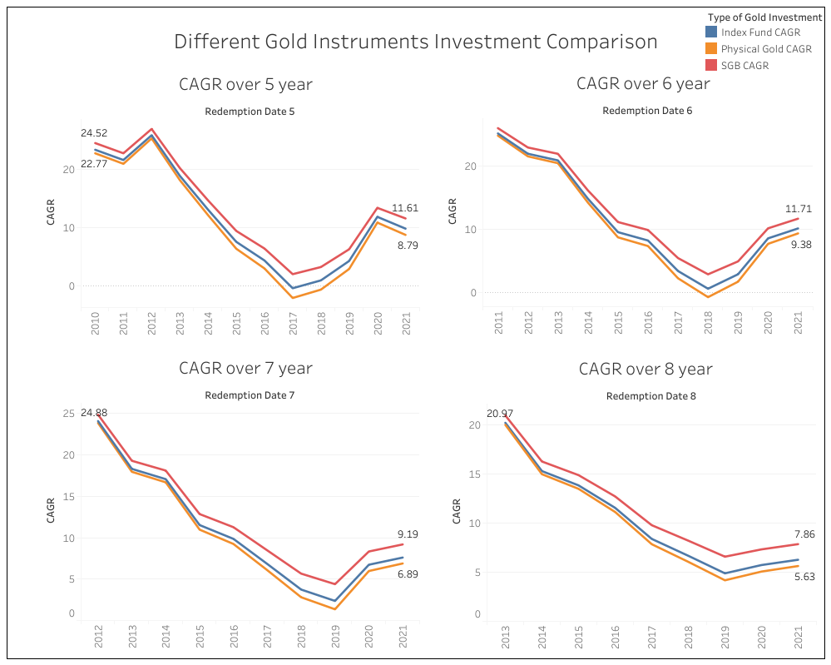
Notes:
(Wait 5 Seconds)
This Data Viz Answers the First Question - What form of Gold Investment is best over various time periods?
As you can see, The red Line representing SGB Returns always beats index Fund represented by blue which always beats Physical Gold represented by yellow which helps us conclude that SGB is the best form of investment over various time periods.

Slide 9
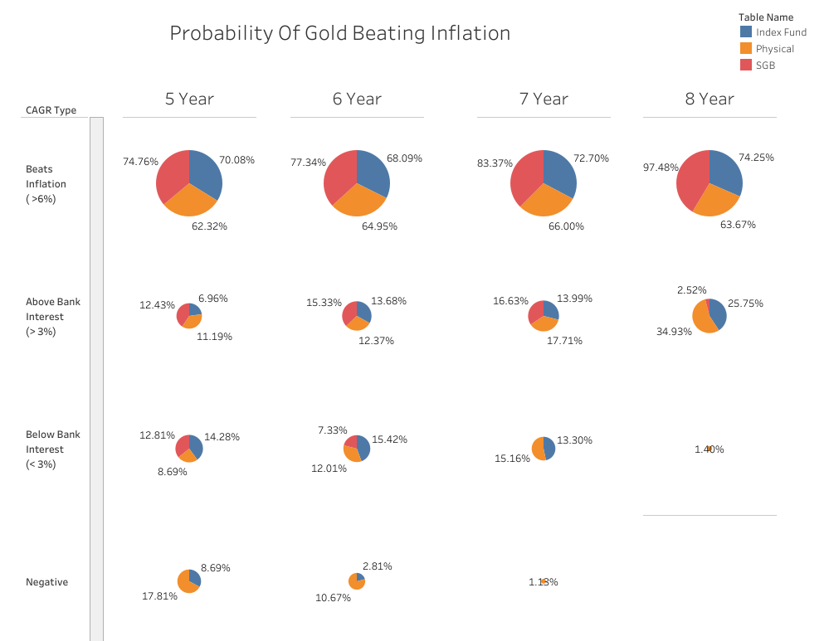
Notes:
As per the above Data Viz there is above 70% chances that Gold held in any form will give above returns above bank interests that is 3%
The chances of getting better returns increases if holding period of Gold increases.
Physical Gold has a maximum chance of 18% to give negative returns in 5 years. This can be solved using SGB which has no negative Returns.

Slide 10
The Key Takeaway
For a Period of 8 Years, Gold if held as Sovereign Gold Bond has a 97.5% chance of beating Inflation !
Hence , gold can also be considered as an investment with it also being a hedge to your overall portfolio.

Slide 11
Thank You

