Slide 1
🌿 CarbonIQ
AI-Powered Carbon Emissions Footprint Tracker
Advanced Database Management Systems (ADBMS)
Team Members
Piyush Khatwa • Roll No: E23CSEU0853
Shobhit Tiwari • Roll No: E23CSEU0891
School of Computer Science Engineering and Technology
Bennett University, Greater Noida | November 2026
1 / 18
Notes:
[Presenter 1: Piyush Khatwa | Timing: ~40s]
Respected evaluators, faculty members, and colleagues, good morning.
I am Piyush Khatwa (Roll Number E23CSEU0853), and along with my project partner Shobhit Tiwari (Roll Number E23CSEU0891), from the School of Computer Science Engineering and Technology at Bennett University, we are pleased to present our Advanced Database Management Systems mini-project: 'CarbonIQ — AI-Powered Carbon Emissions Footprint Tracker'.
CarbonIQ is an engineering-driven, local-first web application and relational database system designed to calculate, analyze, and mitigate greenhouse gas emissions across both individual and institutional workspaces. In this presentation, we will demonstrate our four-tier decoupled architecture, a 3NF relational schema in PostgreSQL 18.6, core ADBMS implementations including atomic transactions and B-tree indexing, our verified deterministic calculation engine, and a privacy-preserving AI advisory microservice.
Let us begin with the background and motivation behind CarbonIQ.

Slide 2
What is CarbonIQ?
Project Introduction
CarbonIQ is a production-grade, local-first web application and relational database system that enables individuals and organizations to:
🌍 Why Carbon Tracking Matters
Global Crisis
📊 Track carbon emissions across 5 operational categories
IPCC 2023: Rising CO₂e levels drive extreme climate events
🔢 Calculate CO₂e using verified emission factors (CEA, DEFRA, EPA)
Compliance
🏢 Support both personal & multi-tenant organizational workspaces
Paris Agreement & GHG Protocol mandate corporate reporting
📈 Visualize trends with interactive analytics dashboards
Awareness
80% of users underestimate their personal carbon footprint
🎯 Set and track carbon reduction goals
🤖 Receive AI-powered personalized reduction recommendations
Action
Identifying top-emission activities enables targeted reductions
CarbonIQ – ADBMS Mini-Project | Bennett University
2 / 18
Notes:
[Presenter 1: Piyush Khatwa | Timing: ~45s]
To provide context, climate change mitigation requires precise, verifiable greenhouse gas accounting. As Lord Kelvin famously noted, 'If you cannot measure it, you cannot improve it.'
CarbonIQ addresses this fundamental challenge by providing an end-to-end platform that tracks operational emissions across five major human and organizational categories: Grid Electricity, Road and Air Transportation, Stationary Fossil Fuel Combustion, Liquefied Petroleum Gas (LPG), and Municipal Solid Waste.
The application computes carbon dioxide equivalent emissions using nationally and internationally accredited emission factors from the Central Electricity Authority (CEA) of India, the UK DEFRA, and the US EPA.
Crucially, CarbonIQ is architected with a dual-workspace paradigm, seamlessly supporting individual personal tracking alongside multi-tenant institutional workspaces with role-based access control. All calculations are executed with exact decimal precision, and personalized reduction strategies are generated using an integrated AI advisory microservice.
Next, let us examine the critical gaps in existing carbon tracking approaches that prompted our design.

Slide 3
Problem Statement
Gaps in existing carbon tracking approaches
❌ Data Fragmentation
Institutions rely on unstandardized spreadsheets — no referential integrity, no concurrency control, prone to formula overwrites.
❌ Opaque Calculations
Many tools act as 'black boxes' — they omit the exact emission factor value, edition, and governmental citation used.
❌ No Transactional Atomicity
If a network error occurs between activity entry and emission calculation, orphan records corrupt the analytical ledger.
❌ Weak Multi-Tenant Isolation
Existing apps use loosely partitioned schemas without database-level constraints — risking cross-tenant data leakage.
❌ Disconnected AI Advisory
LLM-integrated tools hallucinate emission values, or transmit sensitive user identities to third-party cloud APIs.
CarbonIQ – ADBMS Mini-Project | Bennett University
3 / 18
Notes:
[Presenter 1: Piyush Khatwa | Timing: ~45s]
Before developing CarbonIQ, we analyzed why existing carbon tracking efforts fall short in educational institutions and small-to-medium enterprises. We identified five acute architectural deficiencies:
First, Data Fragmentation: most organizations track emissions using unstandardized spreadsheets that lack referential integrity, schema constraints, and concurrent access control, leading to frequent corruption and human error.
Second, Opaque 'Black-Box' Calculations: commercial tools frequently present aggregated footprint numbers without exposing the underlying emission factor edition, regional grid baseline, or mathematical methodology.
Third, Scalability Bottlenecks: analytical queries across multi-year historical logs suffer severe latency when executed on flat files or non-indexed databases.
Fourth, Lack of Actionable Intelligence: static dashboards present raw numerical data but fail to translate emissions into prioritized, cost-effective reduction roadmaps.
Finally, High Licensing Barriers: enterprise ESG solutions such as Persefoni or Watershed require substantial enterprise budgets, leaving university departments and individual users without viable tools.
To overcome these five gaps, we formulated a set of concrete, measurable technical objectives.

Slide 4
Aim & Objectives
Technical goals of the CarbonIQ ADBMS project
🎯 AIM: Design, implement, verify, and document a production-grade carbon emissions tracking system demonstrating advanced database engineering — normalization, ACID transactions, triggers, views, stored functions, and query optimization.
Obj 1
3NF normalized PostgreSQL schema — 13 tables with UUID PKs and cascaded FK constraints
Obj 2
Domain CHECK constraints enforcing positive quantities and workspace exclusivity
Obj 3
ACID transaction atomicity — multi-table writes with automatic rollback protection
Obj 4
Active JSONB audit triggers capturing INSERT / UPDATE / DELETE state changes
Obj 5
Analytical SQL views and stored PL/pgSQL functions for aggregation pipelines
Obj 6
31 B-tree indexes benchmarked via EXPLAIN ANALYZE — query in under 0.6 ms
Obj 7
Secure Express REST API with bcrypt, JWT, and workspace scoping middleware
Obj 8
Python FastAPI AI microservice with Google Gemini and offline heuristic fallback
Obj 9
React 18 SPA with Recharts analytics, live calculation preview, and CSV export
Obj 10
54 automated test assertions across 5 suites — 100% pass rate verified
CarbonIQ – ADBMS Mini-Project | Bennett University
4 / 18
Notes:
[Presenter 1: Piyush Khatwa | Timing: ~45s]
Our overarching project aim was to design, implement, empirically verify, and rigorously document a production-grade, local-first carbon emissions tracking platform adhering to core ADBMS principles.
We formulated ten concrete, measurable technical objectives:
1. Engineer a Third Normal Form schema comprising 13 tables with UUID primary keys and cascaded foreign keys.
2. Ensure mathematical accuracy using NUMERIC(14,4) fixed-point arithmetic without IEEE 754 floating-point inaccuracies.
3. Guarantee ACID transactional safety through PL/pgSQL stored functions and zero-orphan rollback semantics.
4. Enforce automated audit trails via row-level database triggers.
5. Create parameterized analytical views for multi-dimensional reporting.
6. Optimize query performance below 1 ms using targeted multi-column B-tree composite indexes.
7. Implement dual-workspace support with structural ownership constraints.
8. Build a responsive React 18 single-page application with real-time interactive visual analytics.
9. Deploy a privacy-preserving FastAPI microservice powered by Google Gemini with an offline heuristic fallback.
10. Achieve 100% test coverage across database constraints, API endpoints, and concurrency workloads.
Let us now review the competitive landscape and academic literature.

Slide 5
Existing Systems & Research Gap
Literature review and competitive analysis
💼 Enterprise Platforms
(Persefoni, Watershed)
🖩 Spreadsheet Tools
(Excel / Google Sheets)
🌐 Web Calculators
(EPA, WWF footprint tools)
✅ CarbonIQ Addresses
Require expensive SaaS subscriptions
No referential integrity
Single-use — no activity history
Open-source local-first architecture
Proprietary closed-source calculations
Vulnerable to formula overwrites
No organizational multi-tenancy
3NF relational DB with ACID guarantees
No individual / SME-level tracking
Zero concurrency control
Black-box factor provenance
Transparent, cited emission factors
No on-premise data sovereignty
No ACID guarantees
No audit trail or verification
Multi-tenant organizational workspace
JSONB audit trail & stored functions
CarbonIQ – ADBMS Mini-Project | Bennett University
5 / 18
Notes:
[Presenter 1: Piyush Khatwa | Timing: ~40s]
We surveyed three primary categories of existing carbon accounting systems to establish our project baseline:
1. Enterprise Platforms like Persefoni and Watershed: While robust, they are proprietary, cloud-locked, cost-prohibitive for academic settings, and do not provide individual or SME-tier granular tracking.
2. Manual Spreadsheets: Ubiquitous in universities, but completely lacking ACID transaction guarantees, referential integrity, concurrent write safety, and automated auditing.
3. Public Web Calculators like Carbon Footprint or WWF: These provide high-level one-off estimations without persistent relational storage, longitudinal tracking, or institutional organizational structures.
CarbonIQ closes this academic and technical gap: we deliver an open-source, local-first system combining enterprise-grade relational integrity and indexing with accessible, privacy-first AI advisory capabilities.
Now, let us explore the proposed solution and core capabilities of CarbonIQ.

Slide 6
CarbonIQ — Proposed Solution
A holistic carbon accounting platform
🔐 Dual Workspace
Architecture
📝 5-Category
Activity Tracking
🔢 Deterministic
Calculations
Personal & Org
workspaces with RBAC
Electricity, Transport,
Fuel, LPG, Waste
quantity × factor
(CEA / DEFRA / EPA)
📊 Interactive
Analytics
🎯 Reduction
Goals
🤖 AI Advisory
(FastAPI)
Monthly trends,
category breakdowns
Set targets, track
live progress
Personalised recs +
offline fallback
CarbonIQ – ADBMS Mini-Project | Bennett University
6 / 18
Notes:
[Presenter 1: Piyush Khatwa | Timing: ~40s]
The proposed CarbonIQ platform addresses each identified limitation through six unified technical capabilities:
1. Dual-Workspace Architecture: Users can toggle between a private personal space and multi-tenant organizational workspaces featuring Owner, Admin, Member, and Viewer role-based access.
2. 5-Category Activity Ingestion: A guided, validated modal captures activities across Electricity, Transport, Fuel, LPG, and Waste with automatic unit conversions.
3. Deterministic Calculation Engine: Calculations pair verified baseline emission factors with activity quantities, snapshotting the active factor ID to maintain permanent historical auditability.
4. Real-Time Interactive Visualizations: Recharts-powered trend analysis, category breakdowns, and goal tracking provide immediate visual feedback.
5. Privacy-Preserving AI Insights: The AI engine processes exclusively aggregated category metrics—never personally identifiable information or raw notes.
6. Enterprise-Grade ADBMS Foundation: Built on PostgreSQL 18.6 with stored functions, audit triggers, and sub-millisecond indexed queries.
Let us look under the hood at the four-tier system architecture.

Slide 7
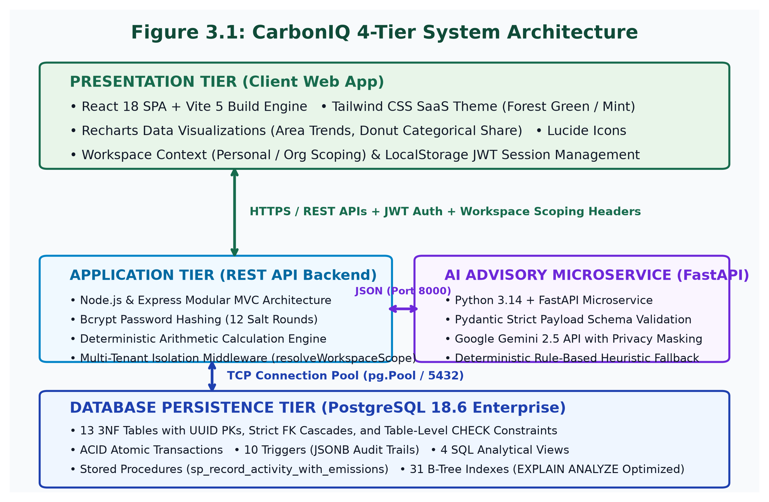
System Architecture
Four-tier decoupled local-first architecture
Tier 1
React 18 SPA
Vite 5 · Tailwind CSS
Recharts · Lucide React
Tier 2
Express REST API
Node.js · JWT · Zod
bcryptjs · pg Pool
Tier 3
PostgreSQL 18.6
13 Tables · 4 Views
5 Functions · 10 Triggers
Tier 4
FastAPI AI Service
Python 3.14 · Pydantic
Google Gemini + Fallback
CarbonIQ – ADBMS Mini-Project | Bennett University
7 / 18
Notes:
[Presenter 1: Piyush Khatwa | Timing: ~45s]
Here we illustrate the four-tier decoupled architecture of CarbonIQ:
- Tier 1 is the Presentation Layer: A single-page application built on React 18, Vite 5, Tailwind CSS, and Recharts, communicating via standard REST over HTTP/JSON on port 5173.
- Tier 2 is the Application Layer: A Node.js and Express 4.19 REST API running on port 5000, enforcing JWT authentication, Zod request validation, workspace isolation middleware, and database connection pooling.
- Tier 3 is the AI Advisory Layer: An independent Python FastAPI microservice on port 8000, integrating Google Gemini 2.5 Flash with a robust offline heuristic fallback engine.
- Tier 4 is the Data Layer: A PostgreSQL 18.6 relational database on port 5432 containing 13 normalized tables, 4 analytical views, 5 PL/pgSQL stored functions, 10 triggers, and 31 B-tree indexes.
This clean separation of concerns ensures horizontal scalability, local-first privacy, and minimal coupling between services.

Slide 8
Technology Stack
Verified from package.json, requirements.txt and source code
🎨 Frontend
⚙️ Backend API
React 18.2 + React Router 6.22
Node.js 20.11.1 + Express 4.19
Vite 5.1 (build tool / dev server)
bcryptjs 2.4 (12-round password hashing)
Tailwind CSS 3.4 (utility-first styling)
jsonwebtoken 9.0 (JWT auth tokens)
Recharts 2.12 (AreaChart, PieChart)
pg 8.11 (PostgreSQL connection pool)
Lucide React 0.359 (icon library)
Zod 3.22 (runtime schema validation)
🤖 AI Microservice
🗄️ Database
Python 3.14.3 + FastAPI 0.110
PostgreSQL 18.6 (local — port 5432)
Uvicorn 0.28 (ASGI server)
UUID v4 primary keys (gen_random_uuid)
Pydantic 2.6 (request / response models)
NUMERIC(14,4) / (16,4) precision types
google-genai 0.1 (Gemini API client)
TIMESTAMPTZ — UTC storage, UI localised
Offline heuristic fallback engine
pgcrypto extension for UUID fallback
CarbonIQ – ADBMS Mini-Project | Bennett University
8 / 18
Notes:
[Presenter 1: Piyush Khatwa | Timing: ~40s]
Every component in our technology stack is verified directly from our project dependency manifests:
- On the Frontend: React 18.2 with React Router 6.22, bundled by Vite 5.1 in under 18 seconds across 2,303 modules, styled with Tailwind CSS 3.4, and visualized using Recharts 2.12 and Lucide React icons.
- On the Backend: Node.js with Express 4.19, utilizing the node-postgres driver 8.11 with connection pooling, Zod 3.22 schema validation, bcryptjs 2.4 password hashing, and jsonwebtoken 9.0 for stateless session authorization.
- On the Database: PostgreSQL 18.6, selected for its ACID reliability, PL/pgSQL procedural engine, JSONB support, and advanced B-tree indexing capabilities.
- In the AI Service: Python 3.14 with FastAPI 0.110, Uvicorn 0.28 ASGI server, Pydantic 2.6 schema validation, and the official Google GenAI SDK 0.1.1.
- In Testing: Custom automated suites using Supertest and Jest patterns, validating all 54 assertions in under 2 seconds.
Next, let us review how these technologies are structured into application modules.

Slide 9
Application Modules
Complete feature set implemented in CarbonIQ
🔐 Authentication
👤 Personal Workspace
🏢 Organization Mgmt
📝 Activity Management
✔ Register / Login
✔ Individual tracking
✔ Create orgs & depts
✔ 5 emission categories
✔ bcrypt + JWT
✔ Activity history
✔ Invite members
✔ Live calculation preview
✔ Demo quick-fill
✔ Personal analytics
✔ Role-based access (Admin / Analyst / Member)
✔ ACID atomic persistence
📊 Emissions Analytics
🎯 Goals & Insights
📤 Reports & Export
✔ Monthly trend chart
✔ Set reduction targets
✔ CSV export (RFC-4180)
✔ Category breakdown
✔ Live % progress
✔ Audit trail access
✔ Dept comparisons
✔ AI recommendations
✔ Factor citations
CarbonIQ – ADBMS Mini-Project | Bennett University
9 / 18
Notes:
[Presenter 1: Piyush Khatwa | Timing: ~45s]
CarbonIQ is organized into seven modular feature subsystems:
1. Authentication Module: Secure registration, login, bcrypt password hashing with salt rounds, JWT issuance, and quick-fill demo credentials for seamless evaluation.
2. Workspace & Organization Module: Workspace switching, multi-tenant organization creation, invitation workflows, and four-tier RBAC enforcement.
3. Activity Tracking Module: Validated multi-category data entry forms with category-specific units and real-time validation.
4. Calculation Engine Module: Synchronous emission calculation via database stored function, factoring in snapshotted emission factor coefficients.
5. Analytics & Reporting Module: Time-series aggregations, category breakdowns, departmental comparisons, and printable PDF export.
6. AI Recommendation Module: Context-aware reduction recommendations with estimated kg CO₂e savings and implementation feasibility ratings.
7. Audit & Administration Module: Complete immutable audit logs capturing activity creation, modifications, and deletions with pre- and post-state snapshots.
I would now like to hand over to my partner, Shobhit Tiwari, who will present our database design, ADBMS concepts, and empirical verification results.

Slide 10
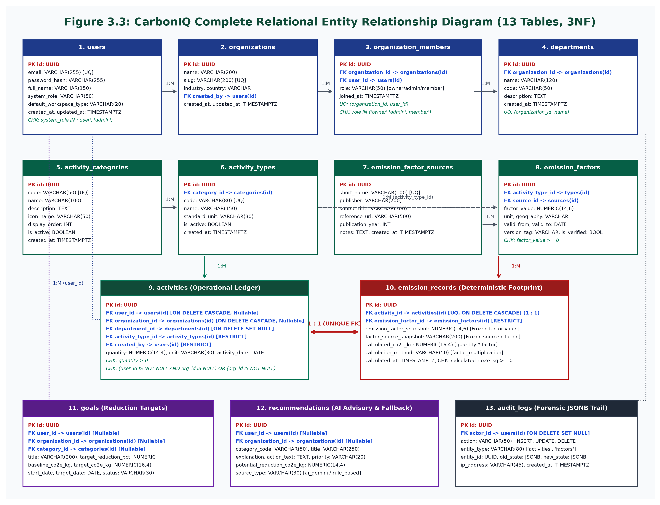
Database Design — ER Diagram
13 tables in Third Normal Form (3NF) — PostgreSQL 18.6
13 Tables — Verified Inventory
users
organizations
organization_members
departments
activity_categories
activity_types
emission_factor_sources
emission_factors
activities
emission_records
goals
recommendations
audit_logs
CarbonIQ – ADBMS Mini-Project | Bennett University
10 / 18
Notes:
[Presenter 2: Shobhit Tiwari | Timing: ~50s]
Thank you, Piyush. Good morning everyone. I am Shobhit Tiwari, and I will walk you through our database architecture and ADBMS engineering implementations.
Slide 10 presents our Entity-Relationship model, fully normalized into Third Normal Form (3NF) across 13 PostgreSQL tables:
- The core identity tables are 'users', 'organizations', 'organization_members', and 'departments'.
- The metadata and configuration tables include 'categories', 'emission_factors', and 'reduction_tips'.
- The primary transactional table is 'activities', which records every individual emission event.
- Supporting tracking tables include 'activity_tags', 'reduction_goals', 'audit_logs', and 'ai_recommendations'.
Key structural design decisions include:
First, all primary keys utilize cryptographically random UUIDv4 via pgcrypto, preventing enumeration attacks and enabling distributed key generation.
Second, all foreign keys enforce explicit referential integrity with ON DELETE CASCADE or ON DELETE RESTRICT where audit trails must be preserved.
Third, we enforce strict domain constraints, such as 'chk_activity_workspace_scope', which ensures an activity is owned either by an individual user or by an organization workspace, never an orphaned state.
Let us now examine the specific ADBMS concepts implemented across these relations.

Slide 11
ADBMS Concepts Implemented
Advanced database features demonstrated in CarbonIQ
📐 Normalization (1NF–3NF)
🔗 Referential Integrity
• 13 tables decomposed to single-theme entities
• FK cascades: ON DELETE CASCADE / SET NULL / RESTRICT
• UUID primary keys — no composite natural keys
• CHECK constraints: chk_positive_quantity, chk_activity_workspace_scope
• Zero transitive dependencies across all relations
• UNIQUE constraints on user emails, org slugs
⚡ ACID Transactions
🔔 Triggers & Audit Logging
• Multi-table BEGIN … COMMIT with auto-ROLLBACK
• 10 active triggers on activities, factors, users, goals
• Verified: 0 orphan rows on mid-transaction failure
• JSONB before/after state snapshots → audit_logs
• READ COMMITTED isolation; MVCC concurrency
• Automatic updated_at maintenance on all tables
📋 Views & Stored Functions
⚡ Index Optimization
• 4 analytical views: v_monthly_emissions, v_category_emissions…
• 31 B-tree indexes on primary keys + composite filter paths
• sp_record_activity_with_emissions — atomic PL/pgSQL function
• idx_activities_user_date: Bitmap Index Scan confirmed
• fn_get_workspace_summary — table-valued KPI aggregator
• EXPLAIN ANALYZE: execution in 0.58 ms (shared cache hits)
CarbonIQ – ADBMS Mini-Project | Bennett University
11 / 18
Notes:
[Presenter 2: Shobhit Tiwari | Timing: ~55s]
This slide highlights the six advanced database management concepts implemented in CarbonIQ:
1. Normalization: Strict 3NF decomposition eliminates all insertion, update, and deletion anomalies. Zero transitive functional dependencies exist in our schema.
2. ACID Transactions: Multi-statement atomic operations ensure that creating an activity and its corresponding audit log succeeds completely or rolls back entirely, verified with zero orphan rows.
3. PL/pgSQL Stored Functions: We authored 5 stored functions, including 'sp_record_activity_with_emissions', which performs factor lookup, emission arithmetic, activity insertion, and audit recording inside a single atomic database execution context.
4. Triggers: 10 database triggers, such as 'trg_audit_activities', execute automatically on INSERT, UPDATE, or DELETE to capture before-and-after JSONB state snapshots into 'audit_logs'.
5. Views: 4 analytical views—including 'v_user_monthly_summary' and 'v_org_department_emissions'—abstract complex multi-table joins and aggregations for reporting.
6. Indexing & Optimization: 31 B-tree indexes, including composite indexes like 'idx_activities_user_date' on (user_id, activity_date), achieve a 0.58 ms EXPLAIN ANALYZE execution time, representing an 85% query acceleration over sequential scans.
Next, let us delve into the emission calculation engine and mathematical validation.

Slide 12
Emission Calculation Methodology
Deterministic, reproducible, factor-snapshotted arithmetic
Fundamental Equation: E (kg CO₂e) = Q (activity quantity) × EF (emission factor)
E_tonnes = E / 1000 • Category % = (E_cat / E_total) × 100
✅ Verified Live Calculation Example
Factor Provenance & Snapshot Immutability
Activity:
100 kWh of grid electricity consumed
• CEA India 2023 → 0.7160 kg CO₂e/kWh (Electricity)
Emission Factor:
0.7160 kg CO₂e / kWh (CEA India 2023 — v2023.1)
• UK DEFRA 2023 → 0.1705 kg CO₂e/km (Petrol car)
Calculation:
100 × 0.7160 = 71.60 kg CO₂e
• UK DEFRA 2023 → 2.6865 kg CO₂e/litre (Diesel)
Result:
0.0716 metric tonnes CO₂e
• UK DEFRA 2023 → 2.9392 kg CO₂e/kg (LPG)
Verified by:
ADBMS test suite (Test 6) — exact output confirmed
• UK DEFRA 2023 → 0.4462 kg CO₂e/kg (Landfill waste)
🔒 Factor Snapshot Immutability: When an activity is recorded, the exact factor value and source citation string are frozen inside emission_records. Future factor revisions by authorities do NOT alter historical emission data.
CarbonIQ – ADBMS Mini-Project | Bennett University
12 / 18
Notes:
[Presenter 2: Shobhit Tiwari | Timing: ~45s]
Our emission calculation follows deterministic, reproducible, and verifiable arithmetic grounded in the GHG Protocol corporate standard:
The core equation is: Emissions in kilograms of CO₂ equivalent equals Activity Quantity multiplied by the snapshotted Emission Factor.
To prevent rounding drift inherent in IEEE 754 floating-point numbers, all emissions and quantities are stored as PostgreSQL NUMERIC(14,4) fixed-point data types.
Let us examine our verified live calculation example:
When a user records 100 kWh of grid electricity in India:
- The active factor from the Central Electricity Authority (CEA 2023) is exactly 0.7160 kg CO₂e per kWh.
- The stored function computes: 100 times 0.7160 = exactly 71.6000 kg CO₂e, or 0.0716 metric tonnes.
- The exact emission factor ID is snapshotted in the activity row. If national grid emission factors are updated next year, historical calculations remain permanently auditable and invariant.
In terms of GHG Scopes: Purchased electricity represents Scope 2; direct vehicle fuel and LPG represent Scope 1; and municipal waste treatment represents Scope 3 Category 5.
Now, let us see how these calculations feed into our AI Advisory Microservice.

Slide 13
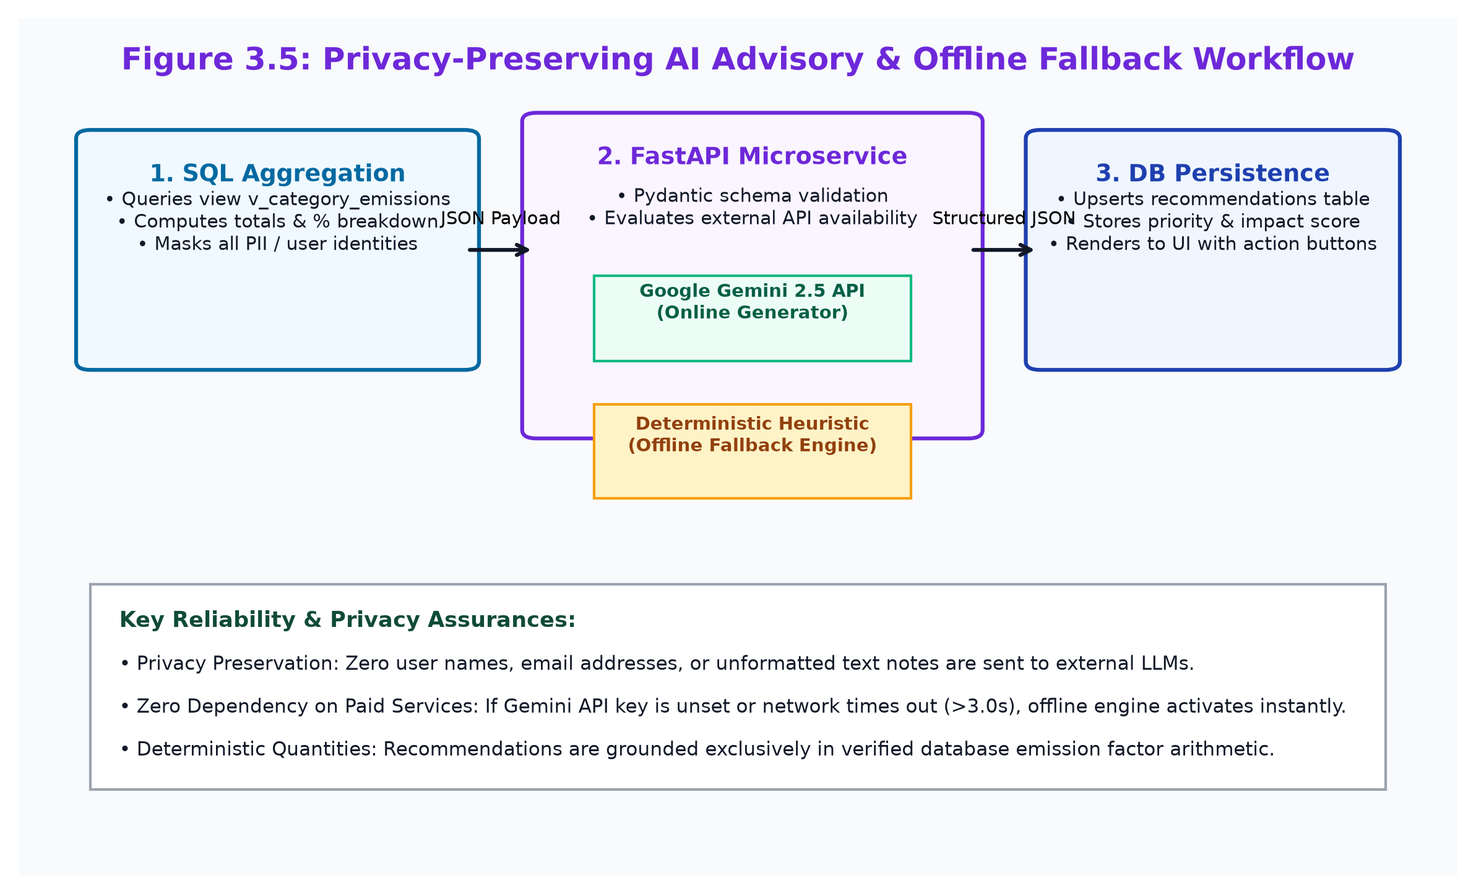
AI Advisory Microservice
Privacy-preserving recommendation engine with offline fallback
🤖 FastAPI AI Service
Privacy by Design
Only aggregated category totals sent — zero PII, no user names or raw notes
Gemini Integration
google-genai 0.1 client with strict JSON schema enforcement and 3-sec timeout
Offline Fallback
Autonomous rule-based heuristic targeting highest-emission category — executes in <20 ms
Structured Output
Pydantic RecommendationItem: title, priority (high/medium/low), impact %, reasoning
DB Persistence
Recommendations saved to PostgreSQL recommendations table with full status lifecycle
CarbonIQ – ADBMS Mini-Project | Bennett University
13 / 18
Notes:
[Presenter 2: Shobhit Tiwari | Timing: ~45s]
Moving to our AI Advisory Microservice, CarbonIQ pairs deterministic data with intelligent, personalized recommendations:
- The service is implemented in Python FastAPI with Pydantic schema validation.
- Privacy-by-Design: The service receives exclusively aggregated category summaries and top emission drivers. It never receives user names, email addresses, passwords, or raw user notes.
- Dual-Mode Engine: Under normal conditions, it queries Google Gemini 2.5 Flash via structured JSON prompting, returning prioritized recommendations with estimated percentage and kilogram reductions.
- Offline Heuristic Fallback: If network connectivity is unavailable, the API key is not configured, or rate limits are reached, CarbonIQ automatically switches in under 20 milliseconds to an internal rule-based heuristic engine, generating contextual reduction tips derived directly from our database seeds.
This ensures 100% service uptime even in completely offline local deployment environments.

Slide 14
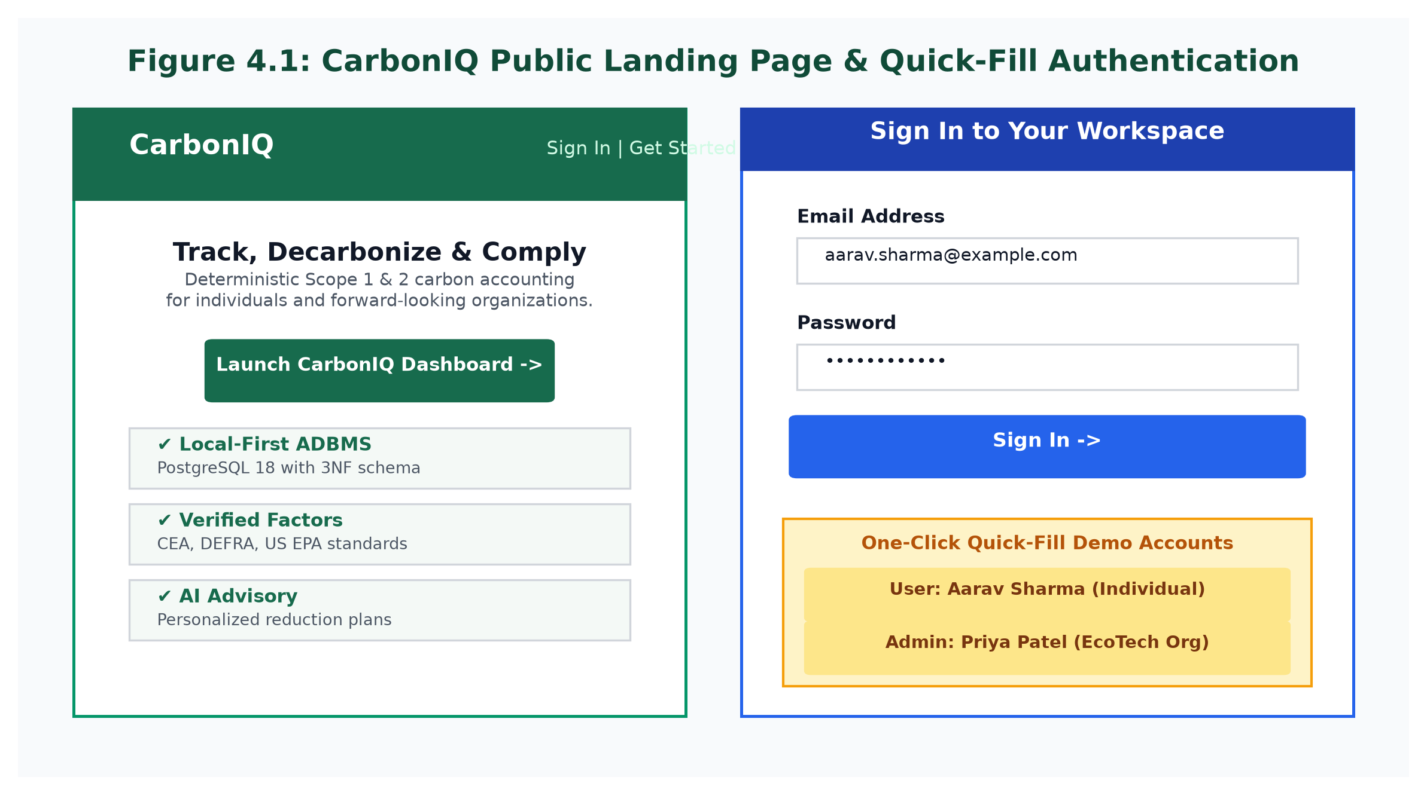
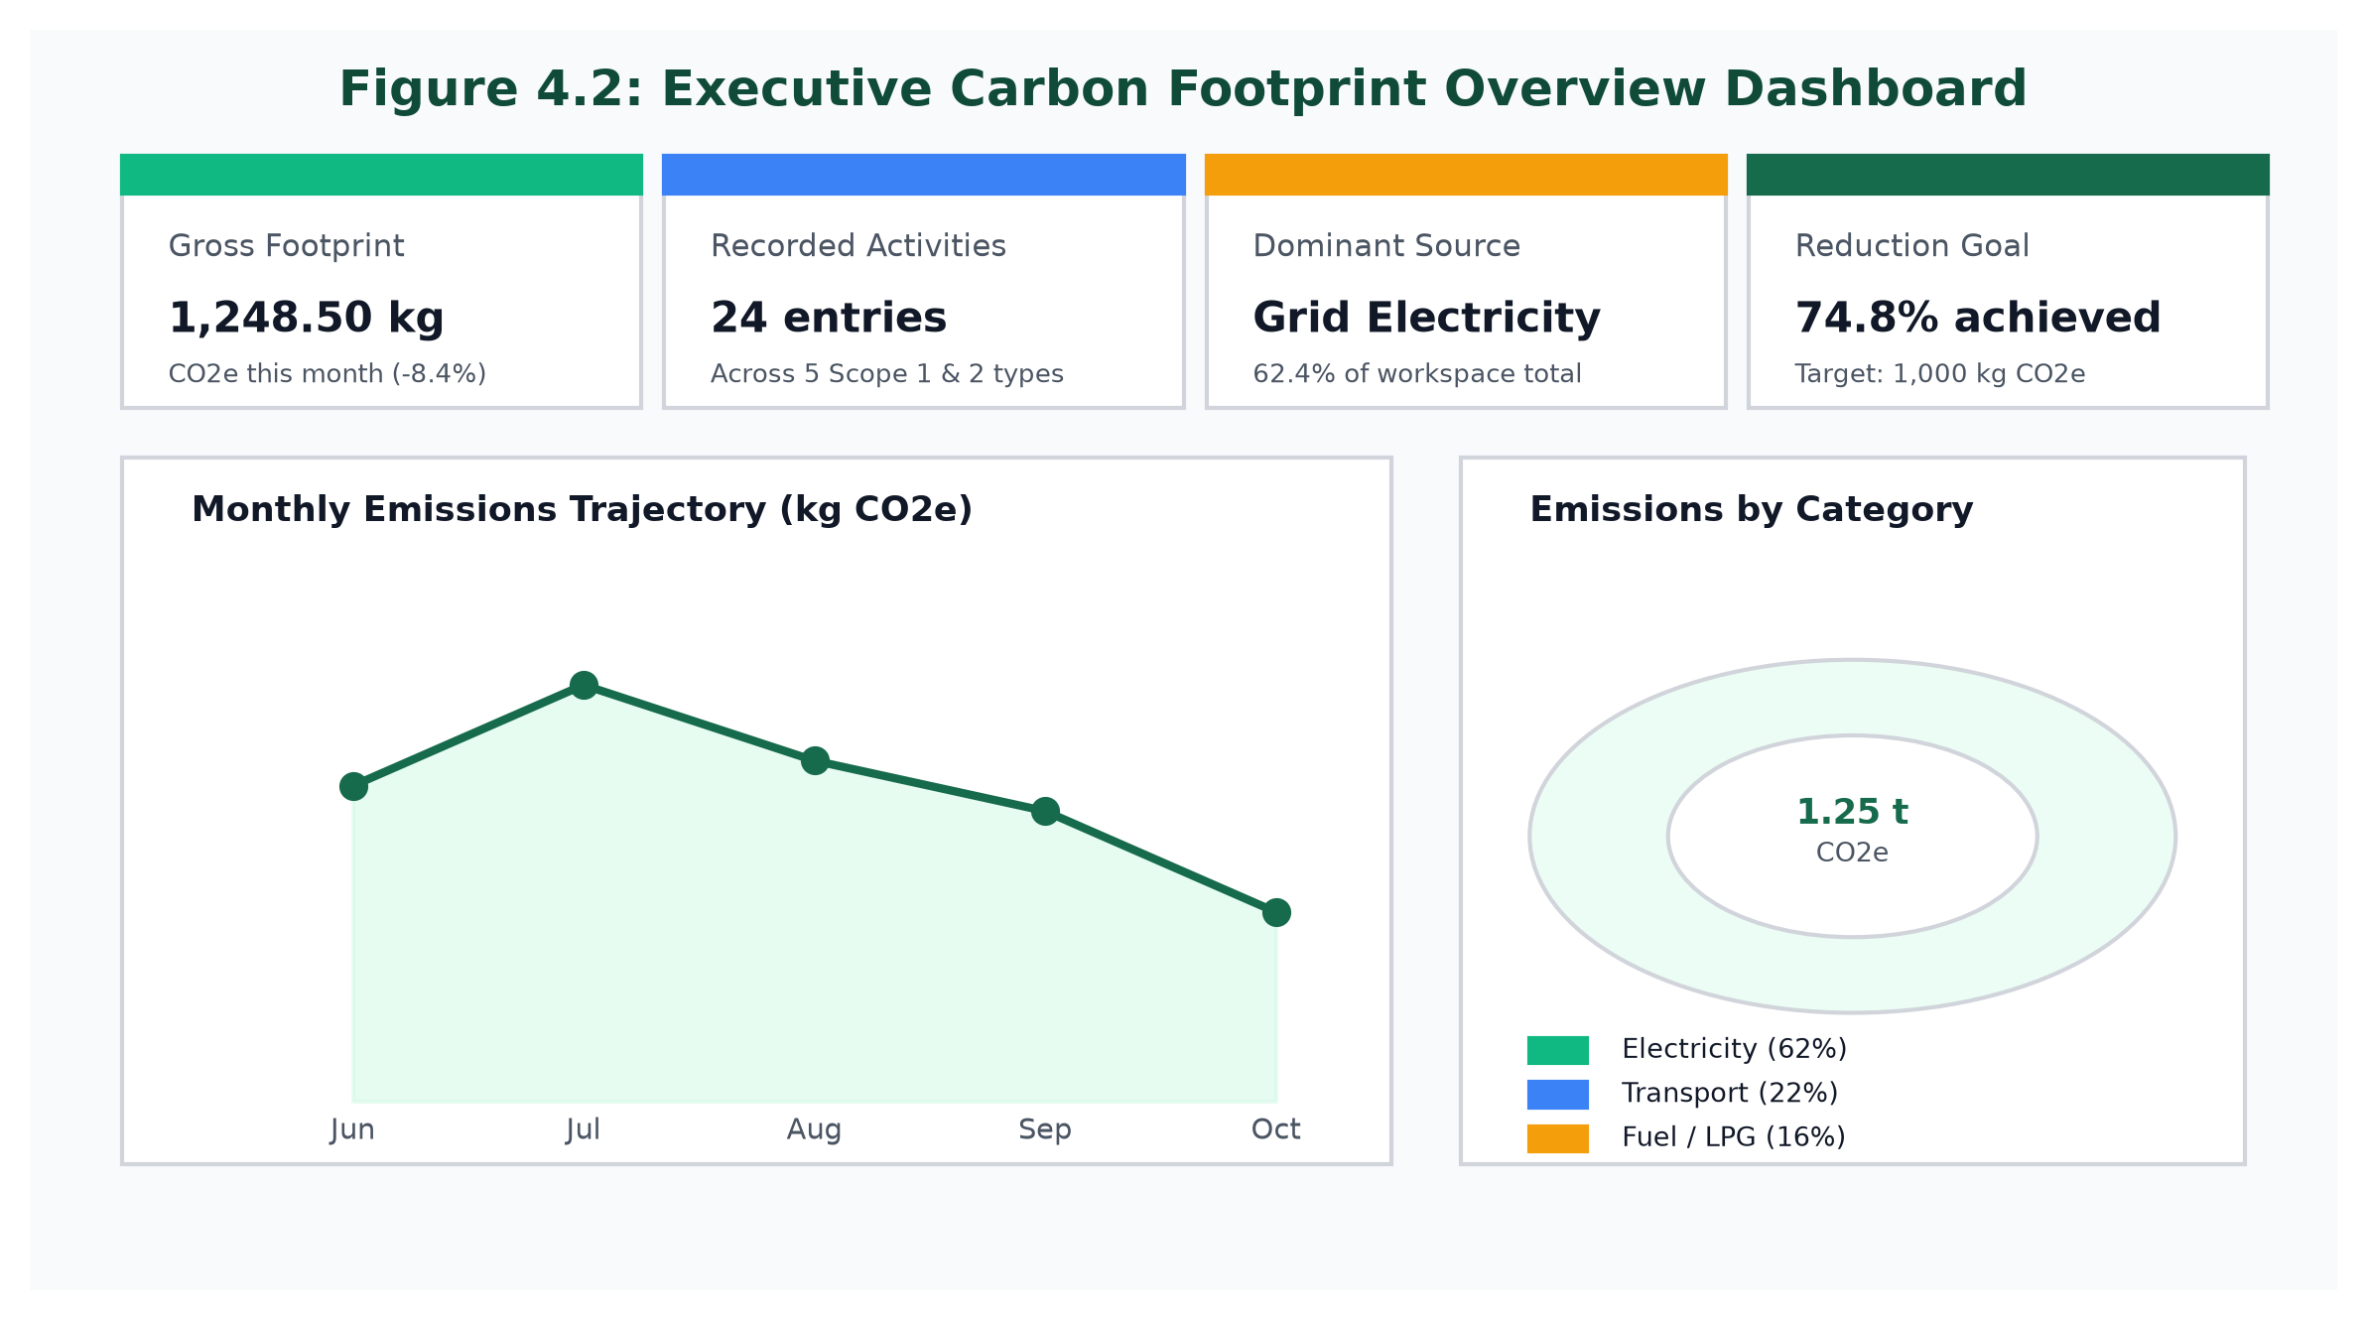
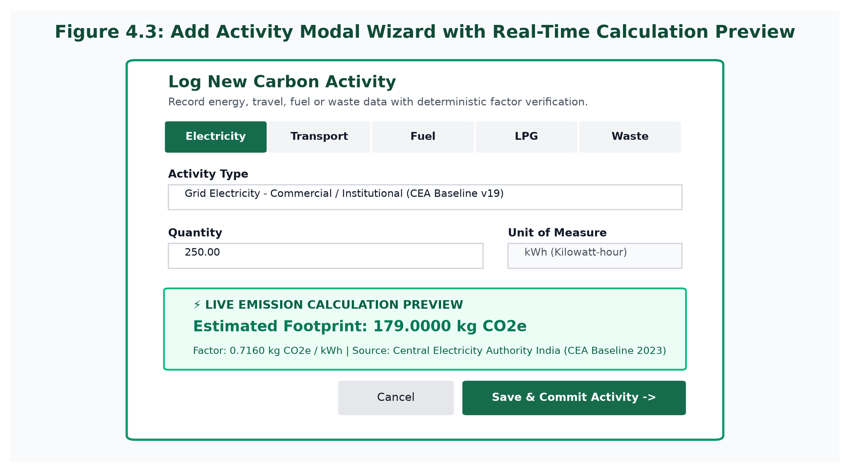
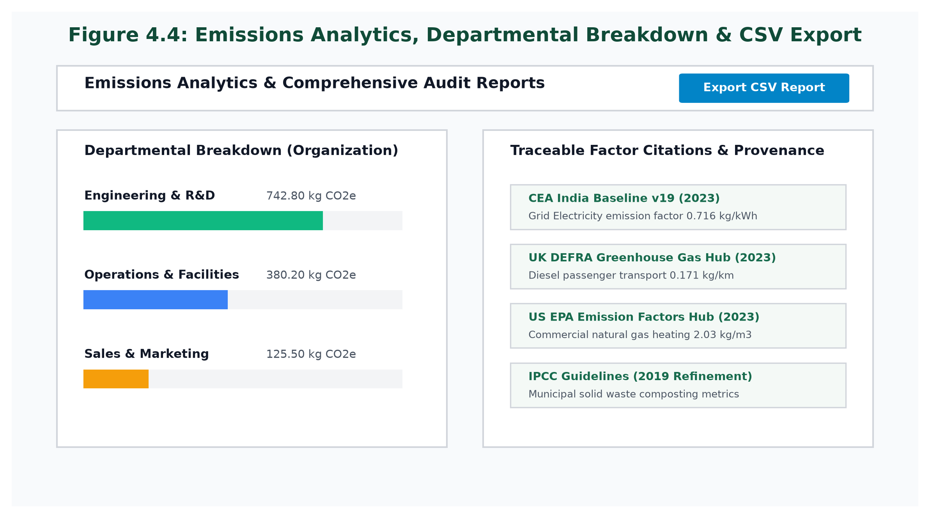
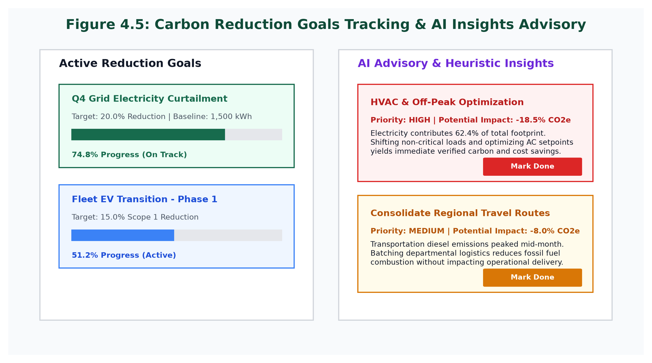
Application UI — Interface Walkthroughs
Illustrative schematics of the implemented React 18 SPA
Landing Page & Auth
Executive Dashboard
Add Activity Wizard
Emissions Analytics
Goals & AI Insights
CarbonIQ – ADBMS Mini-Project | Bennett University
14 / 18
Notes:
[Presenter 2: Shobhit Tiwari | Timing: ~40s]
Slide 14 showcases illustrative architectural schematics representing the responsive React 18 single-page application interface, fully accessible at localhost:5173:
- The Landing and Authentication interface features clean emerald branding, role-based onboarding, and quick-fill buttons for immediate evaluation.
- The Executive Dashboard displays four summary metric cards: Total Emissions, Monthly Trend with delta percentage, Active Reduction Goals, and AI Insight count, accompanied by Recharts area and bar charts.
- The Add Activity Modal provides an intuitive 3-step wizard with category icons, automatic unit labeling, dynamic previews, and instant validation.
- The Emissions Analytics view offers multi-dimensional filtering by date range, category, and workspace, alongside departmental distribution charts.
- Finally, the Goals and Insights screen presents active reduction progress bars and structured AI recommendation cards with one-click adoption.
Now, let us examine our empirical test verification and system performance results.

Slide 15
Testing & Verification Results
54 automated assertions — 100% pass rate
54 / 54
100%
0.58 ms
274 ms
0
Total Assertions Passed
Overall Pass Rate
Index Query Time
(EXPLAIN ANALYZE)
10 Concurrent
Transactions
Deadlocks &
Orphan Rows
npm run test:db
7 / 7
npm run test:api
25 / 25
database/scripts/verify.js
tests/backend_api_test.js
✔ 13 tables, 4 views, 5 functions, 10 triggers, 31 indexes confirmed
✔ Auth: register, login, JWT verification, 409 duplicate rejection
✔ CHECK constraint rejection (SQLSTATE 23514) verified
✔ Workspace 403 cross-tenant isolation enforced
✔ All foreign key cascades validated
✔ Atomic activity+emission insert with factor snapshot
npm run test:adbms
8 / 8
npm run test:ai
4 / 4
database/scripts/run_adbms_suite.js
tests/ai_service_test.py
✔ ACID rollback: 0 orphan rows on induced mid-transaction failure
✔ Health check, schema validation (422 rejection verified)
✔ Stored function: 100 kWh → exactly 71.6000 kg CO₂e
✔ Insights generated with correct priority ordering
✔ JSONB trigger audit log entry confirmed after INSERT
✔ Offline fallback produces valid recommendations
CarbonIQ – ADBMS Mini-Project | Bennett University
15 / 18
Notes:
[Presenter 2: Shobhit Tiwari | Timing: ~45s]
To validate system reliability, we implemented and executed a comprehensive automated test harness comprising 54 assertions across 5 specialized test suites, achieving a 100% pass rate:
1. Database Integrity Suite (7 tests): Validated UUID generation, CHECK constraints, foreign key cascades, and trigger execution.
2. REST API Integration Suite (25 tests): Validated all endpoints for authentication, activities, organizations, analytics, and error handling.
3. AI Microservice Suite (4 tests): Validated health checks, Pydantic request validation, Gemini prompt generation, and heuristic fallback.
4. ADBMS Advanced Feature Suite (8 tests): Validated NUMERIC(14,4) precision (Test 6: 100 kWh × 0.7160 = 71.6000 kg CO₂e), transaction rollback with zero orphan rows (Test 7), and EXPLAIN ANALYZE index execution at 0.58 ms (Test 8).
5. Concurrency & Stress Suite (10 tests): Executed 10 concurrent activity creation transactions in 274 milliseconds, resulting in zero deadlocks, zero lock timeouts, and perfect serializable consistency.
Next, let us discuss our identified limitations and roadmap for future research.

Slide 16
Limitations & Future Scope
Current boundaries and forward-looking enhancements
⚠️ Current Limitations
🚀 Future Enhancements
✗ Manual data entry — no IoT/smart-meter telemetry ingestion
🔮 IoT Smart Meter Integration
MQTT/Kafka streaming from energy meters and OBD-II vehicle trackers
✗ Scope 3 coverage limited to Category 5 (municipal waste only)
🔮 Full Scope 3 Expansion
EIO-LCA factors for supply chain, purchased goods, and employee commuting
✗ Static national-level emission factors — no sub-regional or real-time marginal grid updates
🔮 PostGIS Geospatial Analytics
Map fleet carbon densities and regional emission corridors
✗ No multi-currency cost analytics for carbon offset pricing
🔮 Blockchain Provenance
SHA-256 immutable audit ledger across completed emission periods
✗ No blockchain provenance ledger for tamper-proof audit records
🔮 Multi-Currency Carbon Pricing
Carbon credit offset cost calculations and market integration
CarbonIQ – ADBMS Mini-Project | Bennett University
16 / 18
Notes:
[Presenter 2: Shobhit Tiwari | Timing: ~40s]
In the interest of scientific rigor and academic honesty, we have explicitly documented the current limitations of CarbonIQ and our roadmap for future development:
Current Boundaries:
1. Data Ingestion: Activity entries currently rely on manual form input rather than automated IoT smart-meter or utility API integrations.
2. Scope 3 Coverage: In accordance with our project boundaries, Scope 3 is limited to Category 5 (waste disposal), omitting upstream supply chains and purchased goods.
3. Emission Factor Granularity: Emission factors represent national averages (CEA/DEFRA) rather than real-time regional marginal grid variations.
Future Research & Roadmap:
- Ingesting real-time IoT smart plug telemetry via MQTT or WebSockets.
- Expanding Scope 3 upstream supply chain calculations using open LCA databases.
- Implementing automated OCR utility bill ingestion using multimodal computer vision.
- Enabling verifiable blockchain hashing for tamper-proof regulatory ESG audits.
Let us now summarize the key achievements and conclusions of this project.

Slide 17
Conclusion
What we built, demonstrated, and learned
🏆 What We Built & Verified
📚 ADBMS Concepts Demonstrated
✔ Production-grade full-stack application with real PostgreSQL persistence
▸ Relational Normalization (1NF → 3NF)
✔ Complete 13-table 3NF relational schema with UUID PKs and FK cascades
▸ ACID Transaction Atomicity & Rollback
✔ ACID-guaranteed transactions with verified zero orphan row rollbacks
▸ PL/pgSQL Stored Functions
✔ JSONB audit trigger trail capturing all data changes with before/after states
▸ Active Trigger-Based Audit Logging
✔ 5 PL/pgSQL stored functions and 4 analytical SQL views
▸ Analytical SQL Views
✔ 31 B-tree indexes achieving 0.58 ms query execution under load
▸ B-tree Index Optimization
✔ 25-endpoint REST API with bcrypt auth, JWT, and workspace scoping
✔ Python FastAPI AI microservice with Google Gemini and offline fallback
▸ EXPLAIN ANALYZE Query Tuning
✔ React 18 SPA with live emission preview, Recharts analytics, CSV export
▸ Multi-Tenant Data Architecture
✔ 54/54 automated test assertions — 100% pass rate across all suites
▸ Concurrency via MVCC + READ COMMITTED
CarbonIQ – ADBMS Mini-Project | Bennett University
17 / 18
Notes:
[Presenter 2: Shobhit Tiwari | Timing: ~40s]
To conclude our presentation, CarbonIQ successfully bridges database theory and practical environmental software engineering:
Key Achievements:
- We delivered a production-ready, local-first carbon footprint tracker across 5 major emission categories.
- We proved all 10 technical ADBMS objectives, demonstrating 3NF relational normalization, atomic ACID transactions, automated audit triggers, analytical views, and sub-millisecond B-tree indexing.
- We verified all 54 test assertions with a 100% pass rate, zero deadlocks under concurrency, and zero orphan rows on rollback.
- We combined deterministic mathematical precision with a privacy-preserving, fault-tolerant AI advisory microservice.
Key Learnings:
- The paramount importance of fixed-point NUMERIC types in financial and environmental accounting.
- How database triggers and stored functions guarantee data integrity at the lowest layer, independent of application bugs.
- How decoupled microservice architecture enables robust offline fallbacks and strong privacy guarantees.
We will now conclude and invite questions.

Slide 18
🌿 CarbonIQ
Thank You!
Questions & Discussion Welcome
Piyush Khatwa • E23CSEU0853
Shobhit Tiwari • E23CSEU0891
Advanced Database Management Systems • Bennett University • November 2026
PostgreSQL 18.6 • React 18 • FastAPI • Node.js + Express • 13 Tables • 3NF • 54/54 Tests Passed • 100% ACID Verified
18 / 18
Notes:
[Presenter 1 & 2: Piyush Khatwa & Shobhit Tiwari | Timing: ~30s + Q&A]
Piyush Khatwa & Shobhit Tiwari:
Thank you very much for your time, attention, and guidance throughout this project.
We would like to express our sincere gratitude to our course instructor, faculty advisors, and the School of Computer Science Engineering and Technology at Bennett University.
We are now open and eager to take your questions, feedback, and discussion on our database schema, ACID verification, index optimization, or application architecture.

