Slide 1

‘Samadhan’ A Local Government Service QueryBot
Tribhuvan University Institute of Engineering Thapathali Campus
Department of Electronics and Computer Engineering
Aarogya Bhandari (THA077BCT001)
Aayush Pokharel (THA077BCT002)
Piyush Luitel (THA077BCT031)
Prashant Bhusal (THA077BCT034)
8th January, 2024

Slide 2
Presentation Outline
Motivation
Objectives
Scope of Project
Proposed Methodology
Expected Results
Project Applications
Tentative Timeline
Estimated Project Budget
References

Slide 3
Motivation
Scattered information and no central hub
Lack of a reliable information system
A user-friendly chatbot for local government services
Bridges the gap, providing a centralized platform for the information

Slide 4
Objectives
To develop a chatbot that solves the government service queries in English.
To deploy Samadhan as a web-application.

Slide 5
Scope of Project
Information accessibility
Guidance and assistance
User-Friendly Interface
Transparency and Accountability

Slide 6
Proposed Methodology-[1]
Fig:- Agile Software Development Approach

Slide 7
Proposed Methodology-[2]
Fig: Three-layered System Architecture

Slide 8
Proposed Methodology-[3]
User Interface Layer: User-friendly interactive interface
Logical Layer: Process User Queries
Data Layer: Knowledge base and problem reports from user

Slide 9
Proposed Methodology-[4]
Figure:- UML Use Case Diagram of main program

Slide 10
Proposed Methodology-[5]
Figure:- Workflow of the proposed system

Slide 11
Proposed Methodology-[6]
Software | Reason
Python | Python for coding and utilizing various modules and libraries.
HTML, CSS and Javascript | For front-end development.
Rasa | Rasa for natural language understanding and natural language generation.
spaCy | spaCy for enhanced entity recognition and part-of-speech tagging.
VS code IDE | Visual Studio Code (VS Code) for development and project management.
Canva | Canva for the development of animated videos.

Slide 12
Expected Results-[1]
User-friendly interface for effortless navigation of government services.
Information hub for comprehensive details on various government services.
Problem report logging for continual improvement based on user input.

Slide 13
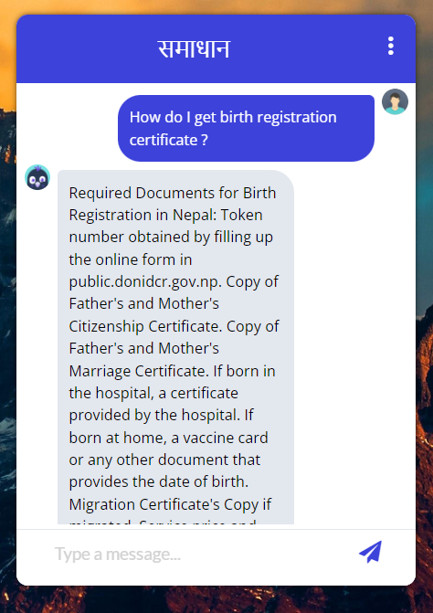
Expected Results-[2]

Slide 14
Project Application
Easy access of information
User interactive solution
User friendly

Slide 15
Tentative Timeline

Slide 16
Estimated Project Budget
S.N. | Particulars | Price (Rs.) | Quantity | Total Price (Rs.)
1 | Server Hosting | 2000 per month | 1 | 2000/-
2 | Acquiring a domain name | 1500 per year | 1 | 1500/-
3 | Canva Pro Subscription | 1700 per month | 1 | 1700/-
4 | Printing | 1300 | 1 | 1300/-
TOTAL |  |  |  | 6500/-

Slide 17
References-[1]
[1] R. K. Sharma, "An Analytical Study and Review of open source Chatbot framework, Rasa," International Journal of Engineering Research & Technology (IJERT), vol. 9, no. 6, 2020.
[2] H. Bansal and R. Khan, "A Review Paper on Human Computer Interaction," nternational Journals of Advanced Research in Computer Science and Software Engineeing, vol. 8, no. 4, 2018.
[3] L. Klopfenstein, S. Delpriori, S. Malatini and A. Bogliolo, "The Rise of Bots: A Survey of Conversational Interfaces, Patterns, and Paradigms," in The 2017 Conference, Urbino, 2017.
[4] Diyo.ai, "Localizing AI | DIYO.AI," [Online]. Available: https://diyo.ai/muna. [Accessed 15 12 2023].

Slide 18
References-[2]
[5] S. Government, "AskGov | Q&A: Your questions answered," Open Government Products, [Online]. Available: https://ask.gov.sg/. [Accessed 15 12 2023].
[6] J. Pennington, R. Socher and C. D. Manning, "GloVe: Global Vectors for Word Representation," in Conference on Empirical Methods in Natural Language Processing (EMNLP), Doha, Qatar, 2014.
[7] A. Jiao, "An Intelligent Chatbot System Based on Entity Extraction Using RASA NLU and Neural Network," Journal of Physics: Conference Series, vol. 1487, no. 012014, 2020.
[8] E. Adamopoulou and L. Moussiades, "An Overview of Chatbot Technology," in IFIP International Conference on Artificial Intelligence Applications and Innovations, 2020.

Slide 19
THANK YOU

