Slide 1
BCA FINAL YEAR PROJECT
KrishiGyaan makes agricultural support usable across language, connectivity, and service boundaries.
AI-assisted multilingual agricultural support platform
AI
+ DATA
+ ACCESS
Prepared by
Piyush Nath
Enrollment No. ____________________
Institution ________________________
Project Guide _____________________
KRISHIGYAAN | BCA FINAL YEAR PROJECT
01

Slide 2
PROBLEM
Farmers face one decision journey spread across many disconnected systems.
Fragmented guidance
Language friction
Weather, disease, schemes, and soil advice are usually accessed separately.
English-first interfaces reduce comprehension and confidence for regional-language users.
Connectivity risk
Trust and safety
Live-only applications lose practical value when rural networks become unstable.
Raw AI or diagnosis output needs validation, context, and clear failure behaviour.
KRISHIGYAAN | BCA FINAL YEAR PROJECT
02

Slide 3
OBJECTIVES
Six verifiable objectives convert the agricultural problem into a software engineering project.
1
Secure farmer registration and password-based login
2
Multilingual, voice-assisted interaction
3
AI advisory with primary and fallback providers
4
Crop, plant, soil, weather, and scheme workflows
5
Offline application shell and last-result restoration
6
Serverless deployment with protected environment secrets
KRISHIGYAAN | BCA FINAL YEAR PROJECT
03

Slide 4
PRODUCT FLOW
One authenticated dashboard connects the complete farmer support workflow.
01
02
03
04
05
06
→
→
→
→
→
Profile
Weather
Soil
Crop / Plant
Schemes
KrishiBaba
Each service uses the same farmer profile, selected language, and protected API boundary.
KRISHIGYAAN | BCA FINAL YEAR PROJECT
04

Slide 5
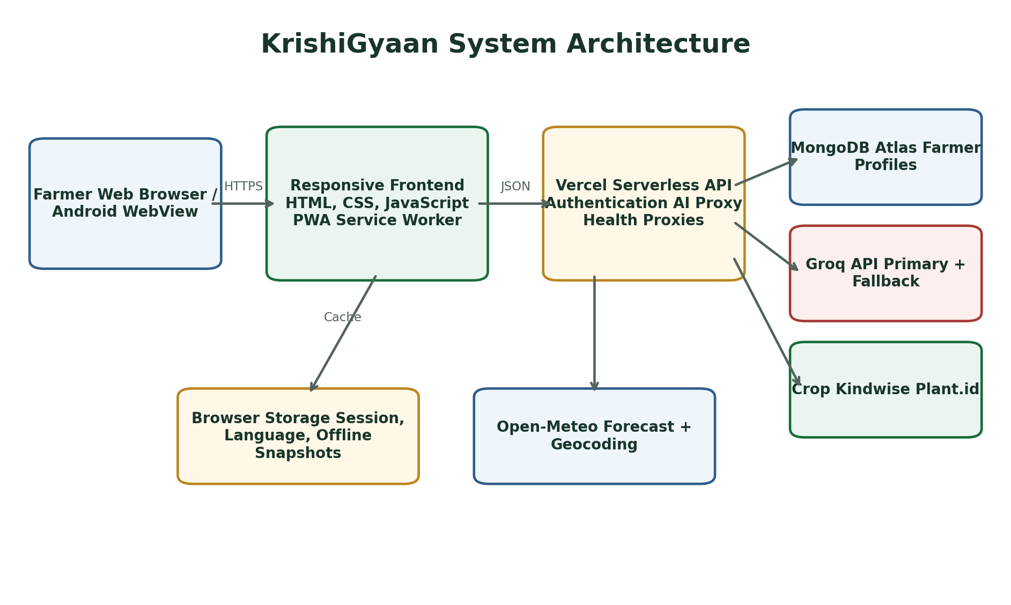
ARCHITECTURE
The system isolates user experience, server-side secrets, persistent data, and external intelligence.
INTERPRETATION
Browser code never receives MongoDB, Groq, Crop Kindwise, or Plant.id credentials.
KRISHIGYAAN | BCA FINAL YEAR PROJECT
05

Slide 6
AUTHENTICATION
Farmer identity is persisted in MongoDB without storing plaintext passwords.
1
2
3
4
Validate
Derive
Persist
Verify
Indian mobile number and password policy
PBKDF2-SHA512, random salt, 120,000 iterations
Unique mobile index and sanitized farmer profile
Timing-safe comparison on every login
KRISHIGYAAN | BCA FINAL YEAR PROJECT
06

Slide 7
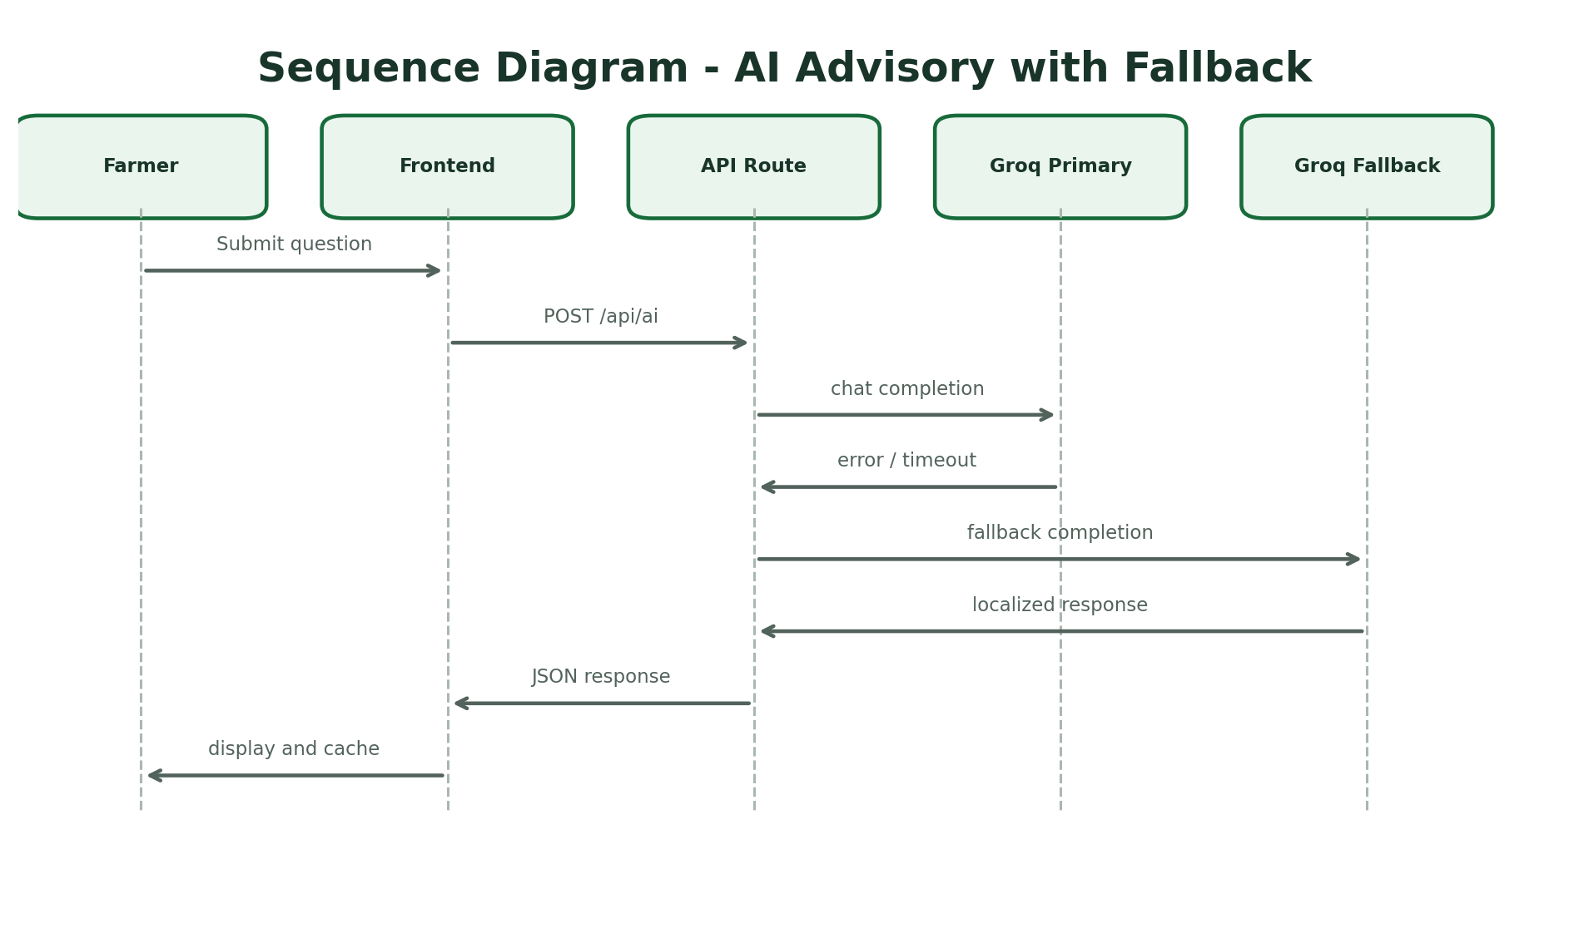
AI RELIABILITY
A second Groq configuration reduces the primary model as a single point of failure.
INTERPRETATION
The API returns a combined, readable failure only after both configured providers fail.
KRISHIGYAAN | BCA FINAL YEAR PROJECT
07

Slide 8
ACCESSIBILITY
Language, speech, and persistent preference are part of the interaction model, not add-ons.
LANGUAGE
VOICE
10 language choices
Speech-to-text questions
Static locale dictionaries
Clicked-line text-to-speech
Dynamic AI response language
Global mute control
Manual selection persists
Browser capability fallback
KRISHIGYAAN | BCA FINAL YEAR PROJECT
08

Slide 9
OFFLINE CONTINUITY
Offline mode preserves reference value and makes reconnection an explicit user decision.
Online use
Network loss
Offline action
Connection returns
Cache application shell and save successful result
→
Keep pages available through the service worker
→
Show the exact last browser snapshot with a timestamp
→
Offer Reload or Cancel before restoring live functions
KRISHIGYAAN | BCA FINAL YEAR PROJECT
09

Slide 10
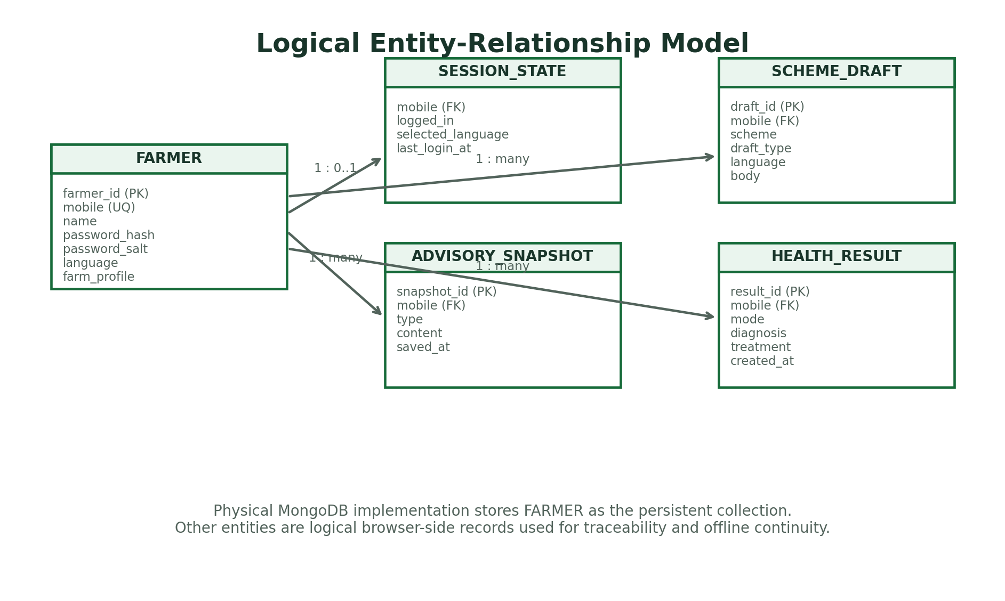
DATA MODEL
Persistent farmer identity is separated from logical session, draft, health, and advisory records.
INTERPRETATION
Only the farmer collection is durable in MongoDB; offline snapshots remain browser-local.
KRISHIGYAAN | BCA FINAL YEAR PROJECT
10

Slide 11
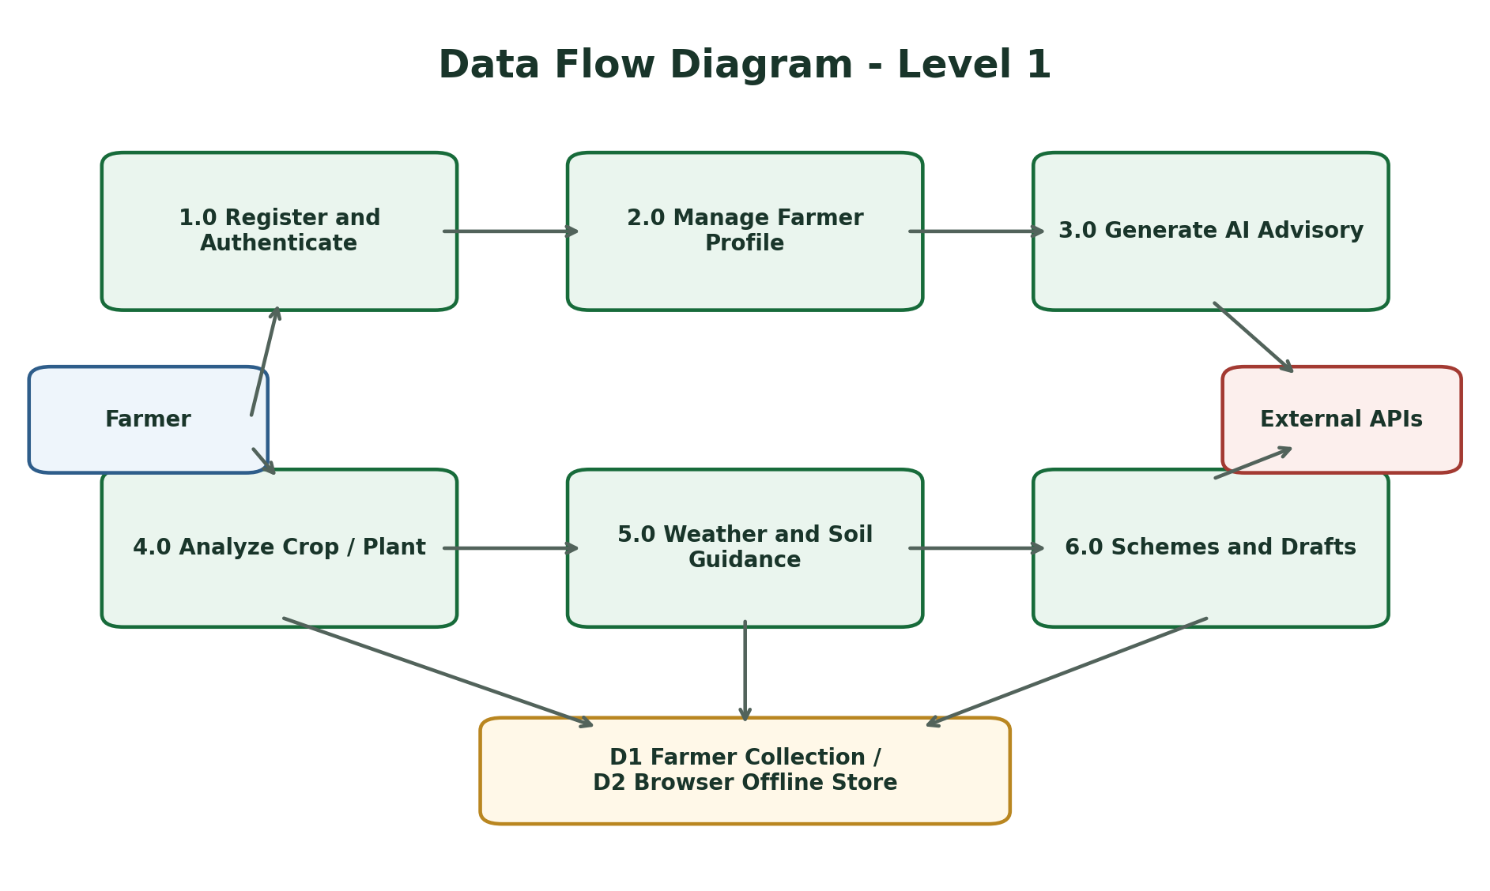
DATA FLOW
Every provider exchange terminates at a defined process and returns a user-facing result.
INTERPRETATION
The DFD separates registration, profile, AI, health, weather/soil, and scheme processing.
KRISHIGYAAN | BCA FINAL YEAR PROJECT
11

Slide 12
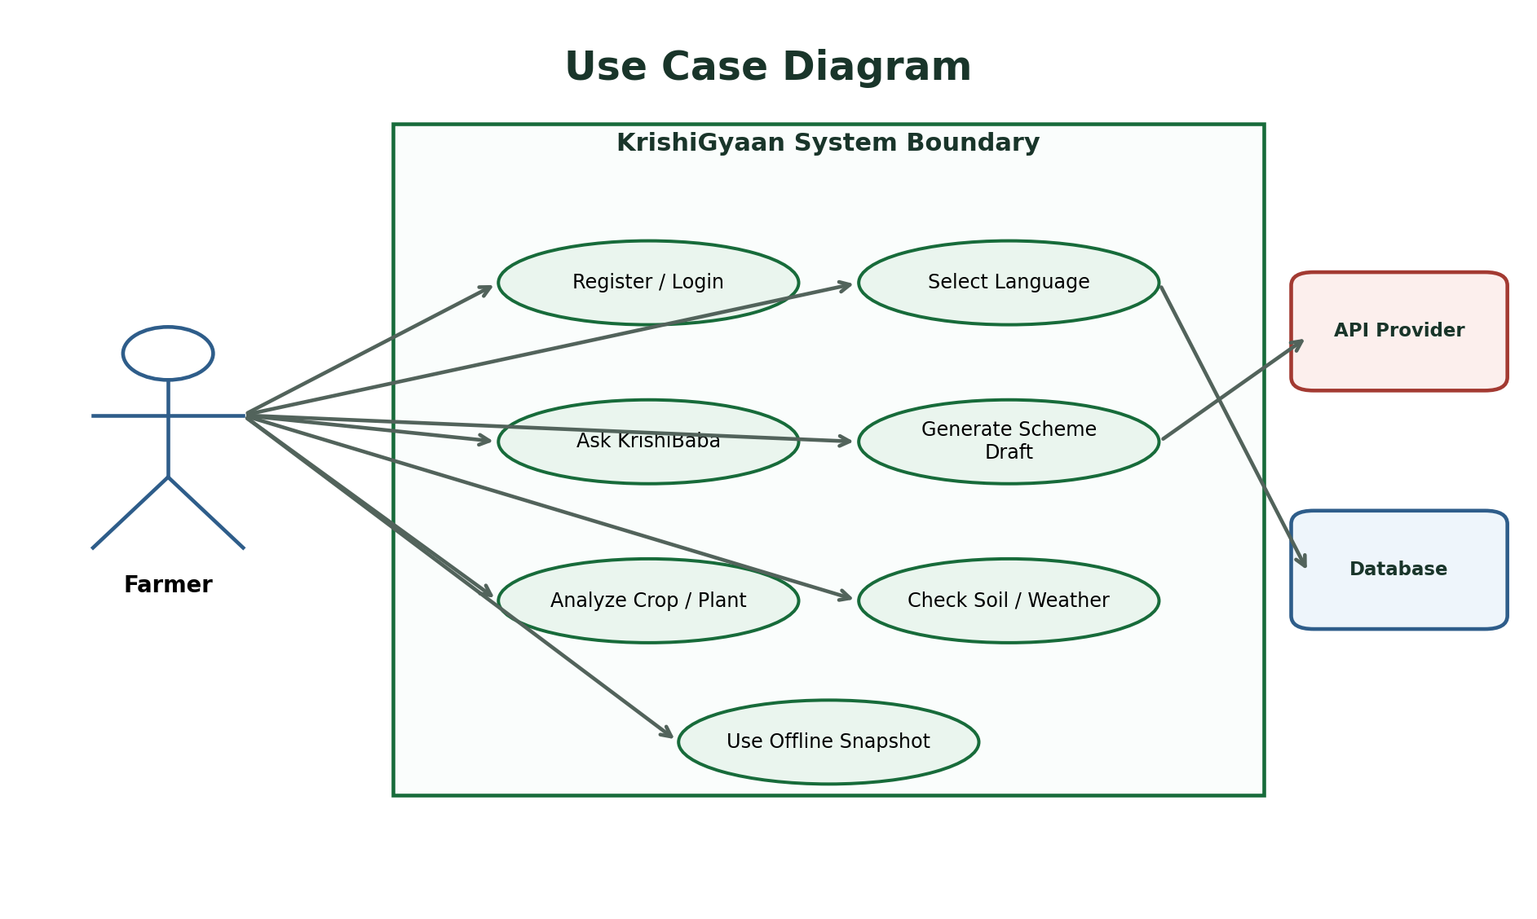
USE CASES
The farmer remains the primary actor across all service and recovery paths.
INTERPRETATION
External APIs and the database support use cases but do not become user-facing actors.
KRISHIGYAAN | BCA FINAL YEAR PROJECT
12

Slide 13
SEQUENCE
The AI request path is deterministic even when the primary provider fails.
INTERPRETATION
A successful response is displayed and cached; failure details remain server-side controlled.
KRISHIGYAAN | BCA FINAL YEAR PROJECT
13

Slide 14
IMPLEMENTATION
Repository ownership maps cleanly to frontend, serverless, local development, and deployment concerns.
frontend/
Pages, localization, speech, offline cache, dashboard workflows
api/auth/
MongoDB connection, registration, login, password recovery
api/*.js
AI, crop health, and plant health serverless proxies
backend/
Local Node.js development server
vercel.json
Static and API routing for production deployment
KRISHIGYAAN | BCA FINAL YEAR PROJECT
14

Slide 15
TESTING
Acceptance testing covers the failure paths most likely to affect a real farmer.
AREA
ACCEPTANCE COVERAGE
Validation
mobile, password, duplicate account, required image
Integration
MongoDB login, AI fallback, health providers, weather
Experience
language persistence, voice, responsive navigation
Resilience
offline shell, snapshots, reconnect prompt
Security
secret isolation, sanitization, generic login errors
Evidence boundary: syntax checks and documented manual acceptance; no automated test framework is claimed.
KRISHIGYAAN | BCA FINAL YEAR PROJECT
15

Slide 16
SECURITY
Security is enforced through data minimization, secret isolation, validation, and safe failure.
Credentials
Passwords
All provider and database keys are loaded from environment variables.
Salted PBKDF2 hashes replace plaintext storage and timing-safe comparison reduces leakage.
Profiles
Failures
Password fields are removed before any profile is returned to the browser.
Readable errors avoid exposing server configuration or raw provider credentials.
KRISHIGYAAN | BCA FINAL YEAR PROJECT
16

Slide 17
ROADMAP
The next version should turn a strong prototype into a measured production service.
Now
Next
Later
Scale
Working responsive PWA, serverless APIs, MongoDB authentication
→
Automated unit/integration suite, token-based sessions, rate limiting
→
Agronomist-reviewed knowledge base, analytics, audited diagnosis quality
→
Role-based administration, alerting, observability, consent controls
KRISHIGYAAN | BCA FINAL YEAR PROJECT
17

Slide 18
CONCLUSION
KrishiGyaan demonstrates the complete BCA project lifecycle in one practical system.
Requirements • Design • Development • Database • APIs • Testing • Deployment
A practical system. A traceable design. An honest evaluation.
Questions and Viva Discussion
KRISHIGYAAN | BCA FINAL YEAR PROJECT
18

