Slide 1


MAGNETIC FLUXION
Submitted by
PIYUSH ROHIT(23ECE1038)
NAVODITH SETH(23ECE1023)
FREDRICK(23ECE1010)
To
Dr.Mallikarjun Errasmshetty
Departement of Electronics and Communication Engineering
National Institute of Technology Goa
November 20,2024

Slide 2


Slide 3
Introduction
Our electromagnetic Fluxion devices utilize magnetic fields to either propel, decelerate or reverse objects along a linear. A switch mechanism and a detecting sensor ensure the magnetic field is activated only when the ball is detected. This design enhances energy efficiency and control.

Slide 4
Working Principle
1. The detecting sensor identifies the ball's position as it moves along the linear path.
2. The switch mechanism activates the magnetic field only when the ball reaches specific positions.
3. The operation carried out depends on which pole of the ball magnet faces the coil.

Slide 5
Components
Key components of the Electromagnetic Fluxion:
- Magnetic Coils
- Detection Sensor
- Switch Mechanism
- Linear Track for Ball Movement

Slide 6

SWITCHING MECHANISM

Slide 7
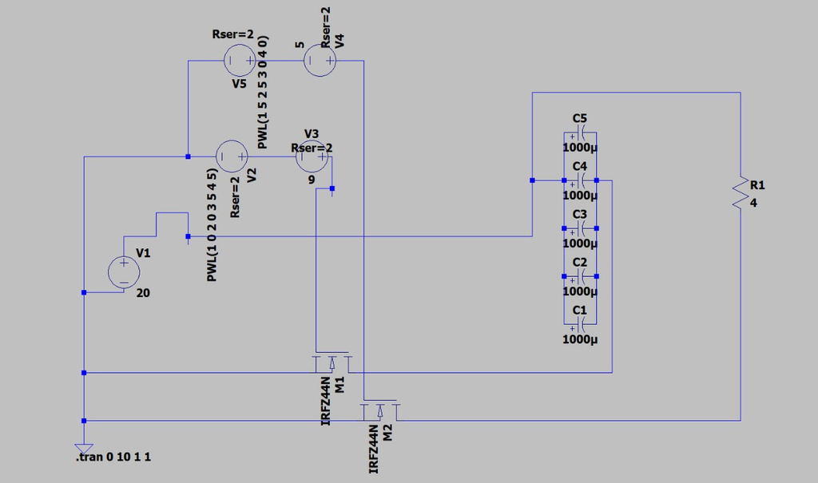
SWITCH MECHANISM CIRCUIT

Slide 8
Advantages
- Energy-efficient design due to selective activation of the magnetic field.
- Compact and scalable for various applications.
- Precise control over the motion of the ball.

Slide 9
Challenges
- Synchronization between the sensor and the magnetic field is critical.
- Heat dissipation in magnetic coils needs effective management.
- Mechanical wear on moving components requires attention.
Choosing a specific task as per our requirement

Slide 10
Applications
Reversal of a trains direction without using circular tracks
Automatic deceleration of cars on busy highway without problems of friction
Particle acceleration for research purposes.

Slide 11
Conclusion
The Electromagnetic Fluxion with switch mechanisms and detecting sensors combine precision and efficiency. They have potential applications in various scientific and industrial fields, paving the way for innovative motion control solutions.

