Slide 1
Project Presentation of CO-OP Project at Industry (Module-2) (22CS421)
On
Machine Learning Enabled Predictive Analytics for Diabetes Risk Detection
Piyush Sacher
2210990653
Supervised By
Dr. Swati Goel
Department of Computer Science and Engineering,
Chitkara University, Punjab

Slide 2
INTRODUCTION
Diabetes is a chronic disease affecting millions worldwide and requires early detection for effective management.
Traditional diagnosis methods can be time-consuming and may not always identify risk at an early stage.
Machine Learning provides a powerful approach to analyze medical data and predict disease risk accurately.
This project uses advanced models like LightGBM, CatBoost, and Artificial Neural Network to predict diabetes risk.
The system also integrates Explainable AI techniques to ensure transparency and trust in predictions.
2

Slide 3
PROBLEM STATEMENT
Early detection of diabetes is challenging due to reliance on traditional diagnostic methods that are often time-consuming and dependent on manual analysis. Many existing systems lack accuracy and fail to identify high-risk patients at an early stage. Additionally, most machine learning models act as black boxes, making their predictions difficult to interpret. Therefore, there is a need for an efficient, accurate, and explainable system that can predict diabetes risk and support healthcare professionals in decision-making.

Slide 4
OBJECTIVE
To develop a machine learning-based system to predict the risk of diabetes at an early stage
To analyze patient health data such as Glucose, BMI, Insulin, and Age for accurate prediction
To apply advanced models like LightGBM, CatBoost, and Artificial Neural Network
To improve prediction performance using data preprocessing and class balancing techniques (SMOTE)
To assist healthcare professionals in early diagnosis and decision-making

Slide 5
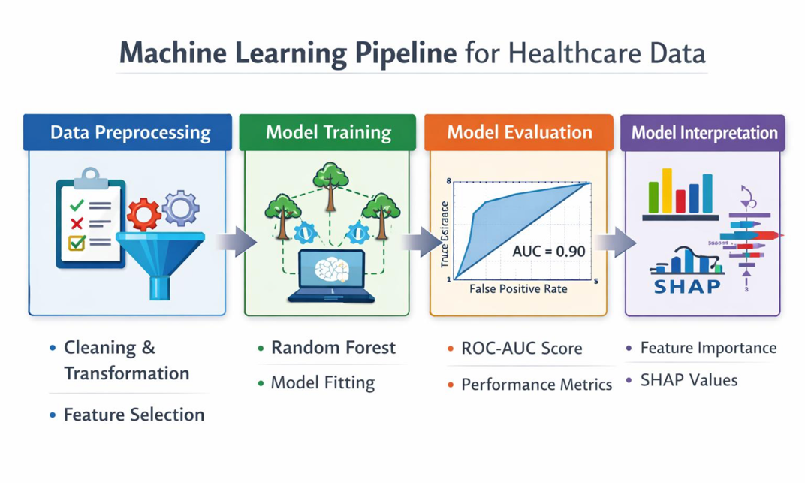
METHODOLOGY

Slide 6
METHODOLOGY
Data preprocessing:
Handling missing values
Replacing invalid zero values
Feature engineering and normalization
Splitting dataset into training and testing sets
Applying multiple machine learning algorithms
Evaluating models using standard metrics
Comparing model performance using graphs
Applying Explainable AI techniques for interpretation

Slide 7
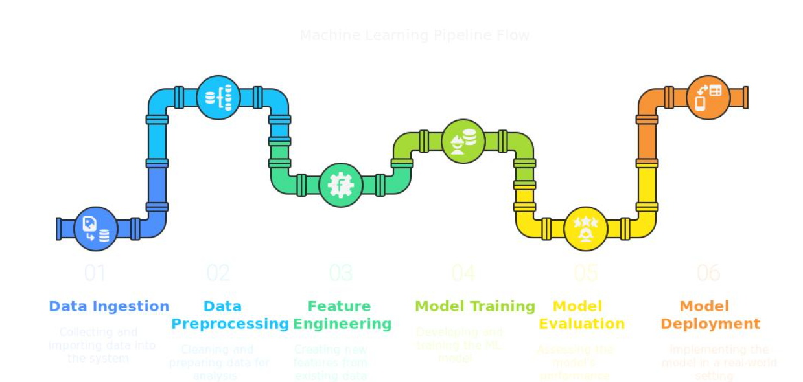
METHODOLOGY

Slide 8
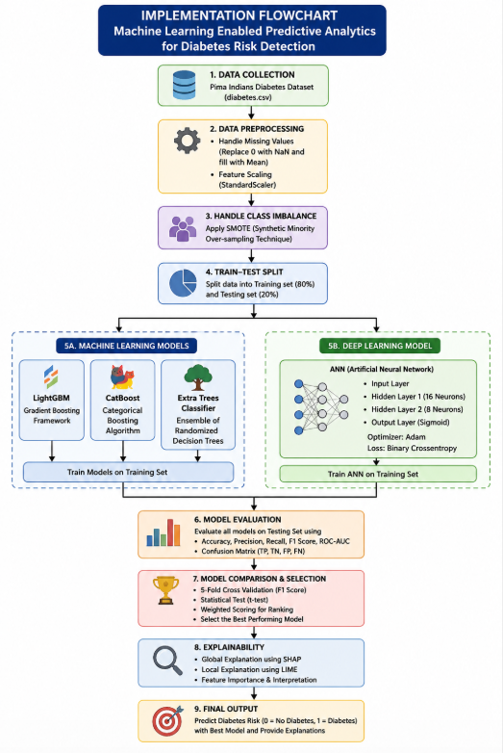
FLOWCHART

Slide 9
ML Models
These are the Supervised Leanring ML models used-
Ensemble Machine Learning Models Used advanced ensemble models like LightGBM, CatBoost, and Extra Trees Classifier to improve prediction accuracy and robustness.
Deep Learning Model (ANN) Implemented an Artificial Neural Network with multiple dense layers to capture complex nonlinear relationships in diabetes data.
Handling Data Imbalance Applied SMOTE to balance the dataset and improve model performance on minority (diabetic) cases.
Model Evaluation & Selection Compared models using Accuracy, Precision, Recall, F1-score, and ROC-AUC, followed by weighted scoring and statistical testing to select the best-performing model.

Slide 10
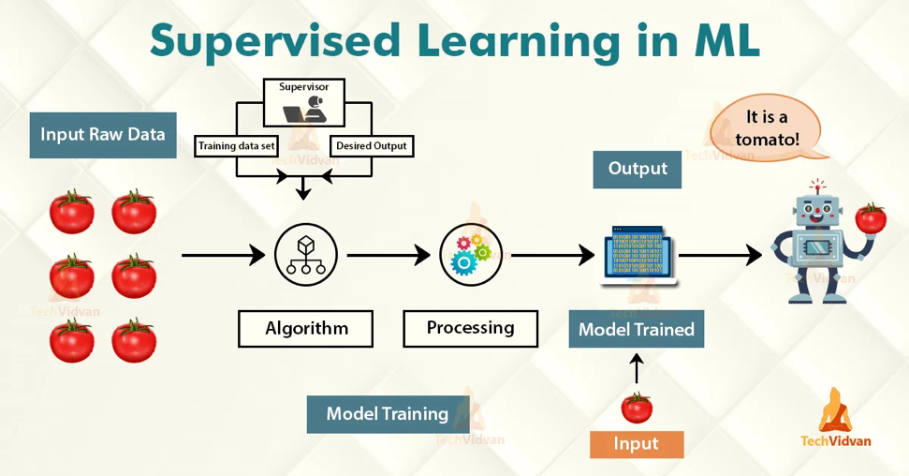
ML Models

Slide 11
Evaluaton Metrics
Accuracy: overall correctness of the model
Precision: correctness of positive predictions
Recall: ability to detect diabetic cases
F1 Score: balance between precision and recall
ROC-AUC: model’s ability to distinguish classes

Slide 12
Explainable AI
SHAP:Provides global feature importance
Shows how each feature affects prediction
LIME:Explains individual predictions
Helps understand specific cases
Improves transparency of ML models
Builds trust among healthcare professionals
Makes model decisions interpretable

Slide 13
Results
Extra Trees Classifier achieved the best performance with: 85.5% Accuracy, 80.00% Precision, 95.05% Recall, 86.88% F1-score, 92.41% ROC-AUC
High Recall (95.05%) indicates excellent ability to correctly identify diabetic patients (critical in healthcare)
CatBoost and LightGBM both achieved 80.5% accuracy, with CatBoost slightly better in Recall and F1-score
Artificial Neural Network showed comparatively lower performance with 79.0% accuracy and 80.19% F1-score
Overall, tree-based ensemble models outperformed ANN, showing better reliability and stability

Slide 14
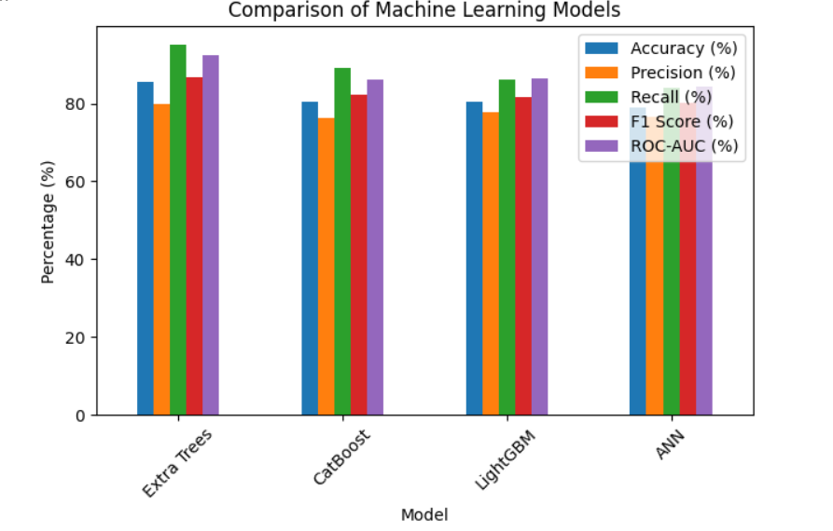
Results

Slide 15
CONCLUSION
Successfully developed a machine learning-based system for diabetes risk prediction
Extra Trees Classifier achieved the best performance among all models
High recall ensures accurate identification of diabetic patients, which is critical in healthcare
Tree-based ensemble models outperformed the Artificial Neural Network on this dataset
Integration of Explainable AI (SHAP & LIME) improved model transparency and interpretability
The system can support early diagnosis and better healthcare decision-making

Slide 16
FUTURE SCOPE
Integration with hospital systems
Development of web/mobile application
Use of deep learning models
Inclusion of lifestyle and genetic data
Real-time monitoring and alerts

Slide 17
Thank You
17

