Slide 1

Assignment

Slide 2
Tour Mangament
By 18mcme21

Slide 3
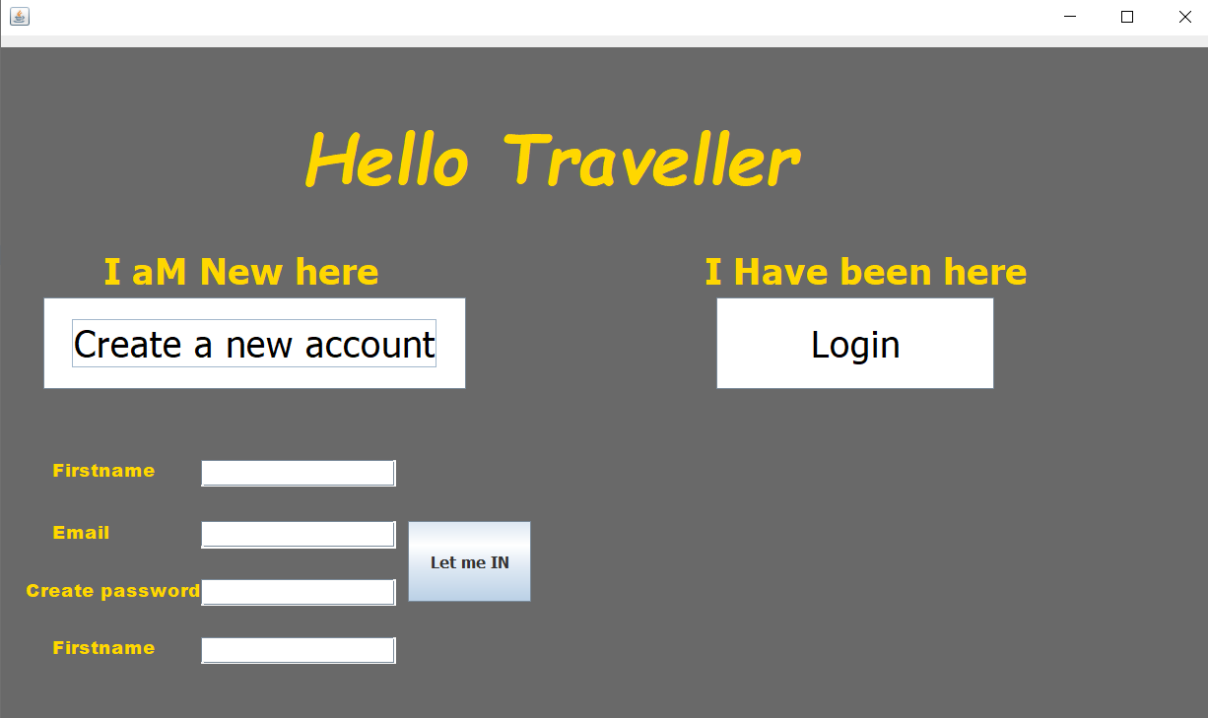
Front page of the gui which requieres u to have an id and password and if you want to create an account your details will be saved in the database called userdata

Slide 4
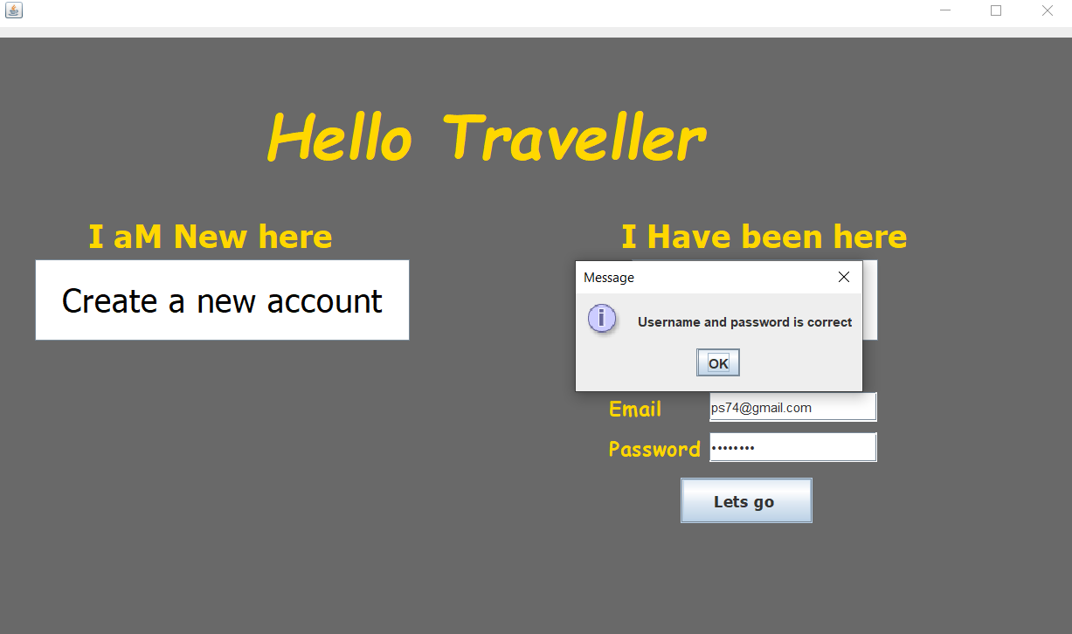
If your id password is correct you are directed to the next frame

Slide 5
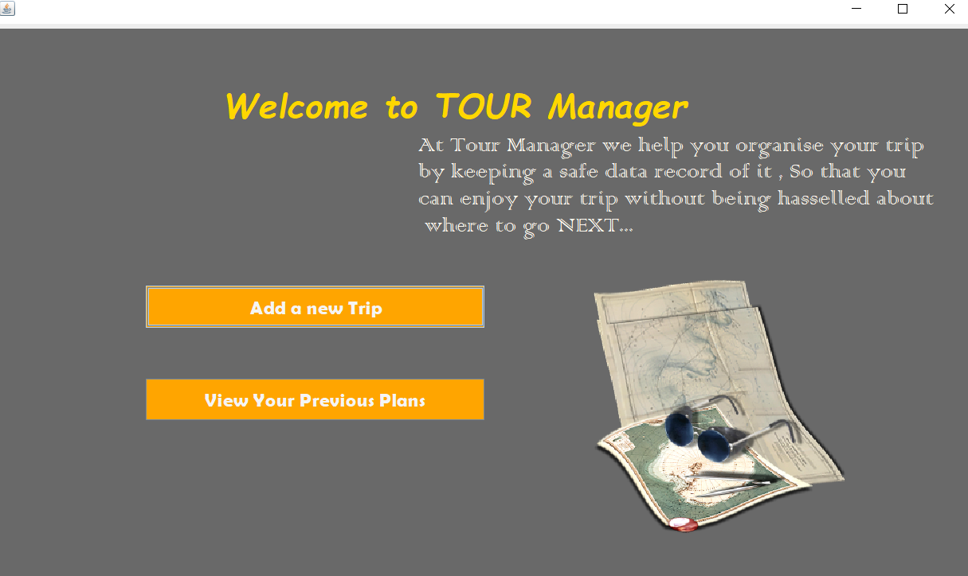
Here you create a new trip or view your previous trip , although the feature of old trip is not added because of my lack of knowledge in database , and will be updated in future , go ahead and add a new trip till then

Slide 6
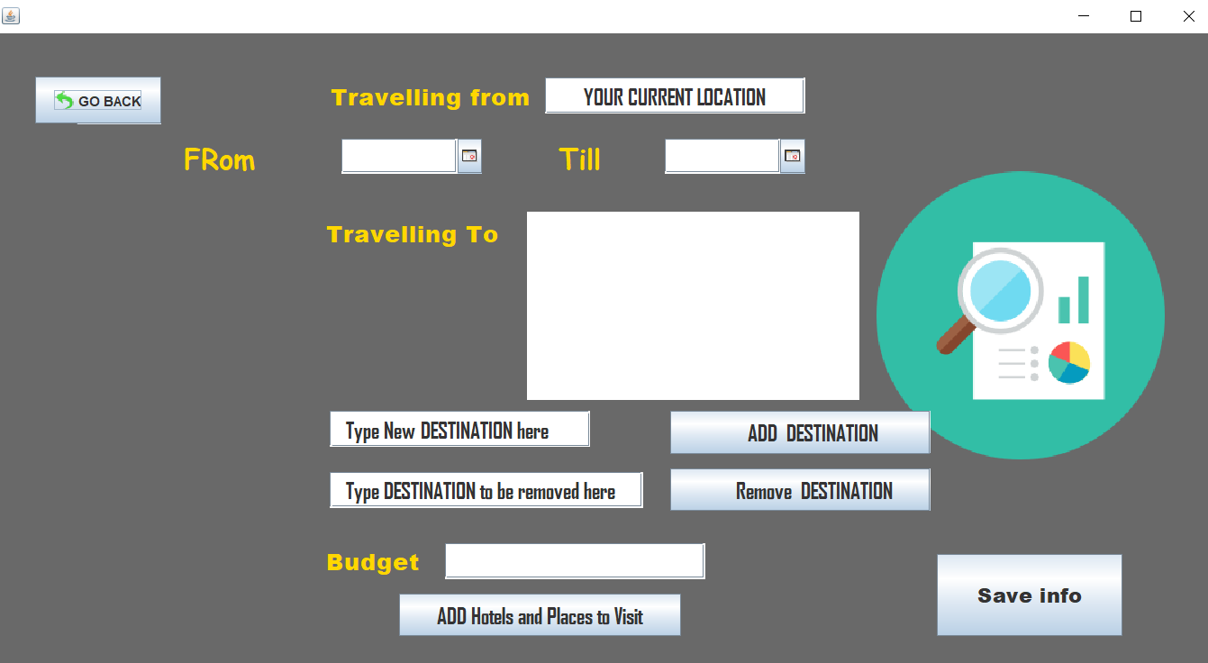
Here you provide the imformation reguarding your trip which is saved in a file name as data2.txt and available in your workspace and as you click save info you are directed to the add hotels folder

Slide 7
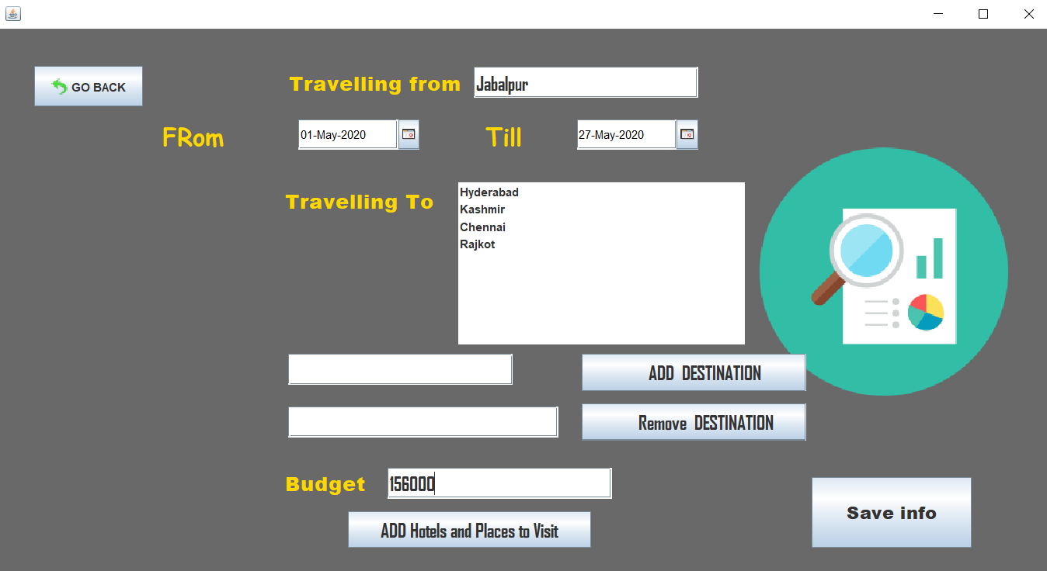
Here you can see I have added a few destinations , to add destination type in the textbox and press add destinations and it will be added in the list and do the same to remove it

Slide 8
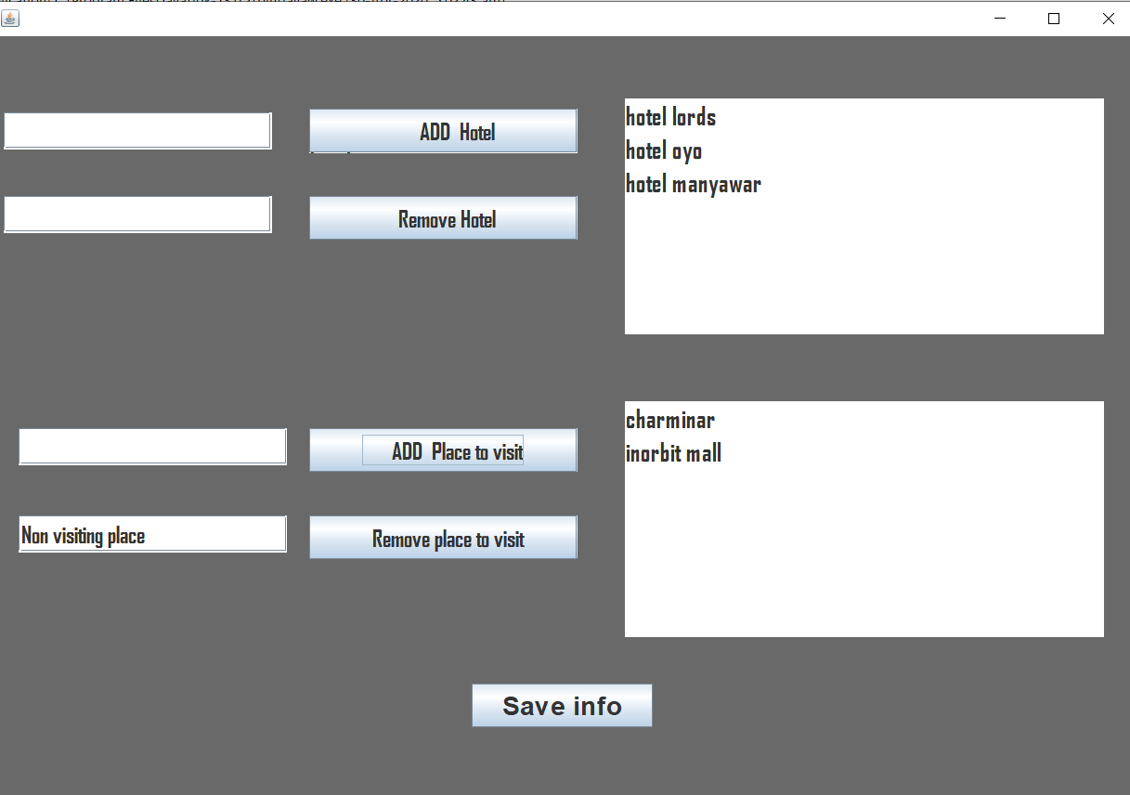
Here you add or remove hotels and add or remove places to visit , To add hotel type name of hotel in the textbox and press add hotel and it will be added in the list and same as removing element from the list

Slide 9
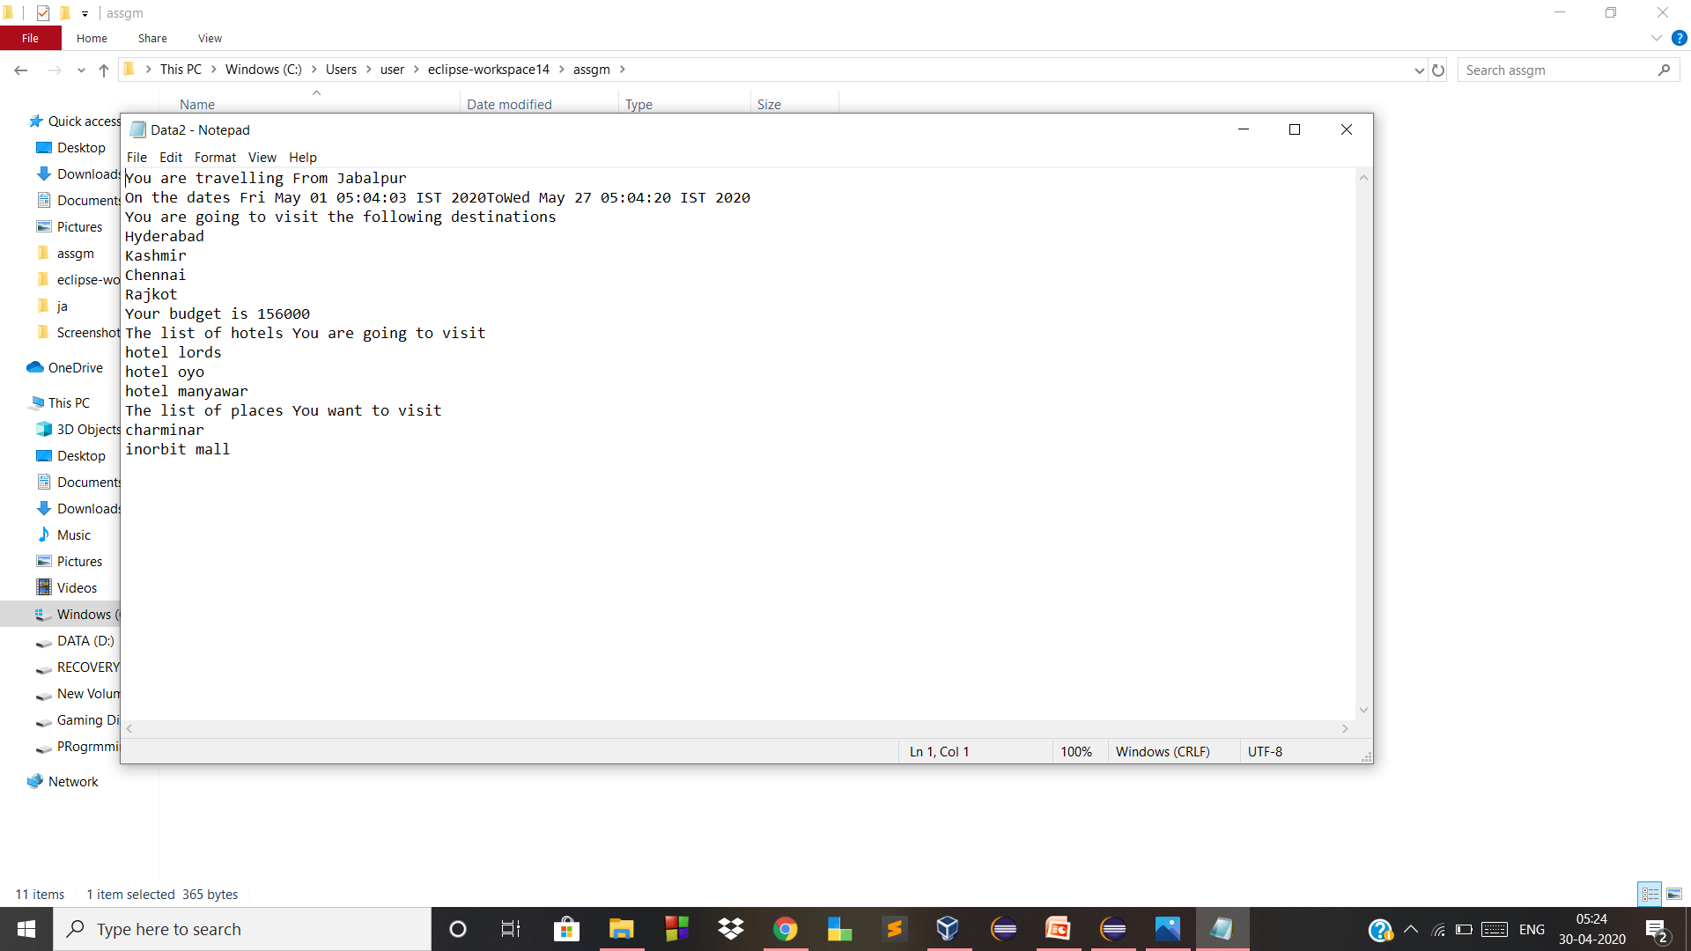
Your data is saved in the data2.txt file

Slide 10
Thankyou😋

