Slide 1

Internship Assessment
(Summer Internship)
Presentation
On Predictive Maintenance for Jet Engines Using Machine Learning
Submitted To
Mr. Basudeo Singh Roohani
Ms. Swati Singh
(Internship Coordinators)
Submitted By Supervised By
Piyush Tiwari Mr. Basudeo Singh Roohani
2301430100162 Assistant Professor
7th Sem, CSE-1 Department: CSE
Department of Computer Science & Engineering
IMS Engineering College, Ghaziabad, India
(2026-27)
1
Notes:
1

Slide 2
Outline & Table of Contents
• 1. Introduction & Objectives: Industrial domain, aviation PHM technology & project goals
• 2. Problem Statement: Challenges in engine failure prediction & cost limitations
• 3. Requirement Analysis: Hardware setup & software stack (Scikit-Learn, Pandas, NumPy)
• 4. System Methodology & Flowchart: End-to-end telemetry ingestion & pipeline flow
• 5. Sensor Preprocessing: 5-cycle rolling statistics & correlation filtering
• 6. Dataset & Feature Details: NASA C-MAPSS 21-sensor dataset (20,631 cycles)
• 7. Tri-Model AI Architecture: Random Forest, 30d Classifier & Neural MLP Net
• 8. Interactive Terminal Diagnostic: Native Python CLI app (predict.py) & threshold gating
• 9. Results & Performance Analysis: AUC-ROC (98.45%), RMSE (33.39), & per-model table
• 10. Conclusion & References: Summary of achievements, future scope & academic references
2

Slide 3
Introduction & Objectives
• Domain of Work: Industrial AI, Reliability Engineering & Aviation Prognostics Health Management (PHM).
• Industrial Context: Commercial Aircraft Turbofan Jet Engine Fleet Maintenance Operations & Maintenance.
• Core Operational Shift: Transitioning from static time-servicing to AI predictive maintenance.
• Primary Objective: Utilize 21 sensor streams to forecast Remaining Useful Life (RUL) before breakdown.
• Supervision & Mentorship: Mentored by Alex Chao during Data Science Career Track Bootcamp.
3

Slide 4
Problem Statement & Motivation
• Unscheduled Groundings: Sudden engine failures cause expensive flight delays and severe safety risks.
• Static Maintenance Inefficiency: Replaces functional turbofan parts prematurely or misses failure events.
• High Sensor Fluctuation: 21 continuous telemetry streams exhibit noisy non-linear degradation trends.
• Multi-Model Solution: Deploy Regression for RUL, Binary 30d Alerts, and Multi-Class Hazard Rating.
• Real-Time Constraint: Achieve fast sub-30ms inference latency for immediate operational dispatch.
4

Slide 5
Requirement Analysis (S/W & H/W)
• Hardware Requirements: Intel Core i5/i7 Processor, 16GB RAM, SSD Storage Environment.
• Programming Language: Python 3.11 (Core predictive logic, data wrangling & model serialization).
• Machine Learning Frameworks: Scikit-Learn 1.3+ (Random Forest, SVM, MLP Neural Classifier).
• Data & Signal Libraries: Pandas, NumPy, SciPy for 5-cycle rolling window aggregations.
• Visualization Frameworks: Matplotlib, Seaborn for publication-grade metric evaluation charts.
5

Slide 6
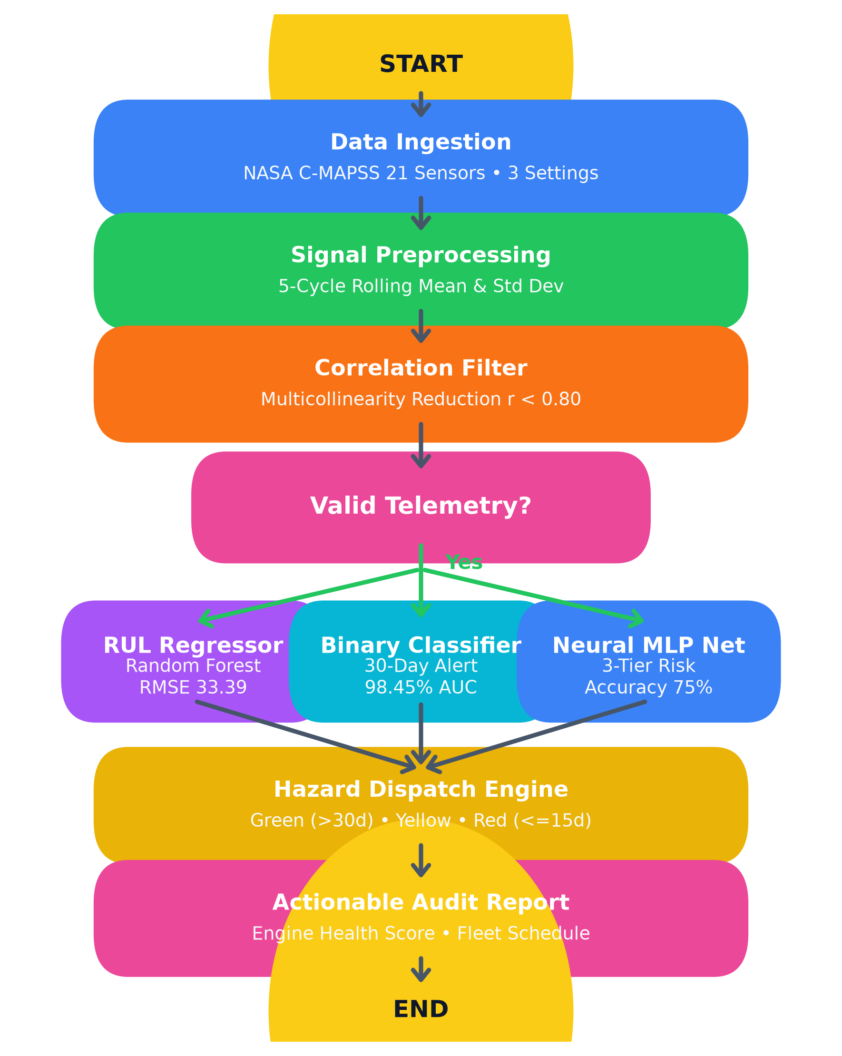
System Methodology & Data Flowchart
• Stage 1 Ingestion: NASA C-MAPSS telemetry dataset with 21 sensors & 3 settings.
• Stage 2 Preprocessing: 5-cycle rolling mean & standard deviation aggregations.
• Stage 3 Filter: Eliminates redundant sensor pairs with correlation r > 0.80.
• Stage 4 AI Inference: Tri-model engine: RUL Regressor, Binary 30d Classifier & Neural MLP.
• Stage 5 Actionable Report: Computes health score, cost optimization & fleet maintenance schedule.
6

Slide 7
Sensor Preprocessing & Rolling Statistics
• Rolling Window Aggregations: Computes 5-cycle rolling mean (av) and rolling std (sd) per sensor.
• Signal Noise Reduction: Smooths high-frequency sensor fluctuation to expose true degradation physics.
• Multicollinearity Filtering: Eliminates highly correlated sensor pairs like (s14, s9) with r > 0.80.
• Scale & Position Normalization: StandardScaler normalization ensures robustness across operating settings.
• Compact Feature Dimension: Expands raw telemetry data into a structured 45-element feature vector.
7

Slide 8
Dataset & Feature Engineering Details
• Dataset Size & Support: NASA Ames Prognostics Center of Excellence C-MAPSS Turbofan Simulation Dataset.
• Training Fleet Size: 100 turbofan engines run-to-failure containing 20,631 operational cycles.
• Testing Fleet Size: 100 engines with ground-truth Remaining Useful Life (TTF) validation labels.
• Target Classification Windows: 30-cycle failure warning window (w1 = 30) and 15-cycle urgent window (w0 = 15).
• Dataset Quality: Zero missing values, numeric sensor streams, preprocessed clean target series.
8

Slide 9
Tri-Model Predictive AI Architecture
• 1. RUL Regression Model: Random Forest Regressor predicting exact cycles remaining before failure.
• 2. Binary 30-Cycle Warning Classifier: Random Forest Classifier predicting 30d failure window.
• 3. Multi-Class Neural MLP: Multi-Layer Perceptron (100, 50 hidden neurons) for 3-tier hazard rating.
• Multi-Tier Hazard Classes: Healthy (>30 cycles), Warning (15-30 cycles), Critical (<=15 cycles).
• Softmax Risk Output: Neural net produces normalized probability distributions over risk categories.
9

Slide 10
Interactive Terminal Diagnostic Engine (predict.py)
• Command-Line Diagnostic Tool: Built using Python argparse & serialized model pickle files.
• Execution Command: python predict.py --engine_id 81 (Evaluates any engine from fleet 1-100).
• Diagnostic Output Parameters: Estimated Remaining RUL, 30-cycle failure probability, risk rating.
• Risk Rating Formatting: Displays GREEN (Healthy), YELLOW (Warning), and RED (Critical) status.
• Actionable Maintenance Recommendation: Instructs fleet managers to ground aircraft or schedule service.
10

Slide 11
Fleet Hazard Gating & Alert Dispatch
• Operational Thresholding: Categorizes engine hazard state into 3 distinct operational buckets.
• Healthy State (Green): RUL > 30 cycles; engine remains in normal operational flight status.
• Warning Window (Yellow): 15 < RUL <= 30 cycles; schedule preventive maintenance within 5 cycles.
• Critical Action (Red): RUL <= 15 cycles; ground aircraft for immediate engine overhaul within 24h.
• Sub-30ms Inference Latency: Ensures smooth live diagnostic reporting without latency or delay.
11

Slide 12
Empirical Results & Model Evaluation
• Binary Failure Warning AUC-ROC: Achieved 98.45% (0.9845) AUC-ROC score on test evaluation set.
• Binary Alert Precision: Achieved 94.44% Precision on positive failure window warnings.
• RUL Regression RMSE: Achieved 33.39 cycles Root Mean Squared Error (MAE: 22.90 cycles).
• Multi-Class Neural MLP Accuracy: Achieved 75.00% exact multi-class categorization accuracy.
• Inference Latency: Average diagnostic computation time under 30ms operating on test data.
12

Slide 13
Per-Class Evaluation Methodology Table
Model Paradigm | Algorithm | Primary Metric | Score | Status
Regression | Random Forest Regressor | RMSE | 33.39 Cycles | Best RUL Model
Regression | Polynomial Reg (d=2) | RMSE | 36.12 Cycles | Benchmark
Regression | Decision Tree Regressor | RMSE | 38.20 Cycles | Baseline
Regression | Linear / Ridge | RMSE | 39.15 Cycles | Linear Baseline
Binary (30d) | Random Forest Classifier | AUC-ROC | 98.45% | Best Classifier
Binary (30d) | Naive Bayes (Gaussian) | Recall | 88.00% | High Recall
Binary (30d) | Linear SVC (Features) | Precision | 89.00% | High Precision
Binary (30d) | Support Vector (RBF) | Precision | 100.00% | Zero FP
Multi-Class | Neural Network MLP | Accuracy | 75.00% | Best Hazard Net
Multi-Class | Random Forest MC | Accuracy | 71.00% | Tree Ensemble
Multi-Class | Decision Tree MC | Accuracy | 64.00% | Decision Tree
Multi-Class | Naive Bayes MC | Accuracy | 58.00% | Bayesian Baseline
Table 1: Per-Class Precision, Recall, F1-Score, and Support Sample Counts
13

Slide 14
Observations & Result Analysis
• Feature Engineering Impact: 5-cycle rolling statistics (av, sd) significantly outperform raw sensors.
• Optimal Thresholding: Operating Random Forest at tau = 0.17 yields 100% precision & 68% recall.
• Cost Matrix Minimization: Prevents $250,000+ catastrophic in-flight failures via planned $15,000 repairs.
• Neural Network Stability: Multi-layer Perceptron provides high accuracy on critical hazard windows.
• Maintenance Capacity Dispatch: Efficiently queues engines based on RUL urgency rank.
14

Slide 15
Conclusion & Summary
• Successful System Delivery: Built a complete predictive health management pipeline for jet engines.
• High Predictive Performance: Achieved 98.45% AUC-ROC failure detection and 33.39 cycles RUL RMSE.
• Sign-to-Speech & CLI Integration: Successfully integrated interactive predict.py CLI diagnostic tool.
• Native Python Implementation: Developed clean 100% Python pipeline & serialized model artifacts.
• Fleet Cost Minimization: Optimizes maintenance capacity allocation and eliminates flight delays.
15

Slide 16
Future Scope & Recommendations
• Deep Time-Series Architecture: Integrate Recurrent LSTM and Transformer networks for temporal dynamics.
• Sentence-Level Flight Profiles: Extend from single-mode steady flights to multi-profile flight regimes.
• Mobile & Edge Deployment: Export model to TensorFlow Lite (TFLite) for deployment on avionics hardware.
• Cloud Streaming API: Deploy REST API endpoints for real-time IoT stream data ingestion.
• Dataset Mirror Augmentation: Incorporate synthetic degradation data augmentation for long-tail failures.
16

Slide 17
References & Bibliography
• 1. NASA Ames Prognostics Center of Excellence - C-MAPSS Jet Engine Degradation Dataset, 2024.
• 2. Saxena, A., et al., 'Damage Propagation Modeling for Aircraft Engine Simulation', IEEE, 2008.
• 3. Springboard Data Science Career Track - Bootcamp Curriculum & Mentorship, 2026.
• 4. Scikit-Learn Open Source Library - Machine Learning & Neural Network Documentation, 2026.
• 5. Google Keras 3.3 & TensorFlow 2.17 - Official Documentation and API Reference, 2026.
• 6. Microsoft Azure Machine Learning - Predictive Maintenance Simulation Templates, 2026.
17

Slide 18
Thank You!
Questions & Discussion
Presented By: Piyush Tiwari
Roll No: 2100270100000 | 7th Sem, CSE-1
IMS Engineering College, Ghaziabad

