Slide 1

INDUSTRIAL TRAINING Project on EMPLOYEE PAYROLL MANAGEMENT SYSTEM
Hindustan College of Science and Technology, Farah, Mathura
Department of Information Technology
Submitted to:
Mrs. Deepti Mittal
Submitted by:
Ms. Piyusha Varshney

Slide 2
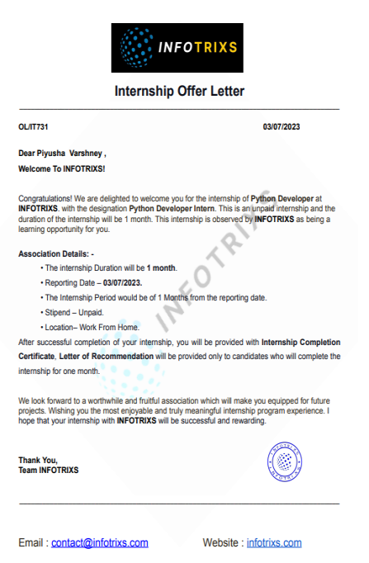
OFFER LETTER

Slide 3
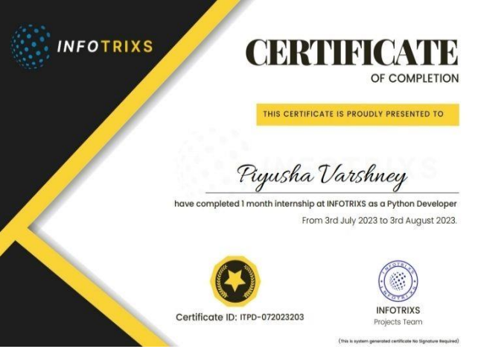
CERTIFICATE

Slide 4
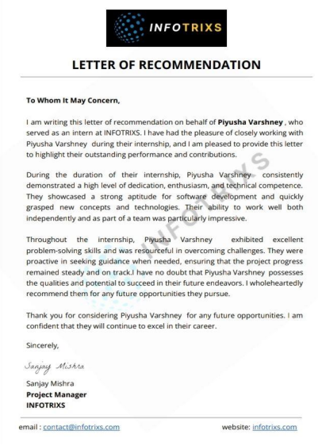
LETTER OF RECOMMENDATION

Slide 5
ABOUT COMPANY
INFOTRIXS specializes in dynamic software solutions, including website development, DevOps, Python programming, AWS cloud services, and educational development.
The company creates visually stunning websites for businesses and develops Android applications tailored to specific needs.
INFOTRIXS delivers cutting-edge cloud computing solutions, recognizing the transformative power of cloud technology in the digital landscape.
The team excels in Python and Java project development, crafting robust and scalable solutions for diverse business needs.
INFOTRIXS is committed to nurturing the next generation of software developers through internship opportunities, providing hands-on experience in the field.

Slide 6
INTRODUCTION
It is a centralised system that stores and manages employee information.
Overtime Tracking and Payroll Processing: Overtime tracking is automated, and payroll processing is simplified.
Compliance and Benefits Administration: Responsible for ensuring tax compliance, benefit administration, and labour legislation adherence.
Reporting and Integration: Creates reports, interfaces with HR systems, and gives employees with self-service portals.
Key features typically include:
Add employee
Delete employee
Edit information
Record tracking
Analysis

Slide 7
FEASIBILITY STUDY
A "feasibility study" is an assessment conducted to determine the practicality and viability of a proposed project or business venture. It involves a thorough analysis of various aspects to gauge whether the project can be successfully implemented.
Market Demand Analysis: As every company requires it for mangement.
Technical Requirements Assessment: Techinal skills are discussed in Prerequisites.
Operational Practicality Review:It is currently used in market

Slide 8
PREREQUISITES
Here is the language and tools I used to make this application Employee Payroll and Paystub System.
You should know about these too make this project work.
Some Basic Python Experience is preferable.
Some High School Mathematics.
With Knowledge of Report generation lab.
And too know about the tkinter ,Mathplotlib library of python.
Known the concept of SQL and DBMS

Slide 9
SYSTEM ANALYSIS
Objective:
Develop an Employees Payroll Management System for efficient salary processing and record-keeping.
Features:
Employee information management, salary calculation, tax handling, payment processing, reporting, and record-keeping.
Requirements:
User roles (admin, HR, accountant), secure access control, scalability, usability, reliability, and compliance with legal regulations.
Integration:
Consider integration with HR, accounting, and timekeeping systems.
Feedback:
Implement a feedback mechanism for issue reporting and system improvement.

Slide 10
LITERATURE SURVEY
The proposal is influenced by a comparative analysis of relevant studies and literature, incorporating concepts from these documents.
Uses HR master lists, with internal attendance management.
Emphasizes the need for computerized payroll systems to update employee info and generate required outputs.

Slide 11
LANGUANGE USED:
Python
SQL
Reportlab
Tkinter
Mathplotlib

Slide 12
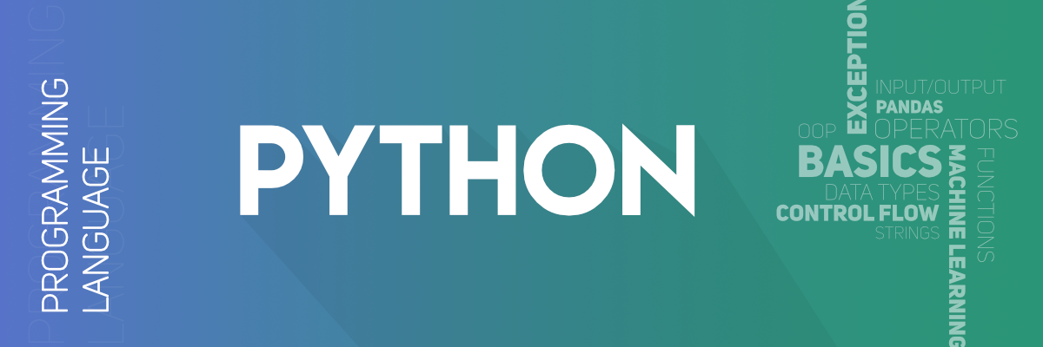
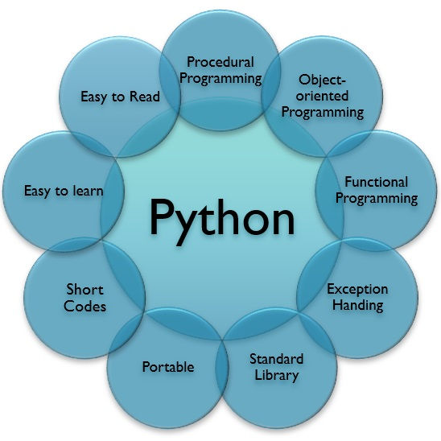
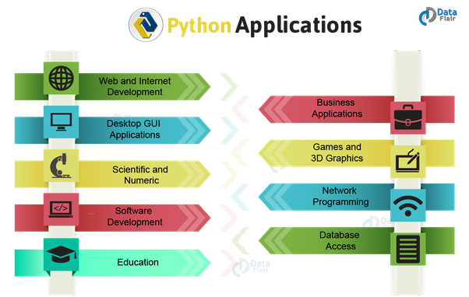
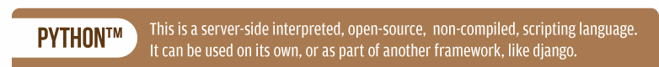

Slide 13
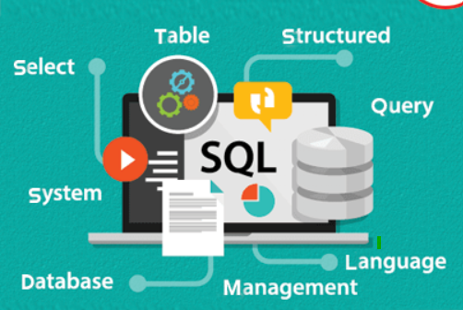
SQL
SQL organizes data into structured databases containing tables.
Tables consist of rows representing data records and columns defining attributes.
SQL queries retrieve, manipulate, and manage data in databases.
Includes SELECT, INSERT, UPDATE, DELETE, CREATE TABLE, ALTER TABLE, and DROP TABLE.
Primary keys uniquely identify rows, foreign keys link tables, and indexes optimize data retrieval.
SQL is a powerful language designed for efficient management and querying of relational databases, offering essential features for data organization, retrieval, and security.

Slide 14

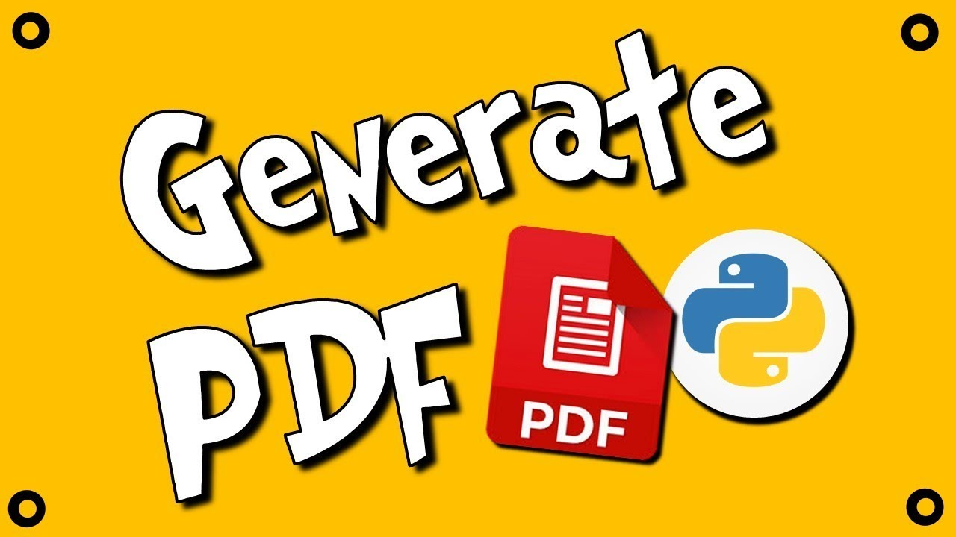
REPORTLAB
Installation: pip install reportlab
PDF Creation: Create or change PDF documents with complete control over layout, fonts, and styling.
Canvas and Flowables: Use the Canvas object to draw content and add Flowables such as text, photos, and tables.
Charts and graphs: Line charts, bar charts, pie charts, and more data visualisation tools are available.
Integration:Integration with web frameworks such as Django and Flask for dynamic PDF generation

Slide 15
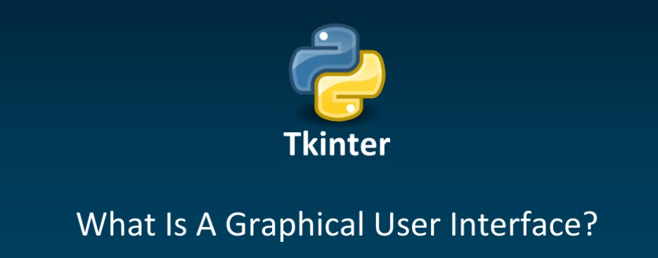
GUI (Graphical User Interface) is a visual way for users to interact with computers, utilizing graphical elements like windows, icons, buttons, and menus to facilitate user interactions with software applications.

Slide 16
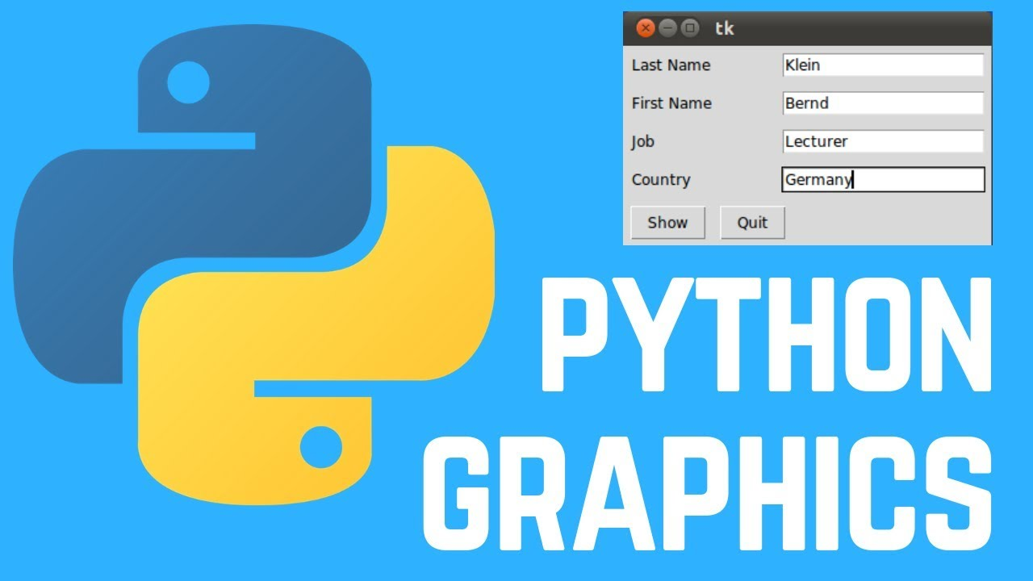
TKINTER
Tkinter in Python for GUI Development
Cross-Platform Compatibility.
Ease of Use& Rapid Development
Wide Range of Widgets & Customization
Compatibility with Other Libraries
Open Source and License-Friendly
Conclusion: Tkinter is a valuable tool for Python developers creating desktop applications with GUIs due to its simplicity, versatility, and broad community support.

Slide 17
MATHPLOTLIB
Matplotlib is a widely-used Python library for creating 2D and 3D static, animated, and interactive plots and charts.
It provides a flexible and powerful platform for data visualization and is particularly popular in the fields of data analysis, scientific computing, and machine learning.
Themes and Styles: Matplotlib provides a variety of built-in styles and themes to change the overall appearance of your plots.
Matplotlib's extensive documentation and a large community of users and developers make it a valuable tool for creating high-quality data visualizations in Python.
It is popular in data analysis, scientific computing, and machine learning

Slide 18
USER MANUAL
User Manual: Installation:
Ensure Python 3.6+ is installed & Reportlab lib.
Running the Application:
Open a terminal or command prompt.
Navigate to the directory containing the code files.
Execute the command: python payroll_management.py.
Using the GUI: Options:
Add Employee: Allows adding a new employee with details.
Edit Employee: Enables editing existing employee information.
Delete Employee: Removes an employee from the system.
Display All Employees: Shows details of all employees.
Process Payroll: Generates a department-wise salary distribution chart.
Exit: Closes the application.
Generating Payslips: Select an employee to view their detailed payslip
Click "Display All Employees" to view the list of employees.

Slide 19
TESTING
Unit Testing:Test individual components and functions of the payroll system, such as calculations for basic pay, overtime, and deductions.
Security Testing:Verify the security measures in place to protect sensitive payroll data.
Data Validation:Validate employee data input for accuracy, completeness, and adherence to predefined formats. Ensure that the system correctly handles various data types, such as names, addresses, and tax information.
Calculation Accuracy:Test the accuracy of payroll calculations, including gross pay, taxes, deductions, and net pay. Verify that the system considers various factors such as overtime, bonuses, and allowances.

Slide 20
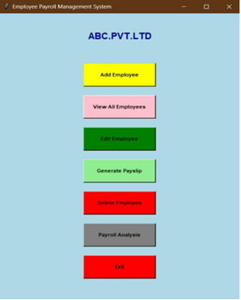
SNAPSHOTS
INITIAL WINDOW

Slide 21
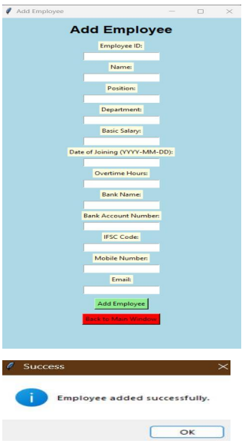

ADD EMPLOYEE MODULE

Slide 22
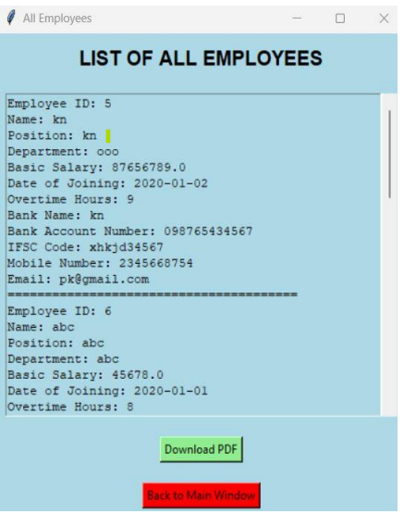
LIST OF ALL EMPLOYEE MODULE

Slide 23
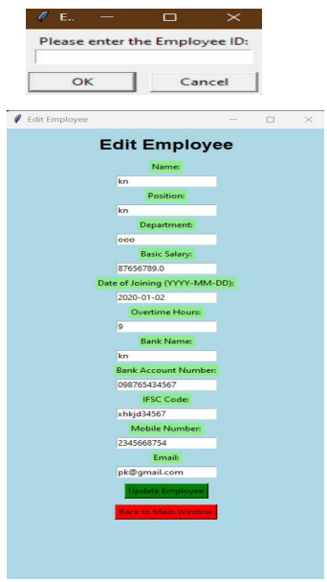
EDIT EMPLOYEE MODULE

Slide 24
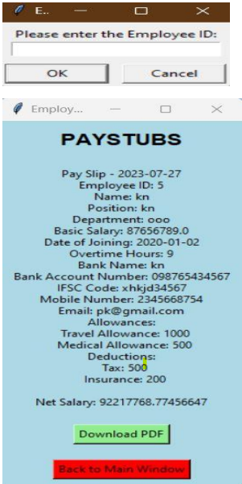
PAYSTUB GENERATION MODULE

Slide 25
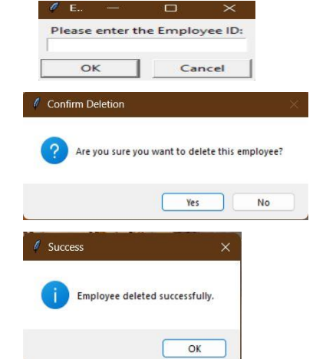
DELETE EMPLOYEE MODULE

Slide 26
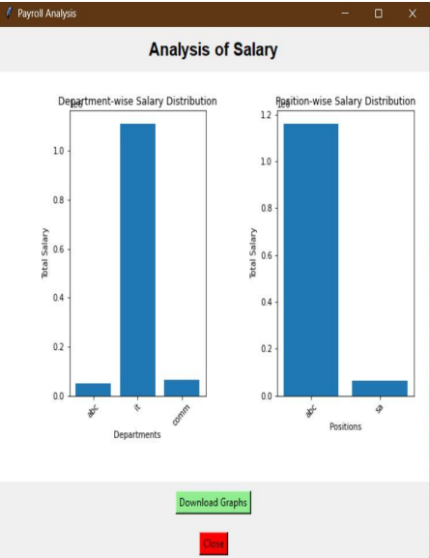
ANALYSIS MODULE

Slide 27
THANKYOU
Presenter:
Piyusha Varshney

