Slide 1

Customer Shopping Behavior Analysis
Uncovering insights from 3,900 transactions to guide strategic business decisions.
DATA ANALYTICS PROJECT

Slide 2
Dataset at a Glance
3,900
18
Purchases
Columns
Across all categories
Features tracked
37
25
Missing Values
Products
In Review Rating only
Unique items

Slide 3

Python Data Preparation
01
Load & Explore
Imported via pandas, inspected with info() & describe()
02
Clean & Impute
Median imputation for missing Review Ratings by category
03
Engineer Features
Created age_group bins & purchase_frequency_days
04
Load to DB
Cleaned DataFrame loaded into PostgreSQL

Slide 4
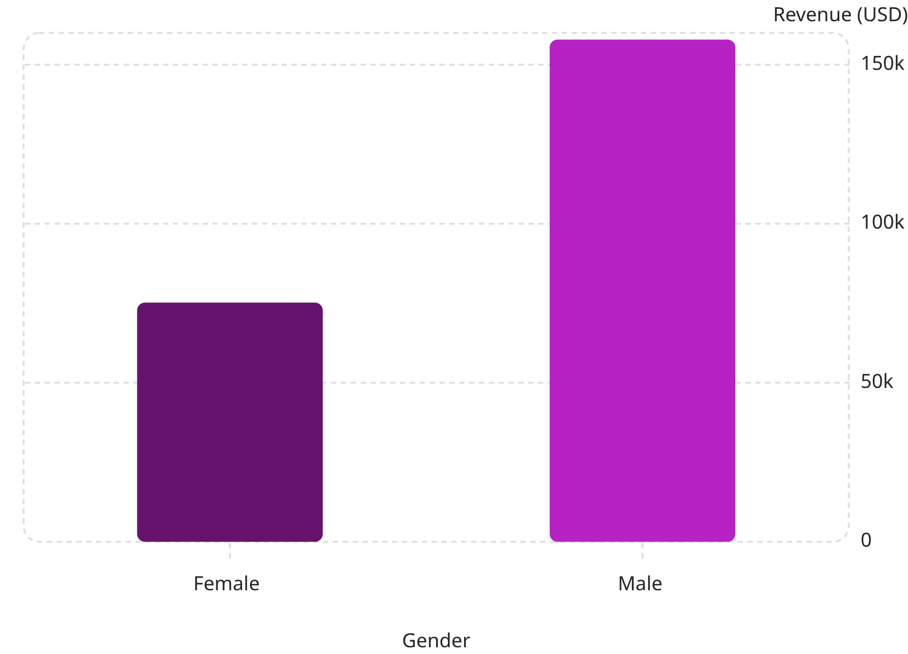

Revenue by Gender
Key Finding
Male customers generated 2.1× more revenue than female customers.
Male
Female
$157,890 — 2,652 customers
$75,191 — 1,248 customers

Slide 5
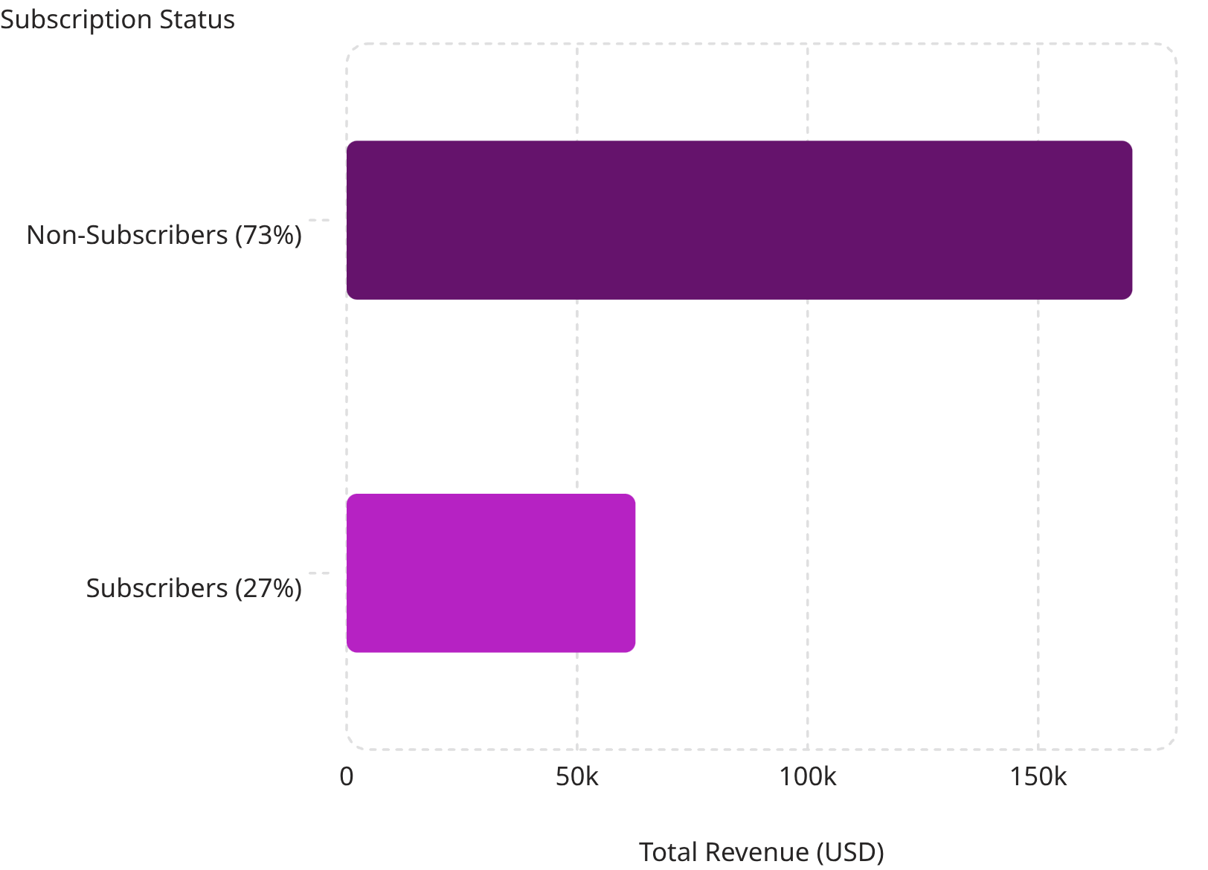

Subscribers vs. Non-Subscribers
Subscription Gap
Only 27% of customers subscribe — yet avg. spend is nearly identical (~$59).
Repeat buyers with 5+ purchases: 958 subscribers vs. 2,518 non-subscribers — a major conversion opportunity.

Slide 6
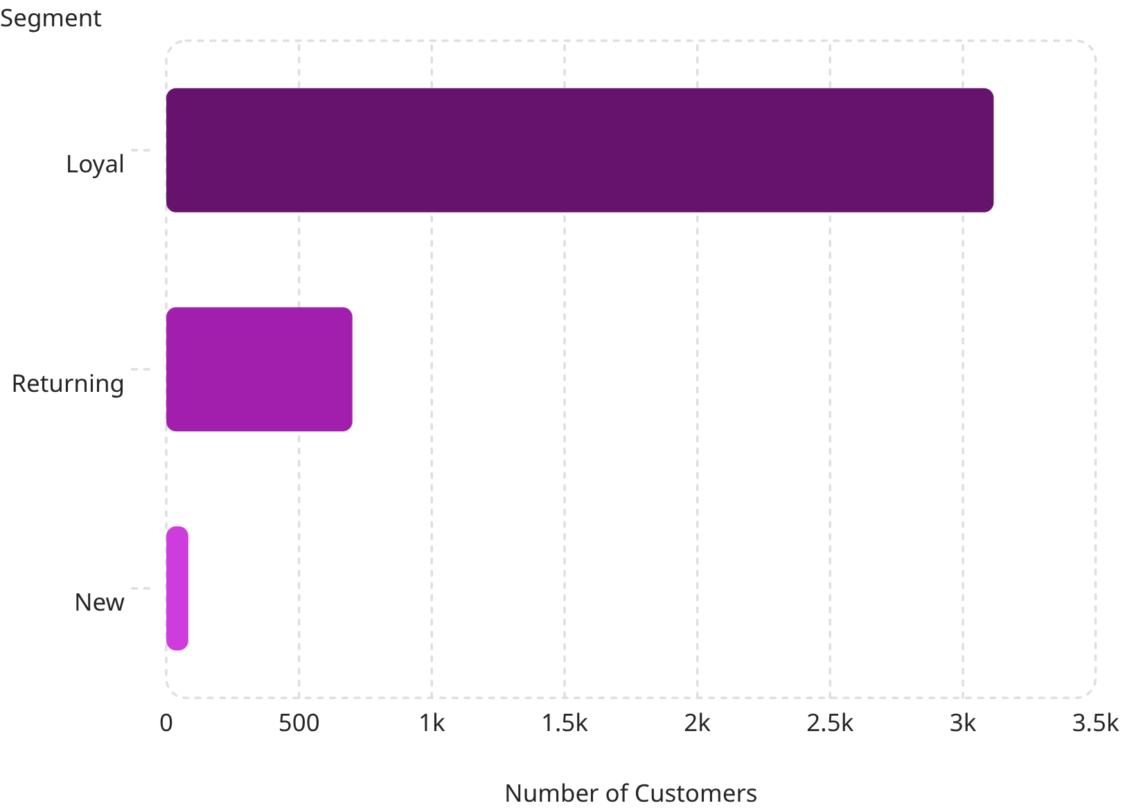
Customer Segmentation
Segment Breakdown
🏆 Loyal
🔄 Returning
3,116 customers — 80% of base
701 customers — 18% of base
🆕 New
83 customers — 2% of base

Slide 7
Top Products & Categories
Top 5 by Rating
Top Products per Category
Accessories: Jewelry, Sunglasses, Belt
Clothing: Blouse, Pants, Shirt
Footwear: Sandals, Shoes, Sneakers
Outerwear: Jacket, Coat
Product
Avg Rating
Gloves
3.86
Sandals
3.84
Boots
3.82
Hat
3.80
Skirt
3.78

Slide 8
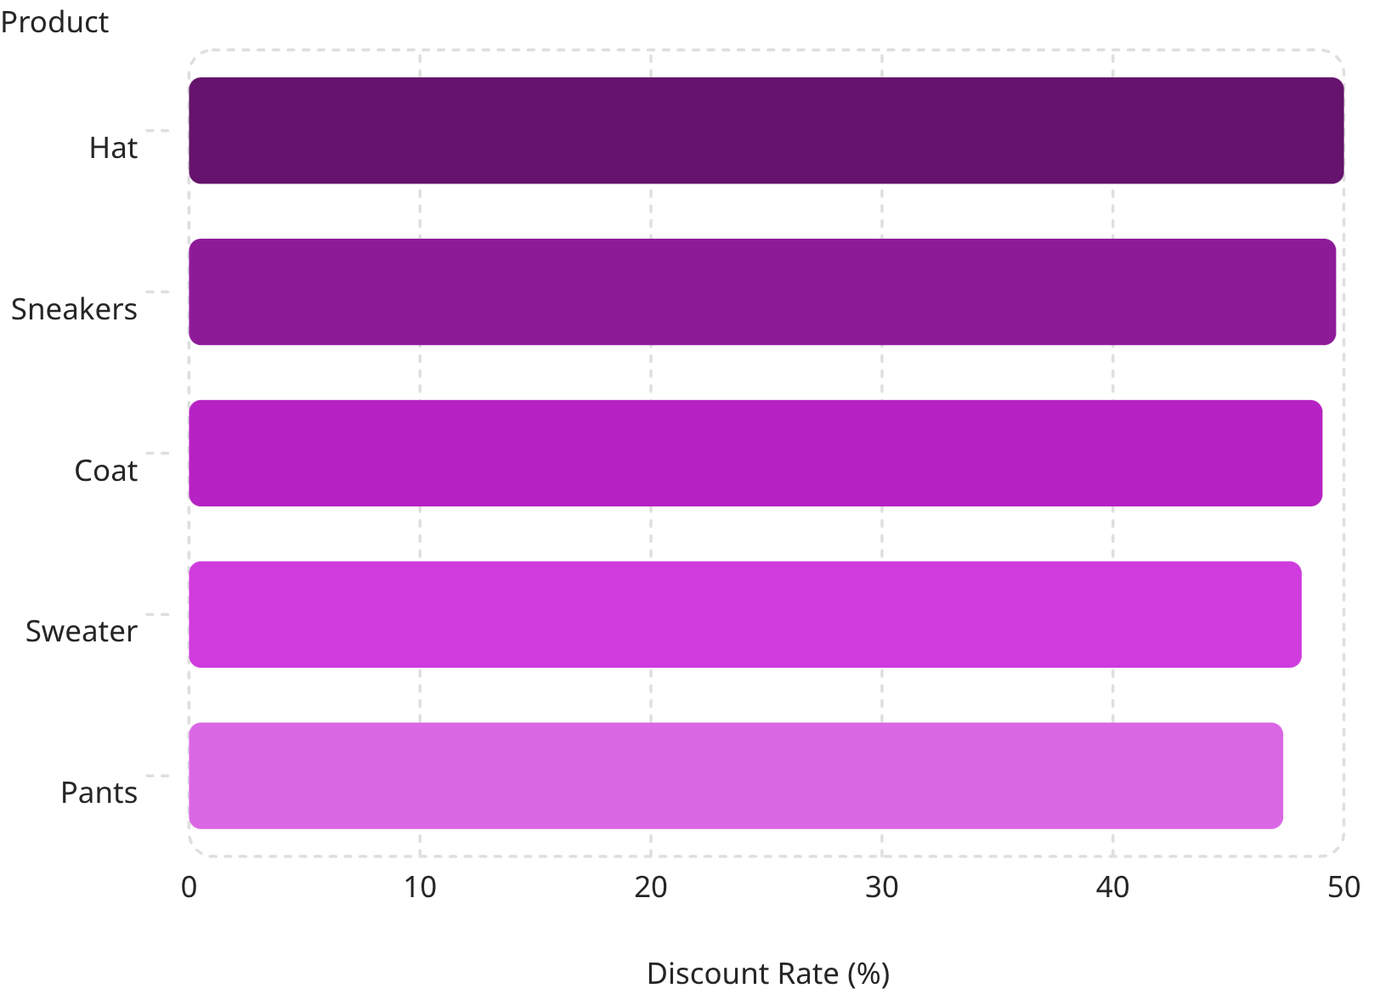
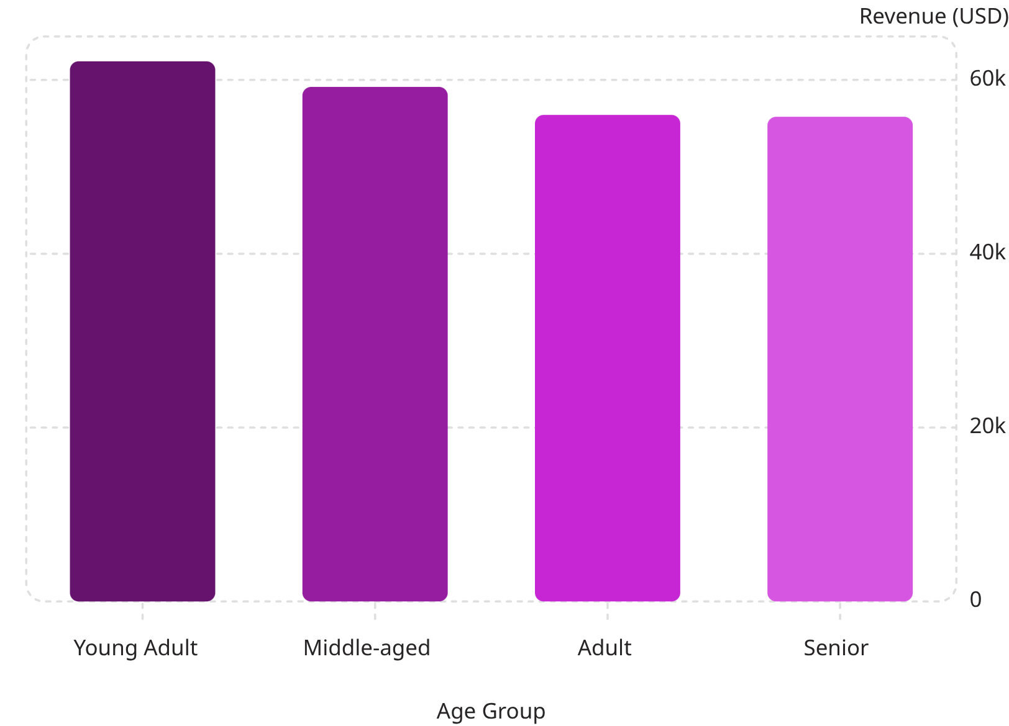
Discount Dependency & Revenue by Age
Products Most Discounted
Revenue by Age Group

Slide 9
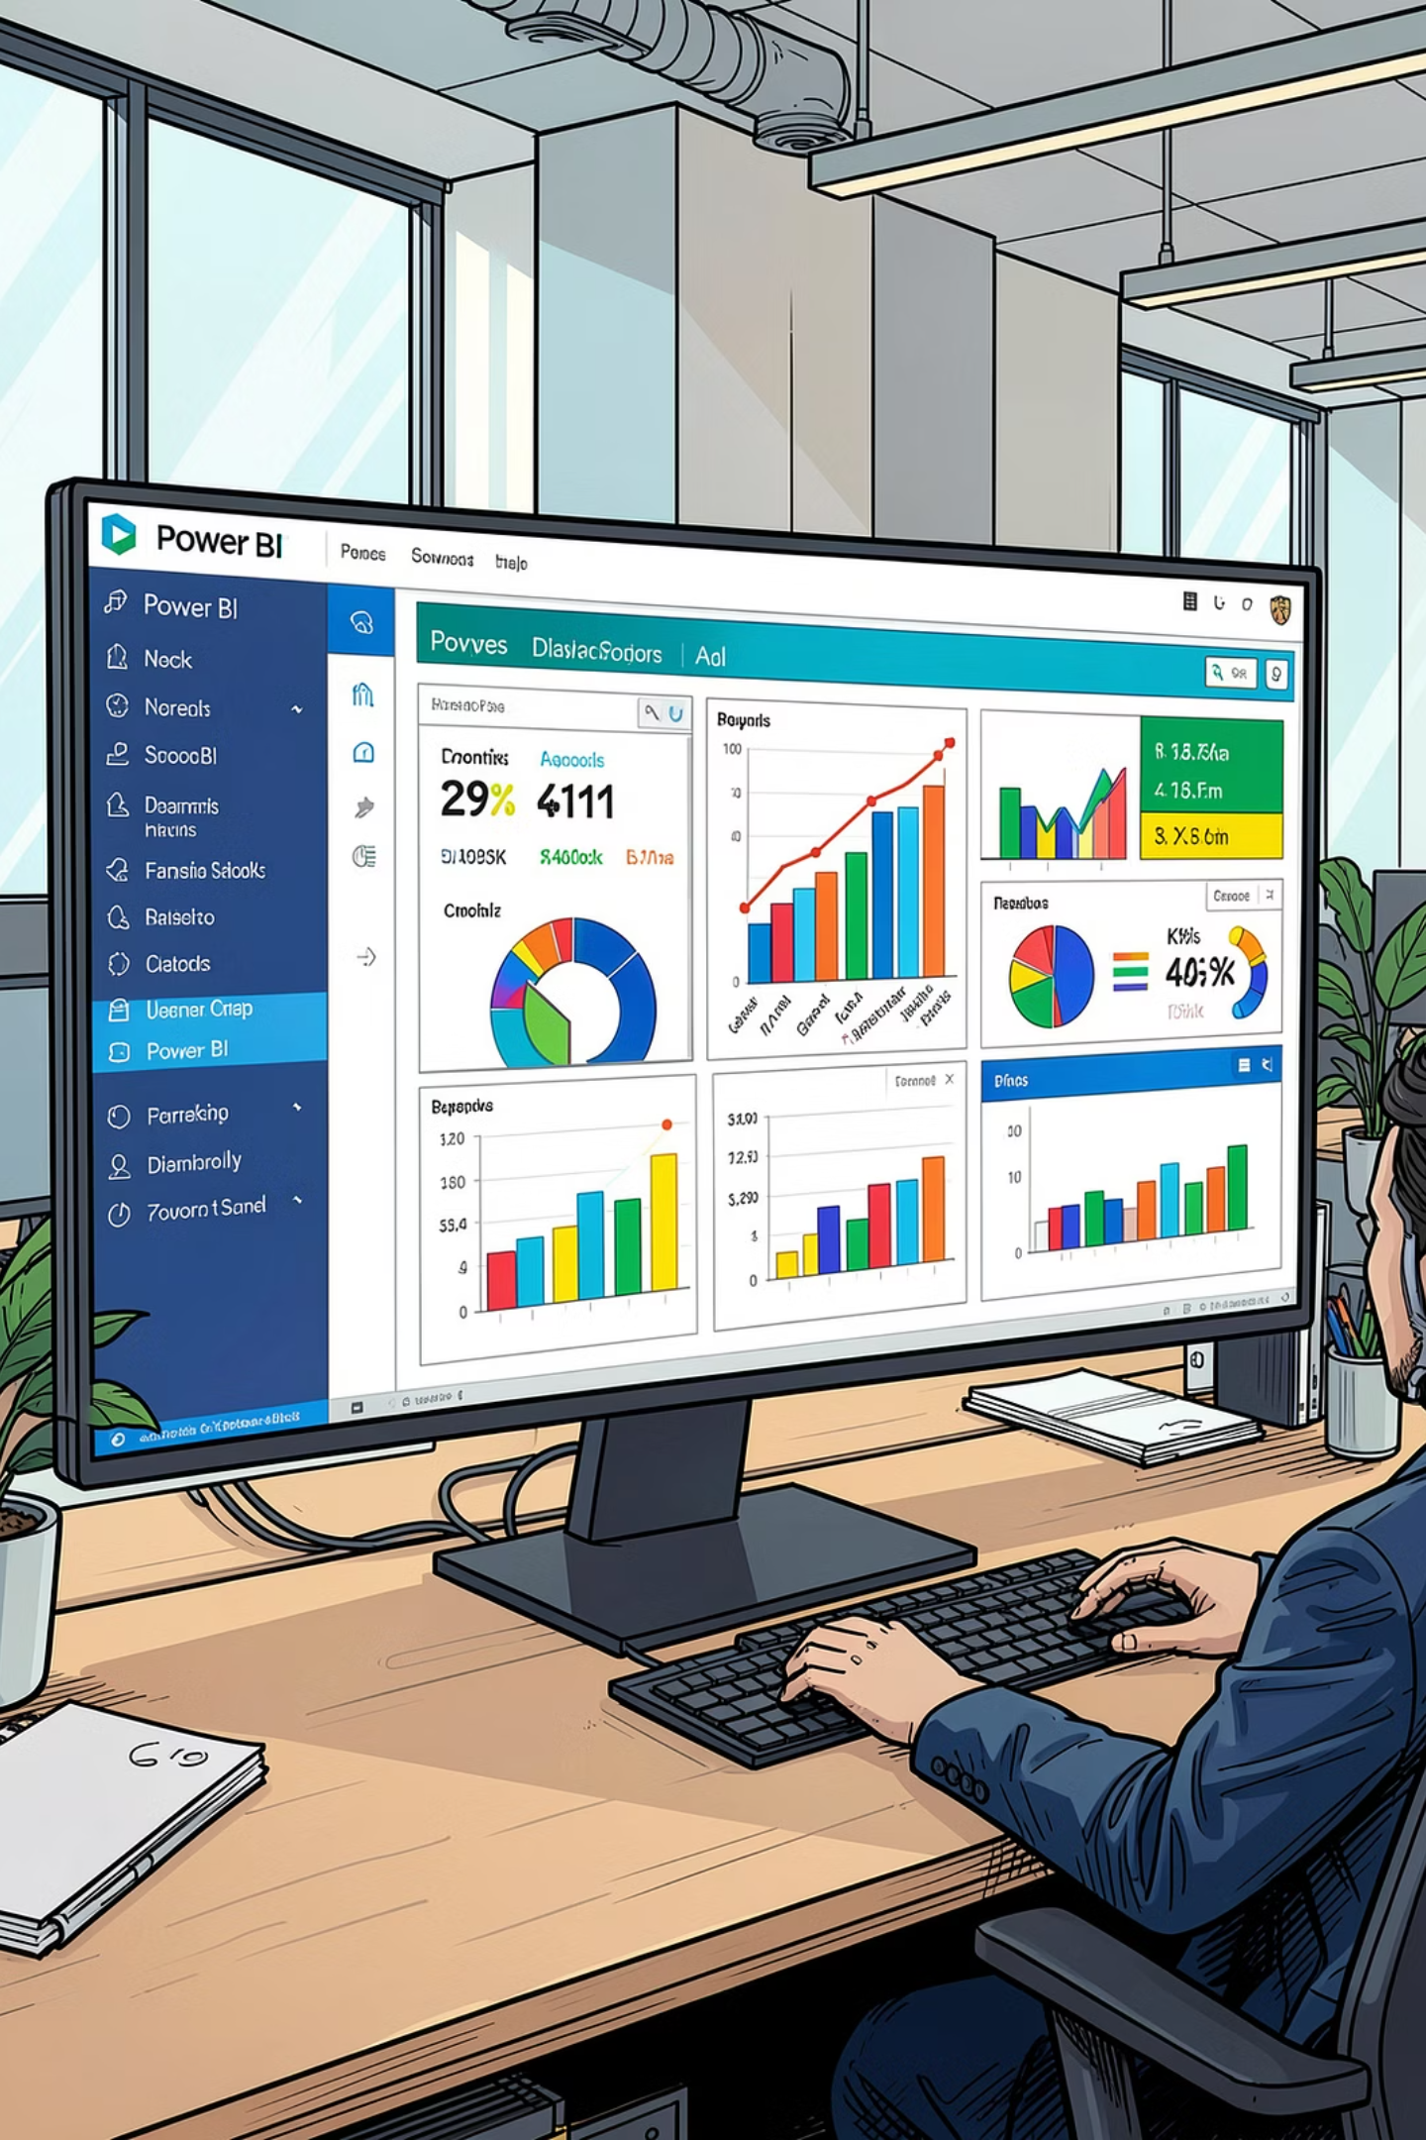
Power BI Dashboard
3.9K
Customers tracked
$59.76
Avg. purchase amount
3.75
Avg. review rating
27%
Subscriber share
Interactive filters: Subscription Status, Gender, Category, Shipping Type — with revenue & sales breakdowns by category and age group.

Slide 10

Business Recommendations
Boost Subscriptions
Promote exclusive subscriber benefits
Loyalty Programs
Reward repeat buyers → Loyal segment
Review Discount Policy
Balance sales lift vs. margin control
Product Positioning
Highlight top-rated & best-selling items
Targeted Marketing
Focus on high-revenue age groups & express-shipping users

