Slide 1
VEHICLE INSURANCE PORTAL
INSTA INSURANCE

Slide 2
GROUP MEMBERS
HARDIK KACHWAHA
RAVINDER KUMAR
SIMRAN AGGARWAL
BHAVYA BATRA
SREEPARNA BASU
PRIYANKA SHARMA
RAGHAV RAWAT
PIYUSH AHUJA

Slide 3
PROBLEM STATEMENT
INSTA INSURANCE is a web based vehicle insurance application which has been developed to override the problems prevailing in the existing manual system.
There is an stringent need to eliminate the mediator between the insurer and the insured, so that there are no excess charges and the insurance process is smooth and not cumbersome for the customers.

Slide 4
FEATURES
Get Policy Quotations anytime
View all relevant policies
Select suitable policy of choice
Online Payments
Track application status
Easy Claims with fast response
NO mediator required
Report Generation

Slide 5
SCOPE
The project automates vehicle insurance system by providing full-fledged, error free, secure, reliable online solution that can store non-redundant and valuable data for a longer period and provide good performance and better services to the customer.

Slide 6
TECHNOLOGIES USED
Spring MVC
Rest Services
Hibernate
Oracle Database
Angular JS
HTML5, CSS & BOOTSTRAP

Slide 7
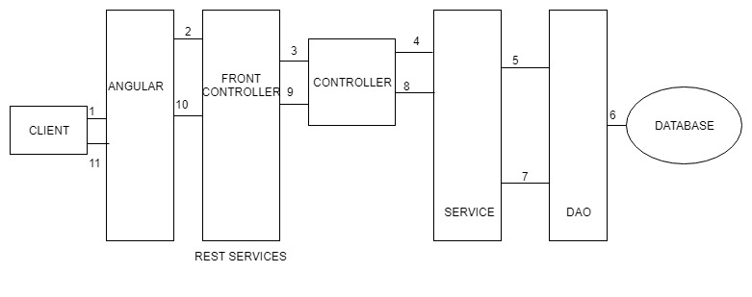
ARCHITECTURE

Slide 8
UML DIAGRAMS

Slide 9
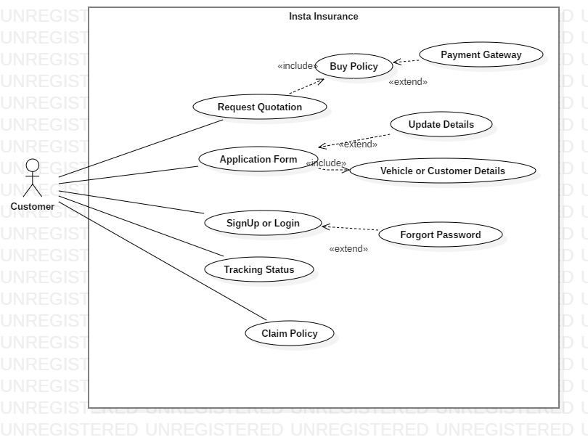
CUSTOMER USE CASE

Slide 10
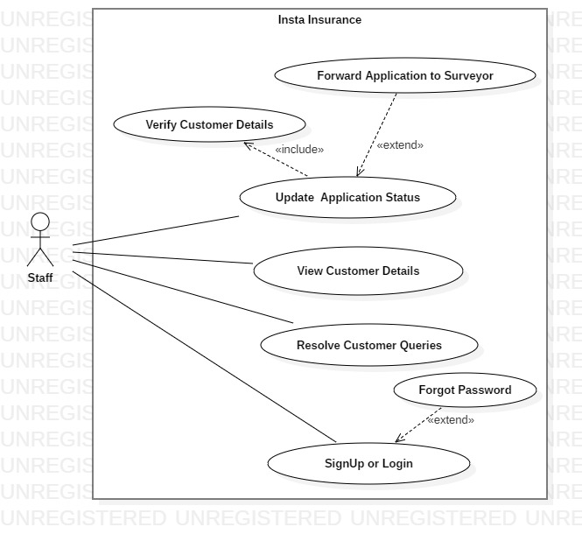
STAFF USE CASE

Slide 11
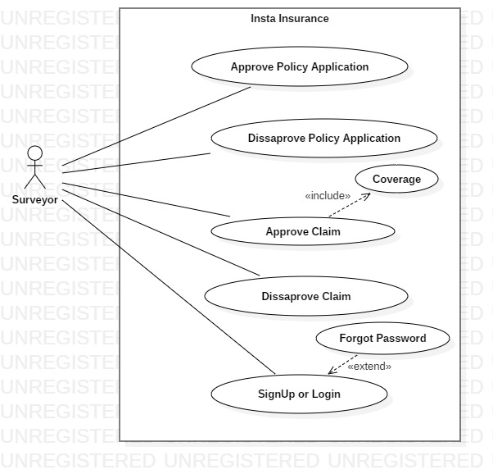
SURVEYOR USE CASE

Slide 12
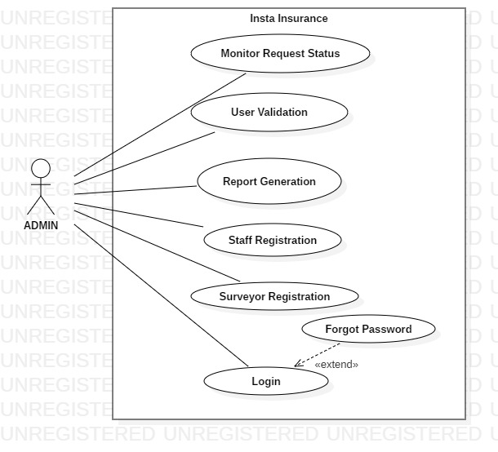
ADMIN USE CASE

Slide 13
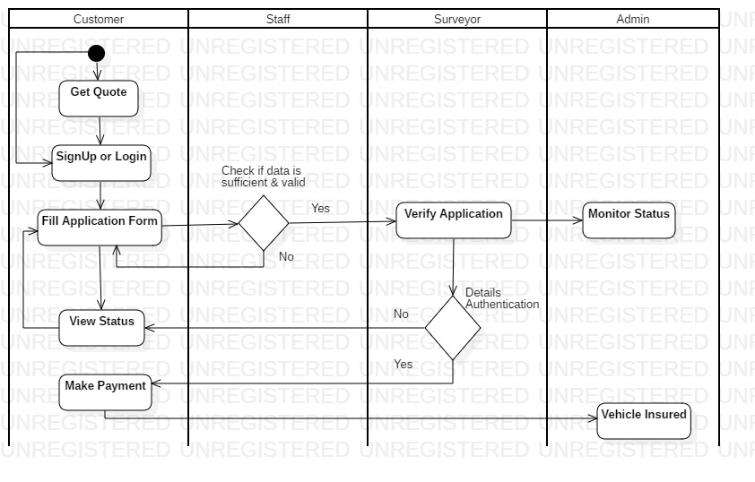
GET QUOTE ACTIVITY

Slide 14
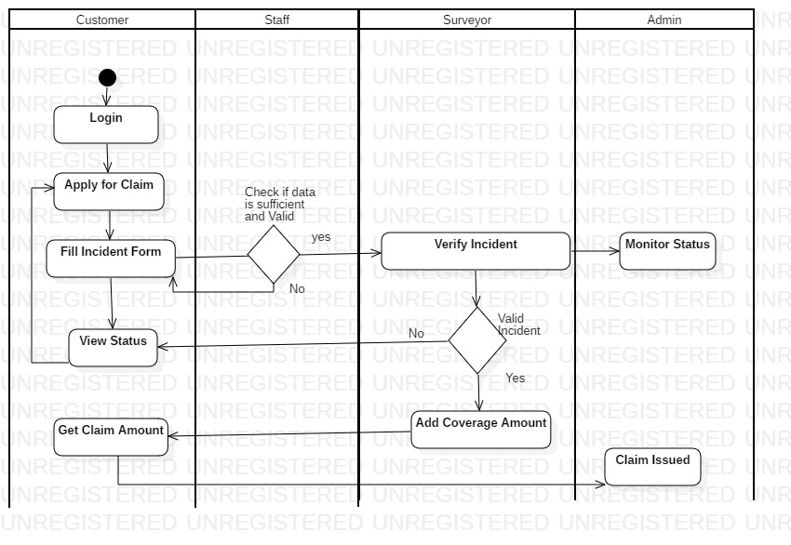
CLAIM ACTIVITY

Slide 15
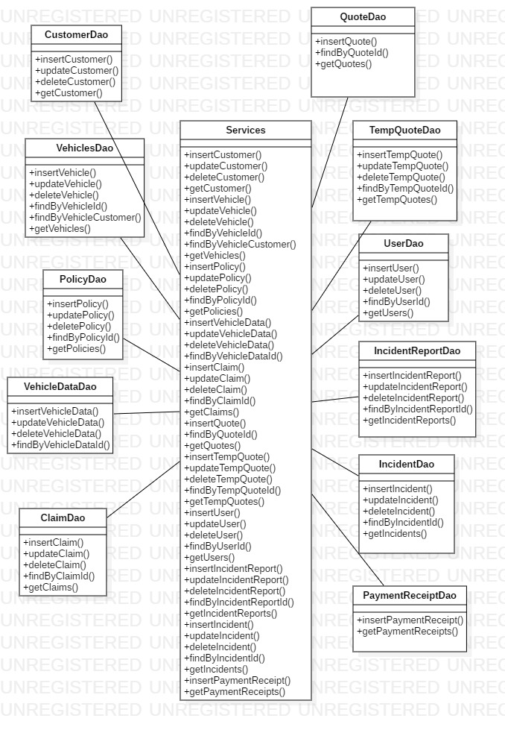
CLASS DIAGRAM

Slide 16
THANK YOU ☺

