Slide 1




















i avi
StO
IySİ
Uncovering insights from transactional data to guide strategic business decision.s.

Slide 2






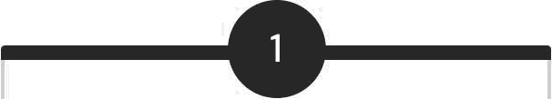

ct
iew
Analyze Behavior
3,900 purchases across categories.
Uncover Insights
Spending patterns, segments, preferences.
Guide Decisions
Optimize strategy for business growth.

Slide 3


Dataset Sum ary
Key Features
Data Points
Customer demographics
Purchase details
Shopping behavior
Rows: 3,900
Columns: 18
Missing: 37 (Review Rating)

Slide 4



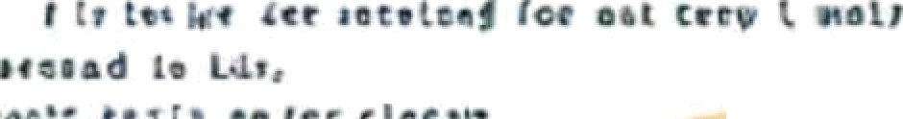








at t o h o t e n
x 1 c t r
: , ' i
cv t e s I i c o t4 •
c i e•• cz n c i c e e
I os t
cn c : e
• • .
r t o cs
- • ' I s. • I ' enn *s t 1 t t: i I t ¥ i : ;
P c c | I v | I • | t nc | t o t I i I r f t r ¿.
I ri | * | n | ' |  | '
I I
Exploratory Data Analysis
O1
Data Loading Exploration
Imported with pandas, checked structure and summary statistics.
Python
Missing Data Handling
Imputed Review Rating with median by category.
03
04
Feature Engineering
Created age_group and purchase_frequency_days.
Database Integration
Loaded cleaned data to PostgreSQL for SQL analysis.

Slide 5












ata lysi
Revenue by Gender
Female: $75,191, Male:
$157,890
High-Spending
Discount Users
Identified 839 customers.
Top 5 Products by
Rating
Gloves, Sandals, Boots, Hat, Skirt.

Slide 6




Insights: Shipping Subscriptions
Shipping Type Comparison
Subscribers vs. Non- Subscribers
Standard: $58.46, Express:
$60.48
Subscribers: 1,053, Avg Spend:
$59.49
Non-Subscribers: 2,847, Avg Spend: $59.87

Slide 7









Insights: Products
Segments
Top Products per Category
Jewelry, Blouse, Sandals, Jacket.
Discount-Dependent
Products
Hat, Sneakers, Coat, Sweater,
Pants.
Customer Segmentation
Loyal (3116), Returning (701), New
(83).

Slide 8



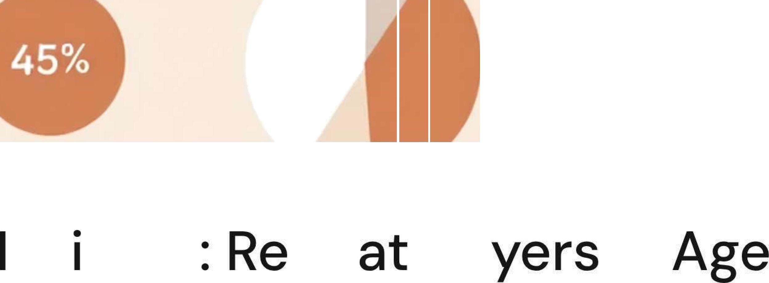













Repeat Buyers Subscriptions
Revenue by Age Group
958 repeat buyers are subscribers.
Young Adult: $62,143
2518 repeat buyers are not subscribers.
Middle-aged: $59,197
Adult: $55,978
Senior: $55,763

Slide 9
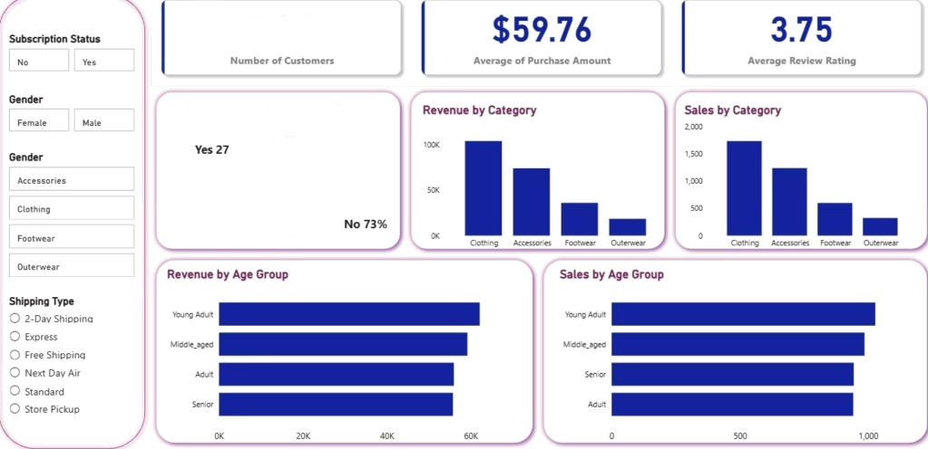
Power BI Dashboard
Interactive visualization of key customer behavior metrics.
3.9K
96 of Customer by Subscription Status

Slide 10

















ati
i es Re
Boost Subscriptions
Promote exclusive benefits.
Customer Loyalty Programs
Reward repeat buyers.
Review Discount Policy
Balance sales with margin control.
Targeted Marketing
Focus on high-revenue age groups.

