Slide 1
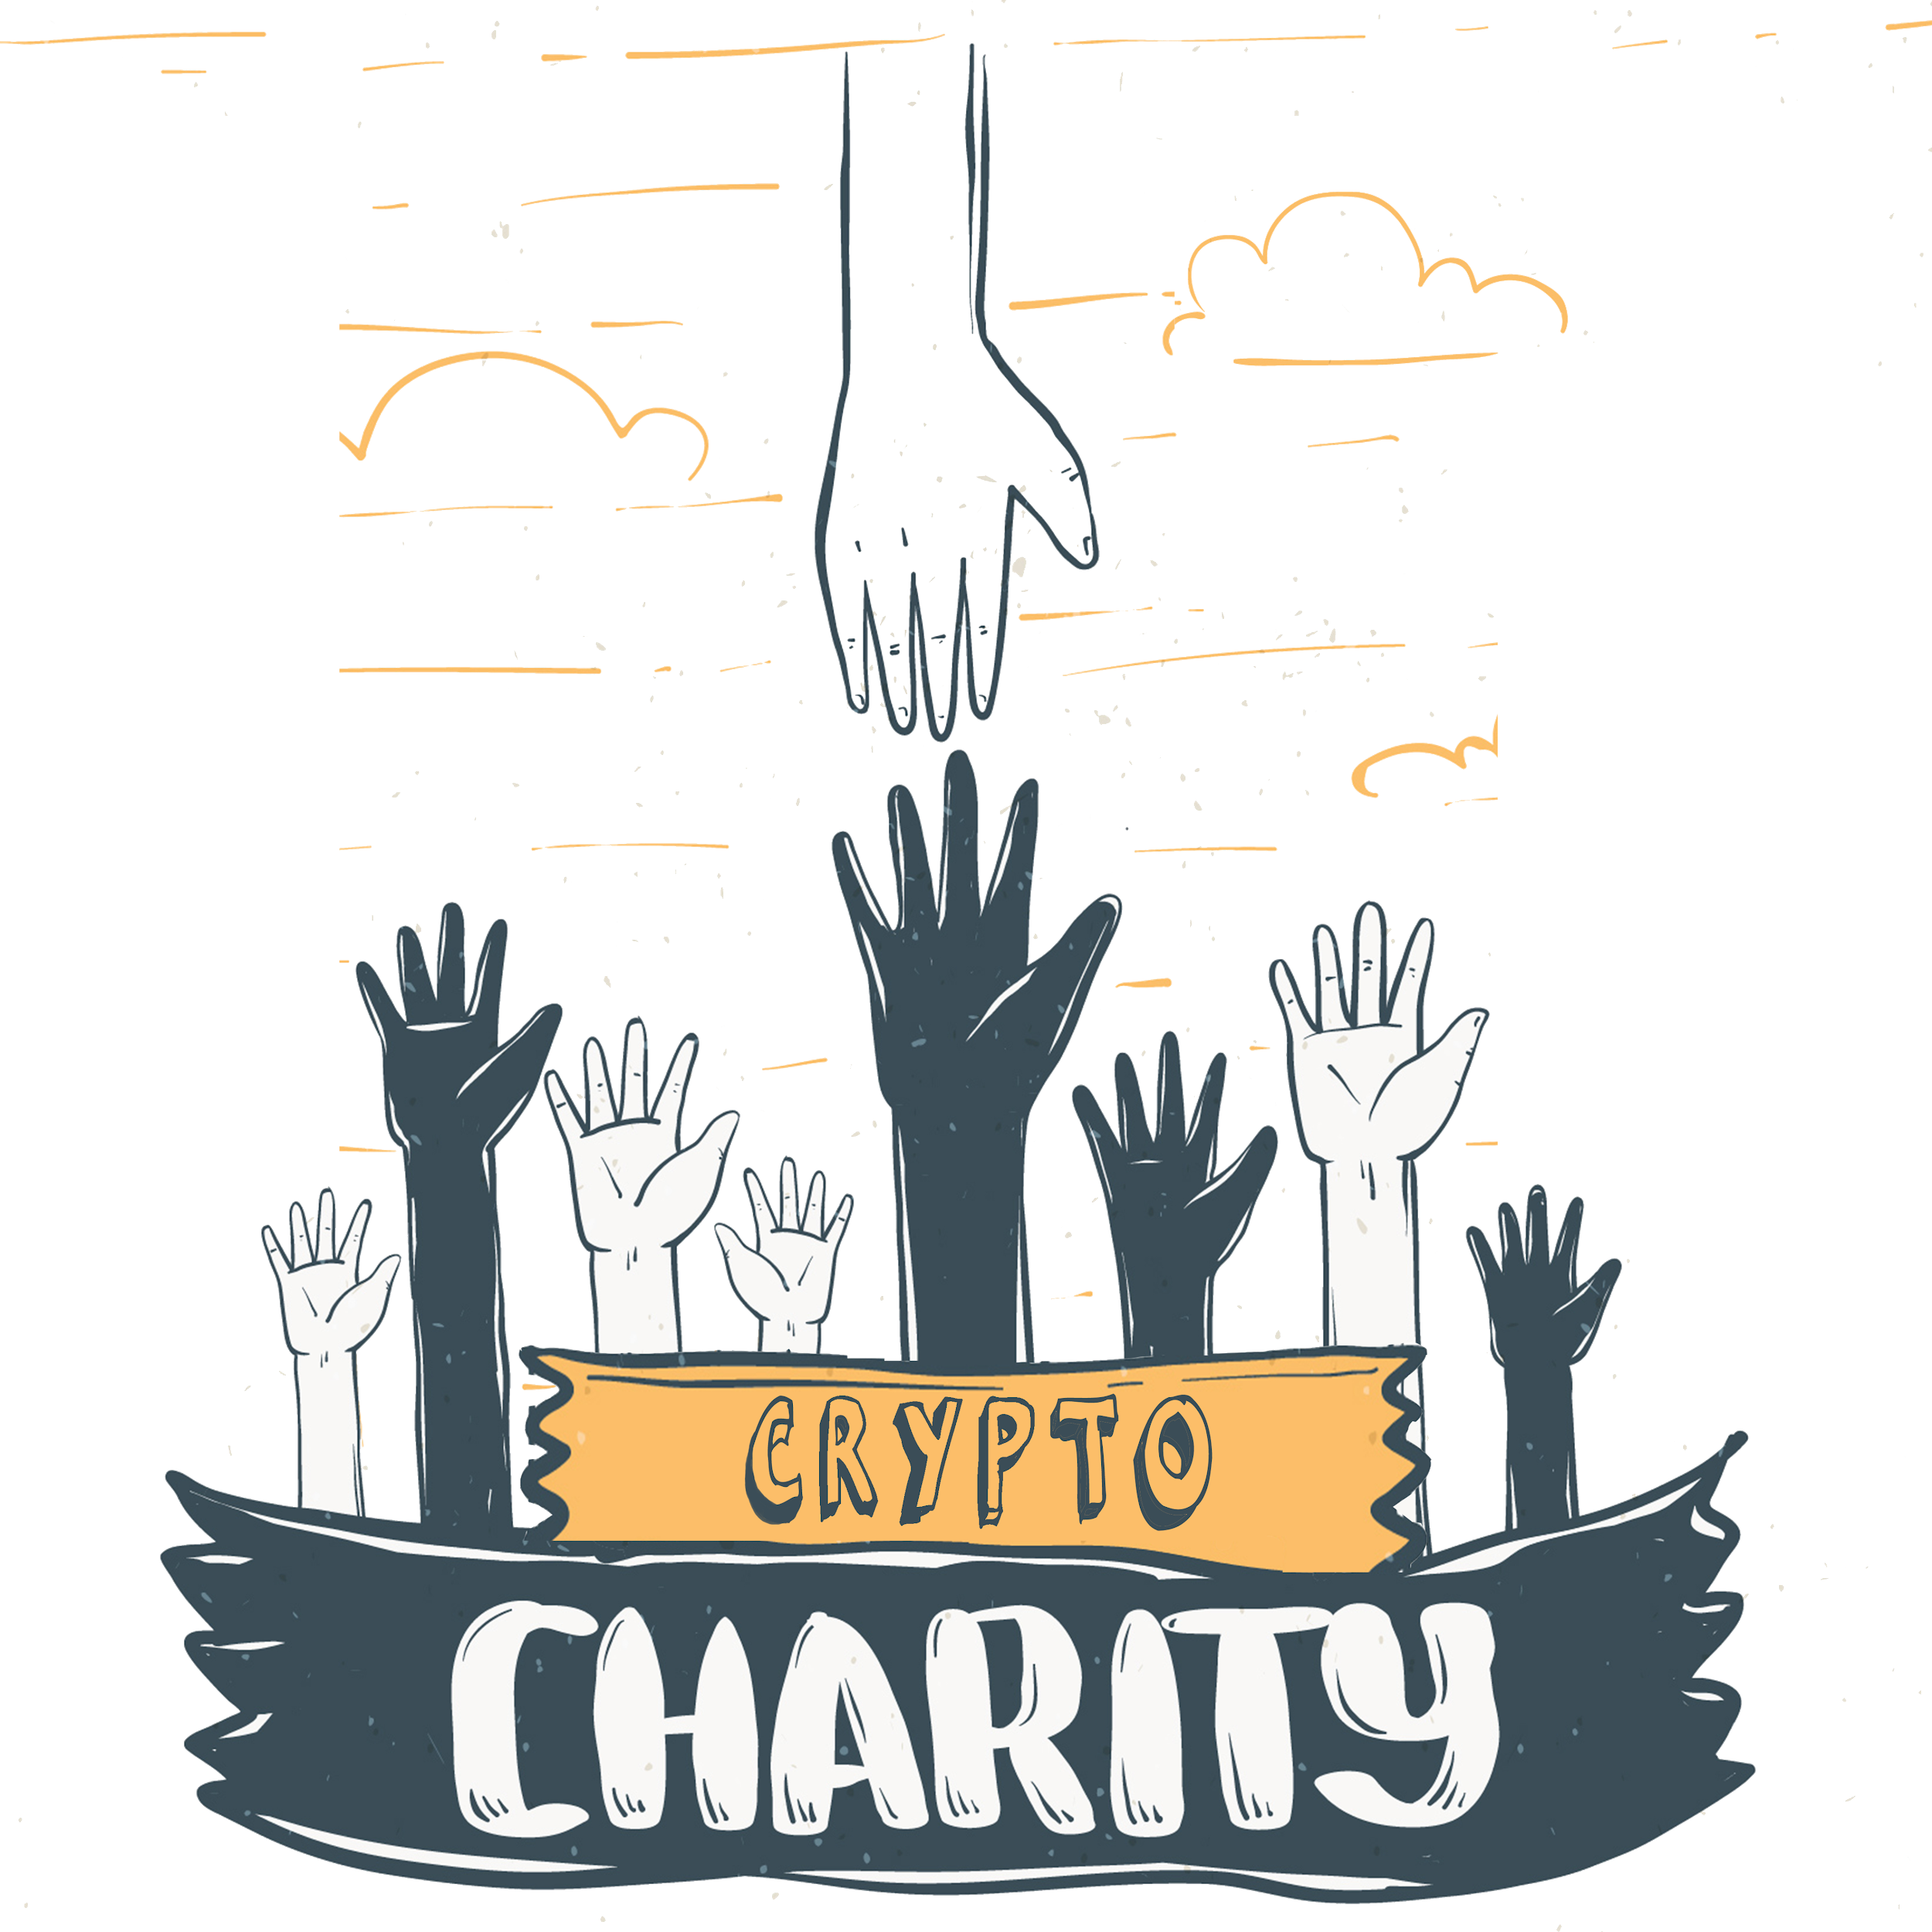

Slide 2
Topics to be covered
Problem to be resolved
About the Issue
Our approach
App’s Reach
Technologies used
Functioning of our app
Effect on the community
Conclusion

Slide 3
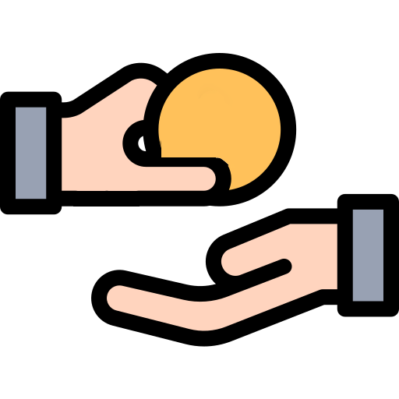
Issue to be resolved :
The lack of a viable interface between people who need support and people who can provide it.
Unavailability of resources at the time of need when
natural disasters occur.

Slide 4
About the issue
Every year when a natural disaster strikes we all start getting message requests for donating some money for helping those who are in between the calamity but even if we donate it is really not sure that they will be able to get their hands on the resources in time and to fix this we should start to prepare from the beginning which will help all of us in facing these disasters with best sources.

Slide 5
If a person who wants to support a cause or help someone in need can find an easy enough platform both people on the platform will be benefited from that. Most of the NGOs are not able to connect with the people who need their help so we are trying to ease this process by making a common interface for them.

Slide 6
Our Approach
We want to increase the donation for the NGOs for which we are making an app that will collect donations in the form of money, goods(clothing, footwear, blankets), food. As we know maintaining a big staff which will collect all this stuff and distributes honestly is nearly impossible and will have plenty of room for mistakes,that is why we would like to use one of the biggest support structures already established in India. Which are our NGOs these organizations are working from far too long and know what they are doing but their only limitation is Funds.

Slide 7
How we will Increase reach of our app to get more donations
India is a country where people are filled with patriotism, whenever there is a disaster or and natural calamity people come together and try to provide their support. So we will explain to people that each of their donations does make a difference.
Now if we take the example of film star Akshay Kumar got ahead in the industry with his acting and patriotic movies, as a result, people started to portray him as a patriotic person.

Slide 8
The business model for our app is going to try to get support from the big companies that are competing in the market.
If we take the case of Flipkart and Amazon. They are one of the two biggest online shopping companies. If one of those Leaders supports us then we will get the support we need and we will provide them our brand value this app can have in the future due to the social causes it is helping in and for that it can also be shown as a major donator of our app which can be helpful both ways.

Slide 9
To increase the donations we will also be providing people with the Support platform so they will be attracted towards the app.
Example: If someone is having a problem which can be solved by an NGO we can guide them to the best option available closer to them. People will start to download the app and some of them will also like to contribute back to society. If they are not able to donate money, goods, food then they can also do some volunteer work for the NGOs.

Slide 10
Technologies used
Blockchain and App Development
To implement this project we used a few software
Android Studio version 3.5.1
Adobe Photoshop
Java Development Kit

Slide 11
Use of Blockchain
We will store transactions in blockchain because of the following reasons:
It increases the transparency of transactions that make it more secure as it is really hard for a single person to manipulate the data.
Transaction is made public means each user will be able to see details of every transaction.
This app can’t be used for Unethical purposes like money laundering and corruption.

Slide 12
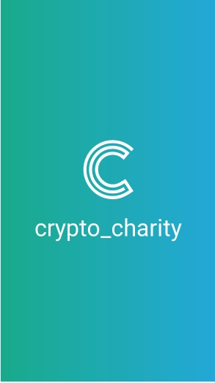
Functioning of our app
This part of our app is called Splash Screen every time the app will start this will be the first activity which will be loaded. This page has our app name as well as the logo. This will transition into the select language page and then proceed forward. The select language page will only be shown on the first start after install later it will stay in settings menu.

Slide 13
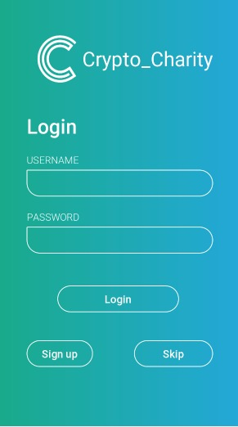
In our Login page if the user wants to log in with their id they can do so but if the user doesn't have a login id or wants to sign up with a new account there is a feature for that too, And of course there is no pressure for sign up or login user can also skip this activity for now and directly go to the homepage where they can explore other activities of the application.

Slide 14
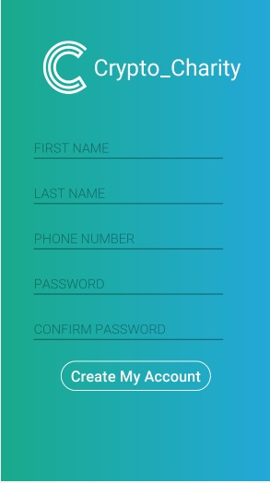
It's a simple Sign-up page which can be used to register a new Id. It's very easy to register because you just need to register your mobile number. Afterwards, you'll have to fill up a few personal details, and we do make sure that your data is safe with us and can’t be used by someone else.

Slide 15
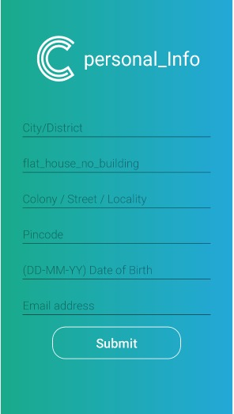
User Will have to update their info to use some of the important features of the application. None of the data will be used to send newsletters or and other advertising content but this helps the environment of the app to work better for the user this will be mandatory for every registered user to fill this form.

Slide 16
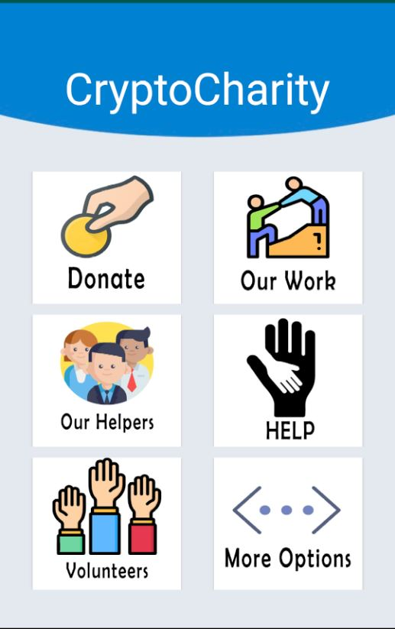
This is our main Home page where you can access the functionality of the app. This page includes numerous activities but to take the full advantage of the app its mandatory for you to signup and provide personal details

Slide 17
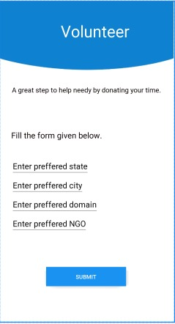
Volunteer page starts this activity.
Trust me it is a really simple process to volunteer you just have to select your state then prefered city
Now you can choose what type of domain you want then you will get to “choose” where you want to volunteer.
That’s it. Another good work in less hassle.

Slide 18
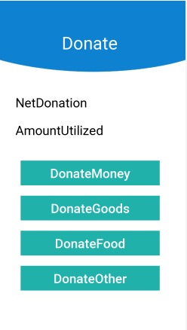
When you will click in the donate page you will get in this menu and you will be able to see net donation ,and the amount utilized till date. We don’t hide any information from our users.

Slide 19
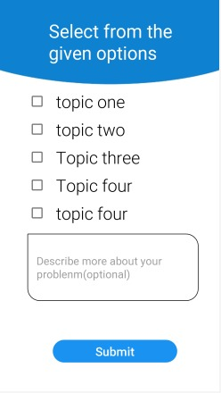
HELP Page on home get us to here.
People can select multiple topics.

Slide 20
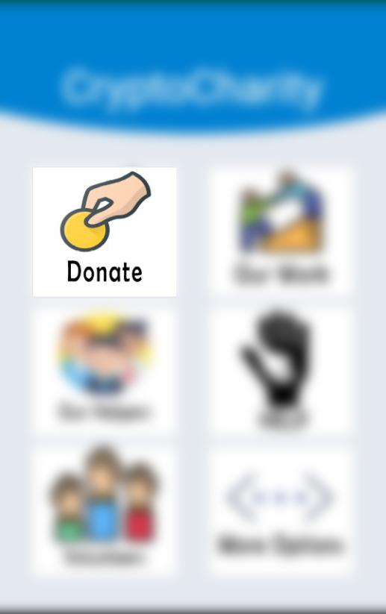
Effect on community
You can find a donate function on the Home page. This page provides 3 facilities :
Donate with food - Food is the basic need of a human being and if you have some to spare it good you donate it instead of let it go waste.
Donate with goods - We should understand that have some new clothes makes us feel great but that does also mean that you old one are now useless NO! Instead of throwing them in garbage you can donate them.
Donate with money - for education and other needs money plays a great role and this can help in medical conditions too. If you have some extra than donating some won’t hurt much.

Slide 21

Effect on community
You know what can be the best use of your free time when you are getting bored. It’s Volunteering of course:
If you are a student and on your holidays then i suppose a day of volunteering won’t get in your plans.
Now if you volunteer with a NGO you will always get to learn something and it could even be fun.

Slide 22
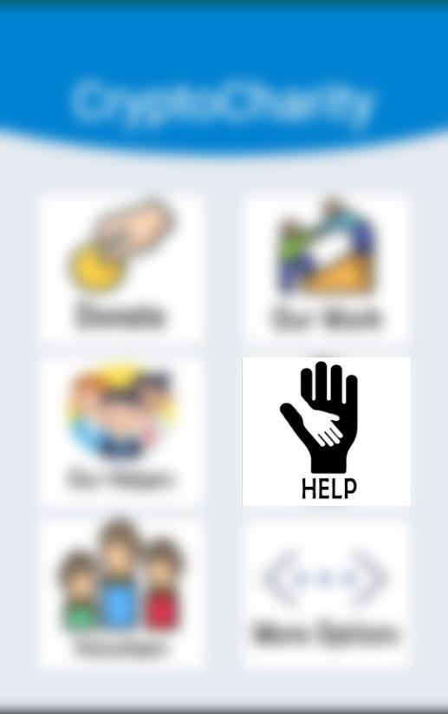
Effect on community
Now That you have understood that you can do good deeds by donating and volunteering let me tell you this not just a one side work if you are are in some problem which we can help with we will be happy to provide you with a solution based on your issue we can provide you with the list of available NGOs which can take some action over that. If they are capable of helping you out the definitely will.

Slide 23
Conclusion
So, from this app we will be able to help all the people needing support ,victims of the emergency cases and Natural disasters from our app this process gets efficient, user friendly. We are covering wide range of population and this app will help us to prepare better for natural calamities. We will help government by helping in raising funds for Natural disaster.

