Slide 1
KELP
Project Apex
Investment Opportunity
Strictly Private & Confidential – Prepared by Kelp M&A Team

Slide 2
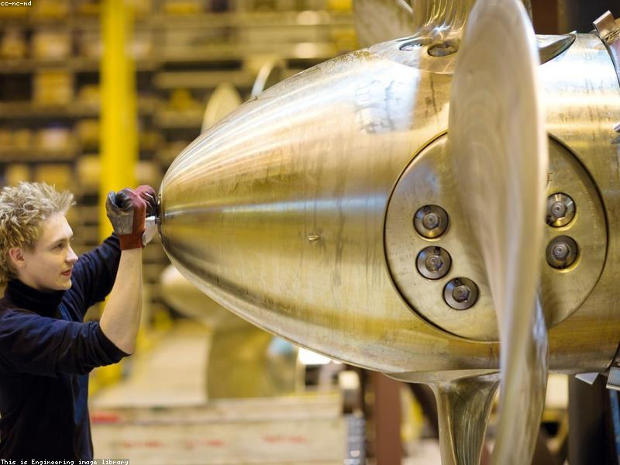
KELP
BUSINESS PROFILE & INFRASTRUCTURE
■ Specializes in defense, aerospace, and space electronics solutions
■ 350,000 sq. ft. manufacturing facility in Bangalore
■ Serves aerospace, defence, space, medical, automotive, telecom sectors
■ Certifications: ISO 9001, NADCAP
■ Headquartered in Bangalore with additional facilities across India
Strictly Private & Confidential – Prepared by Kelp M&A Team

Slide 3
KELP
FINANCIAL & OPERATIONAL SCALE
■ Revenue in 2019: -53.6 million USD
■ EBITDA in 2020: -97.8 million USD
■ Net Debt as of 2021: 23.5 million USD
■ Revenue in 2022: 48.9 million USD
■ EBITDA in 2023: -56.7 million USD
Strictly Private & Confidential – Prepared by Kelp M&A Team

Slide 4
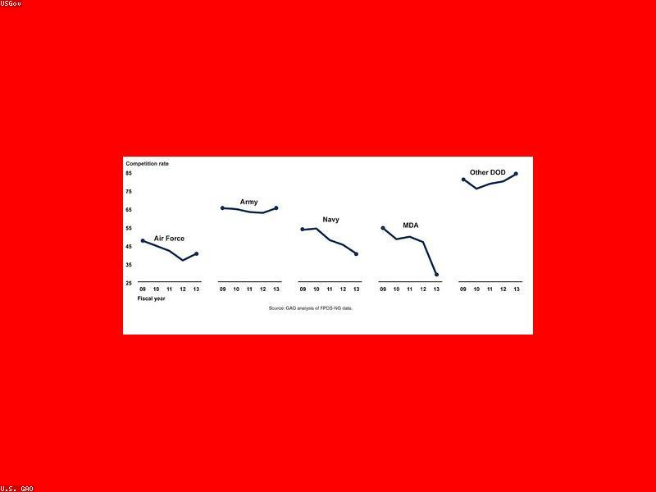
KELP
INVESTMENT HIGHLIGHTS
■ DRDO order for Intersatellite Link Payload Subsystems (16-month execution, 2024)
■ Kaizen Excellence Award winner, National level (2023-24)
■ Certifications: ISO 9001:2015, NADCAP
■ 350,000 sq ft manufacturing facility
■ Headquartered in Bangalore with additional facilities across India
Strictly Private & Confidential – Prepared by Kelp M&A Team

Slide 5
Disclaimer
This presentation is strictly confidential and is being provided to you solely for your information. By accepting this presentation, you agree to keep it confidential and not to distribute it to any other person.
This document does not constitute an offer to sell or a solicitation of an offer to buy any securities. The information contained herein has been obtained from sources believed to be reliable but is not guaranteed as to accuracy or completeness. Project Apex and Kelp M&A Team make no representation or warranty regarding the accuracy of the information.
This presentation may contain forward-looking statements that involve risks and uncertainties. Actual results may differ materially from those projected.
Strictly Private & Confidential – Prepared by Kelp M&A Team

