Slide 1
M.TECH THESIS REVIEW · CONTROL SYSTEMS · IIT KANPUR
System Identification of a DC Gearmotor and L298N Driver
A validated cascade model with region-dependent dynamics
The claim: the plant is a cascade — a direction-specific driver block, then a near-symmetric motor block — and the split is earned from the data, not assumed.
Piyush Tiwari
Roll 241040099 · M.Tech, Electrical Engineering
Supervisor: Prof. Soumya Ranjan Sahoo
Co-Supervisor: Dr. Abhilash Patel · May 2026
12 V · 60:1 gearmotor | L298N H-bridge | 600-PPR encoder | Arduino Uno R4 Minima
Notes:
SAY: This is a review of completed work — open-loop identification plus a closed-loop test — and I'm asking for approval to write it up. One structural question drove the whole thesis: is this plant one black box, or a cascade of physical blocks?

Slide 2
THE ONE RESULT
Asymmetry and drift live in the driver. The motor is clean.
V_{motor}
PWM
cmd
STATIC DRIVER BLOCK
MOTOR DYNAMIC BLOCK
PWM → V_{motor}
V_{motor} → RPM
RPM
hysteretic deadzone
asymmetric up to 2.2×
the only measurable session drift
FOPDT, region-dependent τ
symmetric to within 9%
reproducible to ≈1%
asymmetry + drift live HERE
clean & reproducible
Asymmetry confined to one identifiable block is exactly what earns the cascade — this is contribution one.
System Identification of a DC Gearmotor & L298N Driver
2
Notes:
SAY: Here's the one thing to leave with. The large directional asymmetry and the only measurable session drift BOTH localise to the cheap L298N driver — up to 2.2x near the deadzone — while the motor block is symmetric to within 9% and reproducible to 1%. Asymmetry confined to one identifiable block is exactly what earns the cascade. I'll point back to this slide all talk.

Slide 3
THE QUESTION
The question is structural: one black box, or a cascade of physical blocks?
Five departures from the textbook ideal
A ladder of three models, fixed at the outset
Driver voltage loss — droops below supply
Hysteretic deadzone with fwd/rev breakaway asymmetry
Forward/reverse gain mismatch
Operating-point-dependent dynamics
A small command-to-response delay
Model A single global LTI, no static block — the straw-man baseline
Model B static block + one global time constant
Model C ✓ static block + region- & operating-point-dependent FOPDT — the winner
The data picks the rung — not assumed
System Identification of a DC Gearmotor & L298N Driver
3
Notes:
SAY: I didn't assume the cascade. The L298N rig departs from the textbook ideal in five ways, and I fixed three candidate models in advance — naive LTI, static-plus-one-time-constant, and static-plus-region-dependent dynamics. The data picks the rung. That ladder is the backbone of the whole talk.

Slide 4
METHOD
Steady-state sweeps isolate the driver; step responses isolate the motor.
The rig
How the two blocks separate
12 V, 60:1 geared DC motor
L298N H-bridge (single channel)
600-PPR quadrature encoder
Arduino Uno R4 Minima
Measurement: PWM steps in → encoder RPM out
20 operating points across the envelope
Static sweeps (motor allowed to settle) → isolate the DRIVER block [ PWM → voltage ]
Step responses (the transients) → isolate the MOTOR block [ voltage → speed ]
Each test fixes a different block → every behaviour attributes to one
System Identification of a DC Gearmotor & L298N Driver
4
Notes:
SAY: Because static tests fix the driver and transients fix the motor, every behaviour I observe can be attributed to one block. That's what makes the decomposition testable rather than assumed.

Slide 5
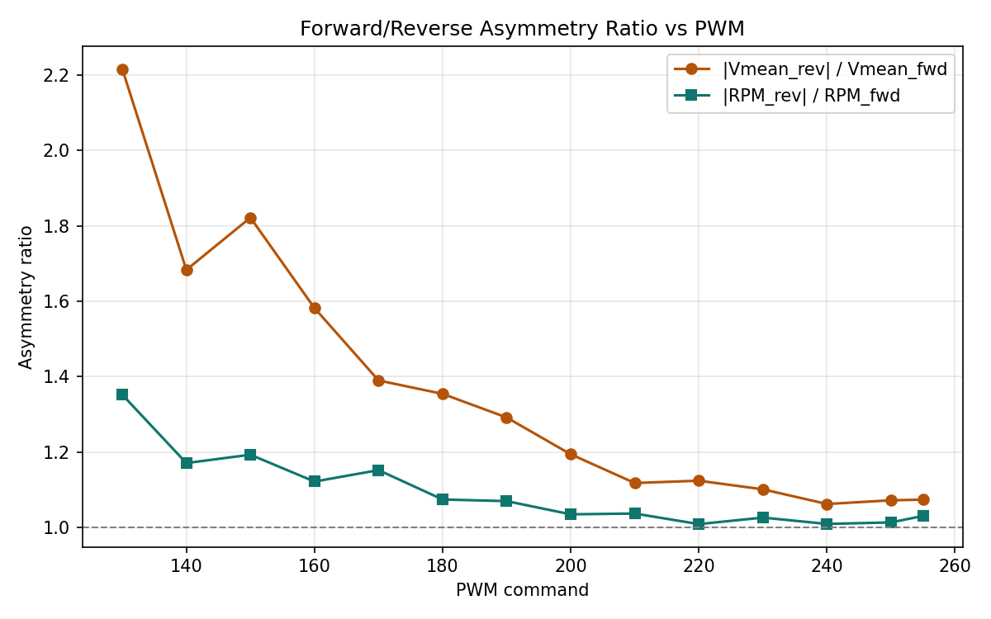
OPEN-LOOP EVIDENCE · 1 OF 3
The driver's PWM→voltage map is asymmetric up to 2.2× — with a hysteretic deadzone.
≤ 2.2×
22–27%
directional asymmetry near the deadzone edge
voltage droop below supply at full duty
Hysteretic deadzone (forward / reverse)
Breakaway: 154 / 144 PWM
Dropout: 114 / 112 PWM
Different thresholds for starting vs stopping → genuine hysteresis
Fig 3.4 — Voltage-ratio (driver, amber) peaks at 2.2× near the deadzone; the RPM-ratio (motor, teal) stays far lower — the asymmetry is in the driver, not the motor.
System Identification of a DC Gearmotor & L298N Driver
5
Notes:
SAY: All the ugliness — asymmetry, deadzone, hysteresis — sits in the cheap driver. The PWM-to-voltage map differs by direction by up to a factor of 2.2 near the deadzone, and the driver droops 22 to 27 percent below supply at full duty.

Slide 6
OPEN-LOOP EVIDENCE · 2 OF 3
The motor block is symmetric to within 9% — the asymmetry is NOT in the motor.
26.94
24.52
9% forward vs reverse gap
K_{fwd} (rpm / V)
K_{rev} (rpm / V)
≈1% run-to-run reproducibility
The large directional asymmetry of the driver does not reappear here. That one-block localisation — dirty driver, clean motor — is precisely what justifies splitting the plant into a cascade. This is contribution one.
System Identification of a DC Gearmotor & L298N Driver
6
Notes:
SAY: And here is the other half of contribution one. The motor's voltage-to-speed gain is direction-symmetric — 26.94 forward versus 24.52 reverse, a nine percent gap — and reproducible to about one percent. The LARGE asymmetry of the previous slide does not reappear in the motor. Asymmetry in one block, a clean other block: that is what earns the cascade.

Slide 7
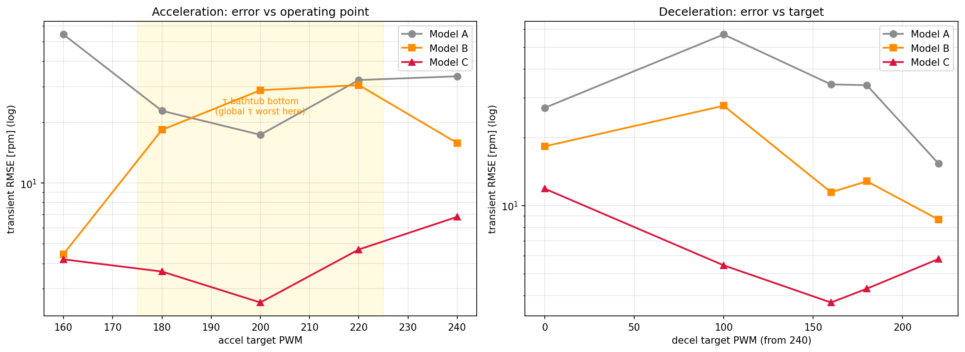
OPEN-LOOP EVIDENCE · 3 OF 3
A single time constant is wrong by ~2×: the dynamics are region-dependent (Model C).
≈ 2×
81 ms
321–366
decel τ vs accel τ
accel τ floor (→200 near breakaway)
decel τ (ms), deadzone coast
Fig 4.8 — Model B's single τ fails worst at the bathtub bottom (PWM 180–220) and at deadzone-edge decel; Model C stays flat-low. Direction asymmetry reverses sign accel ↔ decel.
System Identification of a DC Gearmotor & L298N Driver
7
Notes:
SAY: One global time constant is misspecified by a factor of two and is rejected. Acceleration tau is a broad bathtub in PWM — about 81 milliseconds mid-range, rising to 200 near breakaway and 150 near full drive. Deceleration is a separate regime, roughly twice as slow, peaking at 321 to 366 milliseconds for stops that coast through the high-friction deadzone. The direction asymmetry even reverses sign between speeding up and slowing down.

Slide 8
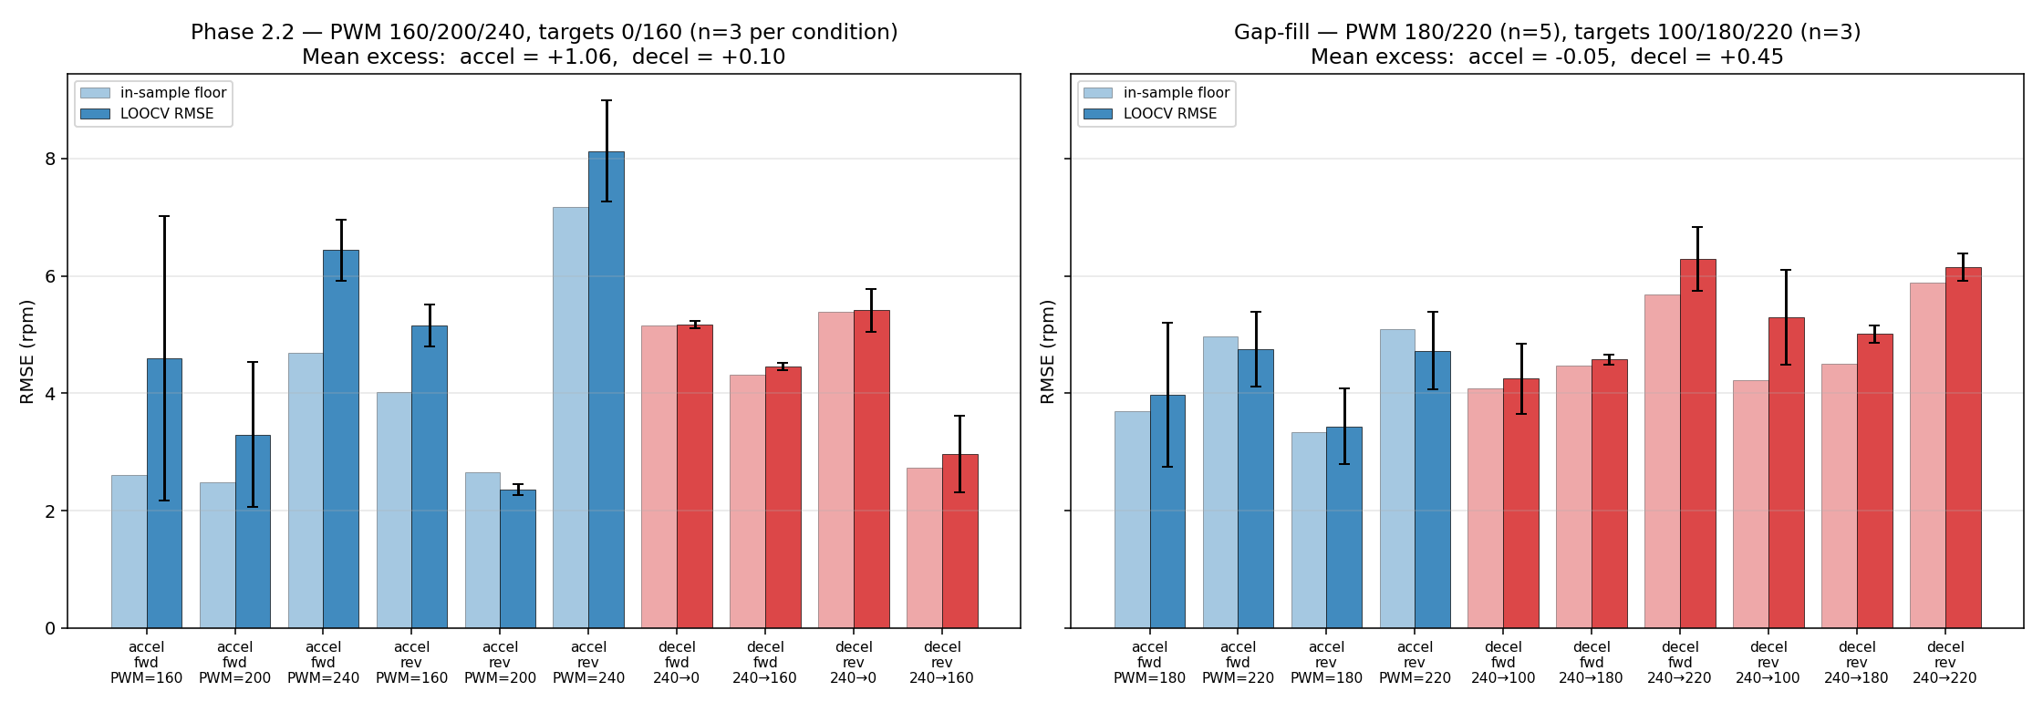
VALIDATION · 1 OF 2
Cross-validation gives ~0.1–1 rpm error — and exposed a cold-start effect I confirmed by prediction.
+1.06
+0.10
−0.05
accel LOOCV excess (rpm)
decel LOOCV excess (rpm)
warm accel excess — prediction met
Fig 5.2 — LOOCV RMSE vs in-sample floor. Left (cool session): accel excess +1.06. Right (warm session): accel excess collapses to −0.05 — the cold-start hypothesis, confirmed. No held-out set ever existed → LOOCV is the honest estimator.
System Identification of a DC Gearmotor & L298N Driver
8
Notes:
SAY: Leave-one-out cross-validation — adopted because no held-out dataset ever existed — gives a predictive excess of about 1 rpm for acceleration and 0.1 for deceleration. The ten-times gap traced to cold-start stochasticity: acceleration from rest catches the motor cold. That was a falsifiable prediction, and a warm-motor session confirmed it directly — the acceleration excess collapsed to minus 0.05 rpm.

Slide 9
VALIDATION · 2 OF 2
Calibration drifts between sessions in a structured way — so reuse is unsafe.
Cold-start transient
Low-speed decel slowdown
Reverse high-PWM speed-up
Forward-accel τ is inflated for the first ≈30 s, then recovers as the motor warms.
Deceleration to low targets runs persistently slower than interpolation predicts.
Reverse τ ran persistently ≈20% below its earlier value.
transient
persistent
persistent
Phase 3 proved the cost: a session-fresh Model A had τ = 155 ms vs the locked 207 ms (~25% off). Reusing the locked parameters would have built a ~30%-overdamped controller. → Recalibrate in situ; never reuse stored parameters.
System Identification of a DC Gearmotor & L298N Driver
9
Notes:
SAY: Re-running the same conditions two weeks later revealed structured drift, not random noise — and it is itself a methodological result. Phase 3 then proved the cost directly: a session-fresh model had a time constant 25 percent off the locked value; reusing the stored parameters would have built a 30-percent-overdamped controller. The rule is firm — recalibrate in situ.

Slide 10
CLOSED-LOOP TEST · 1 OF 2
I pre-registered the comparison, then ran it: cascade wins on steps, loses on the ramp.
BASE − CASC (rpm) · positive = cascade wins
Pre-registered & fair
+5.22
SHA-256 of metrics + success criteria committed before any trial
Fairness gate: cascade RMS PWM ≤ 1.5× baseline — no winning by hammering harder
n = 8 paired trials per profile · 64 trials total
All four 95% CIs exclude zero — three positive (wins), P2 negative (the one loss)
+2.83
+1.03
-1.09
P1 · staircase
p ≈ 0.004
P2 · deadzone ramp
loses
P3 · reversal
p ≈ 0.004
P4 · small-signal
p ≈ 0.004
Cascade wins by 1–5 rpm on stepwise profiles; loses by ~1 rpm on the slow ramp through the deadzone — the “wins universally” hypothesis is falsified, specifically.
System Identification of a DC Gearmotor & L298N Driver
10
Notes:
SAY: The metrics, success criteria and statistics were committed with a SHA-256 hash before a single trial ran — so this is honest in the strict sense. Positive means the cascade wins. It wins on the staircase, the reversal and the small-signal step, all clearly. It LOSES by about 1 rpm on the slow ramp through the deadzone. The pre-registered wins-universally hypothesis is falsified — and the largest win is the reversal, exactly the regime the open-loop work predicted.

Slide 11
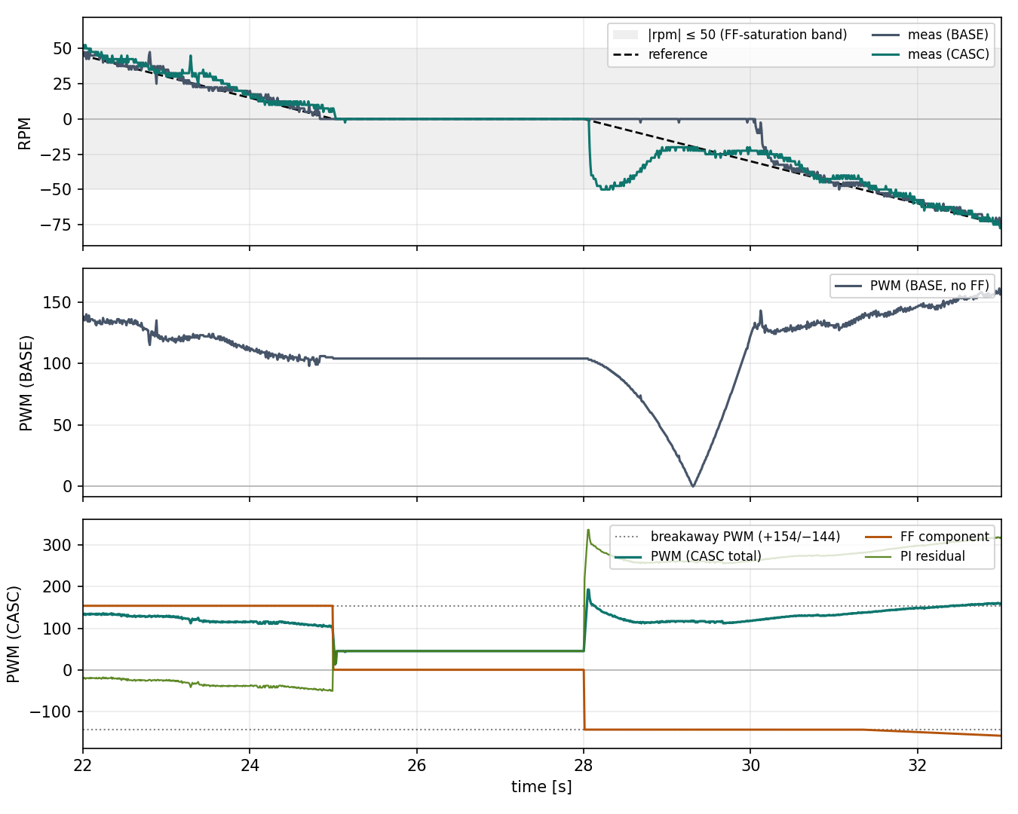
CLOSED-LOOP TEST · 2 OF 2
The one loss has an identified cause — and a concrete fix.
1. The feedforward inverts the static block → it inherits the slope discontinuity at breakaway.
2. On steps that must cross the deadzone fast, that jump is helpful → P1, P3, P4 win.
3. On a slow ramp it injects step-like PWM → ≈55 rpm reverse overshoot at the zero crossing.
4. That breaks the smooth signal a plain PI integrator would give → P2 loses.
Fix: a smoothed-feedforward cascade variant — taper through the deadzone instead of stepping. The natural next bench-day target.
A pre-registered hypothesis, falsified in a mechanistically-identified way that points to a fix, is a result — not a setback.
Fig 6.3 — at the zero crossing the CASC feedforward steps the PWM and drives a ~55 rpm reverse overshoot (blue); BASE (red) stays smooth.
System Identification of a DC Gearmotor & L298N Driver
11
Notes:
SAY: The loss is mechanistically specific. The feedforward inverts the static block, so it inherits the block's slope discontinuity at the breakaway edge. On steps that must cross the deadzone fast, that jump helps — which is why three profiles win. On a slow ramp it injects step-like PWM, producing a 55-rpm reverse overshoot at the zero crossing and breaking the smooth signal a plain PI would give. The fix is a smoothed feedforward. A falsified hypothesis that localises its own failure is a result, not a setback.

Slide 12
HONESTY
The limits — stated before you ask.
Static map
Dynamic tables
FOPDT fits
One sweep (no run02/03), backed by a 2-point spot-check + implicit cross-validation of the step-response endpoints.
An honestly-labelled two-session composite — the bathtub and target-dependence pictures need both sessions.
Effective at the operating-point extremes & coast-to-rest (friction-dominated); T_{d} is an effective parameter, not physical latency.
Validation scope
One noisy point
None of this undermines the structural claim. Naming the limits is part of why the model is trustworthy.
Interpolation within the calibration grid only — not extrapolation, not uncorrected cross-session prediction.
Reverse 240 → 100 is irreducibly noisy through the deadzone.
System Identification of a DC Gearmotor & L298N Driver
12
Notes:
SAY: None of this undermines the structural claim, and stating it up front is part of why the model is credible. The static map rests on a single sweep, backed by a spot-check and the implicit cross-validation of the step-response endpoints. The dynamic tables are an honestly-labelled two-session composite. The FOPDT fits are effective at the extremes. Validation is interpolation within the grid only. One condition is irreducibly noisy.

Slide 13
RECAP & THE ASK
Five contributions — and one request.
1
An earned cascade — asymmetry & drift in the driver; motor symmetric to 9%, reproducible to 1%.
2
Region-dependent dynamics — a single time constant is misspecified by ~2×.
3
Cross-validation that surfaced — and a warm session confirmed — a cold-start effect.
4
A methodological finding — calibration drifts between sessions; recalibrate in situ.
5
A pre-registered closed-loop test — wins stepwise, loses on ramp-through-deadzone, and localises its own failure.
All seven chapters' results are complete and validated within the calibration grid. I'm requesting approval to proceed to thesis writing.
Notes:
SAY: To restate, now proven: the data — not my assumption — splits this plant into a dirty driver and a clean motor; the dynamics need a region-dependent model; it's cross-validated, its drift is characterised, and its closed-loop behaviour is pre-registered and honestly mixed. The work is complete. I'm asking to proceed to writing.

Slide 14
RESERVE
Backup — flip to on demand
Anticipated questions → where each is already answered
The model ladder on real step responses (Fig 4.6 / 4.7)
Closed-loop trajectories & the fairness check (Fig 6.2)
Keep the figure-heavy detail ready; pull it up only when asked.

Slide 15
BACKUP
Anticipated questions — and where each is already answered.
Likely question | Answered on
Why a cascade, not one black-box model? | Slides 3 & 6 · backup ladder
How do you know the asymmetry is the driver, not the motor? | Slides 5 & 6
Is it reproducible? Did you validate? | Slides 8 & 12
Why LOOCV instead of a held-out test set? | Slide 8 — no held-out set existed
Why does it lose on P2? | Slide 11 — FF discontinuity, with the fix
Why trust the time constants given the drift? | Slide 9 — drift characterised; recalibrate in situ
Tip: every “already-in-the-work” question = something shown but not asserted. Flip here, point to the slide.
System Identification of a DC Gearmotor & L298N Driver
15
Notes:
SAY: Every question they ask whose answer is already in the work means I showed something but didn't assert it. When that happens, I flip here and point to the slide.

Slide 16
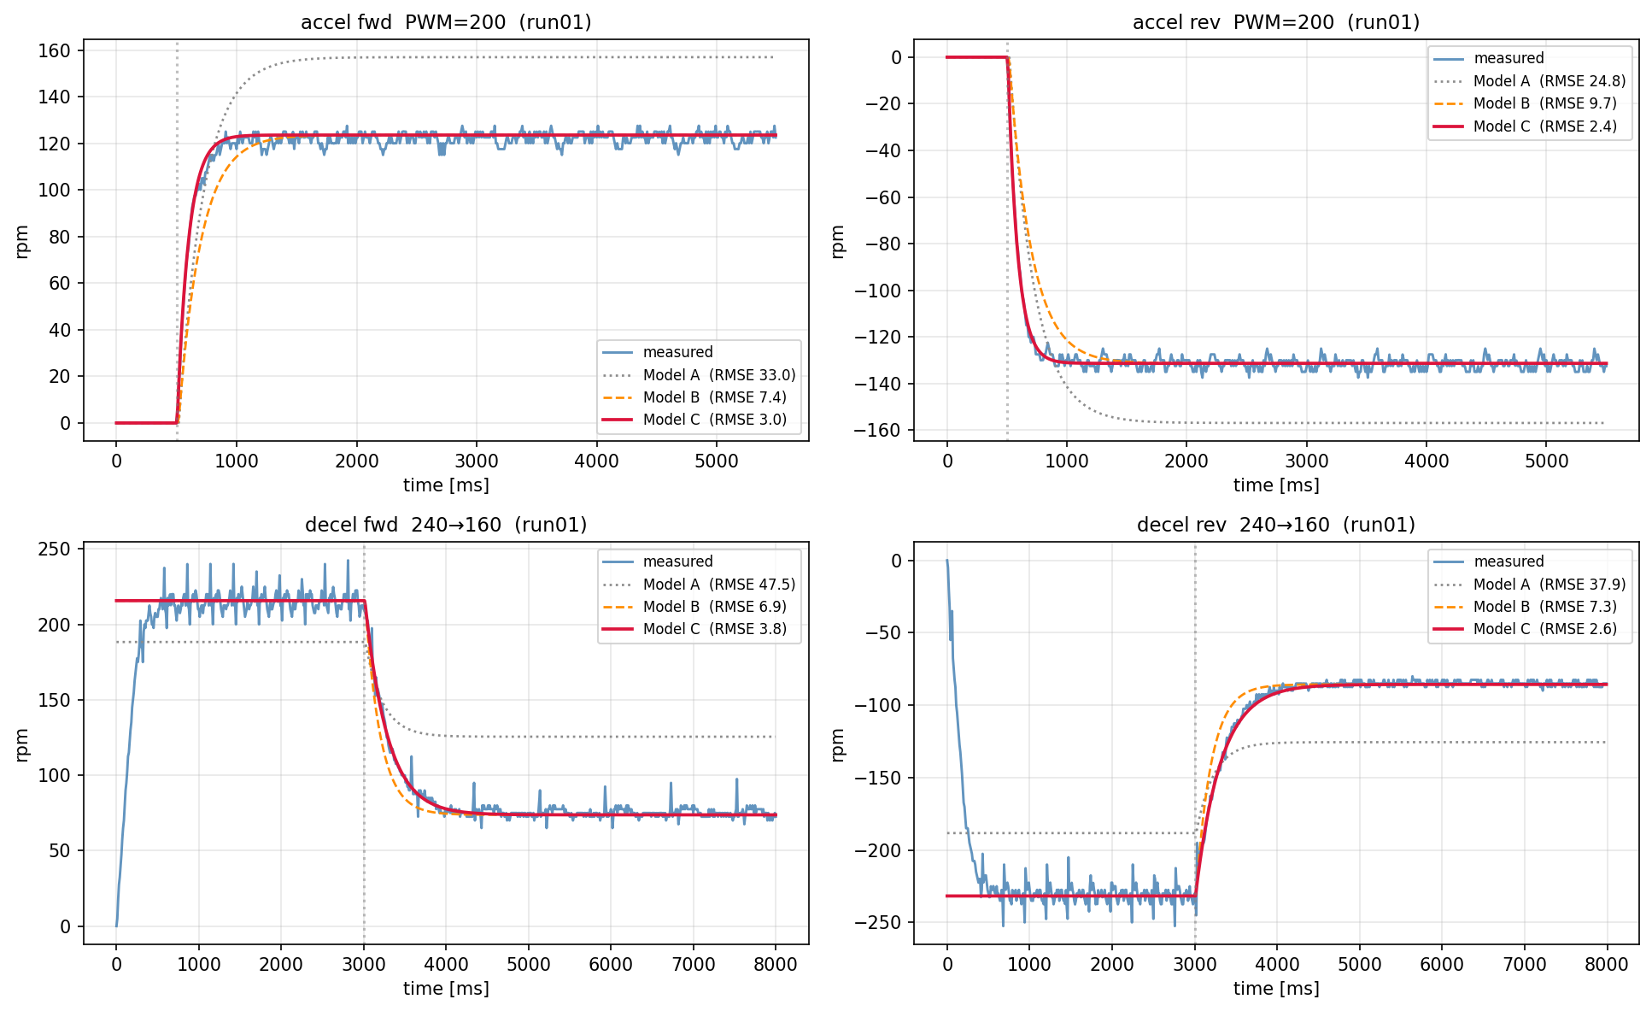
BACKUP
The model ladder, on real step responses.
Why C earns its complexity
Model A reaches the wrong level and rises with the wrong shape.
Model B fixes the level but keeps one global τ.
Model C tracks both level and transient in every panel.
Per-panel RMSE (annotated) drops monotonically A → B → C.
Fig 4.6 — measured vs Model A / B / C on four representative transitions; per-panel RMSE annotated.
System Identification of a DC Gearmotor & L298N Driver
16
Notes:
SAY: If they ask why C earns its complexity over A and B: Model A reaches the wrong level and rises with the wrong shape; Model C tracks both level and transient. The scoreboard on the next slide shows C wins every direction-by-region group.

Slide 17
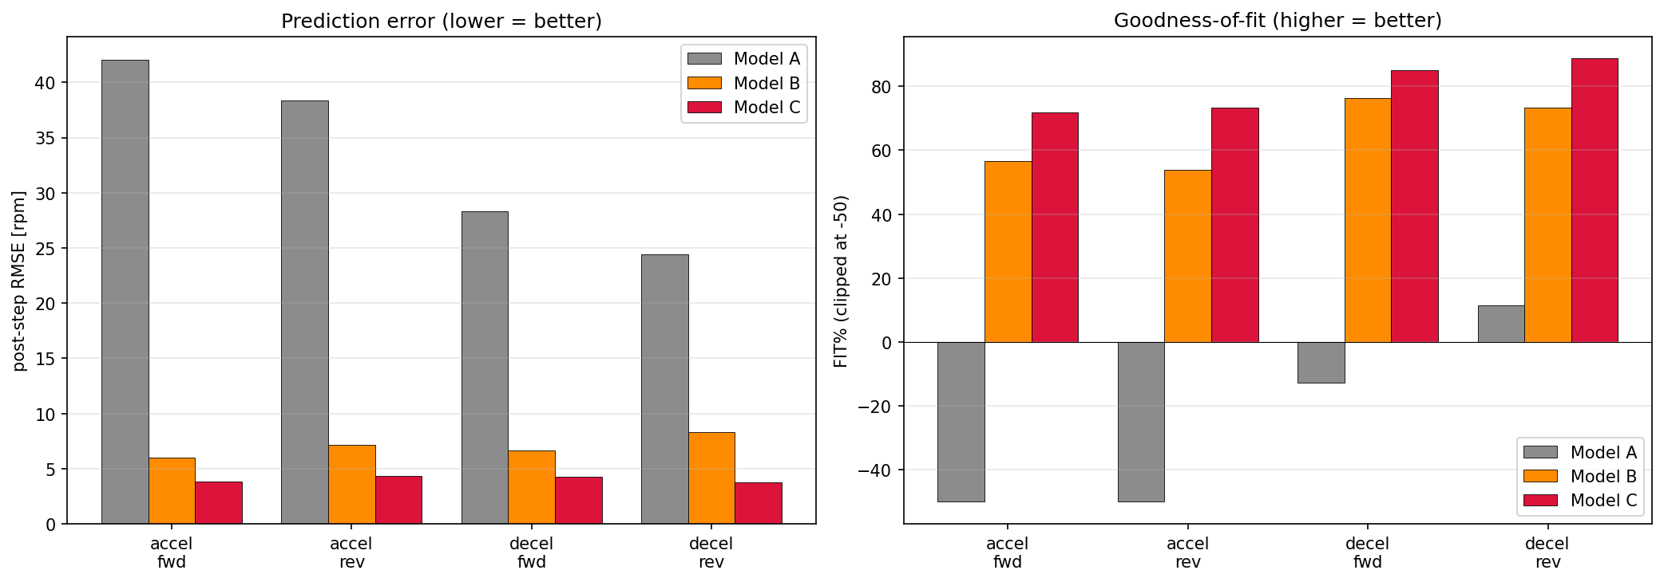
BACKUP
A/B/C scoreboard — Model C wins every direction × region group.
Fig 4.7 — left: post-step RMSE (lower = better); right: FIT% (higher = better, Model A clipped at −50). Model C is best in all four groups on both metrics.
The static block (A → B) is the big jump; region-dependent τ (B → C) is the consistent finisher.
System Identification of a DC Gearmotor & L298N Driver
17
Notes:
SAY: If they want the headline scoreboard: Model C wins every one of the four direction-by-region groups, on both prediction error and goodness-of-fit. The big jump is adding the static block, A to B; region-dependent tau, B to C, is the consistent finisher.

Slide 18
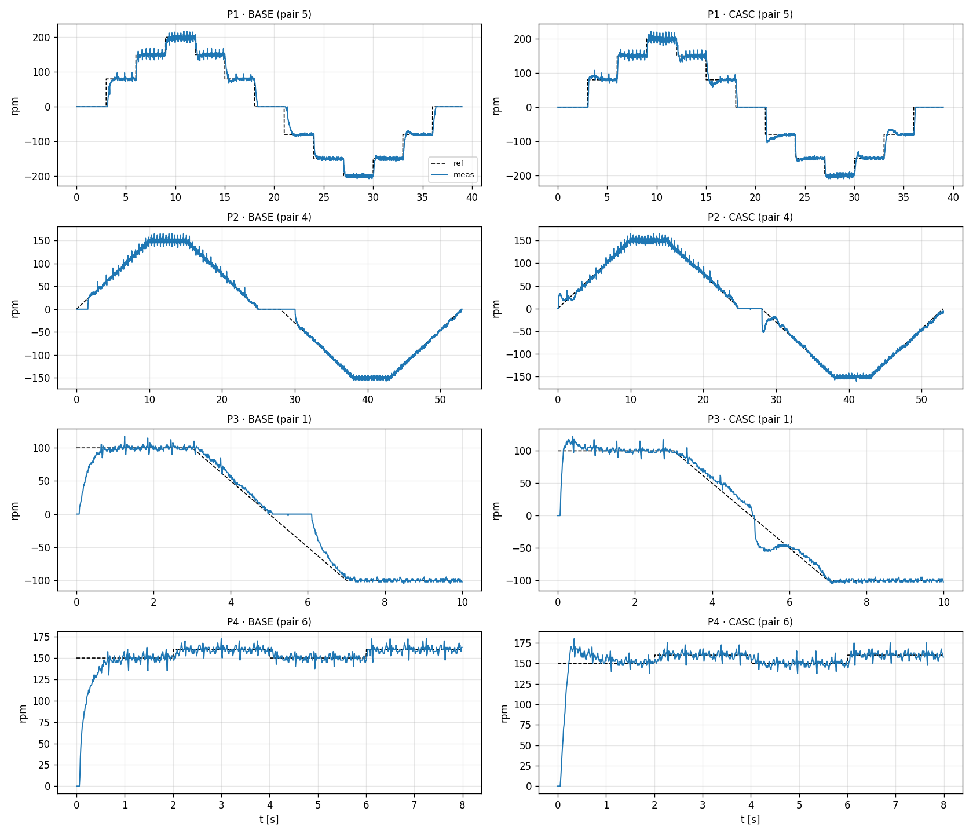
BACKUP
Closed-loop trajectories and the fairness check.
The fairness check
Fairness gate satisfied: cascade RMS PWM ≤ 1.5× baseline on every profile (ratios 0.99–1.04) — no winning by hammering harder.
Pre-registration: SHA-256 of metrics + success criteria committed before bench day.
Per-pair noise small: sd of differences 0.14–0.29 rpm — effects stable across 8 repetitions.
Fig 6.2 — reference vs measured, one pair per (profile × controller).
System Identification of a DC Gearmotor & L298N Driver
18
Notes:
SAY: The trajectory figure shows reference versus measured, one pair per profile and controller; on P2 you can see the cascade deviating at the zero crossings. The fairness gate confirms the cascade did not win by hammering harder, and the pre-registration hash was committed before bench day.

