Slide 1



Customer Shopping Behavior Analysis
Python | PostgreSQL | Power BI
Piyush Jha | Data Analyst
Notes:
Introduce the project: an end-to-end analysis of 3,900 retail transactions using Python, PostgreSQL and Power BI.

Slide 2




Project overview
Analyzed transactional data from 3,900 purchases across product categories to uncover spending patterns, customer segments, product preferences and subscription behavior, and to guide strategic business decisions.
3,900
18
$59.76
3.75
Purchases analyzed
Columns in the dataset
Average purchase amount
Average review rating
Notes:
The headline numbers: 3,900 purchases, 18 columns, an average purchase of $59.76 and an average review rating of 3.75.

Slide 3



Dataset at a glance
Customer demographics
Purchase details
Shopping behavior
Age
Gender
Location
Subscription status
Item purchased
Category
Purchase amount
Season, size, color
Discount applied
Promo code used
Previous purchases
Purchase frequency
Review rating
Shipping type
Data quality: 37 missing values in the Review Rating column, handled during cleaning
Notes:
3,900 rows and 18 columns grouped into demographics, purchase details and shopping behavior. Only Review Rating had missing values (37).

Slide 4
End-to-end analytics pipeline
Step 1
Step 2
Step 3
Python
PostgreSQL
Power BI
Clean and prepare
Answer business questions
Present insights
Load with pandas, fix missing values, standardize columns and engineer new features.
Ten SQL queries on revenue, discounts, shipping, subscriptions and customer segments.
Interactive dashboard with KPIs, charts and filters for stakeholders.
Notes:
Three stages: Python for preparation, PostgreSQL for analysis and Power BI for presentation.

Slide 5






Data preparation in Python
Load and explore
Fix missing values
Standardize columns
Imported with pandas and checked structure with df.info() and describe().
Imputed 37 missing Review Ratings using each product category's median.
Renamed all columns to snake_case for readability and documentation.
Engineer features
Remove redundancy
Load to PostgreSQL
Created age_group by binning ages, and purchase_frequency_days.
Dropped promo_code_used because it duplicated discount_applied.
Pushed the cleaned DataFrame into the database for SQL analysis.
Notes:
Six cleaning and preparation steps before the data was loaded into PostgreSQL.

Slide 6
Male customers drive 68% of revenue
68%
of total revenue comes from male customers
Male customers generated $157,890 against $75,191 from female customers, out of $233,081 in total revenue.
Notes:
Q1: Revenue by gender. Male customers account for roughly two-thirds of total revenue.

Slide 7
Discount users still spend above average
839
customers used a discount and still spent above the $59.76 average
That is about 21.5% of all customers. A discount does not always mean a low-value purchase.
Notes:
Q2: 839 customers received a discount and still spent more than the average purchase amount.

Slide 8
Gloves, sandals and boots rate highest
3.86
Gloves are the top-rated product
The top five products sit in a tight band from 3.78 to 3.86, above the overall average rating of 3.75.
Notes:
Q3: Top five products by average review rating.

Slide 9
Express shipping lifts spend by $2.02
+3.5%
higher average purchase with Express shipping
Express customers spend $60.48 per purchase versus $58.46 for Standard shipping, which makes them a good group to target.
Notes:
Q4: Express shipping customers spend slightly more per purchase than Standard shipping customers.

Slide 10
Subscribers do not spend more per order
Status | Customers | Avg spend | Total revenue
Subscribed | 1,053 | $59.49 | $62,645
Not subscribed | 2,847 | $59.87 | $170,436
Average spend is nearly identical: $59.49 versus $59.87
Subscribers contribute 27% of revenue ($62,645 of $233,081)
73% of customers have not subscribed, a large growth opportunity
Notes:
Q5: Subscribers spend about the same as non-subscribers per purchase, and only 27% of customers are subscribed.

Slide 11
Hats are the most discount-dependent
50%
of Hat purchases used a discount
Nearly half of all purchases of these five products rely on a discount, so the discount policy needs a margin check.
Notes:
Q6: The five products with the highest percentage of purchases with a discount applied.

Slide 12
Four in five customers are Loyal
Loyal
3,116 (80%)
More than 10 previous purchases
Returning
701 (18%)
2 to 10 previous purchases
New
83 (2%)
1 previous purchase
Notes:
Q7: Customers segmented by previous purchases. About 80 percent are Loyal.

Slide 13
Top 3 products in each category
Accessories
Clothing
Footwear
Outerwear
1
Jewelry
1
Blouse
1
Sandals
1
Jacket
171 orders
171 orders
160 orders
163 orders
2
Sunglasses
2
Pants
2
Shoes
2
Coat
161 orders
171 orders
150 orders
161 orders
3
Belt
3
Shirt
3
Sneakers
161 orders
169 orders
145 orders
Notes:
Q8: The most purchased products within each category, ranked by number of orders.

Slide 14
Most repeat buyers are not subscribed
72%
of repeat buyers have not subscribed
2,518 of 3,476 customers with more than 5 previous purchases are not subscribers, so they are a ready-made audience for subscription offers.
Notes:
Q9: Repeat buyers are not more likely to subscribe; most of them are still non-subscribers.

Slide 15
Young Adults generate the most revenue
$62,143
from Young Adults, the top age group
Young Adults contribute 26.7% of revenue. All four age groups sit between 24% and 27%, so revenue is spread evenly across ages.
Notes:
Q10: Revenue contribution of each age group.

Slide 16
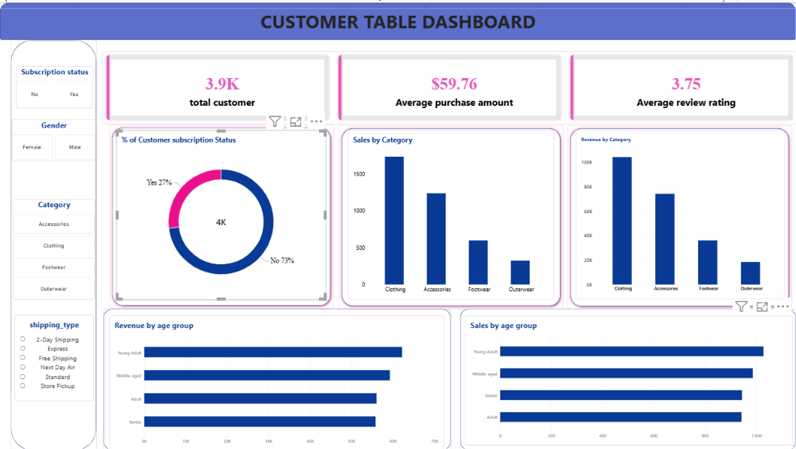
Interactive Power BI dashboard
What it shows
KPIs: 3.9K customers, $59.76 average purchase, 3.75 rating
Subscription split: 27% Yes, 73% No
Sales and revenue by category and age group
Filters: subscription, gender, category, shipping type
Notes:
Walk through the dashboard: KPI cards on top, then subscription share, category and age group charts, with slicers on the left.

Slide 17
Key insights
1
Male customers generate about 68% of revenue ($157,890 of $233,081)
2
Clothing leads in both sales and revenue, followed by Accessories
3
Only 27% of customers subscribe, and they spend no more per order
4
About 80% of customers are Loyal, with more than 10 previous purchases
5
Express-shipping users and Young Adults spend the most
Notes:
Five headline findings from the SQL analysis and dashboard.

Slide 18




Business recommendations
Boost subscriptions
Customer loyalty programs
Review discount policy
Product positioning
Targeted marketing
Promote exclusive benefits for subscribers.
Reward repeat buyers to move them into the Loyal segment.
Balance sales boosts with margin control.
Highlight top-rated and best-selling products in campaigns.
Focus on high-revenue age groups and express-shipping users.
Thank you
Piyush Jha | github.com/Piyushjha1806
Notes:
Close with five actions that follow from the analysis, then invite questions.

