Slide 1
BUG TRACKING SYSTEM

Slide 2
Bug tracking system is essentially and effectively implemented to monitor the status of bugs in an application. All the bugs that are identified are stored in a database. Each bug is assigned with an unique bug id and respective status of bug. Bugs can be created and updated with ease.

Slide 3
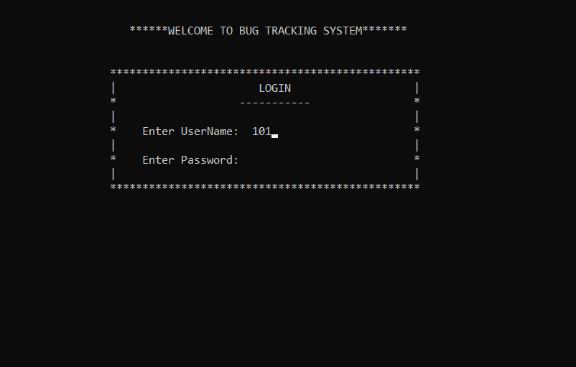

Slide 4
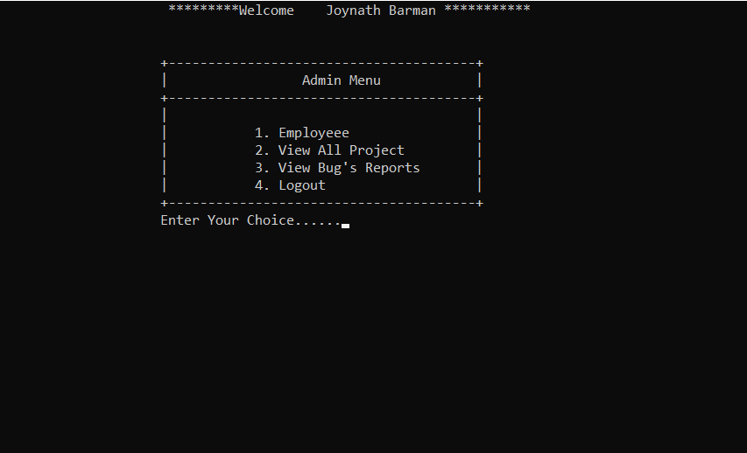

Slide 5


Slide 6
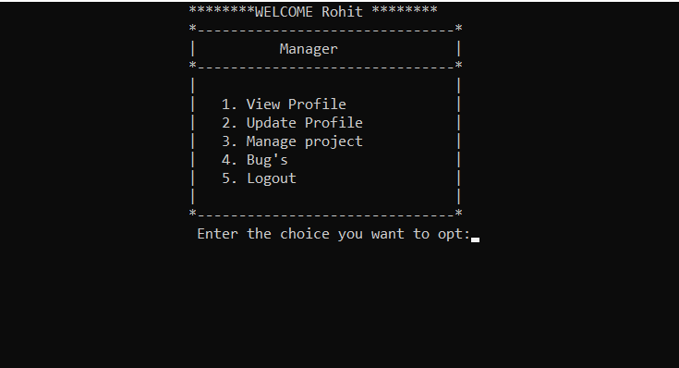

Slide 7


Slide 8


Slide 9


Slide 10
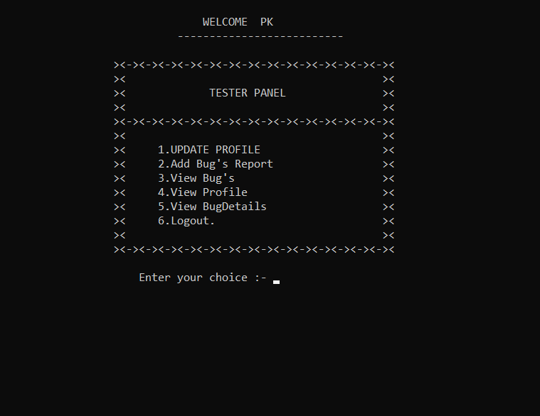

Slide 11
THANK YOU

