Slide 1
TEAM 3
Joynath barman
ROHIT KUMAR
SHIVA DAS
PIYUSH KUMAR

Slide 2
BUG TRACKING SYSTEM

Slide 3
Bug tracking system is essentially and effectively implemented to monitor the status of bugs in an application. All the bugs that are identified are stored in a database. Each bug is assigned with an unique bug id and respective status of bug. Bugs can be created and updated with ease.

Slide 4
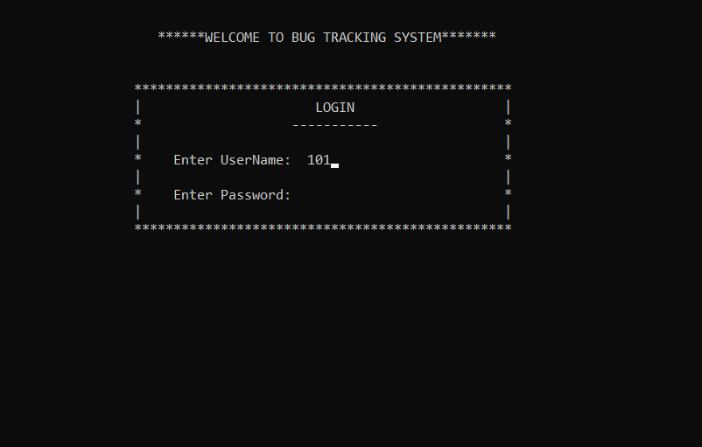

Slide 5
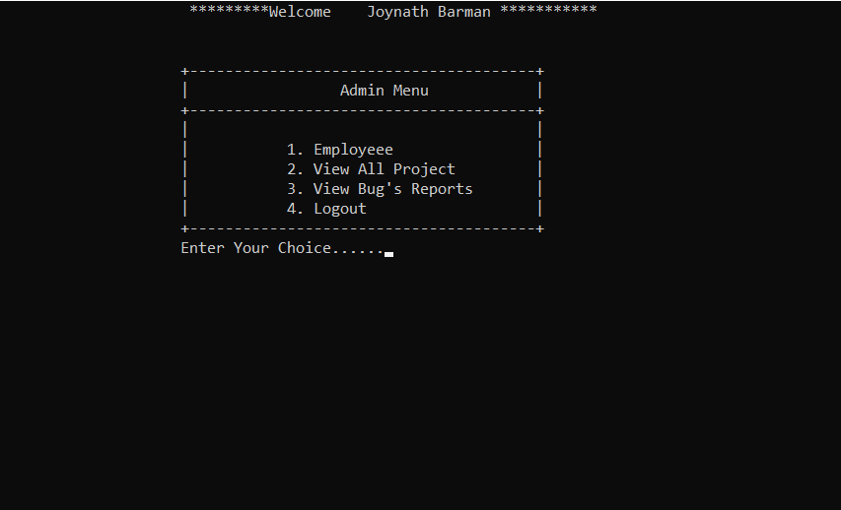

Slide 6


Slide 7
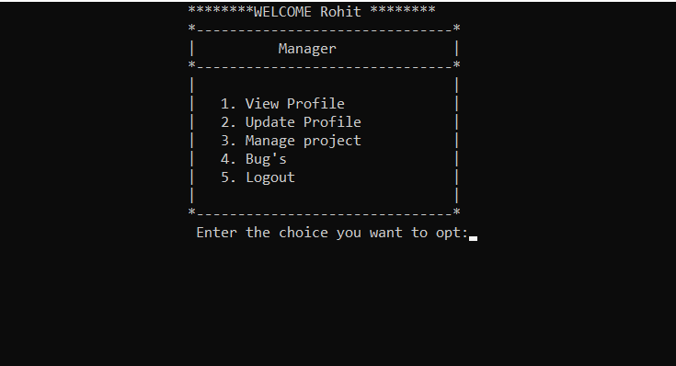

Slide 8


Slide 9


Slide 10


Slide 11
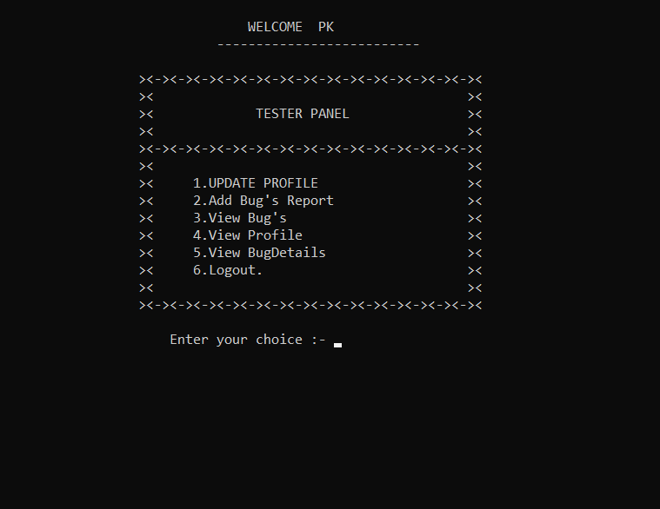

Slide 12
THANK YOU

