Slide 1

Semester: VII Review: 7.1
Title of the Project: Real Time Smart Parking System Using
YOLO And Machine Learning
Domain: Artificial Intelligence And Machine Learning
Group Members:
Member 1 : Piyush Kurseja
Mentor Name : Prof. Anil Ahir

Slide 2

Content
  Overview
  Introduction
  Problem Statement
  Objectives
  Requirements
  Literature Survey
  Proposed System
  Proposed Design (along with UML Diagrams)
  Implementation
  Results and Analysis
  Conclusion
  References

Slide 3
Introduction to Project
The rapid increase in the number of vehicles has created major parking management challenges in urban areas. Traditional parking systems often rely on manual monitoring or fixed parking-space information, making it difficult to provide accurate real-time information about parking availability
The proposed AI & ML Based Smart Parking System uses Artificial Intelligence, Machine Learning, and Computer Vision to automatically analyze parking videos or CCTV footage. A trained YOLO-based model detects parking spaces and classifies them as Space Empty or Space Occupied.
The system continuously processes the parking video and displays the results on a real-time dashboard, automatically calculating the total parking spaces, occupied spaces, empty spaces, available spaces, and occupancy percentage.
r Rates

Slide 4
Problem Statement
The increasing number of vehicles has created significant challenges in efficiently managing parking areas, particularly in malls, commercial complexes, educational institutions, and other high-traffic locations. Drivers often spend considerable time searching for available parking spaces because real-time information about parking occupancy is not readily available. Existing solutions may require specialised infrastructure, complex deployment, or focus primarily on parking booking and management services. Therefore, there is a need for an intelligent and automated system capable of analysing parking areas in real time, accurately identifying occupied and available spaces, and communicating parking availability clearly to users. The proposed system addresses this problem using YOLO-based computer vision and video analysis to monitor parking areas, detect vehicle occupancy, calculate the number of occupied and available parking spaces, and provide real-time parking availability information for efficient parking management and improved user convenience.
r Rates

Slide 5
Objectives of the project
The objectives to be achieved :-
  Automate Parking Space Dectection
  Identify Parking Occupancy
  Provide Real-Time Parking Information
  Reduce Manual Monitoring
  Calculate Parking Statistics Automatically
  Develop An Interactive Dashboard
  Improve Parking Management Efficiency

Slide 6
Requirements of the system (Hardware, software)
Hardware :-
  Any 64-bit x86 CPU
  4 gigabytes or more of primary system memory
  Any GPU (optional but preferred)
  Active internet connection (need not be globally connected)
  10 gigabytes or more free space in secondary memory
  CCTV Camera or Parking Video As The Input Source
  Software :-
  Any version of Windows 10/11
  Python 3.x
  Ultralytics YOLO
  Open CV
  PyTorch
  NumPy
  Visual Stuido Code or any Python IDE
  Web Browser

Slide 7
Literature Survey
Sr.No. | Title | Author(s) | Publish Date | Description
1 | Smart Parking with Pixel-Wise ROI Selection for Vehicle Detection Using YOLOv8, YOLOv9, YOLOv10 and YOLOv11 – 2025 | Gustavo P. C. P. da Luz, Gabriel Massuyoshi Sato, Luis Fernando Gomez Gonzalez, and Juliana Freitag Borin | 2025 | This research proposed a smart parking system using multiple YOLO versions for vehicle detection. It introduced ROI-based parking area selection to improve detection accuracy and compared different YOLO models for parking environments This paper supports the use of YOLO and ROI-based processing for accurate parking monitoring. Our project extends this concept by directly classifying parking spaces as Empty and Occupied and displaying the results on a real-time dashboard.
2 | Smart Parking Space Availability Detection Using Aerial Images and YOLO-Based Deep Learning Models – 2025 | Shreeram H, Nagendra B. S., Sougandh Sunil, and Adwitiya Mukhopadhyay | 2025 | This paper compared YOLOv5, YOLOv7, YOLOv8 and YOLOv9 for detecting vacant and occupied parking spaces from aerial parking images. The study showed that newer YOLO models can improve parking-space detection and localization. Our project uses the same deep-learning concept but applies it continuously to parking video/CCTV footage for real-time occupancy monitoring

Slide 8
Literature Survey
Sr.No. | Title | Author(s) | Publish Date | Description
3 | Comparison of Computer Vision and Convolutional Neural Networks for Vehicle Parking Control | Jonathan Aguilar Alvarado, Karina Garcia Galarza, Wilmer Rivas Asanza, Bertha Mazón Olivo | 2025 | This study compares traditional computer vision techniques with CNN-based approaches for parking occupancy detection. The research highlights the advantages of AI and deep learning for improving parking monitoring accuracy
4 | AI-Based Free Parking Space Detection System for Large Parking Areas | Tuan Luong, Yeongbin Shin, Jooeon Park, Sihoon Leeu, Hyungpil Moon | 2025 | This paper uses CCTV cameras and YOLO-based object detection to identify free parking spaces. The results are transmitted to a cloud platform and visualized through a web application for real-time monitoring

Slide 9
Gaps And Finding Of Papers
Gap / Limitations Of Paper 1:-
The study mainly focuses on comparing different YOLO models and improving vehicle detection using pixel-wise ROI selection. Its primary contribution is detection accuracy, ROI flexibility, and model performance evaluation rather than providing a simple user-oriented system with individually numbered parking spaces and direct space-wise status visualization.
Mine Improvement :-
The proposed system applies YOLO-based vehicle detection to a parking video and maps vehicles to individually identified parking spaces. Each space is assigned a unique serial number (P01–P40) and its status is displayed as Empty or Occupied for easy identification.

Slide 10
Gaps And Finding Of Papers
Gap / Limitations Of Paper 2 :-
The study mainly focuses on aerial-view parking images and compares multiple YOLO models for detecting vacant and occupied parking spaces. Its primary focus is model performance and detection accuracy under different conditions rather than a practical video-based parking monitoring system with clearly numbered parking spaces for direct user identification.
Mine Improvement :-
The proposed system uses parking surveillance video for continuous monitoring and maps detected vehicles to individually identified parking spaces. Each parking space is assigned a unique serial number, such as P01–P40, and its status is displayed as Empty or Occupied for easy user identification.

Slide 11
Gaps And Finding Of Papers
Gap / Limitations Of Paper 3 :-
The study mainly focuses on comparing traditional computer vision and CNN-based approaches for parking occupancy detection. Its primary contribution is evaluating the performance, precision, and sensitivity of different detection methods rather than implementing a complete video-based system with individually numbered parking spaces for direct user identification.
Mine Improvement :-
The proposed system implements YOLO-based vehicle detection on parking video and maps detected vehicles to individually identified parking spaces. Each parking space is assigned a unique serial number, such as P01–P40, and its status is displayed as Empty or Occupied for easy monitoring and identification.

Slide 12
Gaps And Finding Of Papers
Gap / Limitations Of Paper 3 :-
The study presents an advanced CCTV-based parking monitoring system that uses YOLO detection, cloud infrastructure, and a web application for large parking areas. However, the system involves additional cloud-based infrastructure and is designed for large-scale deployment, which may increase implementation complexity for a lightweight local parking monitoring prototype.
Mine Improvement :-
The proposed system focuses on a lightweight video-based implementation that can run locally using YOLO and OpenCV. It provides individually numbered parking spaces, such as P01–P40, and directly displays the Empty or Occupied status of each monitored space for simple and easy user identification.

Slide 13
Comparison Between Park+ and Proposed System
Feature | Park+ | Our Proposed System
Primary Focus | Parking, booking and vehicle-related services | Real-time parking space occupancy detection
Input | User and parking platform data | Live CCTV / Parking video
Core Technology | Commercial parking platform and integrated services | Yolo and Computer Vision
Vehicle Detection | Part of smart parking infrastructure | Core functionality using YOLO
Parking Space Detection | Part of commercial parking services | Automatically monitors configured parking spaces
Main Output | Parking discovery, booking and related services | Number of Occupied and Available spaces
Real-Time Monitoring | Available as part of parking infrastructure | Core functionality with continuous video analysis
Main Purpose | End-to-end parking and mobility solution | Provide real-time parking availability information to users

Slide 14
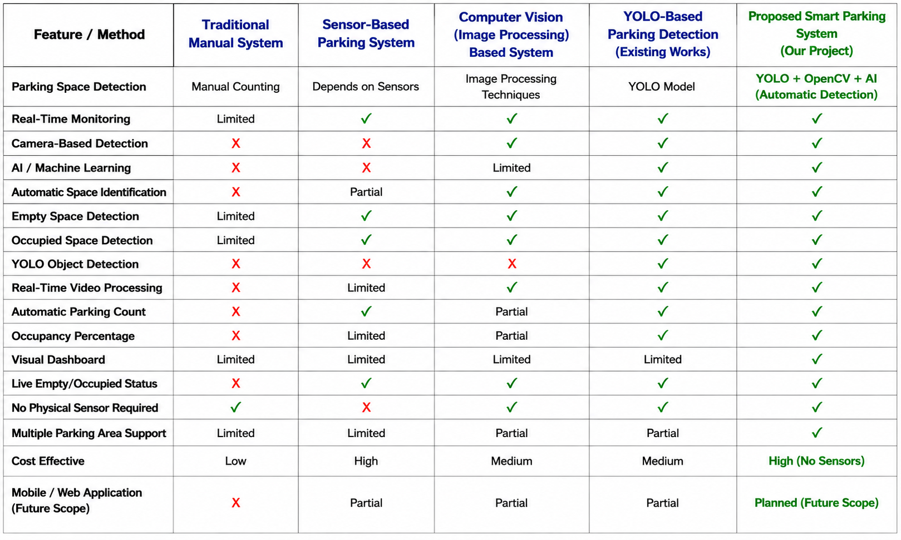
Literature Survey comparison

Slide 15
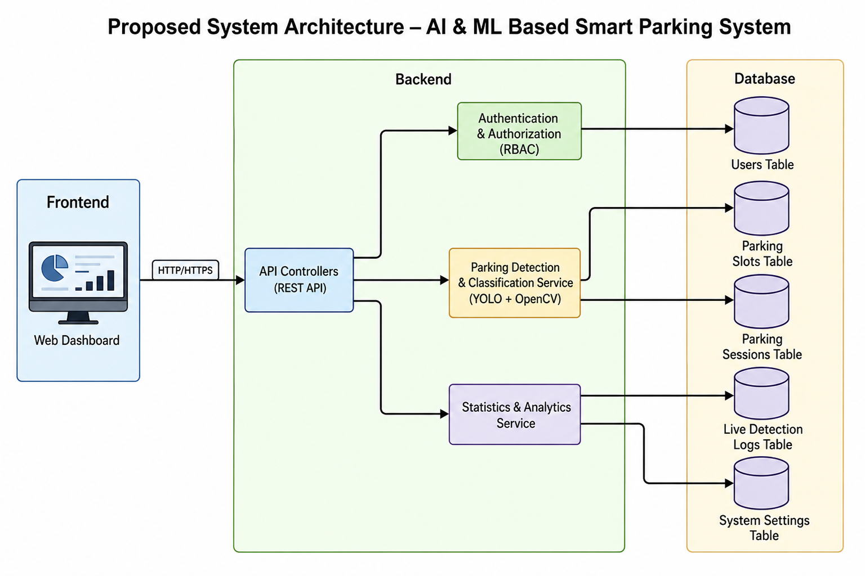
Proposed System
Component
Diagram

Slide 16
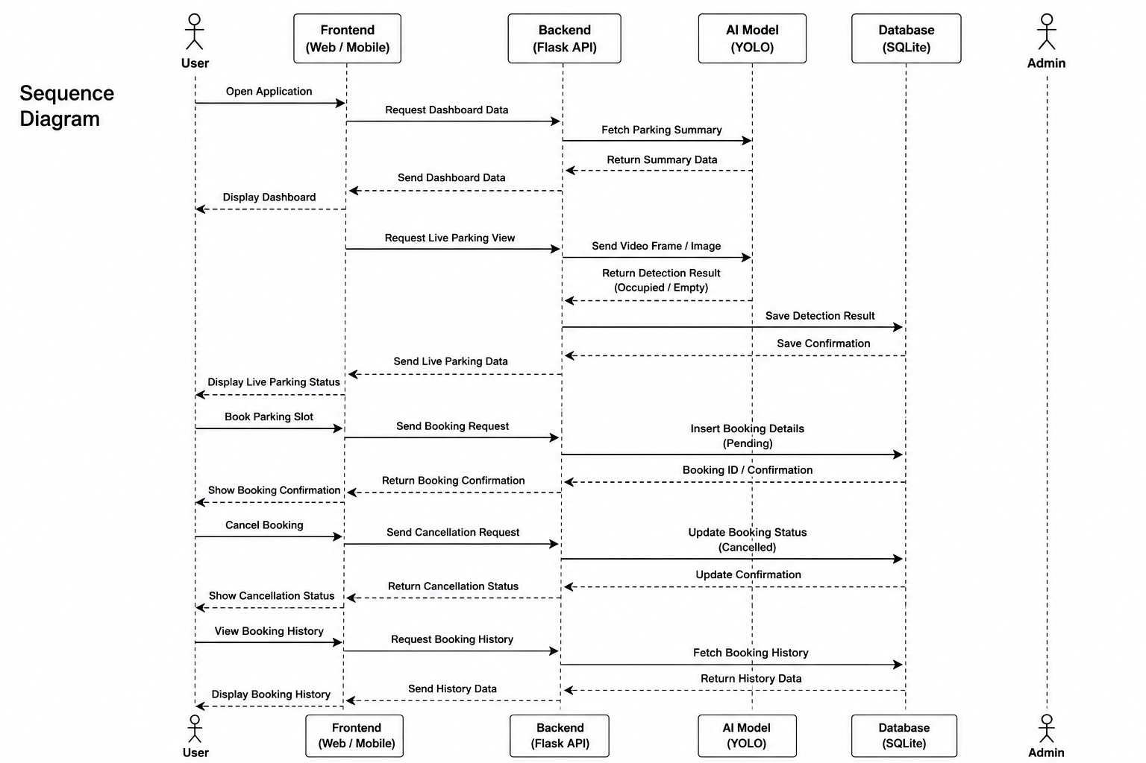
Proposed System

Slide 17
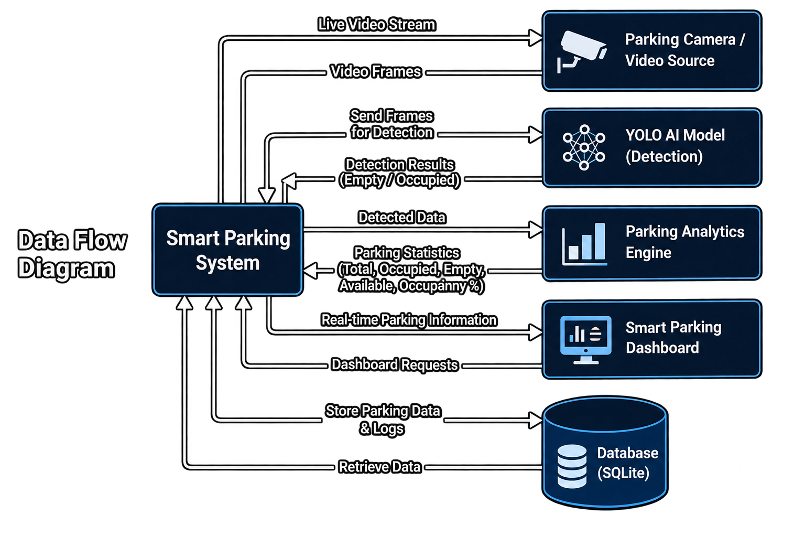
Proposed System

Slide 18
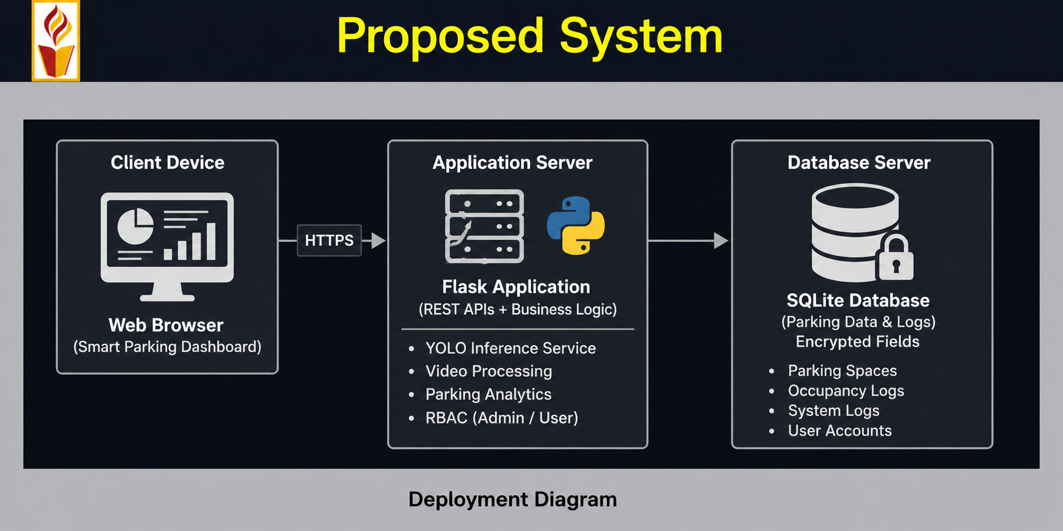

Slide 19
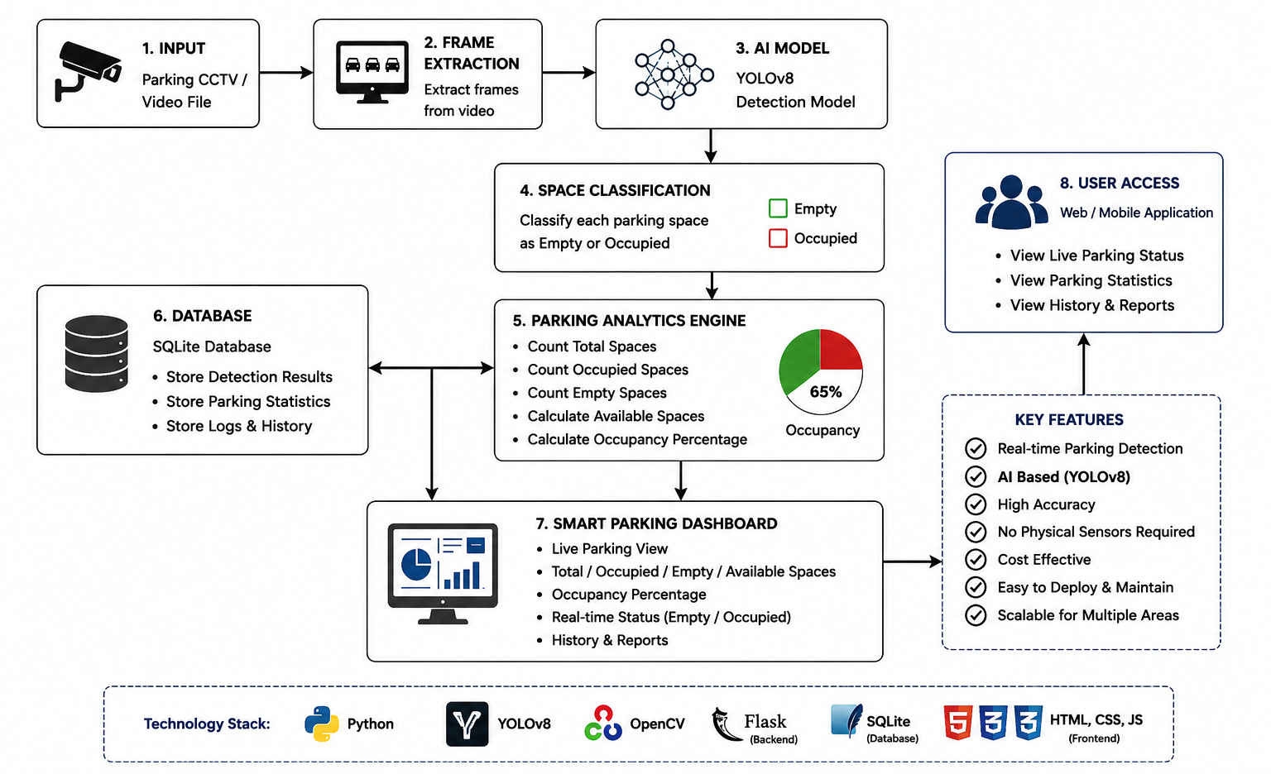
Proposed Design

Slide 20
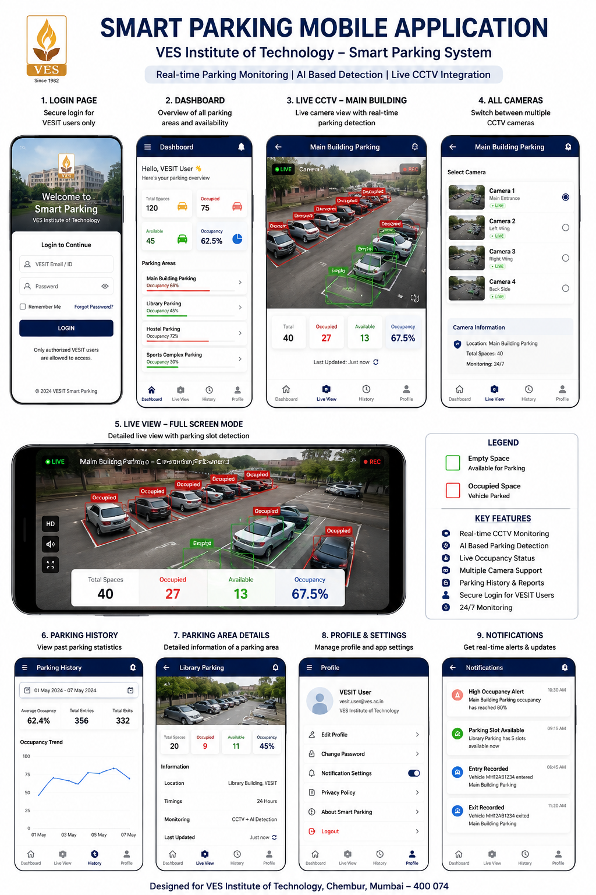
Future System Design

Slide 21
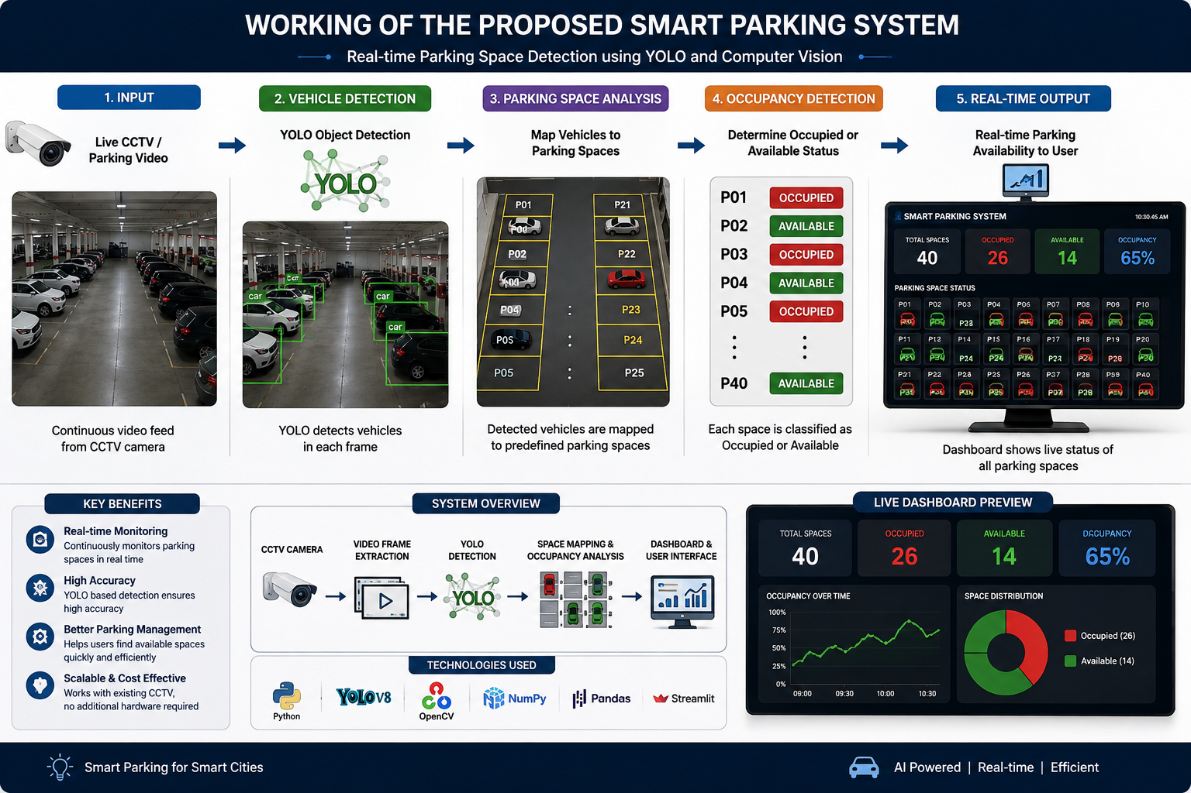

Slide 22
Implementation
The proposed AI-Based Real-Time Smart Parking Management System will be implemented using a computer vision and machine learning architecture. Parking images or video frames will be processed using Python and OpenCV, while a YOLO-based deep learning model will classify parking spaces as Empty or Occupied. The processed results will calculate the total, occupied, and available parking spaces along with the parking occupancy percentage. The system will display this information through a simple real-time dashboard. Initially, the system will use a public parking dataset for training and testing, while integration with live CCTV cameras and a mobile application can be implemented as future work.

Slide 23
Result Analysis
The implemented system was evaluated based on classification performance, processing efficiency, and usability.
Testing demonstrated that the YOLO-based model can successfully classify parking spaces as Empty or Occupied using parking images from the dataset.
The system processes the detected parking information and calculates the total parking spaces, occupied spaces, available spaces, and parking occupancy percentage.
The results demonstrate the potential of AI and Computer Vision to reduce manual parking monitoring and provide an efficient solution for automated parking space management.
Notes:
The max flow algorithm in the visualization is :-

Slide 24
Conclusion
`The proposed AI-Based Real-Time Smart Parking Management System demonstrates the potential of Artificial Intelligence and Computer Vision for automated parking monitoring. Using a YOLO-based machine learning model, the system can classify parking spaces as Empty or Occupied from parking images or video frames.
The system reduces the need for manual parking monitoring and provides useful information such as total spaces, occupied spaces, available spaces, and parking occupancy percentage. The project provides a lightweight and practical foundation for smart parking management.
In the future, the system can be extended by integrating live CCTV cameras, a mobile application, and parking space reservation features.

Slide 25
References
[1] P. R. L. de Almeida, L. S. Oliveira, A. S. Britto Jr., E. J. Silva Jr., and A. L. Koerich, “PKLot – A Robust Dataset for Parking Lot Classification,” Expert Systems with Applications, vol. 42, no. 11, pp. 4937–4949, July 2015.
[2] Ultralytics, “Ultralytics YOLO Documentation: Object Detection, Classification and Computer Vision,” Ultralytics Documentation, 2023 (continuously updated). Accessed: August 31, 2025.
[3] Ultralytics Image Classification Documentation, “Image Classification with Ultralytics YOLO,” Ultralytics Documentation, Nov. 2023 (continuously updated). Accessed: June 31, 2026.
[4] Ultralytics, “Ultralytics YOLO Python Usage,” Ultralytics Documentation. Ultralytics Python Usage Guide

Slide 26
Future Scope
Points for PPT:-
Store Occupied and Available status changes with timestamps.
Maintain historical parking occupancy records.
Analyse parking usage patterns over time.
Identify peak parking hours and highly utilised spaces.
Generate graphical reports for parking administrators.
Support future integration with a web or mobile application.

Slide 27
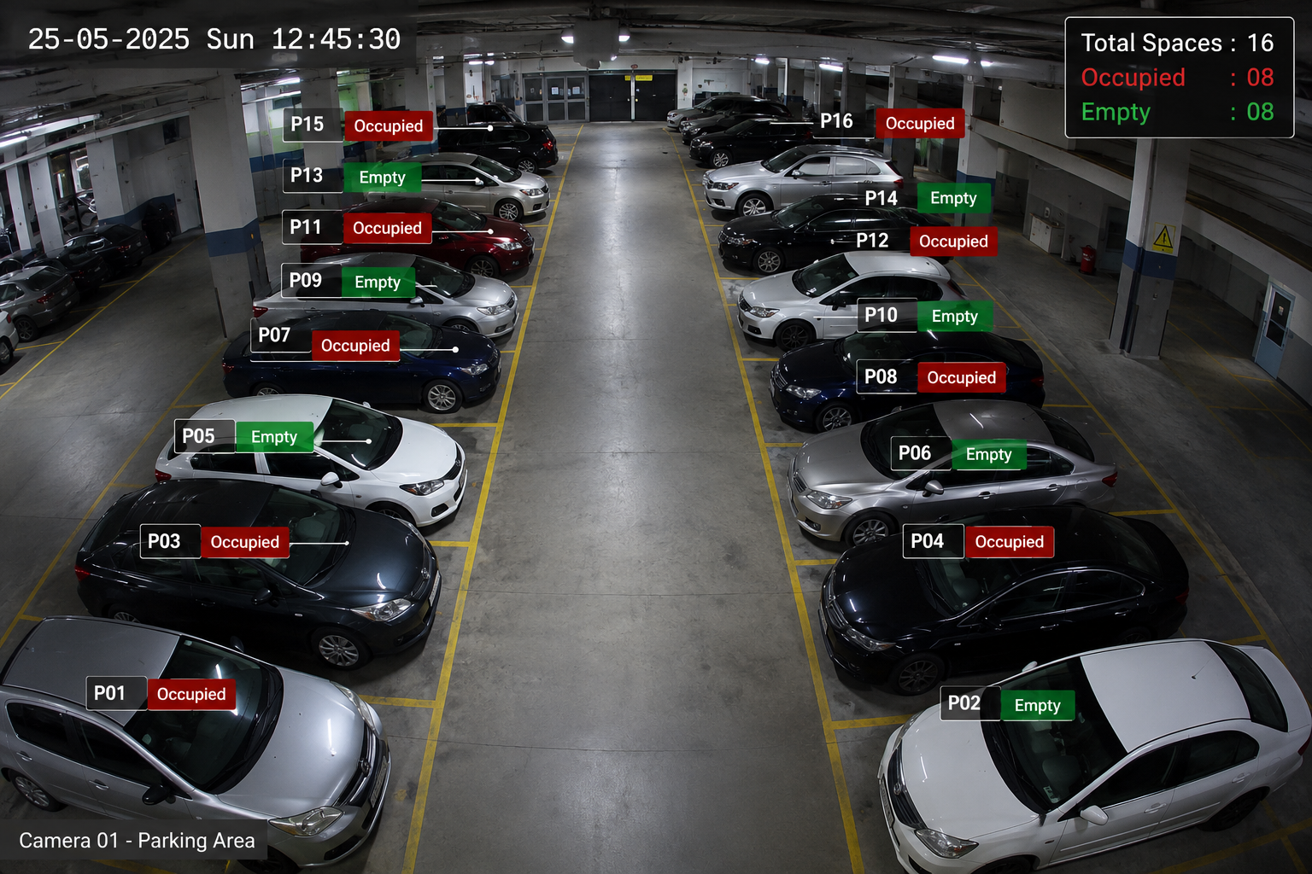

Slide 28


