Slide 1
CS626 - Speech, NLP and Web
Assignment-1 Presentation
(Inhabitant term prediction)
200260023 - 4th year EP BTech - Kaushik Dhandekar
200260032 - 4th year EP BTech - Niare Doyom
200260037 - 4th year EP BTech - Piyush Mourya

Slide 2
Working with Data (1/2)
Collect data for analysis:
Almost all the data we collected was from wikipedia. Wikipedia has many pages with tables having region name and corresponding demonym. https://en.wikipedia.org/wiki/Demonym
The collected data was location name and demonym.
The data was stored into multiple spreadsheets for different countries.
Total data points collected was ~2000.
Cleaning data:
The data scraped from wikipedia has many impurities. For ex:
*Albertan* (Stars)
Bluenosers[3] (Numbers and symbols)
Multiple terms separated by commas
Diacritic words (This were causing some errors while predicting)
And others…..
We used google sheets and python libraries to clean these impurities.
After the cleaning, the remaining data contained about 1200 points.

Slide 3
Working with Data (2/2)
3. Processing the cleaned data:
After cleaning data with impurities, we tried some preliminary ML models and found that accuracy was bad.
So, we tried to eliminate all those rows where Demonym does not contained Place name as substring inside it. There were not many data points like this but after cleaning them it started to give good results.
Then, we have suffixes for each of the place name needed to add to make there demonym.
We then manually filtered rows with those suffixes which are very less in count and also sounds very uncommon.
After this, the data points remaining were ~1050.

Slide 4
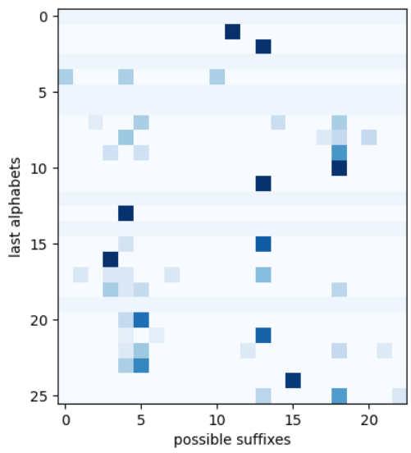
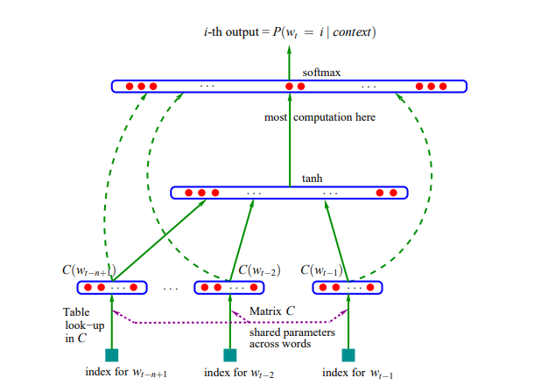
Experimental setup
According to preliminary data analysis, we noticed suffix depend on the last few alphabets in the place name.
So, we used 2 Models:
Ngram Transition Probability Table based model
Word embeddings based Neural Network prediction

Slide 5
Ngram based Model (1/2)
Here we take the last n alphabets of a country name and create a probability transition table for the possible suffixes.
All rows in Transition Table represents last n alphabets.
All columns represents all possible suffixes.
Hyper Parameters:
Block Size : represents number of last alphabets
Smoothing : so that no suffix has probability value of 0
N = 1, smoothing = 0.001

Slide 6
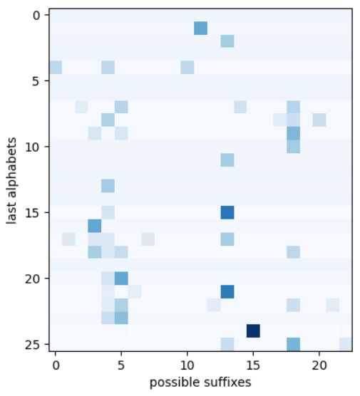
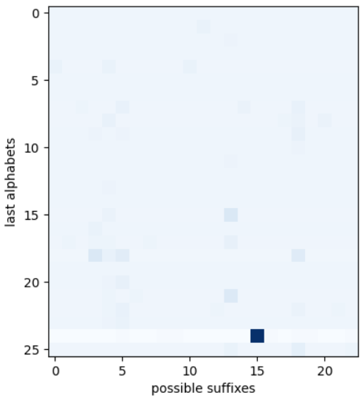
Ngram based Model (2/2)
N = 1, smoothing = 0.001 N = 1, smoothing = 0.01 N = 1, smoothing = 10

Slide 7
Embeddings Model (1/3)
Increasing number of last n words increase the total combination of last alphabets as 26^n, which is bad so instead, we took each alphabet and project it to a k dimensional space.
Then each city name is converted to n*k length vector, which is then fed to neural network to predict the possible suffix.
During the training process the position of each alphabet in k dimensional space is also trained.
Hyper Parameters:
Block Size: represents number of last alphabets used to train our model
Embeddings Dimension: represents the dimension of space where we are projecting the characters in our dataset
Learning Rate, Epochs
We are not using batch size because the dataset that we are using is pretty small and training on the entire dataset does not take a lot of time.

Slide 8
Embeddings Model (2/3)
Source

Slide 9
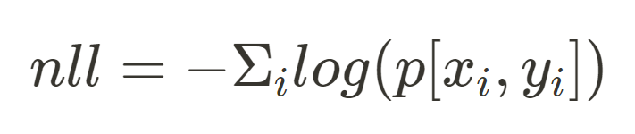
Embeddings (3/3)
Loss Function??
Negative Log Likelihood

Slide 10
For the HyperParameters block size, embedding dimension and epochs, we give a range of values in a numpy array form.
The num configs = 10 is the value provided to define number of iterations used to check accuracy with set of parameter values.
The hyperparameter values are chosen randomly from all possible values and best parameters with best accuracy is chosen for the model prediction.
Hyperparameter tuning

Slide 11
So finally we used word embeddings to decrease the number of inputs fed to the neural network and also, to create some non linearity in the model
Using hyperparameters tuning we got the following hyperparameter values with the best accuracy:
Block size: 4
Embedding dimensions: 9
Learning rate: 0.1
Epochs: 1050
The accuracy we got finally is 0.58
Conclusion

Slide 12
Cannot predict the demonym for which the country names are modified
Like Mexico - Mexican
Where “o” is modified to n
Limitation

Slide 13
Instead of choosing the last few alphabets of the country we could choose the first few alphabets and use alphabet by alphabet prediction to predict demonym
Could possibly use Geography data in our model
For example middle eastern countries mostly have stan as their dymonym
Like pakistan and pakistani
Possible improvements

Slide 14
Thank You

