Slide 1
SMART FRIDGE // ALEXA+ HACKATHON SUBMISSION
Smart Fridge Alexa
Ask what's in your fridge. Get dinner ideas that use up what's about to spoil.
Classifier + Edge API
MCP server
Alexa+ simulator
Dish agent
Notes:
Smart Fridge Alexa: a camera reads the fridge, an Alexa+ style assistant answers questions about it, and a dish agent suggests meals that use up what is about to spoil.

Slide 2
SYSTEM OVERVIEW // ARCHITECTURE
One question, four services
Alexa+ simulator
Web UI + LLM agent
acting as MCP client
MCP server
11 tools, caching,
background refresh
Classifier + Edge API
Claude vision reads
the fridge image
MCP tool calls
GET /inventory
POST /suggest
Dish agent
Ranks dishes, expiring
items first
PORTS simulator 8898 · MCP server 8899 · dish agent 8897 · classifier 9000
Notes:
One question touches four services. The simulator calls the MCP server; the server reads the fridge from the classifier and asks the dish agent for meals.

Slide 3
LIVE DEMO // ASK THE FRIDGE
Quick demo
Ask a question in the simulator and watch the agent call the tools.
"What's in my fridge?"
"What's expiring?"
"What should I cook?"
Notes:
Open the simulator, ask the three questions, and point at the trace of tool calls and timings.

Slide 4



ALEXA+ SIMULATOR // PART 1
How the assistant talks to the fridge
A web UI with an LLM agent
You ask a question; the agent decides which tools to call.
11
TOOLS DISCOVERED FROM THE SERVER
Acts as an MCP client
Discovers the server's tools at deploy, then calls them like Alexa+ would.
500 ms
Every call is traced
The trace shows each tool call with its timing and flags anything over 500 ms.
LATENCY BUDGET PER TOOL CALL
Notes:
The simulator is a web UI with an LLM agent acting as an MCP client, like Alexa+. It discovers tools and calls them, and the trace shows each call with timing.

Slide 5



MCP SERVER // PART 2
11 tools, one server
Fridge (5)
Dishes (3)
Shopping (3)
get_fridge_inventory
check_item
get_expiring_items
correct_fridge_items
get_system_status
suggest_recipes
get_recipe_steps
search_online_recipes
add_to_shopping_list
get_shopping_list
remove_from_shopping_list
Built to stay fast and honest Answers come from a cache that refreshes in the background. If the camera is down it says so, instead of claiming the fridge is empty.
Notes:
Eleven tools in three groups. Results are cached and refreshed in the background. If the camera is down it says so, instead of claiming the fridge is empty.

Slide 6
DISH AGENT // PART 3
Dinner ideas that use up what's expiring
In
Fridge items with days left
Preferences, like vegetarian or quick
Agent
Ranks dishes, expiring items first
Uses tools to check recipes
Out: up to 3 dishes
Why it fits
What you have, what's missing
Step-by-step instructions
Four tools of its own
Rank built-in recipes, get recipe steps, search TheMealDB, read the shopping list.
If the LLM fails
Falls back to 14 built-in recipes ranked by how much they use expiring items.
Notes:
The dish agent puts items about to spoil first and returns up to three dishes with reasons, what you have, what is missing and steps. It has four tools of its own and falls back to 14 built-in recipes.

Slide 7


RELIABILITY // LLM PROVIDERS
It always answers
1
2
3
4
Amazon Bedrock
via Strands Agents SDK,
when AWS credentials exist
Anthropic API
used in this demo
OpenAI
optional extra
Built-in fallback
keyword router and
recipe rules, no key
A failing provider is skipped for 5 minutes
One broken service costs a single slow call, not every answer.
Limits keep answers fast
Time and tool-call caps stop a slow or looping model and move to the next provider.
Notes:
Every LLM-backed part tries Bedrock through Strands when AWS credentials exist, then Anthropic, then OpenAI, then a built-in fallback. A failing provider is skipped for five minutes. The demo runs on Anthropic.

Slide 8
GETTING STARTED // ONE API KEY
Run it in five minutes
1
Install
pip install -r requirements.txt -r classifier/requirements.txt
2
Add one key to .env (copy .env.example)
ANTHROPIC_API_KEY=your-key-here
3
Start four processes, one terminal each, then open http://127.0.0.1:8898
python -m classifier.api.main
python -m mcp_server.server
python -m dish_agent.service
python -m simulator.app
Notes:
One key is enough: put ANTHROPIC_API_KEY in .env, install requirements, start four processes, open the simulator.

Slide 9
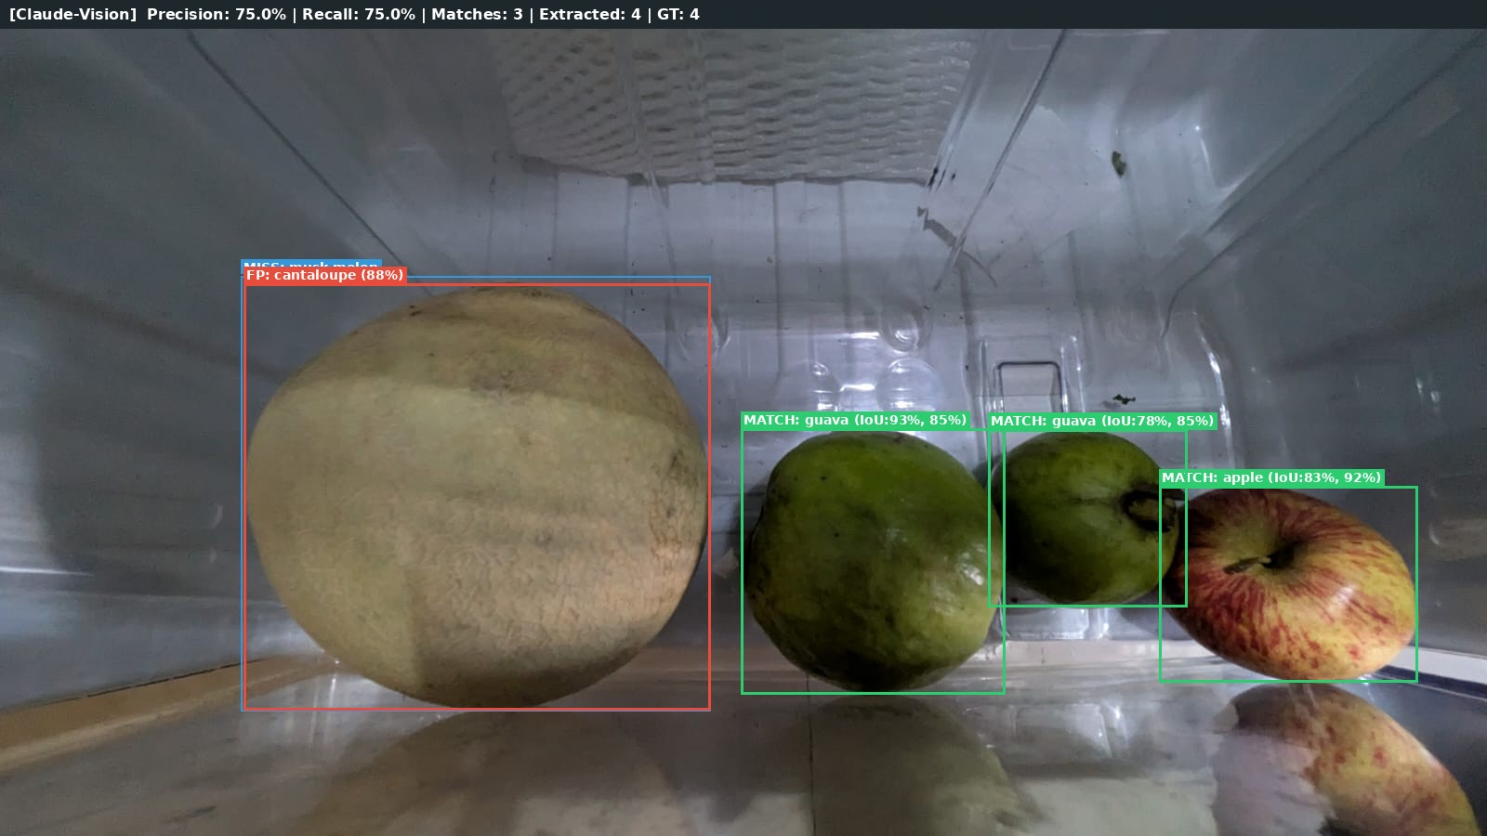
SMART FRIDGE PERCEPTION // EDGE SUBSYSTEM
Vision-Language Zero-Shot Detection & Edge Inventory
FASTAPI EDGE CONTRACT
GET /inventory
Camera inference stream with tracked 2D bounding boxes, confidence, item IDs, and freshness duration.
PATCH /inventory
Allows downstream voice/chat agents or users to manually calibrate labels or correct counts.
FOUNDATION VISION MODEL
Claude 3.5 on Amazon Bedrock
Selected for zero-shot open-vocabulary recognition across occluded containers and varied grocery packaging without manual dataset labeling.
⚡ Resilient: Bedrock ──► Anthropic direct failover in < 2s.
80.0%
RECALL (IoU ≥ 0.5)
74.1%
F1 SCORE
100%
STAPLES PRECISION

Slide 10
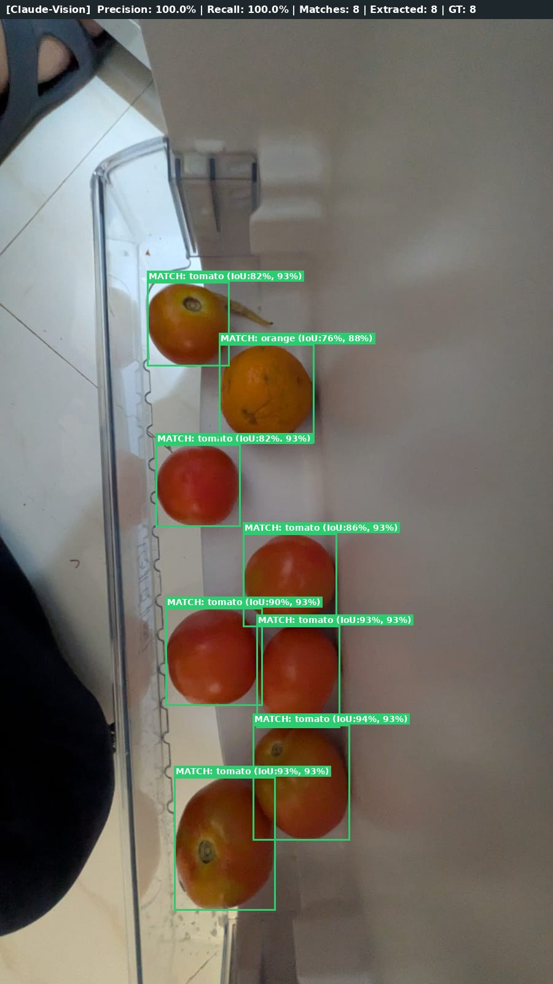
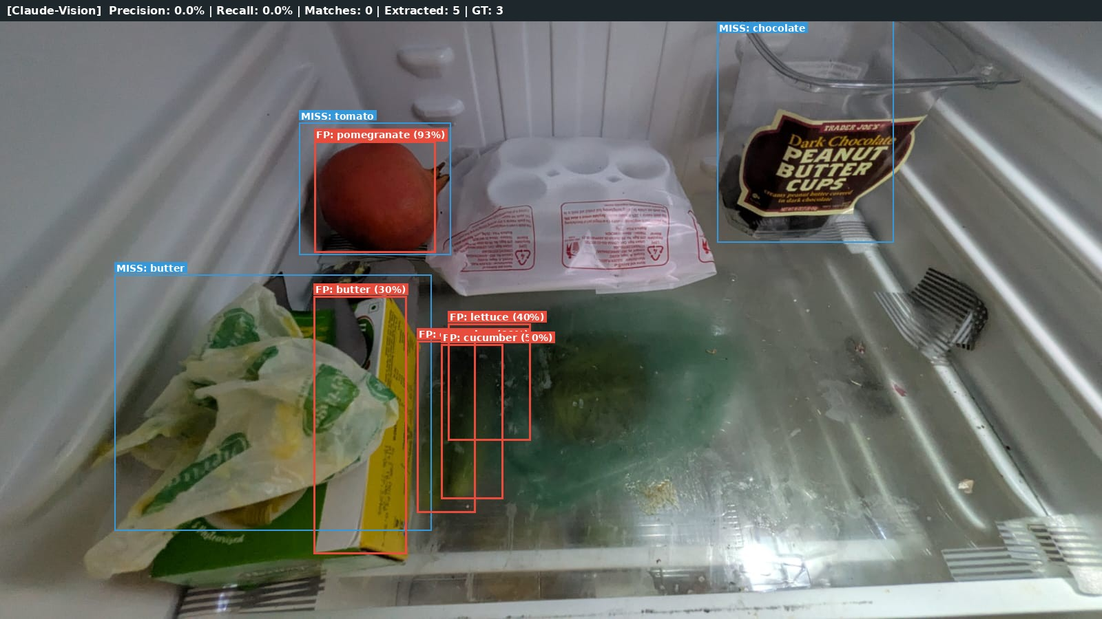
EVALUATION BENCHMARK // MULTI-COMPARTMENT TEST
Multi-Compartment Bounding Box Verification
DOOR BIN
8/8 Items Detected
100% Precision
100% Recall
Tomatoes & Citrus
87.5% - 100%
PRODUCE RECALL
0 Labels
ZERO-SHOT TRAINING
< 1.5s
INFERENCE LATENCY
Dual-Cloud
BEDROCK + DIRECT FAILOVER

