Slide 1
Computer Vision
Chapter6
Neighborhood Operators
藍泓景
r12922134@ntu.edu.tw

Slide 2


6.1 Introduction
6.2 Symbolic Neighborhood Operators
  6.2.1 Region-Growing Operator
  6.2.2 Nearest Neighbor Sets and Influence Zones
  6.2.3 Region-Shrinking Operator
  6.2.4 Mark-Interior/Border-Pixel Operator
  6.2.5 Connectivity Number Operator
    Yokoi Connectivity Number
    Rutovitz Connectivity Number
  6.2.6 Connected Shrink Operator
  6.2.7 Pair Relationship Operator
  6.2.8 Thinning Operator
  6.2.9 Distance Transformation Operator
  6.2.10 Radius od Fusion
  6.2.11 Number of Shortest Paths
6.3 Extremum-Related Neighborhood Operators
  6.3.1 Non-Minima-Maxima Operator
  6.3.2 Relative Extrema Operator
  6.3.3 Reachability Operator
6.4 Linear Shift-invariant Neighborhood Operators
  6.4.1 Convolution and Correlation
  6.4.2 Separability
Notes:
shrinking 縮小
Interior 內部 / border 邊界
Connectivity 連通性

Slide 3
6.1 Introduction
6.2 Symbolic Neighborhood Operators
  6.2.1 Region-Growing Operator
  6.2.2 Nearest Neighbor Sets and Influence Zones
  6.2.3 Region-Shrinking Operator
  6.2.4 Mark-Interior/Border-Pixel Operator
  6.2.5 Connectivity Number Operator
    Yokoi Connectivity Number
    Rutovitz Connectivity Number
  6.2.6 Connected Shrink Operator
  6.2.7 Pair Relationship Operator
  6.2.8 Thinning Operator
  6.2.9 Distance Transformation Operator
  6.2.10 Radius od Fusion
  6.2.11 Number of Shortest Paths
6.3 Extremum-Related Neighborhood Operators
  6.3.1 Non-Minima-Maxima Operator
  6.3.2 Relative Extrema Operator
  6.3.3 Reachability Operator
6.4 Linear Shift-invariant Neighborhood Operators
  6.4.1 Convolution and Correlation
  6.4.2 Separability

Slide 4
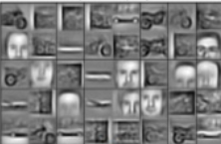
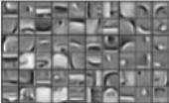


6.1.1 Introduction
1. The workhorse of low-level vision
  What are levels of vision?
input
Low-Level
-----------------------
grouping
Color
Spatial freq.
Local Motion
Mid-Level
-----------------------
Textures
Surfaces
Global motion
Depth
High-Level
-----------------------
Objects
Characters
Actions
intentions
https://goo.gl/ynA9VN
https://goo.gl/o5Q3Qy
Notes:
底層視覺
Workhorse 主力
F ( x ) = y
Character 字元
低階: 輸入影像輸出影像 / 圖像增強,去噪,色彩校正
它包括感知視覺信號的低級特徵，如亮度、顏色、形狀、紋理和運動。
中階: 輸入影像 輸出影像屬性 /
它包括感知視覺信號的低級特徵，如亮度、顏色、形狀、紋理和運動。
高階: 輸入boundaries、region輸出影像屬性 分類 檢測 分割
高層次視覺是指對視覺信息的更高級別的處理，包括物體識別、場景理解和認知處理。

Slide 5
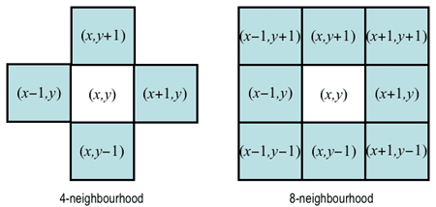
6.1.1 Introduction
2. Definitions and Classifications
  Domain type: numeric / symbolic
    numeric: +, -, min, max
    Symbolic: AND, OR, NOT, table-look-up
  Neighborhood type: 4-connected / 8-connected
  Recursive type: Rec. (sequential) / Non-Rec. (parallel)
    whether output depends on previously generated output
    in the view of “memory”: sequential vs parallel
A1
A2
A3
B1
A2
A3
C1
A2
A3
C1
B2
A3
C1
C2
A3
A1
A2
A3
D1
D2
D3
Notes:
Symbolic: 與數值無關，符號
Numeric:數值的
Ps: mask越大，效果就越像散光

Slide 6
6.1.1 Introduction
neighborhood might be small and asymmetric or large
Notes:
Asymmetric: 非對稱

Slide 7
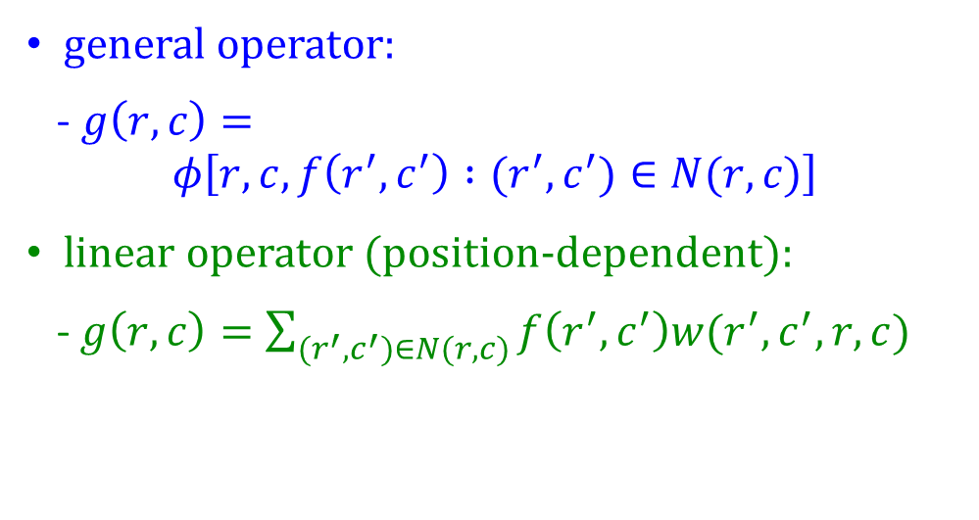

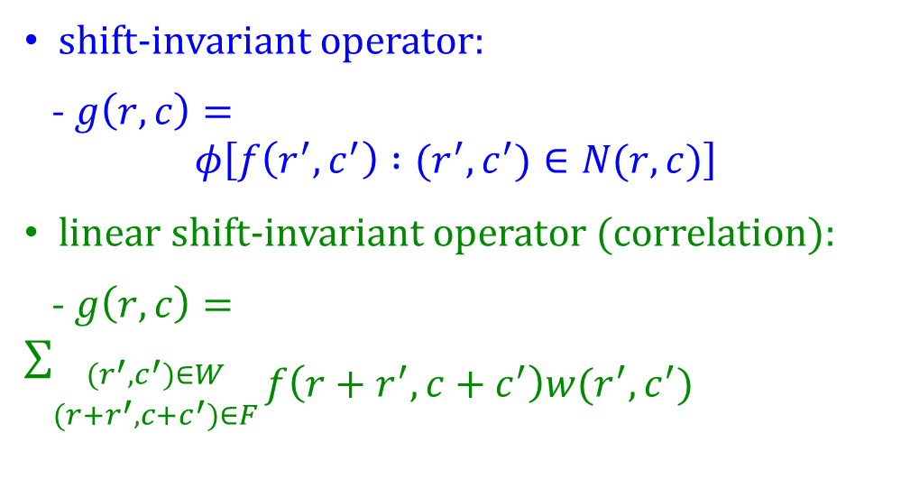
6.1.2 Non-Rec. Neighborhood Operator
Definitions:
given image(input): $f$, output image: $g$, n$eighborhood operator:φ ,$ neighborhood: $N(r,c)$
general operator:
- $g\left(r,c\right)=$
$$φ\left[r,c,f\left(r^{′},c^{′}\right) :(r^{′},c^{′})∈N(r,c)\right]$$
linear operator (position-dependent):
-$g\left(r,c\right)=\sum_{(r^{′},c^{′})∈N(r,c)}{f\left(r^{′},c^{′}\right)w(r^{′},c^{′},r,c)}$
shift-invariant operator:
- $g\left(r,c\right)=$
$$φ\left[f\left(r^{′},c^{′}\right) :(r^{′},c^{′})∈N(r,c)\right]$$
linear shift-invariant operator (correlation):
- $g\left(r,c\right)=\sum_{\begin{aligned}(r^{′},c^{′})∈W \\ ({r+r}^{′},c+c^{′})∈F\end{aligned}}{\begin{aligned} \\ f\left(r+r^{′},c+c^{′}\right)w(r^{′},c^{′})\end{aligned}}$
$$g=f⨂w$$
Notes:
linear operator: one common nonrecursive neighborhood operator
output: possibly position-dependent linear combination of inputs
shift-invariant = position invariant = action same regardless of position
W: weight function
線性算子：一個常見的非遞歸鄰域運算子
輸出：可能與位置相關的輸入線性組合
移位不變 = 位置不變 = 無論位置如何，動作都相同
W：權重函數

Slide 8
6.1.2 Non-Rec. Neighborhood Operator
Common 3 × 3 masks for noise cleaning, (a) box filter
Notes:
清除雜訊

Slide 9

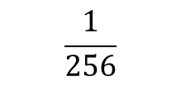
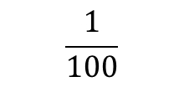
6.1.2 Non-Rec. Neighborhood Operator
Common 5 × 5 masks for noise cleaning
1 | 2 | 3 | 2 | 1
2 | 4 | 6 | 4 | 2
3 | 6 | 9 | 6 | 3
2 | 4 | 6 | 4 | 2
1 | 2 | 3 | 2 | 1
0 | 3 | 4 | 3 | 0
3 | 6 | 7 | 6 | 3
4 | 7 | 8 | 7 | 4
3 | 6 | 7 | 6 | 3
0 | 3 | 4 | 3 | 0
1 | 4 | 6 | 4 | 1
4 | 16 | 24 | 14 | 4
6 | 24 | 36 | 24 | 6
4 | 16 | 24 | 16 | 4
1 | 4 | 6 | 4 | 1
$$\frac{1}{81}$$
$$\frac{1}{100}$$
$$\frac{1}{256}$$
Notes:
這些是常見的5x5 masks
Repeated 3 * 3 box filter
8 – (r **2 + c **2)
C4取r+2, C4取c+2

Slide 10
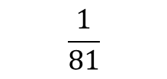
6.1.2 Non-Rec. Neighborhood Operator
Common 5 × 5 masks for noise cleaning
1 | 2 | 3 | 2 | 1
2 | 4 | 6 | 4 | 2
3 | 6 | 9 | 6 | 3
2 | 4 | 6 | 4 | 2
1 | 2 | 3 | 2 | 1
1 | 1 | 1
1 | 1 | 1
1 | 1 | 1
$$\frac{1}{81}$$
Notes:
Repeated 3 * 3 box filter

Slide 11
6.1.2 Non-Rec. Neighborhood Operator
Common 5 × 5 masks for noise cleaning
1 | 2 | 3 | 2 | 1
2 | 4 | 6 | 4 | 2
3 | 6 | 9 | 6 | 3
2 | 4 | 6 | 4 | 2
1 | 2 | 3 | 2 | 1
1 | 1 | 1
1 | 1 | 1
1 | 1 | 1
1 | 1 | 1
1 | 1 | 1
1 | 1 | 1
$$\frac{1}{81}$$
Notes:
Repeated 3 * 3 box filter

Slide 12
6.1.2 Non-Rec. Neighborhood Operator
Common 5 × 5 masks for noise cleaning
1 | 1 | 1
1 | 1 | 1
1 | 1 | 1
1 | 2 | 3 | 2 | 1
2 | 4 | 6 | 4 | 2
3 | 6 | 9 | 6 | 3
2 | 4 | 6 | 4 | 2
1 | 2 | 3 | 2 | 1
1 | 2 | 2 | 1
1 | 2 | 2 | 1
1 | 2 | 2 | 1
$$\frac{1}{81}$$
Notes:
Repeated 3 * 3 box filter

Slide 13
6.1.2 Non-Rec. Neighborhood Operator
Common 5 × 5 masks for noise cleaning
1 | 2 | 3 | 2 | 1
2 | 4 | 6 | 4 | 2
3 | 6 | 9 | 6 | 3
2 | 4 | 6 | 4 | 2
1 | 2 | 3 | 2 | 1
1 | 2 | 3 | 2 | 1
1 | 2 | 3 | 2 | 1
1 | 2 | 3 | 2 | 1
1 | 1 | 1
1 | 1 | 1
1 | 1 | 1
$$\frac{1}{81}$$
Notes:
Repeated 3 * 3 box filter

Slide 14
6.1.2 Non-Rec. Neighborhood Operator
Common 5 × 5 masks for noise cleaning
1 | 2 | 3 | 2 | 1
2 | 4 | 6 | 4 | 2
3 | 6 | 9 | 6 | 3
2 | 4 | 6 | 4 | 2
1 | 2 | 3 | 2 | 1
1 | 2 | 3 | 2 | 1
2 | 3 | 4 | 2 | 1
2 | 3 | 4 | 2 | 1
1 | 1 | 1
1 | 1 | 1
1 | 1 | 1
1 | 1 | 1
……
$$\frac{1}{81}$$
Notes:
Repeated 3 * 3 box filter

Slide 15
6.1.2 Non-Rec. Neighborhood Operator
Common 5 × 5 masks for noise cleaning
1 | 2 | 3 | 2 | 1
2 | 4 | 6 | 4 | 2
3 | 6 | 9 | 6 | 3
2 | 4 | 6 | 4 | 2
1 | 2 | 3 | 2 | 1
1 | 2 | 3 | 2 | 1
2 | 4 | 6 | 4 | 2
3 | 6 | 8 | 5 | 2
2 | 4 | 5 | 3 | 1
1 | 2 | 2 | 1
1 | 1 | 1
1 | 1 | 1
1 | 1 | 1
$$\frac{1}{81}$$
Notes:
Repeated 3 * 3 box filter

Slide 16
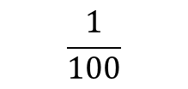

6.1.2 Non-Rec. Neighborhood Operator
Common 5 × 5 masks for noise cleaning
-2 | -1 | 0 | 1 | 2
0 | 3 | 4 | 3 | 0
3 | 6 | 7 | 6 | 3
4 | 7 | 8 | 7 | 4
3 | 6 | 7 | 6 | 3
0 | 3 | 4 | 3 | 0
-2
-1
0
1
2
8 – (${(r)}^{2}$+ ${(c)}^{2}$)
$$\frac{1}{100}$$
Notes:
8 – (r **2 + c **2)

Slide 17

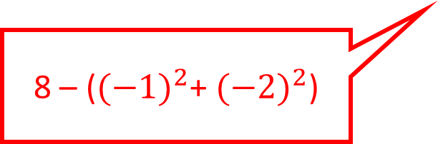
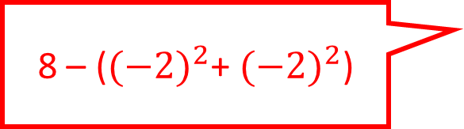
6.1.2 Non-Rec. Neighborhood Operator
Common 5 × 5 masks for noise cleaning
-2 | -1 | 0 | 1 | 2
0 | 3 | 4 | 3 | 0
3 | 6 | 7 | 6 | 3
4 | 7 | 8 | 7 | 4
3 | 6 | 7 | 6 | 3
0 | 3 | 4 | 3 | 0
0
3
0
-2
-1
0
1
2
8 – (${(−2)}^{2}$+ ${(−2)}^{2}$)
8 – (${(−1)}^{2}$+ ${(−2)}^{2}$)
8 – (${(2)}^{2}$+ ${(−2)}^{2}$)
$$\frac{1}{100}$$
Notes:
8 – (r **2 + c **2)

Slide 18
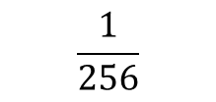

6.1.2 Non-Rec. Neighborhood Operator
Common 5 × 5 masks for noise cleaning
-2 | -1 | 0 | 1 | 2
1 | 4 | 6 | 4 | 1
4 | 16 | 24 | 16 | 4
6 | 24 | 36 | 24 | 6
4 | 16 | 24 | 16 | 4
1 | 4 | 6 | 4 | 1
-2
-1
0
1
2
$C_{\left(r+2\right)}^{4}$ × $C_{\left(c+2\right)}^{4}$
$$\frac{1}{256}$$
Notes:
C4取r+2, C4取c+2

Slide 19

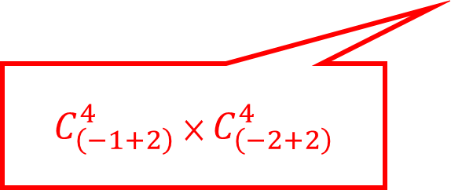

6.1.2 Non-Rec. Neighborhood Operator
Common 5 × 5 masks for noise cleaning
-2 | -1 | 0 | 1 | 2
1 | 4 | 6 | 4 | 1
4 | 16 | 24 | 14 | 4
6 | 24 | 36 | 24 | 6
4 | 16 | 24 | 16 | 4
1 | 4 | 6 | 4 | 1
1
4
1
-2
-1
0
1
2
$C_{\left(−2+2\right)}^{4}$ × $C_{\left(−2+2\right)}^{4}$
$C_{\left(−1+2\right)}^{4}$ × $C_{\left(−2+2\right)}^{4}$
$C_{\left(2+2\right)}^{4}$ × $C_{\left(−2+2\right)}^{4}$
$$\frac{1}{256}$$
Notes:
C4取r+2, C4取c+2

Slide 20
Joke Time

Slide 21
6.1 Introduction
6.2 Symbolic Neighborhood Operators
  6.2.1 Region-Growing Operator
  6.2.2 Nearest Neighbor Sets and Influence Zones
  6.2.3 Region-Shrinking Operator
  6.2.4 Mark-Interior/Border-Pixel Operator
  6.2.5 Connectivity Number Operator
    Yokoi Connectivity Number
    Rutovitz Connectivity Number
  6.2.6 Connected Shrink Operator
  6.2.7 Pair Relationship Operator
  6.2.8 Thinning Operator
  6.2.9 Distance Transformation Operator
  6.2.10 Radius of Fusion
  6.2.11 Number of Shortest Paths
6.3 Extremum-Related Neighborhood Operators
  6.3.1 Non-Minima-Maxima Operator
  6.3.2 Relative Extrema Operator
  6.3.3 Reachability Operator
6.4 Linear Shift-invariant Neighborhood Operators
  6.4.1 Convolution and Correlation
  6.4.2 Separability
Notes:
connectivity 連通性

Slide 22
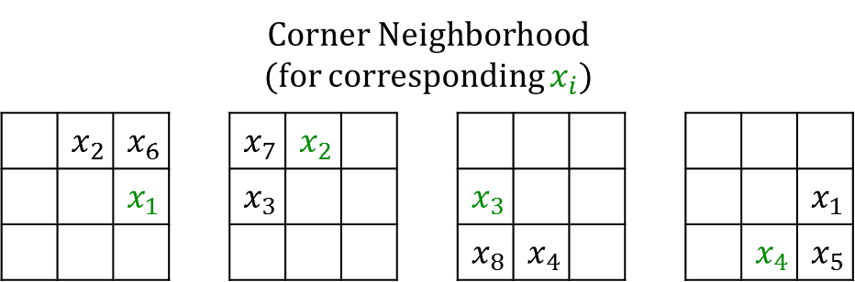



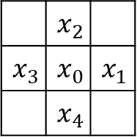
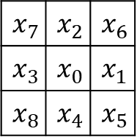
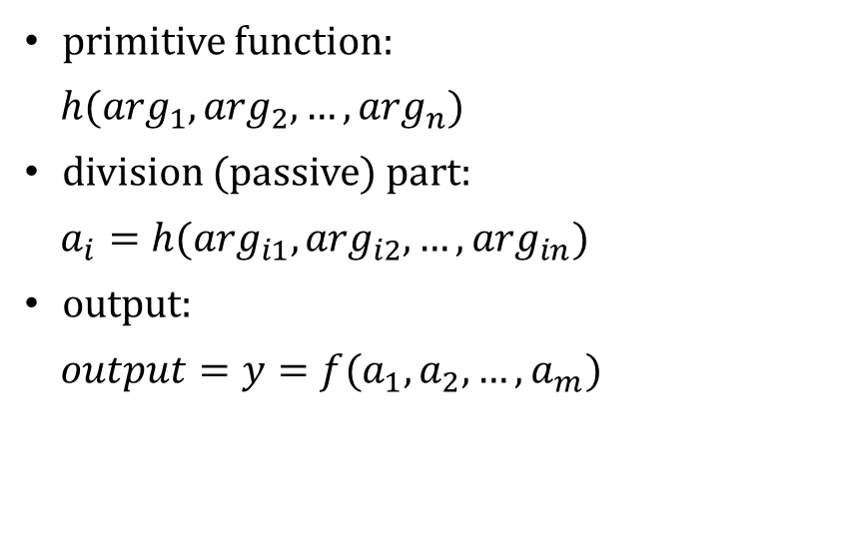
6.2.0 Definition
Indexing of 4-connected and 8-connected neighborhood of $x_{0}$
primitive function:
$h(\arg_{1},\arg_{2},…,\arg_{n})$
division (passive) part:
$a_{i}=h(\arg_{i1},\arg_{i2},…,\arg_{in})$
output:
$output=y=f(a_{1},a_{2},…,a_{m})$
$4$-$connected$
$8$-$connected$
 | $$x_{2}$$
$$x_{3}$$ | $$x_{0}$$ | $$x_{1}$$
 | $$x_{4}$$
$$x_{7}$$ | $$x_{2}$$ | $$x_{6}$$
$$x_{3}$$ | $$x_{0}$$ | $$x_{1}$$
$$x_{8}$$ | $$x_{4}$$ | $$x_{5}$$
(counterclockwise numbering)
Notes:
Primitive 原始
X1 x2 x3 x4
X5 x6 x7 x8 逆時針

Slide 23
6.2.1 Region-Growing Operator
Function
  It changes all pixels whose labels are the background labels to the non-background label of neighboring pixels.
  a.k.a Dilation
Classification
  Non-Rec.
  Symbolic data domain (input/output : region-label)
Notes:
區域增長運算子：通過將像素與其鄰域進行比較，將相似的像素合併成區域。
Dilation:擴張

Slide 24
g | g | g | g | g | g | g
g | g | g | g | g | g | g
g | g | g | a | a | g | g
g | g | g | a | a | g | g
g | g | g | b | b | g | g
g | g | g | g | g | g | g
g | g | g | g | g | g | g
g | g | g | g | g | g | g
g | g | a | a | a | a | g
g | g | a | a | a | a | g
g | g | a | a | a | a | g
g | g | b | b | b | b | g
g | g | b | b | b | b | g
g | g | g | g | g | g | g
Region-Growing
Operator
(for all points)
input
output

Slide 25
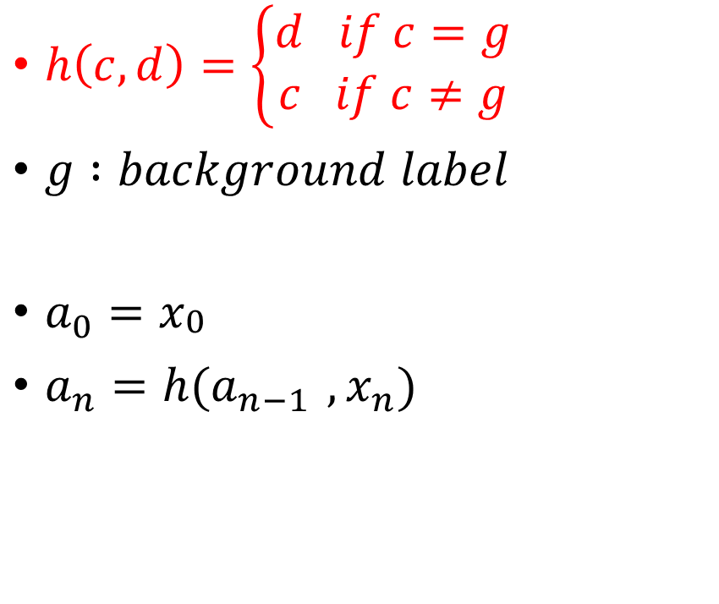
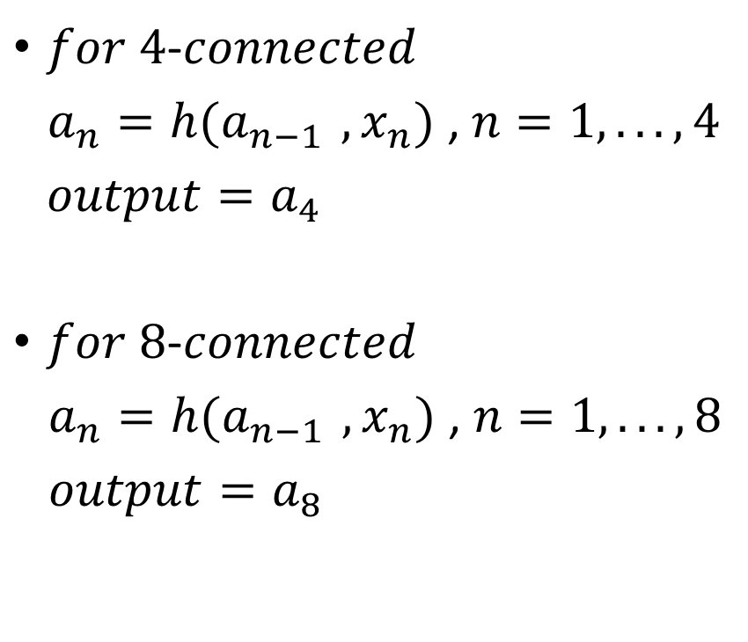
6.2.1 Region-Growing Operator
$h\left(c,d\right)=\left\{\begin{aligned}d if c=g \\ c if c≠g\end{aligned}\right.$
$g :background label$
$a_{0}=x_{\begin{aligned}0 \\ \end{aligned}}$
$a_{n}=h(a_{n−1 },x_{n})$
$for 4$-$connected$
$a_{n}=h(a_{n−1 },x_{n})$ , $n=1,... ,4$
${output=a}_{4}$
$for 8$-$connected$
$a_{n}=h(a_{n−1 },x_{n})$ , $n=1,... ,8$
${output=a}_{8}$
Notes:
C 是背景時 設為d
否則維持

Slide 26
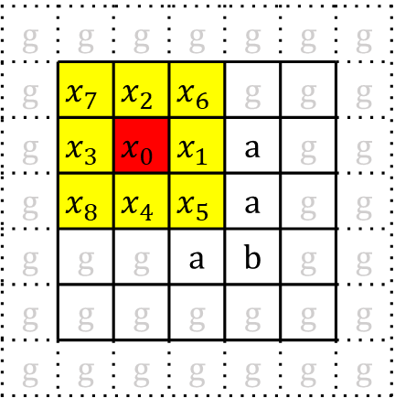

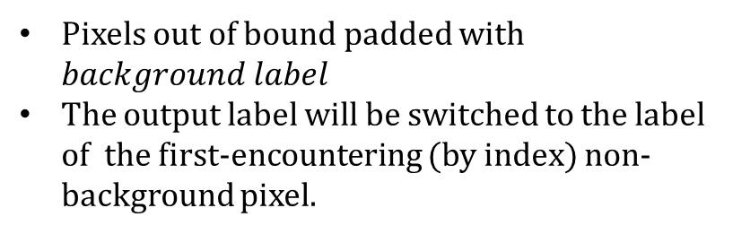
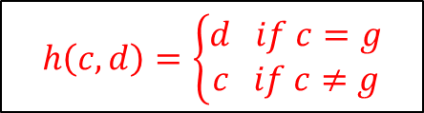
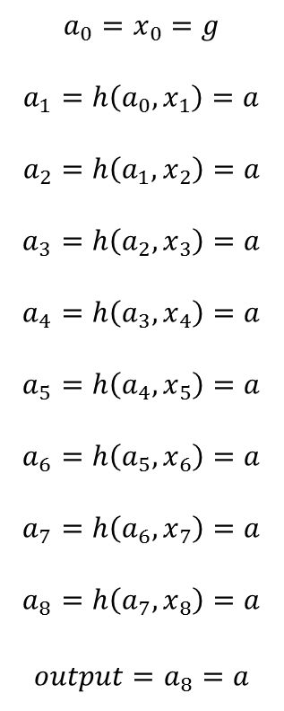
Case 1
Region-Growing
Operator
(at one point)
g | g | g | g | g | g | g
g | g | g | g | g | g | g
g | g | g | a | a | g | g
g | g | g | b | a | g | g
g | g | g | a | b | g | g
g | g | g | g | g | g | g
g | g | g | g | g | g | g
g | g | g | g | g | g | g
g | g | g | g | g | g | g
g | g | a | a | a | g | g
g | g | g | b | a | g | g
g | g | g | a | b | g | g
g | g | g | g | g | g | g
g | g | g | g | g | g | g
$$a_{0}=x_{0}=g$$
$$a_{1}=h\left({a_{0},x}_{1}\right)=a$$
$$a_{2}=h\left({a_{1},x}_{2}\right)=a$$
$$a_{3}=h\left({a_{2},x}_{3}\right)=a$$
$$a_{4}=h\left({a_{3},x}_{4}\right)=a$$
$$a_{5}=h\left({a_{4},x}_{5}\right)=a$$
$$a_{6}=h\left({a_{5},x}_{6}\right)=a$$
$$a_{7}=h\left({a_{6},x}_{7}\right)=a$$
$$a_{8}=h\left({a_{7},x}_{8}\right)=a$$
$$output=a_{8}=a$$
input
output
$$b$$
g | g | g | g | g | g | g
g | $$x_{7}$$ | $$x_{2}$$ | $$x_{6}$$ | g | g | g
g | $$x_{3}$$ | $$x_{0}$$ | $$x_{1}$$ | a | g | g
g | $$x_{8}$$ | $$x_{4}$$ | $$x_{5}$$ | a | g | g
g | g | g | a | b | g | g
g | g | g | g | g | g | g
g | g | g | g | g | g | g
$$h\left(c,d\right)=\left\{\begin{aligned}d if c=g \\ c if c≠g\end{aligned}\right.$$
Pixels out of bound padded with $background label$
The output label will be switched to the label of the first-encountering (by index) non-background pixel.
Index
Notes:
Example of 8 - connected

Slide 27
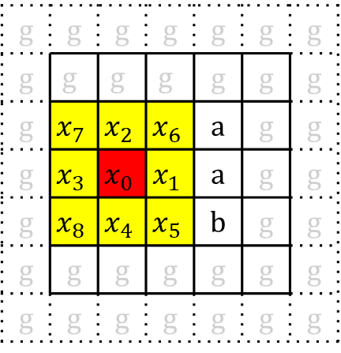

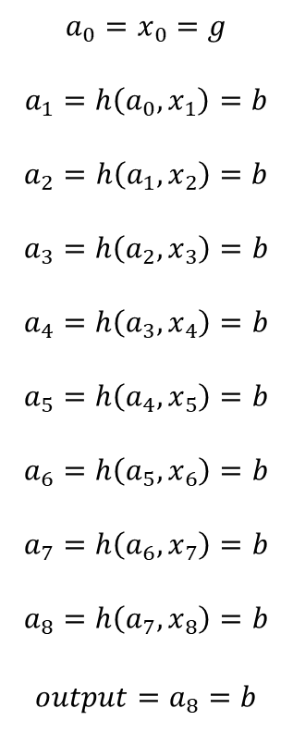
Case 2
Region-Growing
Operator
(at one point)
g | g | g | g | g | g | g
g | g | g | g | g | g | g
g | g | g | a | a | g | g
g | g | g | b | a | g | g
g | g | g | a | b | g | g
g | g | g | g | g | g | g
g | g | g | g | g | g | g
g | g | g | g | g | g | g
g | g | g | g | g | g | g
g | g | a | a | a | g | g
g | g | b | b | a | g | g
g | g | g | a | b | g | g
g | g | g | g | g | g | g
g | g | g | g | g | g | g
$$a_{0}=x_{0}=g$$
$$a_{1}=h\left({a_{0},x}_{1}\right)=b$$
$$a_{2}=h\left({a_{1},x}_{2}\right)=b$$
$$a_{3}=h\left({a_{2},x}_{3}\right)=b$$
$$a_{4}=h\left({a_{3},x}_{4}\right)=b$$
$$a_{5}=h\left({a_{4},x}_{5}\right)=b$$
$$a_{6}=h\left({a_{5},x}_{6}\right)=b$$
$$a_{7}=h\left({a_{6},x}_{7}\right)=b$$
$$a_{8}=h\left({a_{7},x}_{8}\right)=b$$
$$output=a_{8}=b$$
$$a$$
input
output
g | g | g | g | g | g | g
g | g | g | g | g | g | g
g | $$x_{7}$$ | $$x_{2}$$ | $$x_{6}$$ | a | g | g
g | $$x_{3}$$ | $$x_{0}$$ | $$x_{1}$$ | a | g | g
g | $$x_{8}$$ | $$x_{4}$$ | $$x_{5}$$ | b | g | g
g | g | g | g | g | g | g
g | g | g | g | g | g | g
$$h\left(c,d\right)=\left\{\begin{aligned}d if c=g \\ c if c≠g\end{aligned}\right.$$
Pixels out of bound padded with $background label$
The output label will be switched to the label of the first-encountering (by index) non-background pixel.
Index

Slide 28
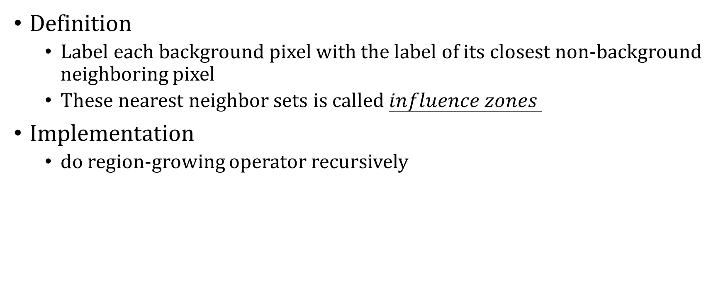
6.2.2 Nearest Neighbor Sets and
Influence Zones
Definition
  Label each background pixel with the label of its closest non-background neighboring pixel
  These nearest neighbor sets is called $influence zones$
Implementation
  do region-growing operator recursively
Notes:
最近鄰集合和影響區域：用於計算像素之間的相似性。

Slide 29
g | g | g | g | g | g | g
g | g | g | g | g | g | g
g | g | g | a | a | g | g
g | g | g | a | a | g | g
g | g | g | a | a | g | g
g | g | g | g | g | g | g
g | g | g | g | g | g | g
g | g | g | g | g | g | g
g | g | a | a | a | a | g
g | g | a | a | a | a | g
g | g | a | a | a | a | g
g | g | a | a | a | a | g
g | g | a | a | a | a | g
g | g | g | g | g | g | g
Region-Growing
Operator
(for all point)
input
output
(influence zones)

Slide 30
6.2.3 Region-Shrinking Operator
Function:
  It change the label on all border pixels to the background pixel
  may change the connectivity of a region and can even entirely delete a region upon repeated application
  a.k.a “Erosion”
Classification
  Non-Rec.
  Symbolic data domain (input/output : region-label)
Notes:
區域收縮運算子：通過將像素與其鄰域進行比較，將不相似的像素分離開來。
可能會改變區域的連通性，甚至可以在重複應用時完全刪除區域
又名侵蝕

Slide 31
g | g | g | g | g | g | g
g | g | g | g | g | g | g
g | g | a | a | a | g | g
g | g | a | a | a | g | g
g | g | a | a | a | g | g
g | g | g | g | g | g | g
g | g | g | g | g | g | g
g | g | g | g | g | g | g
g | g | g | g | g | g | g
g | g | g | g | g | g | g
g | g | g | a | g | g | g
g | g | g | g | g | g | g
g | g | g | g | g | g | g
g | g | g | g | g | g | g
Region-Shrinking
Operator
(for all points)
input
output

Slide 32
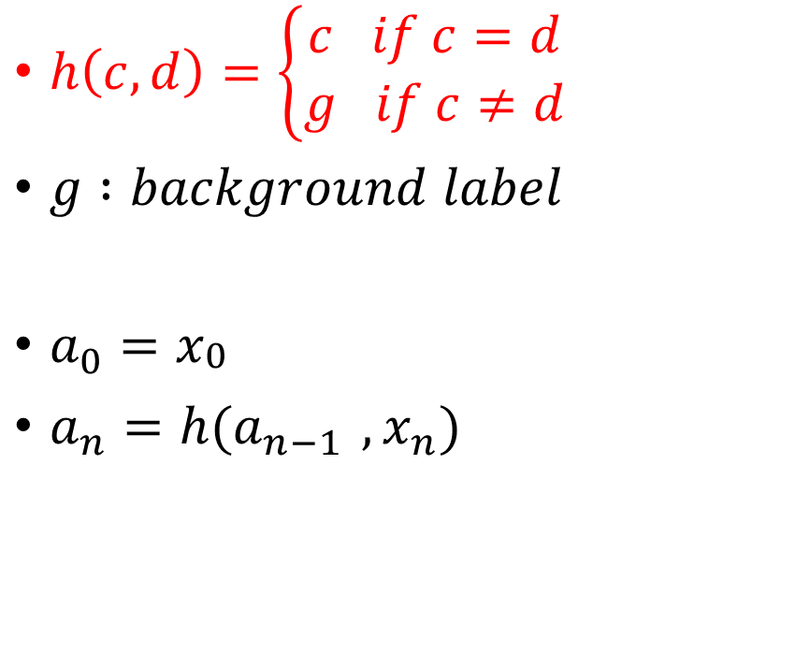
6.2.3 Region-Shrinking Operator
$h\left(c,d\right)=\left\{\begin{aligned}c if c=d \\ g if c≠d\end{aligned}\right.$
$g :background label$
$a_{0}=x_{\begin{aligned}0 \\ \end{aligned}}$
$a_{n}=h(a_{n−1 },x_{n})$
$for 4$-$connected$
$a_{n}=h(a_{n−1 },x_{n})$ , $n=1,... ,4$
${output=a}_{4}$
$for 8$-$connected$
$a_{n}=h(a_{n−1 },x_{n})$ , $n=1,... ,8$
${output=a}_{8}$

Slide 33


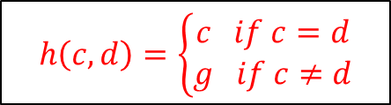
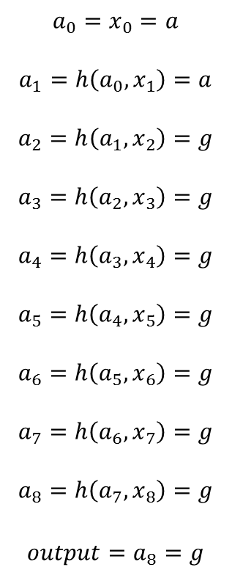
Region-Shrinking
Operator
(at one point)
g | g | g | g | g | g | g
g | g | g | g | g | g | g
g | g | a | a | a | g | g
g | g | a | a | a | g | g
g | g | a | a | a | g | g
g | g | g | g | g | g | g
g | g | g | g | g | g | g
g | g | g | g | g | g | g
g | g | g | g | g | g | g
g | g | g | a | a | g | g
g | g | a | a | a | g | g
g | g | a | a | a | g | g
g | g | g | g | g | g | g
g | g | g | g | g | g | g
$$a_{0}=x_{0}=a$$
$$a_{1}=h\left({a_{0},x}_{1}\right)=a$$
$$a_{2}=h\left({a_{1},x}_{2}\right)=g$$
$$a_{3}=h\left({a_{2},x}_{3}\right)=g$$
$$a_{4}=h\left({a_{3},x}_{4}\right)=g$$
$$a_{5}=h\left({a_{4},x}_{5}\right)=g$$
$$a_{6}=h\left({a_{5},x}_{6}\right)=g$$
$$a_{7}=h\left({a_{6},x}_{7}\right)=g$$
$$a_{8}=h\left({a_{7},x}_{8}\right)=g$$
$$output=a_{8}=g$$
input
output
g | g | g | g | g | g | g
g | $$x_{7}$$ | $$x_{2}$$ | $$x_{6}$$ | g | g | g
g | $$x_{3}$$ | $$x_{0}$$ | $$x_{1}$$ | a | g | g
g | $$x_{8}$$ | $$x_{4}$$ | $$x_{5}$$ | a | g | g
g | g | a | a | a | g | g
g | g | g | g | g | g | g
g | g | g | g | g | g | g
$$h\left(c,d\right)=\left\{\begin{aligned}c if c=d \\ g if c≠d\end{aligned}\right.$$
Pixels out of bound padded with $background label$
$when a_{i}=g , ∀i<8 , output=g$
Index(參考用)
Notes:
原先是a經過遞迴運算後變成g

Slide 34




6.2.3.1 Approach Euclidean-distance
 |  |  | 3
 |  | 3 | 2 | 3
 | 3 | 2 | 1 | 2 | 3
3 | 2 | 1 | 0 | 1 | 2 | 3
 | 3 | 2 | 1 | 2 | 3
 |  | 3 | 2 | 3
 |  |  | 3
3 | 3 | 3 | 3 | 3 | 3 | 3
3 | 2 | 2 | 2 | 2 | 2 | 3
3 | 2 | 1 | 1 | 1 | 2 | 3
3 | 2 | 1 | 0 | 1 | 2 | 3
3 | 2 | 1 | 1 | 1 | 2 | 3
3 | 2 | 2 | 2 | 2 | 2 | 3
3 | 3 | 3 | 3 | 3 | 3 | 3
4-neighborhood: 3 ← $\left|Δx\right|+|Δy|$
8-neighborhood: 3 ← $max(\left|Δx\right|,\left|Δy\right|)$
Euclidean-distance: $\sqrt{5}$ ← $\sqrt{{(Δx)}^{2}+{(Δy)}^{2}}$
Euclidean-distance: $\sqrt{10} \text{← }\sqrt{{(Δx)}^{2}+{(Δy)}^{2}}$
4-neighborhood < Euclidean-distance < 8-neighborhood
Notes:
4-鄰域的距離計算方法

Slide 35
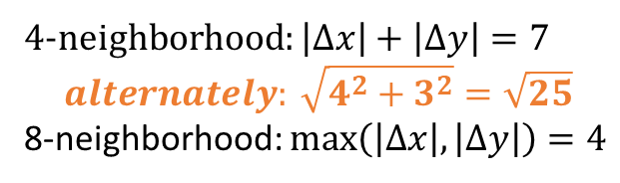
6.2.3.1 Approach Euclidean-distance
 |  |  | 5 | 5 | 5 | 5 | 5
 |  | 5 | 4 | 4 | 4 | 4 | 4 | 5
 | 5 | 4 | 4 | 3 | 3 | 3 | 4 | 4 | 5
5 | 4 | 4 | 3 | 2 | 2 | 2 | 3 | 4 | 4 | 5
5 | 4 | 3 | 2 | 2 | 1 | 2 | 2 | 3 | 4 | 5
5 | 4 | 3 | 2 | 1 | 0 | 1 | 2 | 3 | 4 | 5
5 | 4 | 3 | 2 | 2 | 1 | 2 | 2 | 3 | 4 | 5
5 | 4 | 4 | 3 | 2 | 2 | 2 | 3 | 4 | 4 | 5
 | 5 | 4 | 4 | 3 | 3 | 3 | 4 | 4 | 5
 |  | 5 | 4 | 4 | 4 | 4 | 4 | 5
 |  |  | 5 | 5 | 5 | 5 | 5
4-neighborhood: $\left|Δx\right|+\left|Δy\right|=7$
$$alternately: \sqrt{4^{2}+3^{2}}=\sqrt{25}$$
8-neighborhood: $max\left(\left|Δx\right|,\left|Δy\right|\right)=4$
This is the way how discrete pixels approach a continuous circle.

Slide 36
6.2.4 Mark-Interior/Border-Pixel Operator
Function
  It marks all interior pixels with the label i, and all border pixels with the label b
Classification
  Non-Rec.
  symbolic data domain(input : region-label/output : interior/border-label)
Notes:
標記內部/邊界像素運算符號：用於標記圖像中的內部和邊界像素。

Slide 37
<Legend>
  i: interior label
  b: border label
E | E | E | a | a | a | a
E | E | E | a | a | a | a
E | E | E | a | a | a | a
E | E | E | a | a | a | a
E | E | E | A | A | A | A
E | E | E | A | A | A | A
E | E | E | A | A | A | A
E | E | E | a | a | a | a
E | i | b | b | i | i | a
E | i | b | b | i | i | a
E | i | b | b | b | b | a
E | i | b | b | b | b | A
E | i | b | b | i | i | A
E | E | E | A | A | A | A
Mark interior/border-Pixel Operator
(for all points)
input
output

Slide 38
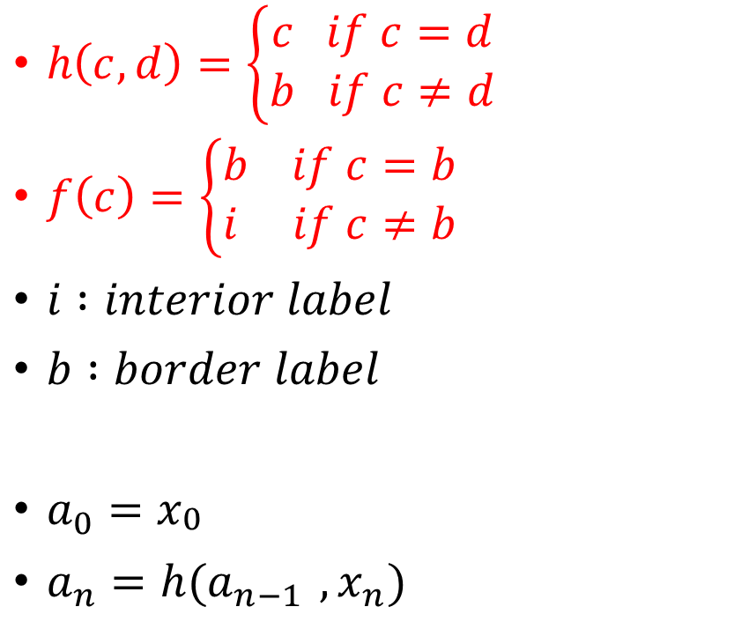
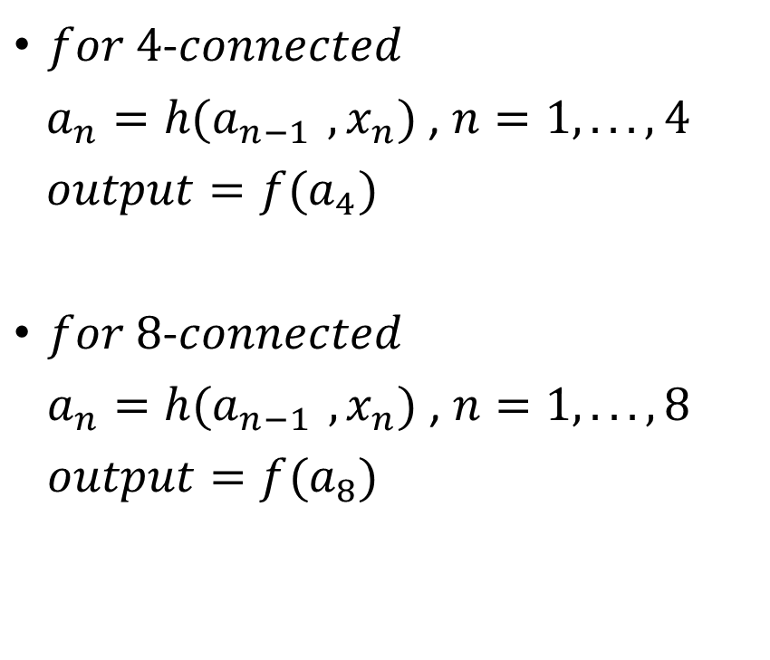
6.2.4 Mark-Interior/Border-Pixel Operator
$h\left(c,d\right)=\left\{\begin{aligned}c if c=d \\ b if c≠d\end{aligned}\right.$
$f\left(c\right)=\left\{\begin{aligned}b if c=b \\ i if c≠b\end{aligned}\right.$
$i :interior label$
$b :border label$
$a_{0}=x_{\begin{aligned}0 \\ \end{aligned}}$
$a_{n}=h(a_{n−1 },x_{n})$
$for 4$-$connected$
$a_{n}=h(a_{n−1 },x_{n})$ , $n=1,... ,4$
${output=f(a}_{4})$
$for 8$-$connected$
$a_{n}=h(a_{n−1 },x_{n})$ , $n=1,... ,8$
${output=f(a}_{8})$
Notes:
h(c, d): similar to region-shrinking function
f(c): 判斷h(c,d)做完的值，不是border的就標成interior
a(n) base on 前一個h做完的結果，跟下一個neighbor index的label值

Slide 39
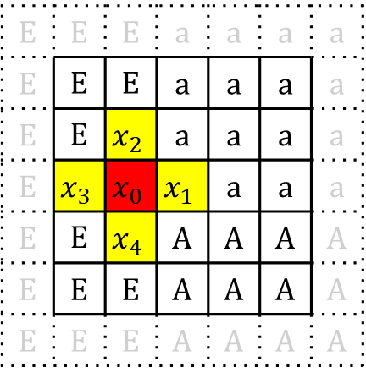
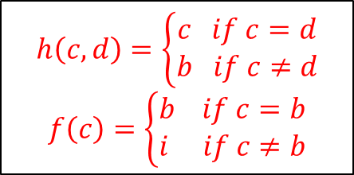
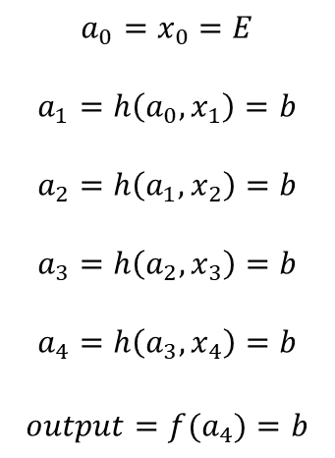
Case 1
Mark interior/border-Pixel Operator
(at one point)
E | E | E | a | a | a | a
E | E | E | a | a | a | a
E | E | E | a | a | a | a
E | E | E | a | a | a | a
E | E | E | A | A | A | A
E | E | E | A | A | A | A
E | E | E | A | A | A | A
E | E | E | a | a | a | a
E | E | E | a | a | a | a
E | E | E | a | a | a | a
E | E | b | a | a | a | a
E | E | E | A | A | A | A
E | E | E | A | A | A | A
E | E | E | A | A | A | A
$$a_{0}=x_{0}=E$$
$$a_{1}=h\left({a_{0},x}_{1}\right)=b$$
$$a_{2}=h\left({a_{1},x}_{2}\right)=b$$
$$a_{3}=h\left({a_{2},x}_{3}\right)=b$$
$$a_{4}=h\left({a_{3},x}_{4}\right)=b$$
$$output={f(a}_{4})=b$$
a
input
output
E | E | E | a | a | a | a
E | E | E | a | a | a | a
E | E | $$x_{2}$$ | a | a | a | a
E | $$x_{3}$$ | $$x_{0}$$ | $$x_{1}$$ | a | a | a
E | E | $$x_{4}$$ | A | A | A | A
E | E | E | A | A | A | A
E | E | E | A | A | A | A
$$h\left(c,d\right)=\left\{\begin{aligned}c if c=d \\ b if c≠d\end{aligned}\right.$$
$$f\left(c\right)=\left\{\begin{aligned}b if c=b \\ i if c≠b\end{aligned}\right.$$
for 4-connectivity
i: interior label
b: border label
Index
Notes:
前後相等 輸出該值；前後不等 輸出b ---→ 當前者(c)是border時，無論如何輸出都是border。

Slide 40
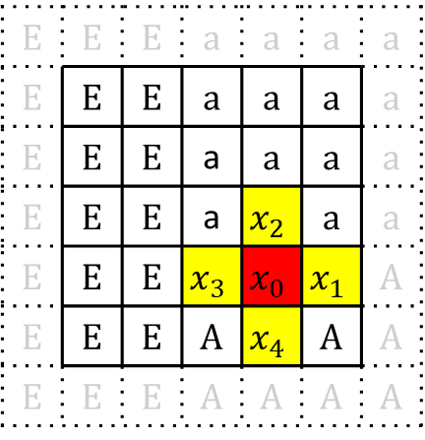
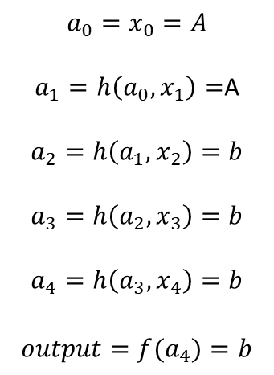
Case 2
Mark interior/border-Pixel Operator
(at one point)
E | E | E | a | a | a | a
E | E | E | a | a | a | a
E | E | E | a | a | a | a
E | E | E | a | a | a | a
E | E | E | A | A | A | A
E | E | E | A | A | A | A
E | E | E | A | A | A | A
E | E | E | a | a | a | a
E | E | E | a | a | a | a
E | E | E | a | a | a | a
E | E | E | a | a | a | a
E | E | E | A | b | A | A
E | E | E | A | A | A | A
E | E | E | A | A | A | A
$$a_{0}=x_{0}=A$$
$a_{1}=h\left({a_{0},x}_{1}\right)=$A
$$a_{2}=h\left({a_{1},x}_{2}\right)=b$$
$$a_{3}=h\left({a_{2},x}_{3}\right)=b$$
$$a_{4}=h\left({a_{3},x}_{4}\right)=b$$
$$output={f(a}_{4})=b$$
a
input
output
E | E | E | a | a | a | a
E | E | E | a | a | a | a
E | E | E | a | a | a | a
E | E | E | a | $$x_{2}$$ | a | a
E | E | E | $$x_{3}$$ | $$x_{0}$$ | $$x_{1}$$ | A
E | E | E | A | $$x_{4}$$ | A | A
E | E | E | A | A | A | A
$$h\left(c,d\right)=\left\{\begin{aligned}c if c=d \\ b if c≠d\end{aligned}\right.$$
$$f\left(c\right)=\left\{\begin{aligned}b if c=b \\ i if c≠b\end{aligned}\right.$$
for 4-connectivity
i: interior label
b: border label
Index

Slide 41
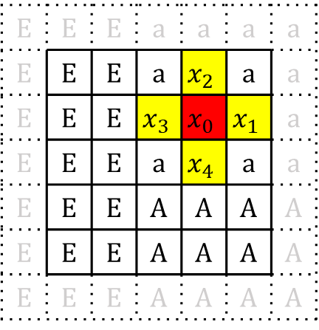
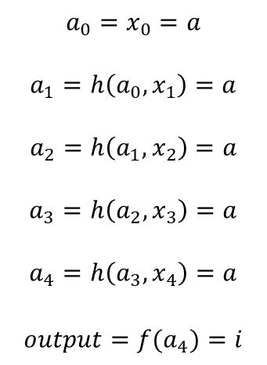
Case 3
Mark interior/border-Pixel Operator
(at one point)
E | E | E | a | a | a | a
E | E | E | a | a | a | a
E | E | E | a | a | a | a
E | E | E | a | a | a | a
E | E | E | A | A | A | A
E | E | E | A | A | A | A
E | E | E | A | A | A | A
E | E | E | a | a | a | a
E | E | E | a | a | a | a
E | E | E | a | i | a | a
E | E | E | a | a | a | a
E | E | E | A | A | A | A
E | E | E | A | A | A | A
E | E | E | A | A | A | A
$$a_{0}=x_{0}=a$$
$$a_{1}=h\left({a_{0},x}_{1}\right)=a$$
$$a_{2}=h\left({a_{1},x}_{2}\right)=a$$
$$a_{3}=h\left({a_{2},x}_{3}\right)=a$$
$$a_{4}=h\left({a_{3},x}_{4}\right)=a$$
$$output={f(a}_{4})=i$$
a
input
output
E | E | E | a | a | a | a
E | E | E | a | $$x_{2}$$ | a | a
E | E | E | $$x_{3}$$ | $$x_{0}$$ | $$x_{1}$$ | a
E | E | E | a | $$x_{4}$$ | a | a
E | E | E | A | A | A | A
E | E | E | A | A | A | A
E | E | E | A | A | A | A
$$h\left(c,d\right)=\left\{\begin{aligned}c if c=d \\ b if c≠d\end{aligned}\right.$$
$$f\left(c\right)=\left\{\begin{aligned}b if c=b \\ i if c≠b\end{aligned}\right.$$
for 4-connectivity
i: interior label
b: border label
Index

Slide 42
6.2.5 Connectivity Number Operator
Function
  Its purpose is to classify the way a pixel is connected to its like neighbors
Classification
  Non-Rec.
  symbolic data domain (input : binary-label/output : number-label)
Types
  Yokoi Connectivity Number
  Rutovitz Connectivity Number
Notes:
連通數運算子：其目的是對像素與其相似鄰居的連接方式進行分類。

Slide 43
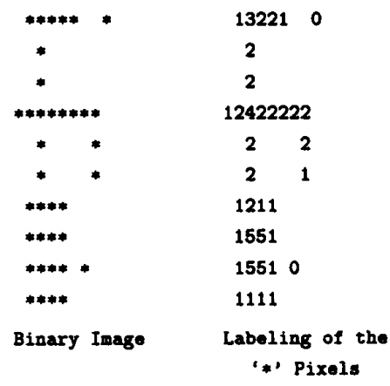
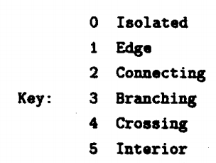
6.2.5.1 Yokoi Connectivity Number
Sample on textbook
Notes:
寫程式

Slide 44
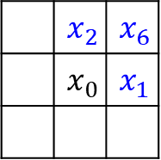
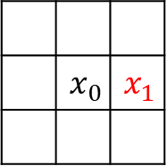
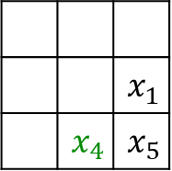
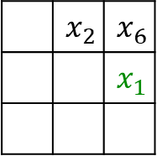
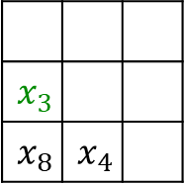
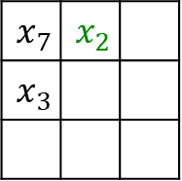

6.2.5.1 Yokoi Connectivity Number
(for 4-connectivity)
A pixel is an interior pixel if its value and that of each of its 4-connected neighbor are the same(Yokoi number of an interior pixel : 5)
The 4-connectivity of pixel is given by the number of times(條件達成次數)
Corner Neighborhood
(for corresponding $x_{i}$)
 | $$x_{2}$$ | $$x_{6}$$
 |  | $$x_{1}$$
$$x_{7}$$ | $$x_{2}$$
$$x_{3}$$
$$x_{3}$$
$$x_{8}$$ | $$x_{4}$$
 |  | $$x_{1}$$
 | $$x_{4}$$ | $$x_{5}$$
 | $$x_{0}$$ | $$x_{1}$$
 | $$x_{2}$$ | $$x_{6}$$
 | $$x_{0}$$ | $$x_{1}$$
Notes:
Eg: q的達成次數(前兩個相等，但剩下兩個有至少一個不等)

Slide 45
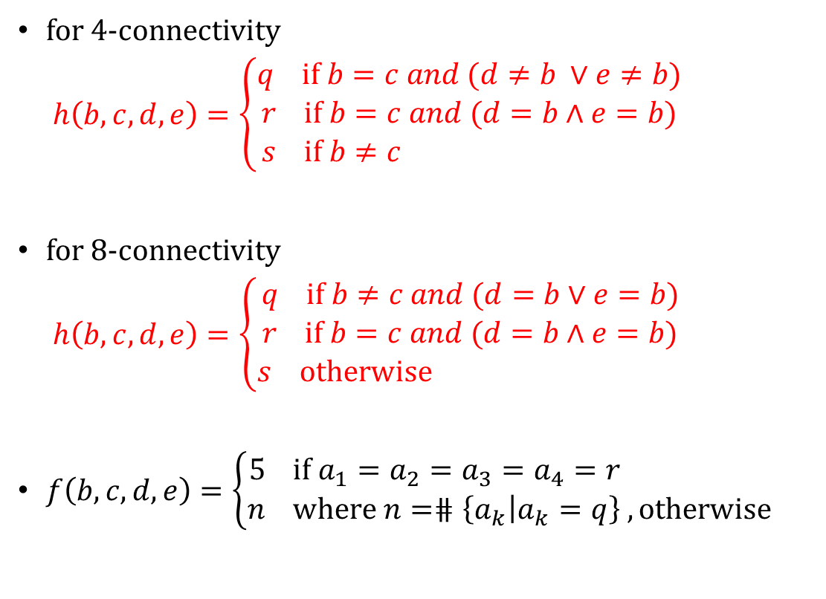

6.2.5.1 Yokoi Connectivity Number
for 4-connectivity
$h\left(b,c,d,e\right)=\left\{\begin{aligned}q if b=c and (d≠b ∨e≠b) \\ r if b=c and (d=b∧e=b) \\ s if b≠c and (d=b∧e=b)\end{aligned}\right.$
for 8-connectivity
$h\left(b,c,d,e\right)=\left\{\begin{aligned}q if b≠c and (d=b∨e=b) \\ r if b=c and (d=b∧e=b) \\ s otherwisend (d=b∧e=b)\end{aligned}\right.$
$f\left(b,c,d,e\right)=\left\{\begin{aligned}5 if a_{1}=a_{2}=a_{3}=a_{4}=r \\ n where n=\#\#⋕\left\{a_{k}\left|a_{k}=q\right.\right\} , otherwise\end{aligned}\right.$
$a_{1}=h(x_{0},x_{1},x_{6}{,x}_{2})$
$a_{2}=h(x_{0},x_{2},x_{7}{,x}_{3})$
$a_{3}=h(x_{0},x_{3},x_{8}{,x}_{4})$
$a_{4}=h(x_{0},x_{4},x_{5}{,x}_{1})$
$output=f({a_{1},a_{2},a_{3},a}_{4})$
Notes:
8-connectivity
If (b=c=d=e): 輸出 r 表示與中心像素相同
If (前兩個不同but後面有至少一個相同): 輸出 q 表示與中心像素不同
(4 8 差在 q的計算)
Else: 輸出 s 表示孤立
Q的個數:中間拿掉之後鄰居剩下幾片

Slide 46



6.2.5.1 Yokoi Connectivity Number
for 4-connectivity
$h\left(b,c,d,e\right)=\left\{\begin{aligned}q if b=c and (d≠b ∨e≠b) \\ r if b=c and (d=b∧e=b) \\ s if b≠c and (d=b∧e=b)\end{aligned}\right.$
$$8\text{−}connected neighborhood$$
$$x_{7}$$ | $$x_{2}$$ | $$x_{6}$$
$$x_{3}$$ | $$x_{0}$$ | $$x_{1}$$
$$x_{8}$$ | $$x_{4}$$ | $$x_{5}$$
$$h(x_{0},x_{1},x_{6}{,x}_{2})=q$$
$$h(x_{0},x_{1},x_{6}{,x}_{2})=r$$
 | 1 | 1
 |  | 1
 | 1 | 1
 | 1
 | 1 | 1
 | 1 | 1
 | 1 | 1
 | $$x_{2}$$ | $$x_{6}$$
 | $$x_{0}$$ | $$x_{1}$$
$$h(x_{0},x_{1},x_{6}{,x}_{2})=s$$
 | 1
 |  | 1
 | 1
 | 1
 | 1
 | 1 | 1
 | 1
Notes:
4-connectivity
If (b=c=d=e): 輸出r
If (前兩個就不相等ㄌ): 輸出s
If (前兩個相等but後兩個有任一個不等): 輸出q

Slide 47


6.2.5.1 Yokoi Connectivity Number
for 4-connectivity
$h\left(b,c,d,e\right)=\left\{\begin{aligned}q if b=c and (d≠b ∨e≠b) \\ r if b=c and (d=b∧e=b) \\ s if b≠c and (d=b∧e=b)\end{aligned}\right.$
$$f(a_{1},a_{2},a_{3},a_{4})=\left\{\begin{aligned}5 if a_{1}=a_{2}=a_{3}=a_{4}=r \\ n where \#n\#=\#\#\#\#\#\#\#\#\#\#numberof\#\left\{a_{k} | a_{k}=q\right\}, otherwise\#\#\#\#\#\#\end{aligned}\right.$$
 | 1
1 | 1 | 1
 | 1
1 | 1 | 1
1 | 1 | 1
1 | 1 | 1
 | 1 | 1
1 | 1 | 1
 | 1
1 | 1 | 1
1 | 1 | 1
1 | 1
a₁ = q
a₁ = r
a₁ = r
a₁ = r
a₂ = q
a₂ = r
a₂ = q
a₂ = r
a₃ = q
a₃ = r
a₃ = q
a₃ = r
a₄ = q
a₄ = r
a₄ = q
a₄ = q
f(a₁, a₂, a₃, a₄) = 4
(crossing)
f(a₁, a₂, a₃, a₄) = 5
(interior)
f(a₁, a₂, a₃, a₄) = 3
(branching)
f(a₁, a₂, a₃, a₄) = 1
(edge)
Notes:
Label值 = q的個數
If (b=c=d=e): 輸出r
If (前兩個就不相等ㄌ): 輸出s
If (前兩個相等but後兩個有任一個不等): 輸出q

Slide 48







6.2.5.1 Yokoi Connectivity Number
(for 8-connectivity)
A pixel is an interior pixel if its value and that of each of its 8-connected neighbor are the same(Yokoi number of an interior pixel : 5)
The 8-connectivity of pixel is given by the number of times(條件達成次數)
Corner Neighborhood
(for corresponding $x_{i}$)
 | $$x_{2}$$ | $$x_{6}$$
 |  | $$x_{1}$$
$$x_{7}$$ | $$x_{2}$$
$$x_{3}$$
$$x_{3}$$
$$x_{8}$$ | $$x_{4}$$
 |  | $$x_{1}$$
 | $$x_{4}$$ | $$x_{5}$$
 | $$x_{0}$$ | $$x_{1}$$
 | $$x_{2}$$ | $$x_{6}$$
 | $$x_{0}$$ | $$x_{1}$$

Slide 49






$$Isolated (label 0)$$
$$Edge (label 1)$$
$$Connecting (label 2)$$
 | 1
1 | 1
 |  | 1
 | 1
1 | 1
1 | 1
1 | 1 | 1
1
 | 1 | 1
f(s,s,s,s) = 0
f(s,q,s,s) = 1
f(q,s,s,s) = 1
f(q,r,s,s) = 1
f(s,q,s,q) = 2
f(s,q,s,q) = 2
1 | 1
1 | 1 | 1
1 | 1 | 1
1 | 1 | 1
1 | 1 | 1
1 | 1 | 1
1 |  | 1
1 |  | 1
1 | 1 | 1
1 | 1 | 1
 | 1
1 | 1 | 1
f(s,r,s,q) = 1
f(r,r,s,q) = 1
f(r,r,s,q) = 1
f(s,q,s,q) = 2
f(q,s,q,s) = 2
$$Branching (label 3)$$
$$Crossing (label 4)$$
$$Interior (label 5)$$
 | 1
 | 1
1 |  | 1
1 |  | 1
 | 1
 |  | 1
1 |  | 1
 | 1
1 |  | 1
1 | 1 | 1
1 | 1 | 1
1 | 1 | 1
f(q,s,q,q) = 3
f(q,q,s,q) = 3
f(q,q,q,q) = 4
f(r,r,r,r) = 5
Notes:
8-connectivity
If (b=c=d=e): 輸出 r
If (前兩個不同but後面有至少一個相同): 輸出 q
Else: 輸出 s
Yokoi 連接可用於影像特徵提取

Slide 50


6.2.5.1 Yokoi Connectivity Number (HW) due OCT. 31, 2023
<Hint>
Binarize the benchmark image Lena as in HW2 by 128.
Using 8x8 blocks as a unit, take the topmost-left pixel as the down-sampled data, Down-sample Lena from 512x512 to 64x64.
Count the Yokoi connectivity number.
Result of this assignment is a 64x64 matrix. Please align the matrix within 1 single A4 page (using 4-connected).
Notes:
HW6
將基準圖像lena二元化，基準為128。
以 8x8 塊為單位，將左上角的圖元作為下採樣數據，將 Lena 從 512x512 下採樣到 64x64。
計算yokoi connectivity number。
結果是一個 64x64 矩陣。請在 1 個 A4 頁面內對齊矩陣（使用 4 連接）。

Slide 51
Joke Time

Slide 52

6.2.5.2 Rutovitz Connectivity Number
The Rutovitz connectivity number simply counts the number of transitions from symbols that are different from that of the center pixel to symbols that are the same as that of the center pixel as one travels around the 8-neighborhood of a pixel.
 |  | $$x_{6}$$
 | $$x_{0}$$ | $$x_{1}$$
 |  | 0
 | 1 | 1
 |  | 1
 | 1 | 0
 |  | 1
 | 0 | 0
 |  | 0
 | 0 | 1
0: background label
1: image label
Notes:
各自標出相同&不同的pixel
Rutovitz 連通性數位只是計算在圖元的 8 鄰域周圍移動時，從與中心圖元不同的符號到與中心圖元相同的符號的轉換次數。

Slide 53





6.2.5.2 Rutovitz Connectivity Number
$h\left(a,b,c\right)=\left\{\begin{aligned}1 if(a=b ∧a≠c)∨(a≠b∧a=c) \\ 0 otherwise \end{aligned}\right.$
$$index$$
$$a_{1}=h(x_{0}{,x}_{1}{,x}_{6})$$
$$a_{2}=h\left(x_{0}{,x}_{6}{,x}_{2}\right)$$
$$a_{3}=h\left(x_{0}{,x}_{2}{,x}_{7}\right)$$
$$a_{4}=h\left(x_{0}{,x}_{7}{,x}_{3}\right)$$
$$a_{5}=h\left(x_{0}{,x}_{3}{,x}_{8}\right)$$
$$a_{6}=h\left(x_{0}{,x}_{8}{,x}_{4}\right)$$
$$a_{7}=h\left(x_{0}{,x}_{4}{,x}_{5}\right)$$
$$a_{8}=h\left(x_{0}{,x}_{5}{,x}_{1}\right)$$
$$output=\sum_{n=1}^{8}{a_{n}}$$
 |  | $$x_{6}$$
 | $$x_{0}$$ | $$x_{1}$$
$$h\left(x_{0}x_{1}x_{6}\right)=1$$
 | a | a
 |  | a
 | a
Notes:
Corner中只能有一個跟他一樣，才能標記成1；否則為0。

Slide 54
6.2.6 Connected Shrink Operator
Function
  The connected shrink operator labels only those border pixels that can be deleted from a connected region without disconnecting the region
Classification
  Rec.
  symbolic data domain(input/output : binary-label)
Notes:
Shrink: 收縮
刪除pixel後還是不會斷開

Slide 55






6.2.6 Connected Shrink Operator
Corner Neighborhood
(for corresponding $x_{i}$)
for 4-connectivity
$h\left(b,c,d,e\right)=\left\{\begin{aligned}1 if b=c∧(b≠d ∨ b≠e) \\ 0 otherwise \end{aligned}\right.$
for 8-connectivity
$h\left(b,c,d,e\right)=\left\{\begin{aligned}1 if b≠c∧(b=d ∨ b=e) \\ 0 otherwise \end{aligned}\right.$
$a_{1}=h(x_{0},x_{1},x_{6},x_{2})$
$a_{2}=h(x_{0},x_{2},x_{7},x_{3})$
$a_{3}=h(x_{0},x_{3},x_{8},x_{4})$
$a_{4}=h(x_{0},x_{4},x_{5},x_{1})$
$output=f\left(a_{1},a_{2},a_{3},a_{4},x_{0}\right)=\left\{\begin{aligned}g if exactly one of a_{1},a_{2},a_{3}{,a}_{4}=1 \\ x_{0} otherwise \end{aligned}\right.$
 | $$x_{2}$$ | $$x_{6}$$
 |  | $$x_{1}$$
$$x_{7}$$ | $$x_{2}$$
$$x_{3}$$
$$x_{3}$$
$$x_{8}$$ | $$x_{4}$$
 |  | $$x_{1}$$
 | $$x_{4}$$ | $$x_{5}$$
Yokoi Connectivity Number
:label 1(edge)
Scan: top-down left-right
Input: last-step output (not the original image)
Notes:
只有剛好一個a值結果是1的話(相當於Yokoi中計算q的個數)，才把他變成background值；否則維持原樣。
Input是上一次的Output → Recursive.

Slide 56


Padded with
$$background label$$
 |  |  | * | *
 |  | * | * | * | *
 | * | * | * | * | * | *
 |  | * | * |  | * | *
 |  |  | * |  | * | *
 |  |  | * |  | * | *
 |  |  | * |  | * | *
 |  |  |  | *
 |  | * | * | * | *
 | * | * | * | * | * | *
 |  | * | * |  | * | *
 |  |  | * |  | * | *
 |  |  | * |  | * | *
 |  |  | * |  | * | *
 |  | * | * | * | *
 | * | * | * | * | * | *
 |  | * | * |  | * | *
 |  |  | * |  | * | *
 |  |  | * |  | * | *
 |  |  | * |  | * | *
$$delete, when r\left(yellow\right)=1$$
$$ref 6.2.5 Yokoi connectivity number$$
Notes:
4-connectivity
因為中間pixel已經貼在image邊緣，因此需要padded外圍的background。
這邊做完一個pixel就刪掉，結果的output會變成下一個pixel計算時的input image。
由上到下左到右

Slide 57
 |  |  | * | * | *
 | * | * | * | * | * | *
 |  | * | * |  | * | *
 |  |  | * |  | * | *
 |  |  | * |  | * | *
 |  |  | * |  | * | *
 |  |  |  | * | *
 | * | * | * | * | * | *
 |  | * | * |  | * | *
 |  |  | * |  | * | *
 |  |  | * |  | * | *
 |  |  | * |  | * | *
 |  |  |  |  | *
 | * | * | * | * | * | *
 |  | * | * |  | * | *
 |  |  | * |  | * | *
 |  |  | * |  | * | *
 |  |  | * |  | * | *
$$delete, when r\left(yellow\right)=1$$
$$ref 6.2.5 Yokoi connectivity number$$

Slide 58
 | * | * | * | * | * | *
 |  | * | * |  | * | *
 |  |  | * |  | * | *
 |  |  | * |  | * | *
 |  |  | * |  | * | *
 |  | * | * | * | * | *
 |  | * | * |  | * | *
 |  |  | * |  | * | *
 |  |  | * |  | * | *
 |  |  | * |  | * | *
 |  |  | * | * | * | *
 |  | * | * |  | * | *
 |  |  | * |  | * | *
 |  |  | * |  | * | *
 |  |  | * |  | * | *
$$delete, when r\left(yellow\right)=1$$
$$ref 6.2.5 Yokoi connectivity number$$

Slide 59
 |  |  | * | * | * | *
 |  | * | * |  | * | *
 |  |  | * |  | * | *
 |  |  | * |  | * | *
 |  |  | * |  | * | *
 |  |  | * | * | * | *
 |  | * | * |  | * | *
 |  |  | * |  | * | *
 |  |  | * |  | * | *
 |  |  | * |  | * | *
 |  |  | * | * | * | *
 |  | * | * |  | * | *
 |  |  | * |  | * | *
 |  |  | * |  | * | *
 |  |  | * |  | * | *
$$delete, when r\left(yellow\right)=1$$
$$ref 6.2.5 Yokoi connectivity number$$

Slide 60
 |  |  | * | * | *
 |  | * | * |  | * | *
 |  |  | * |  | * | *
 |  |  | * |  | * | *
 |  |  | * |  | * | *
 |  |  | * | * | *
 |  |  | * |  | * | *
 |  |  | * |  | * | *
 |  |  | * |  | * | *
 |  |  | * |  | * | *
 |  |  | * | * | *
 |  | * | * |  | * | *
 |  |  | * |  | * | *
 |  |  | * |  | * | *
 |  |  | * |  | * | *
$$delete, when r\left(yellow\right)=1$$
$$ref 6.2.5 Yokoi connectivity number$$

Slide 61
 |  |  | * | * | *
 |  |  | * |  | * | *
 |  |  | * |  | * | *
 |  |  | * |  | * | *
 |  |  | * |  | * | *
 |  |  | * | * | *
 |  |  | * |  | *
 |  |  | * |  | * | *
 |  |  | * |  | * | *
 |  |  | * |  | * | *
 |  |  | * | * | *
 |  |  | * |  | *
 |  |  | * |  | * | *
 |  |  | * |  | * | *
 |  |  | * |  | * | *
$$delete, when r\left(yellow\right)=1$$
$$ref 6.2.5 Yokoi connectivity number$$

Slide 62
 |  |  | * | * | *
 |  |  | * |  | *
 |  |  | * |  | * | *
 |  |  | * |  | * | *
 |  |  | * |  | * | *
 |  |  | * | * | *
 |  |  | * |  | *
 |  |  | * |  | *
 |  |  | * |  | * | *
 |  |  | * |  | * | *
 |  |  | * | * | *
 |  |  | * |  | *
 |  |  | * |  | *
 |  |  | * |  | * | *
 |  |  | * |  | * | *
$$delete, when r\left(yellow\right)=1$$
$$ref 6.2.5 Yokoi connectivity number$$

Slide 63
 |  |  | * | * | *
 |  |  | * |  | *
 |  |  | * |  | *
 |  |  | * |  | * | *
 |  |  | * |  | * | *
 |  |  | * | * | *
 |  |  | * |  | *
 |  |  | * |  | *
 |  |  | * |  | *
 |  |  | * |  | * | *
 |  |  | * | * | *
 |  |  | * |  | *
 |  |  | * |  | *
 |  |  | * |  | *
 |  |  |  |  | * | *
$$delete, when r\left(yellow\right)=1$$
$$ref 6.2.5 Yokoi connectivity number$$

Slide 64


$$output of$$
$$region−shrinking operator$$
$$for comparision$$
$$final output$$
 |  |  | * | * | *
 |  |  | * |  | *
 |  |  | * |  | *
 |  |  | * |  | *
 |  |  |  |  | * | *
 |  |  | * | * | *
 |  |  | * |  | *
 |  |  | * |  | *
 |  |  | * |  | *
 |  |  |  |  | *
 |  |  | * | *
 |  | * | * | * | *
 | * | * | * | * | * | *
 |  | * | * |  | * | *
 |  |  | * |  | * | *
 |  |  | * |  | * | *
 |  |  | * |  | * | *
$$delete, when r\left(yellow\right)=1$$
$$ref 6.2.5 Yokoi connectivity number$$
green region are those pixels deleted

Slide 65
6.2.7 Pair Relationship Operator
Function
  Relabels with a specified label all border pixels that are next to an interior pixel
Classification
  Non-Rec.
  symbolic data domain
Notes:
配對關係運算子：用於計算圖像中像素之間的配對關係

Slide 66



6.2.7 Pair Relationship Operator
for 4-connected
$$output=\left\{\begin{aligned}q if \sum_{n=1}^{4}{h\left(x_{n},i\right)<θ ∨ x_{0}≠b} \\ p if \sum_{n=1}^{4}{h\left(x_{n},i\right)≥θ ∧ x_{0}=b}\end{aligned}\right.$$
for 8-connected
$$output=\left\{\begin{aligned}q if \sum_{n=1}^{8}{h\left(x_{n},i\right)<θ ∨ x_{0}≠b} \\ p if \sum_{n=1}^{8}{h\left(x_{n},i\right)≥θ ∧ x_{0}=b}\end{aligned}\right.$$
$$h\left(a,i\right)=\left\{\begin{aligned}1 if a=i \\ 0 otherwise\end{aligned}\right.$$
Assign p to those pixels satisfy pixel value = b
and have more than $θ$ neighbors whose pixel value = i

Slide 67


 | b | b | b | b | b | b
 | b | i | i | i | i | b
 | b | b | b | i | i | b | b
 | b |  |  | b | b | i | b
 | b |  |  |  | b | b | b
 | b |  |  |  |  |  | b
 | q | p | p | p | p | q
 | p | q | q | q | q | p
 | q | p | p | q | q | p | q
 | q |  |  | p | p | q | p
 | q |  |  |  | q | p | q
 | q |  |  |  |  |  | q
for 4-connectivity
$$output=\left\{\begin{aligned}q if \sum_{n=1}^{4}{h\left(x_{n},i\right)<1∨ x_{0}≠b} \\ p if \sum_{n=1}^{4}{h\left(x_{n},i\right)≥1 ∧ x_{0}=b}\end{aligned}\right.$$
$$Let l =b , m=i , θ=1$$
$$h\left(a,i\right)=\left\{\begin{aligned}1 if a=i \\ 0 otherwise\end{aligned}\right.$$
Notes:
排除內部與無關: 只要是跟interior有4-connect的標p(關注)；剩下標q(不關注)。
周圍只要有一個是interior && 自己是border 就標成p；如果周圍都沒有interior 或 自己是interior(自己不是border) 就標成q。
-> 原本是interior的不動 寫p；部分原本是border(q)的會改成p。

Slide 68

6.2.8 Thinning Operator
HW due: Nov. 7, 2023
lena.thin

Slide 69
6.2.8 Thinning Operator
Step1
  input : original symbolic image
  marked-interior/border-pixel operator
  output : interior/border image
Step2
  input : interior/border image
  pair relationship operator
  output : marked image
Step3
  input : original symbolic image +marked image
  marked-pixel connected shrink operator
    removable(by connected shrink operator on original symbolic image)
    marked(by marked image)
    delete those pixels satisfying the two conditions mentioned above
    output : thinned output image
use thinned output image as next original symbolic image
repeat step1, step2, step3 until the last output never changed
Notes:
重複做到output結果不變才停
後面介紹

Slide 70





Step1 & Step2 : produce two input images for Step3
$$original symbolic image$$
$$Interior/border image$$
$$marked image$$
 | * | * | * | * | * | *
 | * | * | * | * | * | *
 | * | * | * | * | * | * | *
 | * |  |  | * | * | * | *
 | * |  |  |  | * | * | *
 | * |  |  |  |  |  | *
 | b | b | b | b | b | b
 | b | i | i | i | i | b
 | b | b | b | b | i | b | b
 | b |  |  | b | b | i | b
 | b |  |  |  | b | b | b
 | b |  |  |  |  |  | b
 | * | * | * | * | * | *
 | * | * | * | * | * | *
 | * | * | * | * | * | * | *
 | * |  |  | * | * | * | *
 | * |  |  |  | * | * | *
 | * |  |  |  |  |  | *
$$8\text{−}connected$$
$$8\text{−}connected$$
Notes:
8-connectivity
interior周圍的border為我們關注(mark)的pixel

Slide 71







Step3 : marked-pixel connected shrink operator
$$original symbolic image$$
$$marked image for r_{1}$$
$$output after r_{1}$$
$$r_{1}$$ | * | * | * | * | * | *
$$r_{2}$$ | * | * | * | * | * | *
$$r_{3}$$ | * | * | * | * | * | * | *
$$r_{4}$$ | * |  |  | * | * | * | *
$$r_{5}$$ | * |  |  |  | * | * | *
$$r_{6}$$ | * |  |  |  |  |  | *
 | * | * | * | * | * | *
 | * | * | * | * | * | *
 | * | * | * | * | * | * | *
 | * |  |  | * | * | * | *
 | * |  |  |  | * | * | *
 | * |  |  |  |  |  | *
$$r_{1}$$
$$r_{2}$$ | * | * | * | * | * | *
$$r_{3}$$ | * | * | * | * | * | * | *
$$r_{4}$$ | * |  |  | * | * | * | *
$$r_{5}$$ | * |  |  |  | * | * | *
$$r_{6}$$ | * |  |  |  |  |  | *
$$removable$$
為求版面潔淨，若干步驟省略不顯示，
不可整$row$作完才與$marked$比對，每作完一個點就要決定是否$delete$
正式操作仍需要由 $left\text{−}right top\text{− }down scan$
$$ref 6.2.6 connected shrinking operator$$

Slide 72




$$original symbolic image$$
$$marked image for r_{2}$$
$$output after r_{2}$$
$$r_{1}$$
$$r_{2}$$ | * | * | * | * | * | *
$$r_{3}$$ | * | * | * | * | * | * | *
$$r_{4}$$ | * |  |  | * | * | * | *
$$r_{5}$$ | * |  |  |  | * | * | *
$$r_{6}$$ | * |  |  |  |  |  | *
 | * | * | * | * | * | *
 | * | * | * | * | * | *
 | * | * | * | * | * | * | *
 | * |  |  | * | * | * | *
 | * |  |  |  | * | * | *
 | * |  |  |  |  |  | *
$$r_{1}$$
$$r_{2}$$ |  | * | * | * | *
$$r_{3}$$ | * | * | * | * | * | * | *
$$r_{4}$$ | * |  |  | * | * | * | *
$$r_{5}$$ | * |  |  |  | * | * | *
$$r_{6}$$ | * |  |  |  |  |  | *
$$removable$$

Slide 73




$$original symbolic image$$
$$marked image for r_{3}$$
$$output after r_{3}$$
$$r_{1}$$
$$r_{2}$$ |  | * | * | * | *
$$r_{3}$$ | * | * | * | * | * | * | *
$$r_{4}$$ | * |  |  | * | * | * | *
$$r_{5}$$ | * |  |  |  | * | * | *
$$r_{6}$$ | * |  |  |  |  |  | *
 | * | * | * | * | * | *
 | * | * | * | * | * | *
 | * | * | * | * | * | * | *
 | * |  |  | * | * | * | *
 | * |  |  |  | * | * | *
 | * |  |  |  |  |  | *
$$r_{1}$$
$$r_{2}$$ |  | * | * | * | *
$$r_{3}$$ | * | * |  |  | *
$$r_{4}$$ | * |  |  | * | * | * | *
$$r_{5}$$ | * |  |  |  | * | * | *
$$r_{6}$$ | * |  |  |  |  |  | *
$$removable$$

Slide 74




$$original symbolic image$$
$$marked image for r_{4}$$
$$output after r_{4}$$
$$r_{1}$$
$$r_{2}$$ |  | * | * | * | *
$$r_{3}$$ | * | * |  |  | *
$$r_{4}$$ | * |  |  | * | * | * | *
$$r_{5}$$ | * |  |  |  | * | * | *
$$r_{6}$$ | * |  |  |  |  |  | *
 | * | * | * | * | * | *
 | * | * | * | * | * | *
 | * | * | * | * | * | * | *
 | * |  |  | * | * | * | *
 | * |  |  |  | * | * | *
 | * |  |  |  |  |  | *
$$r_{1}$$
$$r_{2}$$ |  | * | * | * | *
$$r_{3}$$ | * | * |  |  | *
$$r_{4}$$ | * |  |  |  | * | *
$$r_{5}$$ | * |  |  |  | * | * | *
$$r_{6}$$ | * |  |  |  |  |  | *
$$removable$$

Slide 75




$$original symbolic image$$
$$marked image for r_{5}$$
$$output after r_{5}$$
$$r_{1}$$
$$r_{2}$$ |  | * | * | * | *
$$r_{3}$$ | * | * |  |  | *
$$r_{4}$$ | * |  |  |  | * | *
$$r_{5}$$ | * |  |  |  | * | * | *
$$r_{6}$$ | * |  |  |  |  |  | *
 | * | * | * | * | * | *
 | * | * | * | * | * | *
 | * | * | * | * | * | * | *
 | * |  |  | * | * | * | *
 | * |  |  |  | * | * | *
 | * |  |  |  |  |  | *
$$r_{1}$$
$$r_{2}$$ |  | * | * | * | *
$$r_{3}$$ | * | * |  |  | *
$$r_{4}$$ | * |  |  |  | * | *
$$r_{5}$$ | * |  |  |  |  | * | *
$$r_{6}$$ | * |  |  |  |  |  | *
$$removable$$

Slide 76




$$original symbolic image$$
$$marked image for r_{6}$$
$$output after r_{6}$$
$$r_{1}$$
$$r_{2}$$ |  | * | * | * | *
$$r_{3}$$ | * | * |  |  | *
$$r_{4}$$ | * |  |  |  | * | *
$$r_{5}$$ | * |  |  |  |  | * | *
$$r_{6}$$ | * |  |  |  |  |  | *
 | * | * | * | * | * | *
 | * | * | * | * | * | *
 | * | * | * | * | * | * | *
 | * |  |  | * | * | * | *
 | * |  |  |  | * | * | *
 | * |  |  |  |  |  | *
$$r_{1}$$
$$r_{2}$$ |  | * | * | * | *
$$r_{3}$$ | * | * |  |  | *
$$r_{4}$$ | * |  |  |  | * | *
$$r_{5}$$ | * |  |  |  |  | * | *
$$r_{6}$$ | * |  |  |  |  |  | *
$$removable$$
$$check stop criterion…$$
Notes:
criterion 標準

Slide 77


$$original symbolic image$$
$$output$$
$$comparison$$
 | * | * | * | * | * | *
 | * | * | * | * | * | *
 | * | * | * | * | * | * | *
 | * |  |  | * | * | * | *
 | * |  |  |  | * | * | *
 | * |  |  |  |  |  | *
 |  | * | * | * | *
 | * | * |  |  | *
 | * |  |  |  | * | *
 | * |  |  |  |  | * | *
 | * |  |  |  |  |  | *
 | * | * | * | * | * | *
 | * | * | * | * | * | *
 | * | * | * | * | * | * | *
 | * |  |  | * | * | * | *
 | * |  |  |  | * | * | *
 | * |  |  |  |  |  | *
Notes:
跟前者對比較為平衡

Slide 78
6.2.9 Distance Transformation Operator
Function
  The purpose of distance transformation operator is to produce a numeric image whose pixels are labeled with distance between each of them and their closest border pixel
Classification
  Rec.*1, Non-Rec.*2
  symbolic data domain (input : binary image/output : numeric image)
Notes:
每個label的pixel距離其邊界的距離
舉一個recursive、兩個non-recursive當作例子
Start

Slide 79

6.2.9 Distance Transformation Operator
(nonrecursive1)
Initialization : set all inner labels i ; otherwise 0.
Iteration : in n-th iteration
label with a n all pixels whose label is i and that are
next to a pixel whose label is n-1
( do region growing operator on $background$)
Stopping criterion : when no pixel with label i
Notes:
從border往內累加數字，相當於對背景做region growing

Slide 80




 |  | $$i$$ | $$i$$ | $$i$$ | $$i$$
 |  | $$i$$ | $$i$$ | $$i$$ | $$i$$
 | $$i$$ | $$i$$ | $$i$$ | $$i$$ | $$i$$
 |  | $$i$$ | $$i$$ | $$i$$ | $$i$$
 |  | $$i$$ | $$i$$ | $$i$$ | $$i$$
 |  | $$1$$ | $$1$$ | $$1$$ | $$1$$
 |  | $$1$$ | $$i$$ | $$i$$ | $$1$$
 | $$1$$ | $$i$$ | $$i$$ | $$i$$ | $$1$$
 |  | $$1$$ | $$i$$ | $$i$$ | $$1$$
 |  | $$1$$ | $$1$$ | $$1$$ | $$1$$
 |  | $$1$$ | $$1$$ | $$1$$ | $$1$$
 |  | $$1$$ | $$2$$ | $$2$$ | $$1$$
 | $$1$$ | $$2$$ | $$i$$ | $$2$$ | $$1$$
 |  | $$1$$ | $$2$$ | $$2$$ | $$1$$
 |  | $$1$$ | $$1$$ | $$1$$ | $$1$$
 |  | $$1$$ | $$1$$ | $$1$$ | $$1$$
 |  | $$1$$ | $$2$$ | $$2$$ | $$1$$
 | $$1$$ | $$2$$ | $$3$$ | $$2$$ | $$1$$
 |  | $$1$$ | $$2$$ | $$2$$ | $$1$$
 |  | $$1$$ | $$1$$ | $$1$$ | $$1$$
1. See region out of i as a union region
2. Do region growing operator and label++ per run
4-connected

Slide 81

6.2.9 Distance Transformation Operator
(nonrecursive2)
$h\left(a_{0},…,a_{N}\right)=\left\{\begin{aligned}i if a_{n}=i,n=1,…,N \\ min\left\{b\left|for some\right. n≤N,a_{n}≠i,b=a_{n}+1\right\} \\ if a_{0}=i and there exists n such that a_{n}≠i \\ a_{0} if a_{0}≠i \end{aligned}\right.$
for 8-connectivity
$output=h(x_{0},x_{1},…,x_{8})$
for 4-connectivity
$output=h(x_{0},x_{1},…,x_{4})$
i | i | i
i | i | i
i | i | i
0 | 0 | 0
0 | i | i
i | i | i
3 | 3 | 3
i | 3 | 3
i | i | 3
i | i | i
i | i | i
i | i | i
0 | 0 | 0
0 | 1 | i
i | i | i
3 | 3 | 3
i | 3 | 3
i | i | 3
Notes:
i: 如果鄰居還沒有被標記
Min: a0=x0, 自己還沒被標記 鄰居已經有被標記的(找最小的+1)
a0: 已經被標記,其值不變

Slide 82







6.2.9 Distance Transformation Operator
(recursive)
 | $$x_{2}$$
$$x_{3}$$ | $$x_{0}$$
 | $$x_{0}$$ | $$x_{1}$$
 | $$x_{4}$$
$$h\left(a_{0},…,a_{N},d\right)=\left\{\begin{aligned}0 if a_{N}=0 \\ min\left\{a_{1},…,a_{n}\right\}+d otherwisw\end{aligned}\right.$$
e
$g$($a_{1}{,...,a}_{N},d$)=$min\left\{a_{1},...,a_{N}\right\}+d$
$$x_{7}$$ | $$x_{2}$$ | $$x_{6}$$
$$x_{3}$$ | $$x_{0}$$
 | $$x_{0}$$ | $$x_{1}$$
$$x_{8}$$ | $$x_{4}$$ | $$x_{5}$$
left-right top-bottom scan
$for 4\text{−}connected$
- $output=h{(x}_{2},x_{3},x_{0},1)$
$for \text{8}\text{−}connected$
- $output=h{(x_{2},x}_{6},x_{7},x_{3},x_{0},1)$
right-left bottom-top
$for 4\text{−}connected$
- $output=min\left\{x_{0},g\left(x_{1},x_{4},1\right)\right\}$
$for \text{8−}connected$
- $output=min\left\{x_{0},g\left(x_{1},x_{4},x_{5},x_{8},1\right)\right\}$
Notes:
如果自己是0就直接output 0；否則找鄰域運算子中最小的值+1。

Slide 83








left-right top-bottom scan
 |  | $$1$$ | $$1$$ | $$1$$ | $$1$$
 |  | $$1$$ | $$1$$ | $$1$$ | $$1$$
 | $$1$$ | $$1$$ | $$1$$ | $$1$$ | $$1$$
 |  | $$1$$ | $$1$$ | $$1$$ | $$1$$
 |  | $$1$$ | $$1$$ | $$1$$ | $$1$$
 |  | $$1$$ | $$1$$ | $$1$$ | $$1$$
 |  | $$1$$ | $$1$$ | $$1$$ | $$1$$
 | $$1$$ | $$1$$ | $$1$$ | $$1$$ | $$1$$
 |  | $$1$$ | $$1$$ | $$1$$ | $$1$$
 |  | $$1$$ | $$1$$ | $$1$$ | $$1$$
 |  | $$1$$ | $$1$$ | $$1$$ | $$1$$
 |  | $$1$$ | $$1$$ | $$1$$ | $$1$$
 | $$1$$ | $$1$$ | $$1$$ | $$1$$ | $$1$$
 |  | $$1$$ | $$1$$ | $$1$$ | $$1$$
 |  | $$1$$ | $$1$$ | $$1$$ | $$1$$
$$input image$$
 |  | $$1$$ | $$1$$ | $$1$$ | $$1$$
 |  | $$1$$ | $$1$$ | $$1$$ | $$1$$
 | $$1$$ | $$1$$ | $$1$$ | $$1$$ | $$1$$
 |  | $$1$$ | $$1$$ | $$1$$ | $$1$$
 |  | $$1$$ | $$1$$ | $$1$$ | $$1$$
…
 |  | $$1$$ | $$1$$ | $$1$$ | $$1$$
 |  | $$1$$ | $$1$$ | $$1$$ | $$1$$
 | $$1$$ | $$1$$ | $$1$$ | $$1$$ | $$1$$
 |  | $$1$$ | $$1$$ | $$1$$ | $$1$$
 |  | $$1$$ | $$1$$ | $$1$$ | $$1$$
 |  | $$1$$ | $$1$$ | $$1$$ | $$1$$
 |  | $$1$$ | $$1$$ | $$1$$ | $$1$$
 | $$1$$ | $$1$$ | $$1$$ | $$1$$ | $$1$$
 |  | $$1$$ | $$1$$ | $$1$$ | $$1$$
 |  | $$1$$ | $$1$$ | $$1$$ | $$1$$
 |  | $$1$$ | $$1$$ | $$1$$ | $$1$$
 |  | $$1$$ | $$1$$ | $$1$$ | $$1$$
 | $$1$$ | $$1$$ | $$1$$ | $$1$$ | $$1$$
 |  | $$1$$ | $$1$$ | $$1$$ | $$1$$
 |  | $$1$$ | $$1$$ | $$1$$ | $$1$$
Notes:
左邊上面最小值+1

Slide 84






left-right top-bottom scan
 |  | $$1$$ | $$1$$ | $$1$$ | $$1$$
 |  | $$1$$ | $$1$$ | $$1$$ | $$1$$
 | $$1$$ | $$1$$ | $$1$$ | $$1$$ | $$1$$
 |  | $$1$$ | $$1$$ | $$1$$ | $$1$$
 |  | $$1$$ | $$1$$ | $$1$$ | $$1$$
 |  | $$1$$ | $$1$$ | $$1$$ | $$1$$
 |  | $$1$$ | $$1$$ | $$1$$ | $$1$$
 | $$1$$ | $$1$$ | $$1$$ | $$1$$ | $$1$$
 |  | $$1$$ | $$1$$ | $$1$$ | $$1$$
 |  | $$1$$ | $$1$$ | $$1$$ | $$1$$
 |  | $$1$$ | $$1$$ | $$1$$ | $$1$$
 |  | $$1$$ | $$2$$ | $$2$$ | $$1$$
 | $$1$$ | $$1$$ | $$1$$ | $$1$$ | $$1$$
 |  | $$1$$ | $$1$$ | $$1$$ | $$1$$
 |  | $$1$$ | $$1$$ | $$1$$ | $$1$$
$$input image$$
 |  | $$1$$ | $$1$$ | $$1$$ | $$1$$
 |  | $$1$$ | $$1$$ | $$1$$ | $$1$$
 | $$1$$ | $$1$$ | $$1$$ | $$1$$ | $$1$$
 |  | $$1$$ | $$1$$ | $$1$$ | $$1$$
 |  | $$1$$ | $$1$$ | $$1$$ | $$1$$
…
 |  | $$1$$ | $$1$$ | $$1$$ | $$1$$
 |  | $$1$$ | $$1$$ | $$1$$ | $$1$$
 | $$1$$ | $$1$$ | $$1$$ | $$1$$ | $$1$$
 |  | $$1$$ | $$1$$ | $$1$$ | $$1$$
 |  | $$1$$ | $$1$$ | $$1$$ | $$1$$
 |  | $$1$$ | $$1$$ | $$1$$ | $$1$$
 |  | $$1$$ | $$2$$ | $$1$$ | $$1$$
 | $$1$$ | $$1$$ | $$1$$ | $$1$$ | $$1$$
 |  | $$1$$ | $$1$$ | $$1$$ | $$1$$
 |  | $$1$$ | $$1$$ | $$1$$ | $$1$$
 |  | $$1$$ | $$1$$ | $$1$$ | $$1$$
 |  | $$1$$ | $$2$$ | $$2$$ | $$2$$
 | $$1$$ | $$1$$ | $$1$$ | $$1$$ | $$1$$
 |  | $$1$$ | $$1$$ | $$1$$ | $$1$$
 |  | $$1$$ | $$1$$ | $$1$$ | $$1$$
Notes:
左邊上面最小值+1

Slide 85






left-right top-bottom scan
 |  | $$1$$ | $$1$$ | $$1$$ | $$1$$
 |  | $$1$$ | $$2$$ | $$2$$ | $$2$$
 | $$1$$ | $$1$$ | $$1$$ | $$1$$ | $$1$$
 |  | $$1$$ | $$1$$ | $$1$$ | $$1$$
 |  | $$1$$ | $$1$$ | $$1$$ | $$1$$
 |  | $$1$$ | $$1$$ | $$1$$ | $$1$$
 |  | $$1$$ | $$2$$ | $$2$$ | $$2$$
 | $$1$$ | $$1$$ | $$1$$ | $$1$$ | $$1$$
 |  | $$1$$ | $$1$$ | $$1$$ | $$1$$
 |  | $$1$$ | $$1$$ | $$1$$ | $$1$$
 |  | $$1$$ | $$1$$ | $$1$$ | $$1$$
 |  | $$1$$ | $$2$$ | $$2$$ | $$2$$
 | $$1$$ | $$2$$ | $$3$$ | $$3$$ | $$1$$
 |  | $$1$$ | $$1$$ | $$1$$ | $$1$$
 |  | $$1$$ | $$1$$ | $$1$$ | $$1$$
$$input image$$
 |  | $$1$$ | $$1$$ | $$1$$ | $$1$$
 |  | $$1$$ | $$1$$ | $$1$$ | $$1$$
 | $$1$$ | $$1$$ | $$1$$ | $$1$$ | $$1$$
 |  | $$1$$ | $$1$$ | $$1$$ | $$1$$
 |  | $$1$$ | $$1$$ | $$1$$ | $$1$$
…
 |  | $$1$$ | $$1$$ | $$1$$ | $$1$$
 |  | $$1$$ | $$2$$ | $$2$$ | $$2$$
 | $$1$$ | $$1$$ | $$1$$ | $$1$$ | $$1$$
 |  | $$1$$ | $$1$$ | $$1$$ | $$1$$
 |  | $$1$$ | $$1$$ | $$1$$ | $$1$$
 |  | $$1$$ | $$1$$ | $$1$$ | $$1$$
 |  | $$1$$ | $$2$$ | $$2$$ | $$2$$
 | $$1$$ | $$2$$ | $$1$$ | $$1$$ | $$1$$
 |  | $$1$$ | $$1$$ | $$1$$ | $$1$$
 |  | $$1$$ | $$1$$ | $$1$$ | $$1$$
 |  | $$1$$ | $$1$$ | $$1$$ | $$1$$
 |  | $$1$$ | $$2$$ | $$2$$ | $$2$$
 | $$1$$ | $$2$$ | $$3$$ | $$3$$ | $$3$$
 |  | $$1$$ | $$1$$ | $$1$$ | $$1$$
 |  | $$1$$ | $$1$$ | $$1$$ | $$1$$
Notes:
左邊上面最小值+1

Slide 86




left-right top-bottom scan
$$input image$$
$$left\text{−}right top\text{−}bottom result$$
 |  | $$1$$ | $$1$$ | $$1$$ | $$1$$
 |  | $$1$$ | $$1$$ | $$1$$ | $$1$$
 | $$1$$ | $$1$$ | $$1$$ | $$1$$ | $$1$$
 |  | $$1$$ | $$1$$ | $$1$$ | $$1$$
 |  | $$1$$ | $$1$$ | $$1$$ | $$1$$
 |  | $$1$$ | $$1$$ | $$1$$ | $$1$$
 |  | $$1$$ | $$2$$ | $$2$$ | $$2$$
 | $$1$$ | $$2$$ | $$3$$ | $$3$$ | $$3$$
 |  | $$1$$ | $$2$$ | $$3$$ | $$4$$
 |  | $$1$$ | $$2$$ | $$3$$ | $$4$$

Slide 87








right-left bottom-top scan
 |  | $$1$$ | $$1$$ | $$1$$ | $$1$$
 |  | $$1$$ | $$2$$ | $$2$$ | $$2$$
 | $$1$$ | $$2$$ | $$3$$ | $$3$$ | $$3$$
 |  | $$1$$ | $$2$$ | $$3$$ | $$4$$
 |  | $$1$$ | $$2$$ | $$3$$ | $$4$$
 |  | $$1$$ | $$1$$ | $$1$$ | $$1$$
 |  | $$1$$ | $$2$$ | $$2$$ | $$2$$
 | $$1$$ | $$2$$ | $$3$$ | $$3$$ | $$3$$
 |  | $$1$$ | $$2$$ | $$3$$ | $$4$$
 |  | $$1$$ | $$2$$ | $$3$$ | $$1$$
 |  | $$1$$ | $$1$$ | $$1$$ | $$1$$
 |  | $$1$$ | $$2$$ | $$2$$ | $$2$$
 | $$1$$ | $$2$$ | $$3$$ | $$3$$ | $$3$$
 |  | $$1$$ | $$2$$ | $$3$$ | $$4$$
 |  | $$1$$ | $$1$$ | $$1$$ | $$1$$
$$left\text{−}right top\text{−}bottom result$$
 |  | $$1$$ | $$1$$ | $$1$$ | $$1$$
 |  | $$1$$ | $$2$$ | $$2$$ | $$2$$
 | $$1$$ | $$2$$ | $$3$$ | $$3$$ | $$3$$
 |  | $$1$$ | $$2$$ | $$3$$ | $$4$$
 |  | $$1$$ | $$2$$ | $$3$$ | $$4$$
…
 |  | $$1$$ | $$1$$ | $$1$$ | $$1$$
 |  | $$1$$ | $$2$$ | $$2$$ | $$2$$
 | $$1$$ | $$2$$ | $$3$$ | $$3$$ | $$3$$
 |  | $$1$$ | $$2$$ | $$3$$ | $$4$$
 |  | $$1$$ | $$2$$ | $$3$$ | $$1$$
 |  | $$1$$ | $$1$$ | $$1$$ | $$1$$
 |  | $$1$$ | $$2$$ | $$2$$ | $$2$$
 | $$1$$ | $$2$$ | $$3$$ | $$3$$ | $$3$$
 |  | $$1$$ | $$2$$ | $$3$$ | $$4$$
 |  | $$1$$ | $$2$$ | $$1$$ | $$1$$
 |  | $$1$$ | $$1$$ | $$1$$ | $$1$$
 |  | $$1$$ | $$2$$ | $$2$$ | $$2$$
 | $$1$$ | $$2$$ | $$3$$ | $$3$$ | $$3$$
 |  | $$1$$ | $$2$$ | $$3$$ | $$4$$
 |  | $$1$$ | $$1$$ | $$1$$ | $$1$$
Notes:
右邊下面最小值+1

Slide 88






right-left bottom-top scan
 |  | $$1$$ | $$1$$ | $$1$$ | $$1$$
 |  | $$1$$ | $$2$$ | $$2$$ | $$2$$
 | $$1$$ | $$2$$ | $$3$$ | $$3$$ | $$3$$
 |  | $$1$$ | $$2$$ | $$3$$ | $$4$$
 |  | $$1$$ | $$1$$ | $$1$$ | $$1$$
 |  | $$1$$ | $$1$$ | $$1$$ | $$1$$
 |  | $$1$$ | $$2$$ | $$2$$ | $$2$$
 | $$1$$ | $$2$$ | $$3$$ | $$3$$ | $$3$$
 |  | $$1$$ | $$2$$ | $$3$$ | $$1$$
 |  | $$1$$ | $$1$$ | $$1$$ | $$1$$
 |  | $$1$$ | $$1$$ | $$1$$ | $$1$$
 |  | $$1$$ | $$2$$ | $$2$$ | $$2$$
 | $$1$$ | $$2$$ | $$3$$ | $$3$$ | $$3$$
 |  | $$1$$ | $$2$$ | $$2$$ | $$1$$
 |  | $$1$$ | $$1$$ | $$1$$ | $$1$$
$$left\text{−}right top\text{−}bottom result$$
 |  | $$1$$ | $$1$$ | $$1$$ | $$1$$
 |  | $$1$$ | $$2$$ | $$2$$ | $$2$$
 | $$1$$ | $$2$$ | $$3$$ | $$3$$ | $$3$$
 |  | $$1$$ | $$2$$ | $$3$$ | $$4$$
 |  | $$1$$ | $$2$$ | $$3$$ | $$4$$
…
 |  | $$1$$ | $$1$$ | $$1$$ | $$1$$
 |  | $$1$$ | $$2$$ | $$2$$ | $$2$$
 | $$1$$ | $$2$$ | $$3$$ | $$3$$ | $$3$$
 |  | $$1$$ | $$2$$ | $$3$$ | $$1$$
 |  | $$1$$ | $$1$$ | $$1$$ | $$1$$
 |  | $$1$$ | $$1$$ | $$1$$ | $$1$$
 |  | $$1$$ | $$2$$ | $$2$$ | $$2$$
 | $$1$$ | $$2$$ | $$3$$ | $$3$$ | $$3$$
 |  | $$1$$ | $$2$$ | $$2$$ | $$1$$
 |  | $$1$$ | $$1$$ | $$1$$ | $$1$$
 |  | $$1$$ | $$1$$ | $$1$$ | $$1$$
 |  | $$1$$ | $$2$$ | $$2$$ | $$2$$
 | $$1$$ | $$2$$ | $$3$$ | $$3$$ | $$3$$
 |  | $$1$$ | $$2$$ | $$2$$ | $$1$$
 |  | $$1$$ | $$1$$ | $$1$$ | $$1$$
Notes:
右邊下面最小值+1

Slide 89






right-left bottom-top scan
$$right−left bottom−top result$$
$$input image$$
$$left\text{−}right top\text{−}bottom result$$
 |  | $$1$$ | $$1$$ | $$1$$ | $$1$$
 |  | $$1$$ | $$1$$ | $$1$$ | $$1$$
 | $$1$$ | $$1$$ | $$1$$ | $$1$$ | $$1$$
 |  | $$1$$ | $$1$$ | $$1$$ | $$1$$
 |  | $$1$$ | $$1$$ | $$1$$ | $$1$$
 |  | $$1$$ | $$1$$ | $$1$$ | $$1$$
 |  | $$1$$ | $$2$$ | $$2$$ | $$2$$
 | $$1$$ | $$2$$ | $$3$$ | $$3$$ | $$3$$
 |  | $$1$$ | $$2$$ | $$3$$ | $$4$$
 |  | $$1$$ | $$2$$ | $$3$$ | $$4$$
 |  | $$1$$ | $$1$$ | $$1$$ | $$1$$
 |  | $$1$$ | $$2$$ | $$2$$ | $$1$$
 | $$1$$ | $$2$$ | $$3$$ | $$2$$ | $$1$$
 |  | $$1$$ | $$2$$ | $$2$$ | $$1$$
 |  | $$1$$ | $$1$$ | $$1$$ | $$1$$
Notes:
結果就跟前兩個non-recursive的一樣

Slide 90


6.2.10 Radius of Fusion
Definition
  The radius of fusion for any connected component of I is the radius $ρ$ of a disk satisfying the condition that if the binary image I is morphologically closed with a disk of radius$ρ$ ,then the given connected region will fuse with some other connected region.
Notes:
Morphologically 形態上的
用一個半徑為p的圓盤disk去滾，就有可能把一些connected components 融合成一個大塊的connected component

Slide 91



6.2.10 Radius of Fusion
Implementation
  region-growing operator *n
  region-shrinking operator *n+1
  “radius” == operation time “n”
$$original$$
$$region−growing operator$$
$$region−shrinking operator$$
 | * | * | * |  |  | * | *
 | * | * | * | * |  | * | *
 | * | * | *
* | * | * | * | * | * | * | * | *
* | * | * | * | * | * | * | * | *
* | * | * | * | * | * | * | * | *
* | * | * | * | * | * | * | * | *
* | * | * | * | *
 | * | * | * | * | * | * | *
 | * | * | * | * | * | * | *
 | * | * | * | *
Notes:
區域增長 n
區域收縮 n + 1
R == n time

Slide 92
6.2.11 Number of Shortest Paths
function
  count for each 0-pixel the number of shortest paths to the set that is represented as the binary-1 pixel on a binary image
Classification
  Rec.
  symbolic data domain(input : binary label /output : numeric label)

Slide 93

6.2.11 Number of Shortest Paths
$$p^{m}\left(r,c\right)=\left\{\begin{aligned}p^{m−1}\left(r,c\right) if p^{m−1}(r,c)≠0 \\ \sum_{(r^{′},c^{′})∈N}{p^{m−1}(r−r^{′},{c−c}^{′})} if p^{m−1}\left(r,c\right)=0\end{aligned}\right.$$
 | 1
 | 1 | 1
 | 1 | 2
 | 1 | 1
 | 1 | 2
 | 1 | 1
 | 1 | 2
 | 1 | 1
Notes:
原本自己如果是0(空)，就要把周圍加總；如果不是0就不用變。

Slide 94






$$p^{0}$$
$$p^{1}$$
$$p^{2}$$
 |  | 1
 |  | 1
 |  | 1
 | 1 | 1 | 1
 | 1 | 1 | 1
 |  | 1
 |  | 1
 | 2 | 1 | 2
1 | 1 | 1 | 1 | 1
1 | 1 | 1 | 1 | 1
 | 2 | 1 | 2
 |  | 1
$$p^{3}$$
$$p^{4}$$
$$p^{5}$$
 | 3 | 1 | 3
3 | 2 | 1 | 2 | 3
1 | 1 | 1 | 1 | 1 | 1
1 | 1 | 1 | 1 | 1 | 1
3 | 2 | 1 | 2 | 3
 | 3 | 1 | 3
6 | 3 | 1 | 3 | 6
3 | 2 | 1 | 2 | 3 | 4
1 | 1 | 1 | 1 | 1 | 1
1 | 1 | 1 | 1 | 1 | 1
3 | 2 | 1 | 2 | 3 | 4
6 | 3 | 1 | 3 | 6
6 | 3 | 1 | 3 | 6 | 10
3 | 2 | 1 | 2 | 3 | 4
1 | 1 | 1 | 1 | 1 | 1
1 | 1 | 1 | 1 | 1 | 1
3 | 2 | 1 | 2 | 3 | 4
6 | 3 | 1 | 3 | 6 | 10
Notes:
原本自己如果是0(空)，就要把周圍加總；如果不是0就不用變。
可以走到P0(原始image)的shortest path 有幾條(總數)

Slide 95
Joke Time

Slide 96
6.1 Introduction
6.2 Symbolic Neighborhood Operators
  6.2.1 Region-Growing Operator
  6.2.2 Nearest Neighbor Sets and Influence Zones
  6.2.3 Region-Shrinking Operator
  6.2.4 Mark-Interior/Border-Pixel Operator
  6.2.5 Connectivity Number Operator
    Yokoi Connectivity Number
    Rutovitz Connectivity Number
  6.2.6 Connected Shrink Operator
  6.2.7 Pair Relationship Operator
  6.2.8 Thinning Operator
  6.2.9 Distance Transformation Operator
  6.2.10 Radius of Fusion
  6.2.11 Number of Shortest Paths
6.3 Extremum-Related Neighborhood Operators
  6.3.1 Non-Minima-Maxima Operator
  6.3.2 Relative Extrema Operator
  6.3.3 Reachability Operator
6.4 Linear Shift-invariant Neighborhood Operators
  6.4.1 Convolution and Correlation
  6.4.2 Separability
Notes:
與極值有關的 鄰域運算子

Slide 97
6.3.0 Extremum-Related Neighborhood Operators
Finding pixels or regions that are relative minima and relative maxima can play an important role in the extraction of interesting points or region primitives for texture analysis or matching purposes.
Notes:
為何要找相對最大最小值呢? 這可以幫助我們去擷取重要/感興趣的資訊
Region primitive: 區域基元

Slide 98
6.3.1 Non-Minima-Maxima Operator
Function
  Pixel is labeled with an index 0, 1, 2 or 3 indicating whether the pixel is non-maximum, non-minimum, interior to a connected set-of equal-valued pixels, or part of a transition region.
Classification
  numeric to symbolic (input : numeric image/output : number image)
Notes:
將Pixel分類成0 1 2 3 四種

Slide 99

6.3.1 Non-Minima-Maxima Operator
$a_{0}=b_{0}=x_{0}$
$a_{n}=min\left\{a_{n−1},x_{0}\right\}, n=1,2,3,4$
$b_{n}=max\left\{b_{n−1},x_{0}\right\}, n=1,2,3,4$
$output=\left\{\begin{aligned}0 \left(flat\right) if a_{4}=x_{0}∧b_{4}=x_{0} \\ 1 \left(nonmaximum\right) if a_{4}=x_{0}∧b_{4}>x_{0} \\ 2 \left(nonminimum\right) if a_{4}<x_{0}∧b_{4}=x_{0} \\ 3 \left(transition\right) if a_{4}<x_{0}∧b_{4}>x_{0}\end{aligned}\right.$
3 | 3 | 3
3 | 3 | 3
3 | 3 | 3
1 | 1 | 1
1 | 1 | 1
1 | 2 | 3
1 | 4 | 1
1 | 4 | 1
3 | 3 | 1
1 | 1 | 4
3 | 3 | 3
3 | 4 | 3
flat
Non-maximum
Non-minimum
transition
Notes:
Transition: 過渡
1 2要有相等的

Slide 100




6.3.2 Relative Extrema Operator
Each pixel on the output image contains the value of highest extrema that can reach it by monotonic path.
Monotonic path :
- 僅向二個以下方向行走,且彼此垂直
- 前進方向之數值不得超過自身值(Max)
- 前進方向之數值不得超過自身值(Min)
Consist of
- Relative Maxima Operator
- Relative Minima Operator
Classification
- recursive
- numeric data domain
left-right top-bottom scans
input
output
$$x_{3}$$ | $$x_{2}$$ | $$x_{4}$$
 | $$x_{1}$$ | $$x_{0}$$
$$l_{3}$$ | $$l_{2}$$ | $$l_{4}$$
 | $$l_{1}$$ | $$l_{0}$$
right-left bottom-top scans
input
output
 | $$x_{0}$$ | $$x_{1}$$
$$x_{4}$$ | $$x_{2}$$ | $$x_{3}$$
 | $$l_{0}$$ | $$l_{1}$$
$$l_{4}$$ | $$l_{2}$$ | $$l_{3}$$
Notes:
相對極值運算子
用於檢測圖像中的相對極大和相對極小點。 相對極大點是指在其鄰域中不存在比它更大的圖元值的點，而相對極小點是指在其鄰域中不存在比它更小的圖元值的點。

Slide 101
6.3.2 Relative Extrema Operator
Monotonic Example (Relative Maxima)
2 | 3 | 5 | 4
9 | 1 | 6 | 2
6 | 5 | 1 | 2
4 | 5 | 3 | 1
2 | 3 | 5 | 4
9 | 1 | 6 | 2
6 | 5 | 1 | 2
4 | 5 | 3 | 1
2 | 3 | 5 | 4
9 | 1 | 6 | 2
6 | 5 | 1 | 2
4 | 5 | 3 | 1
2 | 3 | 5 | 4
9 | 1 | 6 | 2
6 | 5 | 1 | 2
4 | 5 | 3 | 1
2 | 3 | 5 | 4
9 | 1 | 6 | 2
6 | 5 | 1 | 2
4 | 5 | 3 | 1
2 | 3 | 5 | 4
9 | 1 | 6 | 2
6 | 5 | 1 | 2
4 | 5 | 3 | 1
Notes:
9 起始
6 起始
走道低谷的路徑
一直向下走
Monotonic 單調的

Slide 102







6.3.2 Relative Extrema Operator
(Relative Maxima Operator)
$$h\left(b,c,d,e\right)=\left\{\begin{aligned}max\left\{d,e\right\} if c≥b \\ d if c<b\end{aligned}\right.$$
for 4-connectivity
$a_{n}=h\left(x_{0},x_{n},a_{n−1},l_{n}\right) , n=1,2$
$a_{0}=l_{0}$
$output=a_{2}$
for 8-connectivity
$a_{n}=h\left(x_{0},x_{n},a_{n−1},l_{n}\right) , n=1,2,3,4$
$a_{0}=l_{0}$
$output=a_{4}$
input
output
input
output
 | $$x_{2}$$
$$x_{1}$$ | $$x_{0}$$
 | $$l_{2}$$
$$l_{1}$$ | $$l_{0}$$
$$x_{3}$$ | $$x_{2}$$ | $$x_{4}$$
 | $$x_{1}$$ | $$x_{0}$$
$$l_{3}$$ | $$l_{2}$$ | $$l_{4}$$
 | $$l_{1}$$ | $$l_{0}$$
Notes:
如果c<b: 就output上一次的output值a(n-1)；
否則，找上一次的output a(n-1)&這次的output L(n)之間的較大值。

Slide 103







6.3.2 Relative Extrema Operator
(Relative Minima Operator)
$$h\left(b,c,d,e\right)=\left\{\begin{aligned}min\left\{d,e\right\} if c≤b \\ d if c>b\end{aligned}\right.$$
for 4-connectivity
$a_{n}=h\left(x_{0},x_{n},a_{n−1},l_{n}\right) , n=1,2$
$a_{0}=l_{0}$
$output=a_{2}$
for 8-connectivity
$a_{n}=h\left(x_{0},x_{n},a_{n−1},l_{n}\right) , n=1,2,3,4$
$a_{0}=l_{0}$
$output=a_{4}$
input
output
input
output
 | $$x_{0}$$ | $$x_{1}$$
 | $$x_{2}$$
 | $$l_{0}$$ | $$l_{1}$$
 | $$l_{2}$$
 | $$x_{0}$$ | $$x_{1}$$
$$x_{4}$$ | $$x_{2}$$ | $$x_{3}$$
 | $$l_{0}$$ | $$l_{1}$$
$$l_{4}$$ | $$l_{2}$$ | $$l_{3}$$
Notes:
將max改成min

Slide 104






$$h\left(b,c,d,e\right)=\left\{\begin{aligned}max\left\{d,e\right\} if c≥b \\ d if c<b\end{aligned}\right.$$
對(2,3)作一次完整的Relative Maxima Operator
$$original(for ref)$$
$$last output$$
$$a_{0}=x_{0}=1$$
 | 2 | 3 | 5 | 4
2 | 2 | 3 | 5 | 4
9 | 9 | 1 | 6 | 2
6 | 6 | 5 | 1 | 2
4 | 4 | 5 | 3 | 1
 | 2 | 3 | 5 | 5
2 | 2 | 3 | 5 | 5
9 | 9 | 1 | 6 | 2
6 | 6 | 5 | 1 | 2
4 | 4 | 5 | 3 | 1
$$a_{1}=h\left(x_{0},x_{1},a_{0},l_{1}\right)$$
$$a_{1}=h\left(1, 9, 1, 9\right)=9$$
$$∵1<9 \left(by original image\right)$$
$$∴9可與1連繫,表示1可藉由monotonic path 連接到9$$
$$final output$$
 | 2 | 3 | 5 | 4
2 | 2 | 3 | 5 | 4
9 | 9 | 1 | 6 | 2
6 | 6 | 5 | 1 | 2
4 | 4 | 5 | 3 | 1
 | 2 | 3 | 5 | 5
2 | 2 | 3 | 5 | 5
9 | 9 | 1 | 6 | 2
6 | 6 | 5 | 1 | 2
4 | 4 | 5 | 3 | 1
$$a_{2}=h\left(x_{0},x_{2},a_{1},l_{2}\right)$$
$$a_{2}=h\left(1, 3, 9, 3\right)=9$$
$$∵1<3 \left(by original image\right)$$
$∴\text{3}可與1連繫$,但3並非可連繫極值之
最大值,故捨棄
 | 2 | 3 | 5 | 5
2 | 2 | 3 | 5 | 5
9 | 9 | 9

Slide 105





$$h\left(b,c,d,e\right)=\left\{\begin{aligned}max\left\{d,e\right\} if c≥b \\ d if c<b\end{aligned}\right.$$
$$a_{n}=h\left(x_{0},x_{n},a_{n−1},l_{n}\right) , n=1, 2$$
對(2,3)作一次完整的Relative Maxima Operator
left-right top-bottom scan part
$$original$$
$$last output$$
 | 2 | 3 | 5 | 4
2 | 2 | 3 | 5 | 4
9 | 9 | 1 | 6 | 2
6 | 6 | 5 | 1 | 2
4 | 4 | 5 | 3 | 1
 | 2
2 | 2
$$a_{0}=x_{0}=2$$
$$a_{1}=h\left(2, 2, 2, 2\right)=2$$
$$a_{2}=h\left(2, 2, 2, 2\right)=2$$
 | 2 | 3 | 5 | 4
2 | 2 | 3 | 5 | 4
9 | 9 | 1 | 6 | 2
6 | 6 | 5 | 1 | 2
4 | 4 | 5 | 3 | 1
 | 2 | 3
2 | 2 | 3
$$a_{0}=x_{0}=3$$
$$a_{1}=h\left(3, 2, 3, 2\right)=3$$
$$a_{2}=h\left(3, 3, 3, 3\right)=3$$
Notes:
向外padding
1.比自己跟左邊
2.比上一步自己跟上面

Slide 106



$$h\left(b,c,d,e\right)=\left\{\begin{aligned}max\left\{d,e\right\} if c≥b \\ d if c<b\end{aligned}\right.$$
$$a_{n}=h\left(x_{0},x_{n},a_{n−1},l_{n}\right) , n=1,2$$
$$original$$
$$last output$$
 | 2 | 3 | 5 | 4
2 | 2 | 3 | 5 | 4
9 | 9 | 1 | 6 | 2
6 | 6 | 5 | 1 | 2
4 | 4 | 5 | 3 | 1
 | 2 | 3 | 5
2 | 2 | 3 | 5
$$a_{0}=x_{0}=5$$
$$a_{1}=h\left(5, 3, 5, 3\right)=5$$
$$a_{2}=h\left(5, 5, 5, 5\right)=5$$
 | 2 | 3 | 5 | 4
2 | 2 | 3 | 5 | 4
9 | 9 | 1 | 6 | 2
6 | 6 | 5 | 1 | 2
4 | 4 | 5 | 3 | 1
 | 2 | 3 | 5 | 4
2 | 2 | 3 | 5 | 5
$$a_{0}=x_{0}=4$$
$$a_{1}=h\left(4, 5, 4, 5\right)=5$$
$$a_{2}=h\left(4, 4, 5, 4\right)=5$$

Slide 107


$$h\left(b,c,d,e\right)=\left\{\begin{aligned}max\left\{d,e\right\} if c≥b \\ d if c<b\end{aligned}\right.$$
$$a_{n}=h\left(x_{0},x_{n},a_{n−1},l_{n}\right) , n=1,2$$
$$original$$
$$last output$$
 | 2 | 3 | 5 | 4
2 | 2 | 3 | 5 | 4
9 | 9 | 1 | 6 | 2
6 | 6 | 5 | 1 | 2
4 | 4 | 5 | 3 | 1
 | 2 | 3 | 5 | 4
2 | 2 | 3 | 5 | 5
9 | 9
$$a_{0}=x_{0}=9$$
$$a_{1}=h\left(9, 9, 9, 9\right)=9$$
$$a_{2}=h\left(9, 2, 9, 2\right)=9$$
 | 2 | 3 | 5 | 4
2 | 2 | 3 | 5 | 4
9 | 9 | 1 | 6 | 2
6 | 6 | 5 | 1 | 2
4 | 4 | 5 | 3 | 1
 | 2 | 3 | 5 | 4
2 | 2 | 3 | 5 | 5
9 | 9 | 9
$$a_{0}=x_{0}=1$$
$$a_{1}=h\left(1, 9, 1, 9\right)=9$$
$$a_{2}=h\left(1, 3, 9, 3\right)=9$$

Slide 108



$$h\left(b,c,d,e\right)=\left\{\begin{aligned}max\left\{d,e\right\} if c≥b \\ d if c<b\end{aligned}\right.$$
$$a_{n}=h\left(x_{0},x_{n},a_{n−1},l_{n}\right) , n=1,2$$
$$original$$
$$last output$$
 | 2 | 3 | 5 | 4
2 | 2 | 3 | 5 | 4
9 | 9 | 1 | 6 | 2
6 | 6 | 5 | 1 | 2
4 | 4 | 5 | 3 | 1
 | 2 | 3 | 5 | 4
2 | 2 | 3 | 5 | 5
9 | 9 | 9 | 6
$$a_{0}=x_{0}=6$$
$$a_{1}=h\left(6, 1, 6, 9\right)=6$$
$$a_{2}=h\left(6, 5, 6, 5\right)=6$$
 | 2 | 3 | 5 | 4
2 | 2 | 3 | 5 | 4
9 | 9 | 1 | 6 | 2
6 | 6 | 5 | 1 | 2
4 | 4 | 5 | 3 | 1
 | 2 | 3 | 5 | 4
2 | 2 | 3 | 5 | 5
9 | 9 | 9 | 6 | 6
$$a_{0}=x_{0}=2$$
$$a_{1}=h\left(2, 6, 2, 6\right)=6$$
$$a_{2}=h\left(2, 4, 6, 5\right)=6$$

Slide 109


$$h\left(b,c,d,e\right)=\left\{\begin{aligned}max\left\{d,e\right\} if c≥b \\ d if c<b\end{aligned}\right.$$
$$a_{n}=h\left(x_{0},x_{n},a_{n−1},l_{n}\right) , n=1,2$$
$$original$$
$$last output$$
 | 2 | 3 | 5 | 4
2 | 2 | 3 | 5 | 4
9 | 9 | 1 | 6 | 2
6 | 6 | 5 | 1 | 2
4 | 4 | 5 | 3 | 1
 | 2 | 3 | 5 | 4
2 | 2 | 3 | 5 | 5
9 | 9 | 9 | 6 | 6
6 | 9
$$a_{0}=x_{0}=6$$
$$a_{1}=h\left(6, 6, 6, 6\right)=6$$
$$a_{2}=h\left(6, 9, 6, 9\right)=9$$
 | 2 | 3 | 5 | 4
2 | 2 | 3 | 5 | 4
9 | 9 | 1 | 6 | 2
6 | 6 | 5 | 1 | 2
4 | 4 | 5 | 3 | 1
 | 2 | 3 | 5 | 4
2 | 2 | 3 | 5 | 5
9 | 9 | 9 | 6 | 6
6 | 9 | 9
$$a_{0}=x_{0}=5$$
$$a_{1}=h\left(5, 6, 5, 9\right)=9$$
$$a_{2}=h\left(5, 1, 9, 9\right)=9$$

Slide 110


$$h\left(b,c,d,e\right)=\left\{\begin{aligned}max\left\{d,e\right\} if c≥b \\ d if c<b\end{aligned}\right.$$
$$a_{n}=h\left(x_{0},x_{n},a_{n−1},l_{n}\right) , n=1,2$$
$$original$$
$$last output$$
 | 2 | 3 | 5 | 4
2 | 2 | 3 | 5 | 4
9 | 9 | 1 | 6 | 2
6 | 6 | 5 | 1 | 2
4 | 4 | 5 | 3 | 1
 | 2 | 3 | 5 | 4
2 | 2 | 3 | 5 | 5
9 | 9 | 9 | 6 | 6
6 | 9 | 9 | 9
$$a_{0}=x_{0}=1$$
$$a_{1}=h\left(1, 5, 1, 9\right)=9$$
$$a_{2}=h\left(1, 6, 9, 6\right)=9$$
 | 2 | 3 | 5 | 4
2 | 2 | 3 | 5 | 4
9 | 9 | 1 | 6 | 2
6 | 6 | 5 | 1 | 2
4 | 4 | 5 | 3 | 1
 | 2 | 3 | 5 | 4
2 | 2 | 3 | 5 | 5
9 | 9 | 9 | 6 | 6
6 | 9 | 9 | 9 | 6
$$a_{0}=x_{0}=2$$
$$a_{1}=h\left(2, 1, 2, 9\right)=2$$
$$a_{2}=h\left(2, 2, 2, 6\right)=6$$

Slide 111


第4列省略…
以下是作完第一輪left-right top-bottom之結果
$$original$$
$$last output$$
 | 2 | 3 | 5 | 4
2 | 2 | 3 | 5 | 4
9 | 9 | 1 | 6 | 2
6 | 6 | 5 | 1 | 2
4 | 4 | 5 | 3 | 1
 | 2 | 3 | 5 | 4
2 | 2 | 3 | 5 | 5
9 | 9 | 9 | 6 | 6
6 | 9 | 9 | 9 | 6
4 | 9 | 9 | 9 | 9

Slide 112

Then iterates down and up again until there are no more change
$$original$$
$$final output$$
 | 2 | 3 | 5 | 4
2 | 2 | 3 | 5 | 4
9 | 9 | 1 | 6 | 2
6 | 6 | 5 | 1 | 2
4 | 4 | 5 | 3 | 1
 | 2 | 3 | 5 | 4
2 | 9 | 6 | 6 | 6
9 | 9 | 9 | 6 | 6
6 | 9 | 9 | 9 | 6
4 | 9 | 9 | 9 | 9
Notes:
一直操作直到不再改變

Slide 113
6.3.3 Reachability Operator
Definition
  Ascending reachability (relative minima)
  Descending reachability (relative maxima)
Classification
  Recursive
  In the very beginning: numeric input
  Later on: symbolic input & output
Function
  Label each pixel with the relative extrema that can reach it by a monotonic path.
Notes:
可以清楚看到整張圖相對的relative大小關係
可達性運算子：用於確定圖像中的圖元點是否可通過一系列鄰域操作到達其他圖元點。

Slide 114

6.3.3 Reachability Operator
Notes:
g: 非相對極值
c: >=2個extremum可到達的共同區域

Slide 115
6.1 Introduction
6.2 Symbolic Neighborhood Operators
  6.2.1 Region-Growing Operator
  6.2.2 Nearest Neighbor Sets and Influence Zones
  6.2.3 Region-Shrinking Operator
  6.2.4 Mark-Interior/Border-Pixel Operator
  6.2.5 Connectivity Number Operator
    Yokoi Connectivity Number
    Rutovitz Connectivity Number
  6.2.6 Connected Shrink Operator
  6.2.7 Pair Relationship Operator
  6.2.8 Thinning Operator
  6.2.9 Distance Transformation Operator
  6.2.10 Radius od Fusion
  6.2.11 Number of Shortest Paths
6.3 Extremum-Related Neighborhood Operators
  6.3.1 Non-Minima-Maxima Operator
  6.3.2 Relative Extrema Operator
  6.3.3 Reachability Operator
6.4 Linear Shift-invariant Neighborhood Operators
  6.4.1 Convolution and Correlation
  6.4.2 Separability
Notes:
Separability 可分離性

Slide 116
6.4.0 Linear Shift-Invariant Neighborhood Operators
Convolution
Correlation
Linear means we replace every pixel with a linear combination of its neighbors.
Shift-invariant means that we perform the same operation at every point in the image
Notes:
卷積
相關
線性意味著我們用其鄰居的線性組合替換每個圖元。
平移不變意味著我們在圖像中的每個點執行相同的操作 不受它的位置而改變

Slide 117


6.4.1.1 Convolution
Kernel: a.k.a mask, filter, convolution matrix
Use: blurring, sharpening, embossing, etc.
Notes:
Embossing 刻痕，壓印

Slide 118



6.4.1.1 Convolution
Origin: The origin is the position of the kernel which is above (conceptually) the current output pixel.
Sign: 
Notes:
Kernel上的原點是在我們的output pixel的位置

Slide 119



6.4.1.1 Convolution
Convolution of an image I with kernel filter F
By definition, the 3x3 kernel on image pixel [5, 5] can be written as follows:
Filter :
Image :

Slide 120

6.4.1.1 Convolution
Output[5, 5] =
F[ 1, 1]．I [4,4] + F[ 0, 1]．I [5,4] + F[-1, 1]．I [6,4] +
F[ 1, 0]．I [4,5] + F[ 0, 0]．I [5,5] + F[-1, 0]．I [6,5] +
F[ 1,-1]．I [4,6] + F[ 0,-1]．I [5,6] + F[-1,-1]．I [6,6]
= i．I [4,4] + h．I [5,4] + g．I [6,4] +
f．I [4,5] + e．I [5,5] + d．I [6,5] +
c．I [4,6] + b．I [5,6] + a．I [6,6]

Slide 121

6.4.1.1 Convolution
2D Convolution on pixel [1, 1] by definition:
Kernel (same as previous one)

Slide 122


6.4.1.2 Correlation

Slide 123
6.4.1.2 Correlation
Output[5, 5] =
F[-1,-1]．I [4,4] + F[ 0,-1]．I [5,4] + F[ 1, -1]．I [6,4] +
F[-1, 0]．I [4,5] + F[ 0, 0]．I [5,5] + F[ 1, 0]．I [6,5] +
F[-1, 1]．I [4,6] + F[ 0, 1]．I [5,6] + F[ 1, 1]．I [6,6]
= a．I [4,4] + b．I [5,4] + c．I [6,4] +
d．I [4,5] + e．I [5,5] + f．I [6,5] +
g．I [4,6] + h．I [5,6] + i．I [6,6]

Slide 124






6.1.2 Non-Rec. Neighborhood Operator
Cross-correlation
$∈$Linear Shift-Invariant Operator
The weight function $w$ is called the kernel or the mask of weights , $domain\left(w\right)=W$
$(f⨂{w)}\left(r,c\right)=\sum_{\begin{aligned}(r^{′},{ c}^{′})∈W \\ ({r+r}^{′}, c+c^{′})∈F\end{aligned}}{f\left(r+r^{′}, c+c^{′}\right)w(r^{′},c^{′})}$
$$mask$$
$$input image$$
Q&A
6.44 (B) 7.44 (C) 8.44
1 | 2 | 3
4 | 5 | 6
7 | 8 | 9
8 | 8 | 7 | 7 | 6 | 3
8 | 8 | 7 | 7 | 6 | 3
7 | 8 | 7 | 8 | 8 | 2
6 | 6 | 7 | 8 | 2 | 1
6 | 6 | 6 | 7 | 1 | 1
6 | 6 | 6 | 6 | 1 | 1
(B) 7.44
$$\frac{1}{45}$$
$$g\left(1,1\right)=\left(\begin{aligned}1⋅8+2⋅8+3⋅7+ \\ 4⋅8+5⋅8+6⋅7+ \\ 7⋅7+8⋅8+9⋅7 \end{aligned}\right)⋅\frac{1}{45}=7.44$$

Slide 125





6.1.2 Non-Rec. Neighborhood Operator
Convolution 2/2
$(f∗w)\left(r,c\right)=\sum_{\begin{aligned}(r^{′}, c^{′})∈W \\ ({r−r}^{′}, c−c^{′})∈F\end{aligned}}{f\left(r−r^{′}, c−c^{′}\right)w(r^{′},c^{′})}$
$$mask$$
$$input image$$
Q&A
6.66 (B) 7.66 (C) 8.66
1 | 2 | 3
4 | 5 | 6
7 | 8 | 9
8 | 8 | 7 | 7 | 6 | 3
8 | 8 | 7 | 7 | 6 | 3
7 | 8 | 7 | 8 | 8 | 2
6 | 6 | 7 | 8 | 2 | 1
6 | 6 | 6 | 7 | 1 | 1
6 | 6 | 6 | 6 | 1 | 1
(B) 7.66
$$\frac{1}{45}$$
$$g\left(1,1\right)=\left(\begin{aligned}9⋅8+8⋅8+7⋅7+ \\ 6⋅8+5⋅8+4⋅7+ \\ 3⋅7+2⋅8+1⋅7 \end{aligned}\right)⋅\frac{1}{45}=7.66$$

Slide 126



6.4.1 Convolution & Correlation
Some issues :

Slide 127


6.4.1 Convolution & Correlation
Normalization: The sum of kernel must be equal to 1

Slide 128



6.4.1 Convolution & Correlation
An example of Box Blur:

Slide 129


6.4.1 Convolution & Correlation
An example of Sharpen:

Slide 130


6.4.1 Convolution & Correlation
An example of Edge Detection:

Slide 131
6.4.1 Convolution & Correlation
What is the key difference between Convolution and Correlation ?
Convolution is associative.
If F and G are filters,
then F  (G  I) = (F  G)  I.
Notes:
Associative 結合律

Slide 132


Notes:
correlation

Slide 133


Slide 134
6.4.1 Convolution & Correlation
When will Convolution and Correlation be identical with each other ?
They are the same ONLY when the kernel is point symmetric.
Notes:
當kernel點對稱時

Slide 135

6.4.2 Separability
straightforward computation:
multiplications, additions
decomposition:
multiplications, additions

Slide 136

6.4.2 Separability

