Slide 1

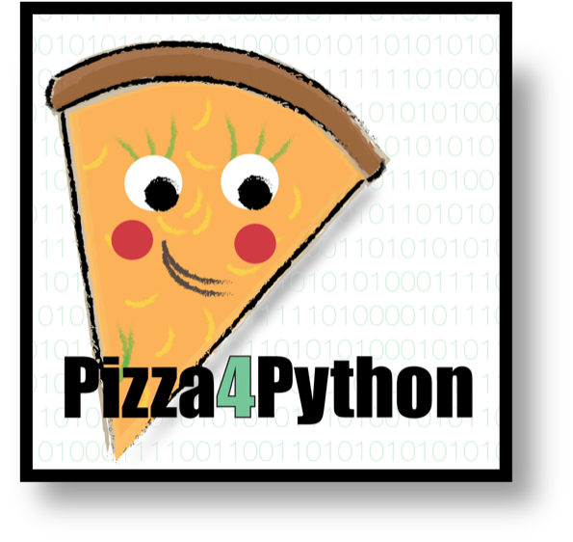
Welcome

Slide 2
Why Pizza4Python?
Improving programming literacy in Life Science
Better science – Better prepared for PhD – Career skill alternatives
Life scientists are often anxious about their programming skills
Build a community across VU Life Science Masters programs
Pizza is delicious!

Slide 3
Who is Pizza4Python for?
A drop-in space for masters students and early life scientists at VU who want to improve their programming skills

Slide 4
What is Pizza4Python NOT?
Programming course
Compulsory
Just Python
Just Pizza
Closed to beginners
Free Pizza

Slide 5
So… What is Pizza4Python?
Place for beginners to self-guide their learning with support
Life Science programmers can suggest/collaborate on projects
Platform to invite speakers, hold workshops and build community

Slide 6
Pizza4Python Ingredients:
Headphone Haven
Collab Central
Speakers
Tutors and Hosts (committee)
Pizza

Slide 7
Pizza4Python online
www.pizza4python.wordpress.com
Tweet: @Pizza4PythonVU
Github: Pizza4Python

Slide 8

Order Pizza
Check website for pizza options:
Share with a friend 5 euro --- Full pizza 10 euro.
Indicate names and pizza, PAY ME!!

Slide 9
Set up Headphone Haven
Beginners – Find a spot, look at learning resource list and perhaps
Prepare for Jose’s Dice rolling workshop
Programmers – Help people if they look lost getting started or installed
Think about what kind of project you want to work on at P4P

Slide 10
How do we start today?
Figure out what you want to achieve today
Order Pizzas & Set up for workshop
(15-20 minutes)
Jose Dice Workshop begins
Dice Discussion (wrap up)
6.30pm
Project Management Blitz
6.45pm
Brainstorming, Eat Pizza (6.45-7.30pm)

Slide 11
To prepare: Jose rolls the dice
Screenshot what you need installed/ open on your desktop
Mac/PC

Slide 12
Let’s go
See you in15-20 mins

Slide 13
Introduction to BASH and suggested Python exercise
The rolling dice simulator

Slide 14
Move though the BASH terminal
pwd: show current directory
ls: show content of current directory
ls <directory path>: show content of selected directory
cd <directory path>: change to the indicated direcory
. (dot): current directory
.. (two dots): previous directory (higher directory)
mv <current path to file> <wanted path to file>: move (or rename) file
rm <path to file>: delete file

Slide 15

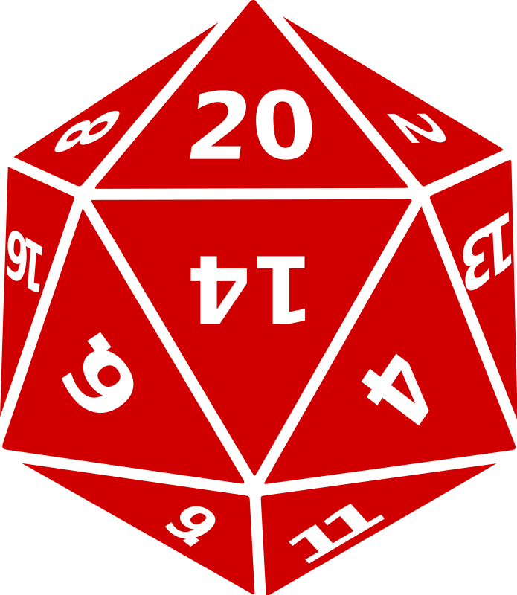


The rolling dice simulator: Importance
Random is important for tasks like selectin validation sets
Random has settings (e.g.: number of options, sides of a dice...)
Random seeds are key for reproducibility
Results of random need to be stored and be useful for later analysis, for instance to classify patients/samples

Slide 16
The rolling dice simulator: Structure
Write a program that prints a list of x dice rolls on a dice of y sides.
Use the random python package (included with basic distribution)
x and y need to be selected from the bash terminal (sys.argv)
Code structured in functions
Output contained in a python list
Try running the code with and without a random seeds several times
Extra: generate a binary (0 and 1) random list along with the throws and use it as a condition to make a selection/mask of your original random list.

Slide 17
Dice Discussions (wrap up):
How did it go?
Which errors did you encounter?
Other possibilities to get the same results?

Slide 18
Project Management Tips
Join Madison now if you want to make a plan for your P4P project management

Slide 19
7pm Eet smakelijk!

Slide 20
Thanks for coming to P4P!

