Slide 1
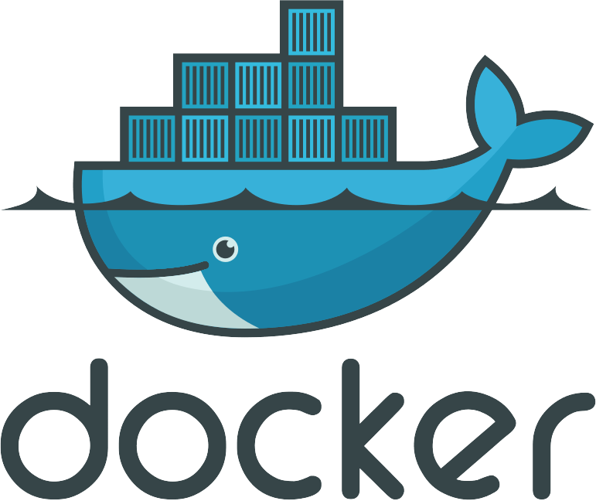
Presentation by: Chris Dufour

Slide 2
Will not be covering
Docker swarm
Docker compose
Docker remote management
Setup/installing docker
cgroups and namespaces
Daemons and services
Comparisons to VMs and other container tools (i.e. Kubernetes)

Slide 3
What is docker?
A tool for packaging software applications with their libraries and dependencies
A service for running and managing sand-boxed processes

Slide 4
Why use docker?
Build once, deploy anywhere
Control over environment
Simplifies setup process
Isolate processes from each-other

Slide 5
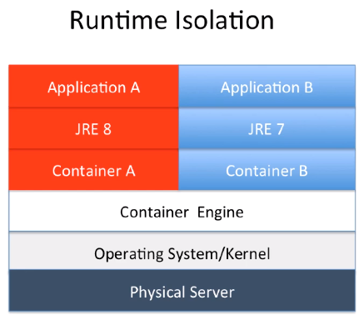
How does it work?
Kernel level virtualisation
Containers use their own operating systems, but use the same kernel
Usually running only one application per container
https://medium.com/devopslinks/docker-containers-vms-and-orchestration-technology-for-the-beginners-68ae979bce5a

Slide 6
Images

Slide 7
Images
A template of a packaged application
Often based off of another image
Usually is based off of a Linux distribution at some point
Can also be an image from “scratch”, meaning you will need to supply libraries and binaries yourself

Slide 8
What is an image?
The instructions to create docker images are Dockerfiles
Dockerfiles are “built” into images by running a series of instructions that will result in a machine with everything it needs to run your application
The resulting image contains file system of the machine and metadata on how the app should be configured to run

Slide 9
Dockerfile Example
FROM debian
RUN apt-get update
RUN apt-get install python -y
COPY hello-world.py /hello-world.py
CMD ["python", "/hello-world.py"]
To build this dockerfile:
docker build .
This will download the parent image (FROM), run the setup commands (ex: RUN, COPY) and produce an image with the metadata specified in the image (ex: CMD)
You can give your docker images tags with the -t flag:
docker build -t hello-world-demo .

Slide 10
Listing images
You can list images that are available locally:
docker images
Images used as part of other images are hidden if they are not explicitly requested. We can see these with the -a flag
docker images -a

Slide 11
Inspecting, Saving and Loading Images
Some useful commands when working with images:
docker inspect [image_id] – Lists out properties of a docker image
docker save [image_id] – Saves all layers of an image as a .tar archive, allowing you to store it and move it across machines
docker load – Loads a saved docker image .tar from stdin, or from a file with -i

Slide 12
The registry
Built Docker images can be saved to a registry, so when building any images that are not available locally can be downloaded automatically
Docker (the company) hosts a public registry with many popular docker images, including operating systems (Debian), programming language environments (node, python) and configurable applications (Elasticsearch, Nginx)
Images will be pulled automatically when building from Dockerfiles, or running the images as containers
You can manually pull images using docker pull [image]

Slide 13
The docker Daemon (dockerd)

Slide 14
What is the docker daemon
Service that runs in the background
Is responsible for managing the docker images, containers and other features
Runs docker containers as child processes
Can receive commands over a unix socket, and can be set up to receive commands over http via a REST api
docker command line tool interacts with the docker daemon

Slide 15
Containers

Slide 16
What is a container?
Runnable instance of an image
“Running” a docker container runs a command on the pre-built image. The image will often define a default command to run, but other commands can be run too
This creates a “container”

Slide 17
Running a container
You can run a container with:
docker run [image]
This will run the image’s default command
You can specify a command (and arguments) by adding them after the image
docker run [image] [command] [args...]
We can run the image we built earlier:
docker run hello-world-demo
You can give your containers names with the --name argument:
docker run --name=Ralph debian bash

Slide 18
Running a container – input and output
Output produced by the docker container (stdout and stderr) is forwarded to their respective outputs on the host
By default when running a container you do not have an interactive session, and you are not running a tty, so you can’t send any input to the container.
Adding the -t and -i arguments allocates a tty, and keeps stdin open, respectively. This will allow you to send input to the process.
You can use this to create a shell in a docker container:
docker run -it debian bash

Slide 19
Running a container – detached mode
You can run a docker container in “detached” mode.
This will run the docker “in the background” without attaching your terminal to the container’s input/output
Useful for running services which don’t exit under normal conditions, like a web server.
You can attach to a detached container using docker attach
Be aware that after attaching you will not detach until the container exits, or is killed

Slide 20
Listing containers
Running containers can be listed with:
docker ps
If you also want to see images that are stopped or have been killed you can add the -a flag
docker ps -a

Slide 21
Starting and stopping containers
Running containers can be sent a SIGTERM by running docker stop [container_id]
  You can add a -t flag to send a SIGKILL after a timeout
If you want to kill a container’s process directly you can use docker kill to send a SIGKILL, or with the -s flag, other signals
If a container is stopped you can start it again with docker start
  This is very useful if you want to run a container multiple times with the same arguments, or to stop the containers, and start them again later
You can pause containers with docker pause. This will send a SIGSTOP to the container. Use with caution as many programs may not work well with this.

Slide 22
Container Logs
All output logged to the main process of a container is logged by docker, you can views these logs for running and stopped containers with:
docker logs [container_id]
Output for both STDOUT and STDERR is logged an will be output to their respective outputs on the host running the command. This is important if you are piping the log results to another command as the STDERR logs will not be piped.
You can print out timestamps for the log entries with the --timestamps flag:
docker logs --timestamps [container_id]
Some containers have extremely long logs. You can print only the last few logs by using the --tail flag:
docker logs --tail 100 [container_id] # This will print only the last 100 logs
If a container is still running you can follow the output with the -f flag, similar to the tail -f command:
docker logs -f [container_id]

Slide 23
Other features

Slide 24
Docker network
Docker containers are run on a network defined by the host
  By default docker containers use a bridged network, so they run in a separate network within the host
Each container has it’s own ports and an internal ip address, so they can run without affecting each other or the host.
Docker containers can communicate with other docker containers on the same network.
If you define a user bridged network instead of using the default network you can use the docker container’s names as host names, see https://docs.docker.com/network/ for more information

Slide 25
Exposing ports
Docker containers have all their own ports, and we can add a setting to forward a host port to a container’s internal port
docker run -p 80:8080 my_website
This will forward any traffic received by the host on port 80 to the docker container’s port 8080
This is extremely useful if you are running multiple containers of the same image as you can forward different host ports to individual containers, while they don’t have to worry about port conflicts even though they are all running without changing their
You can add an EXPOSE instruction to your Dockerfile to show that the image is expecting to listen on a specific port/protocol:
EXPOSE 8080/tcp

Slide 26
Environment variables
Environment variables are a great way to pass configuration options to docker containers
Environment variables can be set in the Docker file with the ENV instruction:
ENV LOG_LEVEL=debug
They can also be set when running a container with the -e flag:
docker run -e LOG_LEVEL=debug my_app
Additionally you can have container run load a .env file to set many environment variables at once.
docker run --env-file app.env my_app
  Be aware that variables set by -e will override those set in .env files, and .env files will override those set in the Dockerfile
  https://docs.docker.com/compose/env-file/

Slide 27
Data persistence
Volumes are a way to provide persistent storage to docker containers.
2 kinds: volumes and bind mounts
  Volumes are file systems managed by docker
  Bind mounts allow you to mount a directory from the host onto the docker container
When using a volume you must specify
  The type (volume or bind)
  The source (host path, or volume name)
  The destination (path in container where the files will be accessible)
The mount can be made read only by adding the “readonly” flag
Dockerfiles can specify the VOLUME instruction to show that a volume should be used for persistence at a given path
VOLUME ["/data"]
If a volume is not specified for that path a volume will be created automatically

Slide 28
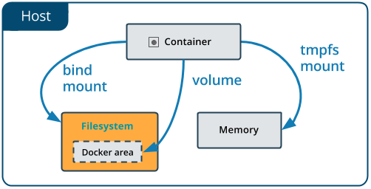
Mount - Bind
To bind a host directory you can add a bind mount to your container:
docker run --mount type=bind,source=”/home/chris/mydir”,target=”/mnt/mydir/” my_app
If the source directory doesn’t exist then it and all it’s parent directories will be created

Slide 29
Mount - Volume
To create a new volume manually you can to run
docker volume create [volume_name]
The files in the volume are stored on the host and managed by docker
A volume can be mounted to a container with the following command:
docker run -–mount type=volume,source=myVolume,target=/mnt/myMountedVolume my_app
If the volume source is not specified an anonymous volume will be created with a random name. They are the sane as named volumes, but with a randomly generated name
You can see existing docker volumes with:
docker volume ls
You can inspect volumes with:
docker volume inspect [volume_name]

Slide 30
Thank you!

