Slide 1
Photoplethysmogram Acquisition
Yuning Wang

Slide 2
Outline
Photoplethysmogram (PPG)
Advantages of PPG
PPG acquisition methods
Wearable devices
Samsung smartwatches
Sensors with embedded systems
SparkFun MAX30105 Particle and Pulse Ox Sensor with Arduino

Slide 3
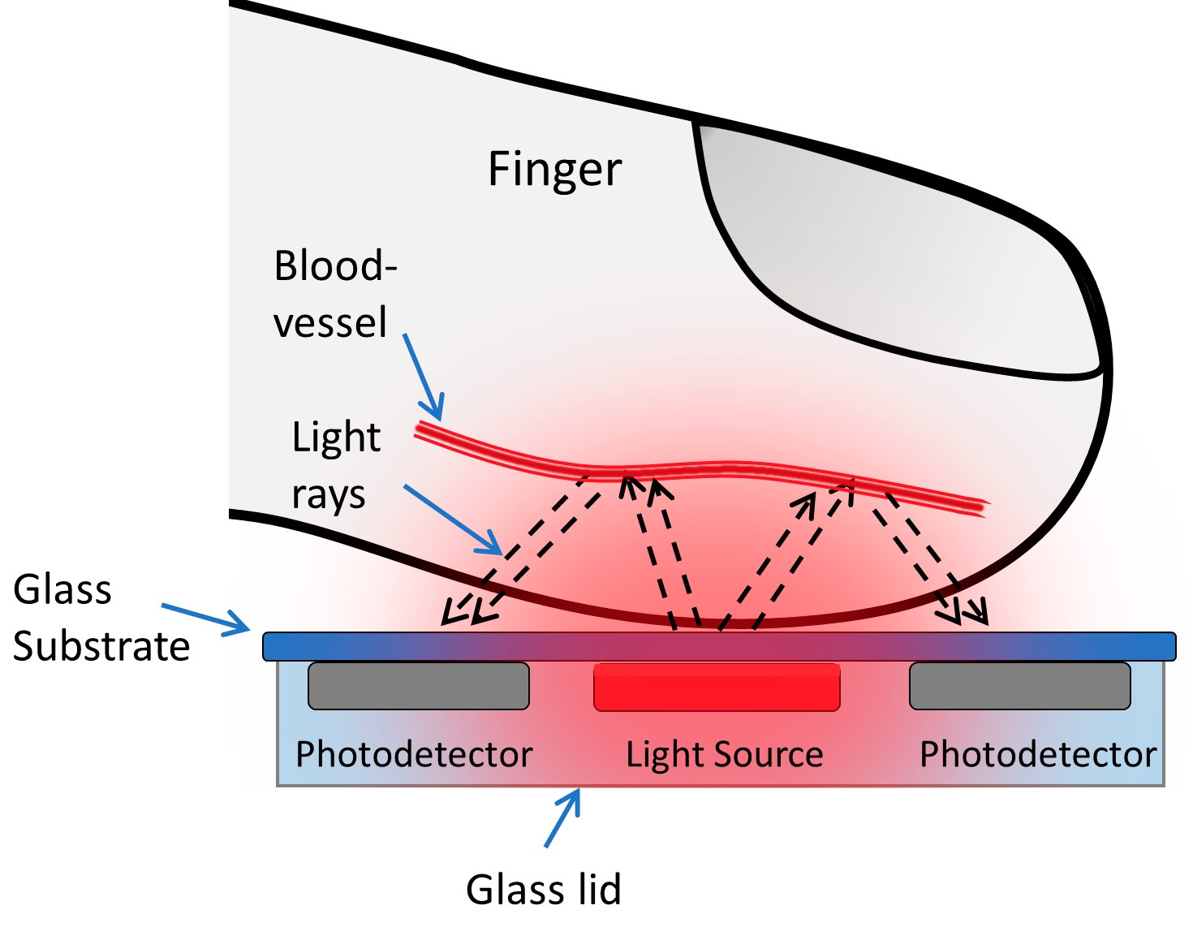
Photoplethysmogram (PPG)
Emitter or light source
Detector or light sensor
Red
Infrared
Green
Elsamnah, Fahed , et al. “Reflectance based organic pulse meter sensor for wireless monitoring of photoplethysmogram signal." Biosensors 9.3 (2019): 87.

Slide 4
Advantages of PPG
Non-invasive
Acquiring heart rate， heart rate variability and SpO₂
Easy to implement
Low-cost
Used in many clinical and commercial wearables
Can be used in remote health monitoring systems

Slide 5
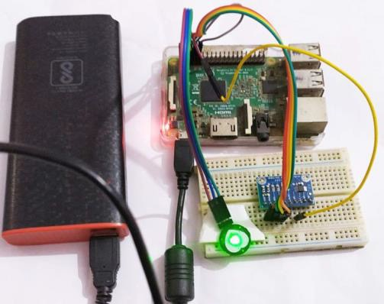
PPG acquisition methods
Wearable devices
Fitbit, Samsung watch, Garmin, etc.
Sensors with Embedded system
https://iotdesignpro.com/projects/iot-heartbeat-monitoring-system-using-raspberry-pi

Slide 6
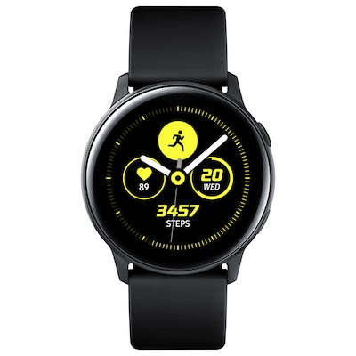
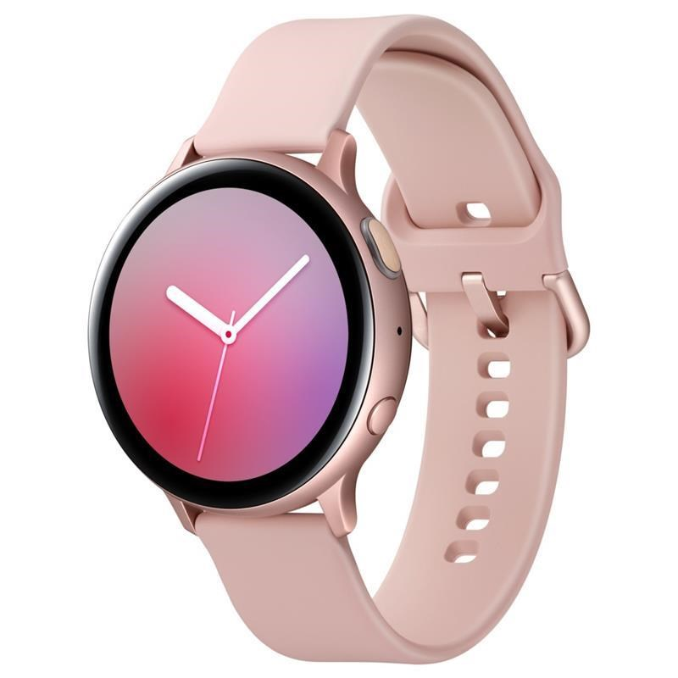
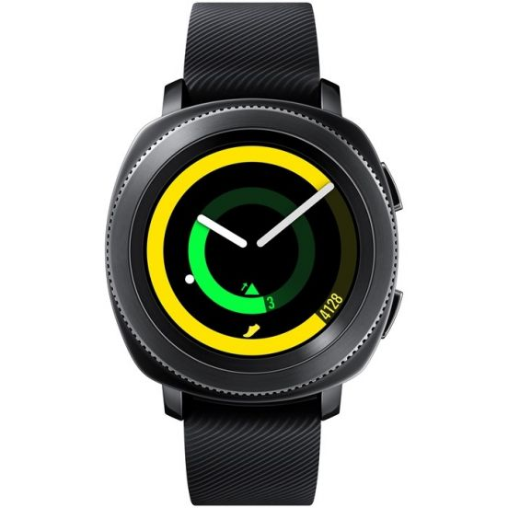
Wearables
https://www.samsung.com/fi/wearables

Slide 7
Samsung smartwatches
Provide raw PPG data with frequency = 20 Hz
Tizen OS
Open source OS
Customized application
Web application HTML5 and javascript
Native application C/C++
Internal memory
CPU
Limited battery life

Slide 8
Considerations
Is the PPG frequency sufficient for your application?
20 Hz can extract HR and some stress-related heart rate variability parameters reliably
Do you need to send the data to the cloud?
Bluetooth, WiFi
How long do you want to collect data?
Continuously
5 minutes per hour

Slide 9
Battery life
In case of continuous data collection battery last for less than 20 hours
Choose proper data collection duration
Heart rate analysis: 30- 60 seconds is enough for
Heart rate variability analysis
Ultra short term analysis: less than 5 minutes
Short term analysis: 5 minutes
Long term analysis: 24 hours
Decide on intervals based on required battery life ( once per hours/per 4 hours/per day …)

Slide 10
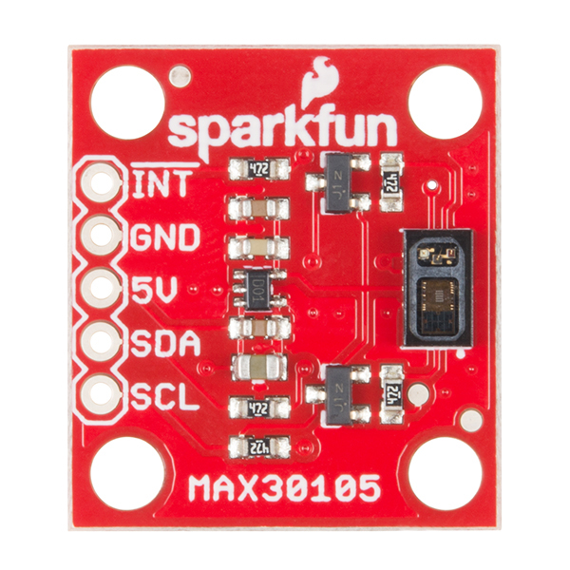
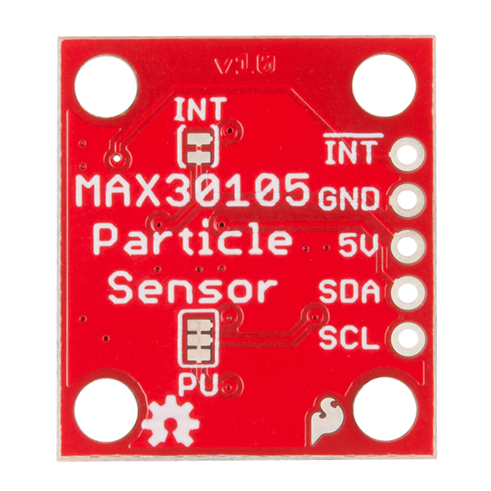
Sensors with Embedded system
SparkFun MAX30105 Particle and Pulse Ox Sensor
Red, IR and green LEDs
A photon detector
Microcontroller development board
Arduino
Video link
https://learn.sparkfun.com/tutorials/max30105-particle-and-pulse-ox-sensor-hookup-guide

Slide 11
Questions?

