Slide 1

PredictOps
Intelligent Equipment Health & Failure Prediction Platform
Metro train air compressor (MetroPT-3) · B.Tech CSE Project · SRM University – AP
[Student 1] · [Student 2] · [Student 3] · [Student 4] Guide: [Guide Name]
Notes:
SPEAKER 1. Good morning. We are presenting PredictOps, a platform that monitors the air compressor of a metro train and tells maintenance staff when the equipment is unhealthy, why, and what to do. We will split the talk four ways: I cover the problem and the data, Speaker 2 the methodology, Speaker 3 the results, and Speaker 4 the application and conclusions.

Slide 2




Who presents what
Speaker 1 · Problem & data
Speaker 1
Speaker 2
Speaker 3
Speaker 4
Problem & data
Methodology
Results
System & wrap-up
Why compressors fail · objectives · MetroPT-3 dataset · EDA
Leakage-safe pipeline · splits · features · imbalance · models
Supervised vs anomaly detection · why accuracy misleads · SHAP · health score
Architecture · dashboard · live simulation · testing · conclusion
Notes:
SPEAKER 1. This is how the talk is divided. Each of us owns one part of the project end to end.

Slide 3
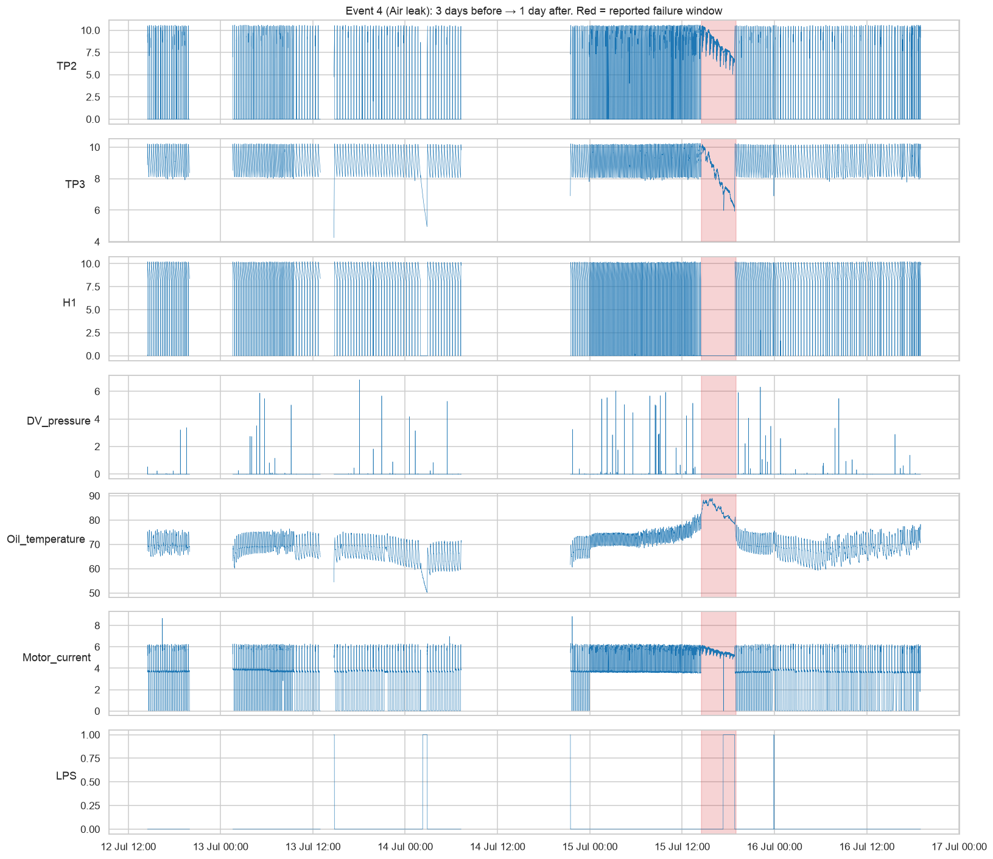



The problem: air leaks stop trains
Speaker 1 · Problem & data
Air Production Unit (APU)
Supplies compressed air for brakes, suspension and doors.
Air leak → overload
The compressor runs almost non-stop, oil overheats, service fails.
Today's maintenance
Fixed intervals or single-sensor alarms — too early or too late.
Sensor behaviour during a reported air leak (event 4)
Notes:
SPEAKER 1. The APU compressor produces the air the train needs for braking and suspension. When there is an air leak, the compressor has to run nearly all the time, the oil gets hot and eventually the train is taken out of service. Maintenance today is either on a fixed schedule or triggered by a single low-pressure switch, which is late. The chart shows what the sensors look like during one of the real leaks.

Slide 4






What we set out to build
Speaker 1 · Problem & data
Detect
Assess
Explain
abnormal and failure behaviour from 15 sensors
health score, failure risk and status
which sensors drove each alert (SHAP)
Deliver
Evaluate honestly
Ship
API, database and interactive dashboard
no leakage, no tuning on test data
tests, monitoring and Docker deployment
Notes:
SPEAKER 1. Our objectives: detect abnormal behaviour, turn it into a health score and risk level, explain every alert, and deliver it as a real application. Just as important, we wanted an honest evaluation — many projects report 99% accuracy because of data leakage, and we wanted to avoid that.

Slide 5
Dataset: MetroPT-3 (real industrial data)
Speaker 1 · Problem & data
1.52 M
15
~10 s
4
sensor readings, Feb–Sep 2020
sensors: 7 analog, 8 digital
sampling interval
reported failures — the only labels
What we found when inspecting it
No label column — targets built only from the official failure windows
230 logger gaps (> 10 min) split the data into 231 segments
7 frozen-sensor periods and 3 unreported failure-like episodes, flagged and excluded
Notes:
SPEAKER 1. We used the public MetroPT-3 dataset: 1.5 million readings from one real compressor over seven months. The key fact is that there are only four reported failures and no label column. We also found logger gaps, sensors that froze for hours, and three periods that look like failures but were never reported — we flagged those rather than guessing labels.

Slide 6
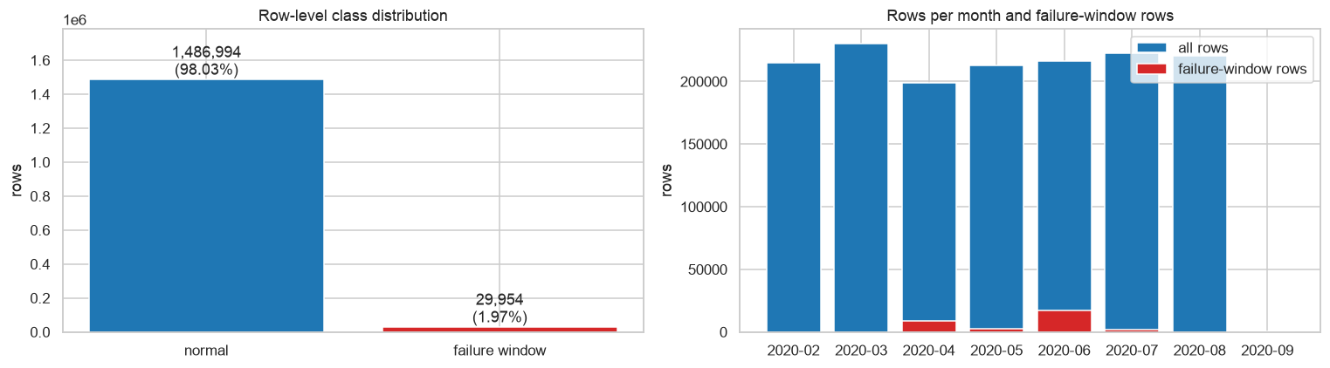
Exploring the data
Speaker 1 · Problem & data
Key EDA findings
Failures are only 1.97% of the data
During a leak the compressor runs continuously and oil temperature rises
No multi-day warning signs before failures
Each failure looks a little different
Notes:
SPEAKER 1. Exploratory analysis showed failures are under 2% of the data, the leak shows up as continuous running and rising oil temperature, and — importantly — each failure looks somewhat different. That last point will matter a lot in the results. Over to Speaker 2 for the methodology.

Slide 7
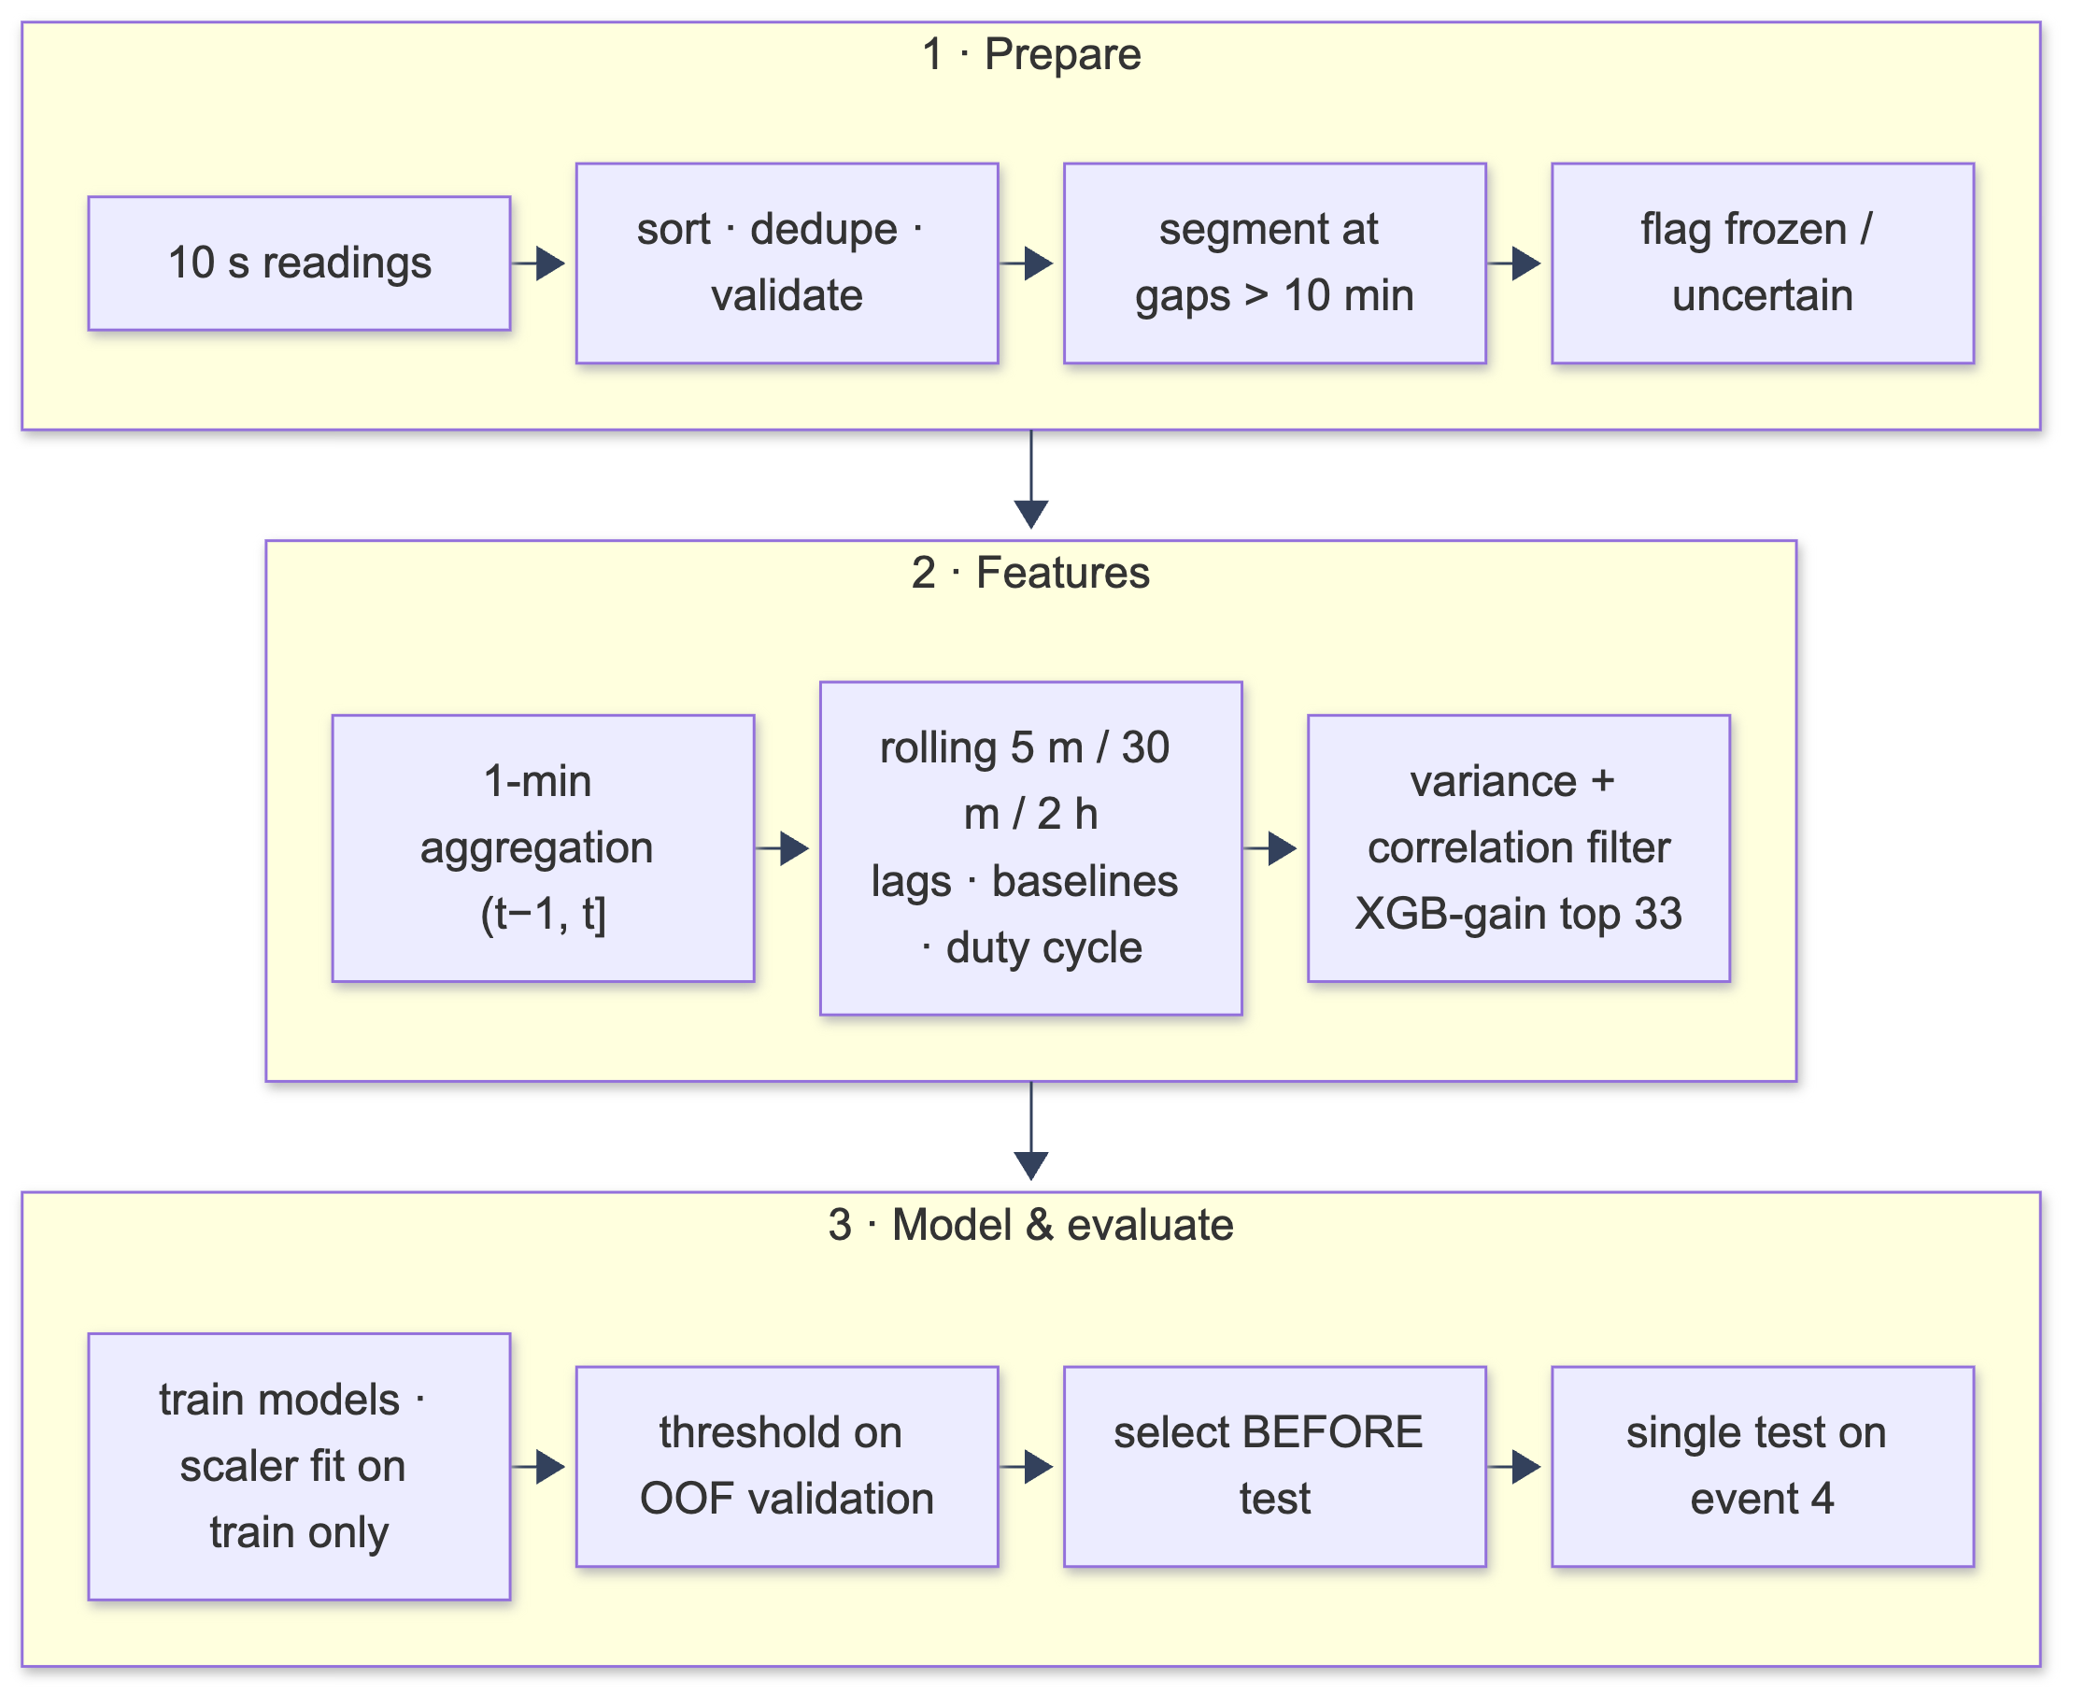
A leakage-safe ML pipeline
Speaker 2 · Methodology
Rules we never broke
Features use only past data (tested)
Scaler fitted on training data only
No rolling windows across logger gaps
Same code for training and prediction
Model chosen before opening the test set
Notes:
SPEAKER 2. Thank you. Our pipeline has three stages: prepare the data, build features, then model and evaluate. On the right are the rules we enforced throughout. Each of them is backed by an automated test — for example, we check that adding future data never changes a past feature.

Slide 8
Splitting by time, not at random
Speaker 2 · Methodology
Train
Validation
Test (used once)
Feb – 20 May · Event 1
21 May – 30 Jun · Events 2, 3
Jul – Aug · Event 4
12-hour embargo between splits · model selection on forward-chaining folds (train on the past, validate on the next event)
Random split (common mistake)
Chronological split (ours)
Neighbouring minutes of the same failure land in train and test → the model memorises → fake 99%+ scores.
The test failure is truly unseen, like a future failure in real use → an honest estimate.
Notes:
SPEAKER 2. Time-series data must be split by time. We trained on February to May with the first failure, validated on June with failures two and three, and kept July–August with failure four as a test set we opened only once. A random split would put minutes of the same failure on both sides and give fake near-perfect scores.

Slide 9


Features and class imbalance
Speaker 2 · Methodology
132 time-series features
Did we use SMOTE? No.
1-minute aggregation of 10-s readings
Rolling mean/std/min/max over 5 min, 30 min, 2 h
Duty cycle, load cycles, lags, rates of change
Deviation from a 24 h baseline
Selected on training data → 33 features
1.1%
of training minutes are failures — all from ONE event
SMOTE, ADASYN, over/under-sampling tested inside training folds only
PR-AUC 0.97–0.999 with or without → rejected; class weights used
Notes:
SPEAKER 2. We turned raw 10-second readings into 132 features that only look backwards in time, and selected 33 on training data. Failures are only about 1% of training minutes, so we tested SMOTE and similar methods — but only inside training folds, never on validation or test. They didn't help, because the real problem is having just one failure to learn from, not too few rows. So we used class weights instead.

Slide 10



Three families of models
Speaker 2 · Methodology
Supervised
Anomaly detection
Deep learning
LR · Decision Tree · Random Forest · SVM · XGBoost
Isolation Forest · LOF · One-Class SVM · robust-z
LSTM · 1D-CNN on 60-minute sequences
Learns what past failures look like
Learns what NORMAL looks like — needs no failure labels
Learns temporal patterns directly
Notes:
SPEAKER 2. We compared three families. Supervised models learn the pattern of past failures. Anomaly detectors learn only what normal operation looks like and flag anything different, so they don't need failure examples. Deep learning models learn from raw sequences. Speaker 3 will now show how they did.

Slide 11
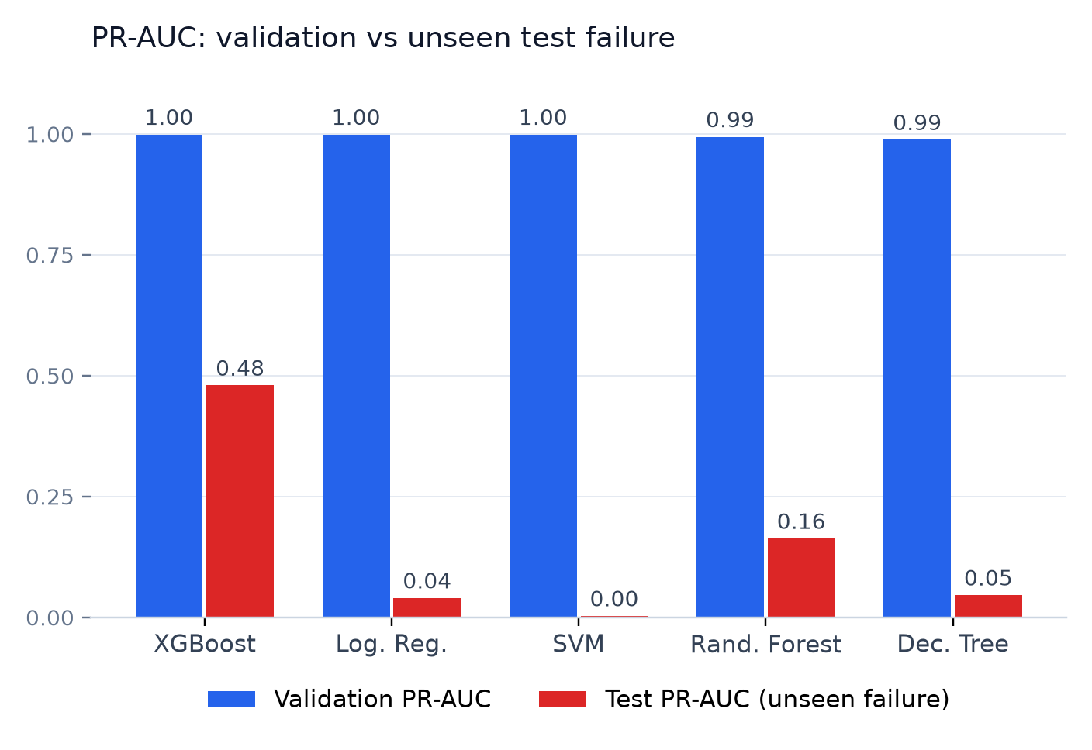
Supervised models: blind on the test failure
Speaker 3 · Results
0 / 5
models caught the test failure at their threshold
Why? SHAP shows they relied on the DV_pressure pattern of failures 1–3. Failure 4 looked different: low TP3, LPS active, hot oil.
Notes:
SPEAKER 3. Thank you. On validation every supervised model looked almost perfect, with PR-AUC near 1. On the unseen test failure, performance collapsed and none of the five models raised an alarm at its chosen threshold. SHAP explains why: the models learned the pressure signature of the first three failures, and failure four had a different signature. We did not lower the threshold afterwards, because that would be tuning on the test set.

Slide 12

Why 99.6% accuracy means nothing here
Speaker 3 · Results
99.6%
0.0
270
accuracy of every model on test
recall — no failure minute caught
failure minutes out of 72,651 (0.37%)
A model that always says “normal” is right 99.6% of the time.
So we never selected models by accuracy. We used PR-AUC, MCC and event-level metrics: failures detected, detection delay and false alarms per day.
Notes:
SPEAKER 3. This is a common trap. Because failures are so rare, a model that never predicts a failure still gets 99.6% accuracy. That is exactly what happened. This is why we judged models by PR-AUC and by whether they actually catch the failure event and how many false alarms they raise per day.

Slide 13
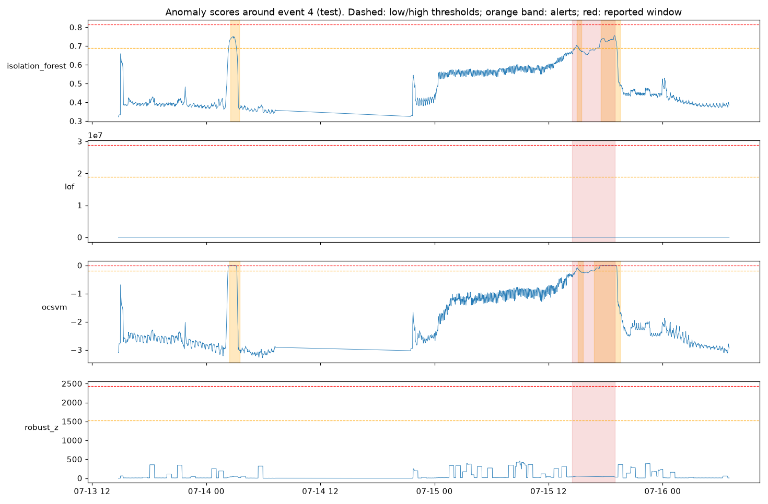
Anomaly detection caught every failure
Speaker 3 · Results
One-Class SVM
3 / 3
failures detected (incl. unseen test)
0.16
false alarms per day (~1 per week)
Alerts 16–34 min after onset: detection, not prediction
Notes:
SPEAKER 3. The anomaly detector, a One-Class SVM trained only on normal operation, detected all three failures we evaluated, including the unseen test failure, with about one false alarm per week. The chart shows its score climbing above the threshold during failure four. Alerts came 16 to 34 minutes after the reported start, so we call this detection, not prediction. Early warning hours ahead was tested and was no better than chance.

Slide 14
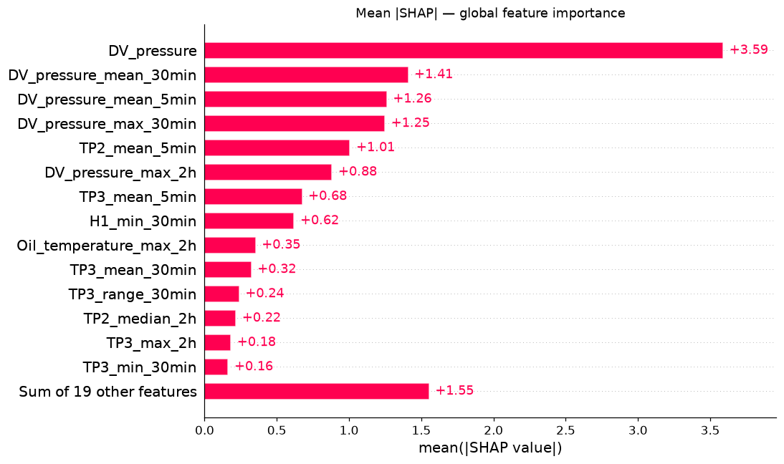
Explaining every alert with SHAP
Speaker 3 · Results
What SHAP gives the engineer
Global view: which sensors matter most
Local view: why THIS minute was flagged
Top deviating sensors for the anomaly model
Contribution ≠ cause — stated in the app
Notes:
SPEAKER 3. Engineers won't trust a black box. SHAP shows which features push each prediction up or down, both overall and for an individual minute. It also helped us diagnose why the supervised models missed failure four. We are careful to say that SHAP shows contribution, not physical cause.

Slide 15
From scores to a health status
Speaker 3 · Results
Health = 100 × (1 − [0.40·anomaly + 0.30·signature + 0.20·sensor range + 0.10·alert history])
Healthy ≥ 75
Warning 45 – 75
Critical < 45
99.3%
61.5%
of normal test minutes rated Healthy
of failure-4 minutes rated Critical
Notes:
SPEAKER 3. The health engine combines four pieces of evidence into one score from 0 to 100, with clear status bands. On the test period, 99.3% of normal minutes were Healthy and most failure minutes were Critical. Every status comes with reasons and a recommended action. Now Speaker 4 will show the application.

Slide 16
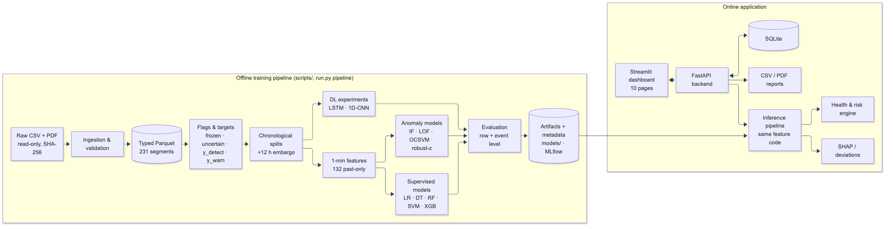



System architecture
Speaker 4 · System & wrap-up
ML
Back end
Front end
Ops
scikit-learn · XGBoost · PyTorch · SHAP
FastAPI · SQLAlchemy · SQLite
Streamlit · Plotly
Docker · MLflow · pytest
Notes:
SPEAKER 4. Thank you. The offline pipeline on the left trains and evaluates the models and saves versioned artifacts. The online application on the right loads them once: a FastAPI back end with an SQLite database, and a Streamlit dashboard. Both sides use the same Python package, so preprocessing can never differ between training and prediction.

Slide 17
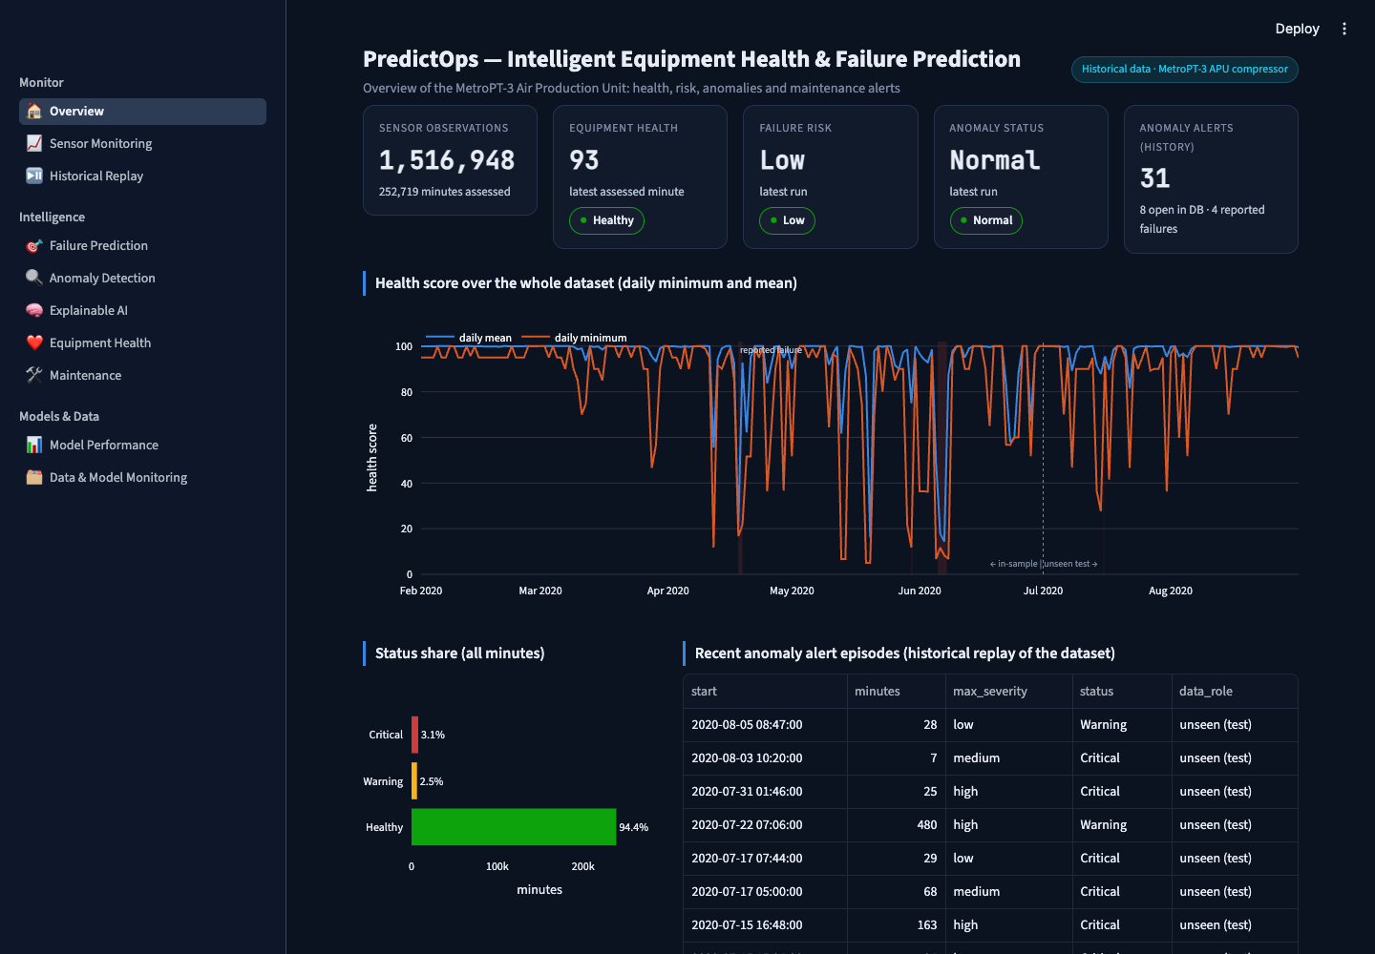
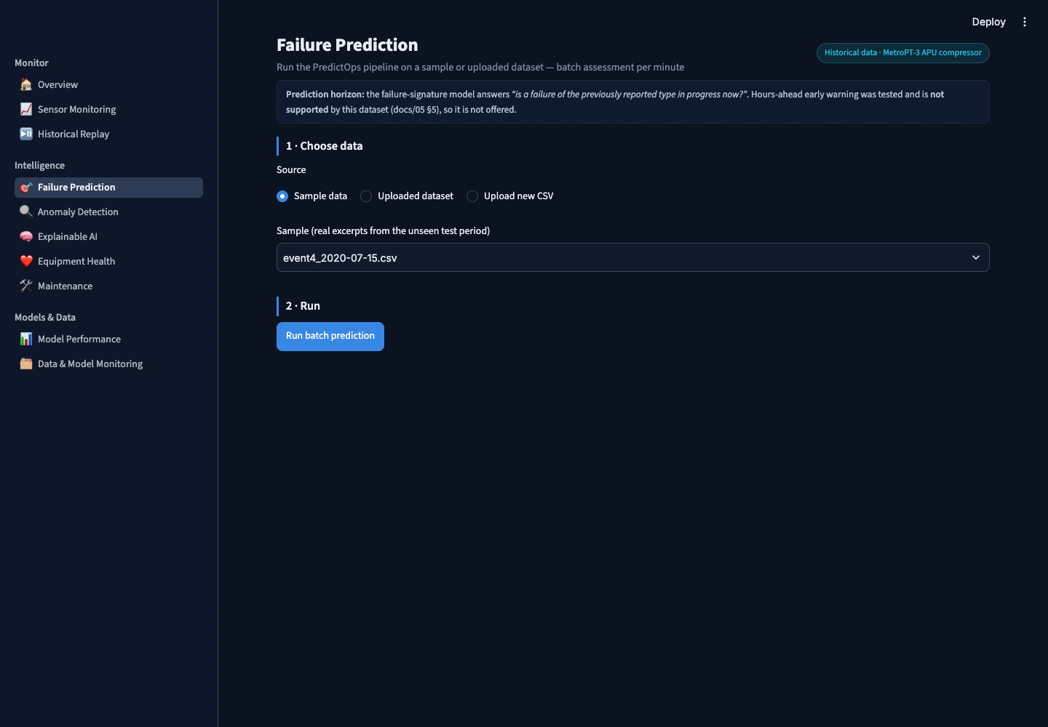
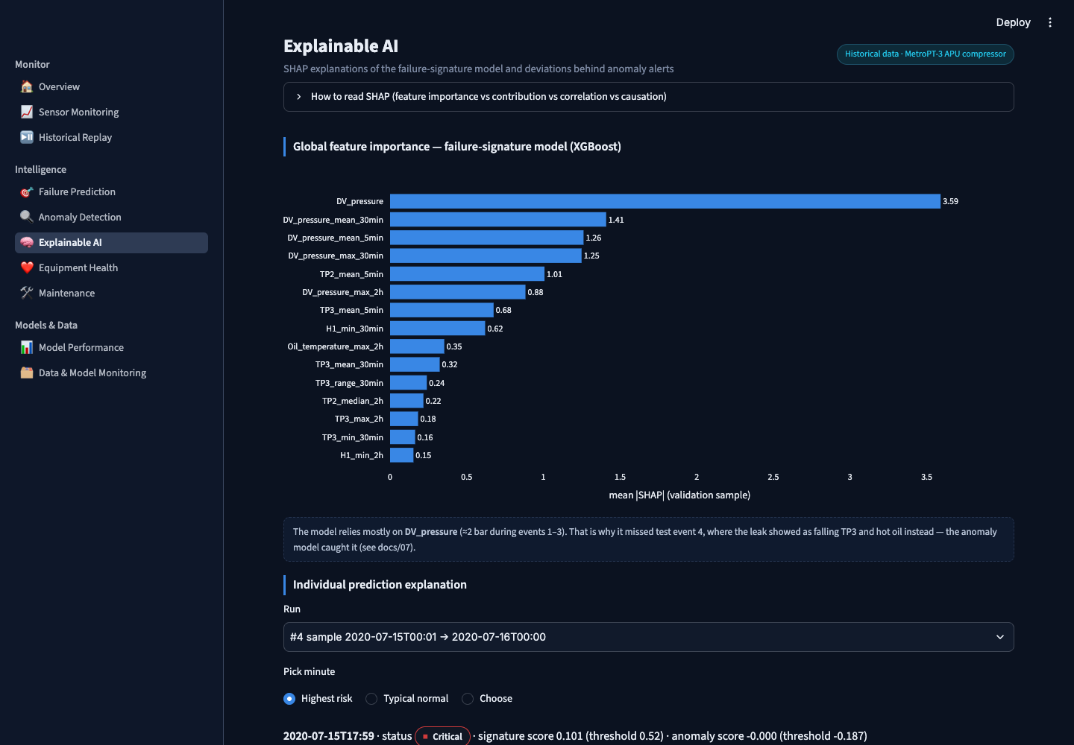
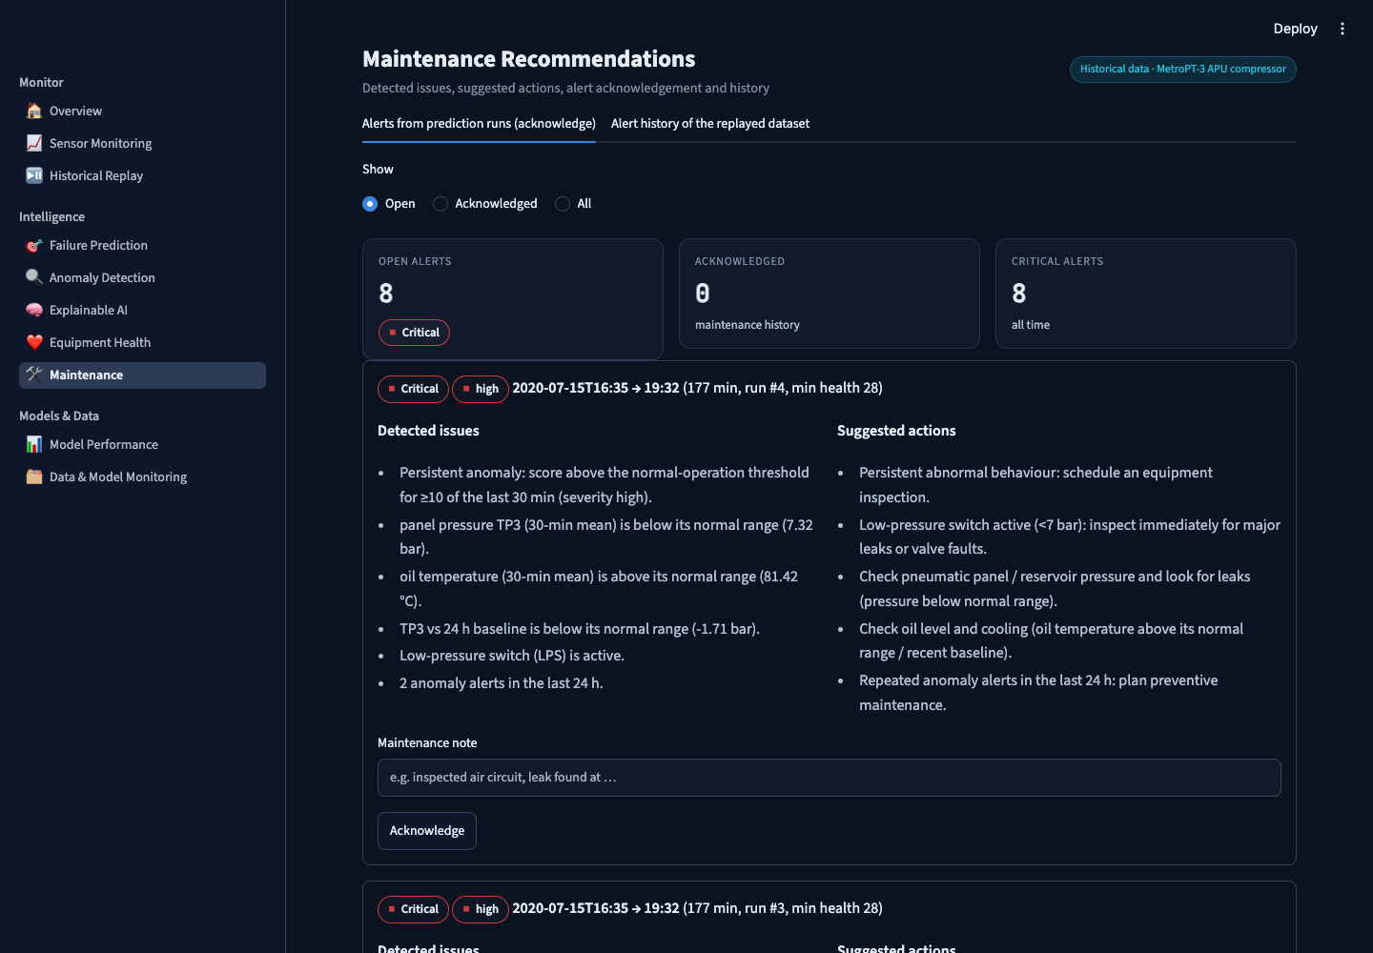
The dashboard: 11 pages
Speaker 4 · System & wrap-up
Overview
Failure prediction
Explainable AI
Maintenance alerts
Notes:
SPEAKER 4. The dashboard has eleven pages. Overview gives the current state; Failure Prediction lets you upload a CSV and get a per-minute assessment; Explainable AI shows SHAP for any minute; Maintenance lists alerts that engineers can acknowledge with a note. Reports can be downloaded as CSV or PDF.

Slide 18
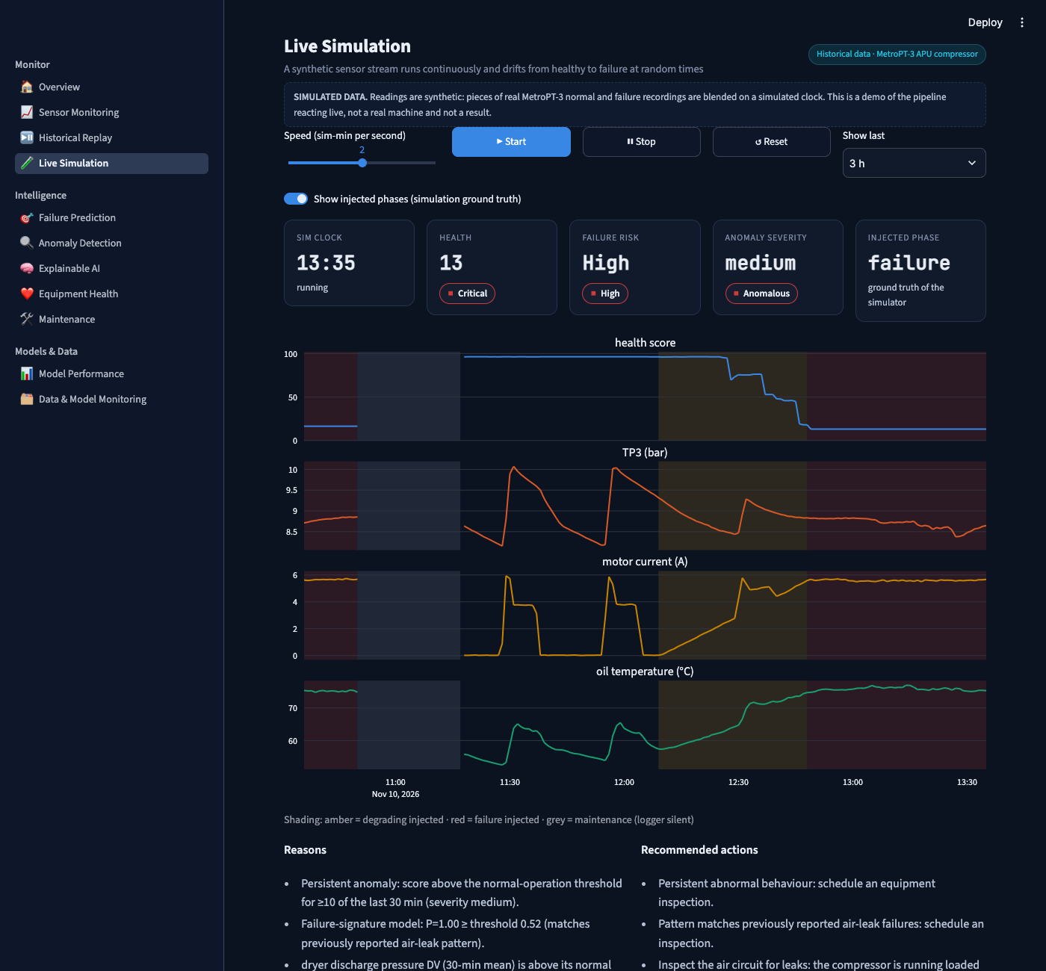
Live simulation demo
Speaker 4 · System & wrap-up
Watch a failure happen
Synthetic stream: healthy → degrading → failure at random times
Built from real normal and failure recordings
Full pipeline scores every minute live
Clearly labelled SIMULATED; never mixed with real results
Notes:
SPEAKER 4. To demonstrate the system reacting in real time, we added a live simulation. It streams synthetic data that slowly degrades into a failure at a random moment. You can see the health score drop and the alert fire. It is clearly labelled as simulated and is only a demo, not an evaluation result. [Optional: switch to the live app here.]

Slide 19
Tested and deployable
Speaker 4 · System & wrap-up
73
0.17 s
29
370
automated tests, all passing
to assess one day of raw data
REST API endpoints
MB memory used by the API container
Unit, integration, API and UI tests — incl. leakage checks, path traversal, oversize uploads
Docker Compose: API + dashboard containers with a persistent database volume
Monitoring: monthly data drift (KS, PSI) and prediction drift
Code and documentation on GitHub
Notes:
SPEAKER 4. The project has 73 automated tests, from unit tests to full dashboard tests, including checks that no future data leaks into features. It runs in Docker with two containers, assesses a whole day of data in under a fifth of a second, and monitors drift month by month.

Slide 20
Limitations and future work
Speaker 4 · System & wrap-up
Limitations
Future work
One compressor, four failures of one type
No hours-ahead warning or RUL — data doesn't support it
Health weights validated on two events
Recorded data only; no live sensors
More trains and failure events
Early warning from the anomaly-score trend
Adaptive thresholds for seasonal drift
Live MQTT ingestion, user accounts and roles
Notes:
SPEAKER 4. We are open about the limits: one machine, four failures, and no hours-ahead prediction because the data doesn't support it. Future work is mainly more data — with more failures, the rising anomaly trend we saw before failure four could become a real early warning.

Slide 21
Key takeaways
Complete system
Honest evaluation
Anomaly detection wins
data → models → API → dashboard → Docker
unseen test failure exposed what really works
3/3 failures caught, ~1 false alarm per week
Thank you — questions?
Notes:
SPEAKER 4. To conclude: we built a complete, tested predictive-maintenance system on real data; our honest evaluation showed that supervised models don't generalise from so few failures; and a model of normal behaviour caught every failure with about one false alarm a week. Thank you — we are happy to take questions.

