Slide 1
FLORIDACAR
FOUNDERS:
-David
-joan
-JOSE
-Manu
-Marcos
-Pablo

Slide 2
HOMEPAGE
-This is the homepage of our website, where we have our travel cards and you can see more information about them.

Slide 3
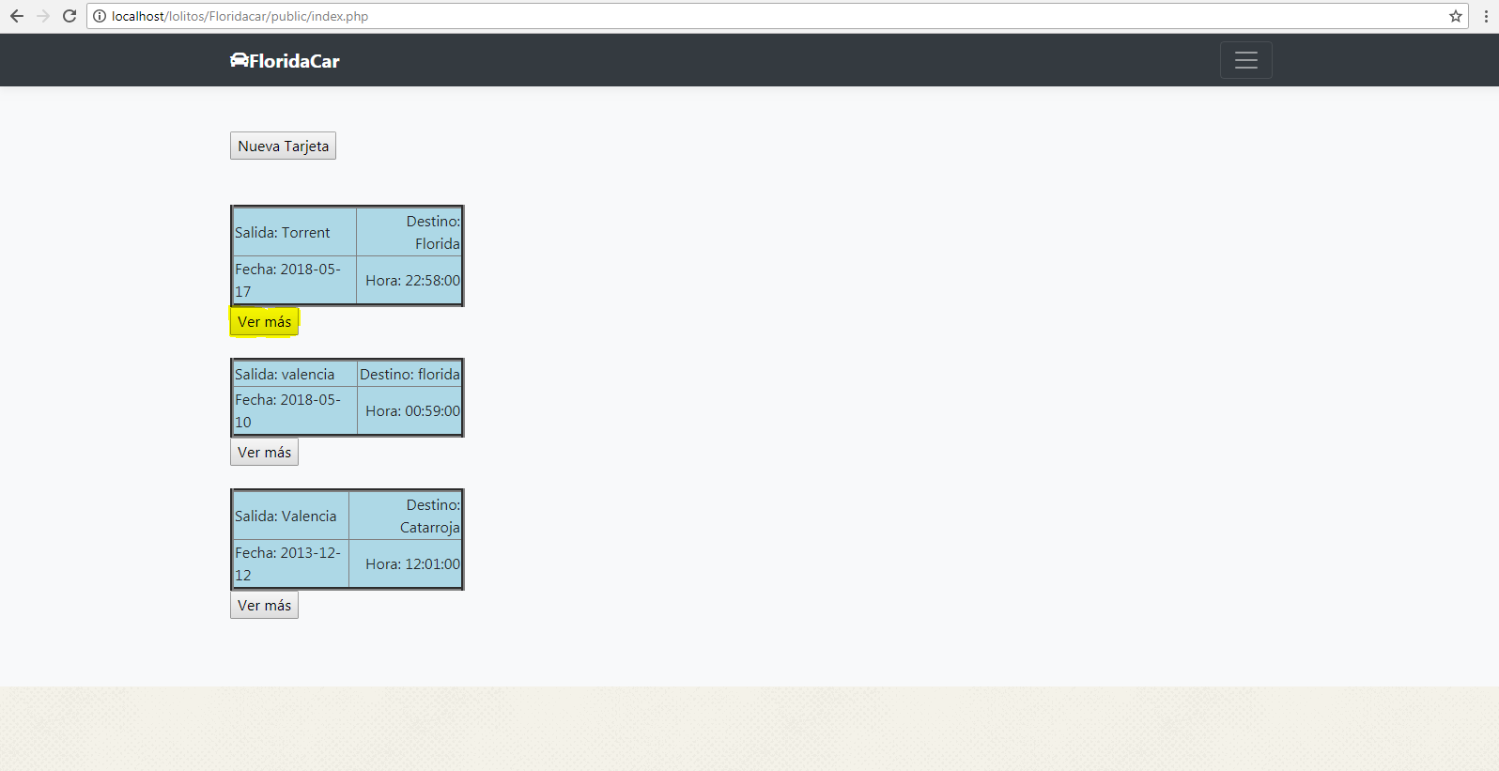
HOMEPAGE

Slide 4
lOG IN
That is the login page, where you can wite your credentials and enter into the web with your account.
If you don’t have an account you can click on registrar to create an account.

Slide 5
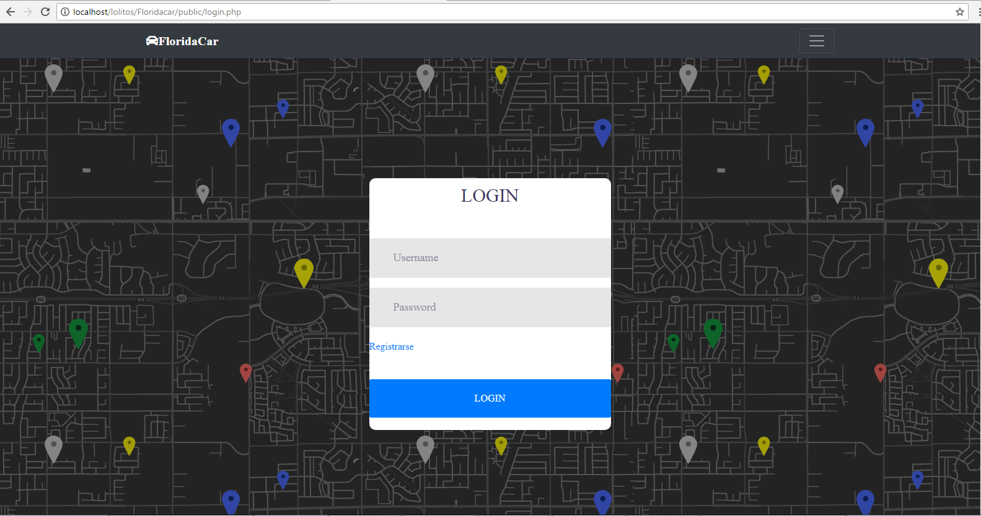
lOG IN

Slide 6
SIGN IN
On this page you can create an account by filling the fields if you don’t have one.

Slide 7
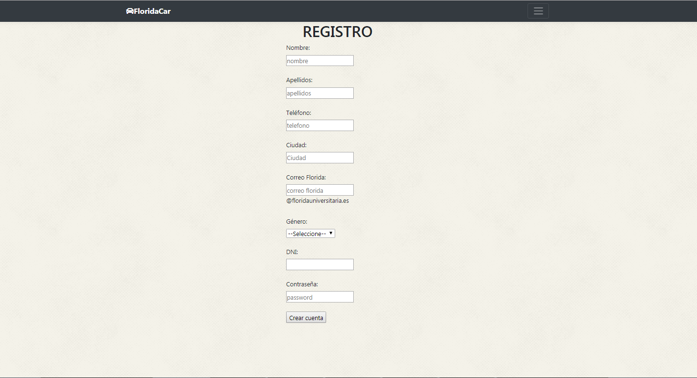
sign in

Slide 8
TRAVEL CARD
On this page we can see all the information about a travel card, and if you want you can sign up in it.

Slide 9
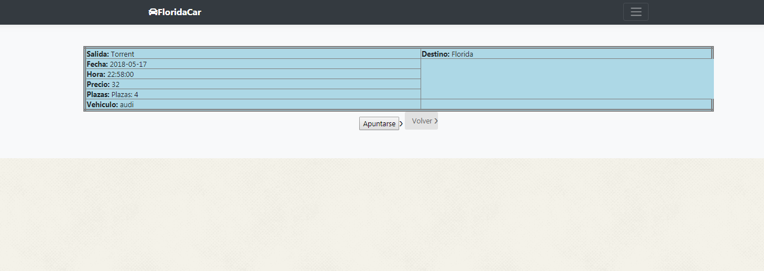
TRAVEL CARD

Slide 10
New travel card
On this page you can créate a new travel card when you choose where the trip starts and finish, the hour and the day.

Slide 11
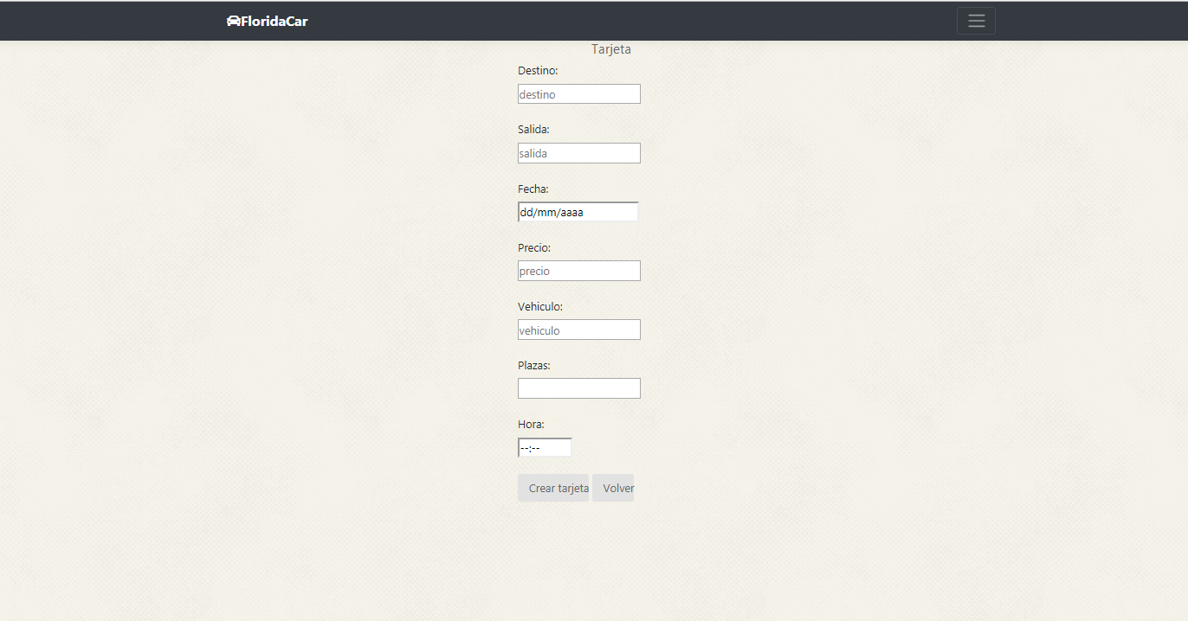
New travel card

Slide 12
MY PROFILE and update
Once we have logged in, we have the option to see our profile and update it if we want.

Slide 13
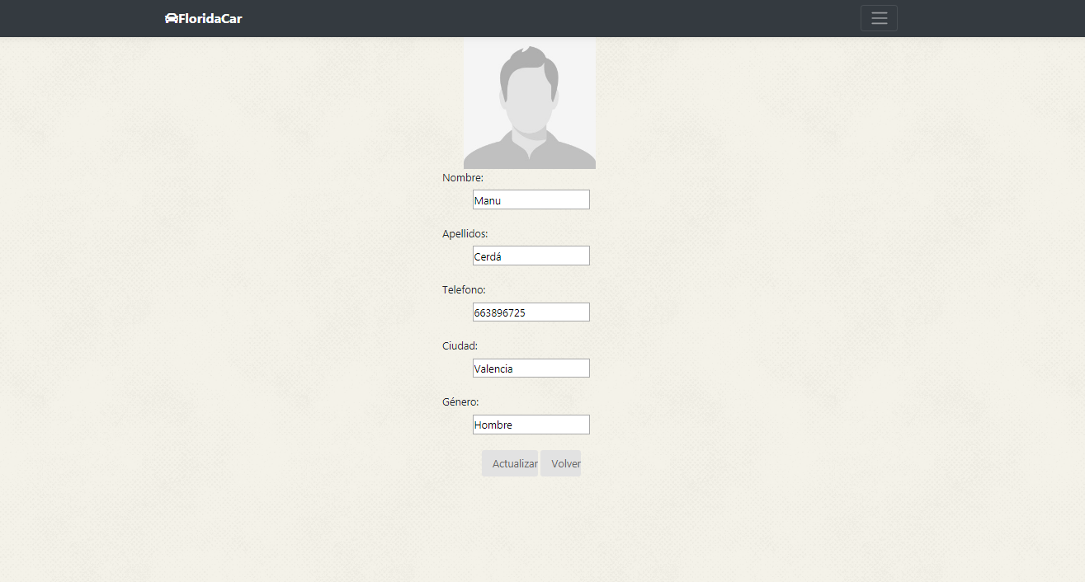
MY PROFILE and update

Slide 14
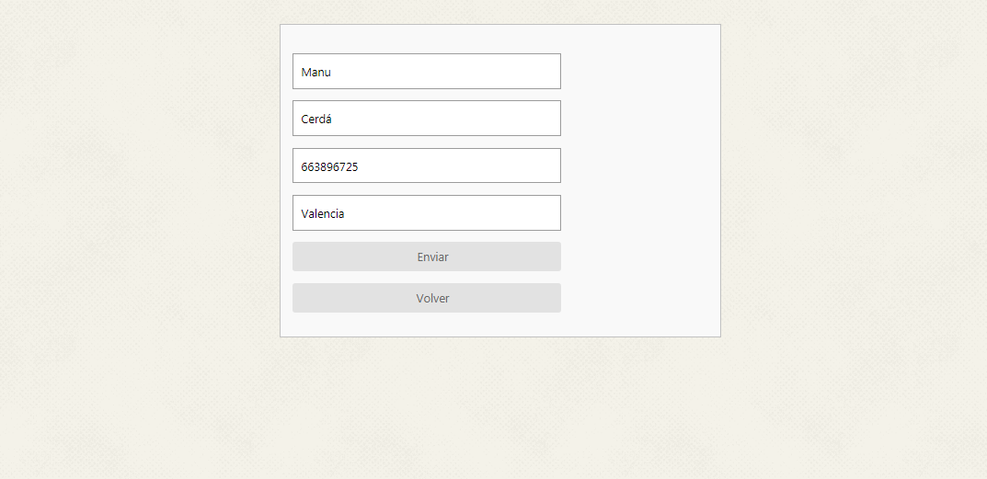
MY PROFILE and update

