Slide 1

Demand Forecasting Analytics Team: Paper Pushers
Forecasting of provided data by applying Logarithmic seasoning and Rolling mean

Slide 2

Pimpri Chinchwad College of Engineering Pune
Team Paper Pushers
Team Members
Animesh S Wankhede
Nikhil Isaac
Prathamesh Khade
Sudhiksha Poojary
Shreya Deshpande
Department
ENTC
ENTC
Mechanical
ENTC
ENTC

Slide 3
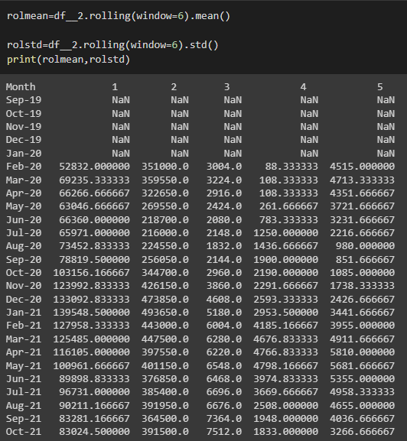
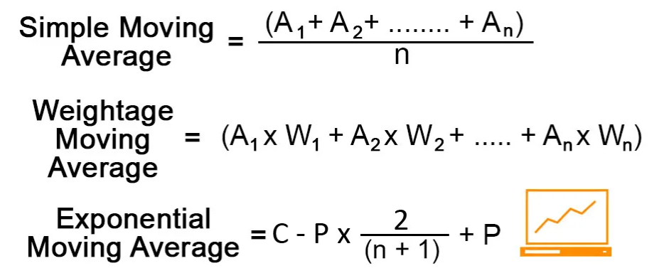
Reason for selection of these two methodologies
Data provided was seasonal and stationary
Each part sales demonstrates seasonality in data
In order to figure out rolling average due to lesser data points we have taken
Resultant rolling mean to be find for window of 6 beacause here we have total 36 datapoints and our model results prediction of next 6 months after feeding previous three years of data

Slide 4
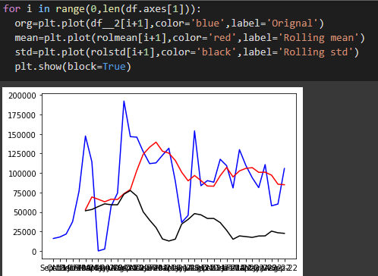
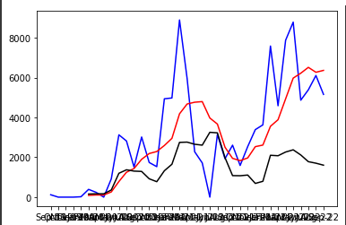
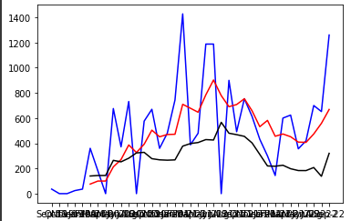
After plotting the moving average with the original data we will find which of the following parts sales provides stationarity in the data
Here after plotting we have inferred that in figure 1 data is stationary and because variation of average with the provided data is less
Whereas in figure 2 and figure 3 the rolling mean indicated in red varies a lot with the original data.
Similar pattern is followed in most of the data points

Slide 5
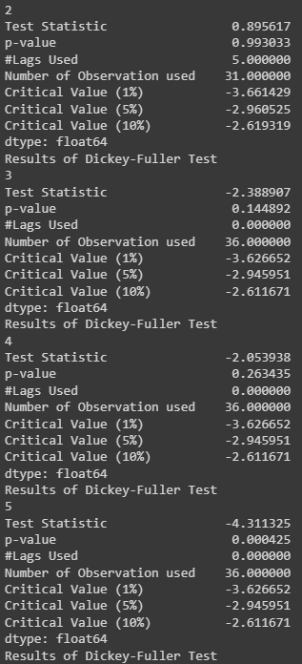
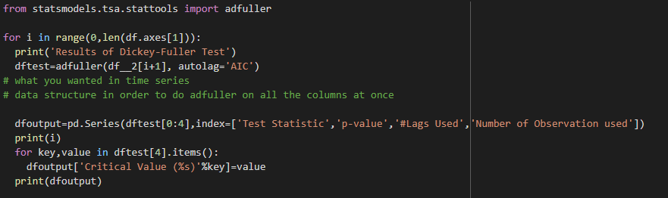
In order to cross validate the stationarity of the data points adfuller test is applied over all the parts which results variation in the value of p
After a brief observation 37% of the data points in the dataset comes out to be stationary which was concluded from the value of ‘p’ which should necessarily less than 0.05 for performing

Slide 6
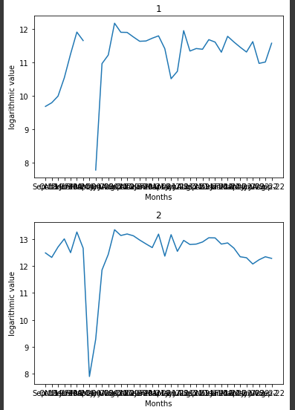
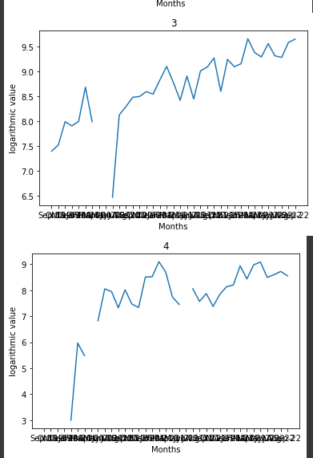
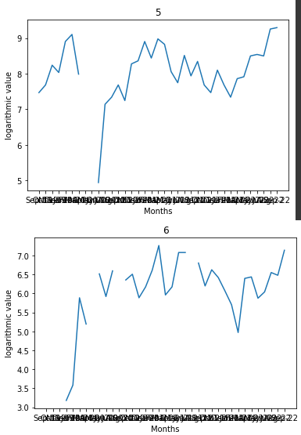
In order to start differencing we took all the rolling mean points on the logarithmic scale after removing all the nan values we obtained above
It is concluded that differencing is required to be done on all the points for correct fitting.
Else it results in overfitting and under fitting of the data.
But while observing trends in the data after applying logarithmic seasoning on the data some points were missing which does not need to be removed

Slide 7
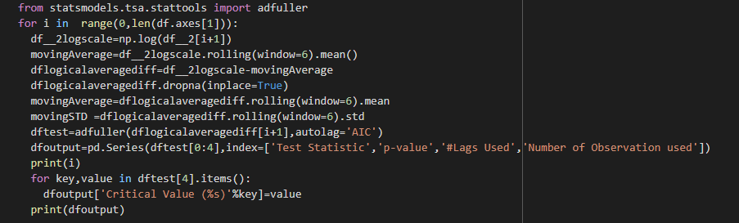
In order to do differencing we took difference of logarithmic seasoning and moving average which will provoke differential logarithmic moving average in use
And parallel we have tested the it by applying adfuller test to it which will provide reduced value of p for each data points wherever value of ‘p’ was greater than 0.05 reduced to less than or nearby 0.05

Slide 8
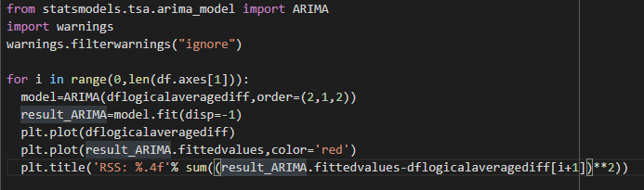
After several iterations values of ‘p’ , ‘q’, and ‘d’ comes out to be 1 ,1 and 2 respectively but shows some anomalies for some of the part numbers but these were resolved when values were taken as 2 ,1 and1 respectively
Hereafter the output of the ARIMA in logarithmic scale is shown below which are certainly the predictions we have made
Now we have plotted the values with original value in order to visualize the stationarity and the results are provided on the next slide

Slide 9
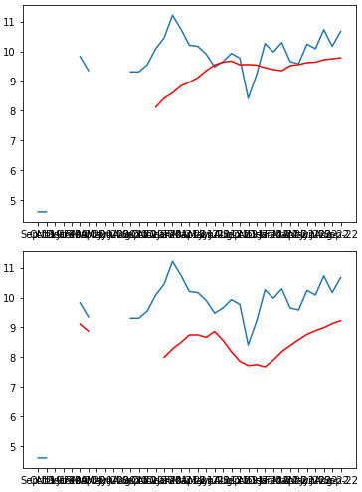
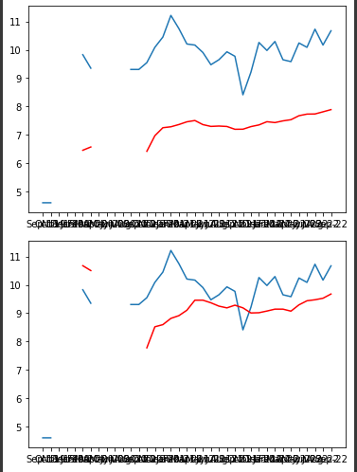
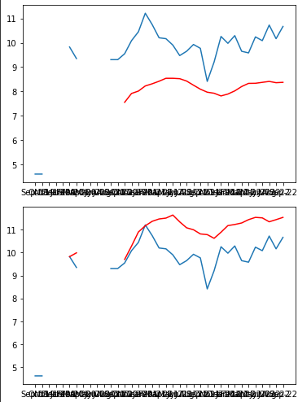
Moving Average after logarithmic seasoning of the provided data
Now final step is to predict the values for next 6 month

Slide 10
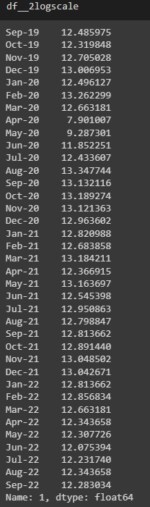
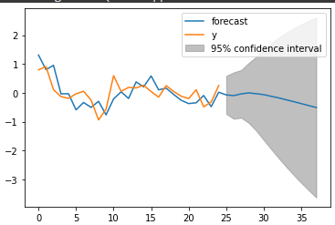
Here is the final arima model with logarithmic seasoning for prediction of future values
Only retrieving the original values is need to be required here after retrieving original values from the logarithmic seasoning and we get prediction with final accuracy of 89.90%

Slide 11


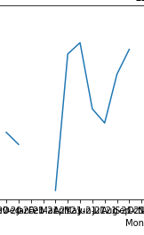
Challenges Faced
Data provided for each part needs cleaning
Data points need to be converted into a float-64 format
36 Data points were provided which leads to elimination of Autoregression method
Train test split requires multiple iteration to split the data
Methods like XGBoost and Decsion Trees were eliminated but proved to give wiser result if applied over dataset provided with project ID
Multivariate time series analysis needs to be done
Below given drop in the trend results higher values of p in adfuller test

Slide 12
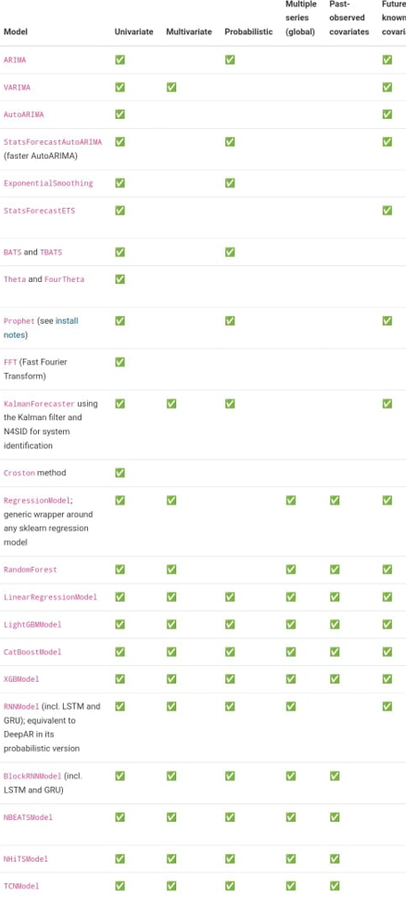
Future Scope and Further improvisation
Darts is a Python library for user-friendly forecasting and anomaly detection on time series. It contains a variety of models, from classics such as ARIMA to deep neural networks.
The forecasting models can all be used in the same way, using fit() and predict() functions, similar to scikit-learn. The library also makes it easy to backtest models, combine the predictions of several models, and take external data into account. Darts supports both univariate and multivariate time series and models.
The ML-based models can be trained on potentially large datasets containing multiple time series, and some of the models offer a rich support for probabilistic forecasting.
Darts also offers extensive anomaly detection capabilities. For instance, it is trivial to apply PyOD models on time series to obtain anomaly scores, or to wrap any of Darts forecasting or filtering models to obtain fully fledged anomaly detection models.
:

Slide 13
Improvisation In the model
Correction in finding accuracy parameters of rolling Mean
Forecasting using LSTN
Forecasting using Linear Regression

Slide 14
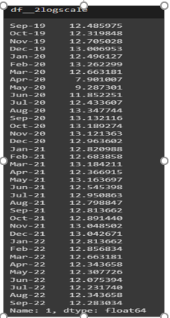
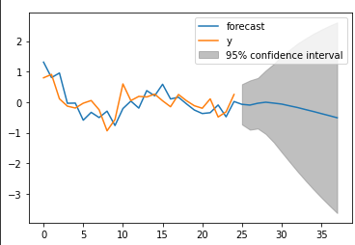
Correction in finding accuracy parameters of rolling Mean

Slide 15
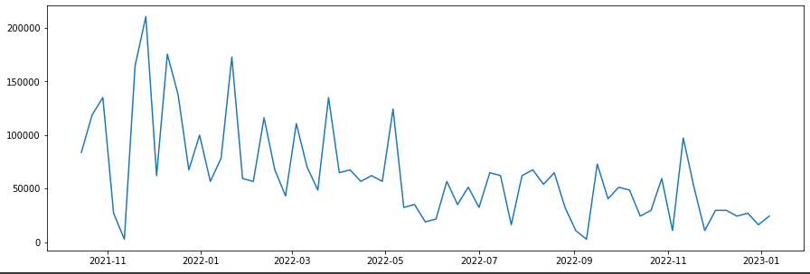
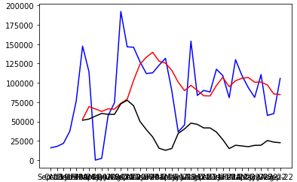
Forecasting using LSTM-Bimonthly data analysis
Variability arrives .
Uncertainty in the sales pattern different halves of the month.
Rolling mean with ARIMA Fails at many parts.
Value of “p” shows uncertain behavior

Slide 16
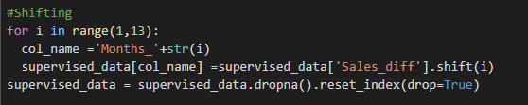
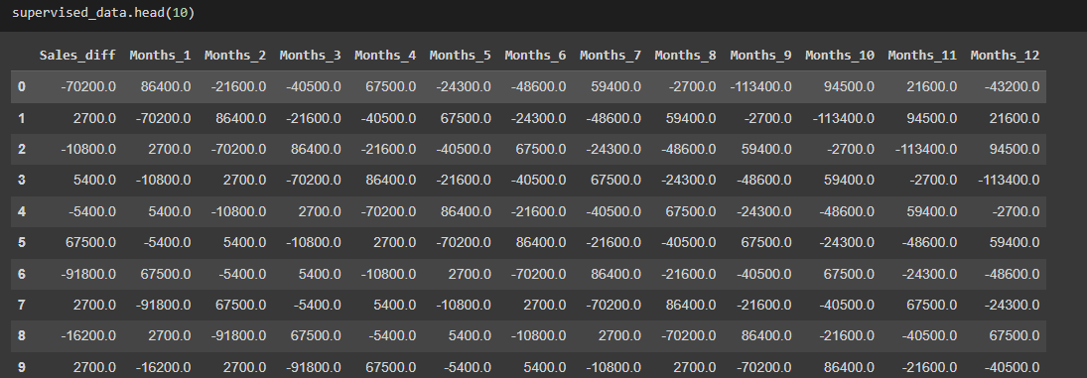
In order to stationaries we did shifting of the data
The shifting follows the monthly pattern
Train test split of the data is done by using min max method

Slide 17
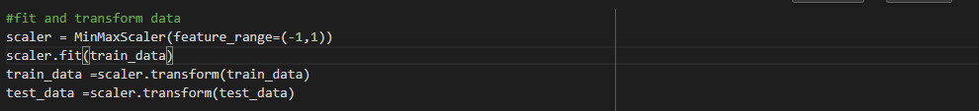
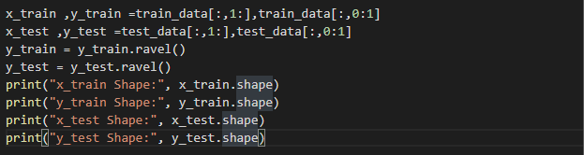

Scaling the data is important because it helps standardize the data and prevents some machine learning models from being affected by the scale of the input features. This can improve the performance and stability of the model.
The input feature matrix is created by taking all columns of the DataFrame except the first one, which is the Sales_diff column. This is done by using the numpy slicing train_data[:,1:] and test_data[:,1:].
The output feature matrix is created by taking only the first column of the DataFrame, which is the Sales_diff column. This is done by using the numpy slicing train_data[:,0:1] and test_data[:,0:1]

Slide 18

This code creates a new DataFrame ”predict_df” that will be used to store the predicted sales for each month in the test set.
The resulting predict_df DataFrame will have 12 rows and 1 column, with the date of each month in the test set as the first column.
The act_sales variable will be used later to compare the predicted sales with the actual sales for each month in the test set.''‘

Slide 19

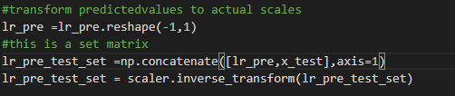
The linear regression model is a simple and interpretable model that finds the linear relationship between the input features and the output variable.
The .fit() method is called on the lr_model object, with the x_train and y_train arrays passed as arguments. This trains the linear regression model on the training data.
The purpose of this is to transform the predicted values back to their original scale, so that they can be compared with the actual sales in the test set

Slide 20
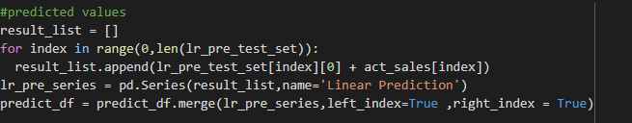
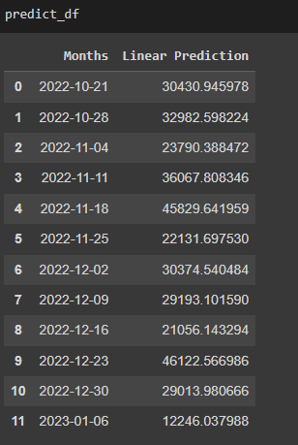
This code creates a new variable lr_pre_series that contains the predicted sales in the test set after being inverse transformed and added with actual sales
Then, the result_list list is converted to a pandas Series using the pd.Series() function, and the name of the series is set to 'Linear Prediction'.

Slide 21
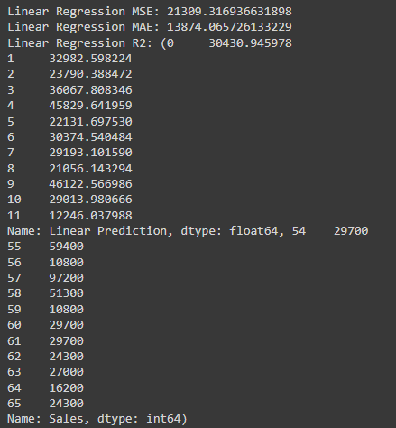
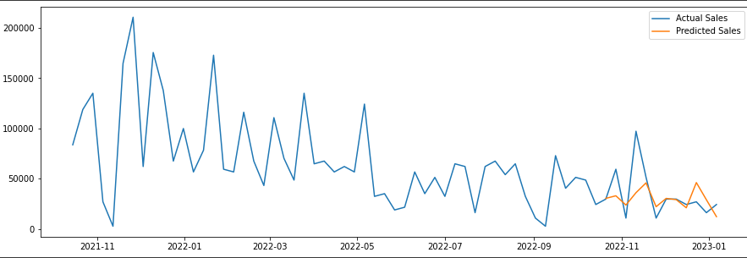
This code calculates the performance of the linear regression model on the test data, by comparing the predicted sales (stored in the 'Linear Prediction' column of the predict_df DataFrame) with the actual sales (stored in the 'Sales' column of the store_sales DataFrame for the last 12 months).

