Slide 1

B.Tech. – Computer Science and Engineering
BCSE497J – Project-I
ATERNET: Adaptive Temporal Expert Routing Network for Probabilistic Solar Power Forecasting
Team members:
<<Name 1>> (<<Reg.No>>)
<<Name 2>> (<<Reg.No>>)
<<Name 3>> (<<Reg.No>>)
Faculty guide:
<<Guide name>>

Slide 2

Approval Mail From Guide
Guide approval for the Review-3 points obtained by mail (screenshot below).
Meeting with guide frequently: <<Satisfied>> | PowerPoint presentation: <<Approved>> | Final project report: <<Satisfied>>
Project demonstration: <<Approved>> | Project outcome: <<Ongoing>> | Turnitin plagiarism: << %>> | AI score: << %>> (should be ≤ 25%)
[ Paste the screenshot of the guide's approval mail here ]

Slide 3
Aim
To design, build and evaluate ATERNET, a probabilistic solar-power forecaster that predicts the next 8 hours (30-minute steps) as a best guess (P50) with an 80% range (P10 to P90).
To make it as accurate as the strongest baseline (LightGBM) while giving reliable, calibrated uncertainty ranges, and to test this honestly over several random runs and two regions.
To demonstrate the system through a plain-language dashboard, including a clearly labelled simulated demonstration for VIT Vellore.

Slide 4
Abstract
Problem: solar output depends on weather; grids need forecasts that also say how sure they are.
ATERNET = PatchTST-style Transformer backbone + 4 weather-regime experts + uncertainty-aware router + probabilistic decoder (P10 ≤ P50 ≤ P90 always).
Data: measured regional PV (Sheffield Solar PV-Live; Yorkshire and South West England, 2023–2026) + 5 NWP models (Open-Meteo). 74 automated tests pass.
Results: nRMSE 3.70 ± 0.02% on Yorkshire (LightGBM 3.72 ± 0.01, PatchTST 4.16 ± 0.00); 2.63 ± 0.01% on South West (LightGBM 2.69 ± 0.00).
Daytime coverage of the P10–P90 range: 0.67 → 0.79 (Yorkshire) and 0.73 → 0.80 (South West) after calibration (target 0.80).
Honest findings: the first learned gate hurt accuracy; only the dense expert loss measurably helped; the India demonstration is simulated.

Slide 5


Literature Review (1/2)
Paper | Objective | Methodology | Pros / Cons (for our goal) | Findings (as reported)
[1] Wang et al., 2026 IEEE Trans. Ind. Appl. | Distributed PV, ultra-short-term, deterministic + probabilistic | Dynamic graph network; shape-amplitude loss (DTW + MSE); quantile regression | + models site correlation and shape − needs many sites | Validated on real distributed-PV data; shape and amplitude kept consistent
[2] Lo et al., 2025 IEEE Trans. Ind. Appl. | Faster, simpler probabilistic solar forecasts | Quantile regression; skips training bounds when output is stable; imputation | + cheaper to run − no uncertainty source modelled | Less forecasting time and better accuracy than compared methods
[3] He et al., 2026 ICSGGE (IEEE) | PV intervals under complex weather | Adaptive VMD + BiLSTM + feature attention; monotonicity penalty | + handles non-stationarity − penalty, not guarantee, against crossing | Better interval reliability in cloudy / convective weather; 141.6 ms run time
[4] Wang et al., 2025 ICEMCE (IEEE) | Robust, explainable PV ensemble | Context-gated mixture of experts; residual corrector; distillation; conformal + MC-dropout | + closest gating idea − no NWP, no NWP-spread signal | Outperforms baselines and ensembles on a multi-location PV dataset
[5] Zhao et al., 2026 IEEE Trans. Power Syst. | Use several NWP sources for probabilistic PV | Two-stage ensemble, meta-learner, feature + temporal attention, non-crossing quantiles | + multi-source NWP as input − spread between NWPs not used as uncertainty | Better reliability, sharpness and skill; multi-source NWP lowers single-source risk
[6] He et al., 2026 IEEE Trans. Ind. Informat. | Day-ahead PV probability density | Similar-moment selection; GAN on measurements + NWP; CNN-LSTM; QR + KDE | + enriches training data − GAN training complexity | Lowest CRPS in most weather scenarios; +45.8% point / +51.5% probabilistic vs QRTransformer
[7] Heidrich et al., 2026 IEEE Access (curtailment) | Curtailment forecast with calibrated intervals | Patch Transformer; SwiGLU mixture of experts + load-balancing loss; conformal prediction | + same building blocks as ours − different series (not PV) | MSE 0.0059 at 3 h (−13.2%); 91.27% coverage at nominal 90%
[8] Lyu & Eftekharnejad, 2024 IEEE Access | Probabilistic solar under rapidly changing weather | Copula theory + XGBoost weather classifier; dynamic spatio-temporal correlations | + weather-dependent modelling − heavy multi-variable setup | Up to 60% higher accuracy in non-sunny autumn / winter
[9] Lin et al., 2025 IEEE Trans. Power Syst. | Regional PV from many plants | Dynamic convolutional graph network, graph pooling, parameter transfer (127 plants) | + end-to-end regional forecast − needs plant-level data | High-quality, reliable regional probabilistic forecasts on public data
[10] Huang et al., 2026 IEEE Trans. Ind. Appl. | Distributed-PV cluster, next 4 hours | Spatial-temporal attention + graph convolution; non-crossing joint quantile loss | + multiple levels at once − graph over sub-regions required | Verified on real-world datasets

Slide 6
Literature Review (2/2)
Paper | Objective | Methodology | Pros / Cons (for our goal) | Findings (as reported)
[11] Rastgoo et al., 2025 IEEE Access | Ultra-short-term PV from sky images | Diffusion model; cross-attention on multi-resolution image patches; ELBO loss | + sees cloud motion − needs sky-image stream | Superior to 64 baselines on four metrics
[12] Seman et al., 2026 IEEE Access (thermal energy) | Thermal-energy forecasting | Hierarchical VMD, architecture search, sparse expert Transformer with load balancing | + expert routing at scale − different series | MAPE 5.94%, about 12–15% lower than competing methods
[13] Phan et al., 2024 IEEE Trans. Ind. Appl. | One-day-ahead PV intervals | Transformer-LUBE; XGBoost imputation; GRU residual correction; NWP | + missing-data handling − bounds, not quantiles | Better NRMSE, NMAPE, PICP, PINAW, CWC than ANN, LSTM, GRU, XGBoost
[14] Jensen et al., 2024 IEEE TNNLS | Valid intervals for any time-series model | Ensemble conformalized quantile regression; asymmetric conformity scores | + distribution-free validity − generic, not PV-specific | Sharper, valid intervals than QR-only or conformal-only
[15] Song et al., 2025 IEEE Trans. Sustain. Energy | Large-scale multi-site PV with missing data | Random coarse-graph attention; adaptive imputation (1,649 sites) | + scalable − multi-site data needed | 7–10% and 6–25% average improvement under missing-data types
[16] Wang et al., 2026 IEEE Trans. Sustain. Energy | PV from satellite cloud forecasts | Diffusion image prediction + neural SDE; multimodal ensemble with PV + NWP | + models cloud uncertainty − needs satellite images | 180-min CRPS −6.06% and −4.73% at two sites; 36.5% lower CRPS in images
[17] Zhao et al., 2024 IEEE Trans. Ind. Informat. (load) | Probabilistic multi-energy load | Hybrid-attention Transformer; Gaussian-process residual learning | + residual modelling − load, not PV | Captures coupling between energy loads; probabilistic output
[18] Ye et al., 2024 IEEE Trans. Power Syst. | Multi-horizon probabilistic energy | TADNet: regular + residual components; convolution + attention; gating | + interval from residual − energy series generally | Best performance on two energy datasets; robust long-term
[19] Wang et al., 2026 IEEE Trans. Ind. Appl. | Distributed-PV intervals from joint distribution | Transformer point forecast; autoencoder fluctuation patterns; Clayton copula | + pattern-dependent intervals − two-step, copula fitting | Intervals from point forecast and error joint distribution
[20] Abedinia et al., 2024 IEEE Trans. Ind. Appl. (wind) | Probabilistic wind forecast | CNN-LSTM predicts spline quantile-function parameters; adaptive weighted CRPS | + full distribution − wind, not PV | More accurate than compared models across scenarios

Slide 7
Research Gap
Uncertainty from disagreement: none of the 20 papers uses the disagreement between several NWP models or between experts as an explicit uncertainty signal that also sets interval width and gate sharpness ([5] uses multi-source NWP as input, [4] gates on prediction variance, not both).
Value of gating: mixtures of experts are reported for PV, curtailment and thermal energy ([4], [7], [12]), but whether a learned gate beats a plain average, and whether it is stable, needs a direct test for regional PV.
Calibration where it matters: PV has exact zeros at night; coverage and conformal calibration should be done on daytime points.
Data needs: graph and image methods ([1], [9], [10], [15], [11], [16]) need plant-level networks or image streams; a regional-aggregate + NWP model is useful where these are missing.
Reliable comparison: differences of a few percent can be smaller than run-to-run variation; use several seeds and a second region.
Regions without open data (e.g. our campus): a clearly labelled simulated demonstration is needed.

Slide 8


Objectives
O1 Route between weather-regime experts using the combined uncertainty (context-gated routing)
O2 Make the interval width depend on uncertainty; P10 ≤ P50 ≤ P90 by construction
O3 Train all parts jointly; keep every expert learning (dense expert loss)
O4 Evaluate per weather regime and per forecast horizon
O5 Compare honestly with LightGBM, PatchTST, LSTM over 3 seeds and on a second region
O6 Deliver a tested, reproducible system, a plain-language dashboard and a simulated Vellore demo
Identified SDGs: SDG 7 – Affordable and Clean Energy; SDG 13 – Climate Action
Technology Readiness Level: TRL 4 (validated in a research environment on real data)
Outcomes: project report + dashboard; conference paper planned

Slide 9
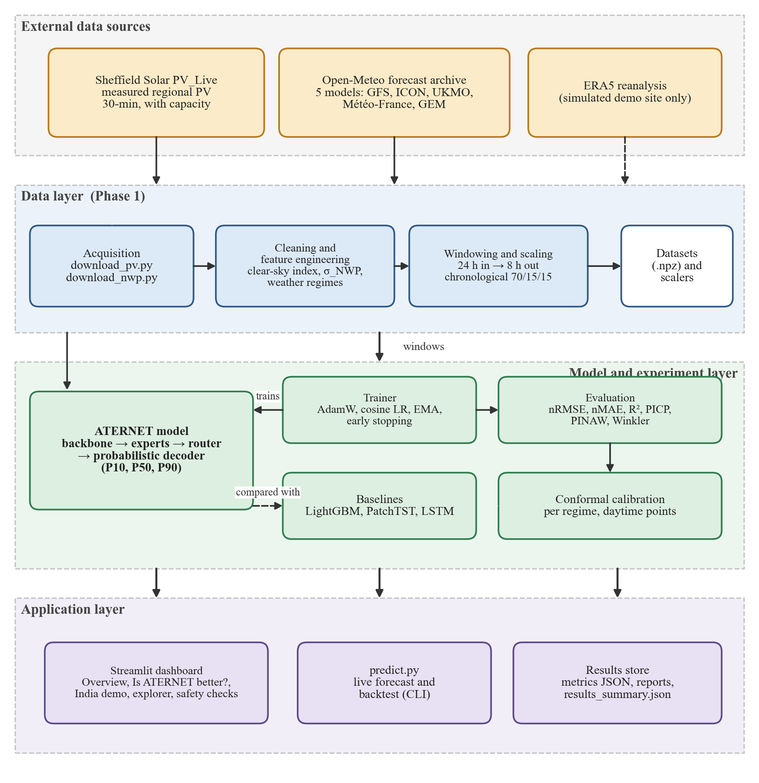
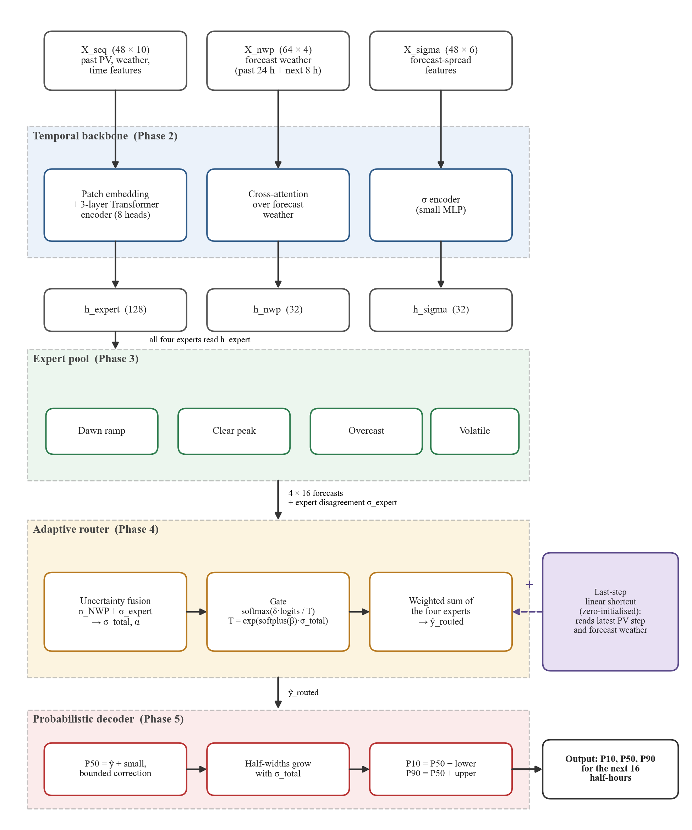
Framework / Architecture / Block Diagram
System architecture: data → model/experiment → application layers
ATERNET model: backbone → experts → router → decoder

Slide 10
Where Each Formula Is Used (F1 – F14)
Model forward pass (one forecast)
Data
preparation
(Phase 1)
Backbone
(Phase 2)
Expert pool
(Phase 3)
Adaptive
router
(Phase 4)
Probabilistic
decoder
(Phase 5)
Output
P10, P50, P90
F1
F2, F3
F4
F5, F6, F7
F8
Around the model
Training
(loss, optimiser, EMA)
Evaluation
(metrics, comparison rule)
Calibration
(daytime conformal)
Simulated Vellore site
(demo data only)
F9, F10
F11, F14
F12
F13
Blue tags = formula numbers; the next two slides give each formula and what it does.
Every formula here is implemented in the project code (src/phase1–5, src/training, src/evaluation); F2/F3 follow PatchTST and the Transformer, F6 follows ReZero, F12 follows CQR.

Slide 11
Formulas and Positions (1/2): Model Forward Pass
No. | Position in the system | Formula | What it does
F1 | Data preparation (Phase 1) | pv_{norm} = P / P_{capacity} CSI = GHI / GHI_{clear-sky} x′ = (x − x_{min}) / (x_{max} − x_{min}) | Capacity-normalised target, clear-sky index feature, min-max scaling (fitted on train only)
F2 | Backbone: patch embedding | n_{patches} = ⌊(L − P) / S⌋ + 1 = ⌊(48 − 8) / 4⌋ + 1 = 11 | History L = 48 steps cut into patches of P = 8 with stride S = 4
F3 | Backbone: Transformer encoder and NWP cross-attention | Attention(Q, K, V) = softmax( Q K^{T} / √d_{k} ) V | Lets PV patches look at the weather-forecast patches (8 heads, d_{model} = 128)
F4 | Expert pool: expert disagreement | σ_{expert} = √( mean_{h} Var_{k}( ŷ_{k,h} ) ) | Standard deviation across the 4 experts, averaged over the horizon (computed on detached outputs)
F5 | Router: uncertainty fusion | σ_{total} = α·n(σ_{NWP}) + (1 − α)·n(σ_{expert}) α = sigmoid(w^{T} h_{expert} + b), n(σ) = BatchNorm(log(1 + σ)) | Mixes the two uncertainty sources; α is learned from the embedding
F6 | Router: gate with temperature and residual scale | T = exp( clamp(softplus(β)·σ_{total}, ±8) ) w = softmax( δ · z / T ), δ(0) = 0 | More uncertainty → higher T → votes spread out. δ starts at 0 = uniform routing (ReZero idea)
F7 | Router output with last-step shortcut | ŷ_{routed} = Σ_{k} w_{k}·ŷ_{k} + ( W_{s} x_{last} + b_{s} ) | Weighted sum of the 4 experts plus a zero-initialised linear shortcut from the latest observation
Notes:
Walk through the forward pass left to right: F1 prepares the inputs, F2-F3 are in the backbone, F4 measures expert disagreement, F5-F7 are in the router, and F8 (next slide) is the decoder.

Slide 12
Formulas and Positions (2/2): Decoder, Training, Evaluation
No. | Position in the system | Formula | What it does
F8 | Probabilistic decoder (Phase 5) | P50 = clip( ŷ_{routed} + 0.1·tanh(g(h_{nwp}, σ_{total})), 0, 1 ) lower_{h} = softplus( a_{h} + softplus(γ_{h})·σ_{total} ) P10 = clip(P50 − lower), P90 = clip(P50 + upper) | Interval width grows with σ_{total}; P10 ≤ P50 ≤ P90 by construction
F9 | Training: loss | ρ_{τ}(e) = max( τ e, (τ − 1) e ), e = y − ŷ L = L_{pinball} + 0.05 L_{sharp} + w(t) Σ_{k} L_{expert,k} + 0.01 L_{balance} | Pinball loss for P10/P50/P90; sharpness; dense expert loss (w = 1 → 0.3); gate load balance
F10 | Training: optimiser and weight averaging | η_{t} = η_{min} + ½(η₀ − η_{min})(1 + cos(π t / T)) θ_{ema} ← d·θ_{ema} + (1 − d)·θ, d = min(0.999, (1 + t)/(10 + t)) | Cosine learning-rate schedule (AdamW); EMA weights used for validation and checkpoints
F11 | Evaluation | nRMSE = 100·√mean((y − ŷ)²), Skill = 1 − RMSE / RMSE_{persistence} PICP = mean(P10 ≤ y ≤ P90), PINAW = mean(P90 − P10) Winkler = mean( width + (2/α)·(below + above) ), α = 0.2 | Accuracy, skill vs 'same as now', coverage, width, and joint interval score
F12 | Calibration (after training) | E = max( P10 − y, y − P90 ) (daytime points, per regime) q̂ = Quantile_{⌈(n+1)(1−α)⌉/n}(E), P10′ = P10 − q̂, P90′ = P90 + q̂ | Conformalized quantile regression; brings daytime coverage to about 0.80
F13 | Simulated Vellore site (demo only) | T_{cell} = T_{amb} + 0.03125·GHI P = P_{peak}·(GHI/1000)·(1 − 0.004(T_{cell} − 25))·0.88·s, P ≤ P_{peak}/1.25 | Temperature, soiling (s) and inverter limit; driven by ERA5 reanalysis, not the forecasts
F14 | Comparison rule (results) | “better” only if | mean_{A} − mean_{B} | > 2·max(σ_{A}, σ_{B}) | A win is claimed only beyond about two run-to-run standard deviations
Notes:
F8 is the decoder; F9-F10 are used during training; F11 and F14 in evaluation and comparison; F12 after training for calibration; F13 only for the simulated Vellore demonstration.

Slide 13
Functional Requirements
Download measured regional PV (PV-Live) and five-model weather forecasts (Open-Meteo); align to a 30-minute grid
Clean, derive features (clear-sky index, time encodings, forecast spread, regime labels) and build 24 h → 8 h windows without look-ahead
Train ATERNET jointly (early stopping, checkpoints, weight averaging); output P10, P50, P90 for 16 steps with P10 ≤ P50 ≤ P90
Evaluate: nRMSE, nMAE, R², PICP, PINAW, Winkler, skill vs persistence; per regime and per horizon
Train and evaluate LightGBM, PatchTST and LSTM baselines under the same protocol
Calibrate the intervals per regime on daytime validation points
Run multi-seed experiments and ablations; aggregate mean ± standard deviation
Live forecast and backtest commands; interactive dashboard; second region and simulated site by configuration only

Slide 14
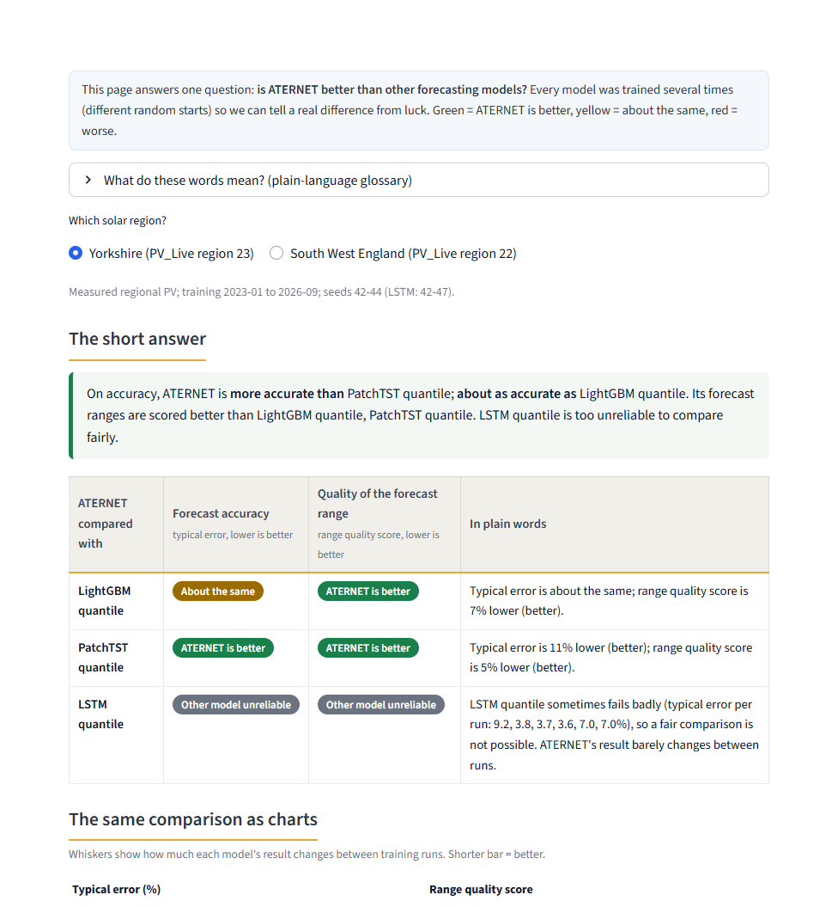
Modules
1 Data pipeline (Phase 1): PV-Live + Open-Meteo → clean → features → windows (48 → 16) → chronological 70/15/15 split
2 Temporal backbone (Phase 2): patches, 3-layer Transformer, NWP cross-attention, σ encoder
3 Expert pool (Phase 3): dawn-ramp, clear-peak, overcast, volatile experts + σ_{e}xpert
4 Adaptive router (Phase 4): uncertainty fusion, residual gate, last-step shortcut
5 Probabilistic decoder (Phase 5): P50 + widths → P10, P90
6 Training and calibration: composite loss, AdamW, EMA, daytime conformal calibration
7 Baselines and evaluation: LightGBM, PatchTST, LSTM; metrics; multi-seed runner
8 Dashboard and live forecast: Streamlit (9 pages), predict.py; 74 automated tests
Dashboard: “Is ATERNET better?” page

Slide 15
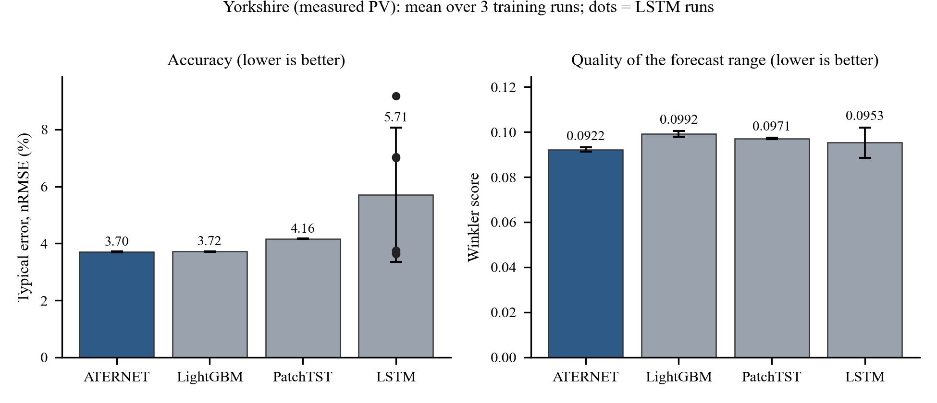
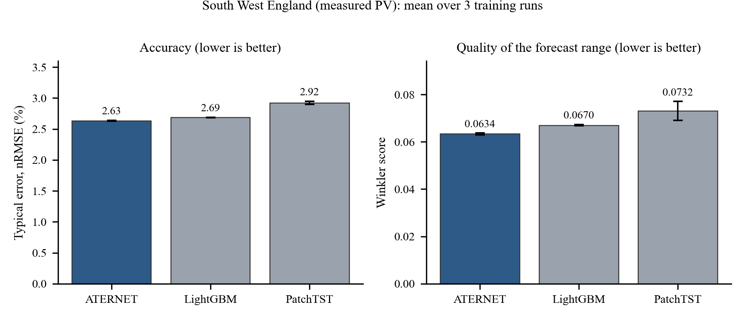
Experiments and Results (1/2): Comparison
Setup: test period 8 Mar – 29 Sep 2026; 3 training runs per model (LSTM: 6); mean ± std; a difference counts only beyond 2 std (F14).
Yorkshire: ATERNET 3.70 ± 0.02% = LightGBM 3.72 ± 0.01% (tie), better than PatchTST 4.16 ± 0.00%; Winkler 0.0922 ± 0.0010 vs 0.0992 ± 0.0013 / 0.0971 ± 0.0003.
South West (no re-tuning): ATERNET 2.63 ± 0.01% vs LightGBM 2.69 ± 0.00% and PatchTST 2.92 ± 0.03%.
LSTM is unstable: 3 of 6 runs failed (nRMSE 7.0–9.2%); ATERNET varies by only 0.02.

Slide 16
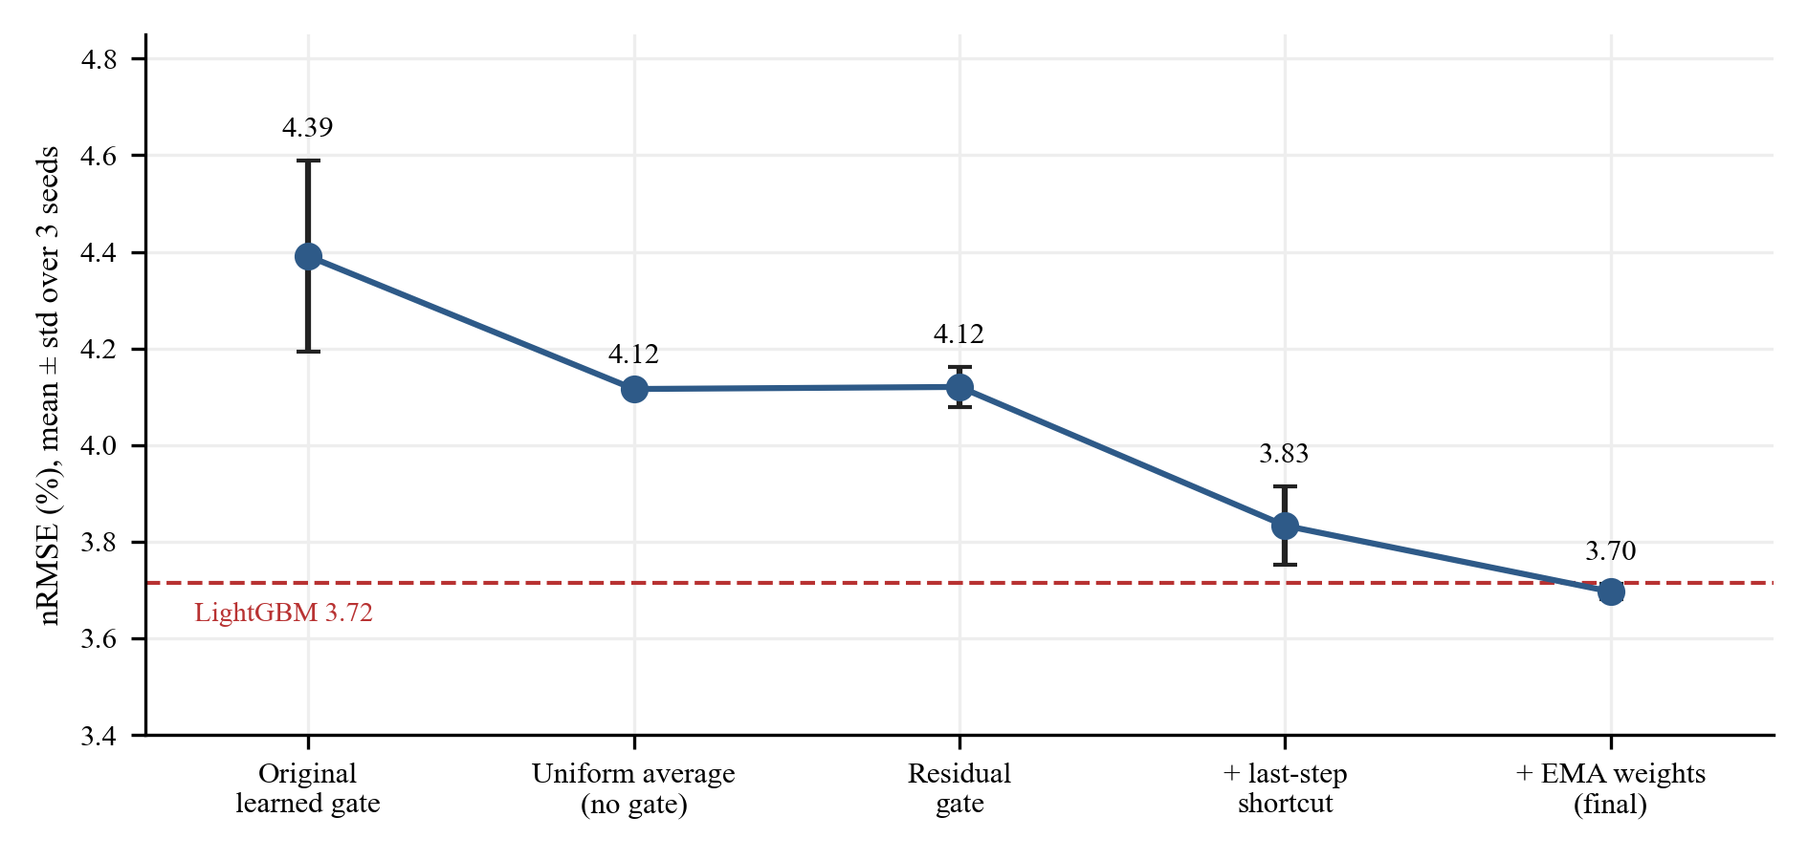
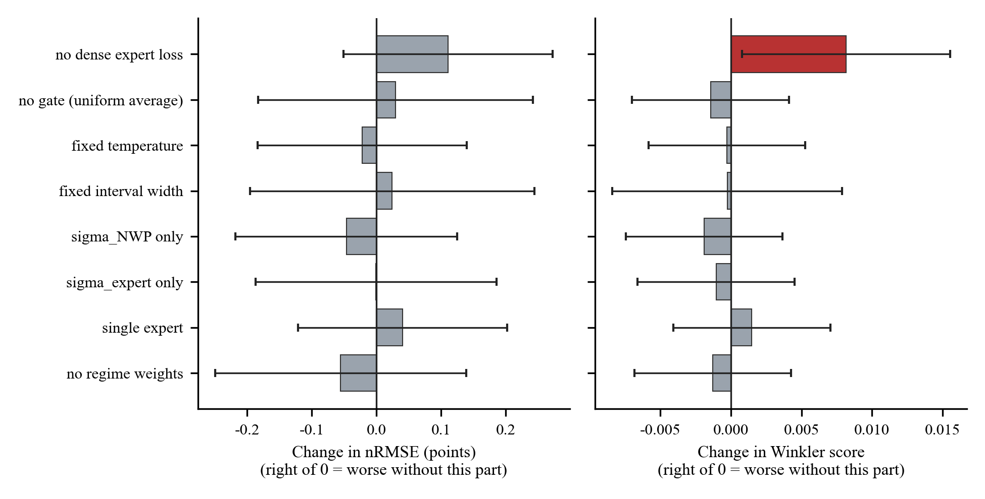
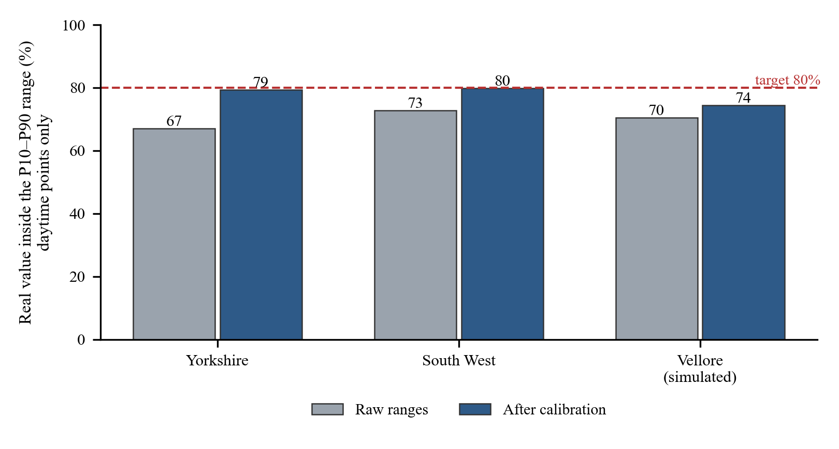
Experiments and Results (2/2): What Helped and Calibration
Development (Yorkshire): original learned gate 4.39 ± 0.20 → residual gate 4.12 → + last-step shortcut 3.83 → + EMA 3.70 ± 0.02 nRMSE (LightGBM 3.72).
Ablations (switch one part off): only the dense expert loss clearly mattered (Winkler +8%, coverage 0.82 → 0.78); gate, temperature, fixed width, single expert, regime weights made no measurable difference.
Calibration (F12): daytime coverage 0.67 → 0.79 (Yorkshire) and 0.73 → 0.80 (South West); simulated Vellore only 0.70 → 0.74.
Backtest 1–16 Oct 2026: daylight MAE 42 MW vs 147 MW for day-ahead persistence (3.5× better). Vellore results are simulated (single run), not real-world accuracy.
Notes:
Left: nRMSE at each development stage. Middle: effect of removing each model part (red = clearly worse). Right: daytime coverage before and after calibration against the 80% target.

Slide 17
Conclusion and Future Work
Conclusion
  ATERNET matches LightGBM on Yorkshire (3.70 vs 3.72 nRMSE), beats it on South West England (2.63 vs 2.69) and beats PatchTST on both; its ranges score better on Winkler.
  A residual gate, a last-step shortcut and EMA fixed the harm done by the first learned gate; training is stable (std 0.02).
  Daytime-only calibration brings coverage to about 0.80; all-hours coverage had hidden under-coverage.
  Adaptive routing and regime specialisation did not improve accuracy; only the dense expert loss did. The India results are simulated.
Future work
  Obtain measured PV data for an Indian site (e.g. a campus plant) and fine-tune / retrain.
  More regions and seasons; tune the baselines equally; ensembles of several ATERNET runs.
  Make the experts specialise genuinely (diversity penalty, regime-specific data) and re-test routing; extend the horizon and deploy as a service.

Slide 18
Outcome Achieved
Patent: <<not filed>> | Conference (Scopus): <<planned – paper on ATERNET results>> | Journal: <<not submitted>>
Start-up / product: <<none>>
Others: project report (71 pages), working Streamlit dashboard, 74 automated tests, reproducible build scripts
Update this slide with proof (screenshot) of any accepted / published outcome before uploading.
Outcome Achieved proof to be uploaded on or before 27 Oct 2026 in the given link: https://forms.gle/B9B71VPy5b9bZ9dJ8

Slide 19
References
[1] Y. Wang et al., “A distributed PV ultra-short-term power deterministic and probabilistic forecasting based on dynamic graph network with shape-amplitude criteria,” IEEE Trans. Ind. Appl., vol. 62, no. 2, pp. 1863–1873, 2026.
[2] H.-Y. Lo et al., “A novel QR-based probabilistic forecasting method for solar power generation,” IEEE Trans. Ind. Appl., vol. 61, no. 4, pp. 5381–5393, 2025.
[3] T. He, Y. Xu, and Y. Guo, “A probabilistic forecasting method for PV power under complex weather conditions based on multi-resolution deep learning,” in Proc. ICSGGE, 2026, pp. 125–130.
[4] H. Wang, R. Duan, and X. Yang, “A robust ensemble framework with context-gated dynamic fusion and temporal residual correction for PV power forecasting,” in Proc. ICEMCE, 2025, pp. 1022–1026.
[5] H. Zhao et al., “A two-stage ensemble learning framework for short-term nonparametric probabilistic PV power forecasting integrating multi-source NWPs,” IEEE Trans. Power Syst., vol. 41, no. 2, pp. 1231–1245, 2026.
[6] Y. He et al., “Day-ahead PV power probability density forecasting with GAN-QRCNLSTM based on high-resolution data reconstruction,” IEEE Trans. Ind. Informat., vol. 22, no. 2, pp. 1428–1439, 2026.
[7] M. Z. Heidrich et al., “Patch-based transformer with mixture of experts and conformal inference for curtailment time series forecasting,” IEEE Access, vol. 14, pp. 64144–64160, 2026.
[8] C. Lyu and S. Eftekharnejad, “Probabilistic solar generation forecasting for rapidly changing weather conditions,” IEEE Access, vol. 12, pp. 79091–79103, 2024.
[9] F. Lin et al., “Short-term probabilistic forecasting for regional PV power based on convolutional graph neural network and parameter transferring,” IEEE Trans. Power Syst., vol. 40, no. 3, pp. 2724–2736, 2025.
[10] C. Huang et al., “Spatial-temporal attention mechanism and graph convolutional networks based distributed PV ultra-short-term probabilistic power forecasting,” IEEE Trans. Ind. Appl., early access, 2026.
[11] R. Rastgoo et al., “A diffusion-based probabilistic ultra-short-term solar power prediction using the sky image sequences,” IEEE Access, vol. 13, pp. 149532–149553, 2025.
[12] L. O. Seman et al., “End-to-end decomposition-aware neural architecture search with sparse expert transformers for thermal energy forecasting,” IEEE Access, vol. 14, pp. 67765–67787, 2026.
[13] Q.-T. Phan, Y.-K. Wu, and Q.-D. Phan, “Enhancing one-day-ahead probabilistic solar power forecast with a hybrid transformer-LUBE model and missing data imputation,” IEEE Trans. Ind. Appl., vol. 60, no. 1, pp. 1396–1408, 2024.
[14] V. Jensen, F. M. Bianchi, and S. N. Anfinsen, “Ensemble conformalized quantile regression for probabilistic time series forecasting,” IEEE Trans. Neural Netw. Learn. Syst., vol. 35, no. 7, pp. 9014–9025, 2024.
[15] K. Song, M. Kim, and H. Kim, “Graph-based large scale probabilistic PV power forecasting insensitive to space-time missing data,” IEEE Trans. Sustain. Energy, vol. 16, no. 1, pp. 160–173, 2025.
[16] K. Wang et al., “Multimodal ensemble photovoltaic power forecasting incorporating diffusion-based satellite image prediction,” IEEE Trans. Sustain. Energy, vol. 17, no. 2, pp. 1425–1436, 2026.
[17] P. Zhao et al., “Probabilistic multienergy load forecasting based on hybrid attention-enabled transformer network and Gaussian process-aided residual learning,” IEEE Trans. Ind. Informat., vol. 20, no. 6, pp. 8379–8393, 2024.
[18] J. Ye et al., “TADNet: Temporal attention decomposition networks for probabilistic energy forecasting,” IEEE Trans. Power Syst., vol. 39, no. 6, pp. 7190–7202, 2024.
[19] W. Wang et al., “Ultra-short-term power probabilistic forecasting method for distributed photovoltaic based on joint distribution modeling,” IEEE Trans. Ind. Appl., vol. 62, no. 1, pp. 26–36, 2026.
[20] O. Abedinia et al., “Wind power forecasting enhancement utilizing adaptive quantile function and CNN-LSTM: A probabilistic approach,” IEEE Trans. Ind. Appl., vol. 60, no. 3, pp. 4446–4457, 2024.
Methods used in the formulas:
[21] A. Vaswani et al., “Attention is all you need,” in Proc. NeurIPS, 2017, pp. 5998–6008. (F3)
[22] Y. Nie et al., “A time series is worth 64 words: Long-term forecasting with transformers,” in Proc. ICLR, 2023. (F2)
[23] G. Ke et al., “LightGBM: A highly efficient gradient boosting decision tree,” in Proc. NeurIPS, 2017, pp. 3146–3154. (baseline)
[24] R. Koenker and G. Bassett, “Regression quantiles,” Econometrica, vol. 46, no. 1, pp. 33–50, 1978. (F9)
[25] R. L. Winkler, “A decision-theoretic approach to interval estimation,” J. Amer. Statist. Assoc., vol. 67, no. 337, pp. 187–191, 1972. (F11)
[26] Y. Romano, E. Patterson, and E. J. Candès, “Conformalized quantile regression,” in Proc. NeurIPS, 2019, pp. 3543–3553. (F12)
[27] T. Bachlechner et al., “ReZero is all you need: Fast convergence at large depth,” in Proc. UAI, PMLR 161, 2021, pp. 1352–1361. (F6)
[28] B. T. Polyak and A. B. Juditsky, “Acceleration of stochastic approximation by averaging,” SIAM J. Control Optim., vol. 30, no. 4, pp. 838–855, 1992. (F10)

