Slide 1
Image Deblurring using low rank image approximation
Pratik Kamble

Slide 2
Introduction

Slide 3
Motivation & Overview
Reduces blur caused by handshakes and motion through mobile phone cameras.
Requires:
Short-exposure image
Auto exposure (normal) image
Short exposure image is enhanced using the low rank approximation of the auto-exposure image (without any external parameters)
This technique offers a much better qualitative results at a better efficiency as well.
However, this technique relies on having a short-exposure image being available.

Slide 4
Data Capture Process
First, the normal, auto-exposure image is captured.
A second image is then captured, with low exposure (faster shutter speed/small aperture) without any human intervention.
Interestingly, a small memory location called also be allocated to the smaller exposure duration within the normal capture itself.
This second image appears deblurred, but obviously darker than the original.
The algorithm then exploits the information captured to generate a blur-free image from the low-exposure one.

Slide 5
Problem History
Previous attempts at image deblurring

Slide 6
Point Spread Function (PSF)
What?
Estimate the PSF of camera motion.
Use it to apply deconvolution filtering
Pros
Extensively used method, good progress made
Deep learning assisted methods based on PSF also exist - existing frameworks can be used
Cons
Computationally demanding
Subject to convolutional ringing artifacts

Slide 7
Inertial Measurement Unit (IMU)
IMU (now available on mobile devices) used to estimate PSF.
Once PSF calculated, previous technique can be used.
Pros
IMUs now found on most mobile devices
Measurements are pretty accurate and can revert a large amount of blur cases
Cons
IMUs are not standardized - inconsistent results.
Preprocessing required - IMUs need to be properly calibrated
Synchronized calibration between the IMU and the camera sensor is essential for optimal results.

Slide 8
Adaptive Tonal Correction (ATC)
First, techniques began emerging that used two images, short and auto exposure.
ATC exploits the statistics of the auto-exposed image.
Results showed that this ATC technique achieved much better results that the previous IMU-estimated PSF based approaches.
Current approach is a computationally more efficient technique (important since this algorithm is mainly used for mobile captured images)

Slide 9
Algorithm

Slide 10
Introduction
Does not require any search to be performed like ATC.
Much faster than previous ATC
Can be implemented on GPU for faster computation
Sees a 40% increase on mobile GPUs.
First Step: Low rank auto-exposure image approximation
Second Step: Incorporate eigen approximation onto the low-exposure image

Slide 11
First Step
Low rank matrix approximation using SVD (support vector decomposition)
Find appropriate number of eigenvectors using AIC (Akaike Information Criterion) from the normal, auto-exposure blurred image.
This approximation image remains undistorted and carries only the brightness and contrast information
SVD & AIC

Slide 12
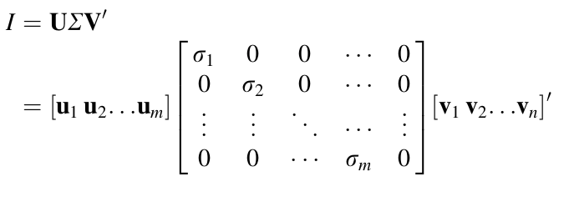
Support Vector Decomposition

Slide 13

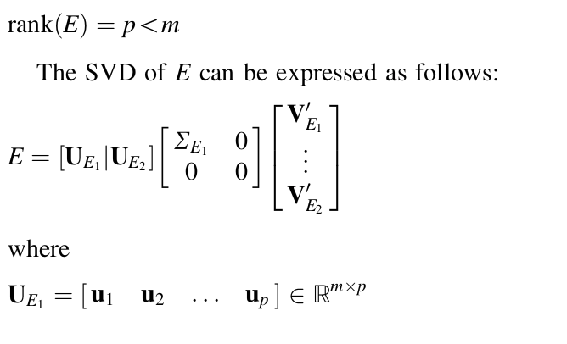
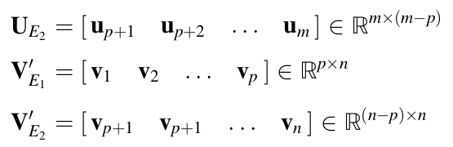
Low Rank Approximation

Slide 14
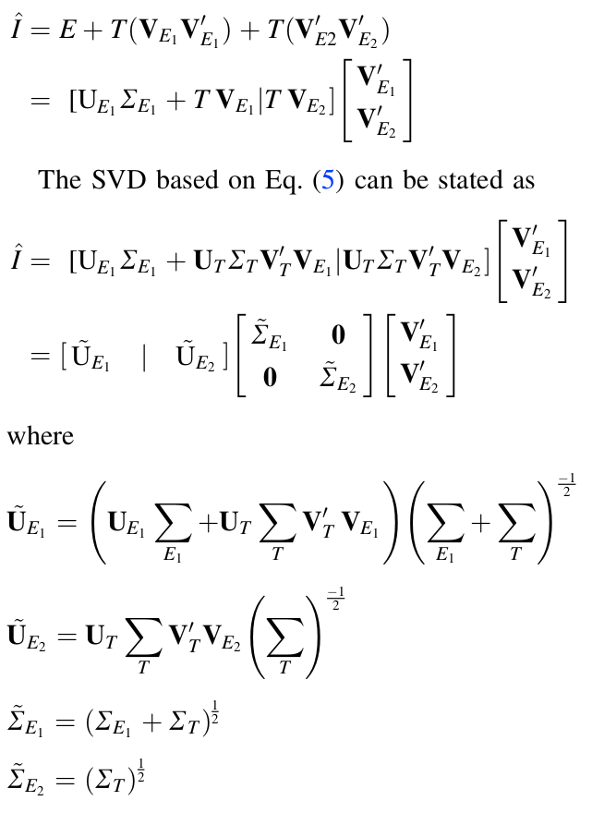
Final Representation
Given that I can be decomposed as a low rank approximation E and the combined detail and blur component, T; the recombination can be expressed as shown.

Slide 15
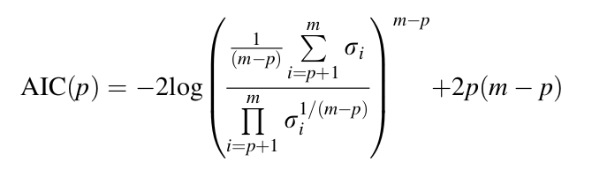
Akaike Information Criterion
To determine this “magical”, p factor, we make use of the AIC.
This allows you to programmatically get the split threshold without having to run back and forth testing the ideal split.

Slide 16
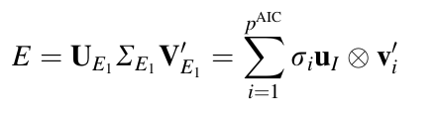
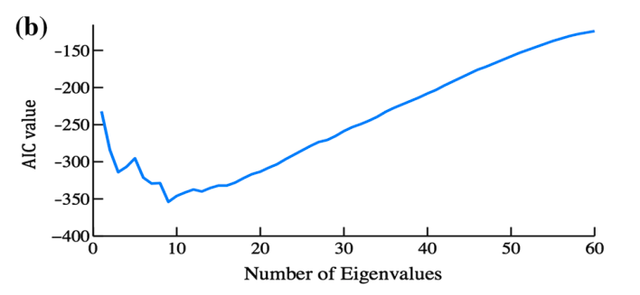
Choice of `p` through AIC

Slide 17
Second Step
Adjust the eigenvalues of the short exposure image (incorporate brightness and contrast details)
Enhance the eigenvalue matrix of SE image, and reconstruct through SVD.
Eigenvalue Transformation & low exposure reconstruction

Slide 18
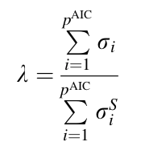
Eigenvalue Enhancement
Sum of all eigenvalues of the original auto-exposure image upto, threshold P (obtained through AIC)
Sum of all eigenvalues of the short exposure image upto P.
Ratio of these is the scaling enhancement factor for the short exposure image.

Slide 19

Final Image Reconstruction
After getting the eigen-ratio, it’s just a matter of enhancing the eigenvalue matrix and reconstructing the SVD decomposition of the under-exposed image.

Slide 20
Results

Slide 21



Indoor Scene

Slide 22
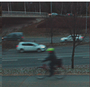
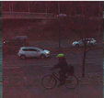
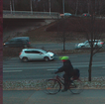
Outdoor Scene

Slide 23
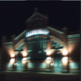
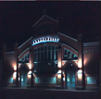
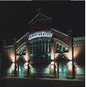
Outdoor Scene (night)

Slide 24
End -
Questions?

