Slide 1
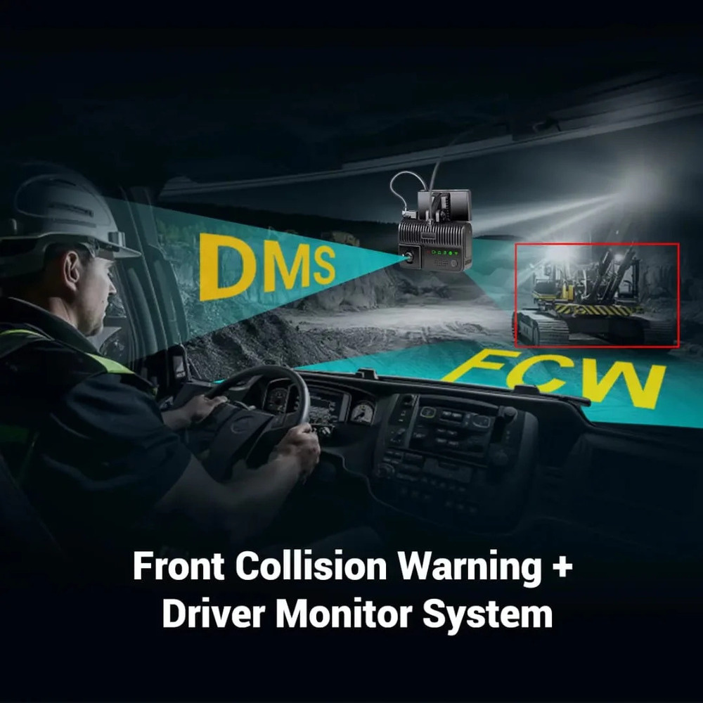
Smart Driver Monitoring & Collision Alert System
A real-time embedded ADAS prototype built on the STM32 Nucleo-F446RE platform, integrating multi-sensor fusion for continuous driver behaviour monitoring, dynamic collision risk assessment, and instantaneous safety alert generation.
Notes:
1

Slide 2
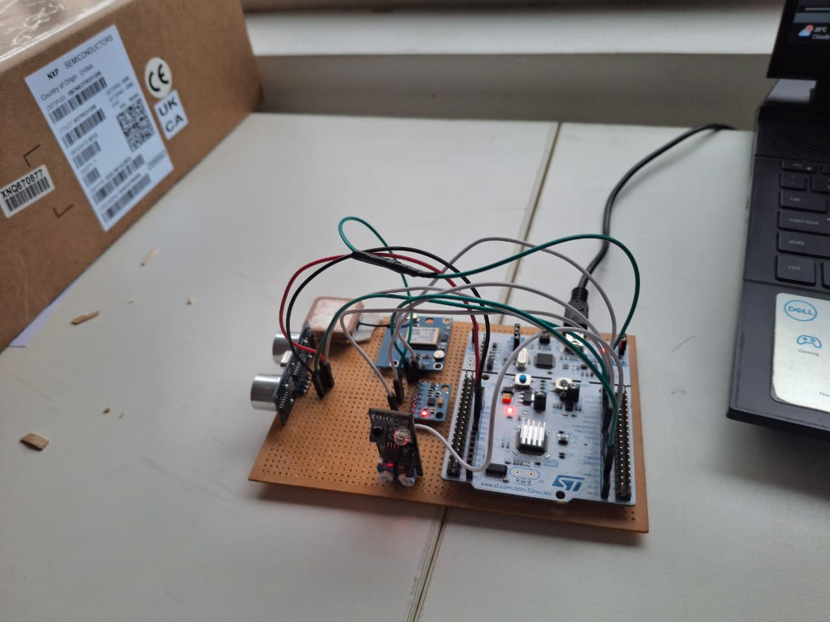
Problem Statement & Objectives
Improving Vehicle Safety with Low-Cost Embedded Hardware
Objective : To build a real-time embedded ADAS prototype capable of continuously monitoring driver state and vehicle dynamics using affordable sensors. The objective is to improve vehicle safety through real-time sensor processing, dynamic threshold-based decision logic, and immediate alert generation all within the resource constraints of a single microcontroller.
Driver Monitoring
Collision Alert
Drowsiness detection via IR eye blink sensing with interrupt-driven timer
Dynamic safe distance calculation based on real-time speed and obstacle proximity
Driving Behaviour
Speed Monitoring
Harsh braking, acceleration, and turning detection through 6-axis IMU data
GPS-based overspeed detection with configurable speed thresholds
Notes:
2

Slide 3

System Architecture
STM32-Centric Multi-Sensor Integration
The STM32 Nucleo-F446RE serves as the central processing unit, interfacing with four distinct sensors across three communication protocols. UART handles GPS data streams, I²C connects the MPU6050 IMU for real-time accelerometer and gyroscope readings, and GPIO manages the ultrasonic distance sensor and IR eye blink sensor. All sensor data is processed through interrupt-driven routines for deterministic, real-time performance.
IR Eye Blink
HC-SR04 Ultrasonic
GPIO — digital input for blink detection
GPIO — trigger/echo distance sensing
STM32 Nucleo-F446RE
MPU6050 IMU
Neo-6M GPS
I2C — accelerometer & gyro data
UART — NMEA position, time & speed
The architecture leverages hardware interrupts for time-critical sensor reads, enabling deterministic response to collision events and drowsiness conditions without polling latency.
Notes:
3

Slide 4
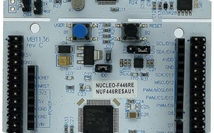
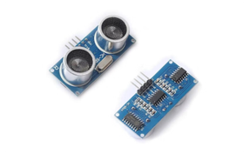
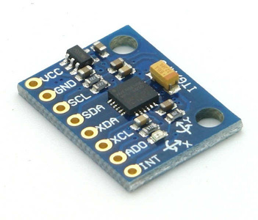
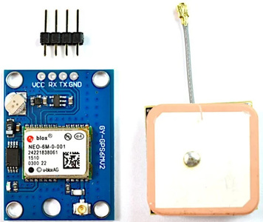
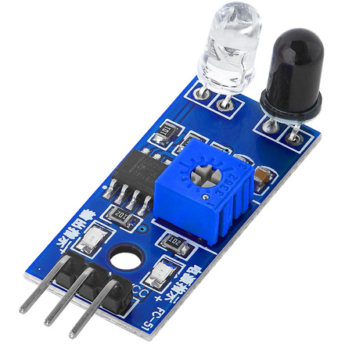
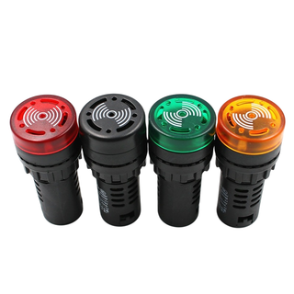
Hardware & Software Stack
Components & Development Tools
STM32 Nucleo-F446RE
HC-SR04 Ultrasonic
MPU6050 IMU
Neo-6M GPS
180 MHz ARM Cortex-M4F core, the central MCU running all real-time processing and alert logic
2 cm – 400 cm range, GPIO-triggered with timer-based echo measurement for obstacle distance
6-axis accelerometer + gyroscope via I²C for harsh braking, acceleration, and turning detection
UART-based NMEA parsing for real-time speed monitoring and overspeed threshold enforcement
IR Eye Blink Sensor
Buzzer & Status LEDs
GPIO-based digital input for drowsiness detection with interrupt-driven 5-second timeout counter
GPIO-driven auditory and visual alert outputs for immediate driver notification of safety events
The firmware is written entirely in Embedded C using the STM32 HAL library, with interrupt-driven UART for GPS NMEA parsing, I²C communication for IMU data acquisition, and hardware timer interrupts for precise drowsiness timeout management and ultrasonic echo measurement.
Notes:
4

Slide 5

System Workflow
Real-Time Sensor Processing Loop
The microcontroller continuously monitors each sensor subsystem, acquiring raw data, running detection algorithms against calibrated thresholds, and generating appropriate alerts before restarting the cycle. Interrupt service routines handle GPS character reception and drowsiness timer events asynchronously.
Read Ultrasonic
Init System
Read MPU6050
Read GPS
Read IR
The loop achieves deterministic real-time performance with no blocking delays, ensuring quick response to critical collision and drowsiness events.
Notes:
5

Slide 6

Detection Algorithms & Thresholds
Threshold-Based Safety Logic
Feature
Logic / Threshold
Drowsiness
No eye blink detected for 5 seconds (interrupt-based timer)
Collision
Obstacle distance < dynamically computed Safe Distance
Overspeed
GPS-measured speed > 20 km/h threshold
Harsh Braking
Longitudinal acceleration Ax < −0.3 g
Harsh Acceleration
Longitudinal acceleration Ax > +0.3 g
Harsh Turning
Z-axis rotational rate |Gz| > 60°/s
Dynamic Safe Distance Model
Reaction Distance = Speed × 1 s
Braking Distance = V² / (2 × a)
Safe Distance = Reaction Distance
+ Braking Distance
Collision Alert when:
Obstacle Distance < Safe Distance
The collision algorithm dynamically computes safe stopping distance based on real-time vehicle speed and assumed deceleration, providing adaptive protection rather than a static distance threshold.
Notes:
6

Slide 7
Implementation & Testing
Validation Results
01
02
Firmware Architecture
Sensor Communication
Embedded C with STM32 HAL, GPS UART, I²C IMU, ultrasonic timer, and GPIO handling
UART GPS NMEA parsing with DMA, I²C MPU6050 register read/write, timer-capture ultrasonic echo measurement
03
04
Real-Time Decision Logic
Validation & Verification
Interrupt-driven drowsiness timer, threshold comparison, dynamic safe distance calculation, prioritized alert generation
Systematic testing of each safety scenario with expected outcomes verified against specifications
Test Scenario
Expected Outcome
Status
Normal Driving
No alerts
✅ Pass
Overspeed Condition
Speed alert triggered
✅ Pass
Obstacle Detection
Collision alert triggered
✅ Pass
Drowsiness Event
Buzzer + LED alert
✅ Pass
Harsh Braking
Behaviour alert triggered
✅ Pass
Harsh Turning
Behaviour alert triggered
✅ Pass
Notes:
7

Slide 8






Results & Outcomes
All Safety Features Successfully Validated
The prototype demonstrated reliable, real-time detection across all seven safety monitoring features during comprehensive bench testing. Dynamic threshold-based decisions adapt to vehicle speed, and multi-sensor integration provides redundant safety coverage within the constraints of low-cost embedded hardware.
Collision Alert
Drowsiness Alert
Dynamic safe distance model triggered accurately at varying speeds
5-second no-blink detection with immediate buzzer and LED response
Overspeed Warning
Harsh Braking
GPS-derived speed exceeding configured threshold reliably flagged
IMU accelerometer threshold of −0.3 g accurately detected
Harsh Acceleration
Harsh Turning
Positive longitudinal acceleration beyond +0.3 g consistently captured
Gyroscope Z-axis rate exceeding 60°/s triggered cornering alerts
Notes:
8

Slide 9





Challenges & Future Scope
Engineering Insights & Roadmap
Challenges Encountered
Future Enhancements
Sensor Noise
GPS Update Latency
Camera-Based Monitoring
Machine Learning
MPU6050 accelerometer and gyroscope readings required software filtering
Sensor fusion models for adaptive threshold learning and driver behaviour profiling
1 Hz NMEA update rate limited overspeed detection granularity
Vision-based eyelid tracking and gaze direction analysis for enhanced drowsiness detection
Threshold Tuning
Sensor Synchronization
CAN Bus Integration
Lane Departure Warning
Calibrating g-force and angular rate thresholds for varied driving profiles
Coordinating async UART and I²C reads within the main loop cycle
Direct vehicle data access for real-time speed, throttle, and brake status
Vision or GPS-based lane monitoring for additional safety coverage
Ultrasonic Limitations
Automatic Emergency Braking
Narrow beam angle and 400 cm max range constrained obstacle coverage
Actuator control beyond alerting for active collision mitigation
Notes:
9

Slide 10

Conclusion & Acknowledgments
Key Takeaways & Thank You
This project successfully demonstrates a real-time embedded Driver Monitoring & Collision Alert prototype on the STM32 Nucleo-F446RE. The system integrates ultrasonic, inertial, GPS, and infrared sensors to continuously monitor driver behaviour, calculate dynamic safe stopping distances, detect unsafe driving conditions, and generate instant safety alerts. The implementation validates core ADAS concepts using low-costvembedded hardware suitable for low-speed prototype validation and educational demonstration.
Multi-Sensor Fusion
Adaptive Safety Logic
Four sensors, three protocols, one MCU deterministic real-time integration
Dynamic safe distance model adapts to vehicle speed, not static thresholds
Thank You
Notes:
10

