Slide 1
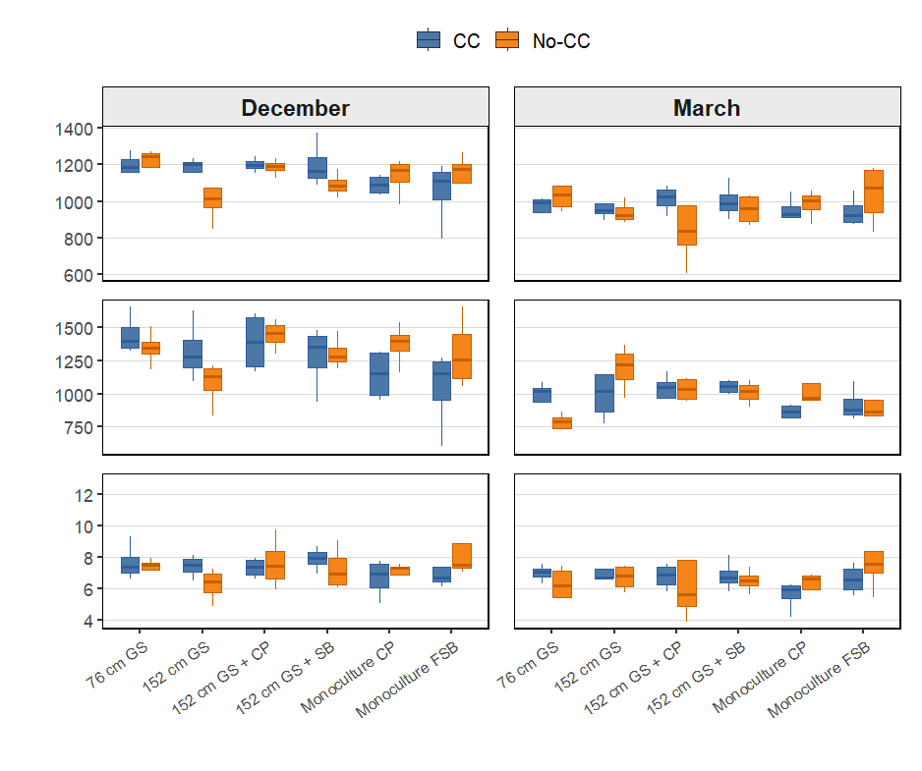
POXC
(mg kg⁻¹)
Mineralizable C
(mg kg⁻¹)
ACE Protein
(mg kg⁻¹)
Figure: POXC, mineralizable C, and ACE soil protein under six SCCS main-plot treatments and two cover-crop split-plot treatments in December and March. Boxplots represent raw observations across four blocks. CC = with cover crops; No-CC = without cover crops.

Slide 2
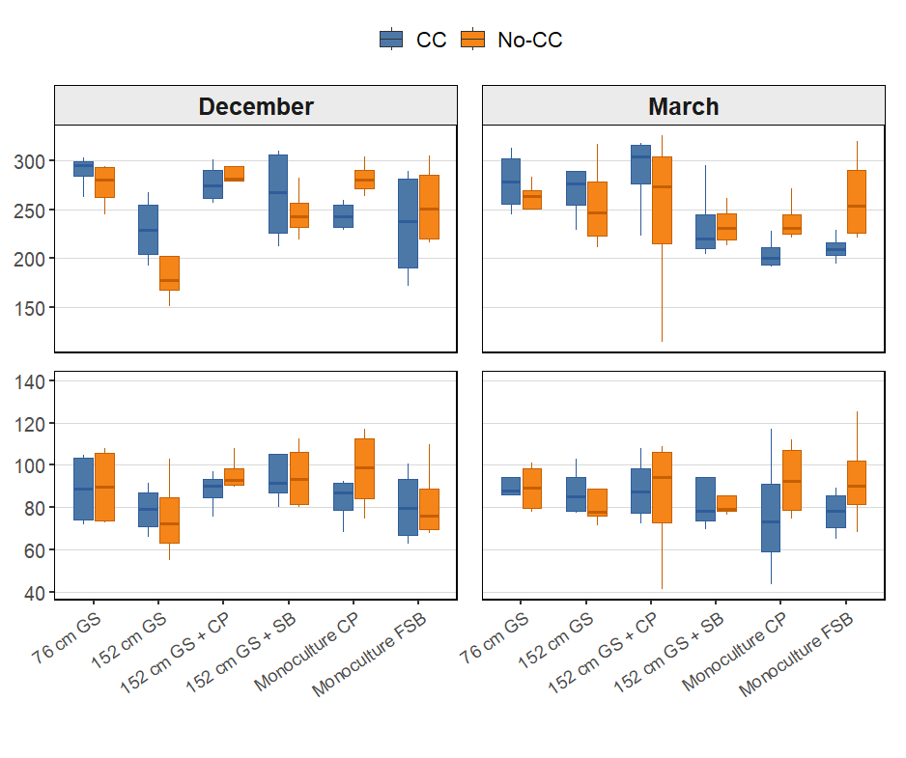
β-Glucosidase
(µg p-nitrophenol g⁻¹ soil hr⁻¹)
β- Glucosaminidase
(µg p-nitrophenol g⁻¹ soil hr⁻¹)
Figure: β-Glucosidase and β- Glucosaminidase under six SCCS main-plot treatments and two cover-crop split-plot treatments in December and March. Boxplots represent raw observations across four blocks. CC = with cover crops; No-CC = without cover crops.

Slide 3
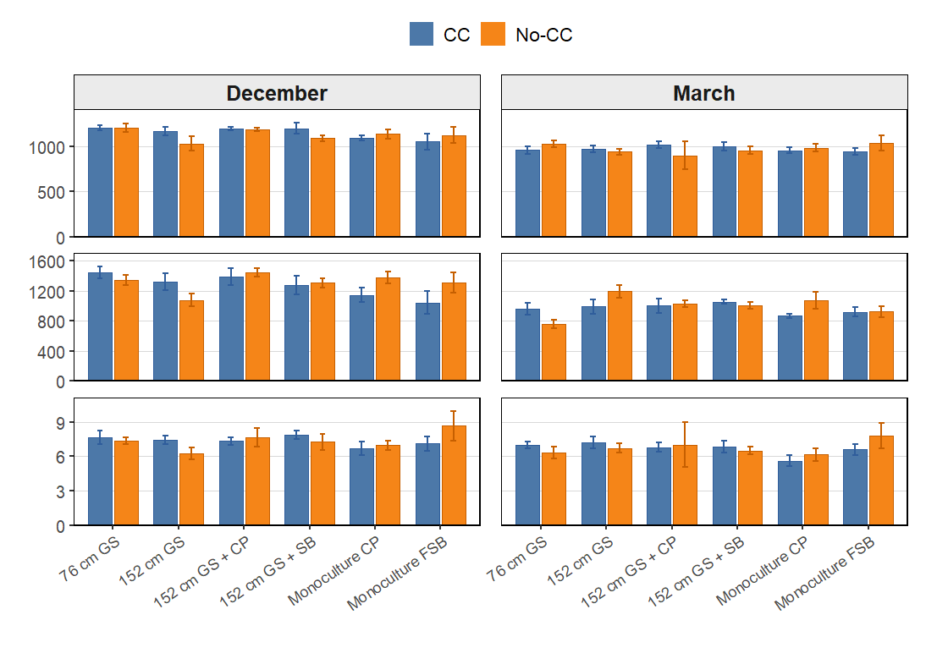
POXC
(mg kg⁻¹)
Mineralizable C
(mg kg⁻¹)
ACE Protein
(mg kg⁻¹)
Figure: POXC, mineralizable C, and ACE soil protein under six SCCS main-plot treatments and two cover-crop split-plot treatments in December and March. Bar graph represent raw observations across four blocks. CC = with cover crops; No-CC = without cover crops.

Slide 4
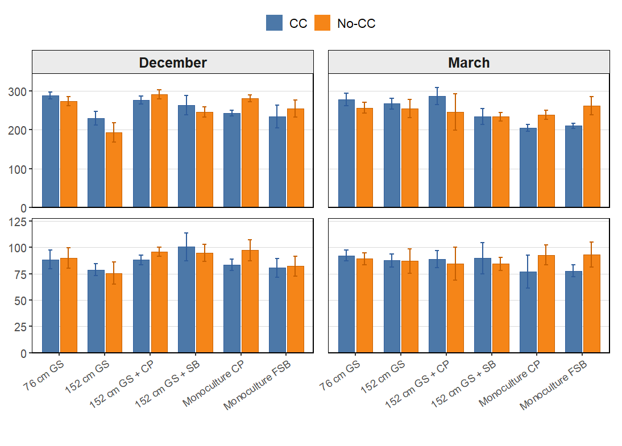
β-Glucosidase
(µg p-nitrophenol g⁻¹ soil hr⁻¹)
β- Glucosaminidase
(µg p-nitrophenol g⁻¹ soil hr⁻¹)
Figure: β-Glucosidase and β- Glucosaminidase under six SCCS main-plot treatments and two cover-crop split-plot treatments in December and March. Bargraphs represent raw observations across four blocks. CC = with cover crops; No-CC = without cover crops.

Slide 5
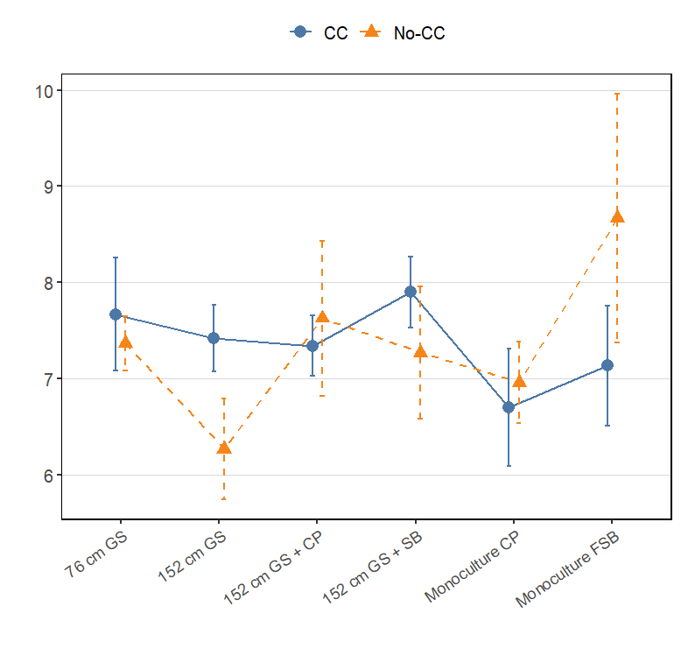
SCCS * Cover = 0.01
ACE Protein
(mg kg⁻¹)
ACE soil protein under six SCCS main-plot treatments and two cover-crop split-plot treatments in December. The SCCS × Cover interaction was significant ($P=0.018$); CC = with cover crops and No-CC = without cover crops.

Slide 6
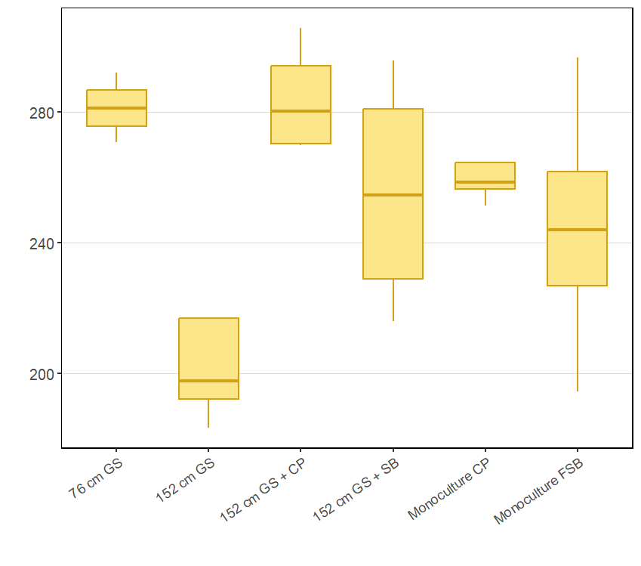
a
ab
a
ab
ab
β-Glucosidase
(µg p-nitrophenol g⁻¹ soil hr⁻¹)
b
Figure. Effect of Solar Corridor Cropping System (SCCS) main-plot treatments on β-glucosidase activity in December. Boxplots represent the distribution of four block-level means for each SCCS treatment. The cover-crop split-plot treatments (CC and No-CC) were averaged within each Block × SCCS main plot because the SCCS × Cover interaction was not significant. Different lowercase letters indicate significant differences among SCCS main-plot treatments according to Tukey-adjusted comparisons at $P<0.05$. Treatments sharing at least one letter are not significantly different.

