Slide 1
NBA: Points Per Game Analysis
Patrik Karlovic
DSC 530-T301
March 6th 2021

Slide 2
Research Question: What variable plays the largest part in the average points per game a player averages in the NBA?
There is no question that the team which scores the most points in a game wins, an age-old answer to Sports. In this analysis we will be observing how the PPG (Points Per Game) relates to other statistics within an NBA game.
Data will be scraped via basketball-reference.com

Slide 3
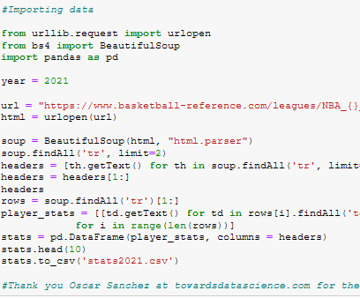
Gathering the Data
Data is gathered by requesting an URL and parsing through the page to scrape statistical data on the statistics for 2020-2021 season.
We then narrowed down our data to variables which related to the amount of points a player scored throughout a game.

Slide 4
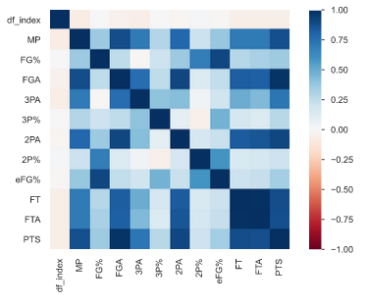
The Data:
Once we loaded our data, we used the pandas profile report for a quick look at our data which includes the correlation charts, scatter plots, as well as information on the distribution of individual variables within our dataset.

Slide 5
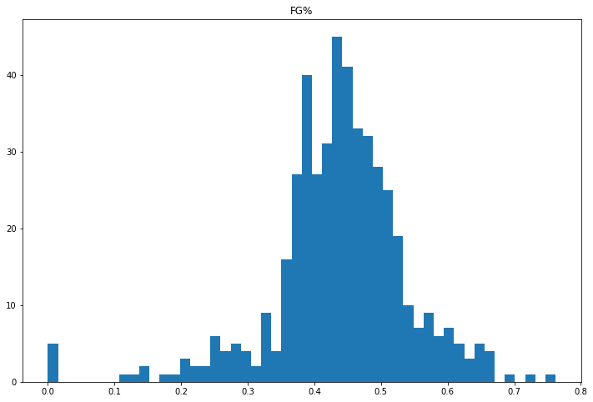
Field Goal Percentage
Minimum: 0
Maximum .762
Mean: .438
Skewed to the Right
We see outliers with players who make 0% of their shots as well as players who make above 70% of their shots. There are low volume shooters who have not made many shot attempts, so their numbers are highly skewed in one direction,

Slide 6
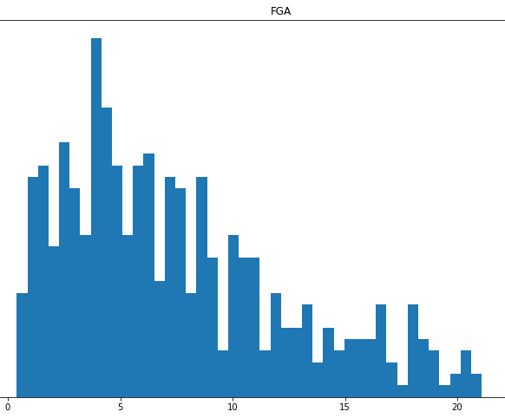
Field Goal Attempts
Mean: 7.49
Maximum: 23.8
Minimum 0.4
Skewed to the left.
We see a few outliers in players who take above 20 shots per game, this is normal as 'Star Players' on lower tier teams tend to have more oppurtunities for field goal attempts.

Slide 7
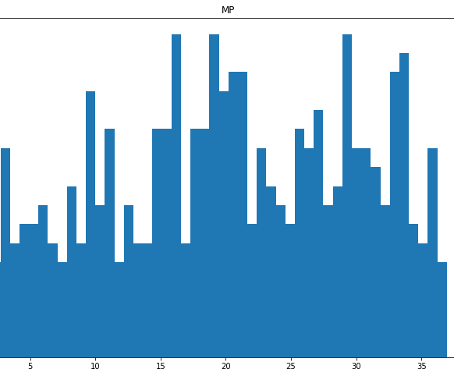
Minutes Played
Mean: 20.49
Maximum: 38.4
Minimum: 2
Skewed slightly to the right.
Data is distributed pretty evenly with no immediate outliers. We see some players who have an increased minutes player per game which is expected as some players are required to be out on the court for extended periods as compared to the rest of the team in order to apply maximum influence within a game. Seems to be distributed pretty evenly with no evident tails of the data.

Slide 8
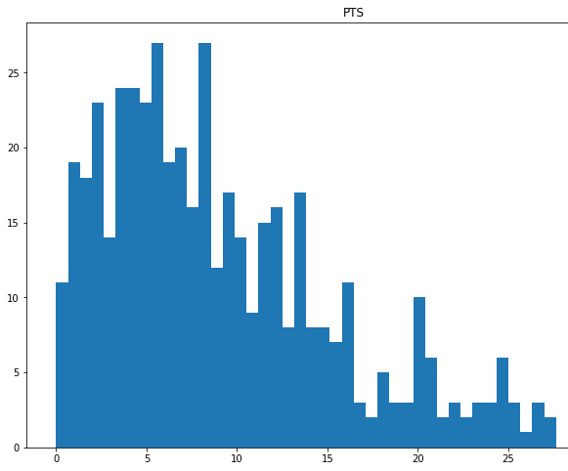
Points Per Game
Mean 9.38
Minimum 0
Maximum 32.9
Skewed to the left with multiple clusters with decreasing counts as the value of Points Scored per game increase.

Slide 9
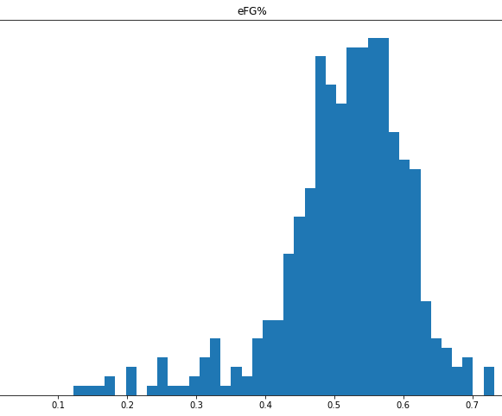
Efficient Field Goal Percentage
Mean .511
Maximum .762
Minimum 0
The data seems to be clustered around mean which quickly drops off as the eFG% drops. The data is skewed slightly to the right.

Slide 10
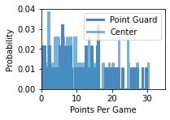
Probability Mass Function
Here we see a distribution of the probabilities for Points Per Game dependent on the position of a Point Guard (Dark Blue) and Center (Light Blue), this is an interesting distribution to look at as these two positions have the largest gaps in heights between all positions. Point Guards tend to be the shortest position in the NBA as centers tend to be the Largest. There is not an evident difference between position played and Points Scored Per Game via the use of Probability Mass Functions of different positions and PPG

Slide 11
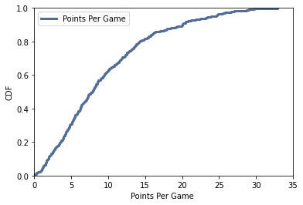
Cumulative Distribution Function
The Shape of our distribution of Percentiles shows that the more points you score per game, the higher the percentile you land in. About 80% of players score below around 16 points per game and scoring about 20 per game puts you in the 90% percentile.

Slide 12
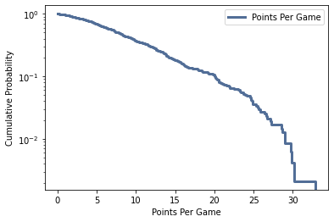
Analytical Distribution: Complementary Cumulative Distribution Function
So the CCDF values are equal to 1-CDF values. This shows us the peak values of our distribution of Points per Game. At any point in this graph it shows the percentage it is at or above that value. The CCDF curve moves towards the right so that Points per Game ratio increases which means that it shows the percentage of players which reach a certain threshold for Points per Game.

Slide 13
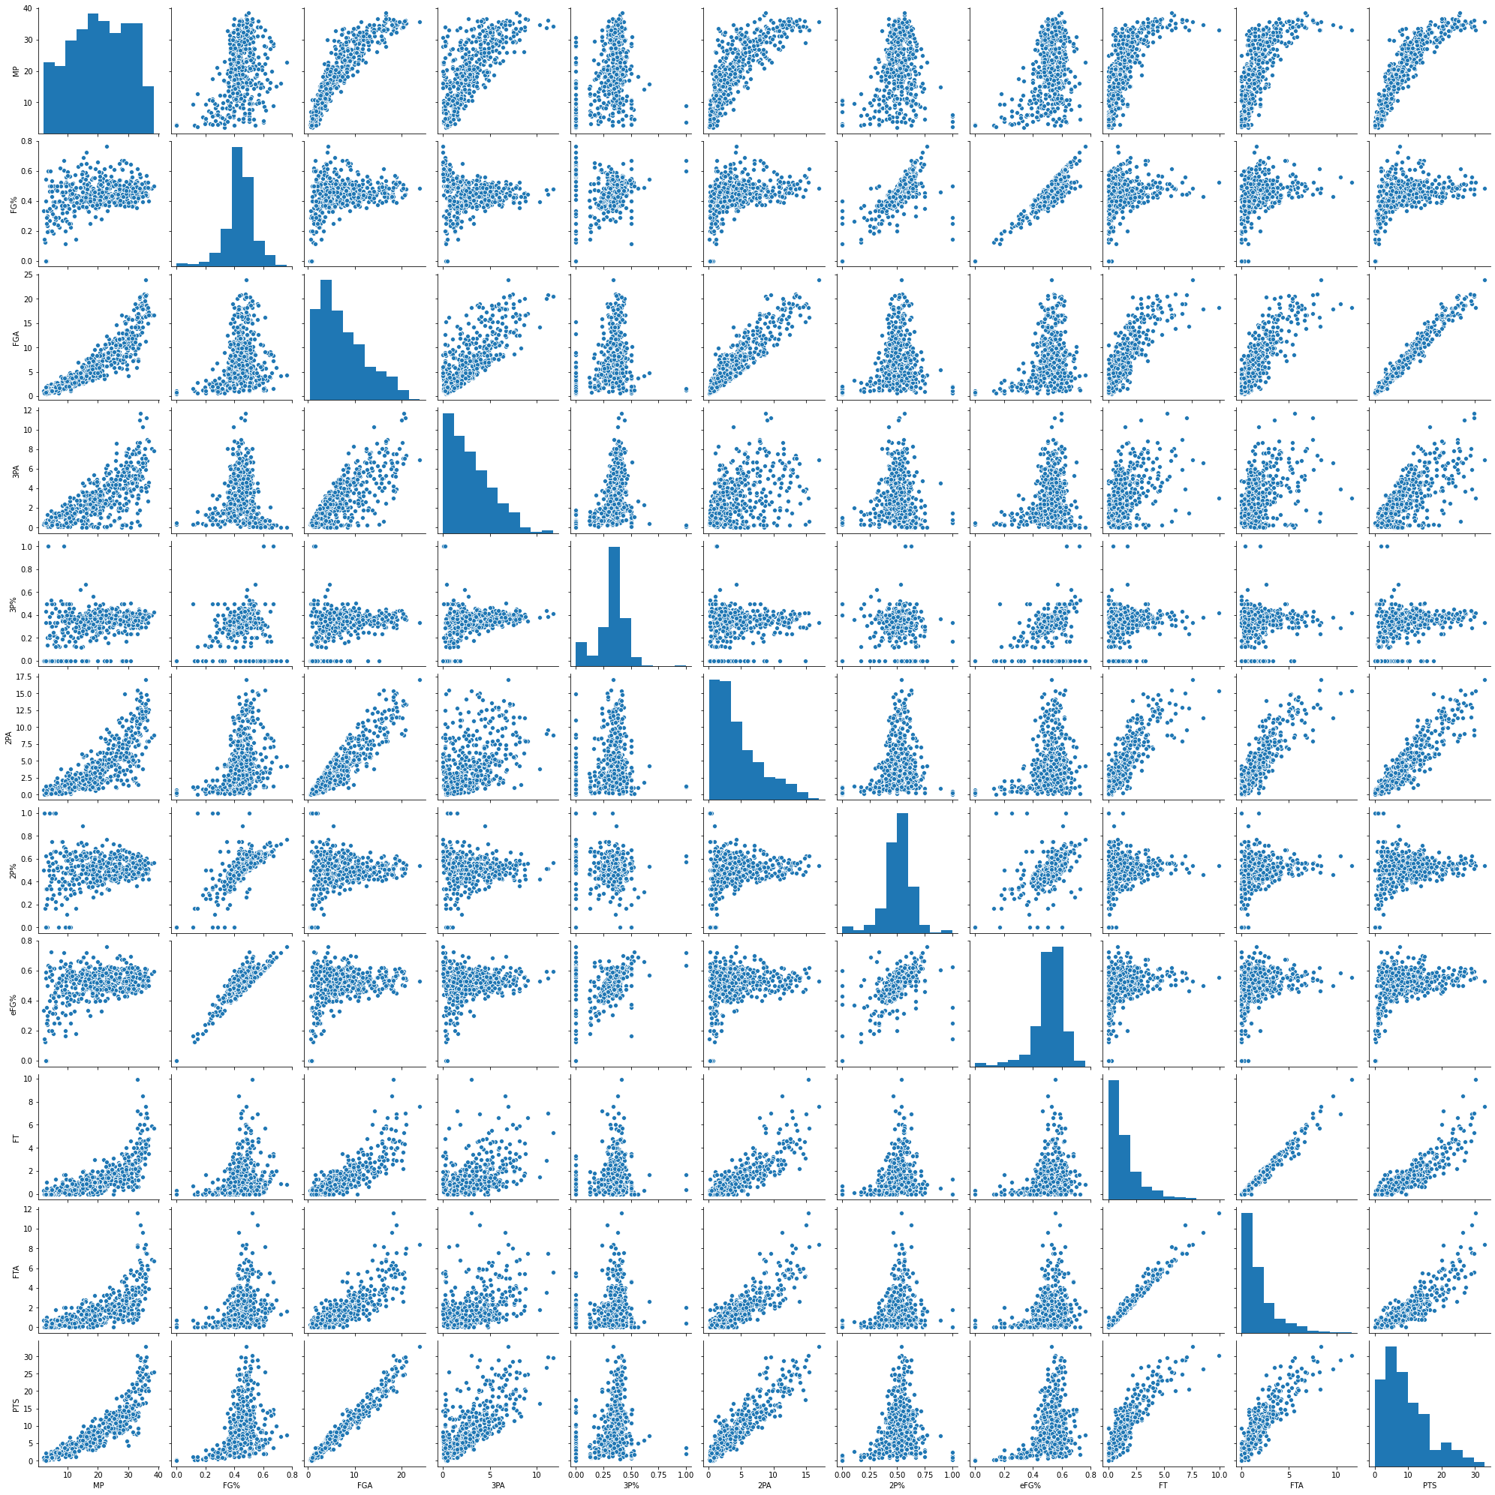
Comparing Variables
Here is a Scatter Plot Matrix of our Data.
Here we can see the correlations between certain statistics. One thing I noticed is the amount of points scored per game does not necessarily have a strong correlation with the Shooting Percentage, this indicates that there is a weak relationship between these 2 variables. This means I can cut these variables out of my regression to see which values have a higher effect.

Slide 14
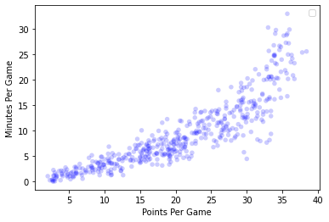
Comparing Variables: PPG vs MPG
Points Per game are Highly Correlated with Minutes Played Per Game with a 87%Pearson’s R Correlation , the relationship seems exponential. The more minutes a player plays, the higher their chance of gaining more points in a game is.

Slide 15
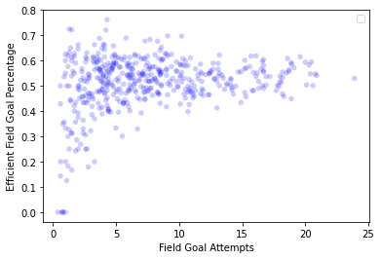
Comparing Variables: eFG% and FGA
This scatter plot gives us a PearsonR Correlation Coefficient of 24.8% , this means that Efficient Field Goal Percentages are only about 25% correlated with Field Goal Attempts. The relationship looks similar to a y=√x graph. This is a weak correlation.

Slide 16

Spearman’s Rank Hypothesis Test: PPG vs MPG
Let us Conduct a Spearman's Rank Hypothesis test on the Relationship between Points per Game and Minutes Played per Game. For our null hypothesis we will say that our two samples are independent. our P value for the samples is <0.05 which means that there is probably dependency between the samples.

Slide 17

Regression: Analysis between PPG and Multiple Variables.
This step will statistically inform us on the relationship between PPG and MPG, FGA, and FTA. The test will be conducted via the code pictured below.

Slide 18
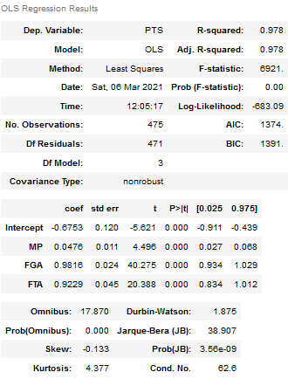
Regression Analysis: Model Summary
R2 value of 98 percent means that our model fits the data very well. F statistic of 6921 and F-Statistic probability of 0.00 tells us that we can reject the null hypothesis that a Intercept Only Model will be a better fit then our regression and that there is a relationship between MP, FGA, and FTA. Now let's look at what features are significant. All of our predictor variables have a P value of <0.05, which means that all these variables are significant in determining how many points a player scores per game. The weight values of these features are nonzero. FGA and FTA have a higher t-score than MP which tells us that these variables have a higher influence on PPG.

