Slide 1
Sentiment Analysis Project
Using Azure Data Factory, SQL, and Power BI for Analysis
Khushali Patel- 200596761
Krushanu Vadgama- 200596765

Slide 2

Introduction
Overview of the project
Objective: Perform sentiment analysis using Azure tools
Key components: Azure Data Factory, SQL Database, Power BI
Goal: Analyze sentiment in feedback data and visualize the results

Slide 3
Tools Used
- Azure Data Factory: For data ingestion and processing
- Azure SQL Database: For storing sentiment analysis results
- Power BI: For visualizing the sentiment data
- Python (Optional): For sentiment analysis

Slide 4
Data Sources
Data Source: Sentiment feedback data in a CSV format
Storage: Data uploaded to Azure Blob Storage
Data Ingestion: Using Azure Data Factory, data was ingested into Azure SQL Database

Slide 5

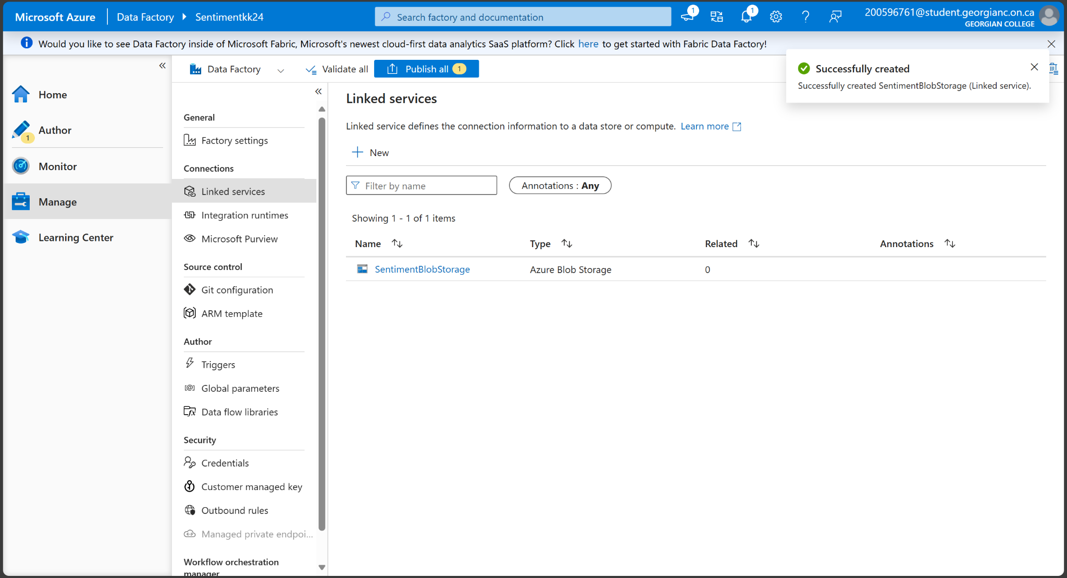
Data Ingestion Pipeline
Created an Azure Data Factory pipeline for data ingestion
Configured linked services to Azure Blob Storage and SQL Database
Successfully ingested sentiment results into Azure SQL Database

Slide 6
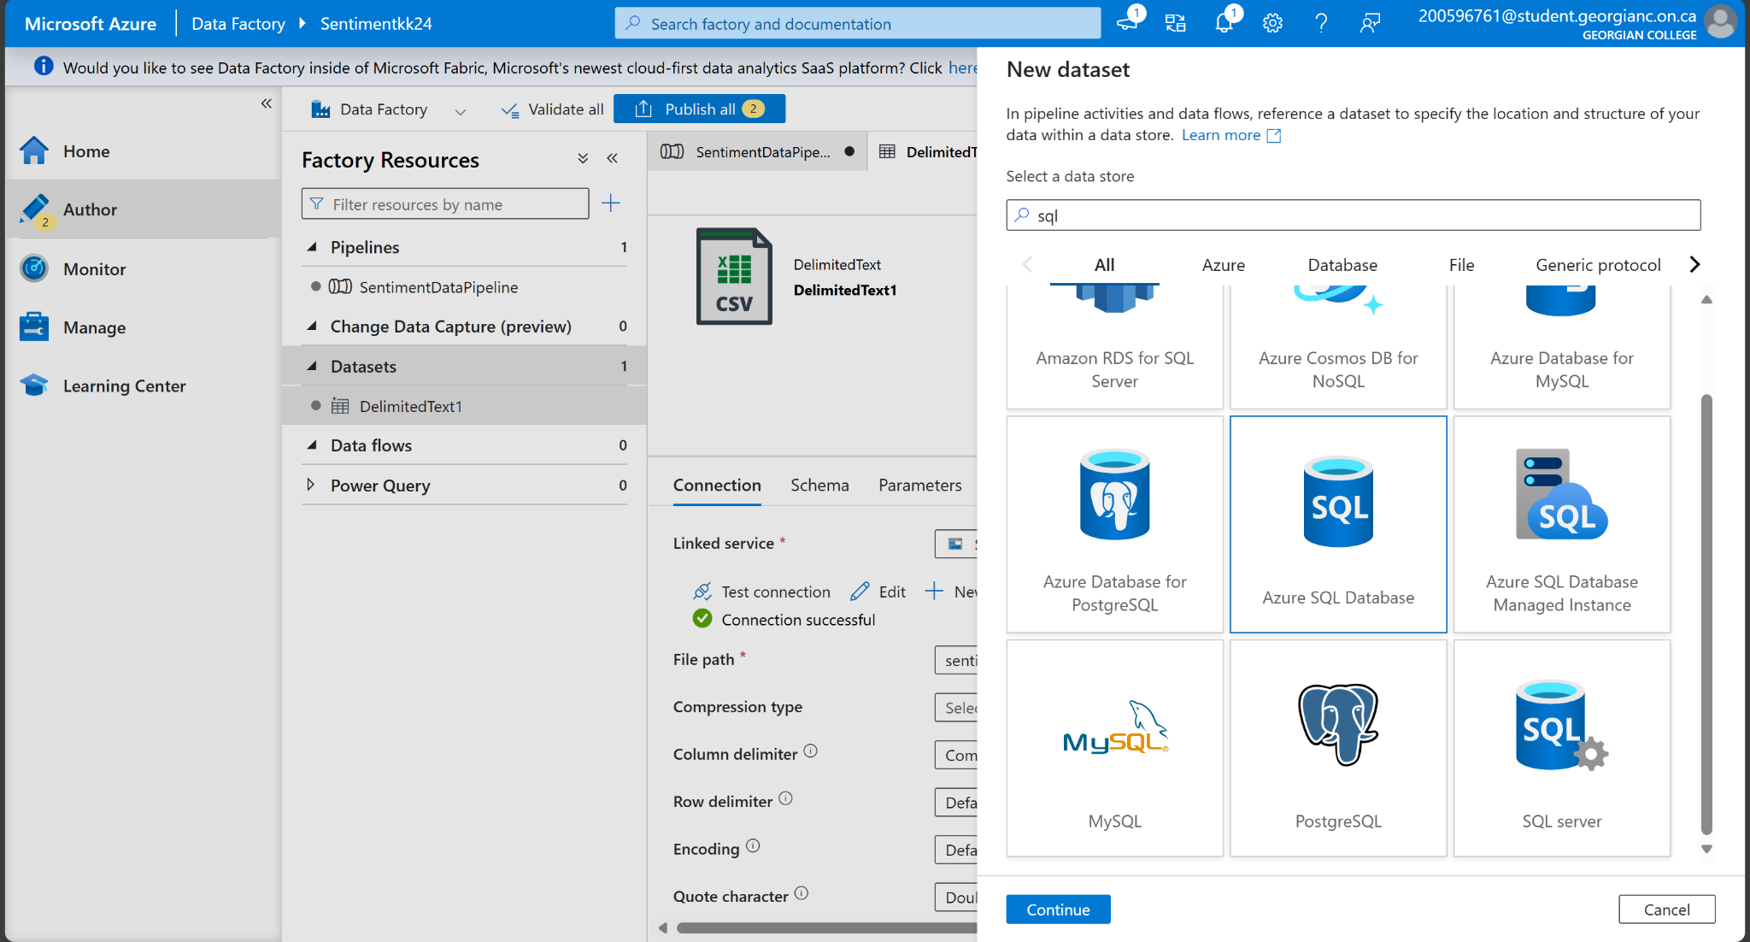
Database Setup
Azure SQL Database: Created SentimentResults table
Table schema: Id, FeedbackText, SentimentScore, SentimentCategory
Example Data:
Great Service: 0.85 (Positive)
Bad Experience: -0.65 (Negative)

Slide 7
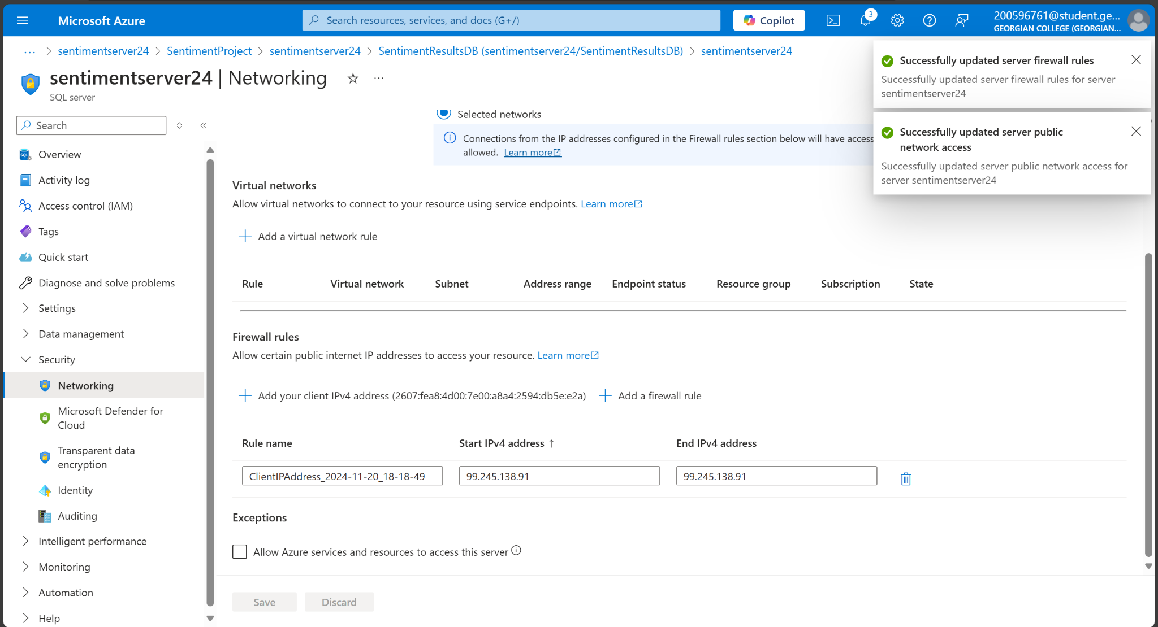
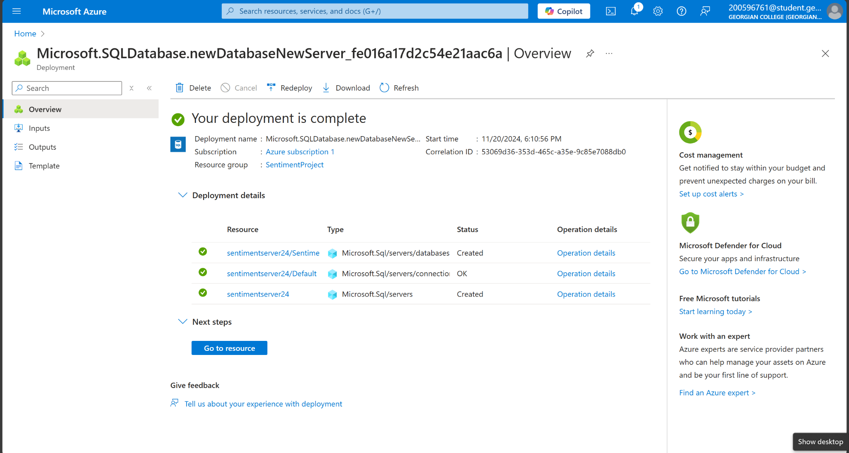
Sentiment Analysis Process
- Python code used for sentiment analysis (TextBlob or Azure Cognitive Services)
- Applied sentiment scoring for categorizing feedback
- Example sentiment categories: Positive, Negative, Neutral

Slide 8
Data Visualization with Power BI
- Linked Azure SQL Database to Power BI
- Created visualizations like pie chart (sentiment breakdown)
- Line chart to show sentiment score trends

Slide 9
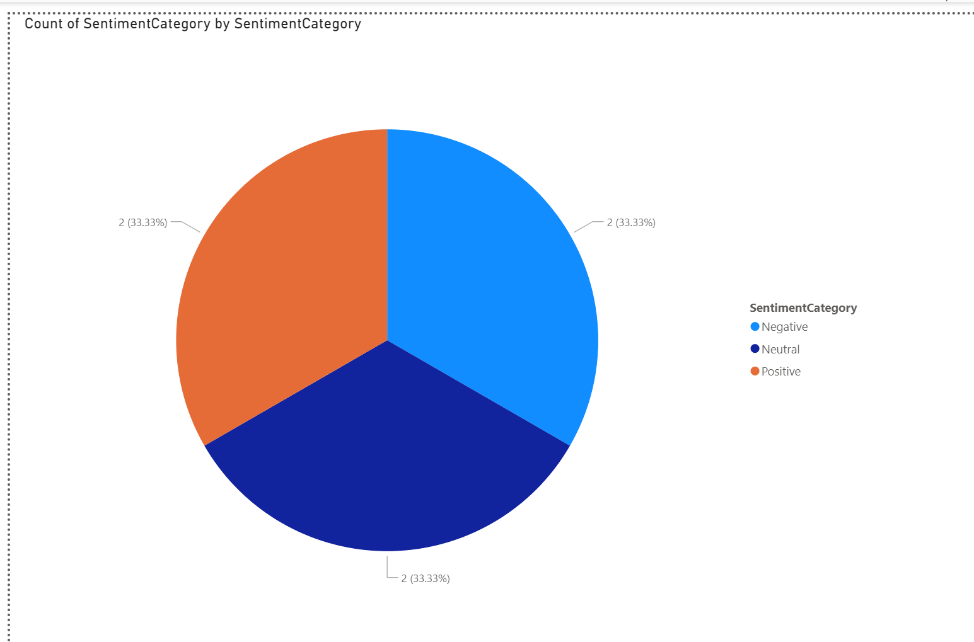
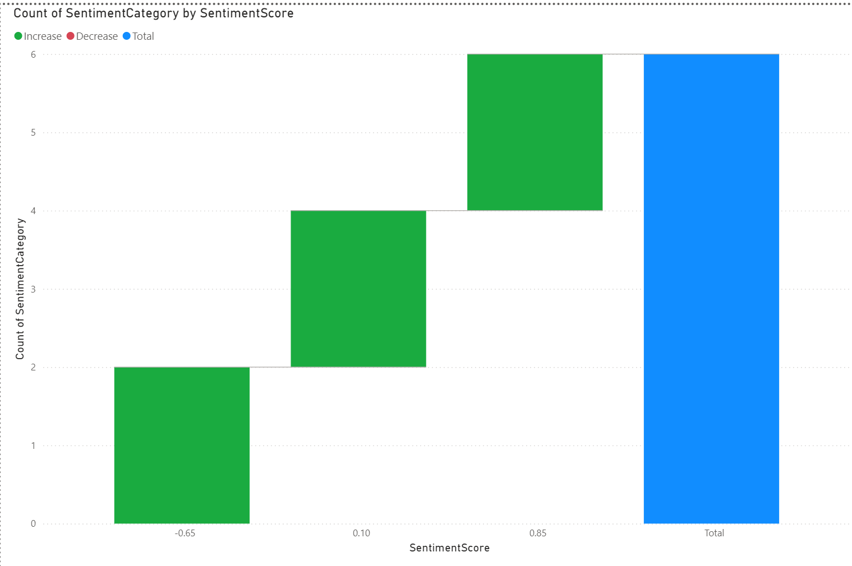
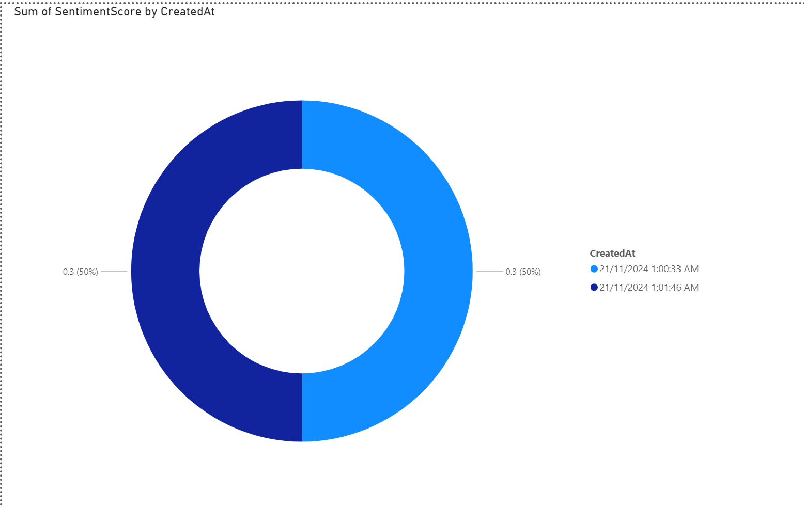
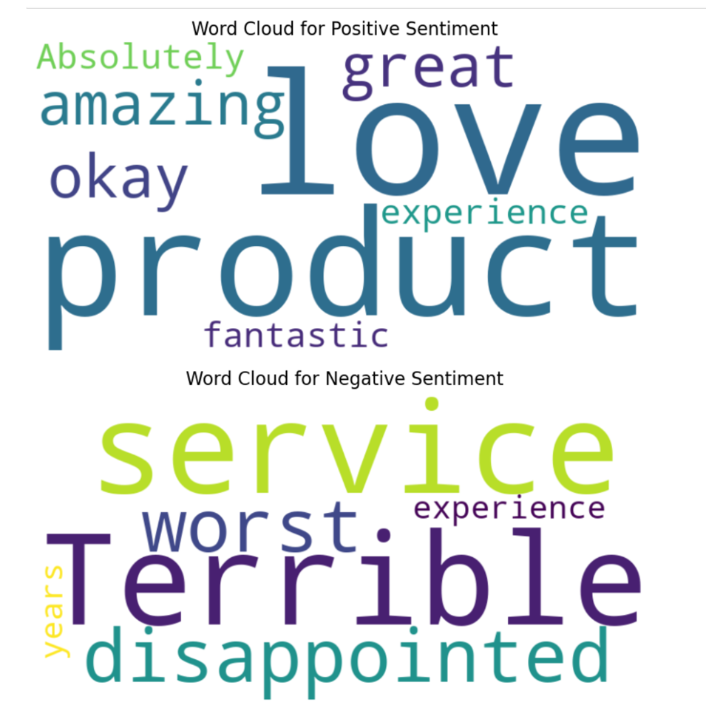
Data Visualization with Power BI

Slide 10
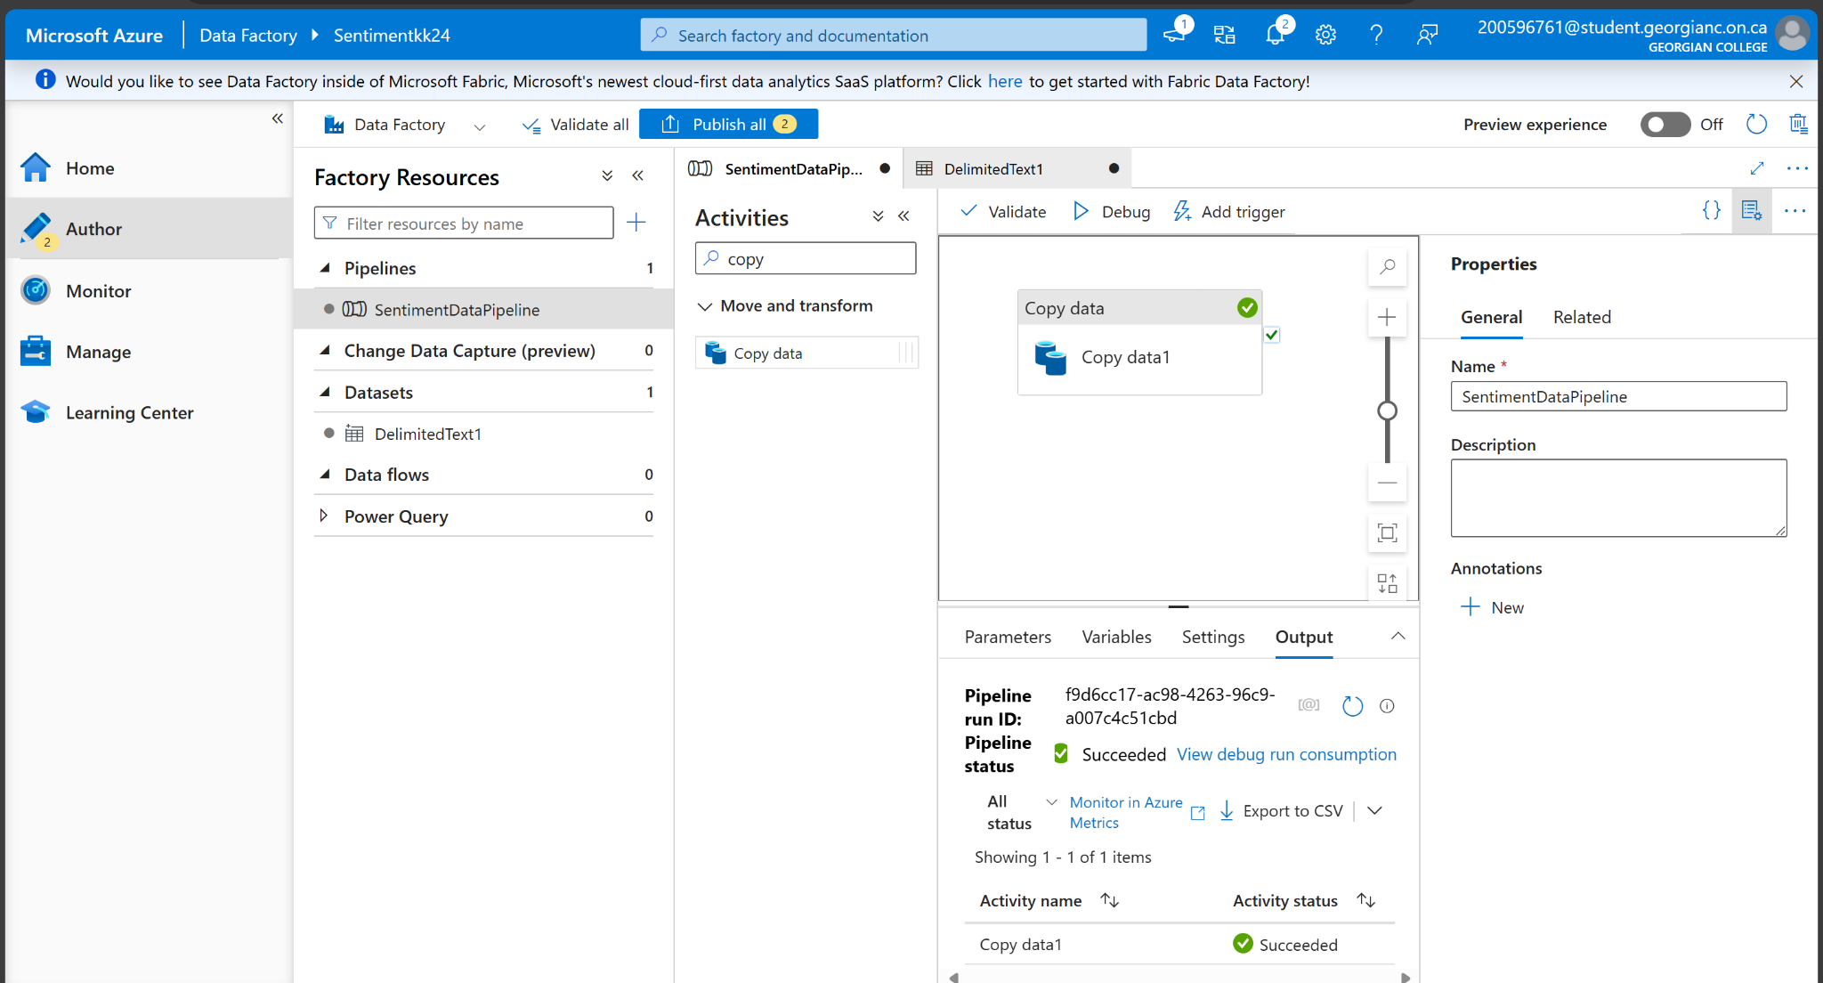
Key Insights from Data
- Insights from sentiment analysis and Power BI visualizations
- Example insights: Positive feedback dominates, or trends of negative feedback increasing over time

Slide 11

Conclusion
Summary of findings: Sentiment analysis revealed positive and negative trends
Project Success: Successfully processed, analyzed, and visualized sentiment data
Future Work: Improvements like machine learning models for sentiment prediction

Slide 12
GitHub Link
Link to the GitHub repository with the code: [Your GitHub link]

Slide 13
Q&A
Questions?
Thank you for your attention.

