Slide 1
The range() function
We can generate a sequence of numbers using range() function.
range(10) will generate numbers from 0 to 9 (10 numbers).
We can also define the start, stop and step size as
range(start, stop,step_size). step_size defaults to 1 if not provided.
We can use the range() function in for loops to iterate through a sequence of numbers. It can be combined with the len() function to iterate through a sequence using indexing. When you want the for loop to run for a specific number of times.
We've converted the range to a Python list, as range() returns a generator-like object that only prints the output on demand.

Slide 2
For Loop
Loops are used in programming to repeat a specific block of code. For loops are used for sequential traversal. For example: traversing a list or string or array etc.
The for loop in Python is an iterating function. If you have a sequence object like (list, tuple, string), you can use the for loop to iterate over the items contained within the list.
Here, iterator_variable is the variable that takes the value of the item inside the sequence on each iteration.
Loop continues until we reach the last item in the sequence. The body of for loop is separated from the rest of the code using indentation.
for iterator_variable in sequence_name:
Statements
. . .
Statements

Slide 3
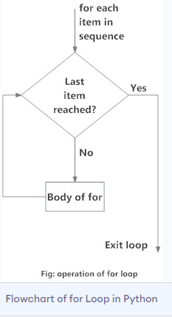

Slide 4

Nested Loops
Nested Loops: Python programming language allows to use one loop inside another loop. Following section shows few examples to illustrate the concept. Syntax:

Slide 5
While loop
While Loops is used to execute a block of statements repeatedly until a given condition is satisfied. And when the condition becomes false, the line immediately after the loop in the program is executed.
While loop falls under the category of indefinite iteration. Indefinite iteration means that the number of times the loop is executed isn’t specified explicitly in advance.
When a while loop is executed, expr is first evaluated in a Boolean context and if it is true, the loop body is executed. Then the expr is checked again, if it is still true then the body is executed again and this continues until the expression becomes false.
While condition :
Statement
. . . . . . .
Statement
#End of the Statements

Slide 6
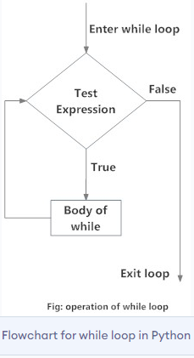

Slide 7

The syntax for a nested while loop statement in Python programming language is as follows:

Slide 8
# Program to add natural
# numbers up to
# sum = 1+2+3+...+n
Print number divisible by 5.
Print prime number.

Slide 9
Break statement with for loop
The break statement is used to exit the for loop prematurely. It’s used to break the for loop when a specific condition is met.
Let’s say we have a list of numbers and we want to check if a number is present or not. We can iterate over the list of numbers and if the number is found, break out of the loop because we don’t need to keep iterating over the remaining elements.

Slide 10
The continue statement
We can use continue statements inside a for loop to skip the execution of the for loop body for a specific condition.
Let’s say we have a list of numbers and we want to print the sum of positive numbers. We can use the continue statements to skip the for loop for negative numbers.
’break’ exits innermost loop while, ‘continue’ stops current iteration and continues with the next.

Slide 11
Pass Statement
Pass Statement: We use pass statement to write empty loops. Pass is also used for empty control statement, function and classes.

Slide 12
# Program to find the sum of all numbers stored in a list
WAP to add from 1-100 and display final result.
WAP to display numbers from 1-10 except number 7.
WAP to read integers 1-10 from user and break the loop immediately if user enters anything other than integer.

