Slide 1
module
Modular programming refers to the process of breaking a large, unwieldy programming task into separate, smaller, more manageable subtasks or modules.
A module is a file containing Python definitions and statements. A module can define functions, classes, and variables. A module can also include runnable code. Grouping related code into a module makes the code easier to understand and use. It also makes the code logically organized.

Slide 2
Individual modules can then be cobbled together like building blocks to create a larger application.
There are several advantages to modularizing code in a large application:
Simplicity
Maintainability
Reusability
Scoping
Functions, modules and packages are all constructs in Python that promote code modularization.

Slide 3
There are actually three different ways to define a module in Python:
A module can be written in Python itself.
A module can be written in C and loaded dynamically at run-time, like the re (regular expression) module.
A built_in module is intrinsically contained in the interpreter, like the itertools module.
create a module create a file that contains legitimate Python code and then give the file a name with a .py extension.

Slide 4
Locating Modules
When the interpreter encounters an import statement, it imports the module if the module is present in the search path.
A search path is a list of directories that the interpreter searches before importing a module.
When you import a module, the Python interpreter searches for the module in the following sequences −
The current directory.
If the module isn't found, Python then searches each directory in the shell variable PYTHONPATH.
If all else fails, Python checks the default path. On UNIX, this default path is normally /usr/local/lib/python/.
The sys.path variable contains the current directory, PYTHONPATH, and the installation-dependent default.

Slide 5
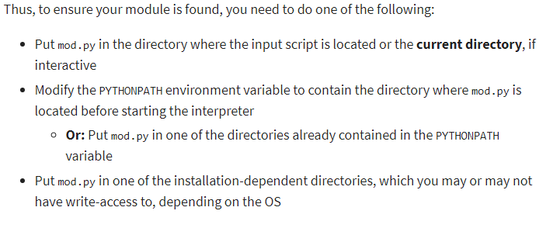
The directory portion of __file__ should be one of the directories in sys.path.

Slide 6
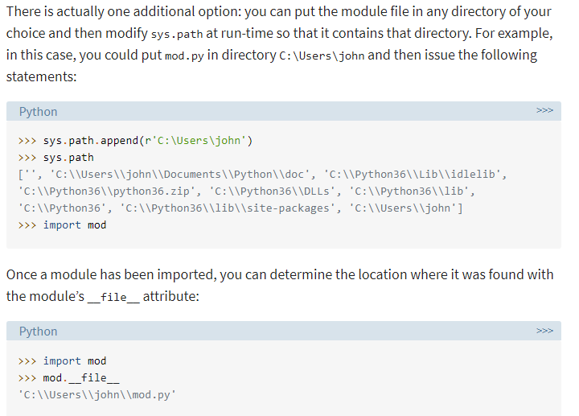

Slide 7
Module contents are made available to the caller with the import statement. The import statement takes many different forms
import <module_name>
Note that this does not make the module contents directly accessible to the caller. Each module has its own private symbol table, which serves as the global symbol table for all objects defined in the module. Thus, a module creates a separate namespace, as already noted.
The statement import <module_name> only places <module_name> in the caller’s symbol table. The objects that are defined in the module remain in the module’s private symbol table.
From the caller, objects in the module are only accessible when prefixed with <module_name> via dot notation, as illustrated below.

Slide 8
The fromimport Statement
Python’s from statement lets you import specific attributes from a module. The from .. import .. has the following syntax :
this form of import places the object names directly into the caller’s symbol table, any objects that already exist with the same name will be overwritten:
The from import * Statement
The * symbol used with the from import the statement is used to import all the names from a module to a current namespace.

Slide 9
Syntax: from module_name import *
This will place the names of all objects from <module_name> into the local symbol table, with the exception of any that begin with the underscore (_) character.
from <module_name> import <name> as <alt_name>
It is also possible to import individual objects but enter them into the local symbol table with alternate names:
import <module_name> as <alt_name>
You can also import an entire module under an alternate name:

Slide 10
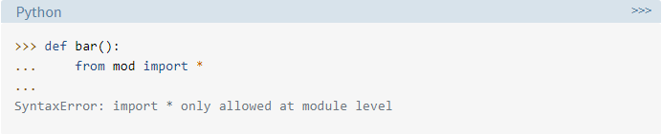
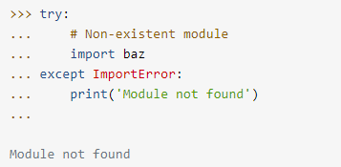
Python 3 does not allow the indiscriminate import * syntax from within a function:
a try statement with an except ImportError clause can be used to guard against unsuccessful import attempts:

Slide 11
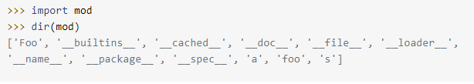
The dir() function
The dir() built-in function returns a sorted list of strings containing the names defined by a module. The list contains the names of all the modules, variables, and functions that are defined in a module.
Variables are names (identifiers) that map to objects. A namespace is a dictionary of variable names (keys) and their corresponding objects (values).

Slide 12
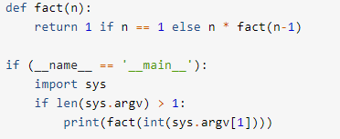
When a .py file is imported as a module, Python sets the special dunder variable __name__ to the name of the module. However, if a file is run as a standalone script, __name__ is (creatively) set to the string '__main__'. Using this fact, you can discern which is the case at run-time and alter behavior accordingly:
if you run as a script, you get output:
But if you import as a module, you don’t:

Slide 13


The file can be treated as a module, and the fact() function imported:
But it can also be run as a standalone by passing an integer argument on the command-line for testing:

Slide 14
Packages
As our application program grows larger in size with a lot of modules, we place similar modules in one package and different modules in different packages. This makes a project (program) easy to manage and conceptually clear.
Similarly, as a directory can contain subdirectories and files, a Python package can have sub-packages and modules.
A directory must contain a file named __init__.py in order for Python to consider it as a package. This file can be left empty but we generally place the initialization code for that package in this file.

Slide 15
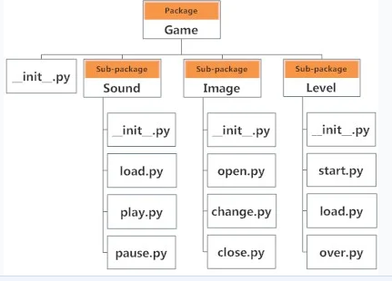
Here is an example. Suppose we are developing a game. One possible organization of packages and modules could be as shown in the figure below.

Slide 16
Importing module from a package
We can import modules from packages using the dot (.) operator.
For example, if we want to import the start module in the above example, it can be done as follows:
import Game.Level.start
Now, if this module contains a function named select_difficulty(), we must use the full name to reference it.
Game.Level.start.select_difficulty(2)

Slide 17
If this construct seems lengthy, we can import the module without the package prefix as follows:
from Game.Level import start
We can now call the function simply as follows:
start.select_difficulty(2)
Another way of importing just the required function (or class or variable) from a module within a package would be as follows:
from Game.Level.start import select_difficulty
Now we can directly call this function.
select_difficulty(2)

