Slide 1
OPERATORS
Arithmetic operators
Comparison/relationship operators
Logical operators
Assignment operators
Identity operator
Membership operators

Slide 2
Arithmetic operators
+,-,/,//,**,*,%
Works on number data types only
Try: take two integer inputs from users and display results using /,// operators

Slide 3
comparison operators
==,!=,>,>=,<,<=
Returns either true or false (boolean)
Try: take two integer inputs from users and display results using !=,== operators.

Slide 4
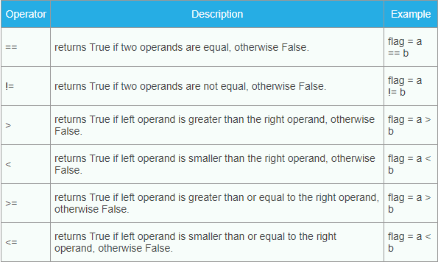

Slide 5
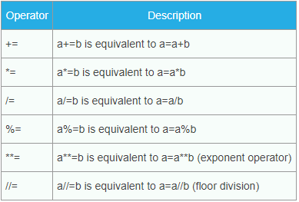
Assignment Operators
=,+=,*=,-=,/=,%=,//=
Assignment operators include the basic assignment operator equal to sign (=).but to simplify code, and reduce redundancy, python also includes arithmetic assignment operators.

Slide 6
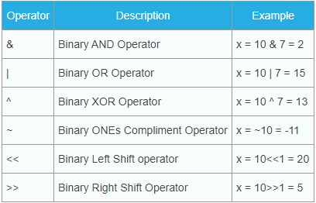
Bitwise Operators

Slide 7
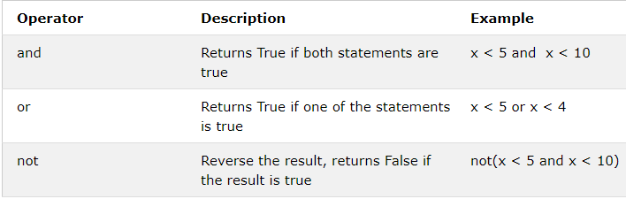
Logical Operators

Slide 8
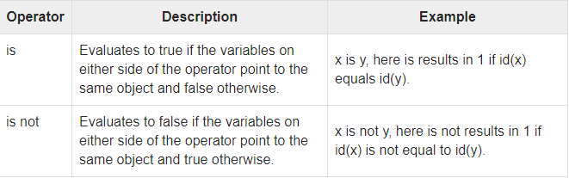
Identity operator
Identity operator: is, is not
Identity operators compare the memory locations of two objects
Identity operators compare the memory locations of two objects.

Slide 9
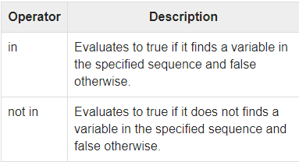
Membership operators
Membership operators: in, not in
Works only with iterables

Slide 10
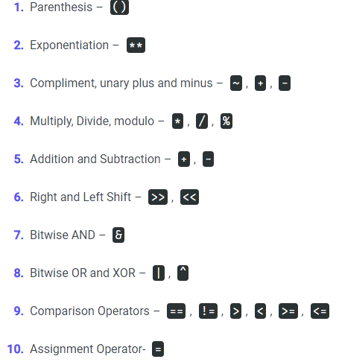
Operator precedence

